Slide 1
Compliance with Ethical Standards
Presentation at the Training Program organised by the
Peer Review Board of ICAI and hosted by the
Hyderabad Branch of SIRC of ICAI
on 21 April 2025
CA. Dr. Chinnsamy Ganesan
FCA DISA (ICA)

Slide 2
Compliance with technical and ethical standards
As per Clause 2 (23) of the Guidelines, the term Technical, Professional and Ethical Standards mean
AS issued by ICAI
AS issued u/s 133 of the Companies Act
Ind AS issued u/s 133 of the Companies Act
Engagement and Quality Control Standards
Statements issued by ICAI
Guidance Notes issued by ICAI
Standards on Internal Audit
Notifications/ Announcements/ Pronouncement of the Council
Framework for preparation and presentation of FS
Provisions of the relevant statutes and/ or rules or regulations which are applicable
Any other Technical, Professional, Ethical and other Standards issued by any authority governing the profession of Chartered Accountancy

Slide 3
Auditors’ Responsibility and Standards on Auditing
We conducted our audit in accordance with the standards on auditing specified under section 143 (10) of the Act. Those standards require that we comply with ethical requirements and plan and perform the audit to obtain reasonable assurance about whether the financial statements are free from material misstatement
Standards on Auditing specified u/s 143 (10)
Ethical requirements
Plan audit
Perform audit
Reasonable assurance
FS are free from Material Misstatement

Slide 4
Auditors’ Responsibility and Accounting Standards
In our opinion and to the best of our information and according to the explanations given to us, the aforesaid financial statements give the information required by the Companies Act, 2013 (‘Act’) in the manner so required and give a true and fair view in conformity with the Accounting Standards prescribed under section 133 of the Act read with the Companies (Indian Accounting Standards) Rules, 2015, as amended from time to time and other accounting principles generally accepted in India
Accounting Standards specified u/s 133
Other generally accepted accounting principles
True and Fair view
Balance Sheet
Statement of Profit and Loss
Statement of Cash Flows

Slide 5
Professional and Ethical Standards
Adherence to the Code of Ethics issued by ICAI
Protecting from
the threat to its Independence
Comply with professional ethics such as integrity, confidentiality, objectivity
Business relationship with the clients
Substantial interest in the audit clients
Long term association with the audit clients
Number of audit clients are within the limits specified
New client acceptance
Minimum scale of fees
Services u/s 144

Slide 6
Questions?
?

Slide 7
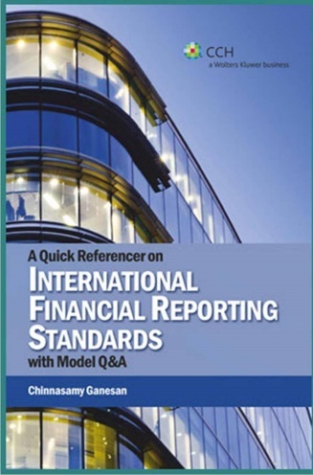
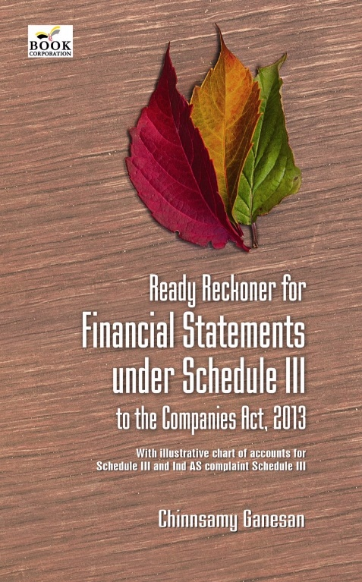
Thank you
ganesanca@yahoo.com/ 0 99401 30403

