Slide 1
De-coding US taxes – The basics made simple
1

Slide 2
United States
US is the 4th Largest Country (in area) in the world.
US is the richest country in terms of GDP ($29.724 Trillion).
3rd most populous country with over 340 Mn people.
US has 50 States and National Capital (Washington, D.C.)
US follows Presidential System of government.

Slide 3
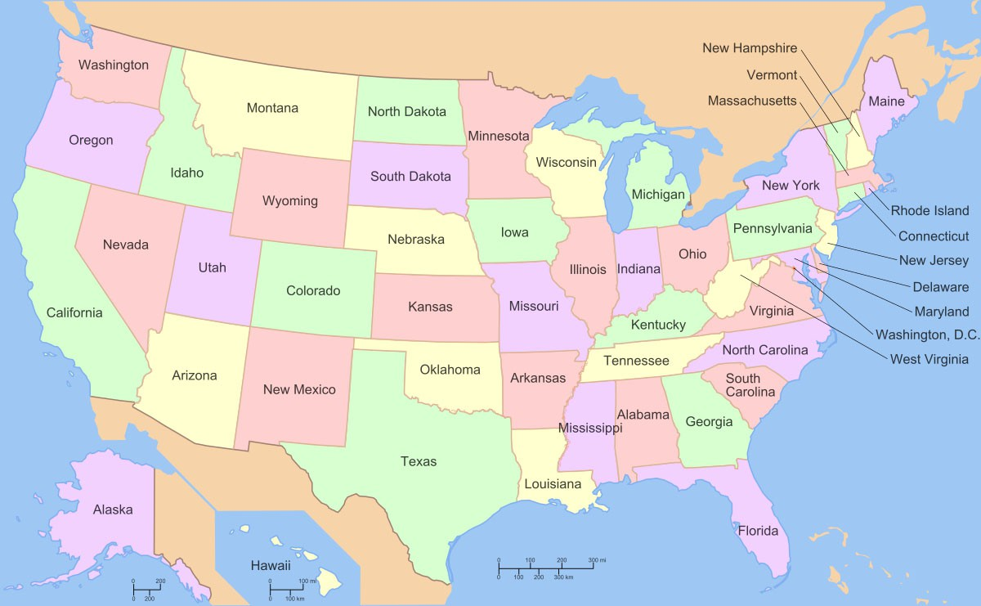
States in the US

Slide 4
Names of States with Abbreviations
Alabama | AL
Alaska | AK
Arizona | AZ
Arkansas | AR
California | CA
Colorado | CO
Connecticut | CT
Delaware | DE
Florida | FL
Georgia | GA
Hawaii | HI
Idaho | ID
Illinois | IL
Indiana | IN
Iowa | IA
Kansas | KS
Kentucky | KY
Louisiana | LA
Maine | ME
Maryland | MD
Massachusetts | MA
Michigan | MI
Minnesota | MN
Mississippi | MS
Missouri | MO
Montana | MT
Nebraska | NE
Nevada | NV
New Hampshire | NH
New Jersey | NJ
New Mexico | NM
New York | NY
North Carolina | NC
North Dakota | ND
Ohio | OH
Oklahoma | OK
Oregon | OR
Pennsylvania | PA
Rhode Island | RI
South Carolina | SC
South Dakota | SD
Tennessee | TN
Texas | TX
Utah | UT
Vermont | VT
Virginia | VA
Washington | WA
West Virginia | WV
Wisconsin | WI
Wyoming | WY

Slide 5
Structure of US Federal Government
Responsible for Drafting Laws House of Representatives & Senate
Legislative (Congress)
Responsible for enforcing laws President, Vice President, Cabinet Members and Agency Heads.
Federal Government
Executive
Responsible for Interpreting Laws Federal Court System
Judicial

Slide 6
Levels and types of Taxation
In The United States of America, Tax is imposed on both federal and state level.
Federal and state taxes are separate, and each has its own authority to charge taxes.
Within the state there may be several jurisdictions that also charge taxes. Local Government bodies like Municipalities, Regional Municipalities, Rural Communities (RC), and Local Service Districts (LSD) impose their taxes separately like property Tax, licensing fees etc.
Income tax, Payroll tax, Capital Gain tax
Income
TAXES ON
Inheritance/ Estate tax, Property tax
Property
Good and Services
Sales and Use tax, Sin tax
6

Slide 7
Tax Administration in the US– Internal Revenue Service (IRS)
Congress established the Office of the Commissioner of Internal Revenue under the Department of the Treasury. The Internal Revenue Service (IRS) administers and enforces U.S. federal tax laws. The Commissioner of Internal Revenue is the head of the Internal Revenue Service (IRS), an agency within the United States Department of the Treasury.
7

Slide 8
Federal Taxes
The US government has jurisdiction over federal taxes.
Federal Taxes include:
Income Tax.
Employment Taxes:
Social Security Tax.
Medicare Tax.
Self employment taxes – 15.3%
Unemployment Tax
Excise Tax
Gift, Estate, Generation-Skipping Transfer Tax.
This Photo by Unknown Author is licensed under CC BY

Slide 9
State Taxes
Apart from income tax, states also collect sales and use tax, excise tax, property tax, business and occupation tax.
Tax Free States – Income tax:
( Ak ) Alaska
( FL ) Florida
( NH ) New Hampshire ( except interest & Dividend )
( NV ) Nevada
( SD ) South Dakota
( TN ) Tennessee
( TX ) Texas
( WY ) Wyoming
Except above mentioned states rest all states will impose income taxes.

Slide 10
Local Taxes
Local Jurisdictions include cities, municipalities, school districts and counties.
Property tax.
Business and Occupation tax.
Income Tax

Slide 11
Individual 1040
Fiduciary 1041
Classification/ Types of Taxpayers
Partnership 1065
Corporations 1120
1
1₁
1

Slide 12
Disregarded entities (DREs)
“Disregarded entity” is a tax term. It refers to an entity that, as the name implies, will be disregarded — or ignored
— for federal income tax purposes. The most common disregarded entity for federal income tax purposes is the
single-member limited liability company (SMLLC).
A single-member limited liability company (SMLLC) is a single-owner business entity that gives the owner limited liability protection and tax benefits. ("Limited liability protection" means that if the business is sued or owes money, your personal assets will usually not be at risk.)
DREs take form of the owner who files on its behalf.
It is not disregarded when it comes to filing some state tax returns

Slide 13
Taxpayer identification number at a glance
TAXPAYER IDENTIFICATION NUMBER | ABBREVIATION & FORMAT | WHO NEEDS IT? | APPLICATION
Social Security Number | SSN XXX-XX-XXXX | Used by individuals, sole proprietors and single-member LLCs | Form SS-5
Employer Identification Number or Federal Employer Identification Number | EIN or FEIN XX-XXXXXXX | Used by employers, corporations, partnerships and multi-member LLCs | Form SS-4 or online
Individual Taxpayer Identification Number | ITIN 9XX-XX-XXXX | Used by nonresident and resident aliens, their spouses and dependents who cannot get an SSN | Form W-7

Slide 14
Return filing dates and Extensions
Business Tax Return Filing Dates for Calendar Year Return: (Calendar v Fiscal)
Individuals – 15th April
Partnership – 15th March (Within two and half months after closing books).
Corporation – 15th April (Within three and half months after closing books).
Extension:
Extension is obtained through filing Form 7004 at federal level, which allows you an additional 6 months to file your tax returns. Extension is just for filing tax returns and not for paying tax.
Individuals – 15th October.
Partnership – 15th September.
Corporation – 15th October.

Slide 15
Estimates
Estimates are advance taxes paid during the year to offset tax liability arising at the time of filing your annual tax returns.
Generally, it is minimum of 90% of your current year tax or 100% of tax paid in the PY.
The installments are generally due by the 15th day of the 4th, 6th, 9th, and 12th months of the tax year. If any due date falls on a Saturday, Sunday, or legal holiday, the installment is due on the next regular business day.

Slide 16
Comparing Direct Taxes
 | INDIAN TAXATION | US TAXATION
File Return with | Income Tax Department and Central Board of Direct Taxes (CBDT) | Internal Revenue Service (IRS)
Number of Income Tax Returns | Single at Central Level only | Federal return as well as State return (State Returns need to be filed based on Domicile and Source Income)
Original due date of filing return | 31st July (non audited) 31st October (audited) 30th November (Transfer Pricing cases) | 15th March – Partnerships, S Corporations. 15th April – Individuals, Corporations (See extensions also)
Tax Forms | ITR 1, 2, 3, 4, 5, 6 ,7 (based on Entity type and income earned) | Form 1065 – Partnerships Form 1120 – Corporations Form 1040 – Individuals (based on Entity type only)
Identification Number | PAN | EIN (entities) SSN (individuals)

Slide 17
Type of persons
INDIAN TAXATION
Individual
Hindu Undivided Family (HUF)
Association of persons (AOP)
Local Authority
Private Limited Companies
Public Limited Companies
Body of Individuals (BOI)
Trust
Government
Partnership
Artificial judicial person (AJP)
US TAXATION
Individual
Partnership
S Corporation
C Corporation
Estate
Trust
Foreign corporation
Foreign partnership
Foreign trust
Foreign estate
Any other person that is not a U.S. person
To evaluate which type of entity best suits the business – E.g. SMLLC to bypass federal compliance

Slide 18
Nature of Income
Indian Tax
Indian Tax
Profits and Gains from Business and Profession
Income from House Property
Profits and Gains from Business and Profession
Income from Other Sources
Salaries
Income from House Property
Capital Gains
Income from Other Sources
Salaries
Capital Gains
US Tax
US Tax
Income taxed at Ordinary rates
Long Term Capital Gain
Income taxed at Ordinary rates
Long Term Capital Gain
Ordinary Income from Operating activities
Short Term Capital Gains
Investment Income
Qualified Investment Income (taxed at lower rates)

Slide 19
Tax Rates Comparison
 | Indian Taxation |  |  | US Taxation
Individuals
 | Individual/ HUF/ AOP/ BOI/ AJP below 60 years of age |  |  | Tax Rate (2024) | Single | Married Filing Jointly | Married Filing Separately | Head of Household
 | 0-2,50,000 | NIL
 | 2,50,001-5,00,000 | 5% |  | 10% | $0 to $11,600 | $0 to $23,200 | $0 to $11,600 | $0 to $16,550
 | 5,00,001-10,00,000 | 20%
 | >10,00000 | 30%
 |  |  |  | 12% | $11,600 to $47,150 | $23,200 to $94,300 | $11,600 to $47,150 | $16,550 to $63,100
 | For Senior citizens (Resident Individuals) at 60 years of age or more but less than 80 years
 |  |  |  | 22% | $47,150 to $100,525 | $94,300 to $201,050 | $47,150 to $100,525 | $63,100 to $100,500
 | 0-3,00,000 | NIL
 |  |  |  | 24% | $100,525 to $191,950 | $201,050 to $383,900 | $100,525 to $191,950 | $100,500 to $191,950
 | 3,00,001-5,00,000 | 5%
 | 5,00,001-10,00,000 | 20%
 |  |  |  | 32% | $191,950 to $243,725 | $383,900 to $487,450 | $191,950 to $243,725 | $191,950 to $243,700
 | >10,00000 | 30%
 | For Resident Individuals of age 80 years or more |  |  | 35% | $243,725 to $609,350 | $487,450 to $731,200 | $243,725 to $609,350 | $243,700 to $609,350
 | 0-5,00,000 | NIL
 |  |  |  | 37% | $609,350 or more | $731,200 or more | $609,350 or more | $609,350 or more
 | 5,00,001-10,00,000 | 20%
 | >10,00,000 | 30%
19

Slide 20
Tax Rates continued
 | Indian Taxation | US Taxation
Partnerships | 30% | NIL. Partnerships are Pass-Through Entities.
Corporations |  | S- Corp – NIL. They are Pass- Through Entities C- Corp - 21%
In the case of a Domestic Company
If T/O in PY 2020-21 < 400 cr | 25%
In other case | 30%
In the case of a Foreign Company
Royalties and Fees for technical services received from Government or an Indian concern under agreement approved by Central Government. | 50%
In other case | 40%

Slide 21
Tax Rates continued
Additional Taxes
Indian Taxes
Surcharge on the tax amount, if applicable
Health & Education Cess (HEC):
4% is applicable on the
amount of Income Tax + Surcharge
US Taxes
No Additional taxes However
NIIT- Additional .09% tax only on investment income
Additional Medicare taxes of 3.8%.

Slide 22
Tax Withholding
 | Indian Taxation | US Taxation
Terminology | Tax Deducted at source (TDS) | Tax Withholding
Form issued by payer to payee | Form 16 – Salaried employees Form 16A – Other payments like interest, commission, professional fees, etc. | Form W-2 – Wages (salaried employees) Form 1099-INT – Interest (residents) Form 1099-DIV – Dividend (residents) Form 1042-S – FDAP Income (non- residents) Form 8805 – ECI Income (non- residents)

Slide 23
Individual Taxation

Slide 24
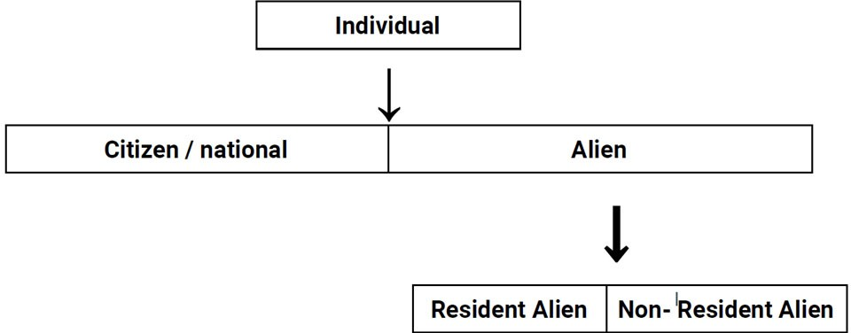
Residential Status
U.S citizen / National :-
Those who are born in the U.S. ( or ) those who possess
Green Cards will be treated as U.S. citizens ( or ) nationals and they are taxed on worldwide income.
Alien :- An individual who is not a U.S. citizen ( or ) a national .
Resident Alien :-
A resident alien is a foreign-born, non-U.S. citizen who lives in the U.S.
Resident aliens must have a green card or pass a substantial presence test.
In general, a resident alien is subject to the same taxes as a U.S. citizen.
Non -Resident Alien :-
A nonresident alien is a noncitizen who "has not passed the Green Card test or the substantial presence test,“
Nonresident aliens only have to pay taxes on U.S. earned income.

Slide 25
Residency status
A foreign-born individual is considered as a resident alien if he/ she meets any one of the following tests.
Green Card Test
Substantial Presence Test ( SPT )
First Year Choice Test ( FYCT )
Dual Status

Slide 26
Dual-status individual
You are a dual-status individual when you have been both a U.S. resident and a nonresident in the same tax year.
Dual status does not refer to your citizenship, only to your resident status for tax purposes in the United States. determining your U.S. income tax liability for a dual-status tax year, different rules apply for the part of the year you are a resident of the United States and the part of the year you are a nonresident. The most common dual-status tax years are the years of arrival and departure.
A dual status individual must file a dual status return as described in Publication 519, U.S. Tax Guide for Aliens.

Slide 27
Filing status
Single. Applies if TP is unmarried or legally separated as of the last day of the tax year.
Married filing jointly.
Married as of the last day of tax year, TP & spouse can choose to file a joint return.
If spouse died during the tax year, TP might choose to file a joint return for that year.
Married filing separately. A married couple can choose to file separate tax returns. They might decide to file separately due to a separation or pending divorce, or simply because they prefer to keep their finances separate.
4.Qualifying widow(er) with dependent child.
Apply if spouse died during the previous 2 yr, & TP have a dependent child.
The surviving spouse must maintain a household that, for the entire taxable year, was the principal place of abode of a son, stepson, daughter, or stepdaughter who qualifies as a dependent of the taxpayer.

Slide 28
Filing status
5. Head of household.
To qualify, the following conditions must be met:
TP must be unmarried to file as HOH OR married & Lived apart from spouse for 6 months or the year at close of taxable year.
TP must have paid more than half the cost of keeping up a home for ourself and a qualifying person, such as a child or dependent relative.
The individual is not a "qualifying widow(er).
The individual is not a nonresident alien.

Slide 29
Dependents
Dependency Definitions:
Certain tax benefits, such as an advantageous filing status or certain tax
credits, require either a qualifying child or qualifying relative. Each category has requirements:
Qualifying Child |  | Qualifying Relative
Close relative |  | Support(Over 50%) Test
Age Limit | Or | Under specific amount of
Residency Requirement |  | Precludes dependent filing a
Eliminate Gross income test |  | Only Citizens test
Support test Changes |  | Relative test
(taxable)gross income test
joint tax return test
Taxpayer lives with individual for whole year test.
29

Slide 30
Standard Deduction Limits
i. Taxpayers under age 65
Sr No | Filling Status | Limits
1 | MFJ or Surviving Spouse | $27,700
2 | HOH | $20,800
3 | Single or MFS | $13,850
ii. Taxpayers aged 65 or older or blind
Sr No | Filing Status | Aged | Additional std deduction
1 | MFJ or MFS(Per Qualifying Individual) | Age 65 or above or Blind | $1,500
 |  | 65 or older & blind | $3,000
2 | Single or HOH(Per Qualifying Individual) 30 | Age 65 or above or Blind | $1,850
 |  | 65 or older & blind | $3,700

Slide 31
Itemized Deduction
Medical – Sub to 10% AGI
Taxes paid - Max up to $10,000 MFJ and $5,000 Single or MFS
State taxes paid
Real estate taxes paid
Mortgage interest
Charitty
Cash
Non-Cash
Casualty theft losses
Only Federal deserter

Slide 32
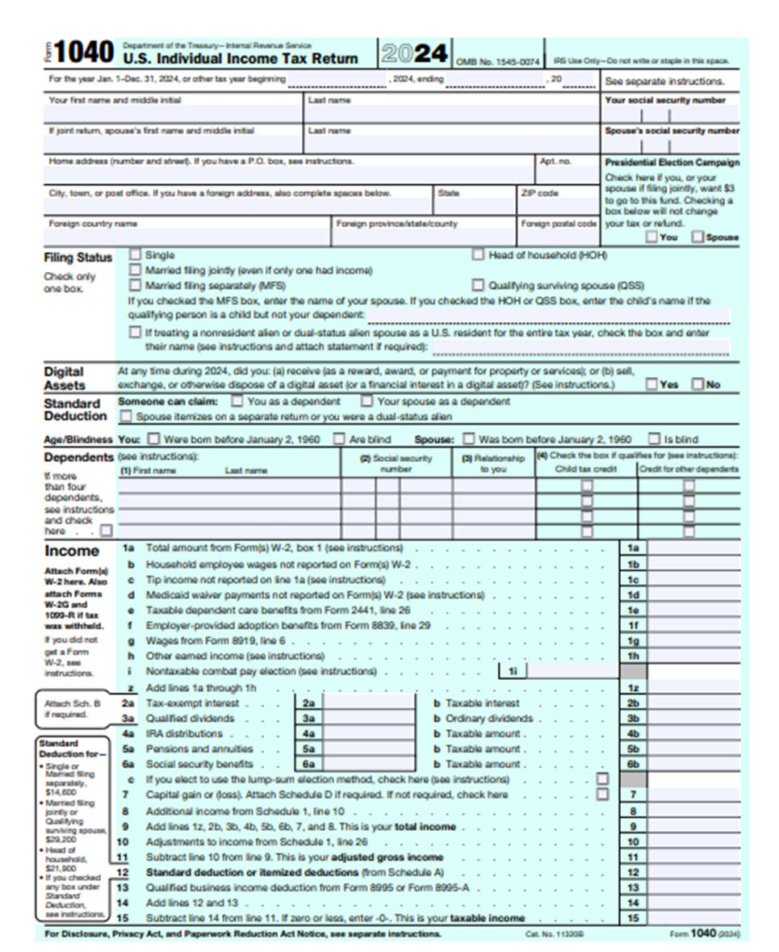
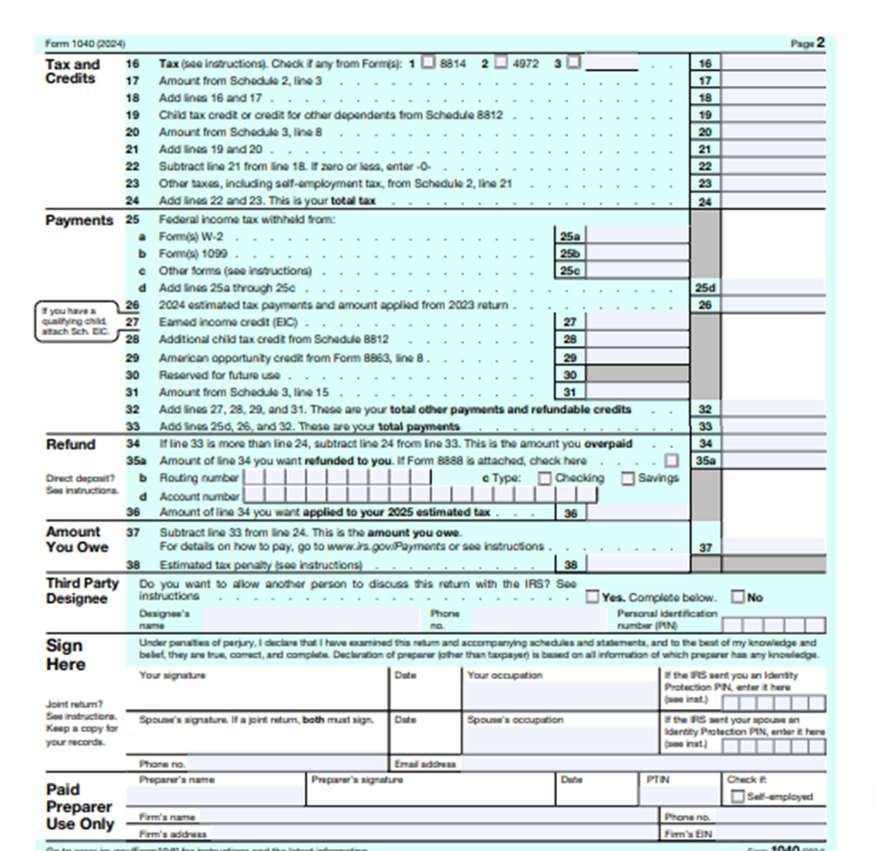
Overview of form 1040 (Page 1and 2)

Slide 33
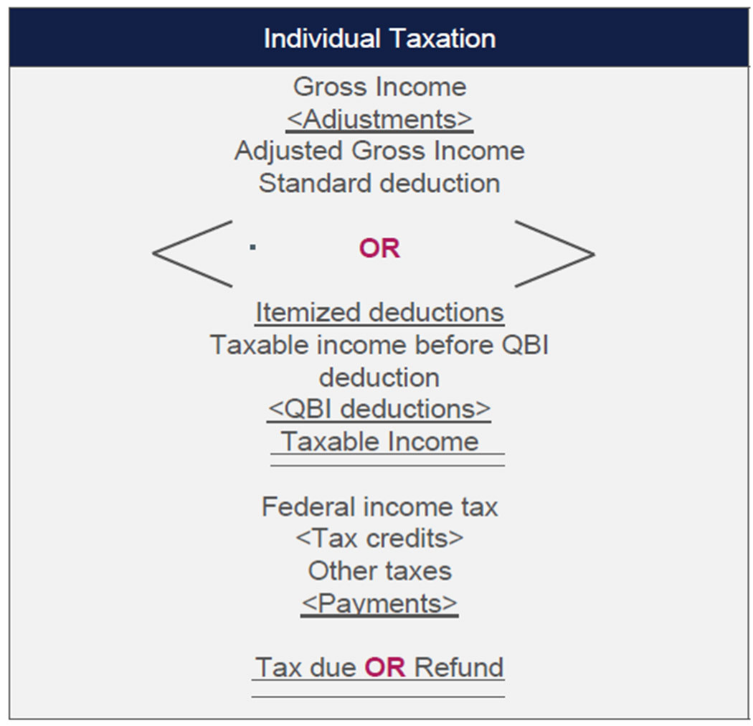
Gross income and taxable income

Slide 34
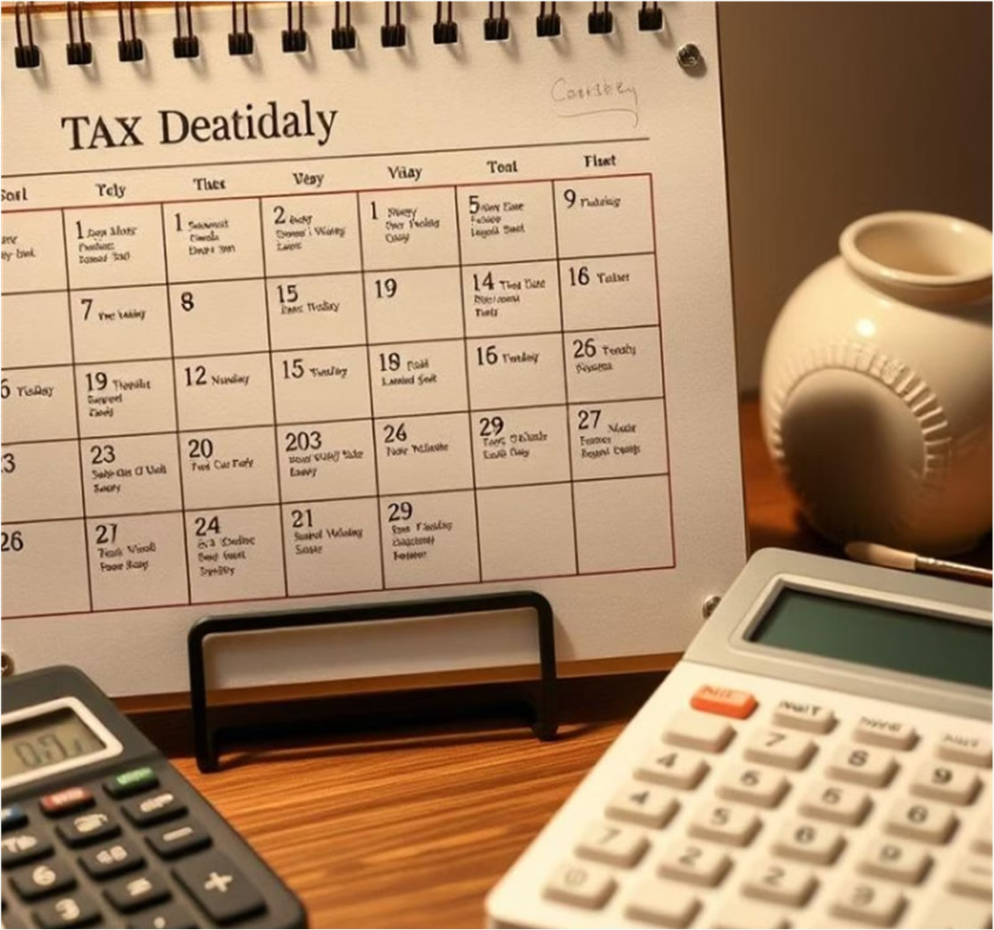
Partnership Taxation

Slide 35
Overview of partnership taxation

Slide 36
Partnership Taxation Comparison
 | Indian Context | US Context
Agreement between partners | Partnership deed | Operating Agreement
Partners Classification | Partners are classified as Active (Working), Sleeping, Nominal, Partners in Profits, Minor Partner, etc. but these classification are not reported on the return. | Partners can be General Partner and Limited Partner which are reported in the return.
Tax paid by | Partnership pays tax at the rate of 30% and the share of profit is exempt in hands of the partners. | Partnership is known as Pass-through entity as it does not pay tax and issues K-1s to its partners and the partners pay tax on the income.
Partnership Return | Partnership files Return in ITR 5 | A Partnership files return in Form 1065

Slide 37
Partnership Taxation Comparison
 | Indian Context | US Context
Compensation to Working Partner | The Working partner receives compensation in form of salary. | The Working partner receives compensation in form of Management fees/ Guaranteed payments (fixed portion), Incentive (if fund is making profits).
Who Pays Taxes | Partnerships | Partners (other than pass through entities)
Rates | 30% + Surcharge and cess | Applicable rates as per income for Partners
Compensation to partners | Salary Share of profits Interest on capital | Management Fees Incentives Guaranteed payments

Slide 38
Partnership – Tax planning strategies
Partnerships issue K-1s to partners. Timely issuance of K-1s play a major role in determination of estimated tax payments by individuals
Whether Sec 163J election to be taken or not? (interest vs depreciation)
Whether PTET election to be taken?
Role of Sec 754 and 704 (c) – sale of partnership interest
Role of Sec 1031 – when there is a sale of property and intend to purchase similar kind of property

Slide 39
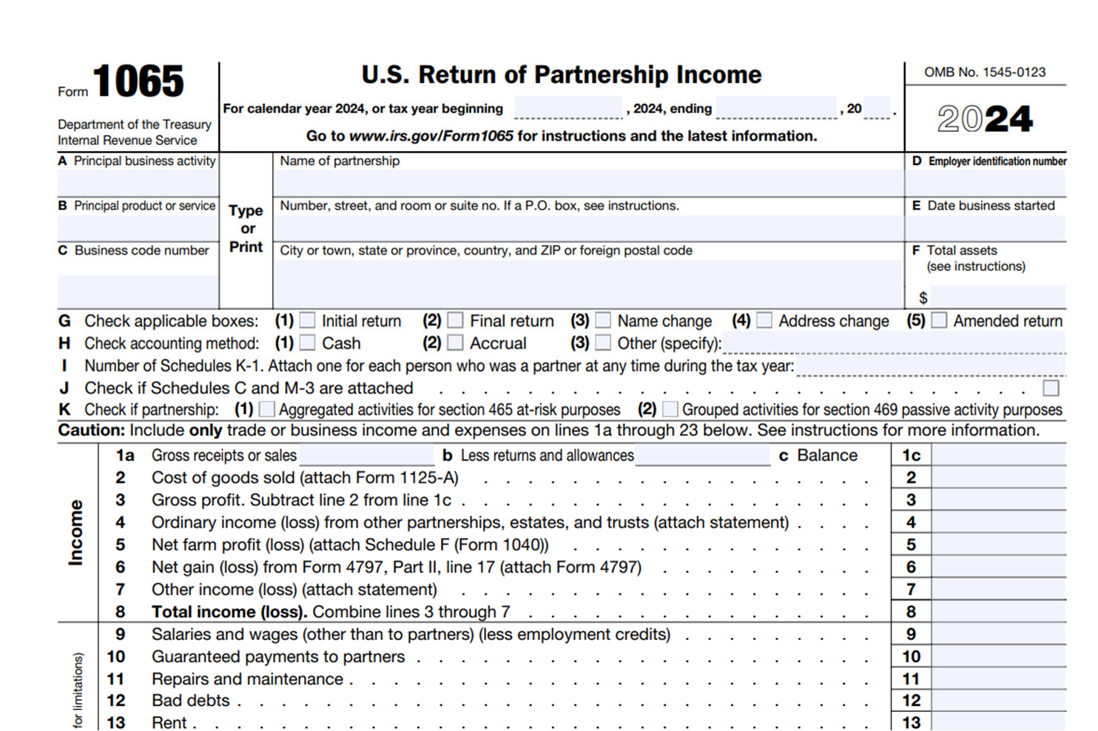
Form 1065 – For Partnerships

Slide 40
Overview of Corporation taxation

Slide 41
Corporations: C-Corps vs. S-Corps
C-Corporations
Taxed at corporate level at a fixed 21% federal rate
File Form 1120 annually
Dividends paid to shareholders are taxed again, causing double taxation
S-Corporations
Pass-through entity avoiding double taxation
Income, losses, and distributions reported on Form 1120-S
Shareholders pay federal tax at individual rates on their share
The concept of S Corp is similar to partnership. The following are the major differences –
Maximum of 100 shareholders
Self employment taxes are not applicable
Shareholders can only be resident individuals, trusts and estates

Slide 42
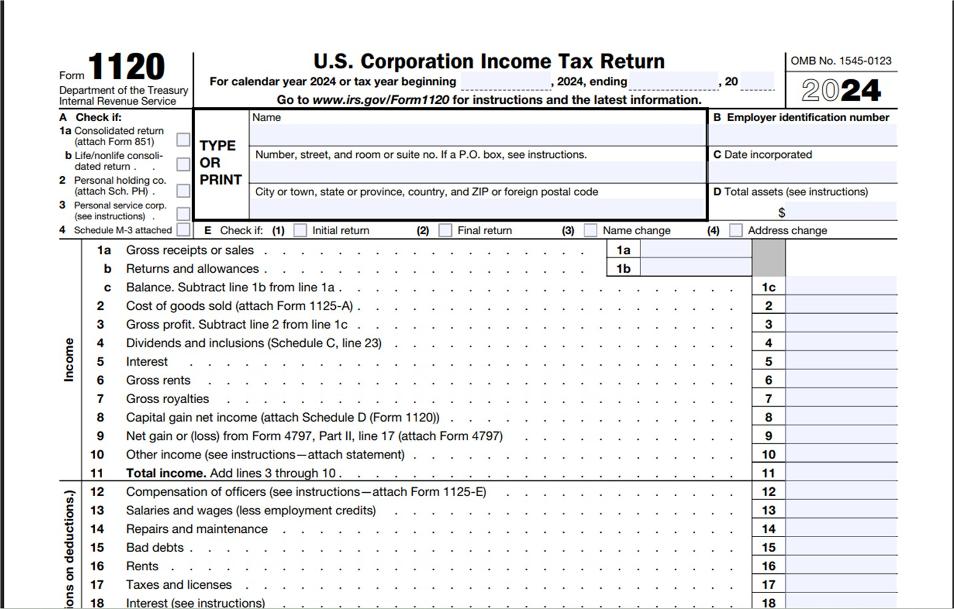
Form 1120 – For Corporations

Slide 43
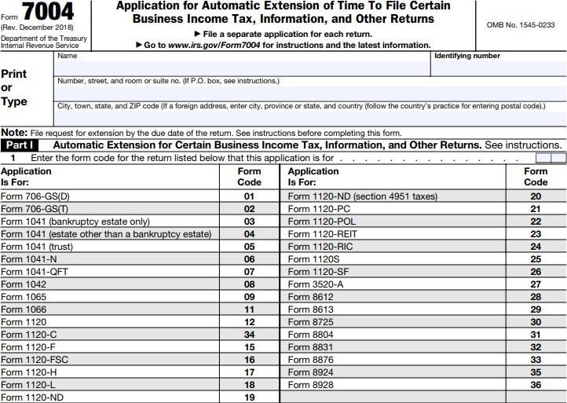
Extension forms
Form 7004 - Application for Automatic Extension of Time to File Certain Business Income Tax, Information, and Other Returns.

Slide 44
Extension forms
Form 4868 - Application for Automatic Extension of Time to File U.S. Individual Income Tax Return
Note 1: ‘Automatic Extension’ means the taxpayer ‘automatically’ gets an extension on filing of Form 7004/4868. They do not need specific written approval from IRS extending the due date of filing return.
Note 2: Extension is always provided to file the return, but not to pay taxes. This means you can file your tax returns by the extended due date, but if taxes are not paid by the original due date, it will attract interest/penalty charges upto date of payment.

Slide 45
Questions?
45

Slide 46
“EisnerAmper” is the brand name under which EisnerAmper LLP and Eisner Advisory Group LLC provide professional services. EisnerAmper LLP and Eisner Advisory Group LLC are independently owned firms that practice in an alternative practice structure in accordance with the AICPA Code of Professional Conduct and applicable law, regulations and professional standards. EisnerAmper LLP is a licensed CPA firm that provides attest services, and Eisner Advisory Group LLC and its subsidiary entities provide tax and business consulting services and provide staff and other administrative resources to EisnerAmper LLP. Eisner Advisory Group LLC and its subsidiary entities are not licensed CPA firms.
This publication is intended to provide general information to our clients and friends. It does not constitute accounting, tax, or legal advice; nor is it intended to convey a thorough treatment of the subject matter.
© 2021 Eisner Advisory Group LLC
46

