Slide 1
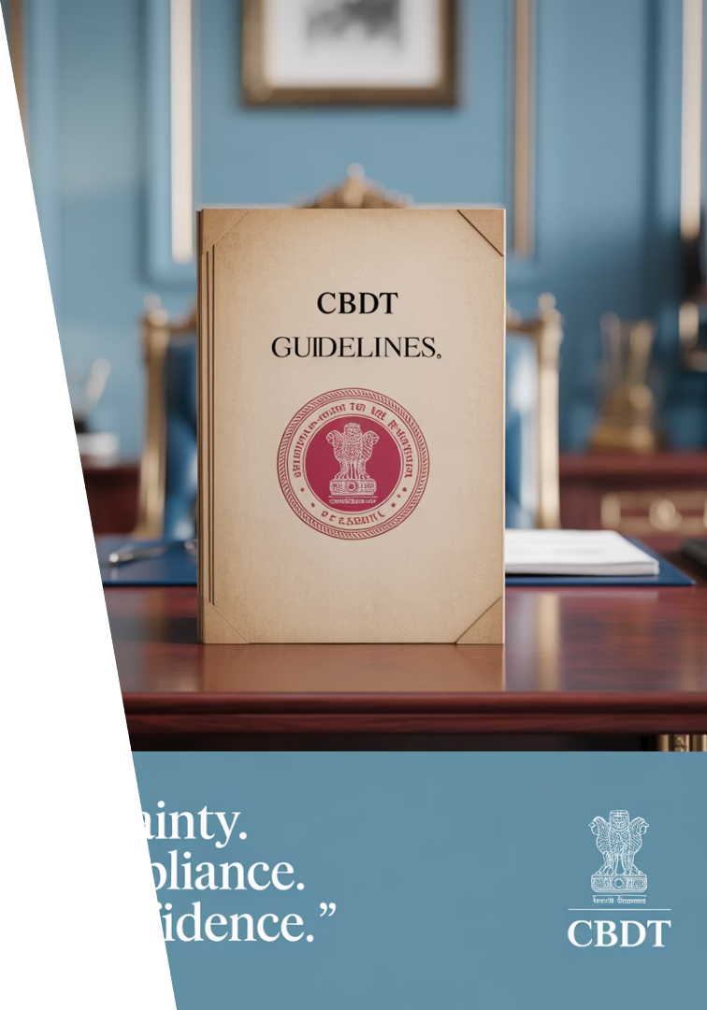
Revised Guidelines for Compounding of Offences under Income Tax Act, 1961
Welcome to this comprehensive presentation on the revised guidelines for compounding of offences under the Income Tax Act, 1961. These guidelines, issued by the Central Board of Direct Taxes (CBDT) on 17 October 2024, represent a significant shift in India's tax administration approach - moving from prosecution to compliance as a paradigm shift.
This presentation will provide a detailed analysis of the changes, implications, and practical considerations for tax professionals dealing with compounding applications under the new regime.
CA Kumar Pal Tated
Partner
KPSV And Associates

Slide 2
Acknowledgement
CA Deepal Ladda
Team Agarwal and Ladda Chartered Accountants

Slide 3
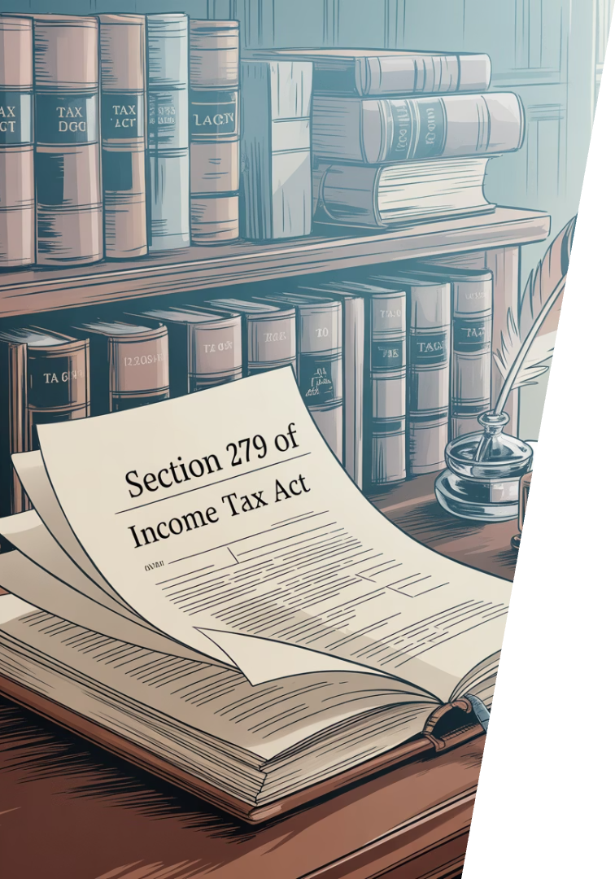
Understanding Compounding of Offences
What is Compounding?
Legal Framework
Compounding is a mechanism whereby the defaulter is reprieved of major legal consequences by affording an opportunity to pay a sum of money to escape prosecution.
Governed by Chapter XXII, specifically Sections 279(2), 278B, and 278C of the Income Tax Act, 1961, empowering authorities to compound offences.
Objective
To facilitate settlement of offences through payment of prescribed compounding fee, avoiding lengthy prosecution and promoting voluntary compliance.

Slide 4
Legal Framework for Compounding
Section 279(2)
Provides for compounding of any offence before or after the institution of proceedings.
Competent Authorities
Principal CCIT, CCIT, Principal DGIT, and DGIT are empowered to compound offences under the Act.
Effect of Compounding
Once compounded, the offence is deemed settled, preventing criminal prosecution, thereby offering a compliance-friendly alternative to litigation.
Governing Circulars
Circular F. No. 285/08/2014-IT(INV.V)/163 dated 17 October 2024 and Circular No. 4 of 2025 dated 17 March 2025.

Slide 5
Introduction & Overview
Objective
Legal Framework
Scope of Compoundable Offences
The compounding mechanism under the Income-tax Act, 1961, is designed to facilitate settlement of offences by taxpayers through payment of a prescribed compounding fee, thereby avoiding lengthy prosecution or litigation. This enables voluntary compliance and early resolution of disputes.
The power to compound offences is primarily provided under Section 279(1) of the Income-tax Act, 1961, which authorizes prescribed income tax authorities—such as Principal Chief Commissioner of Income Tax (Pr. CCIT), Chief Commissioner of Income Tax (CCIT), Principal Director General of Income Tax (PDGIT), and Director General of Income Tax (DGIT)—to compound offences committed under the Act.
All the offence under Income Tax Act, 1961 has been made compoundable in revised guidelines dated 17.10.2025

Slide 6
Background and Evolution
Previous Guidelines
Revised Guidelines
Multiple guidelines with complex categorization of offences, limited time frames, and restrictive conditions created barriers for taxpayers seeking compounding.
CBDT issued revised guidelines on 17 October 2024, superseding all existing guidelines and applying to both pending and new applications.
1
2
3
4
Budget Announcement
FAQs Circular
The Hon'ble Finance Minister announced in July 2024 the intention to simplify and rationalize the compounding procedure for stakeholders.
CBDT issued Circular No. 4 of 2025 dated 17 March 2025 to enhance awareness and understanding among stakeholders about the revised guidelines.

Slide 7
Why Revised Guidelines Were Issued
Budget Announcement
In line with the Hon'ble Finance Minister's budget announcement in July 2024 to simplify and rationalize the compounding procedure.
Reduce Complexities
To reduce complexities arising out of existing multiple guidelines and supersede all existing guidelines on the subject.
Promote Compliance
To encourage voluntary compliance and reduce litigation by making the compounding process more accessible and user-friendly.
Ease of Doing Business
Part of government's broader initiative to improve ease of doing business and decriminalize technical/procedural violations.

Slide 8
Provisions Before the Guidelines Issued on 17-10-2024
Limited Scope of Compoundable Offences
Time Limit for Filing Compounding Applications
Complex and Burdensome Fee Structure
Before the revised guidelines dated 17-10-2024, only certain offences explicitly notified by the CBDT were eligible for compounding. The list excluded many serious offences, including those related to wilful tax evasion or intentional concealment of income. These offences often attracted prosecution with imprisonment or severe penalties.
A strict limitation was imposed requiring applications for compounding to be filed within 36 months from the date the offence was committed or came to the notice of the department. Applications filed beyond this period were generally rejected, restricting relief for offences older than three years.
The compounding fees prescribed by CBDT were complex, varying widely depending on the offence's nature and the amount of tax involved. This led to inconsistent application and increased financial burden on taxpayers. For instance:
Failure to deduct TDS (Section 271C) could attract fees ranging from ₹10,000 to ₹1 lakh depending on the amount involved.
Sections Relevant: 271C (failure to deduct TDS), 272A (failure to pay TDS/TCS), 276B (failure to pay TCS), 276CC (failure to pay tax within prescribed time), 278 (failure to produce accounts/documents).
This time limit posed a significant barrier for taxpayers who became aware of proceedings late or who faced procedural delays.
Failure to pay tax within time (Section 276CC) involved fees which were often a percentage of the tax default, sometimes up to 10-25% of tax payable.
Offences under Section 276D (failure to comply with notice for filing return) were non-compoundable before.
Fees were fixed or slab-based and not uniform across offences, causing confusion.

Slide 9
Additional Limitations Before Issuance of Guidelines
Restriction on Number of Applications
Joint Application by Co-accused Required
Procedural Delays and Discretion
Only one compounding application per offence was permitted. If an application was rejected due to procedural defects or incomplete documentation, the taxpayer had minimal opportunity to reapply. This rigid restriction caused hardship and procedural unfairness.
Where multiple accused persons were involved, the law required a joint compounding application by all co-accused. Separate or independent applications by individual co-accused were not allowed. This created difficulties when some accused persons refused to cooperate or were unavailable, potentially delaying or derailing the compounding process.
The process was marked by procedural rigidity and discretionary delays. The competent authorities had wide latitude to seek additional documents or reject applications on technical grounds, which increased litigation and uncertainty.
On acceptance of the application and payment of fees, the offence was deemed compounded under Section 279(2), effectively extinguishing liability to prosecution or further penal proceedings.

Slide 10
Scope of the Revised Guidelines
Effective Date
Application to Pending Cases
The guidelines come into effect from 17 October 2024 and apply to all applications filed after this date and those filed earlier but not yet disposed of.
For applications pending on the date of issuance, if compounding charges have already been determined but not fully paid, they will be re-determined if lower under the new guidelines.
Resubmission of Rejected Applications
Rejection on Merits
Applications can be resubmitted if they were rejected due to correctable/curable defects, with credit for payments already made against the compounding charges.
Applications previously rejected on merits will not be considered under the revised guidelines.

Slide 11
Comparison: Before vs. After 17 October 2024
Aspect
Before 17-10-2024
After 17-10-2024
Expansion of Compoundable
Offences
Limited to notified offences; serious offences excluded
All offences under Income-tax Act are compoundable
Removal of Time Limit for
Filing
Application must be filed within 36 months from offence or notice
No time limit; can be filed anytime after offence commission
Multiple Number of
Applications
Single application per offence allowed; reapplications restricted
Multiple applications allowed; defects can be cured and re-filed
Co-accused Application
Joint application by all co-accused mandatory
Co-accused may apply jointly or individually
Fee Structure
Complex, varied slabs based on offence and amount
Simplified, uniform fee structure

Slide 12
Conditions for Compounding
Application Submission
Must be made to the specified authority having jurisdiction, in prescribed format as an affidavit on a stamp paper of INR 100/-. Can be filed for one Fiscal Year or multiple years/quarters (Consolidated Compounding Application).
Time of Filing
Applications can be filed suo-moto at any time after the offence(s) is committed, regardless of whether it comes to the notice of tax authorities or not. Can also be filed after initiation of prosecution proceedings.
Application Fee
Non-refundable fee of INR 25,000/- for a single application and INR 50,000/- for a consolidated application. Fee can be adjusted against applicable total compounding charges.
Payment of Dues
All outstanding taxes, interest, penalties, and any other sum due relating to the offence(s) must be paid before making the application.

Slide 13
Expanded Scope of Compoundable Offences
Section 275B
Section 275A
Failure to afford facility to authorized officer during search and seizure.
Contravention of order in search and seizure cases now compoundable.
2
Section 276B
3
Failure to pay tax deducted at source to the credit of Central Government.
All Other Offences
5
All offences under the Income Tax Act are now compoundable, including those previously excluded.
4
Section 276BB
Failure to pay tax collected at source to the credit of Central Government.

Slide 14
Reapplication for Previously Rejected Applications
Curable Defects
Credit for Payments
Applications can be resubmitted if they were rejected due to correctable/curable defects, including:
Credit for payments already made will be allowed against the compounding charges paid under the revised guidelines.
Non-payment of outstanding tax, interest, penalty
Rejections on Merit
Filing application in incorrect proforma
Applications previously rejected on merits will not be considered under the revised guidelines.
Incorrect section or Assessment Year mentioned
Non-payment or short payment of compounding charges
Application Fees
Non-submission of undertaking regarding withdrawal of appeals
Compounding application fees chargeable for a 'consolidated compounding application' would be charged in case of reapplication.

Slide 15
Conditions for Compounding Applications
Compounding Application Fee
Time of Filing
Non-refundable fee of INR 25,000/- for a single application and INR 50,000/- for a consolidated application. Fee can be adjusted against applicable total compounding charges determined by the Competent Authority.
Application Submission
Applications can be filed suo-moto at any time after the offence(s) is committed, irrespective of whether it comes to the notice of tax authorities. Can also be filed after initiation of prosecution proceedings.
Application must be made to the specified authority having jurisdiction, in prescribed format and submitted as an affidavit on a stamp paper of INR 100/-. Can be filed for one Fiscal Year or for multiple years/quarters as a 'Consolidated Compounding Application'.

Slide 16
Additional Conditions for Compounding
1
Payment of Dues
2
Undertaking by Applicant
All outstanding taxes, interest, penalties, and any other sum due relating to the offence(s) must be paid before making the application. If any related demand is found outstanding, it must be settled within 30 days or maximum three months as allowed.
The applicant must undertake to pay the compounding charges within the stipulated timeframe as determined by the Competent Authority.
3
Withdrawal of Appeals
4
Consolidation of Offences
The applicant must undertake to withdraw appeals filed related to the offence(s) sought to be compounded. For mixed grounds appeals, undertaking for withdrawal of grounds related to the offence is required.
Applications for compounding under sections 276B/276BB must cover all defaults for the particular TAN for the specified period. Total default on TDS/TCS for a quarter shall be considered by combining all defaults.

Slide 17
Reviving Defective Applications
Defective Application
Applications not fulfilling specified conditions or having curable defects are treated as 'defective' and not proceeded with.
Cure Period
Such applications can be revived without additional payment of Compounding Application Fee if defects are cured within one month from the date of intimation.
Failure to Cure
If defect is not cured within allowed time, defective application shall be returned to the applicant.
Subsequent Application
Any further application filed for the same purpose will be considered as subsequent compounding application and additional charges will be applicable.

Slide 18
Special Cases Requiring CBDT Chairman Approval
Anti-National Activities
Imprisonment for 2+ Years
Cases involving anti-national or terrorist activity.
Offences where the applicant has been sentenced to imprisonment for 2 years or more.
Tax Evasion Facilitation
Offences related to facilitating tax evasion for others.
Search & Seizure
Offences under section 275A/275B of the IT Act related to search and seizure operations.
Special Acts
Offences under the Black Money Act, 2015 or Benami Property Transaction Act, 1998.

Slide 19
Addressing Misconceptions About Compounding
Non-Admission of Guilt
Clarification in Order
Many taxpayers, especially Non-Resident taxpayers, hesitate to opt for compounding due to misconception that it constitutes admission of offences, impacting reporting obligations at various statutory and international forums.
To address this, the Competent Authority shall include a specific paragraph clarifying that the compounding order is intended solely to resolve the offence and should not be interpreted as an admission of guilt by the applicant.
Encouraging Compliance
This clarification aims to encourage taxpayers to seek compounding without fear of adverse implications, promoting voluntary compliance and reducing litigation.

Slide 20
Addressing Non-Resident Taxpayer Concerns
The Misconception
The Solution
Many taxpayers, especially Non-Resident taxpayers, hesitate to opt for compounding due to the misconception that it constitutes an admission of offences, which could impact their reporting obligations at various statutory and international forums.
To clarify this issue and encourage taxpayers to seek compounding, the Competent Authority shall include a specific paragraph in the compounding order which clarifies that it is intended solely to resolve the offence and should not be interpreted as an admission of guilt by the applicant.

Slide 21
Changes for Companies and HUFs
Previous Requirement
Revised Approach
Earlier, the main accused (companies and HUFs) were required to file the application for compounding, creating procedural hurdles.
The requirement for the main accused to file the application has been dispensed with under Section 278B or 278C of the IT Act.
This often led to delays when the main entity was unable or unwilling to file the application, leaving co-accused without recourse.
The application may now be filed separately or conjointly by the main accused and/or any of the person(s) deemed to be guilty of the offence, referred to as co-accused.
On payment of compounding charges by the main accused and/or any co-accused, the Competent Authority shall compound the offences via an order.

Slide 22
Insolvency Cases and Co-accused Liability
Company under IBC
When a company enters insolvency proceedings under IBC
Company Liability Ceases
Company's liability for offences committed prior to insolvency may cease
Co-accused Liability Continues
Prosecution proceedings against co-accused can still continue
In cases where liability of a company for an offence committed prior to the commencement of the corporate insolvency resolution process ceases due to the provisions of the Insolvency Bankruptcy Code (IBC), it is clarified that prosecution proceedings against the co-accused can still continue. This important clarification ensures that individual accountability remains even when corporate liability is affected by insolvency proceedings.

Slide 23
FAQ: Understanding Compounding
1
What is compounding of offence?
Compounding of an offence is a mechanism whereby major legal consequences of the defaulter are reprieved by affording him an opportunity to pay a certain sum of money to escape prosecution.
2
Are there any offences under IT Act which are not compoundable?
As per the revised guidelines, all offences under the IT Act have been made compoundable.
3
Is compounding application fee adjustable against cross application?
No, cross application adjustment is not allowed.
4
If the compounding application is rejected, is the application fee refundable?
No, the application fees shall neither be refundable nor adjustable against any subsequent application.

Slide 24
FAQ: Application Process
Can previously rejected applications be resubmitted?
Yes, an applicant may apply for compounding of offences through a single consolidated application if one or more applications had been rejected under previous guidelines due to curable defects. However, applications rejected on merits cannot be resubmitted.
Are pending applicants required to file fresh applications?
Applicants whose applications were pending as on 17 October 2024 are neither required to file a fresh application nor required to pay any fresh application fees.
Can an applicant withdraw and file a new application?
Yes, but such new application shall be treated as a subsequent application, and higher compounding charges shall be applicable.
Must all offences be included in one application?
No, the applicant may apply for one or multiple offences in an application. The application cannot be rejected on the ground that the applicant has not applied for a particular offence for which prosecution proceedings are in progress.

Slide 25
FAQ: Limitations and Eligibility
Is there a limit on the number of applications?
Can previously convicted applicants reapply?
No, there is no limitation on the number of times a person can file compounding applications. However, the Competent Authority may reject an application filed by a person on the grounds of being a 'habitual offender'.
Yes, if the rejection was solely on account of conviction, without examination of merits, as per any of the earlier guidelines, such applicant can reapply in accordance with the revised guidelines.
What about applications rejected due to time limitations?
What about pending Writ Petitions?
Applicants with pending Writ Petitions can file new applications after submitting an undertaking to withdraw the Writ Petition, which shall be treated as subsequent applications.
The limitation of 12/24/36 months has been eliminated in revised guidelines. All applicants whose applications were rejected earlier on limitation grounds may file fresh applications, which shall be treated as subsequent applications.

Slide 26
FAQ: Calculation of Compounding Charges
For Previously Rejected Applications
For Pending Applications
Credit for Payments Made
Compounding charges for pending applications are subject to redetermination. All pending applications shall be treated as first compounding applications, and charges shall be recomputed for each offence as given in Annexure-4 of the guidelines.
Credit of the amount already paid for a particular offence pertaining to a particular year shall be allowed for that specific offence and year only. However, any excess payment shall not be refundable or adjustable.
All applications rejected under earlier guidelines shall be deemed to be the fresh compounding application. The fresh consolidated application will be considered as the second application, and compounding charges will be calculated as per para 10 of the revised guidelines.

Slide 27
FAQ: Multiple Applications Scenario
Compounded Applications
1
No action is pending for applications which have been compounded.
Rejected Applications
2
A consolidated application may be filed for all applications which were rejected on account of curable defects.
Pending Applications
3
No fresh application is required for pending applications. All pending applications shall be treated as first compounding applications.

Slide 28
FAQ: Timing and Charges
Suo-Moto Applications
Post-Prosecution Applications
Prosecution Expenses
The compounding charge depends on the sequence of application as well as the offence applied for and is independent of whether the application is filed suo-moto or in compliance with the notice of the department.
If the application is filed within 12 months from the end of the month in which prosecution complaint is filed, the compounding charge will be determined as per para 10.2 to 10.5 of guidelines. For applications filed after 12 months, the compounding charges so calculated shall be increased by 50% as per para 10.
Prosecution Establishment Expenses and Litigation Expenses have been removed in the revised guidelines.

Slide 29
FAQ: Payment Considerations
Payment Under TAN vs PAN
Extension of Payment Time
The compounding charge shall be made under TAN of the deductor. However, if the applicant is the co-accused, then compounding fees may be made under PAN of co-accused as they may not have access to the TAN of the main accused.
Extension beyond 24 months is not allowable, and the application shall be rejected, followed by initiation of prosecution proceedings. However, the applicant can file a new application which shall be treated as a subsequent application.
Calculation of 24-Month Period
Interest on Extended Payments
For applications pending as on 17 October 2024, wherein compounding charges were not fully paid within time allowed or wherein time allowed had not elapsed, the period of 24 months will commence from the end of October 2024.
No interest or additional charges are applicable on extension allowable under para 9.4 of the guidelines. For cases pending as on date of issuance of revised guidelines, additional compounding charges shall not be applicable.

Slide 30
FAQ: Eligibility for Filing Applications
Who Can File Applications?
Unidentified Co-accused Cases
Only the main accused or co-accused can file compounding applications for offences of a company or HUF. The applicant is required to disclose their status as main accused or co-accused in the compounding application.
In cases where co-accused have not been identified under section 278B, either the main accused or any person who can substantiate with supporting documents that they were in charge or responsible for the conduct of the business during the offence can file an application as co-accused.
No person other than the main accused or co-accused can file a compounding application.
In such cases, there will be no requirement to identify other co-accused for compounding purposes. However, if the application is rejected, all co-accused shall need to be identified to file a prosecution complaint.

Slide 31
FAQ: Undertakings and Orders
Undertakings for Appeal Withdrawal
Compounding Order Recipients
Co-accused cannot furnish undertaking for withdrawal of appeal on behalf of the main accused. Such undertaking shall be furnished by the main accused only and must be attached with the application if filed by the co-accused.
The compounding order shall be passed in the name of the person who applied for compounding. If co-accused applied, the order shall include the main accused's name. If main accused applied and co-accused has been identified, the order shall name both.
Order Distribution
Copies of the compounding order are forwarded to the applicant, Assessing Officer, Prosecution Cell, and concerned Court (if applicable).

Slide 32
Step-by-Step Compounding Procedure
Application Preparation
Prepare application addressed to the appropriate authority with all required details and annexures, including payment challans, copies of complaints, ITRs, and affidavit on ₹100 stamp paper.
Submission
Submit two physical copies of the application (as online filing is not yet permitted), with one copy forwarded to the Assessing Officer for a factual report.
Scrutiny and Hearing
Application undergoes preliminary scrutiny, with opportunity for hearing if required. Assessing Officer provides factual report on the case.
Payment and Order
Upon intimation of compounding charges, payment must be made within stipulated time through Challan No. 280. A speaking order is then issued by the competent authority.

Slide 33
Payment of Compounding Charges
Determination of Charges
Intimation Letter
Based on the nature of offence and whether it's a first or subsequent application as per Annexure-4 of guidelines
Competent Authority issues intimation with break-up of charges and payment instructions
Payment Timeline
Payment Method
Payment must be made within 30 days, extendable up to 24 months in installments
Through Challan No. 280 under "Other Receipts (Minor Head 800)"

Slide 34
Time Extensions for Payment
Initial Period
30 days from the date of intimation of compounding charges
First Extension
Up to 3 months may be granted by the Competent Authority upon request with valid reasons
Further Extension
3
Up to 24 months in installments for genuine hardship cases
4
Beyond 24 Months
Extension beyond 24 months is not allowable, and the application shall be rejected, followed by initiation of prosecution proceedings

Slide 35
Compounding Process for Co-accused
Separate Application Allowed
Co-accused can file separately from main accused
Joint Application Option
Main accused and co-accused can file jointly
Single Fee Structure
No separate compounding fee for co-accused
Universal Benefit
4
Payment by any accused benefits all accused
This represents a significant procedural simplification, allowing co-accused to proceed with compounding even when the main accused is unwilling or unable to participate. The revised guidelines ensure that individual co-accused are not penalized for circumstances beyond their control, while maintaining the integrity of the compounding process.

Slide 36
Key Takeaways and Strategic Considerations
Simplified Regime
Proactive Compliance
The revised guidelines represent a significant simplification of the compounding process, making it more accessible and user-friendly for taxpayers and practitioners.
Tax professionals should proactively assess historical defaults and use this window to clean up past liabilities, especially for cases previously rejected due to time limitations.
Non-Admission of Guilt
Documentation
Educate clients on the "non-admission of guilt" clause, particularly important for NRIs and multinational companies with international reporting obligations.
Maintain comprehensive documentation of all communications, payments, and undertakings to ensure smooth processing of compounding applications.
The revised guidelines for compounding of offences under the Income Tax Act represent a progressive step towards a more compliance-oriented tax administration. By eliminating unnecessary complexities, removing time limitations, simplifying fee structures, and clarifying procedural aspects, these guidelines offer taxpayers a genuine opportunity to regularize past defaults and move forward with clean compliance records.

Slide 37
THANKYOU TO ALL FROM
KPSV AND ASSOCIATES
CA KUMAR PAL TATED
+91 9949656765
kpjain09@gmail.com

