Slide 1
Review
GST Annual Returns
(GSTR-9 & 9C)
Reconcile
Rectify
CA Raghavender Kuncharapu | Partner | GPHK & ASSOCIATES |Chartered Accountants
Notes:
Greetings
How many of them filed returns from 2017
How many of them filed for last 2 years
How many of them filed more than 100 GSTR-9 in Total
What is your overall feed back or understanding

Slide 2
Agenda
Intro
Snaps
Work
shop
Q & A
Notes:
Intro – what is AR, how its diff from GSTR3B, Applicability & Relevant dates
Analysis – Snapshot & table-wise , mandatory fields
Work shop – Scenario based workshop
P & D – Source of infor, check list, key aspects to cover
Q & A

Slide 3
Introduction
Annual return
(GSTR-09)
A Return for the Financial year (Sec 44 of CGST Act)
Reconciliation statement
(GSTR-9C)
Statement reconciling GSTR-9 with Audited Financial statements
Ideally
[GSTR-3B & GSTR-1]
GSTR-9 = (+)
[Additional disclosures]
GSTR-9
(vs)
GSTR-3B & GSTR-1
A Standalone form
No Entry into ECL & ELL
No Entry into GSTR-2B

Slide 4
Introduction - Applicability
Applicability
GSTR-9
Exclusions
Registered person
Exemptions
ISD
TDS
TCS
CTP
NRTP
CG Dept/SG Dept/LA subject to audit by C & AG or auditor appointed as per law
Registered person Aggregate turnover up to Rs. 2 Crores
ATO – Turnover to be computed at PAN level, not GSTIN level
If ATO > Rs. 2 Crores, then GSTAR to be filed even for Nil turnover GSTIN
GSTR-9C
ATO > Rs. 5 Crores

Slide 5
Introduction – Relevant Dates
FY 24-25
31st March, 2025
Practical Date
11th Nov, 2025
Due Date
31st Dec, 2025
Last Date
31st Dec, 2028

Slide 6
Sources of Information
Books of Accounts
GSTR-01
GSTR-3B
Sources of information for filling GSTR-9 ?

Slide 7


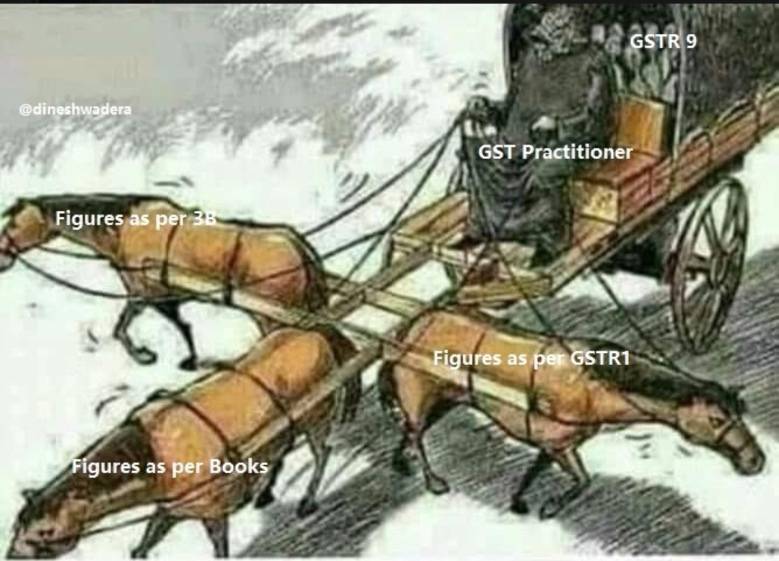
GSTR3B = BOA = GSTR1
GSTR3B <-- BOA --> GSTR1
GSTR3B BOA GSTR1

Slide 8
B2B
GSTR2B
Nil rated
Ineligible ITC
NFY
Eligible
ITC
Exempt
CFY
RCM
Taxable
Export
Permanent Reversal
B2C
Table 8A
Temporary Reversal

Slide 9
Snapshot of GSTR9
GSTR-9
Basic Details
Outward supplies & RCM
ITC
Taxes Paid
Reported in NFY
Other Information
T1 to T3
T6: Availed during the year
T7: Reversed & Ineligible ITC
T8: Reflected vs Claimed vs
Lapsed
T10 & T11: Supplies
T14: Diff. payable & paid
T12& T13: ITC
T15: Demands & Refund
T16: Inward from Comp. RP, Deemed supply…
T17: HSN outward
T18: HSN Inward
T19: Late fee payable & paid
T4: Outward sup. (Tax impacting)
T4: Reverse charge inwards
T5: Outward sup. (Non Tax)
T9: Tax, Interest, penalty & Late fee
[Payable & Paid & Difference]

Slide 10
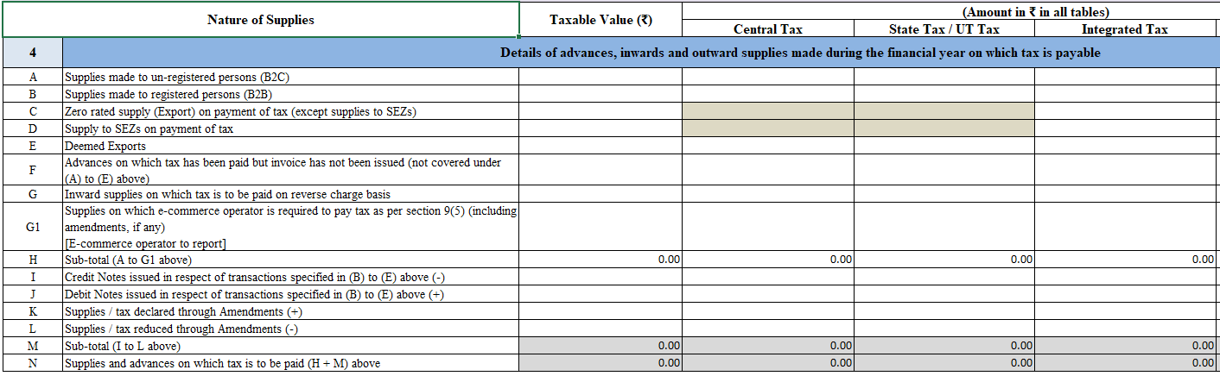
Net of DN/CN & Amnd.

Slide 11
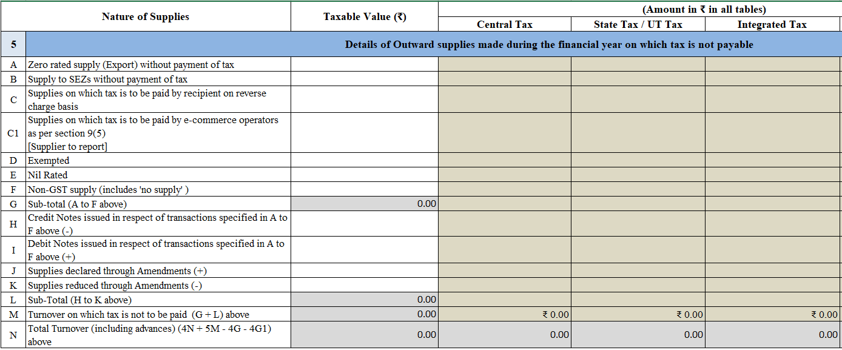
Optional

Slide 12
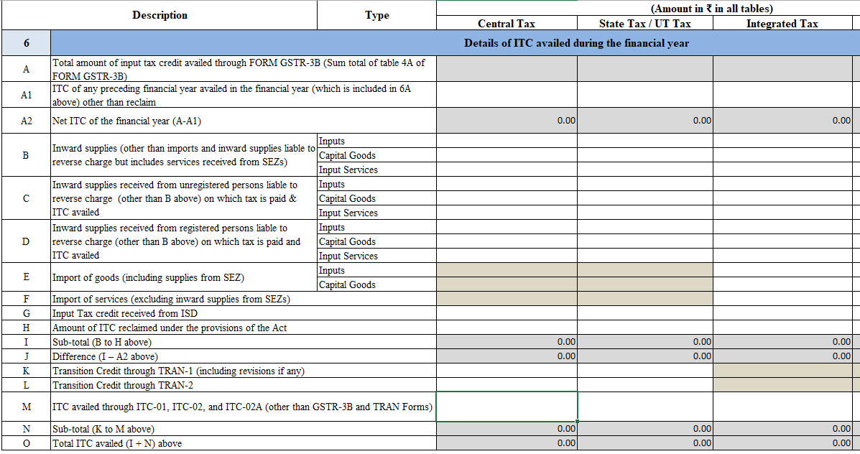
Newly Inserted

Slide 13
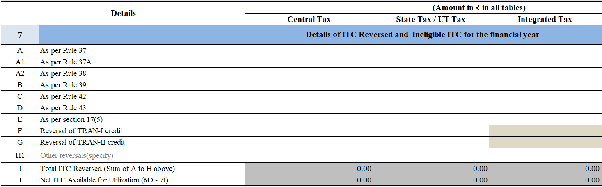
Newly Inserted
More tabs can be added→ Suggest to give bifurcation

Slide 14
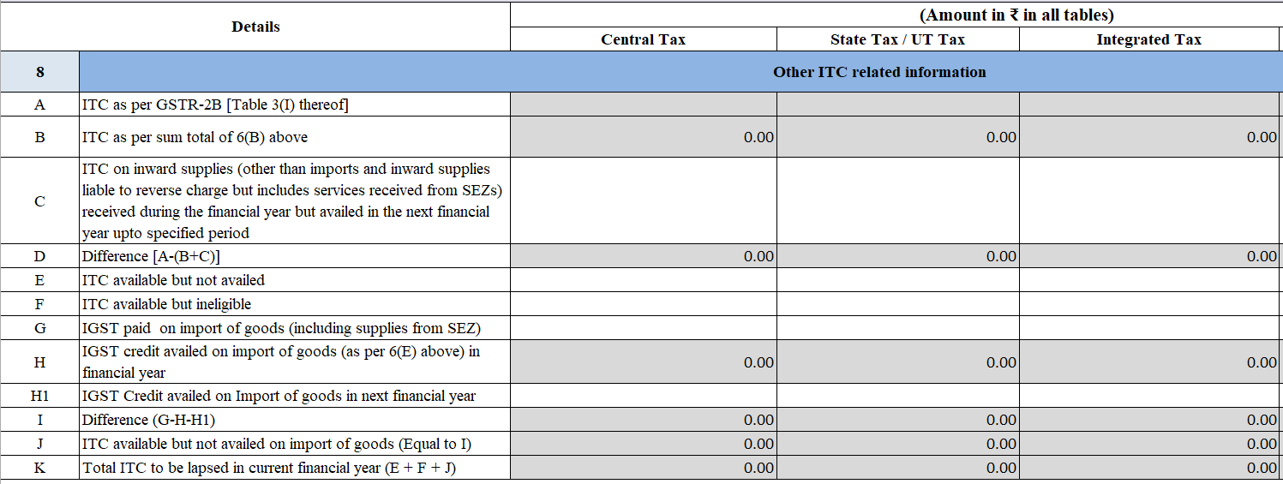
Newly Inserted

Slide 15
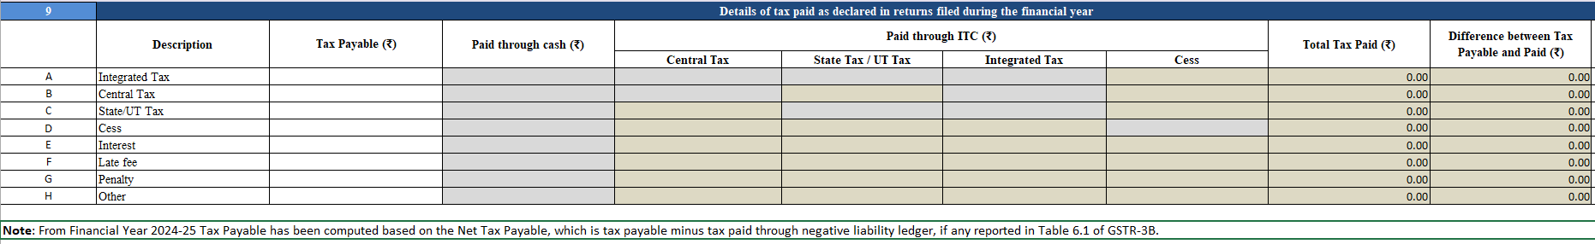
Newly Inserted

Slide 16
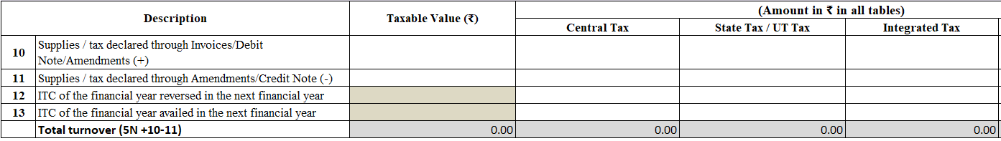

Slide 17
Snapshot of GSTR9C
GSTR-9C
Basic Details
Turnover
Taxes Paid
ITC
Addl. Liability
T1 to T4
T9 & T10 : Rate wise reco.
T11 : Addl. Amount
payable but not paid
Addl. Liability due to Non-Reconciliation
T5 & T6 : Reco. of Gross Turnover
T7 & T8 : Reco. Taxable Turnover
T12 & T13 : Reco. of ITC (Gross)
T14 & T15 : Reco. of ITC (Exp. Wise)
T16 : Liability unreconciled
difference

Slide 18
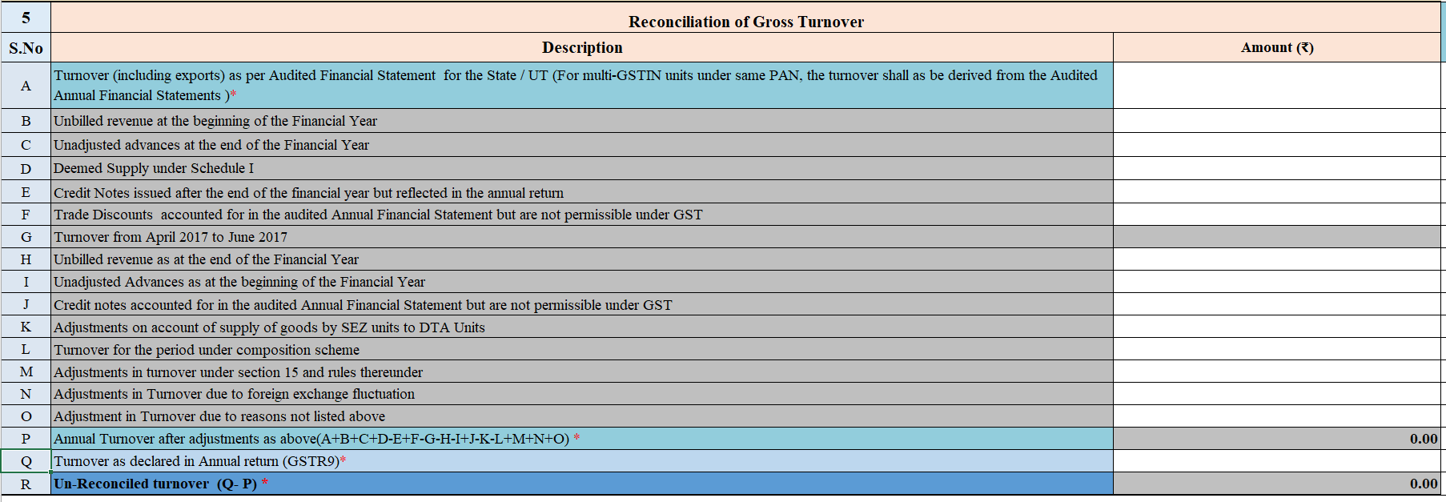

Slide 19
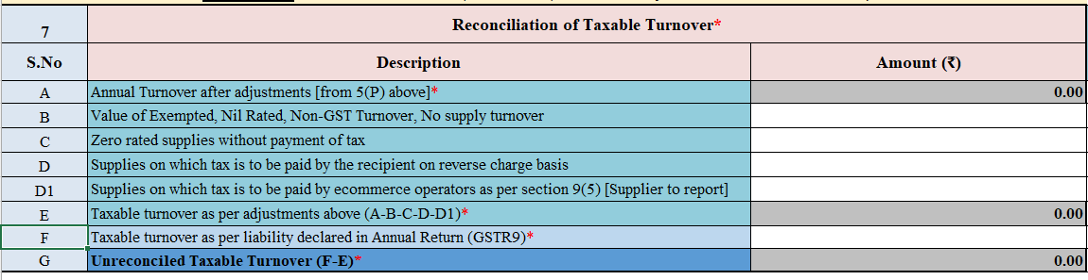

Slide 20
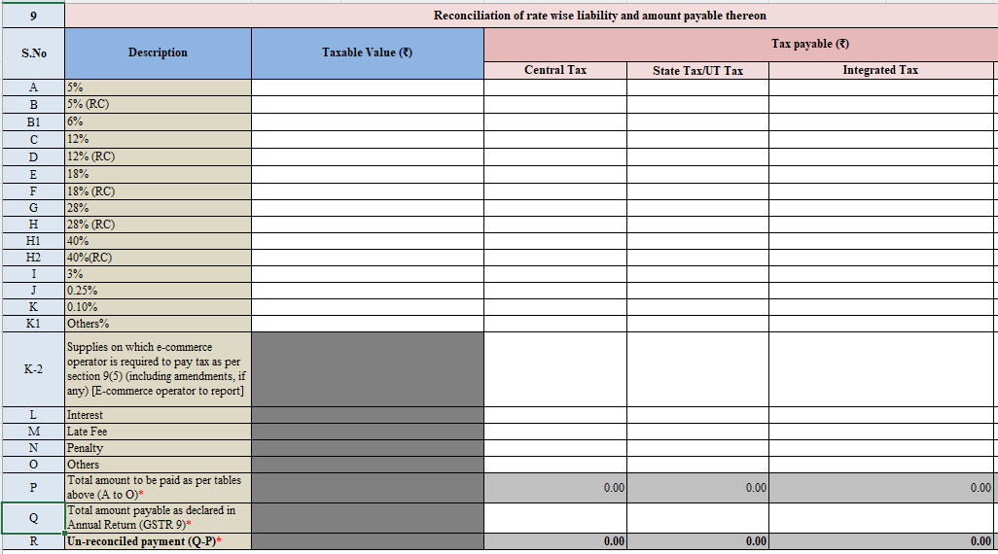
Newly Inserted

Slide 21
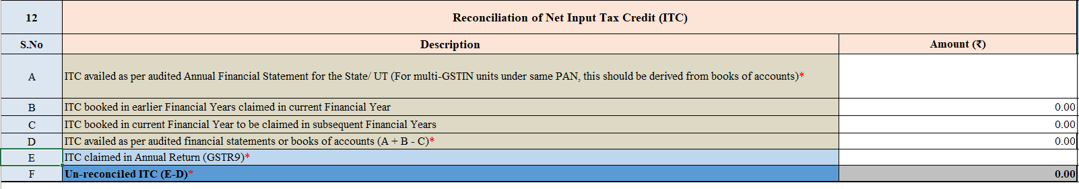
Amendment impact

Slide 22
Workshop- Outward supplies
Outward supplies
Tax Impacting
Non-Tax Impacting
Disclosed
ND
Disclosed
ND
2024-25
CFY G9
T4 + T9
&
DRC-03
2024-25
2025-26
CFY G9
(T5)
2025-26
CFY G9
(T4 + T9)
CFY G9
(T 10/11 + T14)
CFY G9
(T5)
CFY G9
(T 10/11)
CFY- Current year
NFY- Next Year
G9 - GSTR-9
3B - GSTR3B
BOA- Books of accounts

Slide 23
Workshop- ITC
ITC
Table 8A (24-25)
1st → GSTR-3B
FY 24-25
2nd→ GSTR-3B
FY 24-25
Availed
4A(5)
Reversed
4B(2)
Availed
4A(5)
Reversed
4B(1)
T- 6B
(CFY G9)
T- 7H
(CFY G9)
T- 6H
(CFY G9)
T- 7
(CFY G9)

Slide 24
Workshop- ITC
ITC
Table 8A (24-25)
1st → GSTR-3B
FY 24-25
2nd→ GSTR-3B
FY 25-26
Availed
4A(5)
Reversed
4B(2)
Availed
4A(5)
Reversed
4B(1)
T- 6B
(CFY GSTR-9 )
T- 7H
(CFY GSTR-9)
T- 13
(CFY GSTR-9)
(A/c in BOA 24-25)
No
Disclosure
T- 6A1
(NFY GSTR-9)

Slide 25
Workshop- ITC
ITC
(Table 8A)
1st → GSTR-3B
FY 25-26
2nd→ GSTR-3B
FY 25-26
Availed
4A(5)
Reversed
4B(2)
Availed
4A(5)
Reversed
4B(1)
T- 6A1
(NFY GSTR-9)
No
Disclosure
No
Disclosure
No
Disclosure
T- 8C
(CFY GSTR-9)
T- 13
(CFY GSTR-9)
(A/c in BOA 24-25)

Slide 26
Planning & Documentation
Sources of information
AFS (Audited Financial Statements)
GST portal reports (Cons. GSTR1, GSTR3B, Table 8A, Comparison tables)
Relevant Provisions of the law
Industry specific provisions
Circulars
Press releases
Recent amendments
Case laws
Workings files
Check list
Each field of GSTR-9 & GSTR-9C linked to supporting workings
Screenshot of errors faced if any during filling or filing of GST AR

Slide 27

Thank you
CA Raghavender Kuncharapu | Partner | GPHK & ASSOCIATES |Chartered Accountants

