Slide 1
The States and the Economy in Federal India
M.R.Vikram M.Anandam & Co A presentation at ICAI, Hyderabad 22nd March 2026

Slide 2
We are the fastest growing nation in the G20
We are also the poorest per capita income in those nations What does this mean?

Slide 3
We are likely to be a $5 trn economy by 2028 But is GDP the metric we should judge ourselves? Doesn’t growth mean incomes, equality, jobs, security and more?

Slide 4
Growth also means striking a balance between Centre and the States as engines for growth
The Federal structure which India has chosen makes it possible

Slide 5
If India has to remain strong and independent Do we need a commanding Centre managing our taxes or Strong states which have the latitude to manage their finances?
The answer depends both on political dialogue and economic goals

Slide 6
Some issues to discuss
Population
Language
Taxation
North/South Divide

Slide 7
Our population is getting older
We need to get richer before we become older Raghuram Rajan

Slide 8
India’s population projected at 160 cr by 2051 Will India’s population increase forever?
Good news: The “explosion” era is over. Population stability ( no increase ) will be achieved Bad news: Was expected by 2045, present projections now expect not earlier than 2075

Slide 9
 | 2021 | 2051 | in crores
Total population projection | 136 | 159
The most populous states |  |  | Status
Uttar Pradesh | 24 | 31 | expand
Bihar | 12 | 17 | expand
Maharashtra | 12 | 13 | stable
MP | 8 | 11 | expand
Rajasthan | 8 | 10 | expand
West Bengal | 10 | 10 | stable
Total | 74 | 92
 | 55% | 58%
The skewing of the population in the Northern belt will continue

Slide 10
A country within a country
Taken together, UP & Bihar’s population estimate of 36 crores will make it the third largest country in the world, surpassed only by India (142 cr) and China (140 cr) If UP was a separate country, it would be the seventh largest country (in terms of population) in the world.
Fun fact:
UP’s GDP USD 360 bn & budget of USD 110 bn
far exceeds
Pakistan’s GDP of USD 337 bn & budget of USD 62 bn

Slide 11
Projected Population in crores and average annual growth rate is Southern States 2021-51
 | 2021 | 2051 | Average Annual exponential Growth Rate 2021-2051 (%)
AP | 5.3 | 5.3 | 0
Telangana | 3.8 | 4.1 | 0.2
Tamil Nadu | 7.7 | 7.7 | 0
Karnataka | 6.6 | 6.9 | 0
Kerala | 3.6 | 3.6 | 0
In contrast, all the southern States, including demographically advanced states Such as Kerala, Tamil Nadu, and Andhra Pradesh, are expected to record population growth rates well below the national average
Fascinatingly, they are set to cling to their 2021 population figures even in 2051, three decades down the line
PFI projections 2025

Slide 12
Projected Population in crores and average annual growth rate is Northern States 2021-51
 | 2021 | 2051 | Average Annual exponential Growth Rate 2021-2051 (%)
Bihar | 12 | 17 | 1.1
Chattisgarh | 3 | 3.3 | 0.5
Jharkand | 3.8 | 4.8 | 0.7
MP | 8.4 | 10.6 | 0.8
UP | 23 | 31 | 0.9
Rajasthan | 80 | 10.1 | 0.8
The larger Hindi-speaking heartland States are projected to record relatively high average annual population growth rates
PFI projections 2025

Slide 13
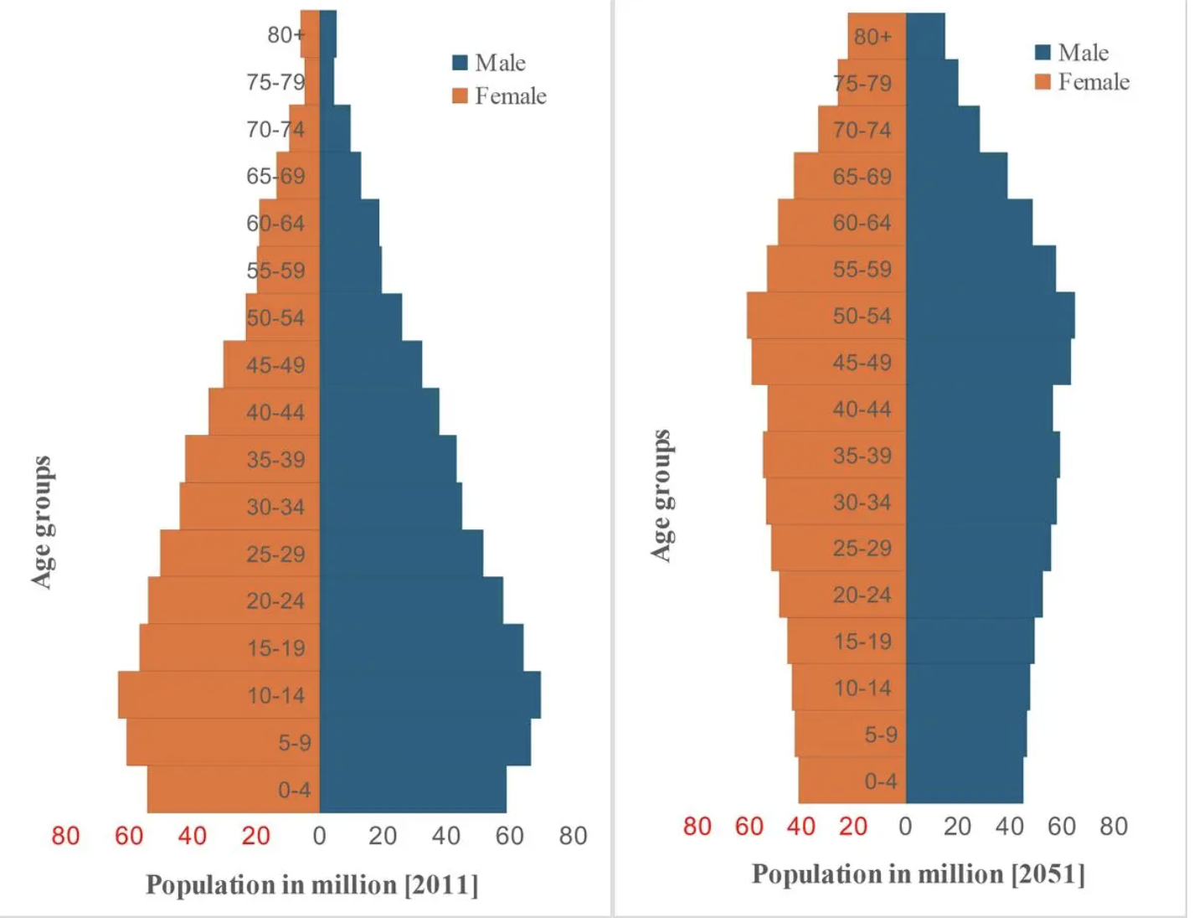
Population Pyramid for India. 2011- 2051
There is a demographic shift with fewer children born in families influencing our age structure.
Challenge more people in the middle ages group greater is the demand for employment
Question As demographic shifts to higher ages, does the demand for schools come down?

Slide 14
This changing Demography both geographically and age-wise will cause tensions in our federal structure
Expect demands for more money, challenges in migration looking for jobs, resentment for distributing money, more welfare for an ageing population etc., Are we prepared?
Who is we?

Slide 15
The simmering strain to Indian Federal Structure Language

Slide 16
Should we speak the same language across the country to strengthen the Federal Unity of the country? Hindi?
As per the 2011 Census India has more than 1369 validated mother tongues. Two examples of the diversity of languages;
It is said 43% of Indians speak Hindi: BUT Bhojpuri, Rajasthani, Chhatisgarhi, Magadhi, Haryanvi, Khortha, Bundeli and Awadhi : each with its own grammar & vocabulary much older than Hindi the same as Hindi? Our erstwhile state of Andhra Pradesh had at least two distinct dialects in Telangana and the present Andhra Pradesh.. One of the fault lines which led to the division of the state.

Slide 17
Historical instances of imposition of single language faults the unity of the country
Stalin imposed Russian throughout the erstwhile Russia. 50 years later the nation broke up largely into language driven divisions Pakistan tried to impose Urdu on the erstwhile East Pakistan.. An area of fierce Bengali nationalism. Pakistan broke up in 1971.

Slide 18
Countries which manage language diversity strengthen the federal structure.
Canada has two official languages Switzerland has four official languages South Africa has 12 official languages including South African Sign Language Belgium manages Dutch, French and German in different territories.

Slide 19
Supporting language diversity is a step to national unity

Slide 20
The Growth Challenge

Slide 21
How to get richer?
Manufacturing Jobs China 21crores
India.
2 crores
China is 10 times as big
Manufacturing?------ the China way. Are we too late in this game?
Our population is more than China’s. When can we catch up in manufacturing jobs?

Slide 22
What is the path?
Is Skilling and services the way forward? If yes, who is to pilot this growth?
Centre or the States?

Slide 23
And the question, that naturally follows..
Where do we find the money for growth and become richer? Taxes? Borrowing? FDI? Portfolio flows? Remittances?

Slide 24
The role of the Finance Commission to distribute the taxes collected
To distribute the monies between the Centre and States ( Vertical devolution)
To determine how much each State will get after determining the total pool between the States ( horizontal devolution)

Slide 25
Many questions
Is the Centre collecting the taxes fairly and equitably?
Are the rates of direct taxes progressive enough ( rich pay more)?
Is there too much of a burden of indirect ( read GST) taxes on the poor?
Is there a fair distribution of the tax pool between the states and the Centre?
Are all states being treated equitably for their shares?

Slide 26
Where are the pressures on finances coming from? Low tax GDP ratios Increasing burden of Welfare Inequality increases: Rich become Richer, poor become poorer & A North South Divide?

Slide 27
The states were expecting more devolution in the 16th FC.
The commission did not do and gave the same 41% as last time. Naturally, States are disappointed. And there is more to this arithmetic…

Slide 28
The dilution of the divisible pool

Slide 29
It is 41% of the “ divisible pool” Cess & Surcharges are NOT included. They go to the Centre
In effect , it is estimated that the effective devolution to the States works out to 32%.
This will seriously undermine fiscal autonomy of the states and centralise financial authority.

Slide 30
What does the Centre collect these cess & Surcharge for?
Health & Education Cess
Financing Centrally sponsored Schemes
Infrastructure initiatives

Slide 31
The Creeping Camel in the Arab’s Tent
 | In lakh crores
Financial year | Cess & Surcharge | Gross Tax Revenue | % of share in GTR
2016-17 | 2.13 | 17.15 | 12.4
2020-21 | 4.5 | 20.27 | 22.2
2026-27 | 8.12 | 44.04 | 18.4
In the last decade, centre has increased its cut in the divisible pool from 12.2% to 18.4%, a 50% increase.

Slide 32
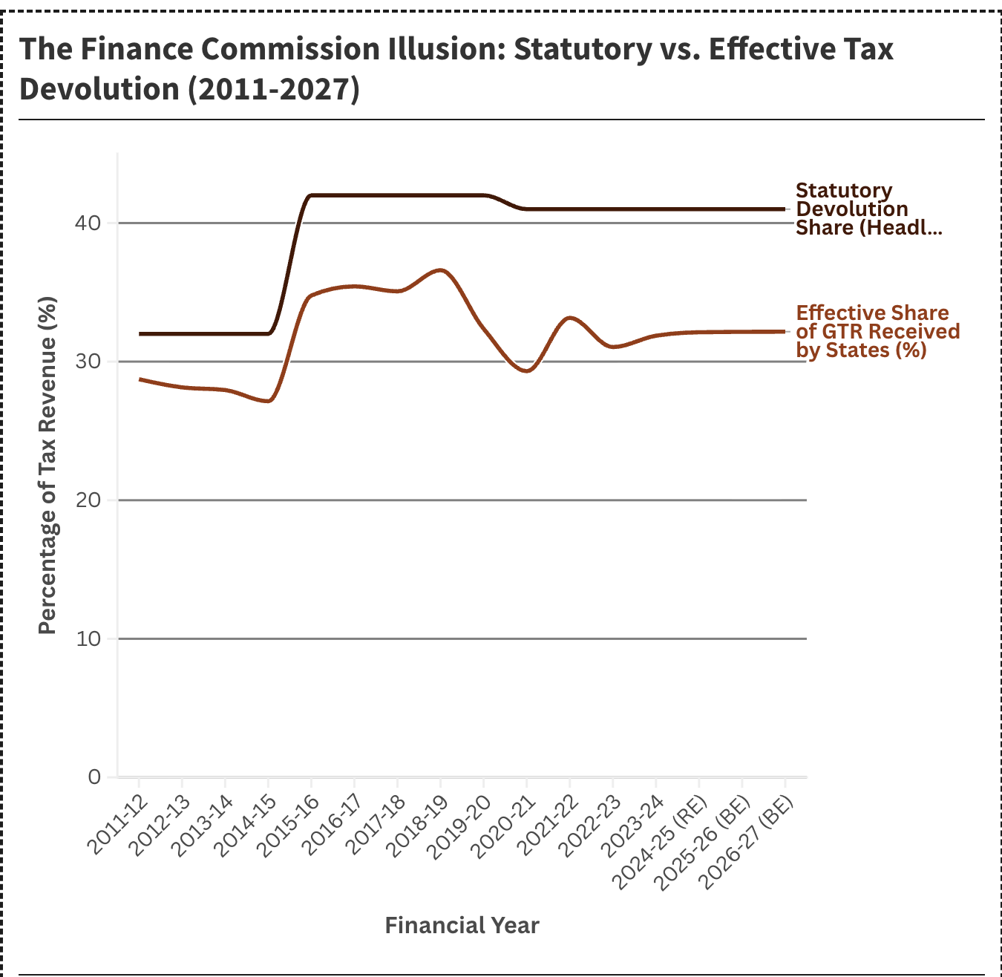
The steady erosion of states share of taxes by the increase of the non-divisible pool can be seen…
In fact, almost reversing the bold move of the earlier Finance commission in 2014-15 to increase the states share from 32% to 42%

Slide 33
In Defense of the Centre
Centre knows the country better and has to balance the needs of all the states.
India is a diverse country. Diversity weakens the polity of the country. It is uniformity that strengthens the Nation.
One Language
One Religion
One Culture One Election
One language
Uniform civil code
All this is possible by a stronger unitary financial structure at an apex level.

Slide 34
Don’t poorer states need support?
(albeit at the cost of the richer states)
We are one nation, after all!

Slide 35
Consequently, do states have enough money for discretionary spending?
The answer seems to be a big NO, and the space is only shrinking

Slide 36
Some Data points on State Expenditures
The total Revenue Expenditure across the States is 80% and Capex is only 20%: A sure guarantee for low growth
Within Revenue Expenditure, Committed expenditure viz., Salaries, Pension, Interest eat up nearly 51%. No discretion. Have to be paid. States , in fact, borrow to just pay interest costs. Contrary to popular notion, Subsidies are only 8% of Revenue Expenditure Asset building like Roads, bridges, Power, Water, Sanitation naturally take a backseat Health & Education infrastructure building have been forgotten not only by the states but also by the Centre

Slide 37
The Huge compromise in the absence of resources which Centre & States are making
Spending on Health & Education has been minimal, showing little signs of increase

Slide 38
The states defense: Each state is different and states should be allowed to build on its needs. A one size fit all does not fit all!
Kerala needs monies to promote industrialization as a way out of the remittance economy
Madhya Pradesh needs money to get out of its trap of low literacy, and poor health care
North east needs monies to improve access to mainland
Tamil Nadu & Maharashtra urgently need monies for strengthening urban infrastructure

Slide 39
Begging the question: Who understands the needs of a diverse people nation and who needs the financial autonomy to do that?
The Centre or the State?

Slide 40
The highly debated North/South Divide

Slide 41
Some facts first
 | GSDP | Per capita GDP | IMR | HDI | Literacy rates
 | in lakh cr | lakhs
Tamil Nadu | 31 | 3.62 | 9 | 2nd in country | 86%
Kerala | 12 | 3.08 | 5 | 1st in country | 95%
UP | 30 | 1.08 | 40 | Low | 78%
Bihar | 10 | 0.7 | 27 | Very Low | 74%
Burkina Faso | 207 | 0.9 | 42 | Very low | 40%
Somalia | 108 | 0.67 | 61 | lowest | 40%
While the Southern States are ahead in every factor, the two northern states compete with Sub-Saharan Africa !! This regional disparity is bound to weaken the federal structure

Slide 42
The southern States are more more powerful …. Economically
- higher GSDP
- higher per capita incomes
- higher literacy
But the Northern states have the political power
- more representation in Parliament
- higher population
- greater weight in GST councils : each state has equal votes, but there are more northern states than southern states
Generally, across the world, where the population is higher, regions are more prosperous USSR & Yugoslavia, two failed states have the Indian situation

Slide 43
The tax collection- devolution Imbalance
Top six states that contribute to Tax Revenue. (46.1%)
Maharashtra. Quasi South
Karnataka. South
Haryana North
Gujarat West
Tamil Nadu South
Telangana South
Top Six states which collect more than they pay. (34.5%)
Uttar Pradesh North
Bihar North
Madhya Pradesh. North
Rajasthan North
Assam East
West Bengal East

Slide 44
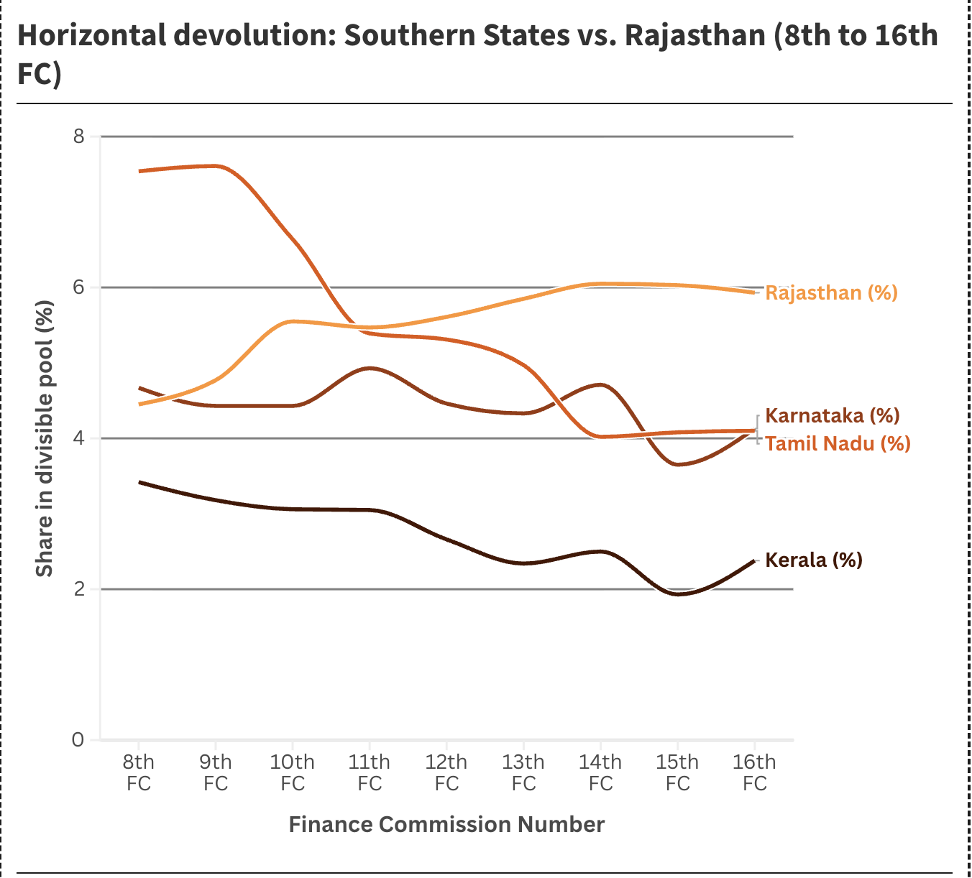
Another view of falling allocations to Southern States
 |  | (%)
 |  | Kerala | Karnataka | Tamil Nadu | Total | Rajasthan
8th Finance Commission | 1984-89 | 3.42 | 4.67 | 7.54 | 15.63 | 4.3
16th Finance Commission | 2026-31 | 2.38 | 4.13 | 4.1 | 10.61 | 5.9

Slide 45
And how does this show up?
Approximate Returns from Centre (per ₹1 Paid):
Karnataka: Receives 12–19 paise.
Tamil Nadu: Receives 24–27 paise.
Telangana: Receives 31–40 paise.
Why would these states feel they are being treated fairly?

Slide 46
Has GST helped in forging national Unity?

Slide 47
The union of markets across India a great leap forward in the tax administration in the country. No more multiple states, multiple rates for the same goods:
The digitization of the tax infrastructure is a transparent system visible to the tax payer on where he stands
GST collections are on a monthly high.. A signal of robustness of the tax system
Efforts continue to simplify, rationalize and make system more transparent and corruption free.

Slide 48
THE DOWN SIDE
Producing states were collecting manufacturing taxes ( excise etc.,)
GST flipped this
Consuming states are collecting these taxes.
The voting pattern in the GST council is not helping

Slide 49
Transition period to correct this imbalance via compensation mechanism is over.
The tensions between the states & the Centre will start now.

Slide 50
GST Council is a politician’s paradise
The Finance Commission has expert economists
Experts don’t make tax decisions
Representatives don’t make revenue decisions
Is this asymmetry a cause for tension?

Slide 51
Conclusion
A crucial decade in the economic and political future of India lies ahead. Let us hope the government and the civil society make informed choices
States have been disadvantaged over a period of time and it is not good news for the strength of the country.

