Slide 1
THE TELANGANA MSME POLICY Director of Industries, Government of Telangana

Slide 2
MSME definition Gazette Notification dated 21.03.25 Effective from 01.04.25
Sno | Category | Investment(Rs. Cr) | Turnover
1 | Micro | 2.5 | 10
2 | Small | 25 | 100
3 | Medium | 125 | 500

Slide 3
MSME earlier Definition
Sno | Category | Investment(Rs. Cr) | Employment
1 | Micro | 1.0 | 10
2 | Small | 25 | 100
3 | Medium | 125 | 500

Slide 4
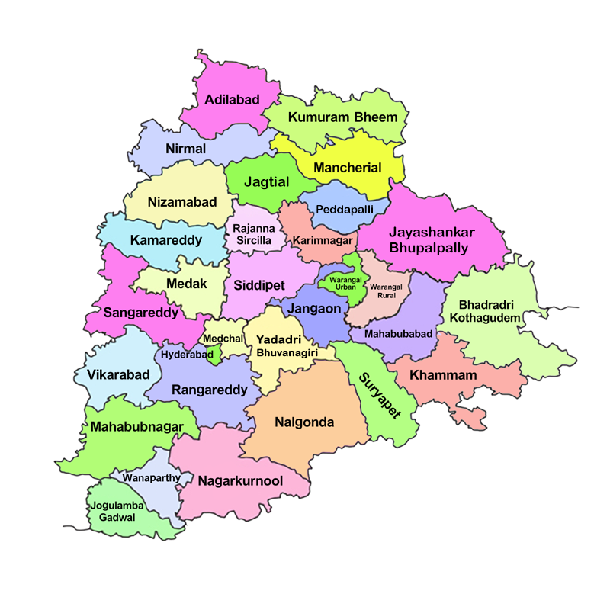
MSMEs in Telangana
NSSO (Sample Survey) – 2.6 million
UDYAM Registered –more than 1 million (1,347,394)
Udyam Assist Platform (UAP) - more than 1 million (1,137,209)
Total - 2,484,603 as on 24.05.2025

Slide 5
Consultative Process
15 MSME representative bodies consulted; 115 suggestions received
25 meetings conducted with stakeholders from government, industry, and research organisations
15 documents reviewed including submissions by industry, external consultants, government surveys, and MSME policies of other states

Slide 6
Challenges Faced by MSMEs
Land
Affordability challenges
Low supply of industrial plots
Zoning restricts supply of land
Finance
Working capital stress
Collateral commitments
High demand of credit not met
Raw Materials
Availability of raw materials
Local testing centres reqd
Easing warehouse construction
Labour
Access to skilled labour
Retaining migrant worker
Low Female labour participation
Technology
Sub-optimal tech systems
High cost of tech
Low adoption of digital solutions
Markets
Low awareness on export requirements
Quality certifications reqd.
Leveraging eCommerce platforms

Slide 7
Target-Indicators
20% increase in job creation in MSME
20% Increase in MSMEs in Districts that have less than 10% of total MSMEs
10% increase in GVA Contribution
10% of MSMEs graduate to next size category

Slide 8
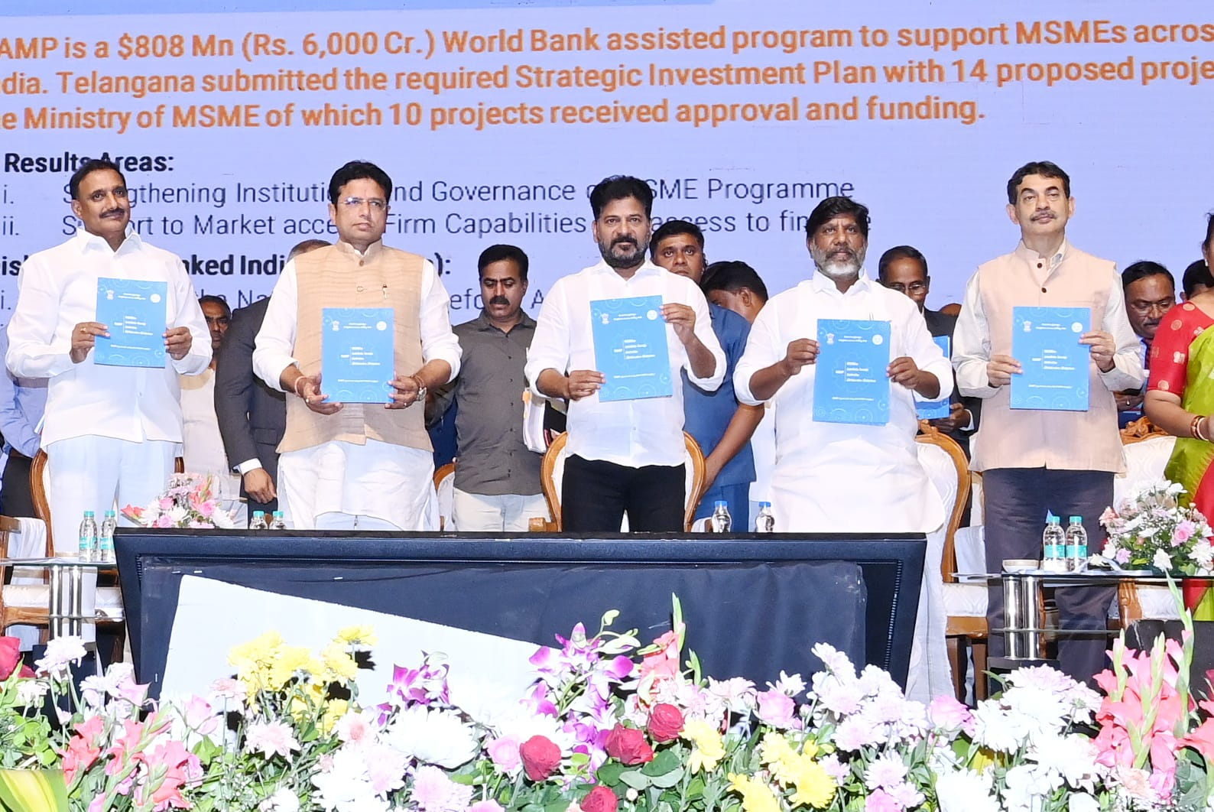
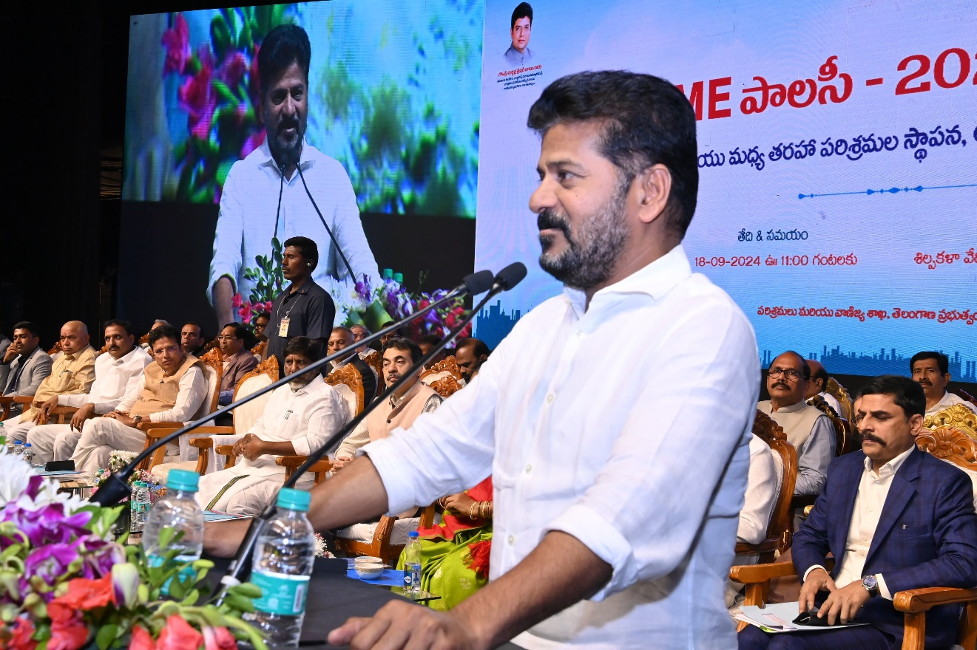
The Policy Launch

Slide 9
Land
Increasing availability of accessible and affordable land
10 industrial parks between ORR-RRR, 5 dedicated to MSMEs (1 park reserved for women-owned MSMEs and innovative startups each)
10% plots reserved for women, 15% plots reserved for SC entrepreneurs and 9% plots reserved for ST entrepreneurs
Expand areas marked for industrial, commercial, and mixed-use zones b/w ORR-RRR, allow green/orange industrial MSMEs to operate in semi-urban areas
Land cost rebate for SC/ST; 50% upto 50L cap
Development of private flatted factory complexes and industrial parks by offering stamp duty discounts and land cost rebates.
Govt to construct flatted factories with in-built facilities for women across 119 constituencies; encourage women members of SHGs to set up small businesses
Scheme permitting TGIIC to lease industrial plots/sheds for 30-year period on recovery of upfront lease premium fixed from time to time

Slide 10
Finance
Increased access to formal credit and alternate credit sources and incentives
Subsidy collateralization scheme: MSMEs use the proof of entitlement of benefit as collateral for loans; GoTG to consult with SLBC to institutionalize this
Capital investment subsidy ↑:
SC/ST: 50% ,1Cr cap
Others: 25% , 30L cap
Women:20% additional, 20L cap
Pilot programme where MSMEs can access credit based on future sales
Adoption of account aggregation practices by tie-ups with third-parties
Empanel 3rd-parties to provide bookkeeping & financial advice support; production of videos for training of basic bookkeeping
Allow MSMEs and financial institutions to enter into reverse factoring agreements for engagements with public contracts

Slide 11
Raw material
Ensure on-time delivery of high-quality raw material
10 new common facility centres around MSME clusters in 10 districts
Provide cluster-based testing facilities under PPP engagements
Encourage warehouses by 100% stamp duty discount, land cost rebates
Reforming parking/setbacks to optimize land.
Construct 1 warehouse in PPP model in each of the 5 ORR-RRR MSME parks
Allotment of raw material by various departments in a timely manner (Coal, Alcohol etc.)
Support import duty drawback by reimbursing the duty incurred on import of raw material at the time of import
Facilitate onboarding business facilitators to onboard MSMEs on to online platforms (ONDC, Power2SME etc.) with B2B transactions
Creation of directory used raw materials
Enlist bona fide suppliers who meet necessary quality standards

Slide 12
Labour
Encourage skilling, improve diversity in urban jobs
Incorporate MSME-focused courses at TG Young India Skills University like advanced manufacturing techniques, industrial management and operations
Integration of apprenticeship opportunities to TG DEET platform to reduce search cost of labour
Review master plans restricting worker hostels in industrial zones; PPP agreements for construction of worker hostels
Simplify labour law related compliances and standards for MSMEs. Eg: Single license with longer validity for contractors with exemplary record
Regulatory reforms in The Telangana Factories Rules, 1950. Eg: Reduce restrictions on women in biotech, pharma and food processing

Slide 13
Technology
Encourage technology upgradation to accelerate production
Constitute Rs 100 crore Yantram Fund to encourage adoption of technology by MSMEs; monetary assistance during payback period of new tech adoption
Commission a comprehensive survey of technology adoption by MSMEs and develop a catalogue of tech products for Industry 4.0
Facilitate bulk purchase of digital tech at discounted rates for MSME clusters and industrial parks
Fiscal incentives on IPR registrations: SC/ST: 100%, 3L cap, Others: 100%, 2L cap
Facilitate engagement with RICH to support research and development activities within the MSME Sector
Organize workshops and technology fairs to facilitate interaction and knowledge sharing between MSMEs and suitable technology providers or larger enterprises

Slide 14
Marketing
Expanding the reach of MSMEs to domestic and global markets
Encouraging large industries to procure locally
Govt to support co-location of ancillary MSMEs that are a part of supply chains for large-scale MNCs setting base in TG; will offer similar benefits to MSMEs
Organize supplier meet-ups to source feedback from large suppliers on MSME products
Govt to support MSMEs by incorporating the feedback
Prepare policy with preferential public procurement from MSMEs
Reimburse duty on samples valued up to Rs 10L imported for prototyping
Enterprise Development Centre platform to outline details of export compliances as well as export-related regulations in India and other countries
Incentivize Green Initiatives (Renewable Energy, Green Manufacturing Practices, Electric Vehicles (EVs) and Green Mobility, Recycling and Waste Management Facilities etc.)
ZED-certified clusters to ease certification

Slide 15
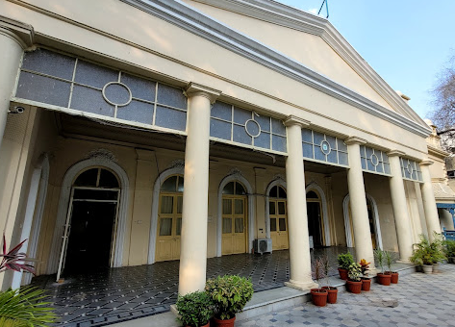
Exclusive MSME Wing
At Directorate of Industries
Nodal Agency to resolve all MSME issues
One Joint Director, one Asst Director and two IPOs always available.

Slide 16
Higher Administrative Structure
Steering Committee
Honourable Minister for Industries; Spl.CS/Prin.Sec Industries; Commissioner / Director of Industries; President CII; FETSIA; VC&MD, TGIIC; MD, TGFC; Director MSME; SLBC
Policy Implementation
Heads of All Line Depts / Regional Wings
Industry Engagement
MSME Wing / Grievance Redressal System
Hand-holding Support
Third Part Consultants / Business Facilitators

Slide 17
Thank You

