Slide 1

Trust Registration & ITR Filing Compliance in India
Simplifying compliance under the Income Tax Act, 1961.
By
Adv. Srinarayan Toshniwal, CA, CS
Standing Counsel for Income Tax (Telangana High Court)
+91-8801701539
M/s PPKG Legal,
Hyderabad

Slide 2
Application of Income & Key Exclusions
Application of Income (on actual payment basis, irrespective of method of accounting):
Key Exclusions from Application of Income:
Spending out of corpus or loans not treated as application in year spent, allowed only on reinvestment/repayment
Capital expenditure on objects
Donations to other trusts
Corpus donations to other trusts
Amounts without TDS deduction (Section 40(a)(ia)): only allowed in year TDS is deducted
Only 85% of donations to other trusts eligible for exemption, balance 15% not required to be invested in specified modes (per CBDT Cir 3/2024, dated 6.3.2024)
Amounts paid in excess of ₹10,000 in cash (Section 40A(3)) not treated as application
Deficit of earlier years no longer allowable
Donee trusts must apply 100% to gain full exemption
Application of income outside India generally not permitted

Slide 3
Type of Donation | Treatment for Donor Trust (Application of Income) | Treatment for Donee Trust (Taxability) | Relevant Sections | Remarks / Notes
Donation - Non-corpus | Yes, but only 85% allowed as application (from A.Y. 2024-25) | Taxable as income u/s 12(1) | Sec 11(1), Explanation 2 | Ensure donee is registered u/s 12AA/12AB and disclosure in Form 10B/10BB
Donation and Corpus | Not allowed as application | Exempt u/s 11(1)(d) as corpus donation | Sec 11(1)(d) | Corpus donation must have specific written direction
Donation from accumulated funds (u/s 11(2)) | Not allowed unless approved u/s 11(3A) | Normal treatment applicable | Sec 11(3A) | Requires prior approval from AO to be treated as application
Donation to unregistered trust | Not allowed as application | Taxable, if applicable | Sec 11(1) read with Sec 12AA | No exemption if donee trust is unregistered

Slide 4


Understanding Section 115BBI
Introduction
Purpose
Applicability
30% flat tax on 'specified incomes' of charitable institutions.
Taxes non-compliant activities at penal rate.
Applies to trusts under Sec. 10(23C) or Sec. 11-13.
Prevents misuse of tax-exempt status.
Introduced by Finance Act, 2022.
Key Takeaway
Penal taxation mechanism for non-compliant institutions.
Reinforces proper use of tax exemptions.

Slide 5

Specified Income Means
Under Section 115BBI, specified income includes:
Income accumulated or set apart exceeding 15% of the total income, where such accumulation is not permitted under the Income Tax Act.
Deemed income under Explanation 4 to the third proviso to clause (23C) of section 10.
Income not exempt under clause (23C) of section 10, section 11(1B), or section 11(3).
Income not excluded under provisions of section 13 or the relevant provisos of section 10.
Any income not excluded from total income under clause (c) of section 11(1).

Slide 6




Anonymous Donation (Section 115BBC)
Definition & Exemption
Tax & Threshold
Voluntary contribution with unrecorded donor identity. Documented donations are exempt.
30% tax if donations exceed Rs. 1,00,000 or 5% of total donations (whichever is higher).
Applicable To
Responsibility
Trusts/institutions (Sec 11)
Recipient institution is liable for this tax.
Educational/medical institutions/ Fund/ Institutions (Sec. 10(23C)

Slide 7

Section 115BBC – Compliance & Exceptions
Distinctions & Exceptions
Compliance Requirements
While Section 115BBC applies broadly, key distinctions and exceptions
exist:
Religious Institutions: Generally exempt from tax on anonymous donations received by way of offerings made in a temple, mosque, gurudwara, church, or other places of worship.
Charitable Institutions: Strict adherence to Section 115BBC is mandatory, with limited exceptions for specific government-notified funds.
Strict adherence to Section 115BBC is mandatory, with limited exceptions for specific government-notified funds.
To avoid adverse tax implications and maintain exemption status, trusts and institutions must adhere to:
Donor Identity: Maintain complete records of donor identity for all non-anonymous donations.
Form 10BD/10BE Filing: Submit Form 10BD annually for all donations received, and provide Form 10BE to donors for their tax deduction claims.
Audit Reporting: Ensure proper audit of accounts and include relevant disclosures concerning anonymous donations in Form 10B.

Slide 8



Section 11(5): Modes of Investment
Purpose:
To ensure safe investment of charitable/religious trust funds
Maintain exemption under Sections 11 & 12
Applies to income accumulated u/s 11(2)
Key Principle:
Funds must be invested only in specified safe modes; otherwise exemption is lost u/s 13(1)(d)

Slide 9

Approved Modes of Investment
Government Savings Certificates and other Government securities
Post Office Savings Bank deposits
Units of UTI
Deposits with scheduled or co-operative banks
Bonds issued by public sector companies
Immovable property (excluding plant/machinery)
Debentures guaranteed by Central/State Government
Equity shares of PSUs or National Skill Development Corporation
Deposits with IDBI / Housing or Urban Development authorities
Mutual funds under section 10(23D)
Other notified modes as per Rule 17C

Slide 10



Types of Accumulated Income for Trusts
Section 11(1): Up to 15% Accumulation
Section 11(2): Beyond 15% Accumulation
Trusts can accumulate up to 15% of income.
Income exceeding the 15% limit.
No specific application required.
Must be applied for charitable purposes within 5 years.
Amount can be utilized for any purposes
Failure to apply leads to tax implications.

Slide 11
Accumulation of Income - Application Rules for Trusts
Accumulation of Income
When application of income falls short of 85 per cent of income - If the income applied to charitable or religious purposes, during the previous year, falls short of 85 per cent of the income derived from property held under trust during such year, the charitable trust or institution has been given the option to spend such income for charitable or religious purposes in the manner given in column 2 of the table:
a. Income has not been received during the relevant previous year
Either during the previous year in which income is so received or during the previous year immediately following such year
b. Because of any other reason
During the previous year immediately following the previous year in which the income was derived

Slide 12





Form 9A: Deemed Application of Income
Purpose
Scenario 1: Income Not Received
Scenario 2: Any other reasons
Exercise option for deemed application under Section 11(1).
Apply in the immediate following year.
Apply in year received or immediately following year.
Filing Requirements
Key Benefit
File Form 9A electronically
Provides flexibility in income application while maintaining tax exemption.
Submit on or before ITR filing due date.
Mandatory for exercising deemed application option.

Slide 13
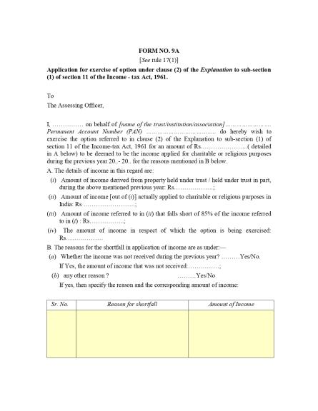


Slide 14



Form 10: Accumulation Notice Requirements
Intimation for accumulating income beyond 15% under Section 11(2)
Purpose of Accumulation
Exact purpose must be specified
Income must be applied within 5 years
Filing Requirements
File Form 10 electronically (before ITR due date)
Invest funds according to Section 11(5)
Required Documents
Governing body resolution
Annual accounts (with investment details)

Slide 15
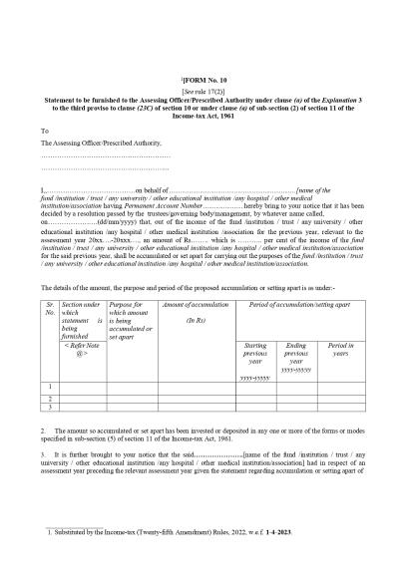
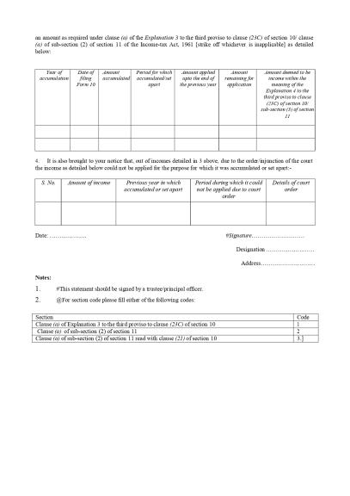

Slide 16




Income Tax Return Filing for Trusts
Annual ITR Filing
Registered Trusts must file annual Income Tax Returns, if required
ITR-7.
Key Forms
Form 10A: New/Provisional registration
Form 10AB: Permanent Registration
Forms 9A, 10B, 10BB: Annual compliance
Form 10BD: Statement of Donations Received
Strict Deadlines
Missing deadlines jeopardizes tax exemptions (Sections 11, 12A, 80G).

Slide 17

Can Section 8 Companies file ITR 7?
Companies Registered under section 8 of Companies Act and which are registered under Section 12AB need to file ITR 7.
FAQ issued by the department
ITR-7 form can be used by persons including companies who are required to furnish return under section 139(4A) or section 139(4B) or section 139(4C) or section 139(4D).

Slide 18
Tax Audit Limits & Forms for Trusts
Understanding the latest tax audit limits and specific forms is crucial for compliance for trusts and institutions claiming tax exemptions in India.
1
2
3
Total income: Up to ₹2.5 Lakh
Total income: ₹2.5 Lakh to ₹5 Crore
Total income: Above ₹5 Crore
Tax Audit: not required
Tax Audit: Mandatory
Tax Audit: Mandatory
Forms: not applicable
Forms: Form 10BB
Forms: Form 10B
ITR Filing: not applicable
ITR Filing: ITR 7
ITR Filing: ITR 7
Books of Account: not Applicable
Books of Account: Applicable
Books of Account: Applicable
*Note: If Assessee receives foreign contribution or applies any part of its income outside India then Form 10B is applicable irrespective
of Total income

Slide 19





Due Dates for Charitable Trust Forms
Form 9A and 10
Form 10BD
ITR-7
Form 10B/10BB
Income statement for unapplied charitable purposes. Due: 31st August.
Statement of Donations - 31st May
Non-Audit –31st July
Audit – 31st October
Audit Report. Due: 30th September.

Slide 20



Consequences of Filing Delays
Financial Penalties
Loss of Tax Exemptions
Filing after due date upto 31 Dec - ₹5,000
Rejection of exemptions (Sections 12A & 80G).
Filing after 31 Dec - ₹10,000
Income of the Trust becomes taxable.
Penalties are automatic and required for filing acceptance.

Slide 21





Additional Consequences of Filing Delays
Reputational Damage
Erodes credibility with donors and agencies.
Hinders ability to receive donations and grants.
Legal Complications
Increased legal and regulatory scrutiny from authorities.
Operational Disruptions
Disrupted normal trust operations and activities.
Future Compliance Issues
Increased scrutiny for future filings and applications.

Slide 22



ITR-7: Structure & Key Components
ITR-7 is the income tax return form for trusts, charitable/religious institutions, political parties, and universities filing under specific Income Tax Act sections.
Part A - General Information
Basic details: Name, PAN
Registration under Sections 12A/12AB, 10(23C), 80G
Nature of activity & constitution
Audit particulars
Part B - Income & Tax Computation
B-TI: Statement of Total Income (includes income applied for charitable purposes)
B-TTI: Computation of Tax Liability (net tax after rebates & credits)

Slide 23



ITR-7: Key Schedules Overview
Schedule I - Amounts accumulated u/s 11(2)
Income accumulated for future charitable use. Covers opening balance, current year accumulation, and utilization.
Schedule J – Corpus funds & investments u/s 11(5)
Corpus funds and investment details, ensuring compliance with prescribed norms.
Schedule AI - Aggregate income for the year
Breakdown of all income sources: donations, investment income, business income, and other receipts.
Schedule D – Deemed application of income under clause (2) of explanation 1 to Section 11(1)
4
To provide relief to charitable and religious trusts in cases where income, although accrued or receivable during the
previous year, is not actually received or cannot practically be applied for charitable purposes within that year.

Slide 24
ITR-7: Key Schedules Overview
Schedule DA - Details of Application from Corpus and Loans
Utilisation of income applied out of corpus or loan in earlier years and the restoration made during the current year
Schedule VC – Voluntary Contribution received
Captures the complete inflow of voluntary contributions.
Schedule IA - To report the taxability of income accumulated in earlier years
to show how much of that accumulation has become taxable because it was either not utilized within the allowed time or
misapplied.
.
Schedule A - Amount applied to stated objects of the trust/institution
4
Schedule A requires the disclosure of any inter-charity donations, specifying amounts given to other registered charitable or religious institutions.

Slide 25
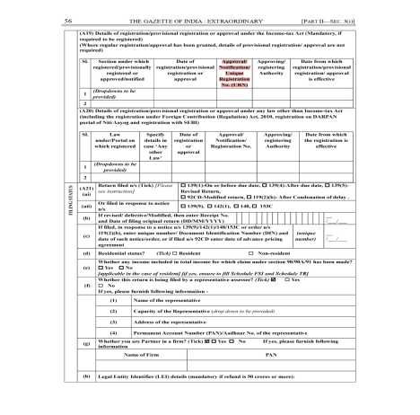
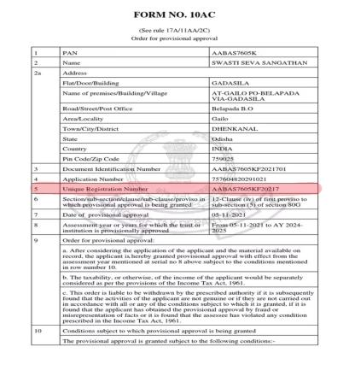
Form 10AC Sample Pages - Registration Certificate

Slide 26



Compliance & Consequences
Compliance
Follow Section 11(5) and Rule 17C strictly
Regular audit via Form 10B
Maintain proper documentation for all investments
Non-Compliance
Income deemed not applied for charitable purposes
Exemption forfeited under Sections 11 & 12
Taxable under Section 13(1)(d)

Slide 27
ITR-7 Schedules Overview
This section provides detailed information about each ITR-7 schedule, their purposes, and audit reporting requirements for trusts and charitable institutions.

Slide 28
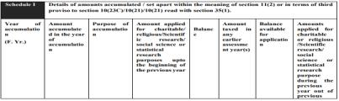
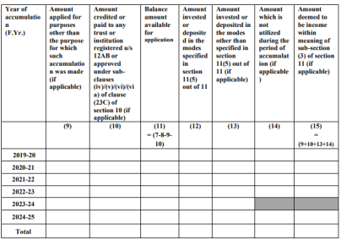
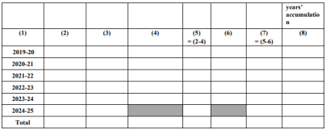
Schedule I - Accumulation or Set-Apart of Income for
Future Application – Form 10
Purpose: must be filled when income accumulated exceeds 15% of total income. This schedule is essential for trusts claiming exemption under section 11(2) for accumulation purposes.
Compliance required: Form 10B – Schedule AC - Clause 37(a), 31(xx) || Form 10BB - Clause 23(xviii) of Form 10BB

Slide 29
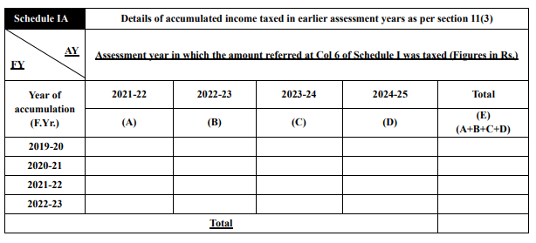
Schedule IA - To report the taxability of income accumulated
in earlier year
Purpose: to show how much of that accumulation has become taxable because it was either not utilized within the allowed time or misapplied.
Compliance required: Form 10B – Schedule ACA

Slide 30
Schedule I |  |  | Details of amounts accumulated / set apart within the meaning of section 11(2) or in terms of third proviso to section 10(23C) )/10(21) read with section 35(1).
 | Sl No. | Year of accumulation (F.Yr.) | Amount accumulated in the year of accumulation | Purpose of accumulation | Amount applied for charitable/ religious/Scientific research/ social science or statistical research purposes up to the beginning of the previous year | Balance | Amount taxed in any earlier Assessment Year(s) | Balance available for application (7)= (5-6) | Amounts applied for charitable or religious/Scientific research/ social science or statistical research purpose during the previous year out of previous years’ accumulation | Amount applied for purposes other than the purpose for which such accumulation was made (if applicable) | Amount credited or paid to any trust or institution registered u/s 12AB or approved under sub-clauses (iv)/(v)/(vi)/(via) of clause (23C) of section 10 (if applicable | Balance amount available for application | Amount invested or deposited in the modes specified in section 11(5) out of 11 | Amount invested or deposited in the modes other than specified in section 11(5) out of 11 (if applicable) | Amount which is not utilized during the period of accumulation (if applicable) | Amount deemed to be income within meaning of sub-section (3) of section 11 (if applicable)
 |  |  |  |  |  | (5)=(2-4) |  |  |  |  |  | (11) = (7) – (8) – (9) – (10) |  |  |  | (15) = (9+10+13+14)
 |  | -1 | -2 | -3 | -4 | -5 | -6 | -7 | -8 | -9 | -10 | -11 | -12 | -13 | -14 | -15
 | 1 | 2019-20 | 10,00,000 | Charitable Purposes | 4,00,000 | 6,00,000 | 0 | 6,00,000 | 3,50,000 | 0 | 0 | 2,50,000 | 2,50,000 | 0 | 0 | 0

Slide 31
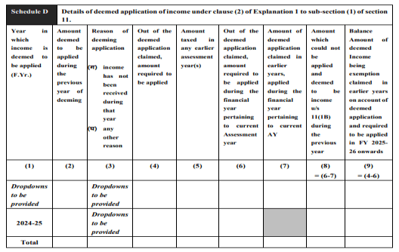
Schedule D - Details of deemed application of income
under clause (2) of Explanation 1 to Section 11(1) – Form 9A
Purpose: To provide relief to charitable and religious trusts in cases where income, although accrued or receivable during the previous year, is not actually received or cannot practically be applied for charitable purposes within that year.
Compliance: Form 10B - schedule DI, Clause 31(xix), 37(B) || Form 10BB - clause 23(xvii)

Slide 32
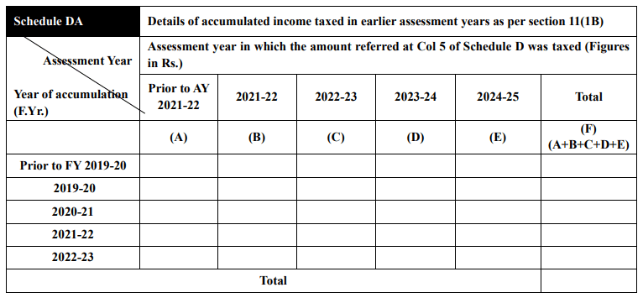
Schedule DA - To report the taxability of income accumulated
in earlier years – Form 9A
Purpose: to capture and disclose details of accumulated income that has become taxable under Section 11(1B
Compliance required: Form 10B – Schedule DA

Slide 33
Schedule D |  |  | Details of deemed application of income under clause (2) of Explanation 1 to sub-section (1) of section 11.
 | Sl No. | Year in which income is deemed to be applied (F.Yr.) | Amount deemed to be applied during the previous year of deeming | Reason of deeming application | Please Enter Reason for Any Other Reason Selected in Reason of deeming application | Out of the deemed application claimed, amount required to be applied | Amount taxed in any earlier Assessment Year(s) | Out of the deemed application claimed, amount required to be applied during the FY pertaining to current AY | Amount of deemed application claimed in earlier years, applied during the FY pertaining to current AY | Amount which could not be applied and deemed to be income u/s 11(1B) during the previous year | Balance Amount of deemed Income being exemption claimed in earlier years on account of deemed application and required to be applied in FY 2025-26 onwards
 |  | (1) | (2) | (3) |  | (4) | (5) | (6) | (7) | (8) = (6-7) | (9) = (4-6)
 | 1 | 2022-23 | 10,00,000 | Income not received |  | 10,00,000 | 0 | 4.00.000 | 4,00,000 | 0 | 6,00,000
 | 2 | 2023-24 | 10,00,000 | Any other reason |  | 10,00,000 | 0 | 10,00,000 | 8,00,000 | 2,00,000 | 0
 | 3 | 2022-23 | 10,00,000 | Income not received |  | 10,00,000 | 2,00,000 | 8,00,000 | 8.00.000 | 0 | 0

Slide 34
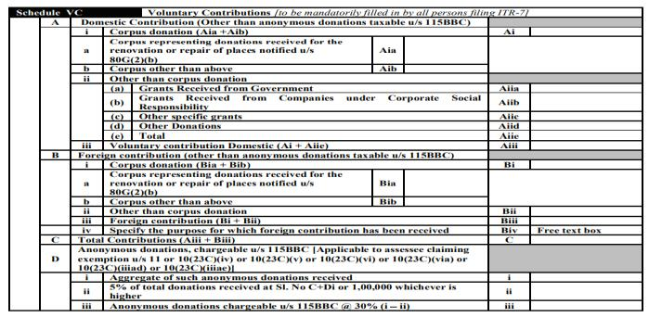
Schedule VC - Voluntary Contributions Received
Purpose: Captures the complete inflow of voluntary contributions — segregating corpus-specific donations from general receipts — ensuring transparency and compliance with exemption provisions under Sections 11(1)(d) and 12(1)
Compliance: to be reported under the head of voluntary contribution, additionally Form 10BD need to be filed

Slide 35
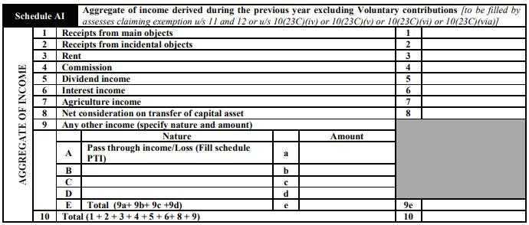
Schedule AI - Aggregate of income derived during the year
excluding voluntary contributions
Purpose: To report the total income derived during the year from all sources of the trust or institution
Compliance: to be reported under clause 28 of Form 10B and clause 21 of Form 10BB

Slide 36
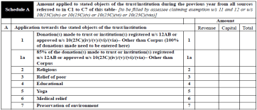
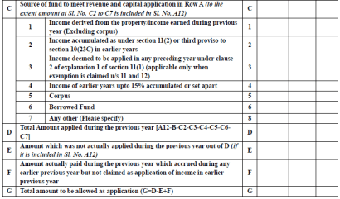
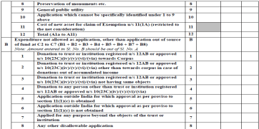
Schedule A - Application of Income Towards Stated
Objects of the Trust/Institution
Purpose: Amount applied to stated objects of the trust/institution during the previous year from all sources referred to in C1 to C7 of this table.
Compliance: to be reported under clause 31 of Form 10B and clause 23 of Form 10BB

Slide 37
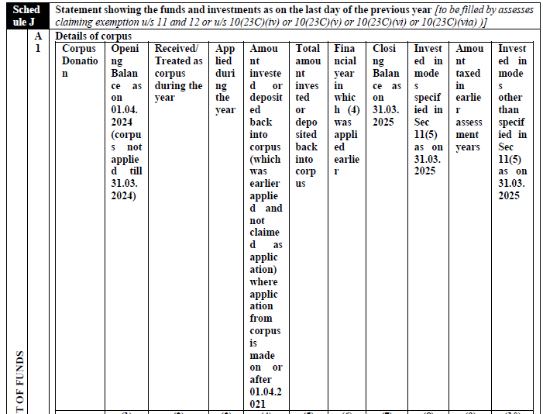
Schedule J – Statement showing the investment of all funds
Of the trust as on the last day of the previous year
Purpose: Schedule J is used to disclose how a charitable or religious institution’s total funds — corpus, investments, loans, and cash — are held or invested at year-end, ensuring compliance with Section 11(5) and transparency of fund deployment.
Compliance: to be reported under clause 31 of Form 10B

Slide 38
Schedule J |  |  | Statement showing the funds and investments as on the last day of the previous year [to be filled by assesses claiming exemption u/s 11 and 12 or u/s 10(23C)(iv)/10(23C)(v)/ 10(23C)(vi)/10(23C)(via)
 | A1 | Details of corpus
 |  | Sl No. | Corpus Donation | Corpus Donation | Opening Balance as on 01.04.2024 (corpus not applied till 31.03.2024) (1) | Received/Treated as corpus during the year (2) | Applied during the year (3) | Amount invested or deposited back in to corpus (which was earlier applied and not claimed as application) (where application from corpus is made on or after 01.04.2021) (4) | Total amount invested or deposited back in to corpus (5) | Financial year in which (4) was applied earlier (6) | Closing Balance as on 31.03.2025 [(1+2+5)-3] (7) | Invested in modes specified in Sec 11(5) as on 31.03.2025 (8) | Amount taxed in Assessment Year 2024-25 (9) | Invested in modes other than specified in Sec 11(5) as on 31.03.2025 (10) = (7-8-9)
 |  | 1 | ii.Other than (i) above received on or after 01.04.2021 | ii.Other than (i) above received on or after 01.04.2021 | 10,00,000 | 2,00,000 | 0 | 0 | 0 | - | 12,00,000 | 10,00,000 | 0 | 2,00,000
Note: Rs. 10,00,000/- has been invested in FD’s

Slide 39

Form Structure Comparison: 10B vs 10BB
Form 10B (Section 12AB Trusts)
49 Clauses, 29 Schedules
More exhaustive and detailed
Feeds into multiple ITR-7 schedules (A, AI, A-J, VC, 115BBI)
Form 10BB (Section 10(23C) Institutions)
32 Clauses, 7 Schedules
Concise and streamlined
Feeds only into basic income-application schedule
This structural difference reflects distinct compliance requirements for each entity type.

Slide 40
Key Additional Clauses in Form 10B (not in 10BB)
Clause 15: Advancement of General Public Utility
Clause 16: Aggregate receipts
Clause 17: Business Undertaking
Clause 18: Business incidental to objects
Clause 19: TDS on receipts
Clause 36: Capital assets
Clause 40: Religious expenditure
Clause 43: Specified violations

Slide 41
Detailed Filing-Level Differences: 10B vs 10BB
Feature
Form 10B
Form 10BB
Registration details
Clause 10
N/A
Objects
Clause 11 and 12
N/A
Capital Assets Transferred
Clause 36 required
Not required
TDS on receipts
Clause 19 required
N/A
Business Activities
Clauses 17 & 18 mandatory
Not included
Sec. 115BBI
Details required
Only amount to be specified

Slide 42
Other Laws Mandating Audit for Trusts
Beyond the Income Tax Act, trusts in India are often subject to audit requirements under various other laws, depending on their specific activities, structure, and the sectors they operate within. Understanding these additional compliance obligations is crucial for ensuring legal adherence and transparency.
1
Foreign Contribution Regulation Act 2010
2
Companies Act, 2013
3
Indian Trust Act, 1882
4
Society Registration Act, 1860
5
Banking Regulation Act, 1949
6
Central Excise Act, 1944
7
Central Sales Tax Act, 1956
8
Central Goods and Services Tax Act, 2017
9
Charitable and Religious Trust Act, 1920
10
Electricity Act, 2003
11
Employees Provident Fund and Miscellaneous Provisions Act, 1952
12
Foreign Exchange Management Act, 1999
13
Govt Superannuation Fund Act, 1956
14
Igst Act, 2017
15
Limited Liability Partnership Act, 2008
16
Payment of Gratuity Act, 1972
17
SEBI Act, 1992
18
Securities Contract (Regulation) Act, 1956
19
State Goods and Services Tax Act, 2017
20
Union Territories Goods and Services Tax Act, 2017
21
Any other relevant law applicable to the trust's operations

Slide 43

Judgements

Slide 44

Delay in Filing Form 10 Condoned Due to Technical Glitches
KSB Care Charitable Trust vs CIT (Exemption) [Bombay HC, 178 taxmann.com 771]
The assessee filed its return claiming exemption under Se 11(2). However, it submitted Form 9A instead of Form 10. The trust subsequently filed Form 10 and sought condonation of delay, which was rejected by the Commissioner (Exemption).
The Bombay High Court noted that the assessee had genuinely accumulated income and utilized it for charitable purposes within the permissible time frame. Since technical glitches were common during the transition to electronic filing, the Court held that the delay was procedural and bona fide. It ruled that substantial compliance must prevail over procedural defaults, quashed the rejection order, and allowed the exemption—emphasizing a justice-oriented approach for charitable institutions.
Adv. Srinarayan Toshniwal, CA, CS

Slide 45
Condonation Granted for Delay in E-Verification of Form 10B
International Resources for Fairer Trade v. CIT, [Allahabad HC, 44 taxmann.com 299]
The assessee-trust obtained its audit report in Form 10B within time but failed to e-verify it before filing its return due to the oversight of its accountant, who subsequently left employment. On discovering the lapse, the trust e-verified the report, filed a revised return, and applied for condonation of a 447-day delay, which the Commissioner (Exemption) refused to grant.
The Bombay High Court observed that the audit report had been prepared on time and filed with other authorities, evidencing no mala fide intent. Holding that the delay arose from human error and not negligence, the Court set aside the rejection order. It emphasized that denial of exemption on purely technical grounds would cause genuine hardship, reaffirming that procedural irregularities should not defeat bona fide charitable compliance when the substantive requirements of Section 11 are satisfied.
Adv. Srinarayan Toshniwal, CA, CS

Slide 46
Amendment to Section 11(3) Held Prospective; Old Accumulations Protected
Sarangpur Talia’s Pole Punch Trust v. ITO [ITAT Hyderabad, 178 taxmann.com 674]
The assessee-trust utilized accumulated income from FY 2016–17 during FY 2022–23. The Assessing Officer denied exemption, citing the Finance Act, 2022, amendment to Section 11(3) restricting utilization to five years. The trust contended that the amendment was prospective.
The ITAT Ahmedabad agreed, ruling that the amendment applies only to fresh accumulations from FY 2022–23 onwards and cannot curtail prior periods. The Tribunal observed that applying the rule retrospectively would create an impossible situation and violate fairness. It deleted the addition, holding that existing accumulations enjoy the original six-year window for utilization.
Adv. Srinarayan Toshniwal, CA, CS

Slide 47
Generic Purpose in Form 10 Not Fatal When Supported by Resolution
Imperial College India Foundation vs. ITO [ITAT Mumbai, 178 taxmann.com 411]
The assessee trust had filed Form 10 under Section 11(2) stating the purpose of accumulation as “for objects of the trust.” The Assessing Officer rejected the claim, calling it vague and non-specific. However, the Tribunal observed that the trust’s board resolution clearly specified that the accumulated income was meant for scholarships (educational purposes). Since the funds were actually used for this stated purpose within the permitted period, the Tribunal held that the description in Form 10, though generic, was supported by substantive evidence and could not invalidate the claim.
Accordingly, the matter was remanded to the AO to verify the board resolution and the subsequent utilization of ₹62.29 lakhs. The Tribunal ruled that the vagueness in Form 10 would not be fatal if the actual use aligned with the trust’s charitable objects, and directed deletion of the disallowance to that extent.
Adv. Srinarayan Toshniwal, CA, CS

Slide 48
Form 10B Filing is Procedural; Exemption Cannot Be Denied
Anjana Foundation vs. CIT(E) [SC, 178 taxmann.com 658]
The Revenue denied exemption to the trust under Sections 11 and 12 for non-filing of Form 10B, and the High Court ruled in favour of the assessee, holding the requirement to be procedural. The Revenue filed an SLP with a delay of 237 days, seeking to overturn the order.
The Supreme Court dismissed the SLP both on delay and on merits, holding that failure to file Form 10B cannot nullify a valid exemption when accounts are audited and charitable intent is proven. The Court reaffirmed that procedural non-compliance should not override substantive rights, cementing a pro-assesse interpretation for charitable trusts.
Adv. Srinarayan Toshniwal, CA, CS

Slide 49

Regular Registration (Form 10A/10AB)
Regular registration, via Form 10A/10AB, grants provisional/permanent status to trusts, enabling full tax benefits under the Income Tax Act.
Permanent Status
Eligibility & Requirements
Final registration under Section 12A for long-term compliance and benefits.
Open to all eligible trusts. Requires trust deed, provisional certificate, activity/financial reports, and PAN.
Section 12A Benefits
Application Process
Crucial for claiming tax exemption on income from charitable/religious activities.
Apply via Form 10A: within 6 months of commencing activities, or before provisional registration expiry.

Slide 50




Understanding Provisional Trust Registration (Form 10AC)
Provisional registration is a temporary measure allowing new trusts to begin operations and access benefits while awaiting permanent approval.
Crucial first step for many charitable organizations.
Grants immediate recognition to new trusts.
Purpose & Nature
Validity & Extension
Legally begin charitable activities.
Valid for 3 years from approval date.
Preliminary, temporary status.
Extendable for an additional 3 years.
Benefits & Eligibility
Digital ID & Conversion
Receive donations.
16-digit unique digital registration number upon approval.
Eligible for 80G benefits (conditions apply).
Must apply for regular registration via Form 10A/10AB:
Primarily for new trusts seeking quick legal standing and funding.
  Before expiry of provisional registration, or
  Within 6 months of commencing activities.

Slide 51

Adv. Srinarayan Toshniwal, CA, CS
Standing Counsel for Income Tax (Telangana High Court)
+91-8801701539
M/s PPKG Legal,
Hyderabad

