Slide 1
CA Professional summit - hyderabad
VALUATIONs for mergers & acquisitions including business valuations
CA PARAG VED
MAY 02, 2026

Slide 2
INDEX
Evolution of valuation
Valuation Standards overview
Valuation concepts & purpose
Valuation Methodologies
  Income Approach
    Discounted Cash Flow Method
  Market Approach
    Market Price Method
    Comparable Companies Multiple (CCM) / Transaction Multiple (CTM) Method
  Cost Approach
    Net Assets Value (‘NAV’) Method
    Replacement / Realisable Value Method
Issues in valuation
Judicial pronouncements

Slide 3
Evolution of valuation

Slide 4
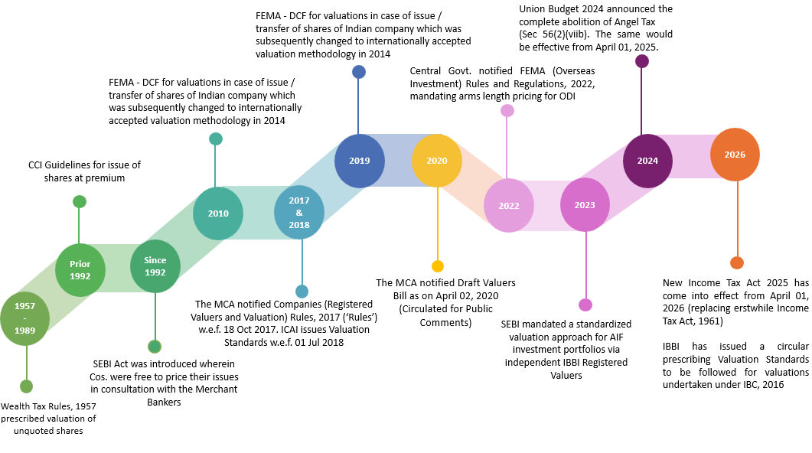
EVOLUTION OF VALUATION

Slide 5
REGISTERED VALUER (1/2)
Section 247 of the Companies Act, 2013 (‘Act’) provides:
  Valuation of property, stocks, shares, debentures, securities, goodwill or other assets / liabilities / net worth of a company under the Act
  To be done by a Registered Valuer (RV)
  Appointed by Audit Committee or in its absence the Board of Directors of that company
Further, as per Section 247(2) of the Act, RV shall
  make an impartial, true and fair valuation of assets;
  exercise due diligence while performing the functions as valuer;
  make the valuation in accordance with such rules as may be prescribed; and
  not undertake valuation of any assets in which he has a direct or indirect interest or becomes so interested at any time during a period of three years prior to his appointment as valuer or three years after the valuation of assets was conducted by him

Slide 6
REGISTERED VALUER (2/2)
On 18 Oct 2017, MCA notified the Companies (Registered Valuers and Valuation) Rules, 2017
Authority to administer & perform the functions under these Rules
Organisation to regulate and impart training to the Registered Valuers
Individual, Firm, LLP or Company
Member of a RVO
Registered with IBBI
Registered Valuer Organization
(‘RVO’)
Registered Valuer
(‘RV’)
IBBI
IBBI

Slide 7
VALUATION STANDARDS OVERVIEW
ISSUED BY THE INSTITUTE OF CHARTERED ACCOUNTANTS OF INDIA

Slide 8
ICAI VALUATION STANDARDS (‘ICAI VS’)2018
ICAI issued Valuation Standards to address the need for consistent, uniform and transparent valuation policies.
Valuation Standards lay down a framework to ensure:
  uniformity in approach; and
  quality of valuation output
Applicability for Chartered Accountants
  On mandatory basis for valuation reports issued under the Companies Act, 2013 on or after 01 Jul 2018
  On recommendatory basis for valuation under other statutes like Income tax, SEBI, FEMA
ICAI RVO has adopted the valuation standards issued by ICAI

Slide 9
ICAI VS 2018
ICAI VS 101
  Definitions
ICAI VS 102
  Valuation Bases
ICAI VS 103
  Valuation Approaches and Methods
ICAI VS 201
  Scope of Work, Analyses and Evaluation
ICAI VS 202
  Reporting and Documentation
ICAI VS 301
  Business Valuation
ICAI VS 302
  Intangible Assets
ICAI VS 303
  Financial Instruments

Slide 10
Valuation CONCEPTS & PURPOSE

Slide 11
VALUATION CONCEPTS
Valuation
Value - Price
Not an Exact science
More of an Art
Date Specific
Subjective
Value varies with Situation

Slide 12
TYPES OF ASSETS
Securities or Financial Assets
Business
Intangible Assets
Land and Building
Plant and Machinery
Others
Archaeological Collections
Drawings
Paintings
Sculptures
Jewellery

Slide 13
PURPOSE OF VALUATION
Business Valuation
Regulatory
Intangibles
Financial Reporting
Restructuring
FEMA
Purchase / Sale
Purchase Price Allocation
Purchase / Sale of shares / business
Income Tax Act
Hypothecation
Private Equity/ Venture Capital Funds
Litigation / Family Settlements
SEBI Regulations
Accounting for purchase
Financial Instruments
Fund raising
Companies Act
Impairment
Ind AS reporting – Fair Value / Impairment

Slide 14
VALUATION METHODOLOGIES

Slide 15
VALUATION METHODOLOGIES
Market Approach
Income Approach
Cost Approach
Net Asset Value (NAV) Method
Replacement Cost Method
Reproduction Cost Method
Discounted Cash Flow (DCF) Method
Market Price Method
Comparable Companies Multiple (CCM) Method
Comparable Transaction Multiple (CTM) Method

Slide 16

INCOME APPROACH

Slide 17
DISCOUNTED CASH FLOW (DCF) METHOD
Value of business is aggregate of discounted value of the cash flows for the explicit period and perpetuity
3
Values a business based on the expected cash flows over a period of time
1
Involves determination of discount factor and growth rate for perpetuity
4
Considers cash flows and not accounting profit
2

Slide 18
FcfE v/s fcfF
Free Cash Flow to Equity
Free Cash Flow to Firm
Discount cash flows to equity
Cash flows after considering all expenses, tax, interest and debt additions/re-payments
Discount rate: Cost of Equity
Discount cash flows to firm
Cash flows after considering all expenses and taxes, but prior to interest and debt additions/re-payments
Discount rate: WACC

Slide 19
Cash flows
Factors to be considered for reviewing projections:
  Industry/Company Analysis
  Dependence on single customer/ supplier
  Existing policy/ legal framework
  Capital expenditure – increasing capacities
  Working capital requirements
  Alternate scenarios / sensitivities
Business
Plan
Business
Cycle
Working
Capital
Capital
Expenditure
Depreciation
Amortization
Tax

Slide 20
Discounting factor
Weighted Average Cost of Capital (WACC) =
D = Debt
E = Equity
Kd = Post tax cost of debt
Ke = Cost of equity

Slide 21
DCF VALUE
Enterprise Value
Future cash flows during explicit period
Cash flows for perpetuity
Present value
Present value

Slide 22
EXAMPLE – DISCOUNTED CASH FLOW (DCF) METHOD

Slide 23
EXAMPLE – DISCOUNTED CASH FLOW (DCF) METHOD

Slide 24
MARKET APPROACH

Slide 25

MARKET PRICE METHOD
Evaluates the value on the basis of prices quoted on the stock exchange
It is prudent to take weighted average of quoted price over a reasonable period
  Significant and Unusual fluctuations in the Market Price
Thinly traded / Dormant Scrip – Low Floating Stock
Regulatory bodies often consider market price as important basis – Preferential allotment, Takeover code

Slide 26
CASE STUDY 1 - SELECTION OF sTOCK EXCHANGE
Particulars | NSE | BSE
Volume | 2,00,00,000 | 1,60,00,000
Volume weighted average price (‘VWAP’) | 98 | 100
Price to be considered | ✔ | ❌
Generally, market price from the stock exchange on which the trading volume is higher is considered

Slide 27
EXAMPLE - MARKET PRICE METHOD

Slide 28
COMPARABLE COMPANIES MULTIPLE (CCM) / TRANSACTION MULTIPLE (CTM) METHOD
CCM Method involves valuing a company using multiples derived from market prices of comparable listed companies.
CTM Method involves valuing a company using multiples based on deals that have happened in comparable listed or unlisted companies
Generally applied in case of unlisted entities

Slide 29
Steps for CCM Method / CTM Method
Identification of comparable companies / transactions
Selection and computation of multiples
Comparison of valuation subject with comparable companies
Adjustment to multiples
Application of multiples on appropriate parameter
Derivation of value

Slide 30
COMPARABLE COMPANIES MULTIPLE METHOD
Earnings Based
EBITDA Multiple (EV / EBITDA)
Revenue multiple (EV / Revenue)
PE Multiple
Book Value Multiple
Enterprise Value
Equity Value
Asset Based
Equity Value

Slide 31
MARKET MULTIPLES - Examples
  Few Industry Specific Multiple - examples
    EV/ Tonne – Cement Manufacturing Companies
    EV/ Bed – Hospital Business
    EV/ Room Keys – Hotel Business
    EV/ Tower – Telecom Tower Companies
    % of AUM – Asset Management Companies
    EV/ Megawatts – Power Companies
    EV/ No. of connections – Cable/ Mobile Operator Companies

Slide 32
MAINTAINABLE PROFITS
Based on past performance and / or estimates
Elimination of material non-recurring/ non operational items
Adjustment for capacity recently added
Profits of various years averaged (simple or weighted)

Slide 33
MULTIPLE
Historical multiples enjoyed on the Stock Exchange by the listed comparable companies
Past and Expected Growth of the Earnings
Performance vis-à-vis Peers
Size, Location & Market Share

Slide 34
Example - CCM Method

Slide 35
COST APPROACH

Slide 36
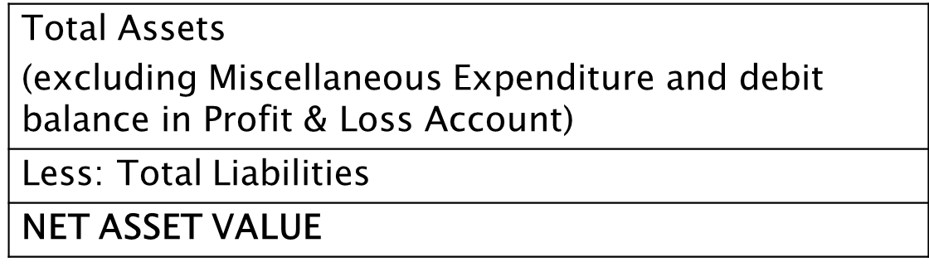
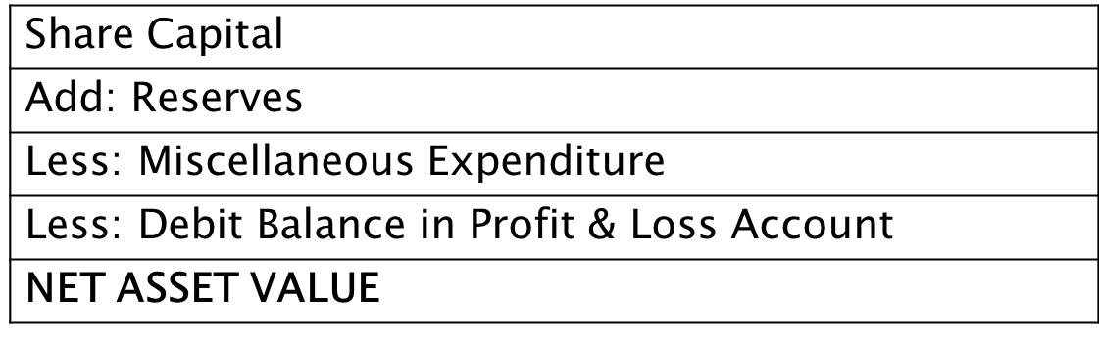
NET ASSETS VALUE (‘NAV’) METHOD
OR

Slide 37
REPLACEMENT / REALISABLE VALUE METHOD
Replacement value of assets
Realisable value of assets
Cost of disposal
Tax on sale (STCG, LTCG etc.)
Time required
Cost of new asset
Similar condition
Equivalent utility
Depreciation for obsolescence

Slide 38
example – NET ASSETS METHOD

Slide 39

COMMON ADJUSTMENTS
Market value of the investments
Other non-operating surplus assets
Surplus cash
Contingent liabilities / assets
Loan Funds
Preference Share Capital
ESOPs / Warrants
Convertible Instruments
Tax Concessions

Slide 40
Selection of methods
Situation | Approach
Knowledge based companies | Income / Market
Manufacturing companies | Income / Market/ Asset
Brand driven companies | Income / Market
Start up companies | Income / Market
Limited life projects | Income
Investment / Properties companies | Asset
Company going for liquidation | Asset

Slide 41
Other Value Drivers
Strategic Positioning
Control Premium
Final Value
Illiquidity Discount
Distress sale
Emerging markets
Alternate opportunity
Final Price is a result of negotiation

Slide 42
REACHING A RECOMMENDATION
Methods throw a range of values
Consider the relevance of each methodology depending upon the purpose and premise of valuation
Mathematical weightage
Professional judgment
Subjective Value

Slide 43

Issues in valuation

Slide 44

Issues in valuation
Availability of information
Sustainability & Scalability of business model
Difficulties in measuring risks
Thinly traded/ Dormant script
Start-up companies
Loss making companies
International companies
Selection of methods
Difficulty in obtaining comparable companies
Illiquidity discount & control premium
Due Diligence issues

Slide 45
JUDICIAL PRONOUNCEMENTS

Slide 46
JUDICIAL PRONOUNCEMENTS
“Exchange Ratio not disturbed by Courts unless objected and found grossly unfair”
  Miheer H. Mafatlal Vs. Mafatlal Industries (1996) 87 Com Cases 792
  Dinesh v. Lakhani Vs. Parke-Davis (India) Ltd. (2003) 47 SCL 80 (Bom)
“Valuation will take into account number of factors such as prospective yield, marketability, the general outlook for the type of business of the company, etc. Valuation is an art, not an exact science. Mathematical certainty is not demanded, nor indeed is it possible”
  Viscount Simon Bd in Gold Coast Selection Trust Ltd. vs. Humphrey reported in 30 TC 209 (House of Lords)
“It is fair to use combination of three well known methods - asset value, yield value & market value”
  Hindustan Lever Employees ‘ Union Vs. HLL (1995) 83 Com. Case 30 SC

Slide 47
JUDICIAL PRONOUNCEMENTS
“It is not possible for a Court to go into the exercise of carrying out a valuation itself. Courts do not have the expertise, the time or the means to do this. I do not believe that they are expected to do it. What the Court’s approach must be to examine whether or not a valuation report is demonstrated to be so unjust, so unreasonable and so unfair that it could result and result only in a manifest and demonstrable, inequity or injustice. This injustice must be shown to apply to a class.”
“No valuation is to be disregarded merely because it has used one or the other of various methods. It must be shown that the chosen method of valuation is such as has resulted in an artificially depressed or contrived valuation well below what a fair-minded person may consider reasonable.”
  Cadbury India Limited Vs. Mrs Malati Samant and Mr Alok C. Churiwala (Samant Group and Churiwala Group) (2014) (Bom HC)

Slide 48
THANK YOU !

