Slide 1
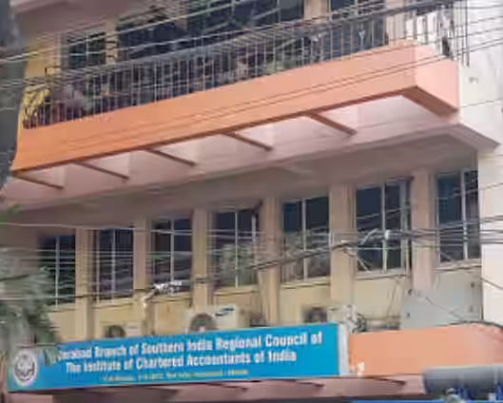

Compliance with Framework of Quality Control General & Specific Controls
Compliance with Technical and Professional Standards
Hyderabad Branch of SIRC of ICAI,
27th November 2025
VIJAY SRINIVAS KOTHAPALLI
M.Com., | FCA | LLB | CISA | CFE | CC | IP(IBBI)
Partner
C Ramachandram & Co.,
Chartered Accountants

Slide 2
Disclaimer
The views and opinions expressed in this presentation are those of the presenter and do not necessarily replace independent professional judgement, nor is endorsed by organisers of the session. Examples included within this presentation are only for illustrative purposes. They may not be utilised in real-world situations as they are based only on very limited information available through public sources. Assumptions made within the examples are not reflective of the position of the entities mentioned above. Source of images used in presentation are from Peer Review Manual issued by ICAI.
The presenter neither is endorsing nor is recommending any of the tools or applications discussed during the presentation and are only used as examples.

Slide 3
My View
Audit is a Serious Business
Peer Reviewer shall evaluate
Quality of Seriousness (Annexure I & II)
Quantity of Seriousness (Annexure III)

Slide 4
Clause 2 (14) of Peer Review Guidelines 2022 :
Peer Review - means an examination and review of the systems and procedures to determine whether the same have been put in place by the Practice Unit for ensuring the quality of assurance services as envisaged by the Technical, Professional and Ethical Standards as applicable including Audit Quality Maturity Model wherever applicable or any other regulatory requirements as may be prescribed by the Council or any Committee and whether the same were consistently applied during the period under review;

Slide 5
The main objective of Peer Review is to ensure that in carrying out the assurance service assignments, the members of the Institute –
comply with Technical, Professional and Ethical Standards as applicable including other regulatory requirements thereto and
have in place proper systems including documentation thereof, to amply demonstrate the quality of the assurance services.
- Statement on Peer Review
The Statement on Peer Review shall be deemed to be a guideline of the Council under clause (1) of Part Il of Second Schedule to the Act and it is obligatory for the Practice Unit to comply with the provisions contained in this Statement.

Slide 6
The Review shall cover:
Compliance with Technical, Professional and Ethical Standards.
Quality of reporting.
Systems and procedures for carrying out assurance services.
Training programmes for staff (including article and audit assistants) concerned with assurance functions, including availability of appropriate infrastructure.
Compliance with directions and / or guidelines issued by the Council to the Members, including fees to be charged, number of audits undertaken, register for Assurance Engagements conducted during the year and such other related records.
Compliance with directions and / or guidelines issued by the Council in relation to article assistants and / or audit assistants, including attendance register, work diaries, stipend payments, and such other related records.

Slide 7
Quality Control Framework
SQC 1 provides the quality control framework for Practicing firm to ensure compliance with professional standards and regulatory requirements.
It covers key elements such as leadership responsibilities, ethical requirements, client acceptance and continuance, human resources, engagement performance, and monitoring.
The firm should establish policies and procedures addressing each element of SQC 1 and communicate them to all personnel.
The framework should be tailored to the firm's size, nature of services, and specific circumstances.

Slide 8
General Controls
Leadership should set the right tone by emphasizing the importance of quality, ethics, and independence.
Establish a code of conduct and provide regular training on ethical standards, such as integrity, objectivity, and confidentiality.
Implement a system for client acceptance and continuance, including risk assessment and due diligence procedures.
Maintain a competent and skilled workforce through robust hiring, training, and performance evaluation processes.
Ensure proper supervision, review, and consultation on engagements to maintain quality standards.

Slide 9
Specific Controls
Perform engagement-level risk assessments to identify areas requiring specific attention or additional procedures.
Implement strict access controls to safeguard client information and maintain data confidentiality.
Enforce segregation of duties to prevent unauthorized actions and ensure proper review and approval processes.
Conduct thorough documentation of all engagement activities, including planning, execution, and conclusions.
Perform regular reconciliations and reviews of financial records, workpapers, and reports to detect any errors or discrepancies.

Slide 10
Ways to comply with Quality Control Framework
Establish a culture of compliance where adherence to professional standards and regulations is non-negotiable.
Regularly monitor the effectiveness of the quality control system through internal inspections and peer reviews.
Promptly address any identified deficiencies or non-compliance issues through corrective actions and follow-up.
Stay updated with changes in professional standards, regulations, and industry best practices and adapt the firm's policies and procedures accordingly.
Foster open communication and encourage personnel to raise concerns or report any potential compliance issues without fear of retaliation..

Slide 11
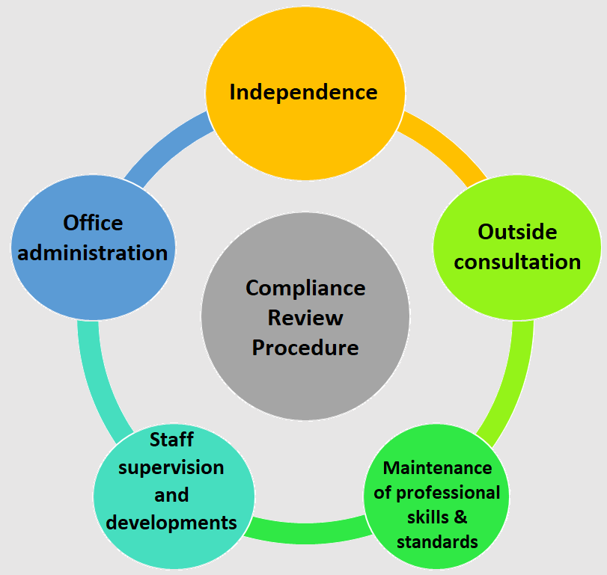
Compliance Review Procedure

Slide 12
Independence
PU have Policy to ensure independence, objectivity & integrity of partners & staff?
- Name the Partner who is responsible for policy and implementation
- PU communicates policies with staff on regular basis.
- The monitoring mechanism adopted by PU to ensure compliance with the policy.
- Procedure PU follows to review the association with clients periodically to ensure - compliance with policy.
- PU or its partners assist the client in preparing financial statements.
AY
DL
DM
DM
DL
NN
Expected Type of responses:
Affirmative as Yes / No (AY), Affirmative with details (AD), Demonstrate (DM), Declarative (DL), Negative as No (NN)

Slide 13
Outside consultation
PU have a policy for consulting experts (both internal and external)
PU have a network of other accountants, solicitors & advocates, technical consultants in industries in which its clients operate
AD
DL
Maintenance of professional skill and standards
PU have an established plan for personnel needs at all levels (incl. future)
PU have an established recruitment policy?
Applicants & new personnel informed of the relevant personnel policies & procedures
PU have CPE programmes for partners and staff
Professional literature made available to the partners and staff
PU conduct development programmes in specialized areas and industries
DM
AY
DM
DM
DM
AD
Affirmative as Yes / No (AY), Affirmative with details (AD), Demonstrate (DM), Declarative (DL), Negative as No (NN)

Slide 14
Staff Supervision and Development
PU have written guidelines on the responsibilities, expected performance & qualifications
PU have performance appraisal system for personnel
PU have a system of counselling on performance & career opportunities
PU have a system of assigning audits based on experience and expertise of staff
PU have written guidelines for maintaining working papers (incl. templates)
PU have standardized forms, checklists, and questionnaires for conducting audit
DM
DM
DM
AD
DM
DM
Affirmative as Yes / No (AY), Affirmative with details (AD), Demonstrate (DM), Declarative (DL), Negative as No (NN)

Slide 15
Office Administration
PU have record retention procedures including security aspects
PU maintains detailed records and time stamp (inc. bills) of client and assignment
PU maintains staff register
PU have a library (physical or digital) with publications of the ICAI
DM
DM
DM
DM
Affirmative as Yes / No (AY), Affirmative with details (AD), Demonstrate (DM), Declarative (DL), Negative as No (NN)

Slide 16
Tech. Proff. Ethical Standards - Illustration
Simulated PU Scenario for Peer Review
Notes:
Expected Type of responses:
Affirmative as Yes / No (AY), Affirmative with details (AD), Demonstrate (DM), Demonstrate with Samples (DS), Declarative (DL), Negative as No (NN)

Slide 17
Peer Review Reporting
Reviewer qualifies the report, due to one ore more of following:
technical standards
professional standards
ethical standards
quality control policies and procedures
Non-compliance with any of
Deficiency in quality control system
Non-existence of adequate training programs for staff

Slide 18
Thank you
Peer Review Board of ICAI
and
Hyderabad Branch of SIRC of ICAI
&
Members of ICAI
for the opportunity
for the active participation
VIJAY SRINIVAS KOTHAPALLI
M.Com., | FCA | LLB | CISA | CFE | CC | IP(IBBI)
Partner
C Ramachandram & Co.,
Chartered Accountants
Hyderabad

