Slide 1

Next frontier for CAs : SME IPO Process and Opportunities for CAs

Slide 2




Major benefits of SME IPO
Growth & Expansion
Access vital funding to scale operations and expand business reach
Visibility & Credibility
Enhanced brand image and stronger market presence
Liquidity
Create valuable exit opportunities for investors and promoters
ESOPs & Talent
Attract and retain top talent through equity options

Slide 3

SME IPO Platforms
Parameter | BSE SME | NSE Emerge
Launch Year | 2012 | 2012
Parent Exchange | Bombay Stock Exchange (BSE) | National Stock Exchange (NSE)
Key Purpose | Facilitates capital access for SMEs while ensuring simplified compliance requirements. | Supports equity fundraising specifically for SMEs and startup companies.
Market Reach | Over 500 listings as of 2025. | 556 listings as of September 2024.

Slide 4
SME IPO: Eligibility Criteria
Parameter | BSE SME | NSE EMERGE
Incorporation | Incorporated under Companies Act 1956/2013 in India
DRHP Approval | By the exchange
Financial reporting | Half-yearly
Post-issue paid-up capital | Not more than Rs. 25 crore (face value)
IPO application size | Minimum Rs. 1,00,000
Lot size | 2 Lots
Minimum number of allottees in IPO | Minimum 50 allottees
Track record | At least 3 years of applicant or proprietorship/partnership converted to company
DEMAT trading | Trading must be in DEMAT form with agreements with both depositories
Website requirement | Required
Underwriting requirement | 100% underwritten
Market making | Required for 3 years post-listing
Operating profit (EBITDA) | Positive earnings in at least 2 out of 3 financial years | EBITDA of at least INR 1 crore in any 2 out of 3 financial years
Net worth | At least Rs. 1 crore for 2 preceding full financial years | Positive net worth
Net tangible assets | At least Rs. 3 crore in the last preceding financial year | Not specified
Free cash flow | Not specified | Positive Free Cash Flow to Equity (FCFE) for at least 2 out of 3 financial years (mandatory from Sept 1, 2024)
Offer for Sale restrictions | Not specified | OFS cannot exceed 20% of issue size; shareholders can't sell more than 50% of their holding
Issue proceeds restrictions | Not specified | Cannot be used for repayment of loans from promoters/promoter group/related parties
Rejection cooling-off period | 6 months from date of rejection | Application should not have been rejected by exchange in last 6 months

Slide 5
Lock-In Conditions for SME IPO Shareholders on BSE SME and NSE Emerge
Category | BSE SME & NSE EMERGE
Promoters | - Minimum Promoter Contribution (MPC): 3 years from allotment. - Excess holdings (beyond MPC): □ 50% released after 1 year □ Remaining 50% released after 2 years
Non-Promoter Pre-IPO Shareholders | - Locked for 1 year from allotment. - Applies to VCs, employees (including ESOPs), and other early investors.
Anchor Investors | - 50% of shares: Locked for 30 days - Remaining 50%: Locked for 90 days
Retail & QIB Investors | No lock-in period.

Slide 6

SME IPO Process: Detailed Timeline
A comprehensive timeline from initial engagement through listing completion, typically spanning 187 days.
Activity | Time Lines
Engagement Sign off with Merchant Banker | X
Conversion into Public Limited Company | X+1
Submission of documents for conversion to ROC | X+7
ROC approval for conversion | X+22
Appointment of Peer Review Auditors & Restating Financials | X+23
Appointment of Registrar and Transfer Agents (RTA), NSDL & CDSL connectivity | X+24
Appointment of Key Directors, Company Secretary, Pay Decisions | X+27
Constitution of Committees (Audit, Shareholder Grievance, Payments) | X+30
Preparation of website & hosting of code of conduct | X+34
Signing of Tri-Partite Agreement with NSDL, CDSL & ISIN issuance | X+37
Preparation of Project Report & Draft Red Herring Prospectus (DRHP) | X+46
Filing DRHP with Stock Exchange & Applying for In- Principle Approval | X+70
Clearance from Stock Exchange | X+160
Lock-in for Pre-Issue Capital | X+170
Appointment of Market maker and others | X+170
Filing of Prospectus with ROC & Getting Clearance | X+170
Filing of Final Prospectus with Stock Exchange & SEBI | X+170
Opening of the Issue | X+175
Closing of the Issue | X+178
Finalization of Basis of Allotment by RTA & Submission to Stock Exchange | X+185
Demat Credit of Shares | X+186
Filing of Listing Application with Stock Exchange | X+187

Slide 7

Eligibility Criteria for SME Migration to Mainboard (NSE & BSE)
Key Requirements Comparison
Parameter | BSE SME n BSE Mainboard | NSE Emerge n NSE Mainboard
Listing History | Minimum 3 years listed on SME platform. | Minimum 3 years listed on SME platform. Recent regulations require over ¹100 crore operational revenue and positive operating profit in at least two of the last three financial years.
Paid-Up Equity Capital | Minimum ¹10 crore. | Minimum ¹10 crore.
Market Capitalization | Minimum ¹25 crore. | Average of ¹100 crore or more.
Revenue (Last FY) | Not specified. | Minimum ¹100 crore revenue during the last financial year.
Operating Profit (EBITDA) | Positive operating profit in two of the three preceding years. | Positive operating profit in two of the three preceding years.
Net Worth | Minimum ¹15 crore over last two financial years. | Minimum ¹75 crore.
Public Shareholders | At least 250 public shareholders on the application date. | At least 500 public shareholders on the application date.
Promoter Holding | Minimum 20% at application. | Minimum 20% at application and at least 50% of shares held at listing.
Regulatory Compliance | Same requirements as NSE. | No IBC/NCLT proceedings, SEBI debarment, or material actions over past three years.

Slide 8
Ecosystem
Merchant Banker
Statutory Auditor
Internal/Virtual CFO
Legal Professional
Company Secretary
Integration Advisor

Slide 9
The Merchant Banker's Role: A Detailed Breakdown
Phase 1: Pitching & Pre-IPO
Planning
Assessing IPO readiness, defining strategy,
developing pitch book.
1
2
Phase 2: Due Diligence and Legal Compliance
Financial and legal due diligence, regulatory approvals.
Phase 3: Document Preparation
Drafting and filing DRHP with Stock
Exchange.
3
4
Phase 4: Marketing and Subscription
Investor presentations, managing subscription process.
Phase 5: Allotment and Listing
Finalizing allotment, achieving successful
listing.
5

Slide 10

Role of internal or virtual CFO
Oversee financial reporting and ensure accuracy of financial statements for IPO readiness.
1
Develop and implement financial controls and compliance systems aligned with regulatory requirements.
2
Assist in preparing the company9s financial projections and Key data points required for filing DRHP
3
Support ongoing communication with stakeholders to maintain transparency throughout the IPO process.
4

Slide 11

Role of Company Secretary for SME IPO and Filing DRHP
Compliance
Ensure compliance with regulatory requirements applicable to SME IPOs.
DRHP Filing
Coordinate timely preparation and filing of the Draft Red Herring Prospectus (DRHP).
Record Keeping
Maintain statutory records and disclosures during the IPO process.
Stakeholder Liaison
Liaise with stock exchanges, regulators, and other stakeholders.
Advisor Support
Support the merchant banker and other advisors in documentation and compliance tasks.

Slide 12

Role of Statutory Auditor in SME IPO for DRHP Filing
The statutory auditor holds a vital responsibility in the SME IPO process, especially in the accurate preparation and timely filing of the Draft Red Herring Prospectus (DRHP).
1
Financial Statement Audit
Ensuring the accuracy, completeness, and adherence to applicable accounting standards and regulatory requirements.
2
Restatement of Financials
Restating financial statements, including the stub period, to reflect true and fair financial position.
3
Certifications
Providing necessary certifications to support the DRHP and regulatory compliance.

Slide 13

Role of Legal Counsel in SME IPO Listing and Filing DRHP
1
Legal Due Diligence
The legal counsel plays a vital role in conducting thorough legal due diligence and preparing a comprehensive report.
2
DRHP Review and Vetting
They review and vet the Draft Red Herring Prospectus (DRHP) to ensure its accuracy, completeness, and compliance with securities laws.
3
Disclosure and Corporate Governance
Legal counsel supports disclosure requirements, addresses legal risks, and advises the company on governance matters throughout the IPO process.

Slide 14

Role of Integration Advisor
Client Representation
Act as the primary point of contact, representing the
1
client throughout the IPO journey from pitching to listing.
2
Coordination of Functions
Integrate all key IPO functions including finance, legal, compliance, and auditing to ensure smooth execution.
Strategic Planning
Devise and manage the overall timeline and milestones to keep the IPO process on track and aligned with client requirements.
3
4
Problem Solving
Address challenges proactively and provide solutions to keep the listing process seamless and efficient.
Stakeholder Communication
Maintain transparent and continuous communication among all stakeholders, and regulatory bodies on behalf of the client.
5

Slide 15

Key Challenges
Understanding the aspirations and conviction of the promoter and
company
1
2
Aligning valuation expectations with market realities
Preparing the company and promoter to be presentable for pitching
3
4
Evaluating multiple offers and structures, and finalizing a single proposal
Coordinating scattered stakeholders according to the estimated timelines
5
6
Drafting the objects clause accurately
Building key data points for the DRHP (mandatory disclosure of KPIs)
7
8
Managing compliance dependencies for DRHP filing
Responding to exchange queries to obtain in-principle approval
9

Slide 16
Fund Raising Strategies
1
Pre-IPO Funding
A targeted funding phase crafted for companies preparing to begin their IPO journey.
2
SME IPO
The primary capital-raising route designed specifically for eligible small and medium enterprises.
3
Post-IPO Equity Fundraise
Additional capital-raising opportunities for established listed companies seeking growth.
Strategic Reverse Merger
Ideal for innovative companies aiming for rapid market entry through mergers.
Immediate market access via merger with a listed SME Leverages existing market infrastructure efficiently
Enables faster capital acquisition with flexible integration options
4
We tailor fund raising strategies to each client9s unique situation, considering their immediate funding requirements, growth potential, and long-term goals.

Slide 17

SME Success Story: Bondada Engineering Limited
From a modest beginning to becoming a market leader, Bondada Engineering exemplifies the potential of Indian SMEs.
Founded in 2012
Started as an EPC services provider in telecom and renewable energy sectors, building a workforce of over 550 professionals
Successful IPO Launch (2023)
Raised ¹42.72 crores at 165 crore valuation approximately with shares doubling on debut
Expanding Operations
Secured major contracts including a ¹575.74 crore solar power plant project, with revenue growing to ¹370.59 crores in FY23
Market Success
Achieved its all time high market capitalization of
¹8,000 crores, delivering over 4,800% returns to investors from IPO price

Slide 18

Opportunities for Chartered Accountants
1
Financial Due Diligence
Conducting financial due diligence and risk identification.
2
Financial Statements
Preparing and restating financials to comply with regulations.
3
Audit and Assurance
Scope for Statutory Audit and Internal Audit.
4
Valuation Services
Determining fair value of equity.

Slide 19

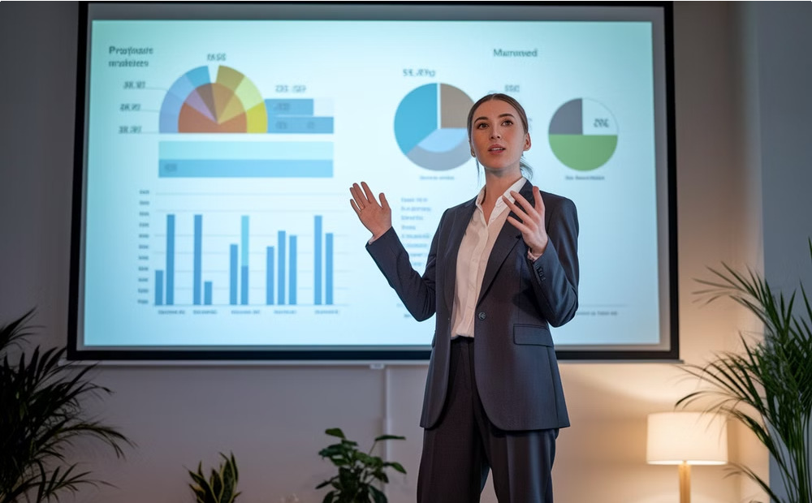

Integrated Advisory Approach
Collaborative Teamwork
Our integrated teams work seamlessly across functions, bringing together expertise from finance, compliance, and strategy.
Dedicated Project Management
Your single point of contact coordinates all aspects of the IPO journey, ensuring clear direction and accountability.
Transparent Communication
Regular updates and structured reporting keep all stakeholders aligned throughout the process.

Slide 20
Thank You, ICAI, for This Valuable Opportunity
We sincerely appreciate the chance to present and collaborate with such a prestigious institution. Your support inspires us to strive for excellence in our endeavors.

