Slide 1

Ind AS 40 Investment properties
Faculty : CA Naga Durga Sudhakar GV
Accounting Standards Board
The Institute of Chartered Accountants of India
New Delhi, India
Disclaimer: The views expressed herein are solely those of the Faculty/Presenter and not that of the ICAI or any of its committees. The ICAI or the Faculty or Preparer of this material do not accept any responsibility for omission or inadequacy of the contents in this document and also for loss caused to any person who acts or refrains from acting in reliance on the contents of this document irrespective of the cause of / reason for the loss.

Slide 2
Objective
The objective of this standard is to prescribe the accounting treatment for property (land and/or buildings) held to earn rentals or for capital appreciation (or both) and related disclosure requirements. Ind AS 40 prescribes the cost model for accounting for investment property.

Slide 3
Scope
This Standard does not apply to:
biological assets related to agricultural activity (see Ind AS 41, Agriculture and Ind AS 16 Property, Plant and Equipment); and
mineral rights and mineral reserves such as oil, natural gas and similar non regenerative resources.

Slide 4
Definitions
Investment property is property (land or a building—or part of a building—or both) held (by the owner or by the lessee as a R-O-U) to earn rentals or for capital appreciation or both, rather than for:
use in the production or supply of goods or services or for administrative purposes; or
sale in the ordinary course of business.
Owner-occupied property is property held (by the owner or by the lessee as a R-O-U) for use in the production or supply of goods or services or for administrative purposes.

Slide 5
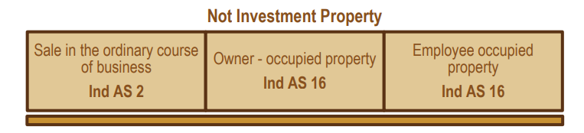
Examples of Investment Property
The following are examples of investment property:
(a) land held for long-term capital appreciation rather than for short-term sale in the ordinary course of business.
(b) land held for a currently undetermined future use. (If an entity has not determined that it will use the land as owner-occupied property or for short-term sale in the ordinary course of business, the land is regarded as held for capital appreciation.)
(c) a building owned by the entity (or a right-of-use asset relating to a building held by the entity) and leased out under one or more operating leases.
(d) a building that is vacant but is held to be leased out under one or more operating leases.
(e) property that is being constructed or developed for future use as investment property.

Slide 6
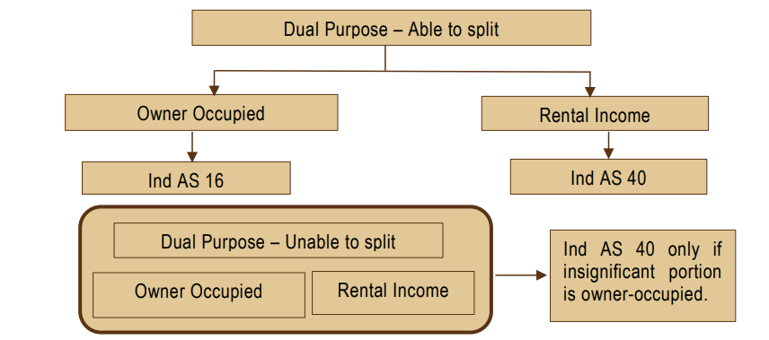
More than one purpose

Slide 7
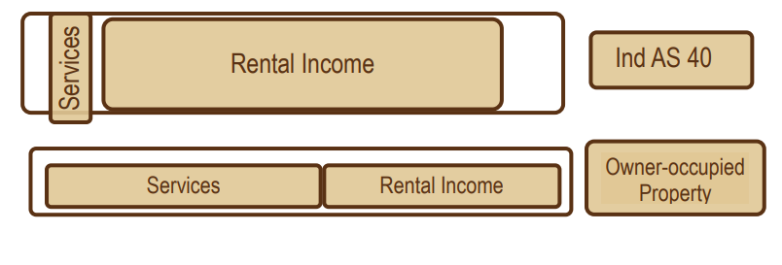
Ancillary services
Ancillary services
In some cases, an entity provides ancillary services to the occupants of a property it holds. An entity treats such a property as investment property if the services are insignificant to the arrangement as a whole. An example is when the owner of an office building provides security and maintenance services to the lessees who occupy the building.
In other cases, the services provided are significant. For example, if an entity owns and manages a hotel, services provided to guests are significant to the arrangement as a whole. Therefore, an owner-managed hotel is owner-occupied property, rather than investment property.

Slide 8
summary
S. No. | Property | Investment property (Y/No) | Standard
1 | Owned by a company and leased out under an operating lease | Yes | Ind AS 40
2 | Held as a right-to-use asset and leased out under an operating lease | Yes | Ind AS 40
3 | Held as a right-to-use asset and leased out under finance lease | No | Ind As 116
4 | Property acquired with a view for development and resale | No | Ind AS 2
5 | Property partly owner occupied and partly leased out under operating lease | Depends | Ind AS 16 / Ind AS 40
6 | Land held for currently undetermined use | Yes | Ind AS 40
7 | Property occupied by employees paying rent at less than market rate | No | Ind AS 16
8 | Investment property held for sale | No | Ind AS 105
9 | Existing investment property that is being redeveloped for continued use as investment property | Yes | Ind AS 40

Slide 9
Issues around classification
Acquisition of Investment property Vs business combination
Judgement is also needed to determine whether the acquisition of investment property is the acquisition of an asset or a group of assets or a business combination within the scope of Ind AS 103, Business Combinations. Reference should be made to Ind AS 103 to determine whether it is a business combination. The discussion in paragraphs 7–14 of this Standard relates to whether or not property is owner-occupied property or investment property and not to determining whether or not the acquisition of property is a business combination as defined in Ind AS 103. Determining whether a specific transaction meets the definition of a business combination as defined in Ind AS 103 and includes an investment property as defined in this Standard requires the separate application of both Standards.

Slide 10
Recognition and measurement
Recognition
Investment property shall be recognised as an asset when, and only when:
it is probable that the future economic benefits that are associated with the investment property will flow to the entity; and
the cost of the investment property can be measured reliably.
Measurement at recognition
An investment property shall be measured initially at its cost. Transaction costs shall be included in the initial measurement.
The cost of an investment property is not increased by:
start-up costs (unless they are necessary to bring the property to the condition necessary for it to be capable of operating in the manner intended by management),
operating losses incurred before the investment property achieves the planned level of occupancy, or
abnormal amounts of wasted material, labour or other resources incurred in constructing or developing the property.

Slide 11
Recognition and measurement
An investment property shall be measured initially at its cost. Transaction costs shall be included in the initial measurement.
Netravati Ltd. purchased a commercial office space as an Investment Property, in the Global Trade Centre Commercial Complex, for Rs. 5 crores. However, for purchasing the same, the Company had to obtain membership of the Global Trade Centre Commercial Complex Association by paying Rs. 6,25,000 as a one-time joining fee. Netravati Ltd. wants to write off the one-time joining fees paid as an expense under Membership and Subscription Charges and value the investment property at Rs. 5 crores. Advise.
Comment whether your answer will change if the office space was purchased with the intention of using it as an administrative centre of the company
Solution - The cost of a purchased investment property comprises its purchase price and any directly attributable expenditure (e.g. professional fees for legal services, property transfer taxes and other transaction costs). Therefore, the investment property shall be measured at Rs. 5,06,25,000

Slide 12
Recognition and measurement
X Limited purchased a building for Rs. 30,00,000 on 1st May, 20X1 with an intention to earn rentals. The purchase price was funded by a loan, interest on which is payable @ 5%.
Property transfer taxes and direct legal costs of Rs. 1,00,000 and Rs. 20,000 respectively were incurred in acquiring the building. X Limited redeveloped the building into retail shops for rent under operating leases to independent third parties. Expenditures on redevelopment were:
• Rs. 2,00,000 planning permission.
• Rs. 7,00,000 construction costs (including Rs. 40,000 refundable purchase taxes)
The building does not qualify the substantial period criteria for redevelopment of property under Ind AS 23. Compute the cost of the building as per Ind AS 40.
Solution:
Purchase price Rs. 30,00,000
Taxes and legal costs Rs. 1,20,000
Planning permission Rs. 2,00,000
Construction costs Rs. 6,60,000
Total Rs. 39,80,000

Slide 13
Recognition and measurement
Deferred payments:
Cost is the cash price-equivalent
Illustration
X Limited purchased a land worth of Rs. 1,00,00,000. It has option either to pay full amount at the time of purchases or pay for it over two years for a total cost of Rs. 1,20,00,000.
Determine the cost of the building under both the payment methods.
Solution
Using either payment method, the cost will be Rs. 1,00,00,000. If the second payment option is used, Rs. 20,00,000 will be treated as interest expenses over the credit period of 2 years.

Slide 14
Recognition and measurement
Acquisition through exchange
The cost of such an investment property is measured at fair value unless:
a) the exchange transaction lacks commercial substance or
b) the fair value of neither the asset received, nor the asset given up is reliably measurable.
If the entity is able to measure reliably the fair value of either the asset received or the asset given up, then the fair value of the asset given up is used to measure cost unless the fair value of the asset received is more clearly evident.
Investment property held by the lessee
An investment property held by a lessee as a right-of-use asset shall be measured initially at its cost in accordance with Ind AS 116.

Slide 15
Exchange - Illustration
Sun Ltd acquired a building in exchange of a warehouse whose fair value is Rs. 5,00,000 and payment of cash is Rs. 2,00,000. The fair value of the building received by the Company is Rs. 8,00,000. The company decided to keep that building for rental purposes.
The building is acquired with the purpose to earn rentals. Hence, it is a case of Investment Property acquired in exchange for a combination of monetary and non-monetary asset.
Therefore, Journal entry at the time of acquisition is :
Investment Property (Building) (5,00,000 + 2,00,000) Dr. 7,00,000
To Cash 2,00,000
To PPE (Property, Plant and Equipment) i.e. Warehouse 5,00,000
However, if the fair value of property acquired is more clearly evident, then the fair value of the asset acquired is considered. In such a situation, the Journal Entry at the time of acquisition (taking information given in the above example) would be Investment Property (Building) Dr. 8,00,000
To Cash 2,00,000
To PPE (Warehouse) 5,00,000
To Gain on Sale of PPE 1,00,000

Slide 16
Recognition and measurement
Measurement after recognition
An entity shall adopt as its accounting policy the cost model prescribed in paragraph 56 to all of its investment property.
This Standard requires all entities to measure the fair value of investment property, for the purpose of disclosure even though they are required to follow the cost model. An entity is encouraged, but not required, to measure the fair value of investment property on the basis of a valuation by an independent valuer who holds a recognised and relevant professional qualification and has recent experience in the location and category of the investment property being valued.
Rebuttable presumption
Exceptions to rebuttable presumption - the fair value of the investment property is not reliably measurable due to the market for comparable properties is inactive
If an entity determines that the fair value of an investment property under construction is not reliably measurable but expects the fair value of the property to be reliably measurable when construction is complete, it shall measure the fair value of that Investment property either when its fair value becomes reliably measurable or construction is completed (whichever is earlier).
If an entity determines that the fair value of an investment property (other than an investment property under construction) is not reliably measurable on a continuing basis, the entity shall make the disclosures required by paragraphs 79(e)(i), (ii) and (iii).
A description of the investment property / Explanation of why fair value cannot be measured reliably; and / If possible, the range of estimates within which fair value is likely to lie

Slide 17
Transfers
Transfers
Transfers to, or from, investment property shall be made when, and only when, there is a change in use, evidenced by:
commencement of owner-occupation, for a transfer from investment property to owner-occupied property (IND AS 40 ➔ IND AS 16)
commencement of development with a view to sale, for a transfer from investment property to inventories (IND AS 40 ➔ IND AS 2);
end of owner-occupation, for a transfer from owner-occupied property to investment property; (IND AS 16 ➔ IND AS 40) or
commencement of an operating lease to another party, for a transfer from inventories to investment property (IND AS 2 ➔ IND AS 40).

Slide 18
Transfers
Moon Ltd. has purchased a building on 1st April, 20X1 at a cost of Rs. 10 million.
The building was used as a factory by the Moon Ltd. and was measured under cost model.
The expected useful life of the building is estimated to be 10 years.
Due to decline in demand of the product, the Company does not need the factory anymore and has rented out the building to a third party from 1st April, 20X5.
On this date, the fair value of the building is Rs. 8 million.
Moon Ltd. uses cost model for accounting of its investment property.
Determine the value of the building on reclassification as investment property.
Solution: Carrying amount of the building after depreciation of 4 years Rs. 6 Million
Building initially recognized as Investment Property Rs. 6 Million (Cost model under Ind AS 40)

Slide 19
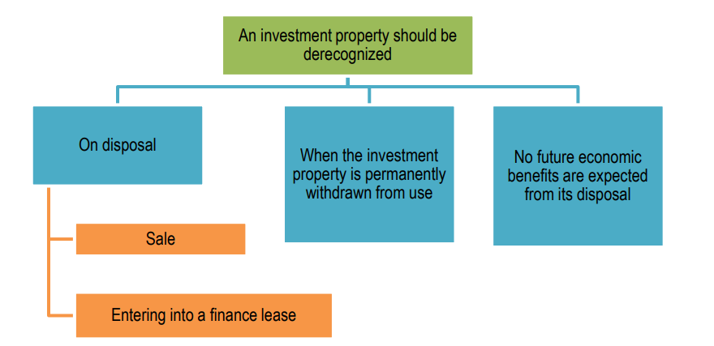
disposals

Slide 20
Disposals
Sun Ltd, an aeronautics company is having a building which is given on an operating lease. The book value of such building in the books is Rs. 2,00,000.
Case -A
Pluto Ltd. offers to buy the building at Rs. 4,00,000.
Bank Dr. 4,00,000
To Investment Property 2,00,000
To Gain on disposal 2,00,000
Case-B
Pluto Ltd. offers to take the building on finance lease for 10 years at a lease rental of Rs. 80,000 p.a. The present value of minimum lease payments is Rs. 3,20,000.
Lease Receivable Dr. 3,20,000
To Investment Property 2,00,000
To Gain on Disposal 1,20,000

Slide 21
A few other matters
Sl. No | Particulars | Accounting
1 | Date of disposal for investment property | • The date is when the recipient obtains control of the investment property for determining when a performance obligation is satisfied. • Ind AS 116 applies to a disposal effected by entering into a finance lease and to a sale and leaseback.
2 | Measurement of consideration receivable on disposal | • The consideration receivable on disposal of an investment property is recognized initially at fair value • If payment for an investment property is deferred, the consideration received is recognized initially at the cash price equivalent. • The difference between the nominal amount of the consideration and the cash price equivalent is recognized as interest revenue
3 | Compensation | Compensation from third parties for investment property that was impaired, lost or given up shall be recognized in profit or loss when the compensation becomes receivable.

Slide 22
Disclosures
An entity shall disclose:
its accounting policy for measurement of investment property.
when classification is difficult (see paragraph 14), the criteria it uses to distinguish investment property from owner-occupied property and from property held for sale in the ordinary course of business.
the extent to which the fair value of investment property (as measured or disclosed in the financial statements) is based on a valuation by an independent valuer who holds a recognised and relevant professional qualification and has recent experience in the location and category of the investment property being valued. If there has been no such valuation, that fact shall be disclosed.
the amounts recognised in profit or loss for:
rental income from investment property;
direct operating expenses (including repairs and maintenance) arising from investment property that generated rental income during the period; and
direct operating expenses (including repairs and maintenance) arising from investment property that did not generate rental income during the period.
the existence and amounts of restrictions on the realisability of investment property or the remittance of income and proceeds of disposal.
contractual obligations to purchase, construct or develop investment property or for repairs, maintenance or enhancements.

Slide 23
Comparison with IAS 40
IAS 40 permits both cost model and fair value model (except in some situations) for measurement of investment properties after initial recognition. Ind AS 40 permits only the cost model.
All transitional provisions have been included in Ind AS 101

Slide 24
Comparison with Indian GAAP
There is no equivalent standard on investment property. AS 13 – Accounting for Investments covers such assets.
Investment Property – definition and scope
AS 13 defines investment property as an investment in land or buildings that are not intended to be occupied substantially for use by, or in the operations of, the investing enterprise.
Investment Property – measurement
Classified as long-term investments and measured at cost less impairment.

Slide 25
Test your knowledge - 1
X Limited has an investment property (building) which is carried in Balance Sheet on 31st March, 20X1 at Rs. 15,00,000.
During the year X Limited has stopped letting out the building and used it as its office premise.
On 31st March, 20X1, management estimates the recoverable amount of the building as Rs. 10,00,000 and its remaining useful life as 20 years and residual value is nil.
How should X Limited account for the above investment property as on 31st March, 20X1?
Transfer from Investment property to PPE at carrying value of Rs. 15,00,000;
Recognise the impairment loss of Rs. 5,00,000
Carrying amount of PPE – Rs. 10,00,000
Useful life is – 20 years

Slide 26
Test your knowledge - 2
In financial year 20X1-20X2, X Limited incurred the following expenditure in acquiring property consisting of 6 identical houses each with separate legal title including the land on which it is built.
5 houses will be will be used for rental purposes and one house will be used for office purposes
The expenditure incurred on various dates is given below:
On 1st April, 20X1 - Purchase cost of the property Rs. 1,80,00,000.
On 1st April, 20X1 – Non-refundable transfer taxes Rs. 20,00,000 (not included in the purchase cost).
On 2nd April, 20X1- Legal cost related to property acquisition Rs. 5,00,000.
On 6th April, 20X1- Advertisement campaign to attract tenants Rs. 3,00,000.
On 8th April, 20X1 - Opening ceremony function for starting business Rs. 1,50,000.
Throughout 20X1-20X2, incurred Rs. 1,00,000 towards day-to-day repair maintenance and other administrative expenses.
The cost of the property = Rs. (1,80,00,000 + 20,00,000 + 5,00,000) = Rs. 2,05,00,000.
Cost of the investment property = Rs. 2,05,00,000 x 5/6 = Rs. 1,70,83,333
Cost of the owner-occupied property = Rs. (2,05,00,000 - 1,70,83,333) = Rs. 34,16,667.

Slide 27
Test your knowledge - 3
X Ltd. is engaged in the construction industry and prepares its financial statements up to 31st March each year.
On 1st April, 20X1, X Ltd. purchased a large property (consisting of land) for Rs. 2,00,00,000 and immediately began to lease the property to Y Ltd. on an operating lease. Annual rentals were Rs. 20,00,000.
On 31st March, 20X5, the fair value of the property was Rs. 2,60,00,000.
Under the terms of the lease, Y Ltd. was able to cancel the lease by giving six months’ notice in writing to X Ltd. Y Ltd. gave this notice on 31st March, 20X5 and vacated the property on 30th September, 20X5. On 30th September, 20X5, the fair value of the property was Rs. 2,90,00,000.
On 1st October, 20X5, X Ltd. immediately began to convert the property into ten separate flats of equal size which X Ltd. intended to sell in the ordinary course of its business. X Ltd. spent a total of Rs. 60,00,000 on this conversion project between 30th September, 20X5 to 31st March, 20X6.
The project was incomplete at 31st March, 20X6 and the directors of X Ltd. estimate that they need to spend a further Rs. 40,00,000 to complete the project, after which each flat could be sold for Rs. 50,00,000.
Examine and show how the three events would be reported in the financial statements of X Ltd. for the year ended 31st March, 20X6 as per Ind AS

Slide 28
Test your knowledge - 3
From 1st April, 20X1, the property would be regarded as an investment property
The property would be measured under the cost model. This means it will be measured at Rs. 2,00,00,000 at each year end.
On 30th September, 20X5, the property ceases to be an investment property. X Ltd. begins to develop it for sale as flats. Ind AS 40 ➔ Ind AS 2;
Transfers between investment property, owner-occupied property and inventories do not change the carrying amount of the property transferred;
Hence, the carrying value of the reclassified property will be Rs. 2,00,00,000
The additional costs of Rs. 60,00,000 for developing the flats - added to the ‘cost’ of inventory to give a closing cost of Rs. 2,60,00,000.
NRV – Rs. 5,00,00,000 – Rs. 40,00,000 = Rs. 4,60,00,000
Cost – Rs. 2,60,00,000

Slide 29
Test your knowledge - 4
Shaurya Limited owns a Building A which is specifically used for the purpose of earning rentals. The Company has not been using the building A or any of its facilities for its own use for a long time. The company is also exploring the opportunities to sell the building if it gets the reasonable amount in consideration.
Following information is relevant for Building A for the year ending 31st March, 20X2:
Building A was initially purchased at the cost of INR 10 crore. At that time, the useful life of the building was estimated to be 20 years; out of which 5 years have been expired as on 1st April, 20X1. The company follows straight line method for depreciation.
During the year, the company has invested in another Building B with the purpose to hold it for capital appreciation. The property was purchased on 1st April, 20X1 at the cost of INR 2 crore. Expected life of the building is 40 years. As usual, the company follows straight line method of depreciation.
Further, during the year 20X1-20X2 the company earned/incurred following direct operating expenditure relating to Building A and Building B:
Rental income from Building A = INR 75 lakh
Rental income from Building B = INR 25 lakh
Sales promotion expenses = INR 5 lakh
Fees & Taxes = INR 1 lakh
Ground rent = INR 2.5 lakh
Repairs & Maintenance = INR 1.5 lakh
Legal & Professional = INR 2 lakh
Commission and brokerage = INR 1 lakh

Slide 30
Test your knowledge - 4
The company does not have any restrictions and contractual obligations against Property - A and B. For complying with the requirements of Ind AS, the management sought an independent report from the specialists so as to ascertain the fair value of buildings A and B.
The independent valuer has valued the fair value of property as per the valuation model recommended by International Valuation Standards Committee. Fair value has been computed by the method by streamlining present value of future cash flows namely, discounted cash flow method.
The estimated rent per month per square feet for the period is expected to be in the range of INR 50 - INR 60. And it is further expected to grow at the rate of 10 percent per annum for each of 3 years. The weighted discount rate used is 12% to 13%.
Assume that the fair value of properties based on discounted cash flow method is measured at INR 10.50 crores. The treatment of fair value of properties is to be given in the financials as per the requirements of Indian accounting standards.

Slide 31
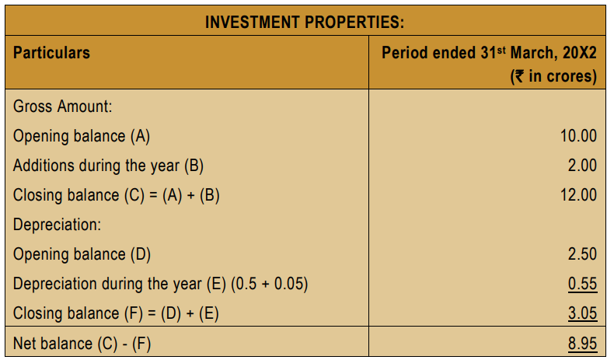
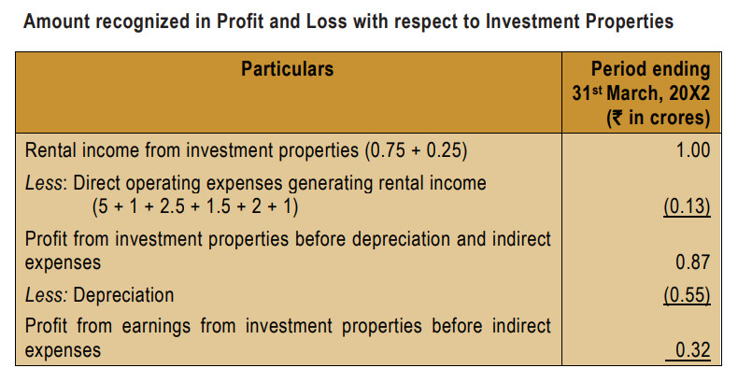
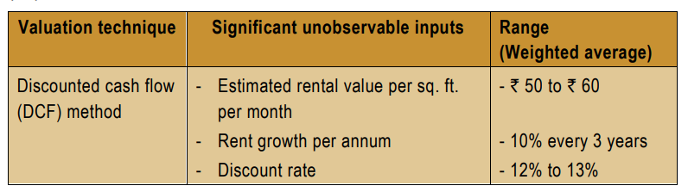
Test your knowledge - 4

Slide 32

G V Naga Durga Sudhakar
98494 90450
gaapdigest@outlook.com

Slide 33
Copyright Notice
"This presentation contains copyright © material of the IFRS Foundation and The Institute of Chartered Accountants of lndia. All rights reserved. Published by The institute of Chartered Accountants of lndia under licence from the IFRS Foundation. Reproduction and use rights are strictly limited. For more information about the IFRS Foundation and rights to use its material please visit www.ifrs.org".

