Slide 1


Framework of Appeals before Tribunals – under other Acts
CA Rajendra Prasad Talluri
B.Com; CA; Grad CWA, DIIT (ICAI), LLB
Date: 21th Dec 2025
Venue : Hyderabad Branch of ICAI
CA RAJENDRA PRASAD TALLURI [RP]

Slide 2
Appeals before Tribunals under other Acts
Sl No | Particulars
Part 1 | Appeals before the Tribunal under the Prohibition of Benami Property Transactions Act, 1988
Part 2 | Appeals before the Tribunal under the Black Money (Undisclosed Foreign Income And Assets) And Imposition Of Tax Act, 2015
Part 3 | Appeals before the Tribunal under the Prevention Of Money Laundering Act, 2002
CA RAJENDRA PRASAD TALLURI [RP]
2

Slide 3
Part 1: Appeals before the Tribunal under the Prohibition of Benami Property Transactions Act, 1988
CA RAJENDRA PRASAD TALLURI [RP]
3

Slide 4
Appeals before the Tribunal under the PBPT Act,1988 [Sec 46, Rule 10, Form3]
Who can file an appeal? Any person (including the Initiating Officer) aggrieved by the order of the Adjudicating Authority can prefer an appeal before the Tribunal.
What is the time limit for filing the Appeal? To file the appeal within 45 days of the receipt of the order of the Adjudicating Authority passed U/s 26(3) or the order passed U/s 54A. [Sec 26(3) = Order of the Adjudicating Authority holding that it is a Benami Property / not and confirming the attachment order or revoking the attachment order] [Sec 54A = Penalty order passed of Rs 25,000/- for failure to comply with the summons issued U/s 19(1) or failure to furnish information as required U/s 21]
Whether condonation possible? The Appellate Tribunal may entertain any appeal after the said period of 45 days, if it is satisfied that the appellant was prevented, by sufficient cause, from filing the appeal in time.
What is the Fees? Sec 46(1): Rs 10,000 [i.e Appeal against order of Adjudicating Authority] Sec 46(1A): Rs 2,000 [i.e Appeal against penalty order passed for Rs 25K for non compliance to summons / non furnishing of information]
What is the time limit by which the order shall be passed by the Tribunal? The Appellate Tribunal, as far as possible, may hear and finally decide the appeal within a period of one year from the last date of the month in which the appeal is filed.
What is the type of order passed by the Tribunal? The Appellate Tribunal may, after giving the parties to the appeal an opportunity of being heard, pass such orders thereon as it thinks fit.
CA RAJENDRA PRASAD TALLURI [RP]
4

Slide 5
Form of Appeal before the Tribunal under the PBPT Act,1988 [Sec 46, Rule 10, Form3]
CA RAJENDRA PRASAD TALLURI [RP]
5

Slide 6
Appeal before the Tribunal under the PBPT Act,1988 [Sec 46, Rule 10, Form3]
Extract of Sec 46
Sec 46(1): Any person, including the Initiating Officer, aggrieved by an order of the Adjudicating Authority may prefer an appeal in such form and along with such fees, as may be prescribed, to the Appellate Tribunal against the order passed by the Adjudicating Authority under sub-section (3) of section 26, within a period of forty-five days from the date on which such order is received by the Initiating Officer or received by such person.
Sec 46(1A): Any person aggrieved by an order passed by the authority under section 54A may prefer an appeal in such form along with such fees, as may be prescribed, to the Appellate Tribunal against the said order within a period of forty-five days from the date on which such order is received by such person.
Sec 46(2): The Appellate Tribunal may entertain any appeal after the said period of forty-five days, if it is satisfied that the appellant was prevented, by sufficient cause, from filing the appeal in time.
Sec 46(3): On receipt of an appeal under sub-section (1) or sub-section (1A), the Appellate Tribunal may, after giving the parties to the appeal an opportunity of being heard, pass such orders thereon as it thinks fit.
CA RAJENDRA PRASAD TALLURI [RP]
6

Slide 7
Appeal before the Tribunal under the PBPT Act,1988 [Sec 46, Rule 10, Form3]
Extract of Sec 46
Sec 46(4): An Appellate Tribunal while deciding the appeal shall have the power—
(a) to determine a case finally, where the evidence on record is sufficient;
(b) to take additional evidence or to require any evidence to be taken by the Adjudicating Authority, where the Adjudicating Authority has refused to admit evidence, which ought to have been admitted;
(c) to require any document to be produced or any witness to be examined for the purposes of proceeding before it;
(d) to frame issues which appear to the Appellate Tribunal essential for adjudication of the case and refer them to the Adjudicating Authority for determination;
(e) to pass final order and affirm, vary or reverse an order of adjudication passed by the Adjudicating Authority and pass such other order or orders as may be necessary to meet the ends of justice.
Sec 46(5): The Appellate Tribunal, as far as possible, may hear and finally decide the appeal within a period of one year from the last date of the month in which the appeal is filed.
CA RAJENDRA PRASAD TALLURI [RP]
7

Slide 8
Part 2: Appeals before the Tribunal under the Black Money (Undisclosed Foreign Income And Assets) And Imposition Of Tax Act, 2015
CA RAJENDRA PRASAD TALLURI [RP]
8

Slide 9
Appeal before the Tribunal under the BM Act,2015 [Sec 18, Rule 7, Form 3 and 4]
Who can file an appeal? Any Assessee, the AO aggrieved by the order of CIT-A can prefer an appeal before the Tribunal. An Assessee, aggrieved by the order passed by the PCIT / CIT under any of the provisions of the Act may also appeal to Tribunal.
What is the time limit for filing the Appeal? To file the appeal within 60 days of the receipt of the relevant order. [Memorandum of cross objections to be filed in 30 days of the receipt of the notice of the appeal.]
Whether condonation possible? The Appellate Tribunal can condone the delay in filing the appeal or the Memorandum of cross objections. The delay should not exceed 1 Year.
What is the Fees? Rs 25,000
What is the time limit by which the order shall be passed by the Tribunal? [Same provisions of the IT Act] i.e The Appellate Tribunal, as far as possible, may hear and finally decide the appeal within a period of 4 years from the end of the financial year in which such appeal is filed.
What is the type of order passed by the Tribunal? [Same provisions of the IT Act] i.e The Appellate Tribunal may, after giving both the parties to the appeal an opportunity of being heard, pass such orders thereon as it thinks fit
CA RAJENDRA PRASAD TALLURI [RP]
9

Slide 10
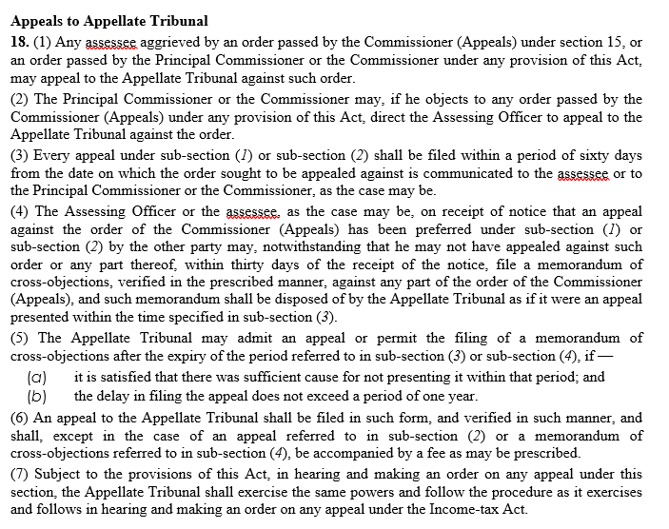
Appeal before the Tribunal under the BM Act,2015 [Sec 18, Rule 7, Form 3 and 4]
Extract of Sec 18
CA RAJENDRA PRASAD TALLURI [RP]
10

Slide 11
Forms of Appeal before the Tribunal under the BM Act,2015 [Sec 18, Rule 7, Form 3 and 4]
CA RAJENDRA PRASAD TALLURI [RP]
11

Slide 12
Part 3: Appeals before the Tribunal under the Prevention Of Money Laundering Act, 2002
CA RAJENDRA PRASAD TALLURI [RP]
12

Slide 13
Appeal before the Tribunal under the PMLA Act,2002 [Sec 26, Rule 3, Form Appended]
Who can file an appeal? Any person (including the Director) aggrieved by the order of the Adjudicating Authority can prefer an appeal before the Tribunal. Any reporting entity aggrieved by the order of the Director made U/s 13(2) can also appeal with the Tribunal.
What is the time limit for filing the Appeal? To file the appeal within 45 days of the receipt of the order.
Whether condonation possible? The Appellate Tribunal may entertain any appeal after the said period of 45 days, if it is satisfied that the if it is satisfied that there was sufficient cause for not filing the appeal within that period.
What is the Fees? Ranges from Rs 1000 to Rs 10,000 depending upon the type of the order appealed against. [Refer Rule 3]
What is the time limit by which the order shall be passed by the Tribunal? The appeal filed before the Appellate Tribunal under section 26(1) or 26(2) shall be dealt with by it as expeditiously as possible and endeavour shall be made by it to dispose of the appeal finally within six months from the date of filing of the appeal.
What is the type of order passed by the Tribunal? the Appellate Tribunal may, after giving the parties to the appeal an opportunity of being heard, pass such orders thereon as it thinks fit, confirming, modifying or setting aside the order appealed against.
CA RAJENDRA PRASAD TALLURI [RP]
13

Slide 14
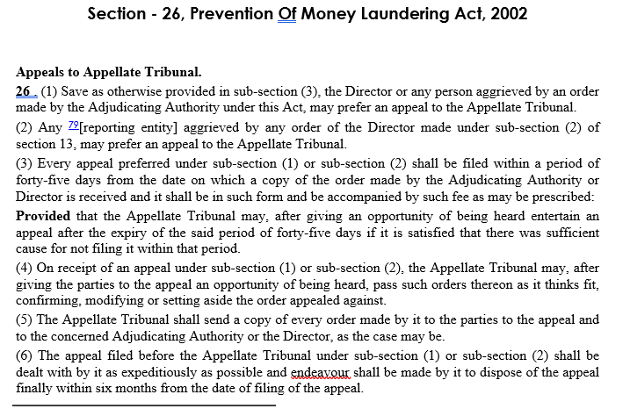
Appeal before the Tribunal under the PMLA Act,2002 [Sec 26, Rule 3, Form Appended]
CA RAJENDRA PRASAD TALLURI [RP]
14

Slide 15
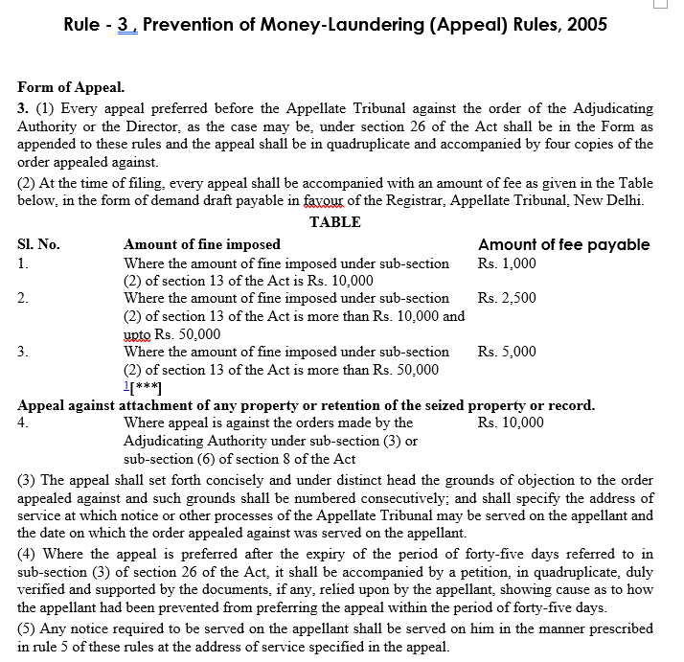
Appeal before the Tribunal under the PMLA Act,2002 [Sec 26, Rule 3, Form Appended]
CA RAJENDRA PRASAD TALLURI [RP]
15

Slide 16
Form of Appeal before the Tribunal under the PMLA Act,2002 [Sec 26, Rule 3, Form Appended]
CA RAJENDRA PRASAD TALLURI [RP]
16

Slide 17
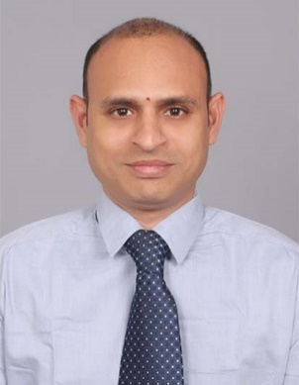
Talluri Rajendra Prasad, fondly known as RP in his professional & personal circles is a member of Institute of Chartered Accountants of India and Institute of Cost & Works Accountants of India. He has 20+ years of post-qualification experience in both direct and indirect tax laws.
He is one of the most distinguished faculties for Direct Tax Laws and Indirect Tax Laws. He contributed several articles on Taxation in leading journals which included magazines of ICAI, Taxmann publications, Student news letters, journals of IFA (International Fiscal Association). He is a visiting faculty at ICAI and ICWAI, Hyderabad, Vijayawada, Bangalore.
He has addressed several seminars at South India Forums on direct and indirect tax laws covering the aspects like GAAR, POEM, TP Provisions, PE, GST Audit, GST Annual Returns, GST impact on Health Care Industry, etc,.
He is a regular trainer for Income Tax officers, Assistant and Deputy Commissioners of IT Department, GST Department and C&AG Department, Practicing Chartered Accountants.
He can be reached at ‘rpdynamic@gmail.com’ or askrpsir@gmail.com and on +91-98495-79413 / 9963 250 500.
Rajendra Prasad Talluri (RP),
B.Com; CA; Grad CWA, DIIT (ICAI), LLB
rpdynamic@gmail.com, +91-98495-79413.

Slide 18

The Views / Comments in the above slides are purely the personal views of CA Rajendra Prasad Talluri
Thank You
Rajendra Prasad Talluri (RP),
B.Com; CA; Grad CWA, DIIT (ICAI), LLB
rpdynamic@gmail.com, +91-98495-79413.

