Slide 1
Rationale and Significance of
Peer Review
Presentation at the Training Program organised by the
Peer Review Board of ICAI and hosted by the
Hyderabad Branch of SIRC of ICAI
on 21 April 2025
CA. Dr. Chinnsamy Ganesan
FCA DISA (ICA)

Slide 2
Agenda
Agenda
Introduction
Rationale of peer review
Significance of peer review
Objectives
Peer review board
Coverage of peer review
Salient features of peer review

Slide 3
Introduction
It is the evaluation of work by one or more people of similar competence.
examination and review of the systems and procedures put to use for ensuring the quality of attestation services

Slide 4
Rationale
The process is an endeavor to enhance the quality of services rendered by Chartered Accountants
It helps in reassuring the stakeholders, the society and ensures highest standards are used for services rendered.

Slide 5
What is peer review?
A peer review means an examination and review of the systems and procedures to determine whether they have been put in place by the practice unit for ensuring the quality of attestation services.
Therefore, it is a review done by a member to ensure that the Technical, Professional and Ethical standards are being followed by the practice unit.
The Council of the Institute of Chartered Accountants of India has issued a Peer Review Guidelines on Peer Review, which lays down the framework for conduct of peer reviews by setting up the Peer Review Board (henceforth referred to as ‘the Board’). The duty of carrying out the provisions of this Guidelines is vested in the Board.

Slide 6
Significance of Peer Review
The introduction of the peer review has brought an overall improvement in the quality and assurance rendered by the members.
Peer review also ensures that a member has in place proper systems to amply demonstrate the quality of assurance services

Slide 7
Objectives of Peer Review
To ensure that the assurance services carried by members comply with the Technical, Professional and Ethical standards issued.
To ensure adherence to various Statutory and Other Regulatory Requirements
To enhance the reliance of users on financial statements for economic decision making.

Slide 8
Peer Review Then vs Now
Procedure of Peer review has gone through number of changes. The same has contributed the Institute to keep the manual upto date and relevant in present working environment.
First Edition | Second Edition | Third Edition | Fourth Revised Edition
March' 2003 | October' 2004 | January' 2014 | June' 2020

Slide 9
Peer Review Then vs Now
Particulars | Peer Review THEN | Peer Review NOW
Mechanism of choosing Peer Reviewer | Manually chosen by the empanelment of members of Board | More robust and considering the professional experience of the Reviewer.
Geographical Considerations | Was one of the primary criteria for selection of reviewers | Owing to digitalization of records and documentations, this is a secondary criterion for selection of Peer reviewers
Samples selection | List of attestation functions would be obtained by the PU | The Board/Institute has access for the entire list of services based on UDIN portal
Level of Automation | Around the computer | Through the computer
Review Procedures | Predominantly procedures are conducted onsite. | Due to virtual working environment, off site procedures to be performed more.
Documentation | Reliance on manual documentations | Reliance on automation of procedures and soft copies.

Slide 10
What is expected from a Peer Reviewer?
Peer Reviewer should not seek to redefine the scope and authority of the Technical, Professional and Ethical Standards specified by the Council but seeks to enforce them within the parameters prescribed.
Reviewer should not sit on judgment of the Practice Unit while rendering assurance services but to evaluate the procedures followed by the Practice Unit in rendering such a service.
Reviewer should ensure to maintain and enhance the quality of assurance services rendered from PU by providing appropriate guidance rather than simply pointing out deficiencies of the Practice Unit.
The job of the peer reviewer is not to identify isolated cases of engagement failure, but to identify weaknesses that are pervasive and chronic in nature

Slide 11
Overall Peer review process
Planning Stage- Selection of reviewer and initial sample selection
Execution Stage- Review of the sample records
Reporting Stage

Slide 12
Peer Review Board
The Peer Review Board has been established in terms of the Statement on Peer Review issued by the ICAI in March 2002.
The board consists of 12 members of which 6 shall be amongst the members of the council.
The Chairman and the Vice-Chairman to the Board are appointed within the elected members of the Council.

Slide 13
Planning Stage
Selection of Practice Unit
PRB selects the PU for review or PU voluntarily applies
Submission of Declaration
PU should submit the Form-1 to the board
Selection of Reviewer
Initial Samples
PRB selects 3 reviewers from the panel and notifies PU
Questionnaire
PU must send the questionnaire to Reviewer
Reviewer to select the initial sample and inform PU

Slide 14
Execution Stage
Initial Meeting
Initial meeting between PU and reviewer
General Controls
Compliance review of the general controls of the PU
Review of records and samples
The extent of review would depend on the general controls of the PU

Slide 15
Reporting Stage
Preliminary Report
Issued to PU in case of any non- compliance/deficiencies
Representations from PU
A reply is received from the PU for the preliminary report issued
Final Report
Final report is issued to PRB, after considering the representations from PU

Slide 16
Who can be a Peer Reviewer?
Eligibility
Ineligibility
He is a member in practice having at least seven years of assurance practice experience
or
A member in employment who has subsequently obtained a Certificate of Practice, having at least ten years of experience in employment and at least three years audit experience in practice and is in whole time practice at the time of enrolment and appointment as Peer Reviewer.
Any disciplinary action / proceeding is pending against him
He has been found guilty of professional or other misconduct by the Council or the Board of Discipline or the Disciplinary Committee at any time
He has been convicted by a competent court whether within or outside India, of an offence involving moral turpitude and punishable with imprisonment

Slide 17
Peer Review Manual
The board in order to guide the members introduced a peer review manual that gives and insight to various aspects of peer review process.
The peer review manual is intended to assist both reviewers and practice units
The peer review manual is intended to provide updated reporting formats for the Reviewer as well as the Practice Unit.
The manual contains Six chapters and twelve Appendices

Slide 18
Peer Review Manual
Introduction
Peer Review Process
It outlines the concept ,scope and objective of Peer review.
The Peer Review process shall apply to all the assurance engagements of a Practice Unit.
A panel of reviewers is maintained by the Peer Review Board.
Intimation of Board on selection of PU
Level to be confirmed by the PU
Fees of Peer review is indicated in the manual

Slide 19
Peer Review Manual
Questionnaire(PU)
Review Procedure
PU to submit Form-1 (Application cum Questionnaire) same as submitted to board, to the reviewer with 1 day after receiving of Form-2 from the Reviewer.
Part A - states the Profile of Practice Unit (PU)
Part B – stated about the general controls(Based on SQC-1)
Review procedures basically comprise of the compliance and substantive procedures based on the information and explanation obtained during Review.
On site and Off-site procedures to be followed
Comparison of audit procedures with the actual workflow
Peer review Procedure and Compliance review procedure are used to obtain sufficient and appropriate audit evidences
Criteria for sample selections are deliberated to assess the sample size based on the risk factor of the assurance functions.
A checklist to illustrate the contents of the audit programme of a reviewee Practice Unit is provided in the manual

Slide 20
Peer Review Manual
Documentation
Reporting
SA 230 – “Audit Documentation” refers to the records or documentation of procedures that auditors performed, the audit evidence that they obtained and the conclusion that is made by them based on the evidence obtained
The nature, form, content and purpose of audit documentation is discussed in the manual
An illustrative checklist for the documentation aspect is present in the manual.
The definition and importance of Audit documentation is discussed here.
In deciding on the type of report to be issued, a reviewer should
consider the evidence obtained and
should document the overall conclusions with reasons.
General grounds for modification of the audit report is discussed in this chapter
Preliminary report with initial findings are issued for comments and representation from PU.
Post that a final report is issued to the PU.
The content of the Peer Review Report is prescribed

Slide 21
Key differences
Financial Reporting Regional Board
Quality Review Board
Peer Review Board
Objective To bring improvements in financial reporting practices and promote investors’ confidence in audited financial statements
Board Members - Central Council of the ICAI, Government of India nominee with representations from the office of the Securities and Exchange Board of India, Comptroller and Auditor General of India, Insurance Regulatory and Development Authority , Central Board of Direct Taxes.
Objective: To ensure that in carrying out the assurance service assignments, the members of the Institute (a) comply with Technical, Professional and Ethical Standards.
Board Members- Minimum of six and a maximum of twelve members to be appointed by the Council, of whom not less than fifty per cent shall be from amongst the members of the Council.
Objective: To make recommendations to the Council with regard to the quality of services, to review the quality of services provided by the members of Institute and to guide the members of the Institute to improve the quality of services and adherence to the regulations
Board Members: The Central Government is empowered to constitute a Quality Review Board consisting of a Chairperson and ten other members.

Slide 22
Key differences
Financial Reporting Regional Board
Quality Review Board
Peer Review Board
Review Process
Preliminary review by an independent Technical Reviewer
FRRG’s will review the report submitted by Technical Reviewer
The report of FRRG’s and technical reviewer is reviewed finally by Financial Reporting Review Board
Review Process
Selection of Practice Unit (PU)
Selection of Peer Reviewer out of the Panel
Questionnaire to be filled by PU within 15 days
Review procedures basically comprise of the compliance and substantive procedures
Comparison of audit procedures with the actual workflow
Review of Documentation
Preliminary report with initial findings are issued for comments and representation from PU
Post that a final report is issued to the PU.
PRB to issue Peer review certificate to PU
Review Process
Selection of Audit Firm and the audit file for review
Technical Reviewer(TR) identification to conduct Quality Review
QRB to send questionnaire to the AFUR
After review, preliminary report to AFUR
Representation to be done by AFUR
The final report along with representation and replies to be sent to QRB
QRB to consider the facts and representation and send the final report to the QRB

Slide 23
Do’s and Don'ts for a Peer Reviewer
Do’s
Don'ts
Peer reviewer should attend the peer review training programs and clear the requisite test for peer review at least once in every 5 years.
The reviewer should study in detail, the peer review manual before commencing the review.
The reviewer must submit the declaration to the board.
Take note of the clause 10 of the statement of peer review i.e. “Eligibility to be a reviewer”
Adhere to the statements and guidelines issued by the board
The peer reviewer is appointed in individual capacity, and all communications to be done in individual capacity
The reviewer must document the working papers to substantiate the review performed and his findings.
Shall not carry any extracts of the records examined by him
Shall be bound by the code of ethics.
Shall be bound by the “Secrecy provision” as mentioned in the statement on peer review.
Cannot, under any circumstances, communicate with or visit the client(s) of the PU.
Cannot challenge the professional judgement exercised by a PU in conducting the audit

Slide 24
Questions?
?

Slide 25
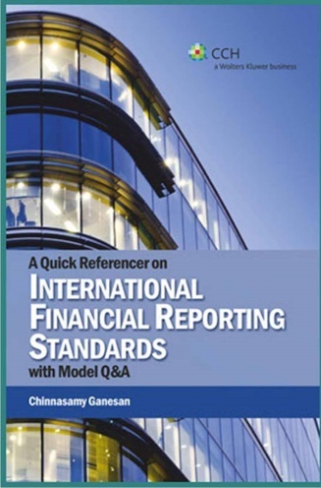
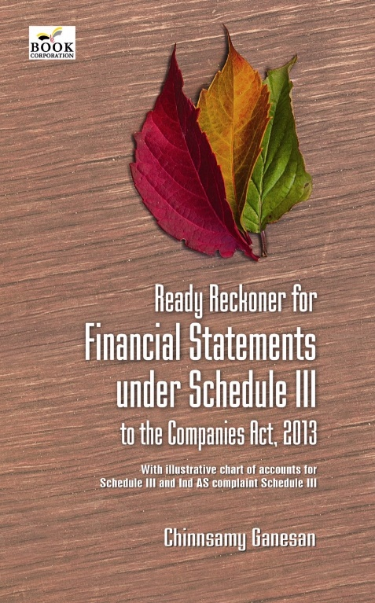
Thank you
ganesanca@yahoo.com/ 0 99401 30403

