Slide 1


Slide 2
Coverage…..
Background and objective
ML & Need of PMLA
FATF
2002 Act journey
Core Legal Framework
- Overview of chapters/Provisions
- Authorities & their roles
- reporting entities & their roles
Actions
By authorities (Arrest, Attachment, adjudication, confiscation etc.,)
Bails, Appeals

Slide 3
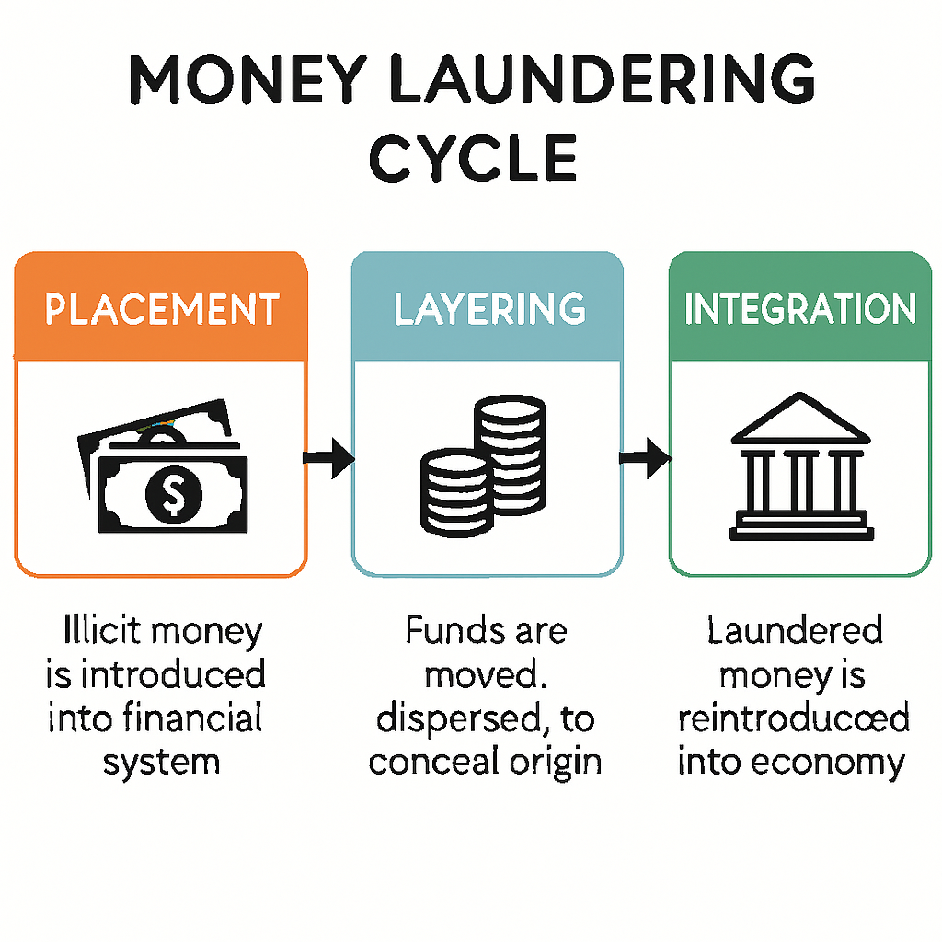
Process by which illegal funds and assets are converted into legitimate funds and assets.
Money Laundering…..

Slide 4
Money Laundering Cycle
1. Predicate Crimes
Corruption and Bribery
Fraud
Organized crime
Drug and human trafficking
Environmental crime
Terrorism
Other serious crimes…
4. INTEGRATION
2. PLACEMENT
The last stage in the laundering process.
Occurs when the laundered proceeds are distributed back to the criminal.
Creates appearance of legitimate wealth.
Initial introduction of criminal proceeds into the stream of commerce
Most vulnerable stage of money laundering process
3. LAYERING
Involves distancing the money from its criminal source:
movements of money into different accounts
movements of money to different countries
Increasingly difficult to detect

Slide 5
Simple Bribe and Money Laundering Transaction
Country 3
Country 1
Company A
Company owned by Minister’s cousin
Needs to generate $1 million for bribe to Minister.
Uses invoices from company in Country 2
Company Bank Account
$500,000 - Purchase of Real Estate
Country 2
Country 1

Slide 6
The Need for Money Laundering Act ​
Part of International/National commitment to fight terrorism, Organized Crime Syndicates, major economic offenders by targeting their financial resources.
PMLA, 2002 fills the gap in the Criminal Justice System where attachment of proceeds of crimes was very difficult in the existing Major Criminal Acts.

Slide 7
The FATF (Financial Action Task force)​
Established by the G-7 Summit in Paris in July 1989 to examine measures to combat money laundering.
An inter-governmental body whose purpose is to establish international standards and promote national and international policies to combat money laundering (ML) and terrorist financing (TF).

Slide 8
The role of the FATF​
40+9 Recommendations (the FATF standards)
Establish international standards to combat money
laundering and terrorist financing.
Mutual evaluation system
Assess compliance with the FATF standards.
Typologies work
Study methods and techniques of money laundering (ML) and terrorist financing (TF).

Slide 9
Objectives of FATF Standards ​
Provide a comprehensive set of measures to enable all countries to implement effective anti-money laundering (AML) / counter-terrorist financing (CFT) systems that will protect the world-wide financial system from misuse by organised crime and terrorist financiers.​
​Foster good governance and longer-term economic development.

Slide 10
​Overview of the standards​​
The 40 Recommendations ​
​Legal systems: criminalisation of money laundering, international cooperation.​
​Comprehensive set of preventative measures to be taken by financial institutions and non-financial businesses and professions (customer due diligence, record keeping).​
​Institutional framework and other measures (reporting of suspicious transactions, compliance, regulation and supervision, sanctions).​
​International cooperation: mutual legal assistance, extradition, information sharing.

Slide 11

The 9 Special Recommendations on Terrorist Financing
Ratify United Nations instruments.
Criminalise terrorist financing.
Freeze and confiscate assets.
Report suspicious transactions.
International cooperation.
Protect against abuse of alternative remittance systems and abuse of non-profit organisations.
Ensure originator information on wire transfers
Detect cash couriers.
Overview of the standards (continued)

Slide 12
Preamble to PMLA 2002​
“An Act to prevent money laundering and to provide for confiscation of property derived from, or involved in money laundering and for matters connected or incidental thereto”

Slide 13
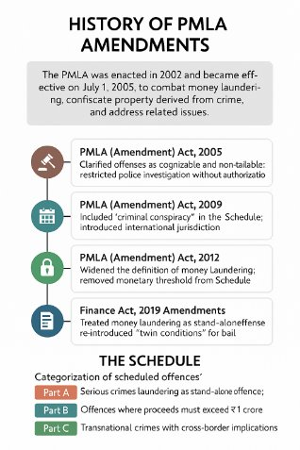

Slide 14
Offence of Money Laundering (Section 3)​
A person shall be guilty if he:​
Directly or indirectly attempts to indulge
Knowingly assists
Is a party to or actually involved
in any process or activity connected with proceeds of crime
including concealment, possession, acquisition, use or projection as untainted property

Slide 15
Predicate Offence ​
A predicate offense is committed for the purpose of committing the greater crime​
Every Scheduled Offence is a Predicate Offence. The Scheduled Offence is called Predicate Offence and the occurrence of the same is a prerequisite for initiating investigation into the offence of money laundering​
Example of Predicate Offence: ​
Bribery, Blackmail and Extortion ​
Fraud ​
Theft ​
Money Laundering ​
Counterfeiting ​
Illegal Betting, or operating a betting ring

Slide 16
Scheduled Offences
Schedule to PMLA has 150+ Offences under 28+ criminal acts
Major acts viz.,
Indian Penal Code (IPC)
Narcotic Drugs And Psychotropic Substances Act (NDPS)
Unlawful Activities (Prevention) Act (UAPA)
Explosive Substances Act

Slide 17
Scheduled Offences under
Arms Act
Wild life Protection Act
Immoral Traffic Act
Prevention of Corruption Act
The Explosive Act
SEBI Act
Customs Act
Bonded Labour System (Abolition) Act
Child Labour (Prohibition and regulation)Act
Trans Plantation of Human Organ Act
The Juvenile Justice Act
The Emigration Act
The Passports Act
The Foreigners Act
The Copyright Act
The Trade Marks Act
The Information Technology Act
The Biological Diversity Act
The Protection of Plant Varieties And
Farmers Right Act
The Environmental Protection Act
The Water (Prevention and Control of
Pollution) Act
The Air (Prevention and Control of
Pollution) Act

Slide 18
PMLA: A multi-agency perspective
ATS
PMLA
Prevention of Corruption Act
Customs Act/NDPS
IPC/UAPA/Arms Act/Explosive Substances Act
NDPS
SEBI Act
Respective Acts
IPC & Other Acts
Customs / DRI
NCB
CBI/ACB
SEBI
Police/CBI
Other
ED

Slide 19
Whether the proceeds of crime involved in money-laundering relate to any offence specified under paragraph 2 of Part A of the Schedule
Yes
Imprisonment (fine also charged up to 5 lakh)
No
Imprisonment (fine also charged up to 5 lakh)
Max (10 Years)
Min (3 Years)
Max (7 Years)
Min (3 Years)
Punishment (Section 4)
In addition, the property shall be confiscated by the Central Government

Slide 20
Authorities under PMLA
1
Enforcement Directorate (ED) – Investigation & prosecution
2
Financial Intelligence Unit – India (FIU-IND) – Receipt and analysis of STRs
3
Adjudicating Authority
4
Special Courts (Designated PMLA courts)

Slide 21
Attachment, Adjudication & Confiscation
1
Provisional Attachment – Section 5
ED may provisionally attach property for 180 days
Adjudication – Section 8
Adjudicating Authority confirms attachment
2
3
Confiscation
Upon conviction, property vests with Central Government

Slide 22
Others acts dealing with attachment, confiscation or forfeiture – Prior to PMLA
1857
The Forfeiture Act, 1857 [Repealed in 1922]
1944
The Criminal Law Amendment Ordinance
1967
The Unlawful Activities (Prevention) Act, 1967 [Chapter V (inserted in 2013)]
1972
The Wild Life (Protection) Act, 1972 [Chapter VIA inserted in 2003]
1973
The Code of Criminal Procedure, 1973 [Chapter XXXIV – Disposal of Property];
1976
The Smugglers and Foreign Exchange Manipulators (Forfeiture of Property) Act
1985
The Narcotic Drugs and Psychotropic Substances Act, 1985 [Chapter VA inserted in 1989];
1988
The Prevention of Corruption Act, 1988 [Section 5(6)];
1999
The Maharashtra Control of Organised Crime Act, 1999 [Section 20] [While this is a State law, it has been adopted by several States, or has served as a model law for other States]; and
2016
The Anti-Hijacking Act, 2016 [Section 19].

Slide 23
Adjudication procedure
Procedural Flowchart (In Legal Words)
4. Appellate Stage (4) Confiscation decision appeal to Appellate Tribunal (45 days) → then HC (60 days) → SC
(1) ED forms belief → issues Provisional Attachment Order under S. 5(1) (→ 180-day validity)
5. Substitution (6) Substitution may be sought during pendency under exceptional judicial discretion
2. Notice Period (1) Notice issued → forwarded to Adjudicating Authority under S. 8
3. Adjudication Process (3) Adjudicating Authority confirms (or rejects) the attachment within statutory time.
If confirmed → remains until reach or dismissal
If not confirmed within 180 days → attachment lifts automatically

Slide 24
Flow of Events
Scheduled offence
Intelligence from FIU/Other sources
Investigation by Police/CBI/NCB/ Forest Deptt.
Investigation by ED
Complaint (Chargesheet) filed in the Jurisdictional Court
Provisional attachment
of Property
Complaint to court
Special court
Adjudicating Authority
Confirmation of Prov. Attachment
Conviction in Scheduled offence
Conviction for ML
Confiscation of Tainted property

Slide 25




Section 45 of PMLA, 2002
Key Provision
Offences to be Cognizable and Non-Bailable
Every offence punishable under the PMLA is:
Cognizable : Police/ED can arrest without a warrant
Non-bailable : Cannot be released on bail as a matter of right
Objective
To ensure that the investigation into money laundering—a serious economic crime—is not compromised by the early release of the accused.

Slide 26



The "Twin Conditions" for Bail
Section 45(1) of PMLA imposes two mandatory conditions for bail:
Opportunity for Public Prosecutor
Court's Satisfaction
The Public Prosecutor must be given an opportunity to oppose the bail application
If the Prosecutor opposes, the Court must be satisfied that:
There are reasonable grounds for believing the accused is not guilty
This ensures the state can present its case against bail
The accused is not likely to commit any offence while on bail
These conditions must be met for bail to be granted under Section 45 of PMLA, 2002.

Slide 27

Legal Evolution & Amendments
Nikesh Tarachand Shah v. Union of India (2017)
Stuck Down
Supreme Court struck down the "twin conditions" as unconstitutional, violating Articles 14 and 21.
2018 Amendment
Parliamentary Response
Parliament amended Section 45 to make "twin conditions" applicable to all offences under the Act.
Vijay Madanlal Choudhary Case (2022)
Validated
Supreme Court upheld the 2018 amendment and "twin conditions" as constitutional.

Slide 28






Exemptions (The Proviso)
The stringent twin conditions do not apply to certain categories of persons. The Special Court may grant bail if the accused is:
Under 16 Years
Women
Minors below the age of 16 years are exempt from the stringent conditions.
Female accused persons are granted exemptions under certain conditions.
Sick or Infirm
Amount Less than ₹1 Crore
Persons with physical or mental disabilities that affect their ability to conduct proceedings.
Added via amendment for money laundering cases involving amounts less than ₹1 crore.
The Special Court may grant bail to accused persons belonging to these categories, even if the general twin conditions would otherwise not be met.

Slide 29






Key Judicial Interpretations & Conclusion
Key Judicial Interpretations
Conclusion
"Bail is the Rule, Jail is the Exception"
Section 45 is one of the most debated provisions of the PMLA due to its high threshold for bail.
Supreme Court in Prem Prakash v. ED (2024) ruled that even under PMLA, bail remains the rule if trial is indefinitely delayed.
It shifts a significant burden onto the accused to show prima facie innocence at the bail stage.
Relationship with Section 19
Arrests under Section 19 must be backed by "reasons to believe" the person is guilty, informing the court's decision under Section 45.
Courts now continue to balance these strict requirements against the fundamental right to personal liberty.
The ongoing judicial evolution shows the dynamic balance between effective anti-money laundering measures and constitutional protections.
anti-money laundering measures and constitutional protections.

Slide 30







Vijay Madanlal Choudhary v. Union of India
2022 - Foundational Judgment
Foundational Judgment
Case Significance
This landmark Supreme Court decision established the constitutional validity of the Prevention of Money Laundering Act (PMLA) and its stringent enforcement mechanisms.
Established ED as an autonomous enforcement agency
Validated stringent bail conditions
Upheld the constitutionality of PMLA's most stringent provisions
Confirmed reverse burden of proof provisions
Established ED's broad investigative and enforcement powers
Created precedent for subsequent money laundering cases
Declared ECIR as an internal
document
Recent Developments in PMLA Jurisprudence

Slide 31




Key Holdings of Vijay Madanlal Case
4 Fundamental Legal Principles
ED Officers' Status
Twin Bail Conditions
ED officers are not "police officers" under the law. Statements recorded by them are admissible in court and do not violate the right against self-incrimination.
Section 45 was upheld, requiring courts to be satisfied that the accused is prima facie not guilty before granting bail.
ECIR Confidentiality
Reverse Burden of Proof
The Enforcement Case Information Report (ECIR) is an internal document, and the ED is not required to provide a copy to the accused.
Section 24 was upheld, placing the burden on the accused to prove that "proceeds of crime" are untainted.
Recent Developments in PMLA Jurisprudence

Slide 32
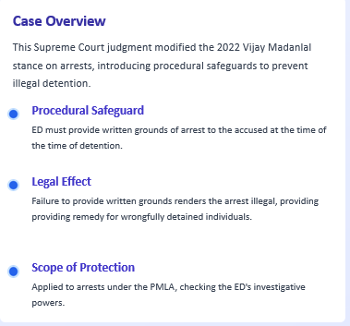


Pankaj Bansal v. Union of India
2023 - Modification of Arrest Procedures

Slide 33
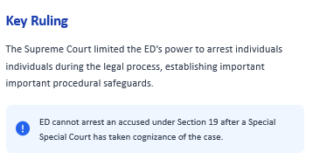




Tarsem Lal v. Directorate of Enforcement
2024 - Limitation on ED's Arrest Powers

Slide 34
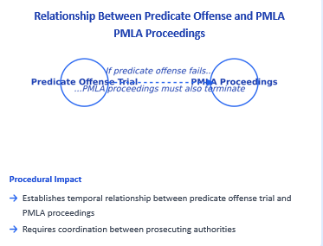
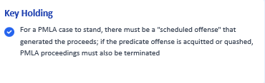
Pavana Dibbur v. Directorate of Enforcement
2023 - Predicate Offense Necessity
Case Overview
Supreme Court clarified the relationship between money laundering and "scheduled offenses" under PMLA.
Recent Developments in PMLA Jurisprudence

Slide 35






Prem Prakash v. Union of India
2024 - Restrictions on Custodial Confessions
Case Overview
The Supreme Court ruled on the admissibility of confessions and statements made by accused persons while in judicial custody, creating important limitations on evidence admissibility in money laundering cases.
Custodial Confessions
Impact on Previous Rulings
Statements made by accused in judicial custody are considered under "duress"
Narrows the broad evidentiary powers granted to ED in 2022
Such statements are generally inadmissible in evidence
Creates higher standards for confession admissibility
Key Implications
This ruling significantly impacts how confessions are treated in PMLA cases, requiring stricter adherence to custodial regulations and providing greater protection against self-incrimination, even in money laundering prosecutions.
Recent Developments in PMLA Jurisprudence

Slide 36
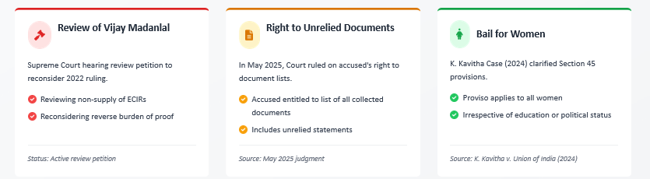
Recent Developments in 2025
Supreme Court's evolving approach to PMLA jurisprudence

Slide 37








Future Implications and Trends
Key Jurisprudential Trends
Future Implications
Judicial Restraint
PMLA jurisprudence moving toward balanced approach, ensuring effective enforcement while protecting rights
Courts scrutinizing ED's enforcement actions in Vijay Madanlal reviews
Procedural Safeguards
Greater judicial oversight of ED's actions, particularly in arrests and evidence collection
Growing emphasis on written grounds and fair defense rights in money laundering cases
Burden of Proof
Enhanced procedural guarantees for accused persons in money laundering cases
Trend toward reasonable adjustments to reverse burden provisions
Conclusion
Evolving PMLA jurisprudence strikes balance between anti-money laundering measures and constitutional protections. Legal practice must adapt to these changing standards.
-Remaining vigilant to emerging trends

Slide 38
Appeal from Adjudicating Authority → Appellate Tribunal
Appeal from Appellate Tribunal → High Court
Any person aggrieved by an order of the Appellate Tribunal may file an appeal to the High Court within 60 days from communication of the Tribunal’s order.
The Director or any person aggrieved by an order of the Adjudicating Authority can prefer an appeal to the Appellate Tribunal.
Appeals must ordinarily be filed within 45 days of the order, but the Tribunal may condone delay.
The Tribunal can confirm, modify, or set aside the order
Appeals under PMLA
From the High Court, further appeal lies to the Supreme Court of India (e.g., by Special Leave Petition), though this isn’t a statutory appeal under PMLA itself (it’s a constitutional route).
This is consistent with how judicial appeals work in the Indian legal system
Final appeal (if needed)

Slide 39
Legal Obligation under PMLA towards FIU
PMLA impose obligations on following reporting entities:
banking companies
financial institutions
intermediaries of the securities market
Persons carrying on designated business or profession
to
maintain records
furnish information
verify identity of clients

Slide 40
“Banking Company” under PMLA includes:
All nationalized banks, private Indian banks and private foreign banks
All co-operative banks viz. primary co-operative banks, state co-operative banks and central (district level) co-operative banks
State Bank of India and its associates and subsidiaries
Regional Rural Banks

Slide 41
“Financial Institution” under PMLA includes:
Financial Institutions as defined in Section 45-I of the RBI Act namely EXIM Bank, NABARD, NHB, SIDBI, IFCI Ltd., IDFC Ltd., IIBI Ltd. and TFCI Ltd.
Insurance companies
Hire Purchase companies
Chit fund companies as defined in the Chit Funds Act.

Slide 42
“Intermediary” under PMLA includes persons registered under Section 12 of the SEBI Act, 1992
Stock brokers
Sub-brokers
Share transfer agents
Bankers to an issue
Trustees to trust deed
Registrars to issue
Merchant bankers
Underwriters
Portfolio Managers
Investment advisers
Depositories
Custodian of securities
Foreign institutional investors
Credit rating agencies
Venture capital funds
Collective investment schemes including mutual funds

Slide 43
Persons carrying on designated business or profession under PMLA includes
(i) a person carrying on activities for playing games of chance for cash or kind, and includes such activities associated with casino;
(ii) a Registrar or Sub-Registrar appointed under section 6 of the Registration Act, 1908 (16 of 1908) as may be notified by the Central Government;
(iii) real estate agent, as may be notified by the Central Government;
(iv) dealer in precious metals, precious stones and other high value goods, as may be notified by the Central Government;
(v) person engaged in safekeeping and administration of cash and liquid securities on behalf of other persons, as may be notified by the Central Government; or
(vi) person carrying on such other activities as the Central Government may, by notification, so designate, from time-to-time;

Slide 44
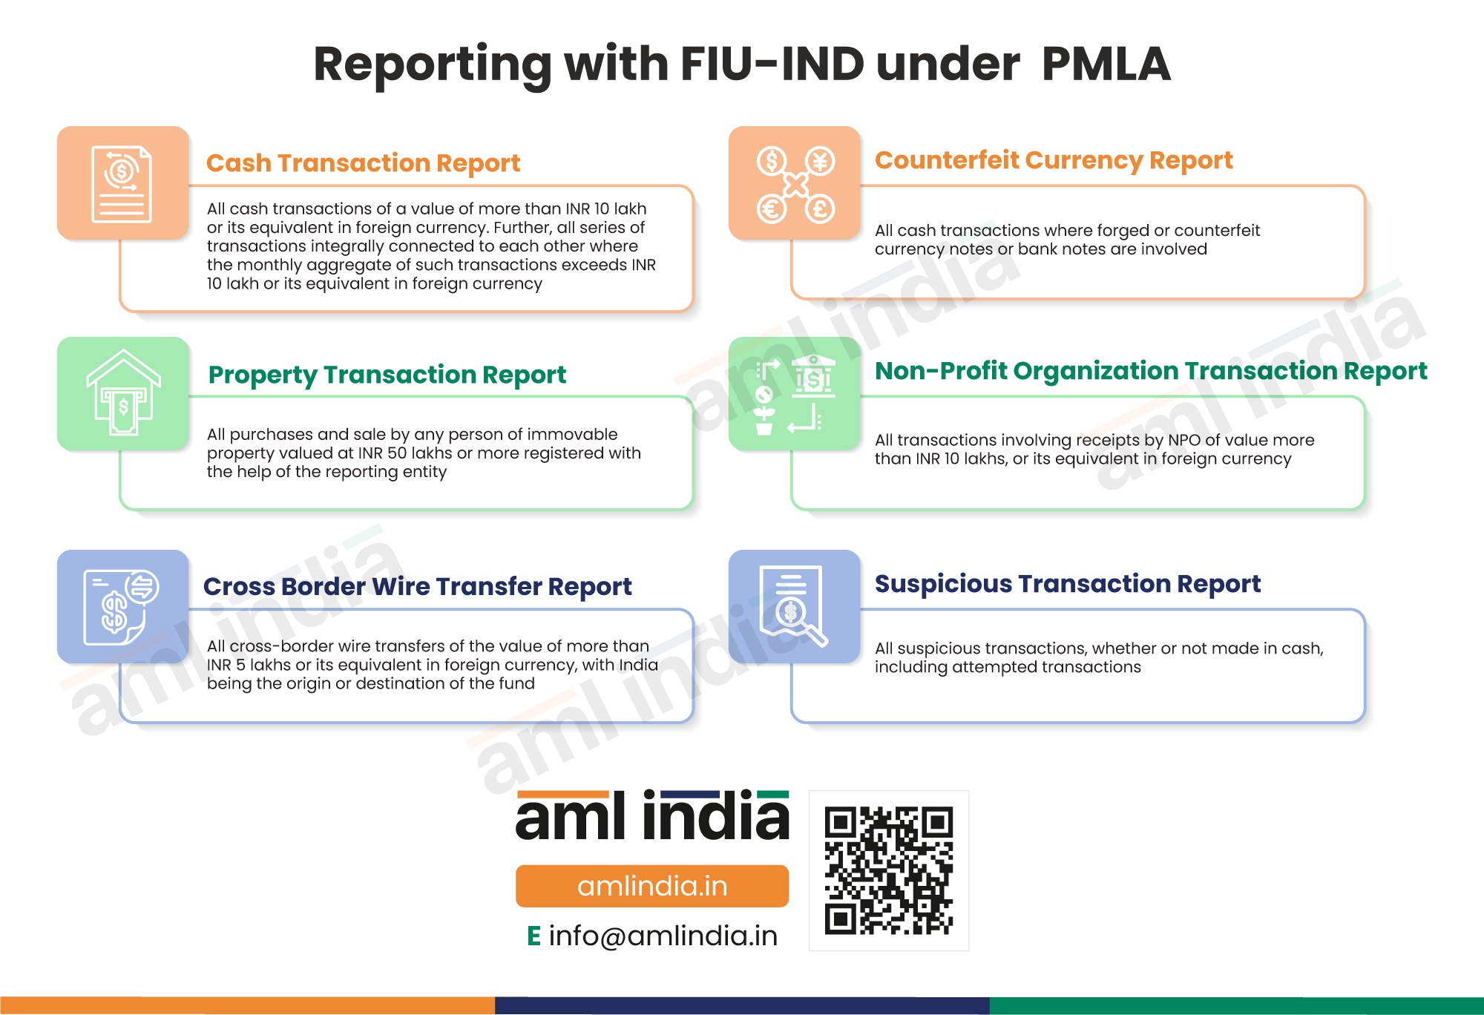
Specified transactions – reporting to FIU:

Slide 45
Special Features
Stringent provisions for attachment and confiscation of proceeds of crime
Provisions for Overseas investigations and attachment of properties abroad
Special Courts for prosecution
Provision for disclosure by Reporting entities
Burden of proof on accused to prove that proceeds of crime are untainted
Statements recorded by ED Officers admissible as evidence

Slide 46
Current Challenges & Criticism
Alleged misuse of powers
Low conviction rate
Debate on civil liberties

Slide 47
Conclusion
PMLA is a stringent economic law
Judiciary largely upholding framework
High compliance & advisory responsibility

Slide 48


THANK YOU!
venkataprasad@hnaindia.com

