Slide 1
Annual Return GSTR 9
Rule 44 read with Rule 80

Slide 2
Legal Background

Slide 3
Annual Returns
Annual Returns : Section 44(1) requires every registered person,
other than an Input Service Distributor, TDS /TCS / CTP / NRTP
shall furnish an annual return for every financial year electronically
in such form and manner as may be prescribed
on or before the thirty-first day of December following the end of such financial year.

Slide 4
Annual Return – GSTR-9ABC
X
Annual Returns Not Applicable
Annual Return
Annual Statement
Registered Person: Rule 80(1)
Composition Dealer : Rule 80(1)
Audit TO > 5 crores : : Rule 80(3)
ISD /TDS
TCS : Rule 80(2)
GSTR 9
GSTR 9A
+ GSTR 9C
CTP /NRTP
GSTR 9B
For FY 2022-23 current due date 31st Dec 2023

Slide 5
Annual Return Extension
73(10) The proper officer shall issue the order under sub-section (9) within three years from the due date for furnishing of annual return for the financial year to which the tax not paid or short paid or input tax credit wrongly availed or utilised relates to or within three years from the date of erroneous refund.
74 (10) The proper officer shall issue the order under sub-section (9) within a period of five years from the due date for furnishing of annual return for the financial year to which the tax not paid or short paid or input tax credit wrongly availed or utilised relates to or within five years from the date of erroneous refund.

Slide 6
Threshold limit
Aggregate Turnover | GSTR 9 | GSTR 9C
(Rs. In crores)
Upto 2 crores | Optional Compulsory Compulsory | Not Required (Sec 35(5) Rule 80(3))
 |  | Not Required (Proviso to Rule 80(3))
> 2 crores till 5crores
> 5crores |  | Compulsory (Rule 80(3))

Slide 7
Aggregate Turnover
“aggregate turnover” means the aggregate value of all
taxable supplies (excluding the value of inward supplies on which tax is payable by a person on reverse charge basis),
exempt supplies,
exports of goods or services or both and
inter-State supplies of persons having the same Permanent Account Number,
to be computed on all India basis but
excludes central tax, State tax, Union territory tax, integrated tax and cess;

Slide 8
Important Notifications
th rd
Press release dated 4 June 2019 & 3
Annual returns
July 2019 Clarifications on
th
56/2019 Central Tax Notification 14 November 2019 Simplification of
reporting
129/48/2019 Circular 24th December 2019 SOPs for Non-filers of Annual returns etc.

Slide 9
Preamble for GSTR 9
The Annual return is an informative return in which one has to furnish information for Reporting and cannot be used for :-
Payment of Taxes
Claiming of Refunds
Availment of ITC
Reversal of ITC
What to Report
Taxes Paid & Relevant Turnover
Input tax credit Availed & Reversed
Do Not Report
ITC NOT Availed & Reversed
Very Important Points
NIL returns also to be filed. Cases TO > 5cr
You cannot correct or file a Revised Returns
Post GSTR 9 Filing no change in Credit or Liability Ledger
GSTR 1 & 3B to be filed before
GSTR 9 Filing
Additional Liability to be discharged in cash if you are using DRC03

Slide 10
NIL GSTR 9
NIL GSTR 9 can be filed, if you have
Not made any outward supply (commonly known as sale); AND
Not received any inward supplies (commonly known as purchase) of goods/services; AND
No liability of any kind; AND
Not claimed any Credit during the Financial Year; AND
Not received any order creating demand; AND
Not claimed any refund during the Financial Year

Slide 11
Consequences of Non -Filing
Notice u/s 46 of CGST Act could be issued to file the return within 15 days
Late fee u/S 47(2) of CGST Act (Lower of)
Rs.100 per day during which such failure continues
0.25% of turnover in state or UT Sec 2(112)
(Similar SGST late fee)
SOPs have been provided vide Circular 129/48/2019 – GST dated 24th December 2019 to deal with Non-filers including and with those not-filing Annual returns

Slide 12
Circular 129 -Summary
A system generated message to all RPs 3 days before the due date as a reminder
A system generated mail/message would be sent after the due date to those who
haven’t filed to
Authorized signatory Proprietor/Partner/Director/Karta
After 5 days of due date – Electronic Notice to return defaulters – Form GSTR-3A to furnish within 15 days
If not filed within 15 days – Best Judgement Assessment in Form GST ASMT 13 along with summary thereof to be uploaded in GST DRC-07

Slide 13
Annual Return – GSTR 9 :: 6 Parts 19 Tables
Parts
Part I
Part II
Part III
Part IV
Part V
Part VI
Circular
26/2017
Adjustments
Basic Info
Liability
Input Tax
Credit
Tax paid
details
Other info
Table 1-3
Table 4-5
Table 6-8
Table 9
Table 10-14
Table 15-19

Slide 14
Source of Information – Liability & ITC
Turnover & Liability
Aggregate value of supplies made to ……. on which tax has been paid shall be declared here.
These will include details of supplies made through E-Commerce operators and are to be
declared as net of credit notes or debit notes issued in this regard.
Table x,y,z along respective amendments in Table 9 and Table 10 of FORM GSTR-1 may be used for filling up these details.
Input Tax Credit
Aggregate value of input tax credit availed on all inward supplies ………..hall be declared here.
It may be noted that the total ITC Availed is to be classified as ITC on inputs, capital goods
and input services.
Table 4(A)(…) of FORM GSTR-3B may be used for filling up these details.
This shall not include ITC which was availed, reversed and then reclaimed in the ITC ledger.
This is to be declared separately under 6(H) below.

Slide 15
Turnover Reporting

Slide 16
Tables for Turnover
Part II
Table 4: Details of advances and outward supplies on which tax is payable as declared in returns filed during the financial year
It may be noted that all the supplies for which payment has been made through
FORM GSTR-3B between April 2018 to March 2019 shall be declared in this part.
Table 5: Details of Outward supplies on which tax is not payable as declared in returns filed during the financial year
Part V
Table 10: Supplies / tax declared through Amendments (+) (net of debit notes)
Table 11: Supplies / tax reduced through Amendments (-) (net of credit notes)
For FY 2023-24 , Particulars of the transactions for the FY 2023-24 declared in returns
between April 2019 till September 2019

Slide 17
Source of the data for Reporting Turnover
Source of the data
Turnover on which taxes have been paid
GSTR 1
GSTR 3B
Books
GSTR 3B
DRC 03

Slide 18
Turnover Reporting- Based on Nature
GSTR 1
Books
GSTR 3b
GSTIN
Wise
GSTIN n
Taxable
Exempt
Table 4
Table 10¹
Table 11
Table 5²
Table 10
Table 11
Provided taxes are paid during the specified period
Consider Actual amount as per Books irrespective of whatever is considered in GSTR 1 and GSTR 3B. As there
is no tax implication, Table 10 and 11 is not applicable

Slide 19
Various Situations and how to handle in Annual Return
FY -21 -22
FY -22 -23
SL.no | Books of Ac | 3B | GSTR 1 | 3B | GSTR1 | Remarks
1 | 10,000 | 10,000 | 10,000 | 0 | 0 | 10,000 in T-4
2 | 10,000 | 8,000 | 8,000 | 2,000 | 2,000 | 8,000 in T- 4 2,000 in T- 10
3 | 10,000 | 8,000 | 8,000 | - | - | 10,000 in T- 4, 0 in T-10 2,000 in DRC – 03
4 | 10,000 | 8,000 | 8,000 | 1,500 | 1,500 | 8,500 in T-4 1,500 in T-10 & T-14 500 pay through DRC -03
5 | 10,000 | 10,000 | 8,000 | - | 2,000 | 10,000 in T-4
6 | 10,000 | 8,000 | 10,000 | 2,000 | - | 8,000 in T-4 2,000 in T-10

Slide 20
Reporting
Taxes paid | Table
Paid correctly in 2022-23 | 4
Short paid in 2022-23, paid via DRC 03 | 4
Partly paid in 2022-23, partly in 2023-24 | 4&10
Not Paid | NA

Slide 21
Turnover Reporting- Based on payment of Tax
GST Turnover Reported in
DRC 03:[Instruction No.9]
1. Additional Tax liability not discharged through GSTR 3B can be paid through DRC-03.
Tax paid in 3B
till Mar 2023
Tax paid in 3B
till Nov 2023*
Balance Tax
Payable
2. Taxpayers shall select "Annual return" in Drop down for DRC-03.
Part II Table 4
Table 4 &
DRC 03
3. Payment to be made only through electronic cash ledger.
Part V : Table
10
*Provided taxes are paid during that period

Slide 22
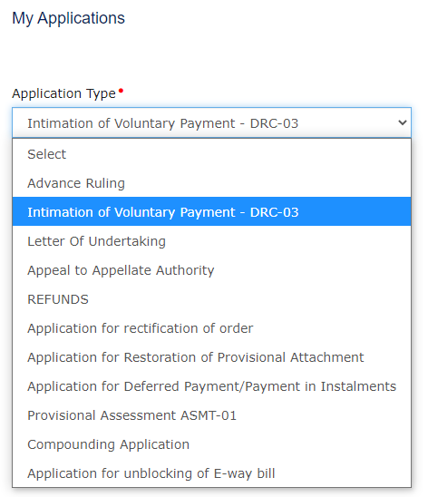
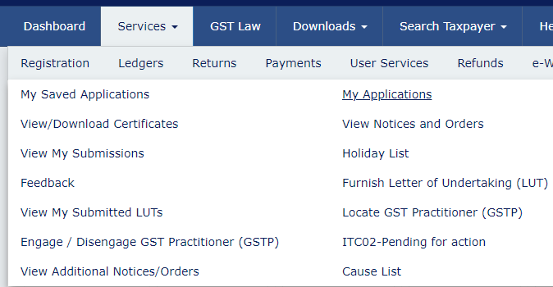
Services >> My Application>> DRC 03

Slide 23
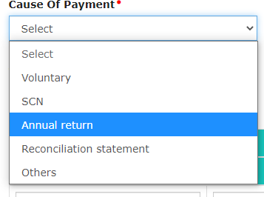
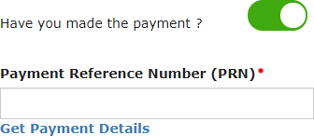
Cause of Payment >> Annual Return
>>
>>
*If you do not recollect the PRN, you can get the same from Electronic Liability Register Part-II under Services > Ledgers
venu@vnv.ca

Slide 24
Payment through DRC 03 – Annual Returns
Additional
Liability
Short Payment
of Taxes
Excess ITC
claimed
In eligible ITC
claimed
Pay through
Cash
Pay through
Cash
Pay through
Cash

Slide 25
Tab | le 4 Details of advances, inward and outward tax is payable
4A | Supplies made to un-registered persons (B2C)
4B | Supplies made to registered persons (B2B)
4C | Zero rated supply (Export) on payment of tax (except supplies to SEZs)
4D | Supply to SEZs on payment of tax
4E | Deemed Exports
4F | Advances on which tax has been paid but invoice has not been issued (not covered under (A) to (E) above)
4G | Inward supplies on which tax is to be paid on reverse charge basis
4H | Sub-total (A to G above)
4I | Credit Notes issued in respect of transactions specified in (B) to (E) above (-)
4J | Debit Notes issued in respect of transactions specified in (B) to (E) above (+)
4K | Supplies / tax declared through Amendments (+)
4L | Supplies / tax reduced through Amendments (-)
4M | Sub-total (I to L above)
4N | Supplies and advances on which tax is to be paid (H + M) above
venu@vnv.ca

Slide 26
 | Table 5: Details of Outward supplies on which tax is not payable
5A | Zero rated supply (Export) without payment of tax
5B | Supply to SEZs without payment of tax
5C | Supplies on which tax is to be paid by recipient on reverse charge basis
5D | Exempted
5E | Nil Rated
5F | Non-GST supply (includes ‘no supply’)
5G | Sub-total (A to F above)
5H | Credit Notes issued in respect of transactions specified in A to F above (-)
5I | Debit Notes issued in respect of transactions specified in A to F above (+)
5J | Supplies declared through Amendments (+)
5K | Supplies reduced through Amendments (-)
5L | Sub-Total (H to K above)
5M | Turnover on which tax is not to be paid (G + L above)
5N | Total Turnover (including advances) (4N + 5M - 4G above)

Slide 27
Data Flow of Input Tax Credit

Slide 28
Premise for Reporting of ITC
ITC | Reporting Table
Purchases of 22-23 Booked in 22-23 and credit availed in 22-23 Booked in 22-23 and credit availed in 23-24 Booked in 23-24 and credit availed in 23-24 | Report in GSTR 9 of 22-23 Report in GSTR 9 of 22-23 Report in GSTR 9 of 23-24
Note: ITC is linked with when it is availed in 3B and not when it is availed in Books of Accounts

Slide 29
Credit flow
Credits to Electronic Credit Ledger(ECrL)
Reported
thru GSTR
Table 6B to 6H >>
Direct Entry
to ECrL
<< Table 6K- 6M
3B
4A-4B=4C
Trans I
Trans II
ITC 01
ITC 02

Slide 30
Total Reporting of INPUT TAX CREDIT
ITC 2023-24
Availed
Reversed
In 22-23
In 23-24
In 22-23
In 23-24
Table 6
Table 13
Table 7
Table 12

Slide 31
Credit Flow of GSTR 3B into GSTR 9
GSTR 9 GSTR 3B
Forward Charge
Credit
6B + 6H
4A5
6C + 6D
4A3
Reverse Charge Credit
Matching
Credits
Import of
Goods
6E
4A1
Import of
Services
6F
4A2
6G
4A4
ISD Credit

Slide 32
ITC Reconciliation with Books & GSTR 9
Net ITC available
Table 7J
ITC availed for the Previous FY Table 13
Reversal of ITC availed during previous FY Table 12
ITC as per
Books

Slide 33
Reconciliation of RCM liability with RCM ITC
RCM
Liability
ITC
Table 4G of GSTR 9
Import of Service
URP / URD
RD
Table 6C of GSTR 9
Table 6D of GSTR9
Table 6F of GSTR9

Slide 34
Control Check for RCM from Registered Person
Table 4 of GSTR 2A
Table 4G of
GSTR 9
(RCM Liability)
Table 4 of GSTR 2A
Table 6D of GSTR 9 (RCM ITC)

Slide 35
Table 8D : Un reported GSTR 2A Line Items
GSTR 2A Credits
8A = 200
Reported in
3B /ECL = 120
Not Reported
3B /ECL = 80
Missed out Taking credit in 3B
Eligible &
Availed
Ineligible but
availed
Availed in
2023-24
Ineligible &
Not availed
60
20
40
35
45
8B
8B
8C
8E
8F

Slide 36
Check between Table 8C and Table 13
Table 8C of GSTR 9
Table 13 of GSTR 9 (ITC claimed in Apr-18 to Sep-18)
Table 8C of GSTR 9 Excludes ITC on imports and ITC on inward supplies liable to
reverse charge
Table 13 of GSTR 9 includes all ITC which is availed during subsequent FY
including ITC on imports and ITC on inward supplies liable to reverse charge

Slide 37
Summary Points for Discussion
Practical Issues
Possible Resolutions
INPUT TAX CREDIT AVAILED
Excess availed in 3B / Trans Returns
DO NOT Correct in GSTR 9
Ineligible Credit Availed
Still Report as ITC Availed
Excess availed Reversed in 2022-23 itself
Show net availment in Table 6 ( Offset only erroneous excess availment and not other reversal)
Credit Short Availed in GSTR 3B of 2022-23 and balance
availed in 2023-24
Actual Availed in 2022-23 Table 6B to 6H
Actual Availed in 2023-24 Table 8C and 13
Credit Short Availed in GSTR 3B of 2022-23 and balance
NOT availed in 2023-24
Actual Availed in 2022-23 Table 6B to 6H
Unaviled credit to reported 8E
INPUT TAX CREDIT REVERSED
Ineligible credit not Reversed
DO NOT Correct in GSTR 9
Reversed in 2023-24
Report in Table 12 not in Table 7
Not reversed in 2023-24 also
DO not Report

Slide 38
GSTR 2A

Slide 39
Deriving Table 8A
ITC in GSTR 2A | Amount
Table 3+5 of GSTR 2A (Cr Note is -ve) | Xxx
Less: Original invoices that are amended | XXX
Less: POS<> LOR | XXX
Less: Supplier Filing status N and time limit | XXX
Less: ISD Credits | XXX
Total - (A) | XXX
Actual Table 8A of GSTR9- Portal | Xxx
Diff | Ideally to be zero

Slide 40
8B, 8E, 8F
Table 8B | ITC in GSTR 3B (Table 6B + 6H)
Table 8E | Missed Credits
Table 8F | Ineligible ITC

Slide 41
Credits
Eligible
Availed in GSTR 3B – same year
Availed in GSTR 3B – Next year
Not availed – Forgot / Lapse
Table 6 & Table 8B
Table 6 & Table 8C + Table 13 Table 8E
In Eligible
Availed in GSTR 3B & Reversed Same year
Availed in GSTR 3B & Reversed Next year
Not availed – Reported in 4D
Table 7 & Table 8B
Table 7 & Table 8B + Table 12
Table 8F
Meaning of 8D
If 8D is positive it means some credits in 2A are not taken in 3B
If 8D is negative it means credits availed in 3B are more than of 2A

Slide 42
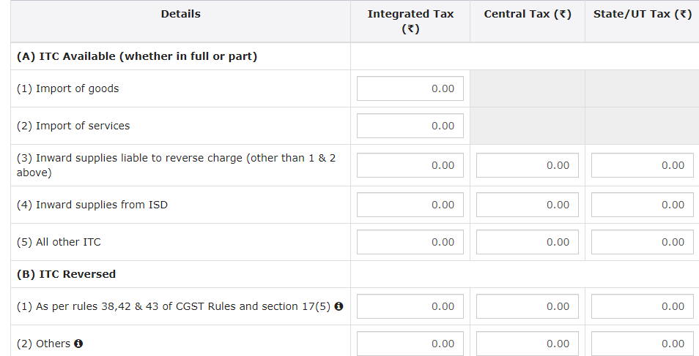
Issues
ITC disclosure in GSTR 9: Considering the changes in reporting of ITC under GSTR-3B, wherein ITC is claimed in Table 4.A.5 and then reversed under Table 4.B.1 or 4.B.2 could lead to inaccurate disclosure in table 6B of GSTR 9. This would lead to incorrect reconciliations in table 8 when compared with GSTR 2A.

Slide 43
Liability Matching

Slide 44
Liability & Tax Payments Data flow
Liability 1 Liability 2 Taxes Paid
Table 4
Table 9(2) Table 9(3-7)
Add: Table 10
Add: Table 14(2)
Add: Table 14(3)
Less: Table 11
Liability 1
Liability 2
Liability 3
Difference represents
DRC-03 / Refund /PY adj

Slide 45
Other Areas

Slide 46
Source of Information – Refund & Demand
Refund
Aggregate value of refunds claimed, sanctioned, rejected and pending for Processing shall be declared here.
Refund claimed means refund claims filed in the financial year.
Refund sanctioned means the aggregate value of all refund sanction orders.
Refund pending will be the aggregate amount in all refund application for which acknowledgement has been received and will exclude provisional refunds received.
These will not include details of non-GST refund claims.
Demand
Aggregate value of demands of taxes for which an order confirming the demand has been issued by the adjudicating authority shall be declared here.
Aggregate value of taxes paid out of the total value of confirmed demand as declared in 15E above shall be declared here.
Aggregate value of demands pending recovery out of 15E above shall be declared here

Slide 47
Table 15 : Refunds : Source of Information
Refunds
Claimed
Sanctioned
Rejected
Pending
Table 15A
Table 15B
Table 15C
Table 15D

Slide 48
Table 15 : Demands: Source of Information
Total demand of taxes Table
15E
Total taxes paid in respect of
E above
Total demands pending out
of E above
Table 15G
Table 15H

Slide 49
Changes
Table | Particulars
4 | Amendments, credit notes and debit notes cannot be shown as net figures in B2B, B2C, etc. now. Table 4I to 4L to be disclosed separately from FY 21-22
5 | Table 5 - Exempted & Nil-rated can be consolidated in ‘Exempted’ column or shown separately. Table 5F - Non-GST to be shown separately from FY 21-22 onwards
5 | Amendments, credit notes and debit notes can be shown as net figures in table 5.
6 | ITC bifurcation into ‘inputs’/’input services’ not mandatory, total value can be consolidated under ‘Inputs’. From FY 2019-20 - under ‘Inputs’ & ‘Capital Goods’

Slide 50
Changes
Table | Particulars | Relaxation
15A to 15D | Details of refund | Optional
15E to 15G | Details of demand | Optional
16A | Supplies received from composition taxpayer | Optional
16B | Deemed supplies from principal to job worker | Optional
16C | Deemed supplies for goods which were sent on approval basis | Optional
17 | HSN wise details of outward supplies | Mandatory
18 | HSN wise details of Inward supplies | Optional

Slide 51
Validation with HSN Wise Reporting
Table 17 HSN
Table 4
Table 5
Table 10
Table 11
Advances
X
RCM
X
Non GST
X
<<<< Items to be Excluded for HSN

Slide 52
Values to check before filing
4 N : Supplies and advances on which tax is to be paid (H + M) above
5 N : Total Turnover (including advances) (4N + 5M - 4G above)
6 O : Total ITC availed (I + N above)
7 J : Net ITC Available for Utilization (6O - 7I)
8 D : Difference [A-(B+C)] 2A vs 3B
10 & 11 : Supplies / tax declared through Amendments
12 : Reversal of ITC availed during previous financial year
13 : ITC availed for the previous financial year
14 : Differential tax paid on account of declaration in 10 & 11 above

Slide 53
Thank You
E: sriram@tavasya.in

