Slide 1


Hyderabad Branch of SIRC of ICAI
Refunds under GST
CA. Phani Kiran MVS
23.07.2025

Slide 2


Contents
Brief overview of refunds
Types of Refunds
Relevant date
Refund application – Documents to be submitted
Refund application – Key points
Procedure for filing and processing
Procedure for bank account validation
Procedure for disbursement
Refund claim – Track application
Rule 89(4) – Refund of accumulated ITC on export of goods and services – without payment of IGST
Refund under Inverted Duty Structure (IDS)
Refund to unregistered persons, Merchant exporters and Refund under deemed exports
Notification 54/ 2018 – central tax
Case laws on GST refunds
GST refunds - Circulars
GSTN Advisory on refunds

Slide 3
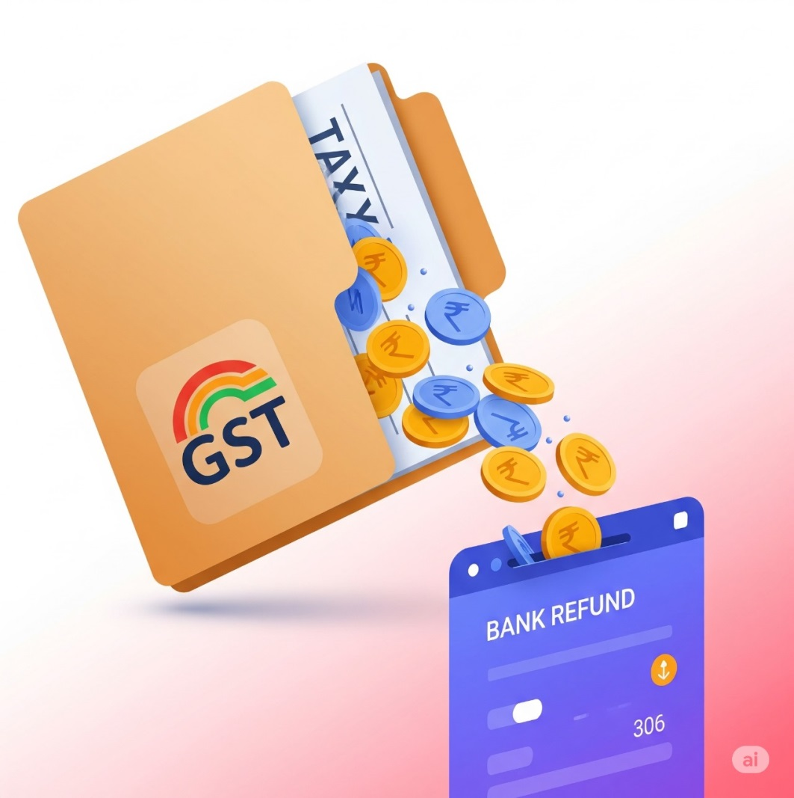
Refunds under GST
(Brief Overview)
What is Refund under GST?
The term “Refunds” under GST is defined in explanation to section 54 of CGST Act 2017 as per the said definition refund includes refund of tax and interest paid on:
Zero-rated supply of goods and services or both
Deemed Exports
Supplies covered Under the Inverted Duty structure
Legal provisions applicable for Refunds:
Central Goods and Services Tax Act, 2017 – Section 54 to Section 58
Central Goods and Services Tax Rules, 2017 – Rule 89 to Rule 97A
Section 16 of the Integrated Goods and Services Tax Act, 2017
Section 77 of Central Goods and Services Tax Rules, 2017

Slide 4
Refunds under GST
(Types of refund)
Refund Types | Section Ref | Note
Refund on account of ITC accumulated against exports/ SEZ supplies without payment of tax | Section 54 of CGST Act read with Rule 89 of CGST Rules | Refund of input tax credit availed in respect of inputs or input services to the extent used in making such export of goods Net ITC = ITC on Goods & Services available during the period – Net ITC
Export of goods/ services with payment of tax | Section 16 of IGST Act read with Rule 96 of CGST Rules | The Refund amount is restricted to the amount of tax paid by the taxpayer at the time of export. Net ITC = ITC on Goods & Services available during the period (including ITC on Capital Goods)
Refund on account of ITC accumulated due to Inverted Tax Structure (IDS) | Section 54(3)(ii) of CGST Act | If the rate of GST on inputs is higher than the rate of GST on output, refund of accumulated ITC can be claimed as per the procedure notified. Option to claim refund under this section is restricted to goods, which is subsequently amended and services is also included.
Refund to supplier / recipient of tax paid on deemed export supplies | Section 147 of CGST Act and Rule 89 CGST Rules | Supply of goods by registered person to an Export Oriented Unit (Shall include EOU, STPI, EHTP, BTP units) Supply of goods to an Advance Authorization holder Supply of goods to an Export Promotion of Capital Goods (EPCG) holder
Refund of Excess Balance in Electronic Cash Ledger | Section 54(1) of CGST Act | Cash deposited erroneously can be claimed as refund under this option. In the latest Finance Act, the Govt has provided an option to transfer amount (vide Form PMT-09) from one ledger to the other TDS and TCS credited into the Electronic Cash Ledger can be claimed as refund

Slide 5
Refunds under GST
(Types of refund)
Refund Types | Section Ref | Note
Refund of taxes erroneously paid | Section 54(1) of CGST Act read with Rule 89(2)(k) of CGST Rules | Taxes erroneously paid can be claimed as refund. Important point here is that the due date of claiming such refund is within 2 years from the date of payment.
Refund on account of Assessment/ Provisional Assessment/ Appeal/ any other Order | Section 54(11), 54(12) , 60(5) of CGST Act | If any refund is sanctioned during litigation, the refund can be claimed by under this category by attaching the sanctioned order copy.
Tax paid on an Intra-State supply which is subsequently held to be Inter-State supply and vice versa (change of POS) | Section 77(2) of CGST Act read with Rule 89 CGST Rules | A registered person who has paid the Central tax and State tax or, as the case may be, the central tax and the Union territory tax on a transaction considered by him to be an intra-State supply, but which is subsequently held to be an inter-State supply, shall be refunded the amount of taxes so paid
Inward Supplies of Goods by Canteen Store Department (CSD) | Rule 95B of CGST Rules | Canteen Stores Department under the Ministry of Defence is eligible to claim the refund of 50% of the applicable central tax paid by it on all inward supplies of goods received for the purpose of subsequent supply of such goods to the Unit Run Canteens of the Canteen Stores Department or to the authorised customers of the Canteen Stores Department. The taxpayer shall apply for refund in FORM GST RFD-10A once in every quarter, electronically on the common portal.

Slide 6
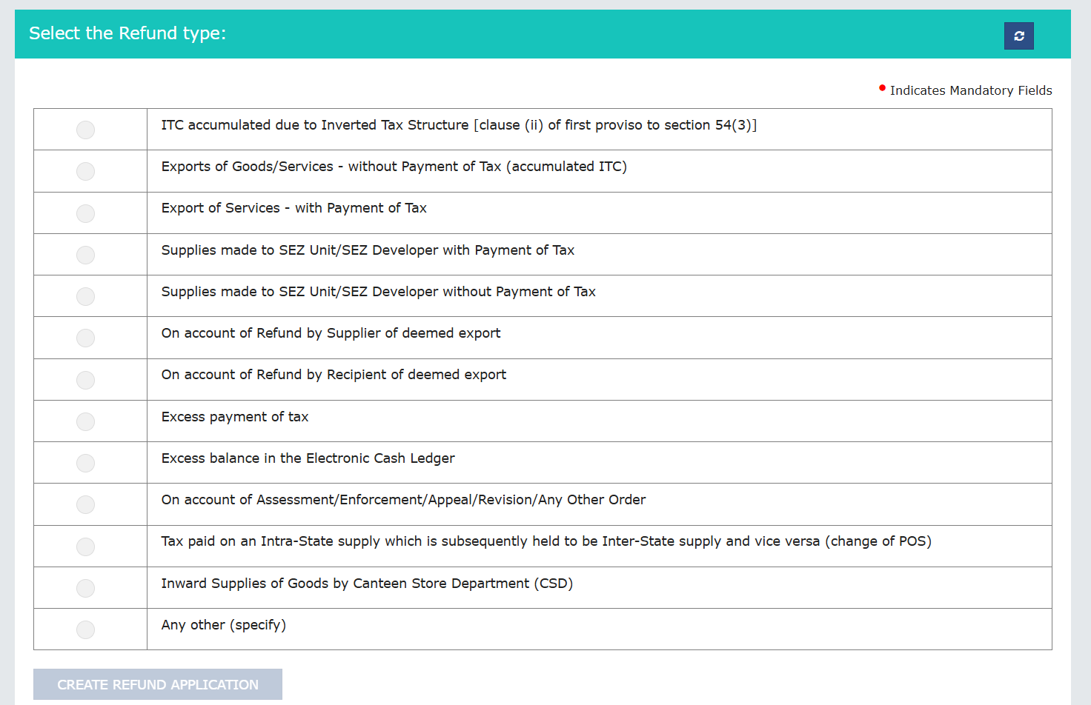
Refunds under GST
(Types of refund - portal view)

Slide 7
Refunds under GST
(Sequence of events)
# | Forms | Details | Timeline | Provisions
1 | RFD-01 | Refund application | 2 years from the relevant date
2 | RFD-02 | Acknowledgment | 15 days from the date of application | Rules 90(1) & Rule 90 (2)
3 | RFD-03 | Deficiency memo | 15 days from the date of application | Rule 90 (3)
4 | RFD-04 | Provisional refund order | 7 days from the date of issuance of RFD – 02 – Sanction 90% | Rule 91 (2)
5 | RFD-05 | Payment Order | 7 days from the date of issuance of RFD – 02 | Rules 91(3), 92 (4) & 92 (5)
6 | RFD-06 | Refund sanction / rejection order | 60 days from the date of issuance of RFD – 02 | 92 (1), 92 (3), 92 (4), 92 (5) & 96 (7)
7 | RFD-08 | Notice for rejection of refund application |  | 92 (3)
8 | RFD-09 | Reply to SCN | 15 days from the date if issuance of RFD - 08 | 92 (3)
9 | RFD-07 | Order for complete adjustment / withholding of sanctioned refund |  | 92 (1), 92 (2) & 96 (6)
10 | PMT -03 | Recrediting the amount into the electronic credit ledger if rejection order under RFD – 06 is passed |  | 92 (1A), 93(2)
11 | RFD - 10 | Refund application for UIN
12 | RFD – 10A | Application for refund by Canteen Stores Department |  | Rule 95
13 | RFD – 11 | Letter of undertaking
RFD – 07 comes into picture where any amount is due from the tax-payer to the govt, the same shall be adjusted from the refund sanctioned under RFD – 06.
The above procedure is applicable to all the refund claims (i.e., refund of accumulated ITC without payment of tax)
A refund application filed can be withdrawn on or before issuance of the show cause notice.

Slide 8
Refunds under GST
(Relevant date)
An application for refund have to be filed online in GST RFD -01 within two years from the relevant date which is as following
In Case of
Relevant date
Export by Sea/Air
The date on which the ship or the aircraft in which such goods are loaded, leaves India
Export by Land
The date on which such goods pass the frontier
Export by Post
The date of dispatch of goods by the Post Office concerned to a place outside India
Deemed Export
The date on which the return relating to such deemed exports is Furnished
Export of Service
The date of –
Receipt of payment in convertible foreign exchange, where the supply of services had been completed prior to the receipt of such payment; OR
Issue of invoice, where payment for the services had been received in advance prior to the date of issue of the invoice
Order/Judgement
The date of communication of such judgment, decree, order or Direction
Refund of accumulated ITC under Inverted Duty Structure (IDS)
Date of filing of return under Section 39 in respect of such supplies
Supplies to SEZ unit/ developer
Date of filing of return under Section 39 in respect of such supplies
Provisional payment of Tax
The date of adjustment of tax after the final assessment
Other Cases
The date of Payment of Tax

Slide 9
Refund Application – Documents
Documents to be submitted as Prescribed in Circular No. 125/44/2019- GST |  | Documents additionally requested by the GST department
Declaration under second and third proviso to section 54(3) Statement of invoices (Annexure-B) Copies of goods or service export invoices Copies of FIRC/ EBRC for export of services and shipping bills for export of goods Endorsements from specified officer of SEZ in case of refund under ITC accumulated against SEZ supplies. Self-declaration under rule 89(2)(l) if amount claimed does not exceed 2 lakhs CA certificate if amount claimed exceeds 2 lakhs Copy of order in case of pre-deposit refund |  | Invoices of inward supplies Service agreements entered by the parties Bank statements highlighting receipt of foreign currency Incorporation certificates of the foreign entities Declaration under section 2(6) of IGST Act, 2017
Statements :
Statement 1 under rule 89(5), Statement 1A under rule 89(2)(h) | Refund of ITC unutilized on account of accumulation due to inverted tax structure
Statement 2 under rule 89(2)(c) | Refund of tax paid on export of services made with payment of tax
Statement 3 under rule 89(2)(b) and rule 89(2)(c) , Statement 3A under rule 89(4) | Refund of unutilized ITC on account of exports without payment of tax
Statement 4 under rule 89(2)(d) and rule 89(2)(e) | Refund of tax paid on supplies made to SEZ units/developer with payment of tax
Statement 5 under rule 89(2)(d) and rule 89(2)(e), Statement 5A under rule 89(4) | Refund of unutilized ITC on account of Supplies made to SEZ units/developer without payment of tax
Statement 5(B) under rule 89(2)(g) | Refund to supplier/ recipient of tax paid on deemed export supplies
Statement 6 under rule 89(2)(j) | Refund of tax paid on intra-state supply which is subsequently held to be an inter-state supply
Statement 7 under rule 89(2)(k) | Refund of excess payment of tax

Slide 10
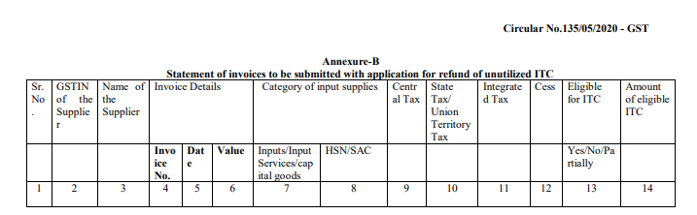
Refund Application – Key points
The details of the invoices to be submitted with application for refund of unutilized ITC shall be reported in the statement - Annexure - B as provided in the prescribed format in Circular No. 135/05/2020- GST.
The turnover of zero-rated supply of goods and services should not be greater that or equal to adjusted total turnover.
The refund application for the past period shall be filed before filing the refund application for relevant refund period. In case of no refund available for the previous period a nil return has to be filed by the taxpayer.

Slide 11
Refund claim
(Procedure for filing and processing)
File RFD 01 with all relevant details within 2 years from relevant date*
ARN will be generated & transferred to proper jurisdictional officer
If transferred to wrong jurisdictional officer, then he/she shall reassign to correct jurisdictional officer
RFD 03
Deficiency Memo
Application is deemed to have not been filed and a will re-credited to ECL automatically. File fresh RFD 01 for this period again
Is amount sanctioned in RFD 06 is greater than amount disbursed in RFD 04
Residual amount will be
Credited in Bank
NO
Within 15 days of ARN, Officer find application as COMPLETE
Once an acknowledgement has been issued, then no deficiency memo can be issued
RFD 04
Provisional
Refund @ 90%
Upon
Verification
RFD 06
Final Refund
Order
If Difference is
Between 90 -100%
Difference – Credit in Bank Not sanctioned – Credit in ECL
NO
YES
RFD 02
Acknowledgement for complete application
Within 7 days
Officer fully Satisfied
YES
RFD 06
Final Refund
Order
Is amount sanctioned in RFD 06 is less than amount disbursed in RFD 04
Show cause in RFD 08 for excess refund credited
Statements/ declarations/ undertakings shall form part of the application and are not required to be uploaded separately
Comprehensive list of documents is provided in Annexure A to the circular. Requisite documents are to be uploaded online, no physical submission required
The jurisdictional officer shall issue both the sanction order (FORM GST RFD-04/06) and the corresponding payment order (FORM GST RFD-05) for the sanctioned refund amount, under all tax heads (i.e., both central/ state tax portions).
Sanctioned refund shall be disbursed through PFMS after validation of Bank a/c.

Slide 12
Refund claim
(Bank Account Validation Procedures)
For validation of bank account details provided in the refund application
Unique Assessee code is a combination of GSTIN + validated bank account number
UAC will be used by PFMS for all refund payments made to the applicant in the said bank account
Filing of refund application
Master file is generated
Master file is shared with PFMS
PFMS will create a UAC
Refund credited to bank account basis UAC
GST RFD - 01 is filed by the applicant
Details of Bank account to which applicant wishes to credit the refund is to be selected (if there are multiple bank accounts)
Master File will contain the relevant details like (Name + GSTN + Bank Account)
Note: If the application wishes to get the refund credited to a new bank account, then the above validation process and creation of new unique assessee code shall be repeated.

Slide 13
Refund claim
(Procedure for disbursement)
Earlier the disbursement of refund was done as follows:
IGST and CGST component was disbursed by Central Authorities
SGST was disbursed by State authorities.
The above process is changed and currently, the entire refund is processed by the respective jurisdictional authority (i.e. Central / state) to whom the refund application is assigned to.
Refund assigned to | Forms | Disbursement authority
State tax officer | Refund sanction order (RFD – 04 / 06) | State Tax authority (Irrespective of the refund of IGST, CGST)
 | Corresponding payment order (RFD – 05)
Central Tax officer | Refund sanction order (RFD – 04 / 06) | Central Tax authority (Irrespective of the refund of SGST)
 | Corresponding payment order (RFD – 05)
The refund disbursement procedure has been explained vide para 27 to the Circular No. 125/44/2019 – GST dated 18th November 2019 and is outlined below:
Refund is disbursed through Public Financial Management System (PFMS) of Controller General of Accounts (CGA), Ministry of Finance, GOI.
As per Section 54(10) of the CGST Act,2017:
The taxable person who has defaulted in furnishing any returns or required to pay any tax, interest or penalty which has not been stayed by court, tribunal or appellate authority by specified date, then the proper officer can -
Withhold payment of refund until the taxable person furnish the returns or make payment against the tax, interest or penalty
(Or)
Deduct the same from the refund amount which the taxable person is liable to pay

Slide 14
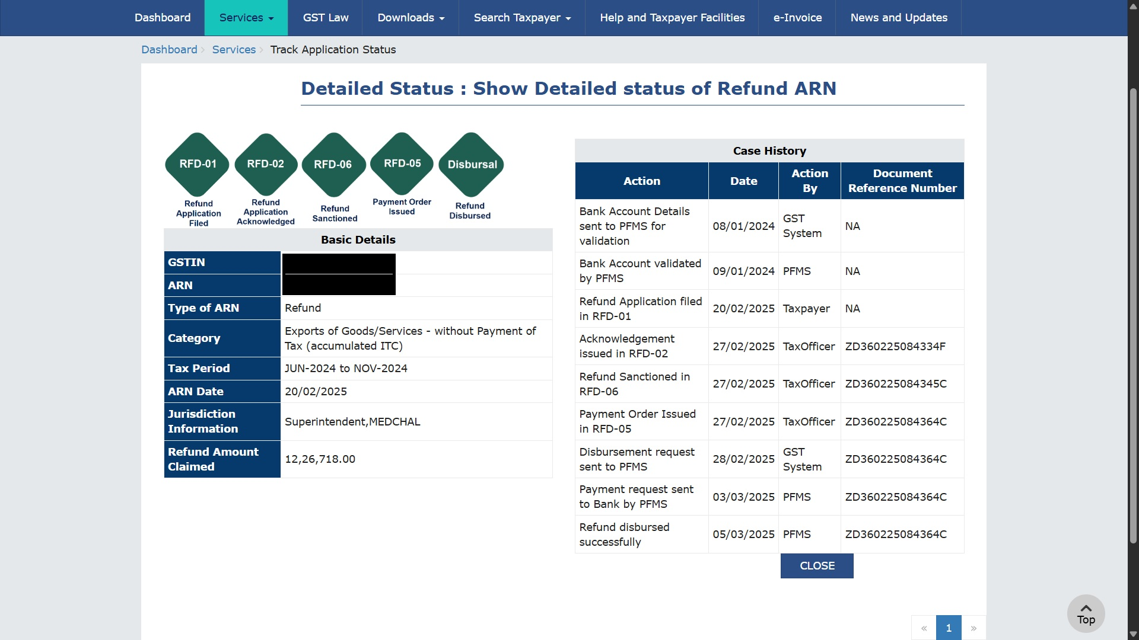
Refund claim
(Status – Track application)

Slide 15

Rule 89(4) – Refund of accumulated ITC on export of goods and services – without payment of IGST

Slide 16
Refund of accumulated ITC – without payment of IGST
(Refund computation – under Rule 89 (4))
In case of Zero-rated supply
(Turnover of zero-rated supply of goods + Turnover of zero-rated supply of services) x Net ITC
Refund Amount
Adjusted Total Turnover
Net ITC = ITC on Goods & Services available during the period – ITC on Capital Goods
Turnover of Zero-rated Supply of goods = Turnover of zero-rated supply of goods" means
Turnover of Zero-rated Supply of Services: Zero-rated supply of services is
i. Value of zero-rated supply of goods made during the relevant period without payment of tax under bond or letter of undertaking
(Or)
whichever is less
1.5 times
The value of like goods domestically supplied by the same
ii. The value which is
(Or)
The value of similar goods supplied by others in the market
Payments received during the relevant period for zero-rated supply of services.
Zero-rated supply of services where supply has been completed for which payment had been received in advance in any period prior to the relevant period.
Advances received for zero-rated supply of services for which the supply of services has not been completed during the relevant period.

Slide 17
Refund of accumulated ITC – without payment of IGST
(Refund computation – under Rule 89 (4))
Exempt supplies
*Note : Value of all taxable supplies is exclusion of value of inward supplies on which tax is payable under reverse charge
Adjusted total turnover
Value of all taxable supplies*
Exports of goods or services
Inter-state supplies
Illustration:
Below is the sales structure of a manufacturer who supplies in both domestic and international market. Suppose the supplier has an ITC of INR. 1,100. Compute the refund eligible.
# | Particulars | Actual Turnover | Adjusted Total Turnover
1 | Domestic Turnover | 5,000 | 5,000
2 | Export Turnover | 10,000 | 7,500¹
Total Turnover (1+2=3) | Total Turnover | 15,000 | 12,500
 | Net ITC (4) | 1,100 | 1,100
Refund Amount (2*4/3) | Refund Amount | 733 | 660
As per the amendments, the export turnover will be considered as 7,500 (5,000 x 1.5 times).

Slide 18
Refund under Inverted Duty Structure (IDS)

Slide 19
Refund under Inverted Duty Structure (IDS)
(Refund computation)
Where the credit has accumulated on account of rate of tax on inputs being higher than the rate of tax on outward supplies (other than nil rated or fully exempt supplies), except supplies of goods or services or both.
The taxpayer should have atleast one of the inward supplies of goods which attracts higher rate of tax than the outward supply made in order to be eligible for refund under IDS.
Amendment of the formula for computation of the refund under the IDS. The changes of the same are highlighted below:
Old Formula:
New Formula:
The effect of the change in formula is that reduction of output tax on inverted rated supply is to be done in the same proportion in which input tax credit has been availed on inputs and input services.
Maximum Refund Amount
(Turnover of inverted rated supply of goods and services) x Net ITC
Tax payable on such inverted supply of goods and services
-
{Adjusted Total Turnover}
(Turnover of inverted rated supply of goods and services) x Net ITC
Maximum Refund Amount
Tax payable on such inverted rated supply of goods and services
Net ITC
-
x
{Adjusted Total Turnover}
ITC availed on inputs & input services

Slide 20
Refund under Inverted Duty Structure (IDS)
(Refund computation - Illustration)
Refund under Old Formula
Refund under New Formula
Particulars | Amount
ITC on Inputs [A] | 5,000.00
ITC on Services [B] | 2,000.00
Total ITC [C] | 7,000.00
Total Turnover [D] | 15,000.00
TO of IDS [E] | 10,000.00
TO other than IDS [F] | 5,000.00
Output tax on IDS [G] | 500.00
Formula [(E*A/D)-(G)] | 2,833.33
Particulars | Amount
ITC on Inputs [A] | 5,000.00
ITC on Services [B] | 2,000.00
Total ITC [C] | 7,000.00
Total Turnover [D] | 15,000.00
TO of IDS [E] | 10,000.00
TO other than IDS [F] | 5,000.00
Output tax on IDS [G] | 500.00
Formula [(E*A/D)-(G*A/C)] | 2,976.19

Slide 21
Refund under Inverted Duty Structure (IDS)
(Key changes and clarifications)
Can refund under IDS category applicable where input and output is same ? (Circular 173/05/2022 – dated 06.07.22)
  Clarified that refund under IDS is applicable in case where there is an accumulation due to higher rate of tax on inputs when compared to tax rate on output.
  Where the input and output being same and different tax rates apply to both at different points of time, the same shall not be covered under IDS refund category.
  In such cases, where there is an accumulation due to concessional rate of tax on output tax rate, then IDS is applicable
  IDS is not applicable in the case where output tax on goods is
    Exempted
    Nil rate
    Good which are notified by the Government on the non applicability of IDS.
New formula under Rule 89 (5) - Where the Net ITC includes Input services (Circular 181 /13/2022 – GST dated 10.11.22)
  As this is a prospective amendment, the new formula is be applicable for refund applications filed on or after 05.07.22.
  For applications filed before 05.07.22, - Old formula is applicable
  Restriction placed on refund of Unutilised ITC on account of IDS on edible oils and coal, shall apply prospectively, i.e., for all refund applications to be made on or after 18 July 2022.

Slide 22
Refund to Unregistered person, Merchant exporter and Refund under deemed exports

Slide 23
Refund to unregistered person
Circular No 188/20/2022 dated 27.12.2022 has been issued along with amendment in GST rules providing mechanism for un-registered person to claim refund and verification to be carried out by the Proper officer for allowing refund application of such nature by un-registered person.
Eligibility:
In case of TERMINATION of contracts with unregistered recipients for construction of flat/building or on termination of long-term insurance policy,
Time limit under Section 34 for issuance of credit note would have been expired and there is no scope of issuance credit note for such supply could be issued by the registered person
Section 54(1) allows any person, including unregistered persons, to claim a refund of tax paid. If the tax burden has not been passed on, refund is granted directly to the person.
Relevant date:
2 years from the date of cancellation letter of the contract/ agreement for supply by the supplier will be considered as the date of receipt of the services by the applicant.”
Refund application:
Temporary registration shall be obtained using PAN
Refund application shall be filed in FORM GST RFD-01 in the common portal along with Statement 8.
Separate applications must be filed for each supplier and for suppliers in different States/UTs.

Slide 24
Refund to Merchant exporter
The manufacturer supplier is a registered supplier under GST. He supplies goods to a merchant exporter, who is a registered recipient. The Merchant Exporter can clear the goods on payment of 0.10% IGST or 0.5% CGST and 0.5% SGST/UGST. Merchant exporters must also fulfill crucial conditions when procuring supplies at a concessional GST rate of 0.10% for export.
In order for a supplier to supply the goods at a concessional rate of tax, the conditions specified in the concessional rate notification are to be fulfilled by the recipient, where the goods procured by such recipient are exported by the recipient.
The conditions the said notification are as follows:
Condition 1
The registered supplier shall supply the goods to the registered recipient on a tax invoice
Condition 2
The registered recipient shall export the said goods within a period of ninety days from the date of issue of a tax invoice by the registered supplier
Condition 3
The registered recipient shall indicate the Goods and Services Tax Identification Number of the registered supplier and the tax invoice number issued by the registered supplier in respect of the said goods in the shipping bill or bill of export, as the case may be
Condition 4
The registered recipient shall be registered with an Export Promotion Council or a Commodity Board recognized by the Department of Commerce

Slide 25
Refund to Merchant exporter
Condition 5
The registered recipient shall place an order on registered supplier for procuring goods at concessional rate and a copy of the same shall also be provided to the jurisdictional tax officer of the registered supplier
Condition 6
The registered recipient shall move the said goods from place of registered supplier –
(a) directly to the Port, Inland Container Deport, Airport or Land Customs Station from where the said goods are to be exported; (or)
(b) directly to a registered warehouse from where the said goods shall be move to the Port, Inland Container Deport, Airport or Land Customs Station from where the said goods are to be exported
Condition 7
If the registered recipient intends to aggregate supplies from multiple registered suppliers and then export, the goods from each registered supplier shall move to a registered warehouse and after aggregation, the registered recipient shall move goods to the Port, Inland Container Deport, Airport or Land Customs Station from where they shall be exported.
Condition 8
In case of situation referred to in condition (vii), the registered recipient shall endorse receipt of goods on the tax invoice and also obtain acknowledgement of receipt of goods in the registered warehouse from the warehouse operator and the endorsed tax invoice and the acknowledgment of the warehouse operator shall be provided to the registered supplier as well as to the jurisdictional tax officer of such supplier.
Condition 9
When goods have been exported, the registered recipient shall provide copy of shipping bill or bill of export containing details of Goods and Services Tax Identification Number (GSTIN) and tax invoice of the registered supplier along with proof of export general manifest or export report having been filed to the registered supplier as well as jurisdictional tax officer of such supplier.

Slide 26
Refund of IGST paid on deemed exports
Supplies notified as deemed exports:
Notification no. 48/2017 – Central Tax dated 18th October 2017 has notified the following supply of goods as deemed exports:
Supply of goods by the registered person against Advance Authorisation (AA) i.e. Supplier must be registered under GST and recipient must be an Advance Authorisation holder.
Supply of capital goods by the registered person against Export Promotion Capital Goods Authorisation (EPCG).
Supply of goods by the registered person to Export Oriented Unit (EOU)/ Electronic Hardware Technology Park Unit (EHTP) / Software Technology Park Unit (STP) / Bio-Technology Park Unit (BTP).
Supply of gold by Bank or Public Sector Undertaking against AA.
Taxability:
Deemed exports are subject to GST at the time of supply. Refund is eligible upto the extent of the tax paid on such supplies.
Refund of tax paid can be claimed by either of the following persons:
(a) Supplier of goods or
(b) Recipient of goods.
*Note: The recipient is not eligible to claim the ITC in case refund of tax paid is being claimed by the supplier.
Documents required:
EOU/ EHTP/ STP/ BTP unit must give prior intimation by filing Form A to the supplier and the jurisdictional GST officer of supplier and recipient.
Record of such goods received by EOU/ EHTP/ STP/ BTP unit must be maintained in Form B.

Slide 27
Notification No. 54/2018 – Central Tax

Slide 28
Notification No. 54/2018 – Central Tax
Notification No. 54/2018 – Central Tax, issued on 9th October 2018 by the Government of India, makes changes to the GST Rules, particularly focusing on how exporters can claim tax refunds under certain conditions.
What Does This Notification Do?
This notification makes two important amendments to the CGST Rules, 2017, specifically:
Changes to Rule 89(4B) (related to refunds of unutilised Input Tax Credit - ITC).
Changes to Rule 96(10) (related to refunds of IGST paid on exports).
These rules are important for exporters who are not paying GST on their exports (called zero-rated supplies) but are still incurring GST on their purchases (inputs and input services). They often claim refunds of ITC or IGST paid.
Rule 89(4B) Amendment – Refund of Unutilised Input Tax Credit (ITC)
This rule is for exporters who make zero-rated exports without paying tax and want a refund of ITC.
It says:
If you’re an exporter and:
  You buy supplies from registered suppliers who are using duty exemption schemes like Notification 40/2017-Central Tax (Rate) or Notification 41/2017-Integrated Tax (Rate), OR
  You import goods using Customs exemption notifications like 78/2017-Customs or 79/2017-Customs,
You can still claim refund of ITC, but only for:
The ITC related to inputs received under the above specified notifications for export purposes.
The ITC related to other inputs or services, used in making such export.
You won't lose refund eligibility entirely, but the refund is limited to the inputs and services which are used directly for exports.

Slide 29
Notification No. 54/2018 – Central Tax
Rule 96(10) Amendment – Refund of IGST Paid on Exports
This rule is for those who export goods by paying IGST and then claim a refund of that IGST.
It says:
You cannot claim IGST refund on exports if:
  You’ve benefited from certain GST or Customs exemptions (like Notification 48/2017-Central Tax for domestic purchases, or 78/2017 & 79/2017-Customs for imports), unless it's only for capital goods under EPCG scheme (Export Promotion Capital Goods).
If you bought goods at concessional rates under special government schemes for exporters and then try to claim IGST refund, that’s not allowed—except if you used those benefits only for purchasing machinery or capital goods under EPCG.
Why These Changes?
These changes are intended to:
Prevent double benefits: You cannot both get input tax at concessional or zero rate and then also claim a refund on the same.
Ensure fair use of export promotion schemes without misuse of tax refunds.
Summary
Scenario | Can You Claim Refund? | Conditions
You export without paying GST and use inputs under concessional schemes | Yes, ITC refund allowed | Only for inputs/service directly related to exports
You export with IGST payment, but availed input concessions | No IGST refund allowed | Unless it’s only for capital goods under EPCG
These rules help keep the system transparent by allowing legitimate refunds and blocking double benefits.

Slide 30
Recent GST Case Laws on Refund

Slide 31
GST Case Laws on Refund
# | Caselaw | Citation | Summary
1 | ABN industries Vs Union of India | High Court of Gujarat-[2025] 172 taxmann.com 822 (Gujarat)/[2025] 109 GST 539 (Gujarat)/[2025] 97GSTL 355 (Gujarat)[13-03-2025] | Where refund application was approved, assessee filed another application for certain purchase invoices which were not included in first application, second refund application filed under “Any other (specify) category” for the same period should not be rejected by department.
2 | SICPA India Pvt. Ltd Vs GST authorities | Sikkim High Court - (2025) 31 Centax 268 (Sikkim) [10-06-2025] | SICPA India Pvt. Ltd. discontinued its business operations in Sikkim and applied for a refund of ₹4.37 crore in unutilized Input Tax Credit (ITC). The GST authorities rejected the claim, stating that closure of business is not an eligible ground under Section 54(3) of the CGST Act. However, the Sikkim High Court held that validly accumulated ITC must be refunded, even upon business closure, as there is no legal prohibition against the claiming the refund.
3 | Kuehne Plus Nagel Pvt. Ltd Vs Union Of India | High Court of Gujarat - (2025) 32 Centax 176 (Guj.) [26-03-2025] | Assessee filed a refund application claiming refund of unutilized ITC on export of services. Refund claim was rejected on ground that assessee had not submitted FIRC as required by CBIC Circular No. 125/44/2019. The court has held that, only on ground that assessee had not submitted FIRC as required by CBIC Circular No. 125/44/2019, refund claim could not be rejected as the assessee had submitted Chartered Accountant's certificate certifying receipt of net foreign exchange and assessee had provided all requisite documents along with refund claim application. Therefore, refund claim was to be processed without insisting for FIRC and the certificate issued by Chartered Accountant was to be accepted for receipt of net foreign exchange.

Slide 32
Circulars related to refunds under GST

Slide 33
GST Refund - Circulars
# | Circular | Clarification
1 | Circular No. 125/44/2019- GST dated 18.11.2019 | All refund applications for unutilized ITC on account of accumulation due to inverted tax structure for subsequent tax period(s) shall be filed in FORM GST RFD-01 under the category “Refund of unutilized ITC on account of accumulation due to inverted tax structure”. It is hereby clarified that all those registered persons required to make the reversal in terms of the said notification and who have not yet done so, may reverse the said amount through FORM GST DRC-03 instead of through FORM GSTR-3B.
2 | Circular No. 135/05/2020- GST dated 31.03.2020 | 1. Removal of Restriction on Bunching Refund Claims Across Financial Years Taxpayers can now club refund claims across different financial years. Earlier restriction removed, enabling greater flexibility in filing refund claims. 2. Ineligible Refund Under Inverted Duty Structure (IDS) for Rate-Reduction Cases Refund not allowed under IDS when: Input tax rate was higher due to an earlier rate, and Output tax rate was lower due to a later rate reduction. Such rate mismatch due to timing, especially in trading scenarios, is not treated as inverted duty structure. 3. Mode of Refund – Credit vs Cash As per Notification 16/2020 and clarifications: Refund will now be paid in the same ratio as original mode of tax payment (i.e., part in cash, part in credit ledger). This does not apply to zero-rated supplies (exports) and deemed exports, which will continue to receive refund entirely in cash. 4. Refund of Accumulated ITC – Matching Requirement Refund is restricted to ITC based on: Invoices uploaded by the supplier in GSTR-1, and Appearing in GSTR-2A (later updated to GSTR-2B as per newer circulars).. Unmatched ITC (i.e., not appearing in GSTR-2B) is not eligible for refund. 5. HSN/SAC Code Requirement in Refund Applications Applicants must provide HSN/SAC codes as mentioned in inward invoices. However, if supplier is not mandated to mention HSN/SAC, then applicant need not furnish it for such invoices in refund application.

Slide 34
GST Refund - Circulars
# | Circular | Clarification
3 | Circular No. 139/09/2020- GST dated 10.06.2020 | The refund sanctioning authorities cannot reject the refund of accumulated ITC in respect of ITC availed on Imports, ISD invoices, RCM, etc.
4 | Circular No. 162/18/2021- GST dated 25.09.2021 | Clarification in respect of refund of tax specified in section 77(1) of the CGST Act and section 19(1) of the IGST Act. 1. Eligibility for Refund under Section 77 (CGST Act) / Section 19 (IGST Act): Refund is allowed when a taxpayer pays: CGST + SGST on a supply initially treated as intra-State, but later held to be inter-State, or vice versa. The term “subsequently held” includes: Cases where taxpayer realizes the error on their own, or Cases where the error is identified by officer/adjudication/appellate proceedings. Refund can be claimed in both scenarios, provided correct tax is paid under the right head. As per Rule 89(1A) of CGST Rules (inserted via Notification No. 35/2021 dated 24.09.2021): Refund claim must be filed within 2 years from the date of payment of tax under the correct head.
5 | Circular No. 166/22/2021- GST dated 17.11.2021 | Time Limit for Refund of Excess Balance in Electronic Cash Ledger Clarification: Time limit under Section 54(1) for filing refund application does NOT apply to refunds of excess balance in the electronic cash ledger. Certification/Declaration Under Rule 89(2)(l)/(m) for Cash Ledger Refunds Clarification: No need to furnish Declaration under Rule 89(2)(l) for refunds up to ₹2 lakhs, or CA/Cost Accountant Certificate under Rule 89(2)(m) for refunds above ₹2 lakhs in cases of excess balance in the electronic cash ledger, since unjust enrichment is not applicable.

Slide 35
GST Refund - Circulars
# | Circular | Clarification
 |  | Refund of TDS/TCS Credited to Electronic Cash Ledger Clarification: TDS/TCS credited to the electronic cash ledger is treated as equivalent to cash deposit. Not mandatory to use TDS/TCS only to pay tax liability; can be used as per taxpayer’s discretion. Unutilized TDS/TCS in the cash ledger can be claimed as refund of excess cash balance under Section 54(1) proviso, read with Section 49(6). Relevant Date for Deemed Export Refunds (Supplier vs Recipient) Clarification: Clause (b) of Explanation (2) to Section 54 applies to deemed export refunds, regardless of whether refund is claimed by the supplier or recipient. Since tax is paid by the supplier, the relevant date is the date of filing of return by the supplier for the relevant tax period.
6 | Circular No. 173/05/2022-GST dated 06-07-2022 | When Refund Is Not Allowed: If input and output goods are the same, and the difference in tax rate is due to rate changes over time (i.e., historical rate difference), refund is not allowed. Such cases do not qualify under Section 54(3)(ii) of the CGST Act. When Refund Is Allowed: If input and output goods are the same but output is taxed at a lower rate due to a concessional notification (e.g., exemption or reduced rate notification) and the input is taxed at a higher rate at the same point in time, Then the accumulated ITC is eligible for refund under Section 54(3)(ii). Exceptions – Refund Not Allowed If: Output supply is: Nil-rated Fully exempted

Slide 36
GST Refund - Circulars
# | Circular | Clarification
7 | Circular No. 181/13/2022-GST dated 10-11-2022 | Amended Refund Formula (Rule 89(5)): New formula for refund of ITC under IDS applies only to refund applications filed on or after 05.07.2022. Refund applications filed before 05.07.2022 will be processed as per the old formula (pre-amendment). Restriction on Refund for Specified Goods (Chapter 15 & 27): Refund of unutilised ITC under IDS is restricted for goods under Chapter 15 (animal/vegetable fats) and Chapter 27 (mineral fuels, oils, etc.).This restriction is applicable only to refund applications filed on or after 18.07.2022. Refund applications filed before 18.07.2022 are not subject to this restriction.
8 | Circular No. 197/09/2023- GST dated 17-07-2023 | Restriction on ITC Refund Based on GSTR-2B: Refund of accumulated ITC will now be allowed only on the basis of credit available in GSTR-2B, effective from January 2022 tax period onwards. Credit from current or previous GSTR-2B will be considered. Amendments to Annexure-A of Circular 125/44/2019-GST: Revised Declarations/Requirements: Undertaking now required only under Section 16(2)(c). Section 42(2) reference removed. Requirement to upload copy of GSTR-2A as supporting document is removed. Requirement to upload self-certified invoices not found in GSTR-2A is also removed. Clarification on Adjusted Total Turnover (Rule 89(4)): Export turnover value for refund calculation will be as per the Explanation inserted in Rule 89(4), as notified via Notification No. 14/2022-CT dated 05.07.2022. Exports Beyond Prescribed Timelines (Rule 96A): Even if exports (goods/services) occur beyond prescribed timelines, zero-rated benefit cannot be denied, provided goods are actually exported, or payment is realized in case of service exports. Exporters will be eligible for refund of unutilized ITC under Section 54(3) if other conditions are met.

Slide 37
GST Refund - Circulars
# | Circular | Clarification
9 | Circular No. 226/27/2024-GST dated 11-07-2024 | Mechanism for refund of additional Integrated Tax (IGST) paid on account of upward revision in price of the goods subsequent to exports: Upward Price Revision (Post-Export): Additional IGST is paid on increased value. Refund can be claimed by filing Form GST RFD-01 under "Any other" category. Mention: “Refund of additional IGST paid on account of increase in price subsequent to export of goods”. Submit supporting documents like revised invoice, export contract, and proof of IGST payment. Downward Price Revision (Post-Export): If IGST was refunded on a higher value, the exporter must repay the excess refund with interest. Repayment can be done through Form DRC-03 voluntarily, or via demand by tax authorities.
10 | Circular No. 227/21/2024-GST dated 11-07-2024 | Canteen Stores Department under the Ministry of Defence is eligible to claim the refund of 50% of the applicable central tax paid by it on all inward supplies of goods received for the purpose of subsequent supply of such goods to the Unit Run Canteens of the Canteen Stores Department or to the authorised customers of the Canteen Stores Department. The taxpayer shall apply for refund in FORM GST RFD-10A once in every quarter, electronically on the common portal. The said refund application form shall be accompanied with the following documents: (i) An undertaking stating that the goods on which refund is being claimed have been received by the CSD for the purposes of subsequent supply of such goods to its Unit Run Canteens or to its authorized customers; and (ii) A declaration stating that no refund has been claimed earlier against the invoices on which the refund is being claimed. Relevant date: 2 years from the last day of the quarter in which such supply was received

Slide 38
GST Refund - Circulars
# | Circular | Clarification
11 | Circular No. 233/20/2024- GST dated 10-09-2024 | Rule 96 (10) of Central Goods and Services Tax Rules, 2017 (‘CGST Rules’) restricts refund of IGST paid on export of goods or services wherein benefits are claimed at the time of import of goods under certain exemption / concessional notifications. The said circular clarifies that refund claimed under Rule 96 (10) of CGST Rules, “Exports with payment of IGST” is regularized in the following circumstances: Where the taxpayer has re-assessed the Bill of entries and made the payment of IGST and Compensation cess along with interest. Where the taxpayer is now willing to get the bill of entries “re-assessed” and pay the IGST and compensation cess along with interest.
Further, the challenge is with reference to the re-assessment of Bill of entries in
the following cases:
where the Advance authorizations licenses were already closed and EODC is obtained
where the assets were de-bonded from STPI units
Can there be any restriction in re-assessment of bill of entries beyond a specific period? or the re-assessment be made for the bill of entries from 1st July 2017.
Where the payment of IGST along with interest be made through TR – 6 challan, can a view be taken that refund is regularized.
Where the taxpayer now makes the payment of IGST along with interest, can the taxpayer avail the input tax credit (ITC)?

Slide 39
GSTN Advisory on refunds

Slide 40

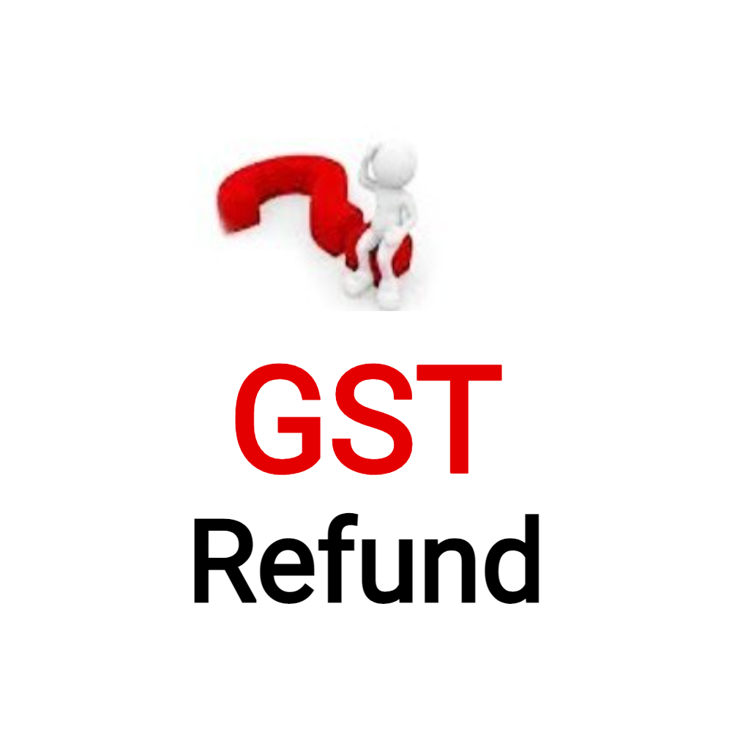
GSTN Advisory on refunds
Update in Refund Filing Process – Effective May 2025
Applicable Refund Categories:
  Export of services with payment of tax
  Supplies to SEZ (Unit/Developer) with payment of tax
  Deemed exports (Supplier’s refund)
Key Changes:
  No need to select tax period (“From–To”) while applying
  Filing is now Invoice-Based instead of Tax Period-Based
  Relevant Statements:
    Statement 2 – Export of Services
    Statement 4 – SEZ Supplies
    Statement 5B – Deemed Exports
Other Points:
  All prior returns must be filed before claiming refund
  Uploaded invoices are locked until:
    Refund is withdrawn
    Or deficiency memo is issued
Streamlined process allows direct refund application based on eligible invoices.

Slide 41
GSTN Advisory on refunds
Refund Filing Update – Recipient of Deemed Export (Effective May 2025)
Key Changes:
  No need to select 'From' and 'To' tax periods
  Refund can be filed non-chronologically
  Must file all relevant GST returns before applying
Revised “Amount Eligible for Refund” Table Includes:
  ECL balance at application time (auto-filled)
  Net ITC on deemed exports from Statement 5B (auto-filled)
  Refund claimed amount (downward editable)
  Eligible refund (auto-calculated as per Circular 125/44/2019-GST)
  Ineligible refund due to insufficient balance
Enhanced Functionality:
Allows maximum eligible claim even if specific head-wise ITC is insufficient in Electronic Credit Ledger
Beneficial change to simplify and maximize refund for recipients of deemed exports.

Slide 42




HYDERABAD
4th floor, S2 Techno Park, Krithika Hills Layout, Madhapur, Hyderabad – 500081
Thank You
BENGALURU
No. 10, Sumukha Towers, 1st Floor, Dr Puneeth Rajkumar Rd, Ittamadu,
Banashankari 3rd Stage, Bengaluru - 560085
+91 72071 65162
+91 91777 88805
Info@akiraadvisors.in www.akiraadvisors.in

