Slide 1
Practical difficulties in filing of ITR 7
By
Exemptions Range Hyderabad

Slide 2
Who should file ITR 7?
For persons including companies required to furnish return under sections
139(4A) : Charitable/religious trusts
139(4B) : Political parties
139(4C) : Scientific and other research organisations
139(4D) : University, college/other institutions

Slide 3
DUE DATES
ITR 7 filing due date u/s 139
Non auditable: 31st July
Auditable: 31st Oct
Audit report to be filed on or before due date electronically

Slide 4
ITR 7: basic structure
Part A: general information
Part B- T1 : statement of Income
TT1 : Computation of tax liability on total
Schedules (selective)
I (amounts accumulated)
J (funds and investments)
AI ( Aggregate of Income)
IE (Income and expenditure)
VC (Voluntary Contribution)
115TD (Accreted Income

Slide 5
Relevance of the presentation
Role as JAO Recurring Issues
Rectification u/s 154 1. Delay in filing
Mistakes apparent ITR/ audit report
from the record 2. Registration related issue
( quoting wrong section, political party )
3. Mismatch between ITR and Audit report
4. Miscellaneous

Slide 6
Delay in Filing audit report
● Going to appeal for remedy? Conditions specified ( 7/2023)
● Condonation of delay u/s 119 (2)(b) From AY 23-24, Form 10B
Genuine hardship in filing to be verified irrespective of the registration regime
CIT/PCIT is the approving authority 1. Annual receipts > 5Cr
(upto 365 days), delay beyond > 365 days, 2. Received any Foreign Contribution
approving authority Pr.CC 3. Applied any part of income outside India
All other cases, 10BB

Slide 7
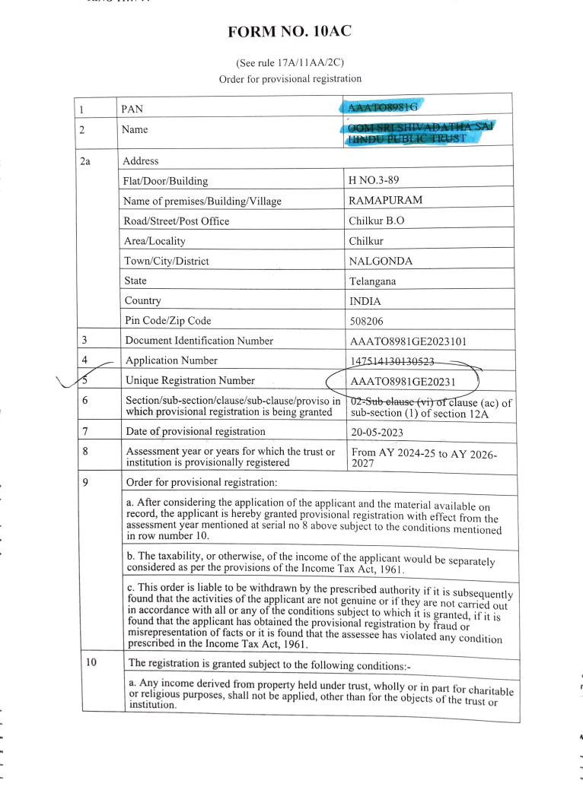
Registration related issue

Slide 8
Registration related issues
Political Party
Schedule LA
Return filed u/s 139(4B)
Regd u/s29A of RoPA,1951?
Voluntary contribution
from any person in
excess of Rs 20000 received
this year?

Slide 9
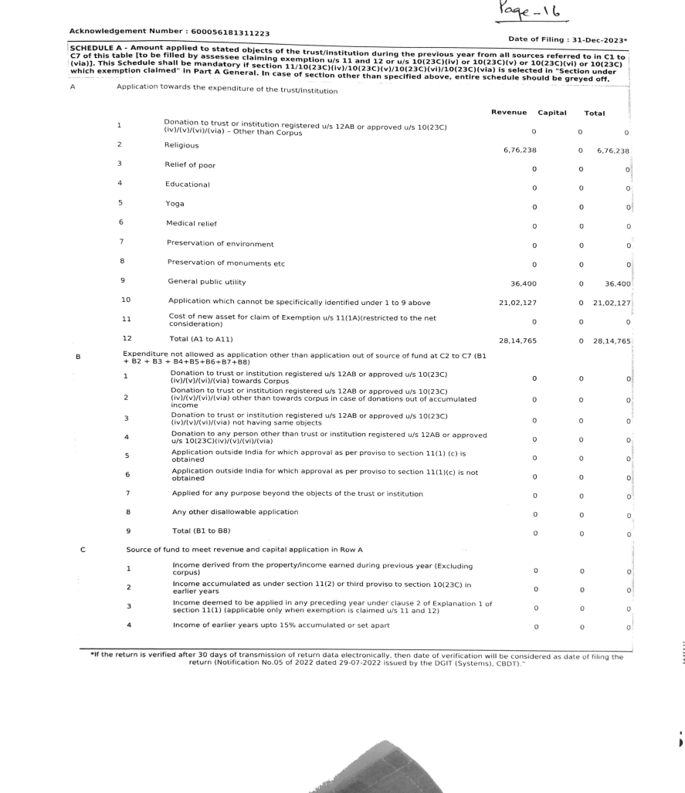
Mismatch between ITR 7 and Audit report
Combined schedule A instead of ER and EC Amount applied to stated objectives from all sources

Slide 10
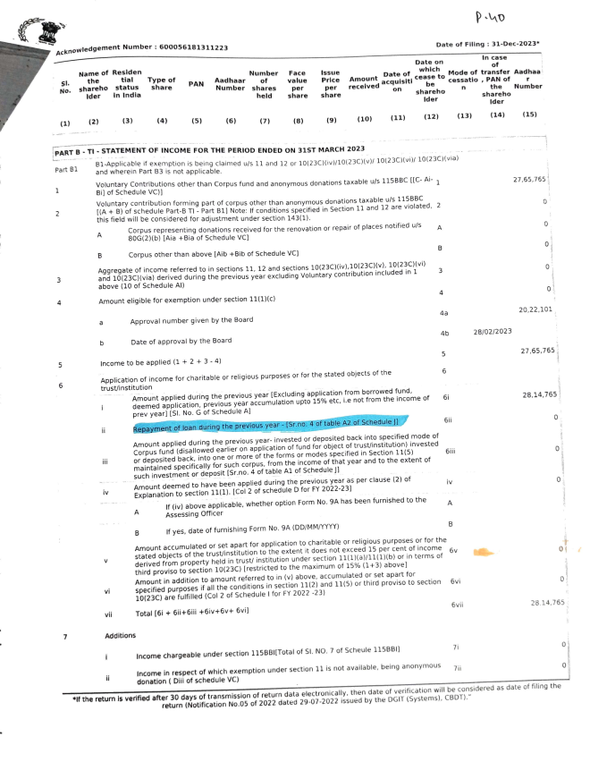
Mismatch between ITR 7 and Audit report

Slide 11
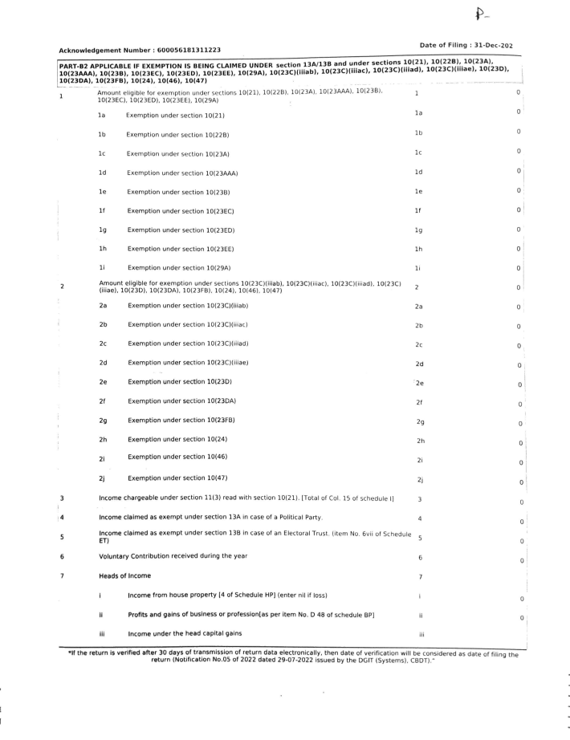
Mismatch within ITR 7 (Part B-T1 and Schedule IE

Slide 12
Miscellaneous issues
Accumulation of income (Sch IA)
Form 10 to be filed within 2 months of due date of filing ITR - 31st Oct
(Accumulation to be utilised within 5 years not in the 6th year If not applied with 5 years, taxable in 5th year)
Form 9A : deemed application for 1 year

Slide 13
Other areas
17(2): employees getting treatment in hospital get exempted perquisite
10(46). CG notified, no commercial activity, benefit of general public
10(46A) housing development/planning/development

Slide 14
Points to reconsider
2C Approach
Be Compliant with the rules
Ensure valid registration details
Filing ITR and audit report
Filing ITR and audit report within time
Replying to notice/letter
Be Careful while filing the details
Recheck every entry
avoid last moment rush

Slide 15
THANK YOU

