Slide 1
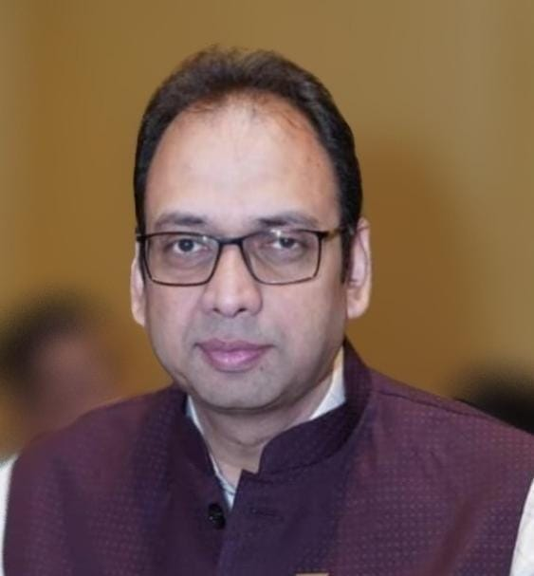
CASH TRANSACTIONS PROVISIONS AND PENALTIES
By CA Madhusudan Agarwal

Slide 2
CASH TRANSACTIONS PROVISIONS AND PENALTIES
A cash transaction is a financial exchange where physical currency, like coins and bills, is used to pay for goods or services. It's a direct exchange of cash for the item or service at the time of purchase. This differs from non-cash transactions, like credit card or debit card payments, where the payment is not made immediately.
Cash transactions are not only payments, but receipts are also cash transactions.
Restrictions and limits of cash transactions apply to both receipts and payments.
Cash transactions include bank deposits and withdrawals. No income and expenditure but monitoring and TDS on cash deposited or withdrawn from bank accounts.

Slide 3
CASH TRANSACTIONS PROVISIONS AND PENALTIES
Some of the Cash transactions above certain limits attracts penalties and others are required to report
Penalties are prescribed for non reporting of cash transactions.
The restrictions on cash transactions are applicable for whom
It is applicable for all entities.
It is mostly applicable for businesses transactions and personal taxable transactions.

Slide 4
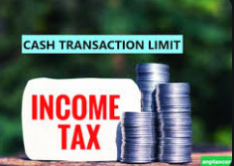
CASH TRANSACTIONS PROVISIONS AND PENALTIES
What is the limit of cash transactions
Rs. 2,000/- (Rupees Two Thousand)
Rs. 10,000/-(Rupees Ten Thousand)
Rs.20,000/-(Rupees Twenty Thousand)
Rs.2,00,000/-(Rupees Two Lacs Only)
5. No Limit……No cap on cash transactions -Agriculture Income (some cases)

Slide 5
CASH TRANSACTIONS PROVISIONS AND PENALTIES
The government has introduced strict rules to regulate cash transactions under the Income-tax Act, 1961
These provisions aim to:
Curb Black Money
Promote Digital Payments/Banking Channel
Enhance transparency in financial dealings
Applicable to Individuals, HUF, Businesses, Non-Profit Organisations
Penalties for contravention can include:
Heavy monetary fines
Disallowance of certain expenses or deductions
As an auditor we have a responsibility to report these transactions.

Slide 6
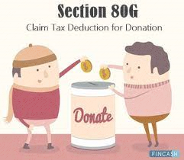
Section 80G Donations in Cash
Provision
Donations made in cash over ₹2,000 are not eligible for tax deduction.
Only payments through non-cash modes are valid.
Penalty/Impact
Loss of deduction benefit under Section 80G, resulting in higher tax liability.

Slide 7
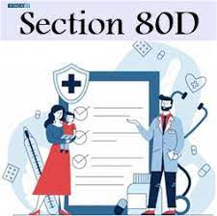
Section 80D Premium on Medical Policy paid in Cash
Provision
Paying Mediclaim insurance premiums in cash renders one ineligible for tax benefits under Section 80D of the Income Tax Act. Tax deductions are only applicable to premiums paid through digital modes such as Net Banking, credit cards, or debit cards.
Penalty/Impact
Loss of deduction benefit under Section 80D, resulting in higher tax liability.

Slide 8
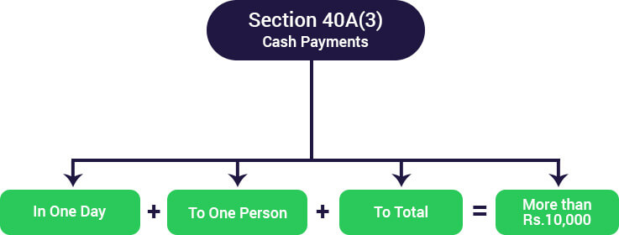
Section 40A(3) – Disallowance of Cash Expenditure
Provision
Business expense paid in cash exceeding ₹10,000 (₹35,000 for transporters) is disallowed.
Expense must be made via cheque, draft, or electronic modes.
Penalty/Impact
The entire expense is not allowed as a deduction, increasing taxable income.

Slide 9
Section 40A(3) – Disallowance of Cash Expenditure
Exceptions (Rule 6DD)
Payments made in villages without banking facilities.
Payment to government agencies.
Payments to farmers for agricultural produce.
Payment made due to genuine business exigency (e.g., transporters, emergencies).

Slide 10
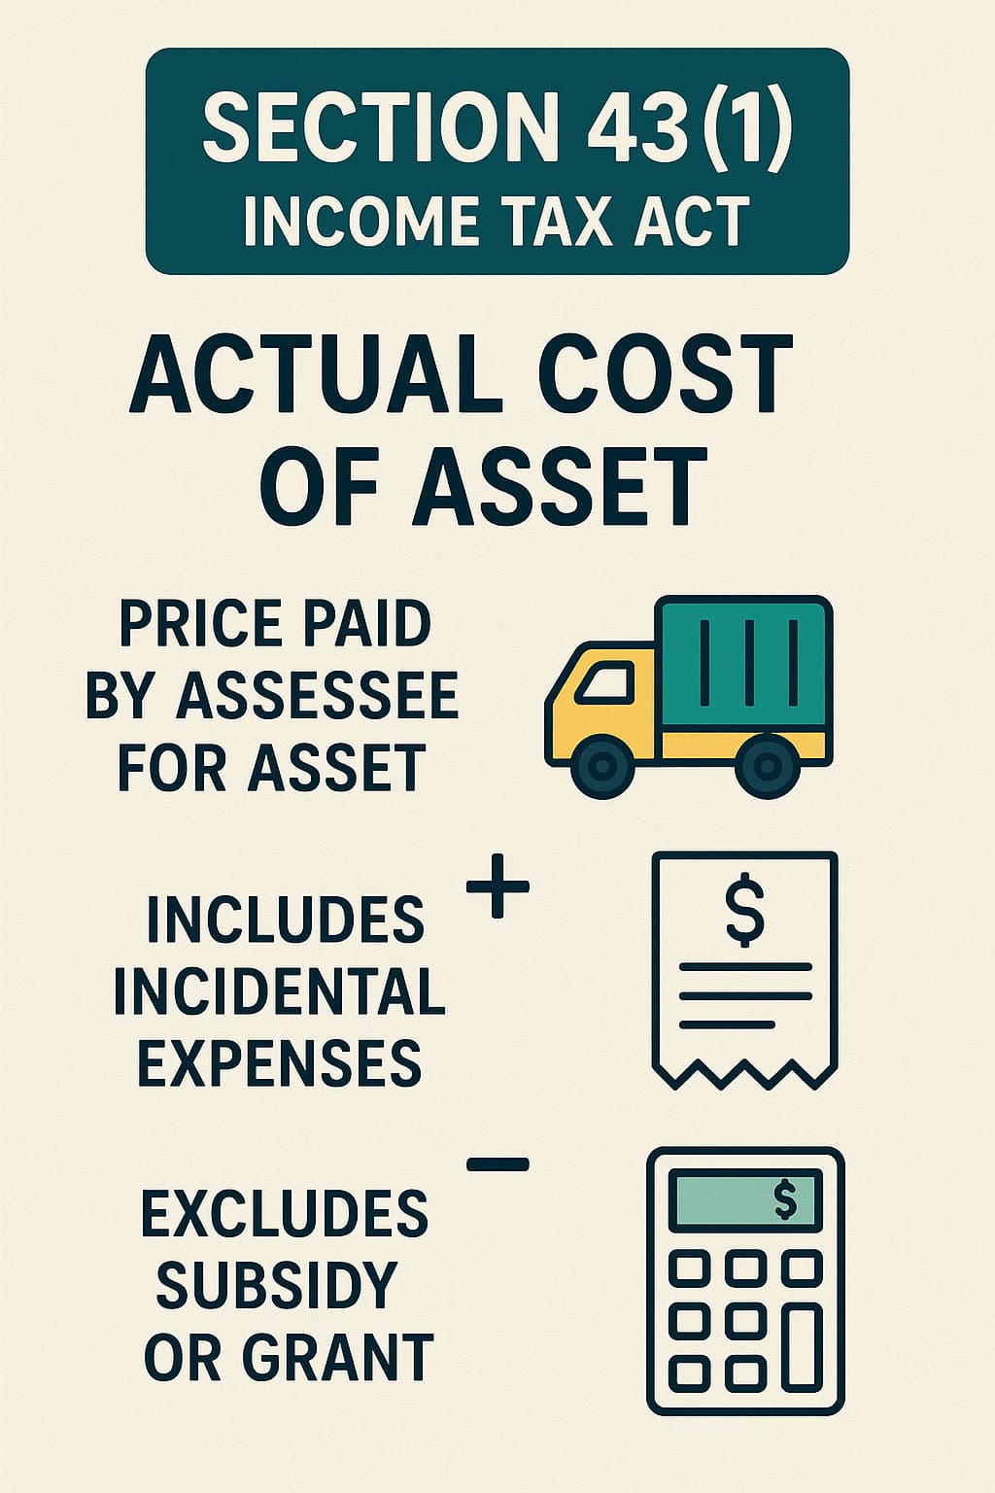
Section 43(1) – Actual Cost for Capital Asset
Provision
Cash payment exceeding ₹10,000 for purchase of capital assets is excluded from the cost.
Part payment in cash and part through bank – cash portion is excluded from the cost
Cash amount will not be considered for Depreciation
Penalty/Impact
Reduced depreciation and tax benefit loss on such purchases.
Exceptions
No specific exceptions in statute.
Payments below ₹10,000 are allowed in cash.

Slide 11
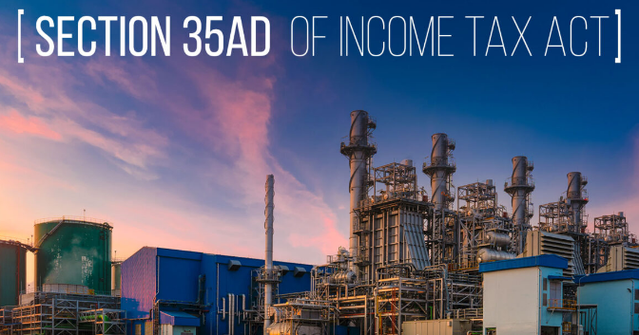
Section 35AD – Deduction for Specified Business Expenditure
Provision
100% deduction available for capital expenditure in notified businesses.
Cash payment exceeding ₹10,000 for capital assets is not allowed.
Penalty/Impact
Expenditure disallowed, reducing available tax deduction.
Exceptions
No deduction for cash payments exceeding ₹10,000 toward capital expenditure.
No exceptions – all such payments must be via non-cash modes to claim deduction.

Slide 12
Section 269SS – Restriction on Taking/Accepting Loans or Deposits in Cash
Provision
Applies to loans, deposits, or any specified sum.
No person can accept loans or deposits or specified sum of ₹20,000 or more in cash.
Must be accepted only via account payee cheque, draft, or electronic modes.
"specified sum" means any sum of money receivable, whether as advance or otherwise, in relation to transfer of an immovable property, whether or not the transfer takes place
Restriction purchase of land and building

Slide 13
Section 269SS – Restriction on Taking/Accepting Loans or Deposits in Cash
Penalty/Impact
(Section 271D) 100% of the amount accepted in contravention
Exceptions
(Applies to restriction on accepting loans/deposits of ₹20,000 or more in cash)
Transactions with government, banking company, cooperative bank, or public financial institution.
Partners and firm (loan/advance from partner to firm and vice versa – judicially accepted in some cases).
Agricultural income if not taxable.
Transactions between relatives not always exempt — only if not treated as loan/deposit.

Slide 14
Section 269SS – Restriction on Taking/Accepting Loans or Deposits in Cash
CASE STUDY
Sri Nikhil Banik Mazumder Vs. JCIT (ITAT Kolkata)
We have given a careful consideration to the rival submissions, and perused the materials available on record, we note that assessee had accepted the loan in cash of Rs. 4,00,000/- from Shri Mithun Banik Mazumder, (son of the assessee) and repaid Rs. 1,50,000/-. Assessee repaid loan to his another son Sri Indranil Banik Mazumder at Rs. 2,25,098/- and also repaid loan to his wife Smt. Sandhya Banik Mazumder at Rs. 54,928/. All these transactions are between husband and wife, and between father and son, being close relative of one family. We also note that assessee is a salaried employee and not a businessman. Therefore, based on the facts narrated above, these transactions do not fall within the ambit of sections 269SS and 269T of the Act and for that we rely of the judgment of coordinate Bench in the case of Anant Himatsingka and Manisha Prakash Amin (supra). To support the family members, the money has been given by the assessee to his son/wife. This is simply a transfer of money from one family member to another family member to support day to day expenses, educational expenses and other family expenses. Going through the facts of case before us, we are of the view that the transaction between son and father and wife and husband, for giving a support and help, in law,is not a loan or deposit in stricter sense of section 269SS of the Act and it is only a financial support, therefore, penalty imposed by the Assessing Officer and confirmed by the ld CIT(A) needs to be deleted, and accordingly we quash both the penalty orders, i.e, under section 269SS and 269T of the Income Tax Act.

Slide 15
GIFTS RECEIVED IN CASH
There's no specific restriction on gift to be given or received in cash from specified relative
However, Sec. 269ST prohibits any person from receiving any amount of Rs. 2 lakhs or more in aggregate from a person in a day or in respect of a single transaction or in respect of transactions relating to one event or occasion from a person, etc. Thus, as an abundant caution, it is advisable that such cash gifts be restricted to less than Rs. 2 lakhs.
Gifts from other than relative is restricted to Rs 50 thousand either in cash or bank or kind.
Anyhow, the cash gifted should be from an explainable source of income on which appropriate income tax, as applicable, has been paid.
Also, in case the cash gift to be made is of substantial amount, it is advisable to execute a proper gift deed as a valid documentary evidence which ensures proof of such transfer and thus, avoid confusions and misuse that may arise in the future.

Slide 16
Other exceptions if the transaction is proven as genuine and due to reasonable cause (relief under Section 273B).
clause (b) or clause (c) of sub-section (2) of section 273, no penalty shall be imposable on the person or the assessee, as the case may be, for any failure referred to in the said provisions if he proves that there was reasonable cause for the said failure.
The Apex Court, interpreting the powers conferred on the revenue under Section 273B of the Act in ASST. DIRECTOR OF INSPECTION ( INVESTIGATION) v. A.B. SHANTHI (255 ITR 258)
held that if there was a genuine and bona fide transaction and the taxpayer could not get a loan or deposit by account-payee cheque or demand draft for some bona fide reason, the authority vested with the power to impose penalty has a discretion not to levy penalty.

Slide 17
Section 269T – Restriction on Repayment of Loans or Deposits in Cash
Provisions
No person can repay loans or deposits of ₹20,000 or more in cash.
Repayment must be through banking channels (cheque, draft, or electronic transfer).
Includes repayment of any specified advance.
Penalty/Impact
(Section 271E) Equal to the amount repaid in cash

Slide 18
Section 269T – Restriction on Repayment of Loans or Deposits in Cash
Exceptions
(Applies to restriction on repaying loans/deposits of ₹20,000 or more in cash)
Repayment to government, bank, or public financial institution.
Transactions involving partners and firms (subject to interpretation and genuine case law support).
Repayment by adjustment in books of accounts (not involving actual cash).
Relief under Section 273B: If a reasonable cause is shown, penalty may not be levied.

Slide 19
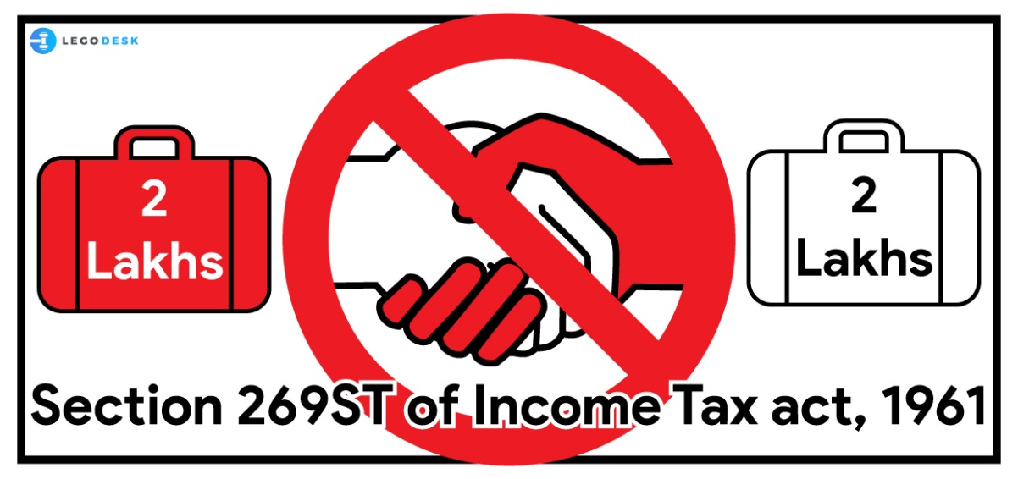
Section 269ST – Restriction on Receipt of Cash
Provision
No person shall receive ₹2,00,000 or more:
In aggregate from a person in a day,
In respect of a single transaction,
In respect of transactions relating to one event or occasion.
Cash receipts must be through banking modes.
Penalty/Impact
(Section 271DA) Equal to the amount received in cash.

Slide 20
Section 269ST – Restriction on Receipt of Cash
Exceptions
(Applies to cash receipts of ₹2,00,000 or more)
Government transactions.
Receipts from banking companies, post offices, cooperative banks.
Specified persons exempted via notification by the Central Government.
Transactions like withdrawal from bank account are not covered under this section.
Relief under Section 273B: No penalty if the person proves reasonable cause for contravention.

Slide 21
Section 269SU – Mandatory Digital Payment Facility
Provision
Applies to businesses with turnover over ₹50 crore.
Must provide digital payment options (e.g., UPI, debit cards).
Penalty/Impact
(Section 271DB) ₹5,000 per day of non-compliance (Section 271DB).
Exceptions
Applies only to businesses with turnover exceeding ₹50 crore in the preceding year.
Small businesses (below ₹50 crore) are not required to provide digital facilities.

Slide 22
Special Acts Governing Cash Transactions
Act | Key Provisions | Penalties | Exceptions
Prevention of Money Laundering Act (PMLA), 2002 | Cash transactions exceeding ₹10 lakh must be reported by banks and financial institutions. Prohibits activities involving proceeds of crime ED can attach, freeze, and confiscate assets. | Non-reporting or money laundering may lead to: Fine: Up to 5 lakh or more. Imprisonment: 3 to 7 years, extendable to 10 years in some cases. | Transactions with legal source of income and proper documentation are not covered. Applies only to scheduled offences (predicate offences) Excludes petty offences or unintentional reporting lapses in most cases.
Benami Transactions (Prohibition) Act, 1988 | Prohibits holding property in another person’s name. Benami properties are liable for confiscation by the government. | Imprisonment: Up to 7 years. Fine: Up to 25% of the property's market value. | Transactions where: Property is held in spouse/child’s name and paid from known sources. Held in a fiduciary capacity (e.g., trustee, partner, director). Made in the name of HUF members and paid from HUF income. These are not considered benami if conditions are met

Slide 23
Special Acts Governing Cash Transactions
Act | Key Provisions | Penalties | Exceptions
Foreign Exchange Management Act (FEMA), 1999 | Governs all foreign exchange dealings in India. Applies to cross-border investments, remittances, and transactions. | Up to 3 times the amount involved or ₹2 lakh (whichever is higher) Additional ₹5,000 per day for continuing offence | Transactions under general permission by RBI (e.g., remittances within limit). Small-scale transactions by NRIs and resident individuals under prescribed schemes. Certain FDI and ECB transactions through automatic route are exempt from prior approval.

Slide 24
Special Acts Governing Cash Transactions
Act | Key Provisions | Penalties | Exceptions
Payment and Settlement Systems Act, 2007 | Provides framework for secure and efficient digital payments. RBI regulates and supervises payment systems like NEFT, RTGS, UPI. | ₹5 lakh for first offence ₹10 lakh or more for subsequent violations RBI may suspend or cancel license of payment system operators | Transactions with: Central/State Governments Banks or cooperative/post office savings banks Notified entities Agricultural income earners under certain conditions Emergency cash transactions under Rule 6DD (IT Act) Individuals making or receiving payments are not liable unless acting as operators. Penalties apply to system providers/operators, not end-users. RBI may waive penalties in case of bona fide errors or technical glitches.

Slide 25
Conclusion
India's financial laws are moving toward a cashless, accountable economy.
Each provision — from income tax sections to special acts — serves a specific compliance objective.
Understanding the scope, limits, and penalties is crucial for sound financial management.
Non-cash transactions are not just encouraged — they are enforced through legal and financial consequences.
Staying compliant ensures legal safety, financial integrity, and contribution to national economic goals.

