Slide 1

Ind AS 16 Property, Plant & Equipment
Faculty : CA Naga Durga Sudhakar GV
Accounting Standards Board
The Institute of Chartered Accountants of India
New Delhi, India
Disclaimer: The views expressed herein are solely those of the Faculty/Presenter and not that of the ICAI or any of its committees. The ICAI or the Faculty or Preparer of this material do not accept any responsibility for omission or inadequacy of the contents in this document and also for loss caused to any person who acts or refrains from acting in reliance on the contents of this document irrespective of the cause of / reason for the loss.

Slide 2
Bird’s eye view
What is an asset?
Conceptual Framework for Financial Reporting under Indian Accounting Standards (Ind AS) defines the word asset as under:
4.3 An asset is a present economic resource controlled by the entity as a result of past events.
4.4 An economic resource is a right that has the potential to produce economic benefits.
This section discusses three aspects of those definitions:
(a) right (see paragraphs 4.6–4.13);
(b) potential to produce economic benefits (see paragraphs 4.14–4.18); and
(c) control (see paragraphs 4.19–4.25).

Slide 3
Bird’s eye view
Purpose | Classification | Reference
Assets held for sale in the ordinary course of business; | Inventories | Paragraph 6(a) of Ind AS 2
Tangible items that are held for use in the production or supply of goods or services … | Property, plant and equipment | Paragraph 6 of Ind AS 16
property held NOT for the above two purposes, but rather held for rentals or capital appreciation | Investment property | Paragraph 5 of Ind AS 40
Any property held for sale (PPE/Intangible asset / Investment property) | Non-current assets held for sale | Paragraph 6 of Ind AS 105
Bearer plants | Property, plant and equipment | Paragraph 5 of Ind AS 41 Paragraph 6 of Ind AS 16

Slide 4
introduction
One fundamental problem in the financial reporting is how to account for periodically, the performance when many of the expenditures an entity incurs in the current period also contribute to future accounting periods.
Ind AS 16 - PPE
Appendix A - Changes in existing decommissioning, restoration and similar liabilities
Appendix B - Stripping costs in the production of a surface mine

Slide 5
Structure of the Standard
Ind AS 16
Recognition
Measurement at recognition
Subsequent measurement
De-recognition
Disclosures
Initial costs
Subsequent costs
Elements of cost
Measurement of cost
Cost model
Revaluation model
Depreciation
Useful life
Impairment
Compensation for impairment

Slide 6
Objective and Scope
Objective: Prescribe the accounting treatment for PPE so that users of the financial statements can discern information about an entity’s investment in its property, plant and equipment and the changes in such investment.
(Amount of PPE in NIFTY 500 Companies’ FS)
Scope: This Standard does not apply to:
(a) property, plant and equipment classified as held for sale in accordance with Ind AS 105 Non-current Assets Held for Sale and Discontinued Operations;
(b) biological assets related to agricultural activity (see Ind AS 41 Agriculture);
(c) the recognition and measurement of exploration and evaluation assets or
(d) mineral rights and mineral reserves such as oil, natural gas and similar non-regenerative resources.
However, this Standard applies to property, plant and equipment used to develop or maintain the assets described in (b)–(d).

Slide 7
Definitions
Definition:
Property, plant and equipment are tangible items that:
(a) are held for use in the production or supply of goods or services, for rental to others, or for administrative purposes; and
(b) are expected to be used during more than one period.
Recognition:
An item of PPE should be recognised only if:
its cost can be measured reliably and
it is probable that the future economic benefits associated with the entity will flow to the entity

Slide 8
Recognition
Recognition:
An item of PPE should be recognised only if:
its cost can be measured reliably and
it is probable that the future economic benefits associated with the entity will flow to the entity
Spare parts and minor items:
Major spare parts shall be capitalized as PPE while smaller spares would be carried as inventory;
As a matter of practicality, many companies will have the minimum value for capitalising the assets;
Unit of measure
The Standard does not prescribe the unit of measure for recognition, ie what constitutes an item of property, plant and equipment. (eg: Tools, moulds and dies shall be aggregated and the principles of the standard shall be applied for the aggregated amounts.

Slide 9
Recognition
Recognition:
An item of PPE should be recognised only if:
its cost can be measured reliably and
it is probable that the future economic benefits associated with the entity will flow to the entity
Environmental and safety equipment:
Items acquired for safety or environmental reasons even though they are indicative of deficiency in the recognition criteria.

Slide 10
Recognition
Recognition:
An item of PPE should be recognised only if:
its cost can be measured reliably and
it is probable that the future economic benefits associated with the entity will flow to the entity
Initial and subsequent expenditure:
No distinction in principle between the initial costs and any subsequent expenditure upon it.
Distinction between servicing (day to day servicing) and more major expenditure (replacement of significant part of the asset)
Major inspection:
The standard allows a separate part to be recognised if an entity is required to perform regular major inspections for faults, regardless of whether any physical parts of the asset are replaced.
Ind AS 16 Vs Ind AS 37

Slide 11
Measurement
Measurement at recognition
(At cost)
Initial purchase price | XXXX
Add: Import duties
Add: Non-refundable purchase taxes
Less: Trade discounts and rebates
Directly attributable costs | YYYY
Initial estimate of dismantling costs | ZZZZ
Total cost of the item of PPE | AAAA

Slide 12
Directly attributable costs
Handling and delivery
Installation and Assembly
Site preparation
Cost of testing – proceeds from sale
Employee benefits
Directly attributable costs
Professional fee
Borrowing costs on qualifying assets under Ind AS 23

Slide 13
Nonprofit Revenue Sources
Ineligible costs
New facility
New location / customer
01
03
New product / service
Cost of introducing the product in new location or to a new customer
Administrative costs
Inauguration expenses
02
04
Cost of introducing new product or service into the market
Administrative costs

Slide 14
Measurement at recognition

Slide 15
Measurement at recognition
Administration and other general overheads:
Administration and other general overhead costs are not costs of an item of PPE – General management salaries.
Cessation of capitalization:
Cost capitalisation ceases once an item of PPE is in the location and condition necessary for it to be capable of operating in the manner intended by the management.
Self built assets
If an asset is self built by the entity, the same general principles apply as for an acquired asset. If the asset is built for resale, then the cost of building shall be the cost of production of that asset.
Internal profits are eliminated
cost of abnormal amounts of wasted material, labour, or other resources incurred in self-constructing an asset is not included
Bearer plants
Same way as self-constructed items of PPE;
Construction should be read as activities necessary for cultivation;
Deferred payments:
Extended credit period – cost to be recognised is the cash price equivalent of the asset.

Slide 16
Measurement at recognition
Example
On 1st April, 20X1, XYZ Ltd. acquired a machine under the following terms:
List price of machine 80,00,000
Import duty 5,00,000
Delivery fees 1,00,000
Electrical installation costs 10,00,000
Pre-production testing 4,00,000
Purchase of a five-year maintenance contract with vendor 7,00,000
In addition to the above information XYZ Ltd. was granted a trade discount of 10% on the initial list price of the asset and a settlement discount of 5%, if payment for the machine was received within one month of purchase. XYZ Ltd. paid for the plant on 20th April, 20X1.
Compute the cost of the asset to be recognized.
Solution
Maintenance contract is a separate contract to get service, therefore, the maintenance contract cost of 7,00,000 should be taken as a prepaid expense and charged to the profit or loss over a period of 5 years.
In addition, the settlement discount received of 3,60,000
(72,00,000 x 5%) is to be shown as other income in the profit or loss.
List price | 80,00,000
Less: Trade discount (10%) | -8,00,000
 | 72,00,000
Import duty | 5,00,000
Delivery fees | 1,00,000
Electrical installation costs | 10,00,000
Pre-production testing | 4,00,000
Total amount to be capitalized at 1st April, 20X1 | 92,00,000

Slide 17
Measurement at recognition
Example
On 1st April, 20X1, an item of property is offered for sale at 10 million, with payment terms being three equal instalments of Rs.33,33,333 over a two-year period (payments are made on 1st April, 20X1, 31st March, 20X2 and 31st March, 20X3). Implicit interest rate of 5.36 percent p.a.
Solution
Year | Payment | Discounting factor @ 5.36% | Present value
1.4.20X1 | 33,33,333 | 1.000 | 33,33,333
31.3.20X2 | 33,33,333 | 0.949 | 31,63,333
31.3.20X3 | 33,33,334 | 0.901 | 30,03,334
Initial date cash price equivalent | 1,00,00,000 |  | 95,00,000
Year | Opening balance (a) | Interest @ 5.36% (b) = (a) x 5.36% | Total payment at year beginning (c) | Principal amount in the instalment (d) = (c) – (b) | Closing balance (e) = (a) - (d)
1.4.20X1 | 95,00,000 | - | 33,33,333 | 33,33,333 | 61,66,667
31.3.20X2 | 61,66,667 | 3,30,533 | 33,33,333 | 30,02,800 | 31,63,867
31.3.20X3 | 31,63,867 | 1,69,467* | 33,33,334 | 31,63,867 | Nil

Slide 18
The two types of income
Income from incidental operations | Income during the testing phase
Example – income generated from using the plot of land as car parking while the manufacturing is in place | Which is generated by selling the output from the testing phase
Treated as income | It is reduced from the cost of testing
In other words, such income does not reduce the cost of capitalising the asset | In other words, the income during the testing phase reduces the cost of capitalising the asset

Slide 19
Measurement at recognition
Land and buildings to be redeveloped:
Procurement of land along with building and planned redevelopment necessitates demolition of existing building and construction of a new building that suits the business requirements of the buyer.
Contributions of PPE by customers: Ind AS 115 shall be applied
Accounting for parts of the assets: Ind AS 16 requires significant parts of the assets to be depreciated separately;
Cost of replacing the part is recognised and the replaced part is derecognised;

Slide 20
Measurement at recognition
Component accounting – replacement of component
An entity buys a piece of machinery with an estimated useful life of ten years for Rs.10 million. The asset contains two identical pumps, which are assumed to have the same useful life as the machine of which they are a part. After seven years one of the pumps failed and is replaced at a cost of Rs. 200,000. The entity had not identified the pumps as separate parts and does not know the original cost.
It uses the cost of the replacement part to estimate the carrying value of the original pump. With the help of the supplier, it estimates that the cost would have been approximately Rs. 170,000 and that this would have a remaining carrying value after seven year's depreciation of Rs. 51,000. Accordingly it derecognises Rs. 51,000 and capitalises the cost of the replacement.

Slide 21
Measurement at recognition
Incidental and non-incidental income
Incidental income – sale of samples produced when testing the equipment concerned
Non-incidental income – Rental income earned by letting out the land during the construction of a building.
Asset is already in the locations and ready for use – Income shall be recognised as revenue in the profit and loss account.

Slide 22
Measurement at recognition
Exchange of assets:
Measured at fair value unless
the exchange transaction lacks commercial substance or
the fair value of neither the asset received nor the asset given up is reliably measurable.
If the fair value of neither the asset given up nor the asset received can be measured reliably, the cost of the asset is measured at the carrying amount of the asset given up and there is no gain or loss.
Where both the fair value of the asset given up and the fair value of the asset received can be estimated with equal reliability, the fair value of the asset given up is used to measure the cost of the asset received. However, if the fair value of the asset received can be measured with more reliability, that value is used.

Slide 23
Measurement at recognition
When do we say that the transaction lacks commercial substance?
An exchange transaction has commercial substance if:
a) the configuration (risk, timing and amount) of the cash flows of the asset received differs from the configuration of the cash flows of the asset transferred; or
b) the entity-specific value of the portion of the entity’s operations affected by the transaction changes as a result of the exchange; and
c) the difference in (a) or (b) is significant relative to the fair value of the assets exchanged
Example
Pluto Ltd owns land and building which are carried in its balance sheet at an aggregate carrying amount of INR 10 million. The fair value of such asset is INR 15 million. It exchanges the land and building for a private jet, which has a fair value of INR 20 million, and pays additional INR 3 million in cash.

Slide 24
Measurement AT recognition
Assets acquired under lease:
The cost of initial recognition of assets held under lease is determined in accordance with Ind AS 116 “Leases”
Assets acquired with the assistance of government grants
The carrying amount of an item of PPE may be reduced by the amount of government grant in accordance with Ind AS 20 “Accounting for government grants and disclosure of government assistance”

Slide 25
Measurement after recognition

Slide 26
Measurement after initial recognition
Cost model
Cost less Accumulated depreciation less impairment losses if any;
Revaluation model
Measurement at revalued amount less any subsequent accumulated depreciation and any subsequent accumulated impairment losses.

Slide 27
Revaluation model
01
Revaluation model is allowed only if the fair value can be determined with reference to an active market for the item of PPE. If an entity chooses an accounting policy to measure an item of PPE at revalued amount, it must apply the revaluation model to all the assets in that class, unless there is no active market for those other assets.
02
The revaluations have to be performed with such regularity that at the end of the reporting period that the carrying amount does not materially differ from the fair value of the asset;
03
Increase in the value of the PPE - OCI except to the extent the revaluation gain reverses the revaluation loss earlier recognised in profit and loss account
04
Decrease in revaluation reserve - profit and loss account except to the extent the revaluation loss reverses the earlier revaluation gain in which case, it shall be recognised in OCI

Slide 28
Accumulated depreciation
How to treat accumulated depreciation at the date of revaluation?
Jupiter Ltd. has an item of property, plant and equipment with an initial cost of INR 100,000. At the date of revaluation accumulated depreciation amounted to INR 55,000. The fair value of asset, by reference to transactions in similar assets, is assessed to be INR 65,000.
Method – I: Depreciation Elimination Approach
The net result is that the asset has a carrying amount of INR 65,000 (100,000 – 55,000 + 20,000).
Method – II: Restatement Approach
Carrying amount (100,000 – 55,000) = 45,000 Fair value (revalued amount) 65,000 Surplus 20,000
% of surplus to the carrying amount (20,000 / 45,000) 44.44%
Asset (1,00,000 x 44.44%) Dr. 44,444
Accumulated Depreciation (55,000 x 44.44%) Cr. 24,444
Revaluation Reserve Cr. 20,000

Slide 29
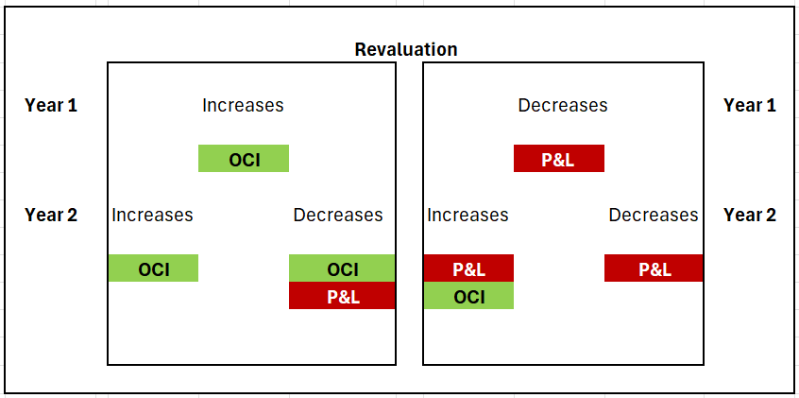
Revaluation results

Slide 30
Class of assets
01
Land
02
Land and buildings
03
Machinery
04
Ships or aircrafts (two separate classes)
05
Motor vehicles
06
Furniture and fixtures
07
Office equipment
Bearer plants is a separate class of item of PPE

Slide 31
depreciation

Slide 32
depreciation
Objective - Operating profit of the Company should reflect the cost of use of the property, plant and equipment in the period.
defined as: “…the systematic allocation of the depreciable amount of an asset over its useful life”.
Allocated on a - systematic basis over its useful life.
Recognised as - an expense unless they are included in the carrying amount of another asset.
Significant components - significant components with substantially different useful lives shall be treated separately for depreciation purposes.
Commences - when the asset is ready for use
Ceases - when an asset is derecognised or held for sale under Ind AS 105.
Idle asset - Depreciation does not stop when an asset is idle
Methods of depreciation – SLM / Diminishing balance / units of production / Annuity (reverse declining)
For revalued assets - The revalued amount is the basis for the carrying amount and depreciable.

Slide 33
Changes in estimates

Slide 34
Changes in estimates
Of useful life
Useful lives of property, plant and equipment should be reviewed at least at each year end
If expectations are different from previous estimates, the change should be accounted for as a change in estimate in accordance with Ind AS 8, 'Accounting policies, changes in accounting estimates and errors’.
Prospective in nature
Of residual value
Residual values of property, plant and equipment should be reviewed at least at each year end
If expectations are different from previous estimates, the change should be accounted for as a change in estimate in accordance with Ind AS 8, 'Accounting policies, changes in accounting estimates and errors’.
Prospective in nature
Change in the method of depreciation
The depreciation method applied to an asset should be reviewed at least at each year
If there has been a significant change in the expected pattern of consumption of the asset's future economic benefits, the method should be changed to reflect the changed pattern.
Any such change in method should be accounted for as a change in accounting estimate in accordance with Ind AS 8

Slide 35
Retirement & disposals

Slide 36
Retirement & disposals
An item of property plant and equipment should be derecognised when:
It is disposed of.
No future economic benefits are expected from its use or disposal.
Ind AS 16 requires that the gain or loss on derecognition (that is, on disposal or retirement from use) of an item of property, plant and equipment is the difference between the estimated net disposal proceeds and the carrying amount.
Compensation for impairment
Compensation from third parties for items of property, plant and equipment that were impaired, lost or given up shall be included in profit or loss when the compensation becomes receivable.

Slide 37
disclosures

Slide 38
disclosures
1
Land
For each class of intangible assets:
Measurement bases;
Depreciation method used;
Useful life and depreciation rate used
Gross carrying amount and the accumulated depreciation;
Reconciliation of carrying amount at the beginning and end of the period showing:
Additions;
Classified as sale;
Revaluations;
Impairment losses (recognized and reversed);
Depreciation;
Exchange differences;
Others
2
Land and buildings
3
Machinery
4
Ships or aircrafts (two separate classes)
5
Motor vehicles
6
Furniture and fixtures
7
Office equipment

Slide 39
Disclosures
The financial statements are also disclose:
a) the existence and amounts of restrictions on title, and property, plant and equipment pledged as security for liabilities;
b) the amount of expenditures recognised in the carrying amount of an item of property, plant and equipment in the course of its construction;
c) the amount of contractual commitments for the acquisition of property, plant and equipment; and
d) if it is not disclosed separately in the statement of profit and loss, the amount of compensation from third parties for items of property, plant and equipment that were impaired, lost or given up that is included in profit or loss.
For revalued assets
a) the effective date of the revaluation;
b) whether an independent valuer was involved;
c) for each revalued class of property, plant and equipment, the carrying amount that would have been recognised had the assets been carried under the cost model; and
d) the revaluation surplus, indicating the change for the period and any restrictions on the distribution of the balance to shareholders
Recommended disclosures
a) the carrying amount of temporarily idle property, plant and equipment;
b) the gross carrying amount of any fully depreciated property, plant and equipment that is still in use;
c) the carrying amount of property, plant and equipment retired from active use and not classified as held for sale in accordance with Ind AS 105; and
d) when the cost model is used, the fair value of property, plant and equipment when this is materially different from the carrying amount.

Slide 40
Practical illustrations

Slide 41
Illustration 1
A manufacturing company has acquired agricultural land for setting up a factory building. For construction of the building, certain permissions are required from regulatory authorities. The company has to incur significant costs (non-refundable) for obtaining such permissions such as environmental clearance and change of land use, etc. Whether such cost can be capitalised? If yes, whether this can be capitalised as a cost of construction of the factory building?
Whether obtaining permission is a formality – can be capitalised;
Not a formality – Shall be charged off

Slide 42
Illustration 2
ABC Ltd. is setting up a new refinery outside the city limits. In order to facilitate the construction of the refinery and its operations, ABC Ltd. Is required to incur expenditure on the construction/development of railway siding, road and bridge. Though ABC Ltd. incurs (or contributes to) the expenditure on the construction/development, it will not have ownership rights on these items and they are also available for use to other entities and public at large. Whether ABC Ltd. can capitalise expenditure incurred on these items as property, plant and equipment (PPE)? If yes, how should these items be depreciated and presented in the financial statements of ABC Ltd.?
Not individually, but can be included as part of the cost of the project

Slide 43
Illustration 3
Continuing the illustration in Question 2 above, ABC Ltd. under an understanding with local authorities also construct a school, which will be subsequently handed over to be managed by an independent trust. Though ABC Ltd. incurs expenditure on the construction/development of the school, it will not have ownership rights and the assets will also be available for use to the general public (however, preference will be given to employees of the Company). Whether ABC Ltd., can capitalise expenditure incurred as its property, plant and equipment?
No obligation to construct the school – Shall be charged off

Slide 44
Illustration 5
A manufacturing company enters into a contract with a supplier to procure equipments over a period of 3 years. The Company has to pay cancellation fees for terminating the contract. The cancellation fees would only be in respect of those equipments which are not procured by the Company as per the contract.
The Company decides to terminate the contract at the end of year 1 since it has identified another supplier which would result in a significant reduction in cost for the company. It pays the cancellation fees in respect of the remaining equipments not yet procured. Whether the cancellation fee paid by the Company should be capitalised as part of the cost of the equipment purchased?
Cancellation fee is for “not” buying the products – Charged off

Slide 45
Illustration 6
An entity has employed a contractor for construction of chemical plant. The terms of the agreement clearly specify that the liquidated damages are paid as compensation for failure to meet performance conditions in terms of the desired quality and level of output subsequent to commissioning of the plant.
The damages will be calculated based on the shortfall in the output as a percentage of the contract price. Whether such liquidated damages received be deducted from the cost of the related asset or recognised as income?
Received after the asset is available for use – To be treated as income

Slide 46
Illustration 7
An entity PQR Ltd. employed a contractor to build a power plant on turnkey project basis for a total consideration of Rs. 100 crores. As per the terms of the contract, if there is more than one month delay in the completion of construction, PQR Ltd. is entitled to recover liquidated damages at 0.25% of the contract value for every week of delay subject to the maximum of 5% of contract value.
The contractor delayed the completion of construction by 45 days and therefore, PQR Ltd. received liquidated damages from the contractor. The management believes that liquidated damages basically compensate it for its loss of revenue for the period of 45 days. What will be the treatment of these liquidated damages received on delays by the contractor?
Still the asset is not available for use / directly identifiable with the project

Slide 47
Illustration 8
Company A is constructing a building for its business use. The construction of the building is interrupted because of protests by the farmers for additional compensation for land sold by them in that area for an indefinite period.
Company A continues to incur certain fixed cost. Whether such fixed costs, including abnormal costs, incurred during the period of interruption will be capitalised to the cost of building?
Abnormal costs – to be charged off

Slide 48
Summary of the ABOVE Illustrations
Instance | Suggested answer
Cost of filing for obtaining permissions to construct a building | Whether obtaining permission is a formality – can be capitalised; Not a formality – Shall be charged off
Enabling assets (expenditure on the construction/development of railway siding, road and bridge) | Not individually, but can be included as part of the cost of the project
Cancellation fee paid for terminating the contract that has minimum purchase quantities | Fee was paid “NOT for purchasing” the item but rather paid for “NOT purchasing” the item. Hence, charged off
Liquidated damages received from Vendor as the asset was not performing as specified | As the amount was received after the asset is available for use – Hence treated as income
Liquidated damages received from vendor for not completing the commissioning of the asset on time | As the asset is not available for use, the amount received is considered as a n adjustment to the purchase price

Slide 49
Additional SCENARIOS
Scenario | Response
Customised machinery spares expected to be used for more than one accounting period | Capitalised as PPE
Company has set an internal limit for capitalisation of spares to be Rs. 50,000 i.e., any item of spare having useful life of more than 1 year and value more than Rs. 50,000 would be capitalised by the Company. | Standard does not define unit of account; Individually insignificant items can be aggregated; In the given case, spares that are not expected to be used during more than one annual period should not be capitalised as item of property, plant and equipment.
Company A has exhibited certain rare and expensive paintings and sculptures for aesthetic purposes at entrance hall, conference rooms. The entity does not trade in these items in the ordinary course of business. | One possible answer – Administrative in nature and hence PPE; Second possible answer – Benefits are intangible and hence, artistic related intangible asset
Cost of replaced items | Capitalised – Component accounting – Replaced item is derecognized – New item is capitalized
Company XYZ plans to construct a hotel on a site which is currently occupied by the residents of a small town. The Company XYZ agrees to pay the cost of relocating the residents to another site. Whether the cost of relocating should be capitalised as part of the cost of land for the hotel? | Capitalised - it is directly attributable cost to bring the land to the condition necessary for it to be capable of operating in the manner intended by management.

Slide 50
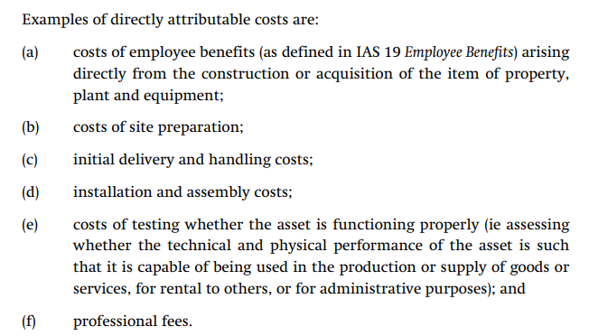
Comparison with IAS 16 / IFRIC 1 / IFRIC 20
Transitional provisions have been incorporated in Ind AS 101;
Wherever applicable, the standard has been modified to reflect the cost model of accounting for Investment properties;
Paragraph 13 A in Appendix C has been added to provide clarity on stripping costs accounting;
Proceeds during testing phase
IAS 16 Ind AS 16
Directly attributable costs:
Costs of employee benefits – site-workers, in-house architects and surveyors etc);
Costs of site preparation;
Initial delivery and handling costs;
Installation and assembly costs;
Costs of testing minus net proceeds from selling any item produced while bringing the asset to that location or condition;
Professional fee;

Slide 51
Comparison with AS 10
Area | Ind AS 16 | AS 10
Real estate developers | Included in its scope | Excluded from the scope
Subsequent expenditure | No difference between initial cost and subsequent costs | Qualifies for capitalization only if it increases the previously assessed standards of performance
Component approach | Mandatory | Not mandatory. Recommendatory in nature
Cost of major inspection | Should be capitalized | Does not deal with this aspect
Cost of dismantling | Included in the cost of asset | Does not deal with the same. Guidance note on Accounting for Oil and Gas producing activities requires capitalisation of such costs
Subsequent measurement | Cost or revaluation model | Allows for revaluation. But the principles are completely different

Slide 52
Comparison with AS 10
Area | Ind AS 16 | AS 10
Review of residual value and useful life | Shall be reviewed at least at each financial year end | Such review is not obligatory
Review of depreciation method | Same as above | Method can be changed only if the change is required as per the Standard or results in more meaningful presentation
Compensation for impairment | Included as income when recoverable | Does not deal with such concept
Exchange transactions | At fair value | Similar provisions
Gains on derecognition | Not as revenue | Silent on this aspect

Slide 53
Changes in the existing decommissioning liabilities
When to apply guidance in Appendix A to Ind AS 16
The guidance in Appendix A to Ind AS 16 applies to changes in the measurement of any existing de-commissioning, restoration or similar liability that is both:
recognised as part of the cost of an item of property, plant and equipment in accordance with Ind AS 16 or as part of the cost of a right-of-use asset in accordance with Ind AS 116; and
recognised as a liability in accordance with Ind AS 37
When can a change occur?
a change in the estimated outflow;
a change in the current market-based discount rate; and
an increase that reflects the passage of time (also referred to as the unwinding of the discount)
Cost model
Changes shall be added or deducted from the carrying cost of the asset;
any such decrease cannot exceed the carrying amount of the asset; the excess is recognized immediately as income
Check whether this change is an indication of impairment;
Revaluation model
Increase in liability - adjusted against revaluation surplus to the extent credit balance is available relating to that particular asset through 'other comprehensive income;
Decrease in liability - recognised in the revaluation reserve ie equity through 'other comprehensive income subject to any previous revaluation recognized in P&L;
Decrease in liability - in excess of the carrying amount of the asset, recognized in P&L;
Change in evaluation surplus shall be disclosed separately

Slide 54
Illustration
H Limited purchased an item of PPE costing 100 million which has useful life of 10 years. The entity has a contractual decommissioning and site restoration obligation, estimated at 5 million to be incurred at the end of 10th year. The current market-based discount rate is 8%.
The company follows SLM method of depreciation. H Limited follows the Cost Model for accounting of PPE.
Determine the carrying value of an item of PPE and decommissioning liability at each year end
When
There is no change in the expected decommissioning expenses, expected timing of incurring the decommissioning expense and / or the discount rate
At the end of Year 4, the entity expects that the estimated cash outflow on account of decommissioning and site restoration to be incurred at the end of the useful life of the asset will be 8 million (in place of 5 million, estimated in the past).
Determine in case (b), how H Limited need to account for the changes in the decommissioning liability?

Slide 55
Illustration
Present value of the decommissioning liability – 2.32 million [5/(1.08)^10]
Year | Opening Amount of PPE | Depreciation Charge (on SLM) for 10 Years | Carrying Amount of PPE at the end of the year | Opening Decommissioning Liability | Unwinding of Interest @ 8% | Closing Decommissi oning Liability
1 | 102.32 | 10.23 | 92.08 | 2.32 | 0.19 | 2.50
2 | 92.08 | 10.23 | 81.85 | 2.50 | 0.20 | 2.70
3 | 81.85 | 10.23 | 71.62 | 2.70 | 0.22 | 2.92
4 | 71.62 | 10.23 | 61.39 | 2.92 | 0.23 | 3.15
5 | 61.39 | 10.23 | 51.16 | 3.15 | 0.25 | 3.40
6 | 51.16 | 10.23 | 40.93 | 3.40 | 0.27 | 3.68
7 | 40.93 | 10.23 | 30.69 | 3.68 | 0.29 | 3.97
8 | 30.69 | 10.23 | 20.46 | 3.97 | 0.32 | 4.29
9 | 20.46 | 10.23 | 10.23 | 4.29 | 0.34 | 4.63
10 | 10.23 | 10.23 | - | 4.63 | 0.37 | 5.00
Total |  | 102.32 |  |  | 2.68
Revised decommissioning obligation - The present value of the decommissioning liability at the end of Year 4 works out to be 5.04 million [being 8 / (1.08)^6] = 1.89 million (being 5.04 million less 3.15 million)

Slide 56
Illustration
Year | Opening Amount of PPE | Depreciation Charge SLM – 10 Years | Carrying Amount of PPE at end of the year | Opening Decommissioning Liability | Unwinding of Interest @8% | Closing Decommissioning Liability
5 | 63.28 | 10.55 | 52.73 | 5.04 | 0.40 | 5.44
6 | 52.73 | 10.55 | 42.19 | 5.44 | 0.44 | 5.88
7 | 42.19 | 10.55 | 31.64 | 5.88 | 0.47 | 6.35
8 | 31.64 | 10.55 | 21.09 | 6.35 | 0.51 | 6.86
9 | 21.09 | 10.55 | 10.55 | 6.86 | 0.55 | 7.41
10 | 10.55 | 10.55 | - | 7.41 | 0.59 | 8.00
Total |  | 63.28 |  |  | 2.96

Slide 57
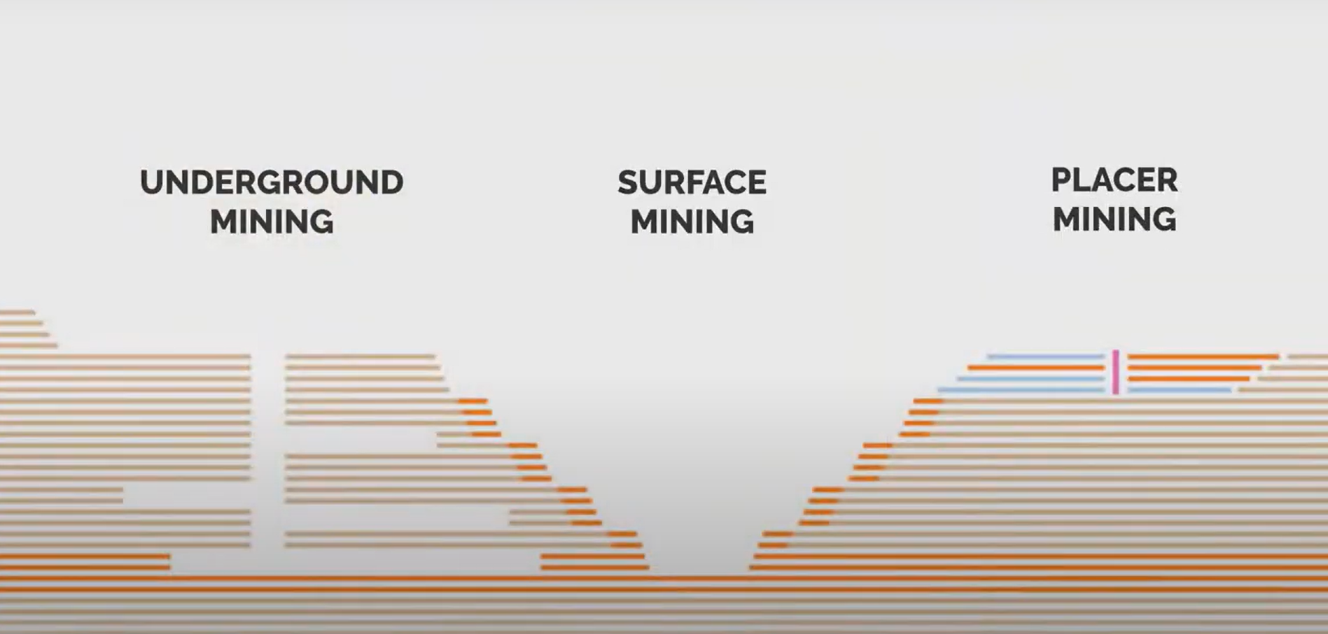
Stripping costs in the production phase of surface mine
In Situ Mining (ISR technique)

Slide 58
Stripping costs in the production phase of surface mine
In surface mining operations, entities may find it necessary to remove mine waste materials (‘overburden’) to gain access to mineral ore deposits.
This waste removal activity is known as ‘stripping’.
Cost of stripping during development phase – usually capitalized as cost of developing and constructing the mine. Charged off using unit of production method once the production begins
A mining entity may continue to remove overburden and to incur stripping costs during the production phase of the mine.
The material removed when stripping in the production phase will not necessarily be a total waste; often it will be a combination of ore and waste. The ratio of ore to waste can range from uneconomic low grade to profitable high grade. This removal might also provide access to deeper levels of material that have a higher ratio of ore to waste. There can therefore be two benefits accruing to the entity from the stripping activity: usable ore that can be used to produce inventory and improved access to further quantities of material that will be mined in future periods.
This Appendix addresses the following issues:
(a) recognition of production stripping costs as an asset;
(b) initial measurement of the stripping activity asset; and
(c) subsequent measurement of the stripping activity asset.

Slide 59
Stripping costs in the production phase of surface mine
Recognise the Stripping costs as an asset
An entity shall recognise a stripping activity asset if, and only if, all of the following are met:
(a) it is probable that the future economic benefit (improved access to the ore body) associated with the stripping activity will flow to the entity;
(b) the entity can identify the component of the ore body for which access has been improved; and
(c) the costs relating to the stripping activity associated with that component can be measured reliably.
The stripping activity asset will be accounted for as part of an existing asset.
Initial measurement of the stripping activity asset
Measured at cost
When the costs of the stripping activity asset and the inventory produced are not separately identifiable, the entity shall allocate the production stripping costs between the inventory produced and the stripping activity asset by using an allocation basis that is based on a relevant production measure.
Subsequent measurement of the Stripping activity Asset
After initial recognition, the stripping activity asset shall be carried at either its cost or its revalued amount less depreciation or amortisation and less impairment losses.
The units of production method shall be applied unless another method is more appropriate.
(REFER COAL INDIA’s ANNUAL REPORT Pages 432 and 433 FOR ACCOUNTING POLICY ON STRIPPING ACTIVITY)

Slide 60

G V Naga Durga Sudhakar
98494 90450
gaapdigest@outlook.com

Slide 61
Copyright Notice
"This presentation contains copyright © material of the IFRS Foundation and The Institute of Chartered Accountants of lndia. All rights reserved. Published by The institute of Chartered Accountants of lndia under licence from the IFRS Foundation. Reproduction and use rights are strictly limited. For more information about the IFRS Foundation and rights to use its material please visit www.ifrs.org".

