Slide 1



INCOME TAX DEPARTMENT
DEPUTY COMMISSIONER OF
INCOME TAX, EXEMPTIONS
CIRCLE, HYDERABAD
OUTREACH PROGRAM
ON EXEMPTION PROVISIONS
04.09.2025
ICAI Branch office, Red Hills, Hyderabad

Slide 2
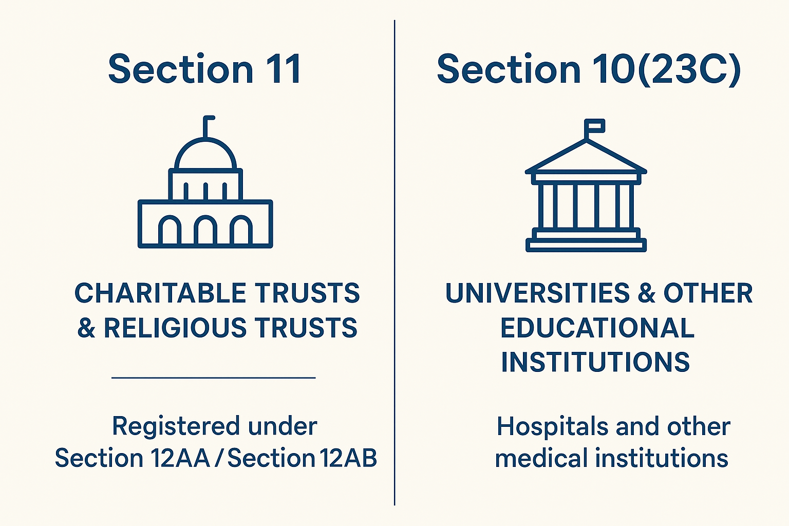
INCOME TAX PROVISIONS FOR ENTITIES
CLAIMING EXEMPTIONS

Slide 3
AUTHORITIES ENGAGED IN
INCORPORATION/REGISTRATION/REGULATION OF NPOs IN INDIA
CHARITABLE & RELIGIOUS TRUSTS
SECTION 8 – NOT FOR PROFIT COMPANY
REGISTERED SOCIETY
Charity Commissioners/State Authorities
Trusts/Societies
Registrar Of Companies
Section 8 company
MHA – FCRA 2010
Foreign Donations
NITI Aayog
DARPAN Portal
Govt. Projects/ CE opening bank accounts
ITD
All Charitable or Religious Institutions

Slide 4

Key Features
Bound by Conditions
Registered u/s 12AB (w.e.f. 1.4.21)
Spend (including accumulation) - 85% of total receipts towards - On the objects of the Trust, or
File Form 10 & 9A
File - ITR-7 (within due date)

Slide 5
Relevant Sections
Section 2(15)
Section 10(23C)
Section 11/12/12A/12AB/13
Section 80G
relief of the Poor,
education,
yoga,
medical relief,
Preservation of environment (including watersheds, forests and wildlife)
preservation of monuments or places or objects of artistic or historic interest,
Advancement of any other object of general public utility

Slide 6
Two regimes: Legal provisions
First regime - Under section 10(23C)
Second regime - Under sections 11 and 12

Slide 7
Section 10(23C) – The First Regime
Clauses
(iiiab)
(iiiac)
(iiiad)
(iiiae)
Institutions solely or substantially ﬁnanced by Government
Education or Medical Institutions not for proﬁt with gross receipts less than
Rs 5 Crores (w.e.f. AY 2022-23 onwards)
No requirement of any approval from Income Tax Department.
No Rules w.r.t application, accumulation or investment apply.
If a Charitable Institution runs both medical and educational institutes, the annual receipt from all such institutes shall be aggregated and Exemption shall be available only if it does not exceed Rs.5 crores. (Prior to 01.4.2022 only Rs.1 Crore)
The only statutory obligation is to ﬁle ITR [u/s139(4C)(e)]

Slide 8
The Second Regime –Exemption u/s 11
Income from property held for charitable or religious purposes.
Sec11 Income derived from property held under trust wholly for charitable or religious purposes
Income either fully applied or applied upto 85% to charitable or religious purposes in India

Slide 9
REGISTRATION/APPROVAL PROCESS

Slide 10
Role of CPC/CIT(E) w.e.f. 01.04.2021
Revised process for Registration/ approval w.e.f. 01.04.2021
Registration & periodical re-registration for all trusts
By CPC/ CIT(E)
3 categories –
  (i) entities which had registration prior to 01.04.2021
  (ii) entities which existed prior to 01.04.2021, but were not registered with Income Tax Department
    a) Not commenced activities.
    b) Commenced activities but no exemption claimed earlier.
  (iii) new entities formed after 01.04.2021
CIT(E) – examine nature of objects/genuineness of activities – pass registration/approval order or reject Form 10AB and cancel provisional registration/approval

Slide 11
Time Line for Registration
Section 12A(1) (ac) | Proviso to Sec. 10(23C)/ Sec 80G(5) | Form to be filed | Purpose (Registration/Approval) | Issuing Authority | Time Period for filing of Authority Application | Order received in
(i) | (i) | 10A | Old entities Regular Registration for 5 years | CPC | 30.06.2024 | 10AC
(ii) | (ii) | 10AB | Renewal of regular Registration under sub-clause (ii) | CIT(E) | 06 Months prior to expiry of registration | 10AD
(iii) | (iii) | 10AB | Provisional to Regular | CIT(E) | 06 Months prior to expiry of registration or within 06 months of the commencement of activities whichever is earlier | 10AD
(iv) | N/A | 10AB | Regularization of 10AB inoperative registration (u/s 11(7) | CIT(E) | 06 Months prior to commencement of relevant AY | 10AD
(v) | N/A | 10AB | Modification of Objects | CIT(E) | Within 30 days in case of modification of objects | 10AD

Slide 12
Time Line for Registration
Section 12A(1) (ac) | Proviso to Sec. 10(23C)/ Sec 80G(5) | Form to be filed | Purpose (Registration/Approval) | Issuing Authority | Time Period for filing of Authority Application | Order received in
(vi)A | (iv)A | 10A | Provisional Registration for 03 years | CPC | 01 Month prior to the PY for the relevant AY | 10AC
(vi)B | (iv)B | 10AB | Regular Registration for 5 years (If activities commenced but not claimed exemption in any P.Y.) | CIT(E) | Exemption will be available from the AY immediately following the FY in which the application was made | 10AD
15

Slide 13

IMPORTANT NOTE
Renewal of regular Registration
As per the amended provisions, Old Entities who have obtained Regular registration for 5 years from CPC (Order in Form-10AC) for the period from A.Y. 2022-23 to A.Y. 2026-27
Need to apply for Renewal before
30th September 2025.

Slide 14
Replenishment of corpus/Loan
10(23C)-third proviso- Explanation 2
Corpus/Loan
Application
Not allowed
Section 11(1)-Explanation-4
Not towards corpus
Application before
01.04.21 not allowed to be re-plenished/repaid
Not in cash
Replenishment of corpus/ repayment of loan
Replenishment within 5 years of the original application
Allowed
TDS deduction
Conditions to be satisﬁed
Actual payment
No carry forward
No beneﬁt to speciﬁed person
In India

Slide 15
Donations to other trusts
Corpus donations
Not allowed
12th proviso to 10(23C)
Explanation 2 to 11(1)
Other than corpus donations
Up to AY 23-24-100%
allowed
Wef AY 2024-25-Only 85% allowed
11(1)-Explanation 4- clause(iii)
10(23C)-third proviso- Explanation 2-clause(iii)

Slide 16
Business by CIs
Only incidental business is allowed
Receipts from the business are not more than 20% of the receipts of trust
Separate books of account are to be maintained
[ACIT (Exemption) Vs. Ahmedabad Urban Development Authority 2022 (SC)]
Depreciation(Sec 11(6))
Either of the following is allowed as application:
Cost of acquisition
Depreciation
Modes of Investment
Surplus funds to be kept in 11(5) modes only (Rule 17c)

Slide 17
Audit Report
10B: trusts u/s 11/12
Audit report
Previous Forms
10BB: trusts u/s 10(23C)
Annual receipts > Rs 5 crore
Detailed report: 10B
Foreign donation received
Proposed form (both regimes- w.e.f 01.04.2023)
Small report: 10BB
Application outside India

Slide 18
Return of Income
Return of income mandatory
For both the regimes
Exemption allowed till the time allowed for ﬁling belated ITR i.e. till 31st December (w.e.f AY 23-24)

Slide 19
Section 13 violations
Section | Particulars | Consequences of Violation
13(1)(a) | If income of the trust is used for private religious purpose which does not enure for the beneﬁt of the public | Cancellation of registration
13(1)(b) | Income of the trust or institution created /established for the beneﬁt of any particular religious community or caste | Cancellation of registration
13(1)(c) | Income used/applied for the beneﬁt of speciﬁed persons -section 13(3) | Income taxed at special rate of 30% (u/s 115BBI)
13(1)(d) | Funds not deposited in 11(5) modes | Taxed at special rate of 30% (u/s 115BBI)
13(2)(a) to (h) | Beneﬁts to speciﬁed persons | Income taxed at special rate of 30% (u/s 115BBI)

Slide 20
SPECIFIED PERSONS U/S. 13(3)
OF THE IT ACT, 1961
Author/Founder of the Trust
Person who made donation of more than 50,000/- (W.e.f. 01.04.2025 exceeds Rs. 1,00,000/- or in aggregate up to the end of relevant year exceeds Rs. 10,00,000/-).
Trustee or Manager of the Trust.
Relative of Founder, Donor, Member, Trustee, and Manager
Any concern in which any of the above person has substantial interest.

Slide 21
Violations and consequences
Violations of diﬀerent provisions
A) Taxing certain speciﬁed income @30% u/s 115BBI
B) Registration to continue and taxing net income under section 13(10)/(11)
C) Registration to be cancelled in case of speciﬁed violations u/s 12AB (4)/(5) or under 15th proviso to section 10(23C)
Violations of diﬀerent provisions

Slide 22
A) Taxing certain speciﬁed income @30% u/s 115BBI
Accumulation without form 10/9A
For the surplus in the ITR: tax slab rates not allowed now
Violations w.r.t accumulated income:
  Applied to purposes other than Charitable/Religious
  Ceases to remain invested/deposited as per 11(5)
  Not utilized for the speciﬁc purpose
  Credited/Paid to other Charitable Institutions
Income invested in modes other than 11(5) modes any other form or mode of investment or deposit as may be prescribed
Beneﬁts to speciﬁed persons
Application outside India without CBDT approval
Treated as income in the year immediately after the year of receipt/in the year immediately after the year in which income was derived if not utilized for the purposes for which accumulated.
Penalty u/s 271AAE
First instance - 100% of the amount of unreasonable beneﬁt provided to the speciﬁed person.
Subsequent instance – 200% of the amount of the unreasonable beneﬁt

Slide 23
B) Registration to continue and taxing net income under section 13(10)/(11)
Not maintaining books of account
Not getting the books of account audited or submitting the audit report late
Not ﬁling the return of income or submitting the same late.
(Genuine Hardship - Remedy : Condonation of delay)
  Income to be calculated subject to fulﬁllment of basic conditions –
    Expenditure not to be out of the Corpus Fund/Loan
    Depreciation wrt asset whose COA has already been claimed as application - not allowable
    Donations not to be to any other person
    Only revenue expenditure is allowed.
    Capital Expenditure not allowed.

Slide 24
C) Registration to be cancelled in case of speciﬁed violations u/s 12AB (4)/(5) or under 15th proviso to section 10(23C)
3 possible scenarios:
(a) Suo moto
(b) Reference made by the AO
  Application beyond objects
  Non-incidental business/ non maintenance of books of incidental business:
  Application for private religious purpose
  Beneﬁts to particular religious community or caste
  Ingenuine activates/violation of conditions for registration
  Violation of other Laws
Incomplete/false information or incorrect application – (w.e.f 01.04.2023)
(c) RMS(Risk Management Strategy)
Procedure
CIT has the right to carry out enquiries
CIT may cancel the registration on the basis of facts
Section 115TD applicable to the charitable institutions u/s 10(23C)(iv)/(v)/ (vi)/(via) as well.

Slide 25
Effects of cancellation of registration
Section 115TD/115TE/115TF
Applicable to the charitable institutions u/s 10(23C)(iv)/(v)/(vi)/(via) as well w.e.f. 01.04.23 (for other institutions u/s 11/12 - w.e.f 01.04.2021)
Applicable where:
  Registration of the trust is cancelled and or
  Institution merged with entity having different objects and or
  Failed to transfer upon dissolution all its assets as per its dissolution clause
Only after the order cancelling the registration is upheld by the ITAT or no appeal is ﬁled.
115TD - Accreted value of the assets to be taxed (Rule - 17CB)
  - Due date of payment --Sec.115TD(5)
115 TE – Simple Interest @ 1%
115TF – Assessee deemed to be assessee in default – collection and recovery proceedings as per I T Act, 1961.

Slide 26
Failure in ﬁling application for registration - Application of section 115TD –- Changes by the Finance Act, 2023
Provisional registration
New trust (activities not commenced)
Application
Provisional to regular registration
Failure to apply: 115TD
One time re-registration
Failure to apply: 115TD
Old trust (already registered)
Renewal after 5 years
Failure to apply: 115TD
Old trusts (not registered and activities commenced)
Common registration

Slide 27
CHANGES RELATED TO CHARITABLE INSTITUTIONS – Finance Act 2023
1. Any expenditure incurred out of any loan or borrowings, the repayment of such loan must be within 5 years to make it eligible to be considered as application of income.
2.Any expenditure incurred from the corpus fund, the replenishment of such corpus to be done within 5 years to make it eligible to be considered as application of income.
3. If a CI has given donation to another trust, then only 85% of the same will be considered as application.
4.Now the beneﬁt of registration of Section 12A will not be available in the years prior to the year of fresh registration .
(ITAT, Kolkata case in Sree Sree Ramakrishna Samithy)

Slide 28
CHANGES RELATED TO CHARITABLE
TRUSTS – Finance Act 2023
5. As per present Section 12AB, ﬁrst provisional registration is done, then permanent registration is granted for 5 years. But as per Finance Bill 2023, if a trust not registered earlier has commenced its activities, it can apply for permanent registration directly.
6. Power to cancel the registration of Provisional 12AB has also been inserted in the Act.
7. Trust will have to pay tax under Section 115TD in case of failure to apply for renewal of registration/approval after 3/5 years of registration/ approval under section 12AB or 10(23C).

Slide 29
NEW AMENDMENTS IN BUDGET 2024
Merger of Entities covered under section 10(23C) with Entities covered under section 12A. (Effective from 01.10.2024)
Condonation of delay in filing Form 10AB for regularization of Provisional Registration by CIT(E). (Applicable from 01-10-2024)
Time limit for passing the order of registration of section 12AB/80G – Within 6 months from the end of the quarter in which the application is made. In Form 10AB

Slide 30
AMENDMENTS IN BUDGET 2025
Section | Amendment
12AB | In order to provide relief to small trust whose total income without giving effect to Section 11 and Section 12 does not exceed Rs. 5 Crore during each of the two previous years preceding the previous year in which the application is made, registration shall have effect for 10 years instead of 5 years.
13(3) | As per existing provisions, a specified person includes any person who has made a substantial contribution to the trust i.e. any person whose total contribution up to the end of relevant year exceeds Rs. 50,000/-. Now it is proposed that a specified person includes any person whose total contribution to the trust or institution during the relevant year exceeds Rs. 1,00,000/- or in aggregate up to the end of relevant year exceeds Rs. 10,00,000/-.

Slide 31
Practical difficulties in filing of
ITR 7

Slide 32
Who should file ITR 7?
For persons including companies required to furnish return under sections
139(4A) : Charitable/religious trusts
139(4B) : Political parties
139(4C) : Scientific and other research organisations
139(4D) : University, college/other institutions

Slide 33
DUE DATES
ITR 7 filing due date u/s 139
Non auditable: 31st July
Auditable: 31st Oct
Audit report to be filed on or before due date electronically

Slide 34
ITR 7: Basic structure
Part A: General information
Part B- T1 : statement of Income
TTI : Computation of tax liability on total
Schedules (selective)
I (amounts accumulated)
J (funds and investments)
AI ( Aggregate of Income)
IE (Income and expenditure)
VC (Voluntary Contribution)
115TD (Accreted Income

Slide 35
Relevance of the presentation
Role as JAO
Rectification u/s 154
Mistakes apparent from the record
Recurring Issues
1. Delay in filing ITR/ audit report
2. Registration related issue
3. Mismatch between ITR and Audit report
4. Miscellaneous

Slide 36
Delay in Filing audit report
Going to appeal for remedy?
Condonation of delay u/s 119 (2)(b)
Genuine hardship in filing to be verified irrespective of the registration regime
CIT/PCIT is the approving authority (upto 365 days), delay beyond > 365 days, approving authority Pr.CC
Conditions specified ( 7/2023)
From AY 23-24, Form 10B
1. Annual receipts > 5Cr
2. Received any Foreign Contribution
3. Applied any part of income outside India
All other cases, 10BB

Slide 37
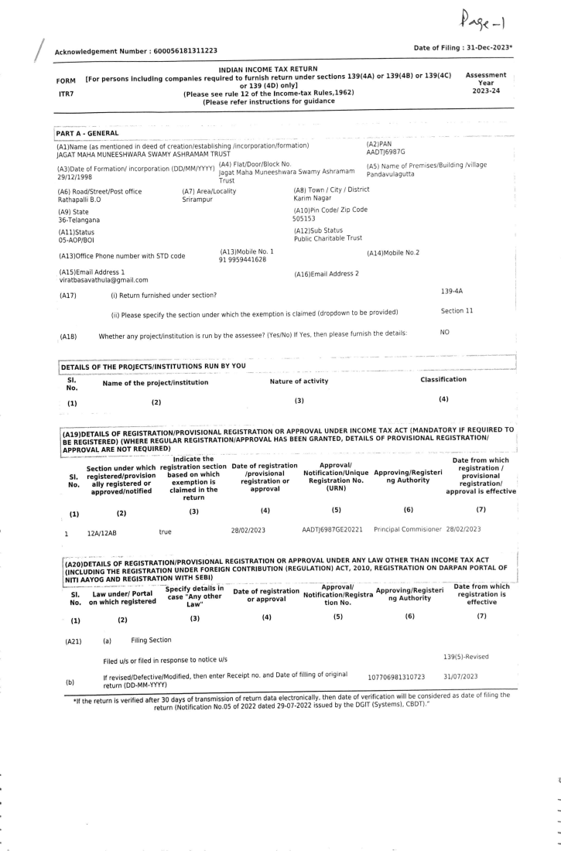
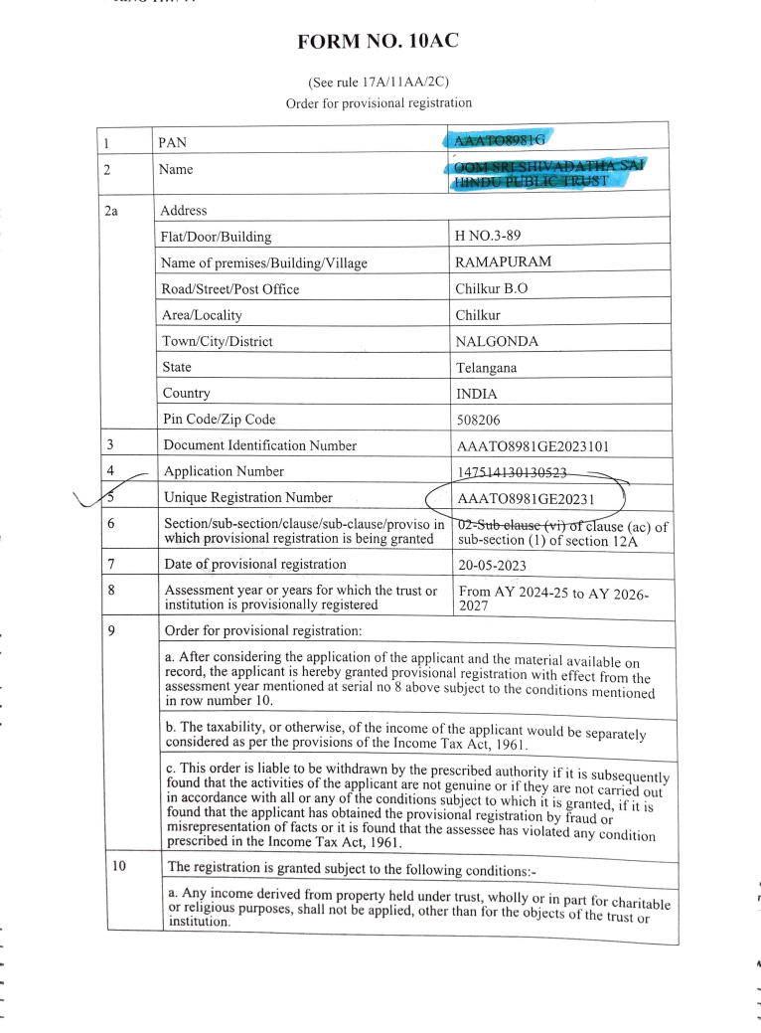
Registration related issue

Slide 38
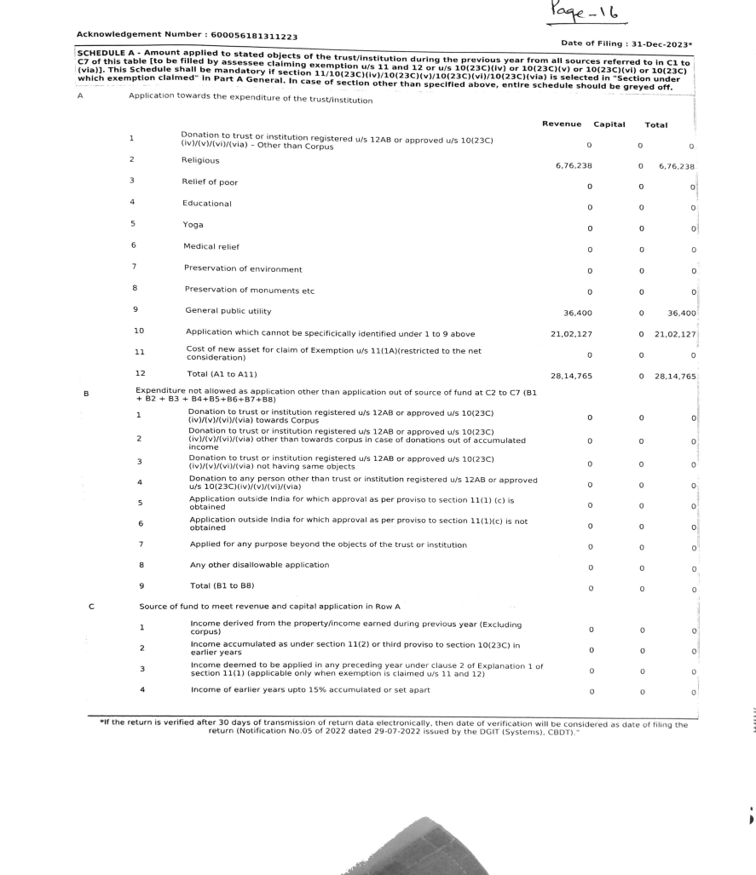
Mismatch between ITR 7 and Audit report
Combined schedule A instead of ER and EC Amount applied to stated objectives from all sources

Slide 39
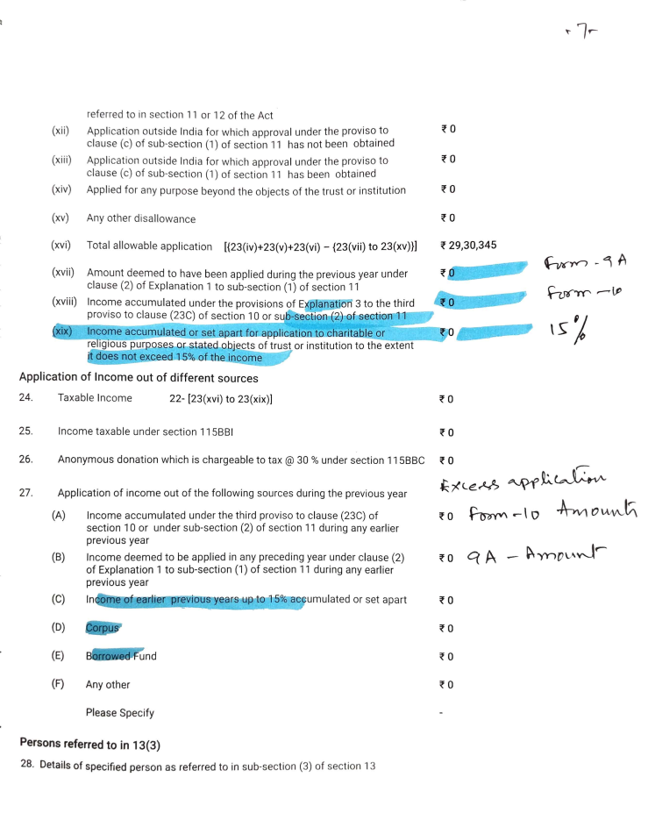
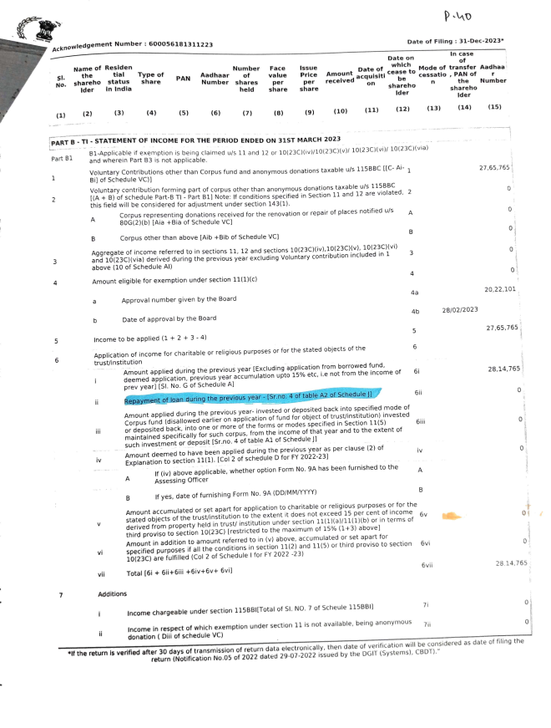
Mismatch between ITR 7 and Audit report

Slide 40
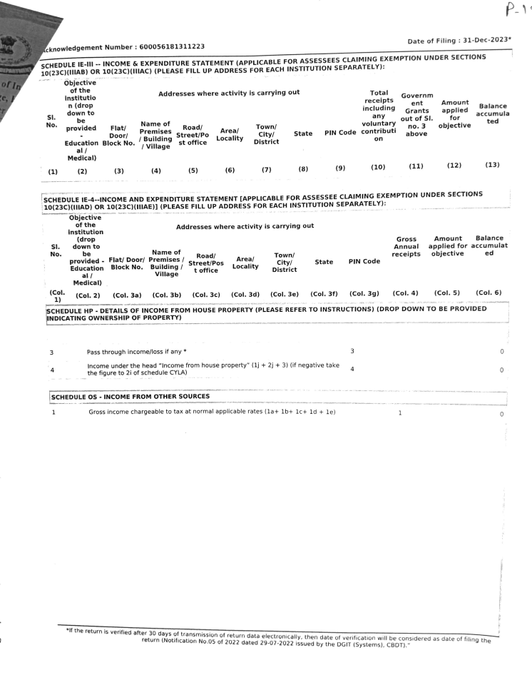
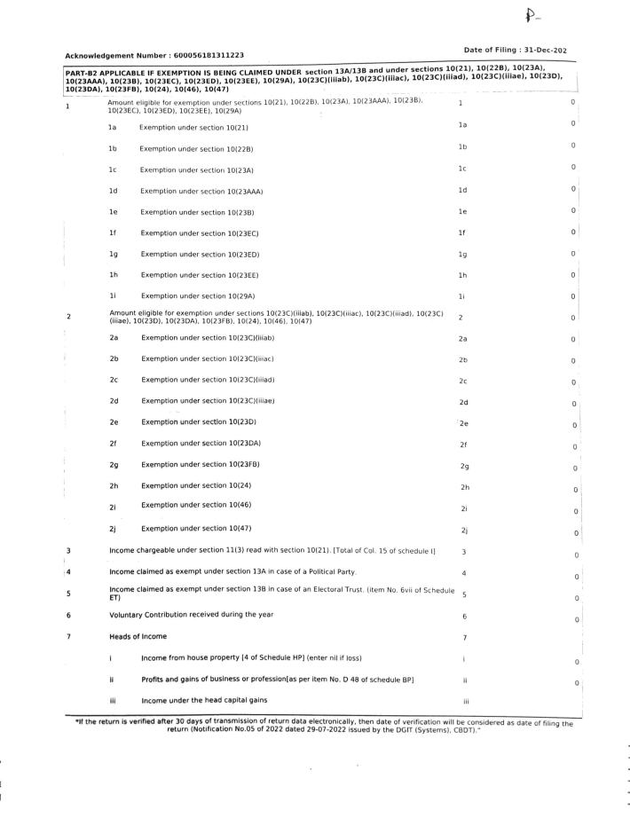
Mismatch within ITR 7 (Part B-T1 and Schedule IE

Slide 41
Miscellaneous issues
Accumulation of income (Sch I)
Form 10 to be filed within 2 months of due date of filing ITR - 31st Oct
(Accumulation to be utilised within 5 years not in the 6th year If not applied with 5 years, taxable in 5th year)
Form 9A : deemed application for 1 year

Slide 42
Points to reconsider
2C Approach
Be Compliant with the rules
Ensure valid registration details
Filing ITR and audit report
Filing ITR and audit report within time
Replying to notice/letter
Be Careful while filing the details
Recheck every entry
avoid last moment rush

Slide 43
IT ACT 2025
provisions are spread across Chapters
12,800 words to 7,600 words.
A common term registered non-profit organisation
clauses of section 10 have been placed in 6 different schedules
Clause 23C of section 10 contains 15 sub-clauses with numbers such as 10(23C)(i)-(via). Clause (23C) has 24 provisos. The 3rd proviso to clause (23C) has 7 Explanations and Explanation 2 to the 3rd proviso has again 8 provisos.
there are provisos within clauses, Explanations to these provisos and again provisos to the Explanations making it difficult to comprehend the provisions.

Slide 44


