Slide 1
CA Kedarnath

Slide 2
Hyderabad Branch of SIRC of ICAI
{Take risks in your life, If you win, you can lead! If you loose, you can guide}
- Swami Vivekananda

Slide 3
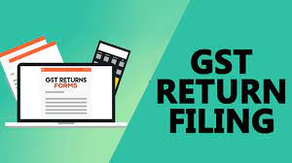
A Session on GSTR-1 & GSTR-3B Return Filing & Reporting
On 04th Jun 2025
By CA Kedarnath

Slide 4
Introduction to GST Returns:
Return means a Summary Statement
Furnished by a tax payer / dealer
With the Statutory Authorities
Through the “returns mechanism” the tax payer informs to the department about his Sales / Purchases / ITC / Tax Payments etc.,
Such return is filed voluntarily
Government always keeps reliance on the tax payer to declare correct and fair disclosure in the return
It is the responsibility of the tax payer to declare the correct details accordingly
Failure to do the same would attract interest and penalty and other consequences from the department
Hence, true and correct disclosure is required in the returns always

Slide 5
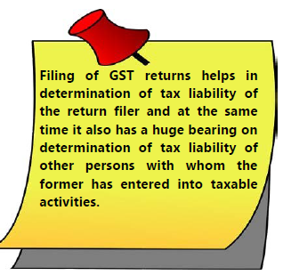
GST Returns:
In any tax law, “filing of returns” constitutes the most important compliance procedure which enables the Government/ tax administrator to estimate the tax collection for a particular period and determine the correctness and completeness of the tax compliance of the taxpayers.

Slide 6
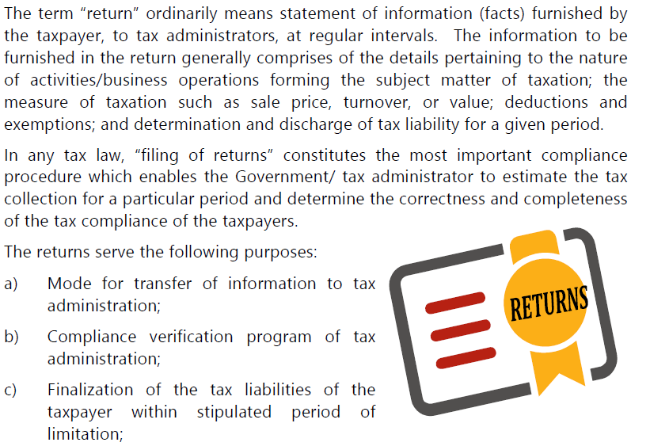
Introduction to GST Returns:

Slide 7
List of Returns / Statements under GST GSTR-1 Sec 37

Slide 8
Who requires to File GSTR-1 :

Slide 9
GSTR-1

Slide 10
GSTR-1 : Outward Supplies
DE : Deemed Export Invoices
SEZ Supplies with Payment
SEZ Supplies without Payment
Supply attract reverse charge
Intra-State Supplies attracting IGST : It will be enabled only when the supply attract RCM is selected
B2B

Slide 11
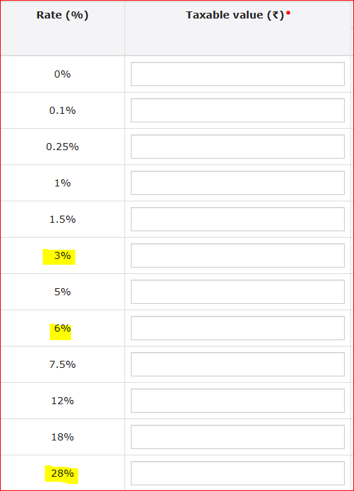
GSTR-1 : Outward Supplies & Tax Rates
B2CL: If a business makes a high-value sale (over Rs.2.5 lakh) to a customer in another state who isn't GST-registered, it falls under a B2C large invoice.
One of the significant outcomes of the 53rd GST Council meeting was that starting from August 1, 2024, interstate sales to unregistered persons exceeding Rs.1 lakh must be reported under the B2CL section in GSTR-1. Previously, this threshold invoice limit was Rs.2.5 lakh.

Slide 12
GSTR-1 : Outward Supplies

Slide 13
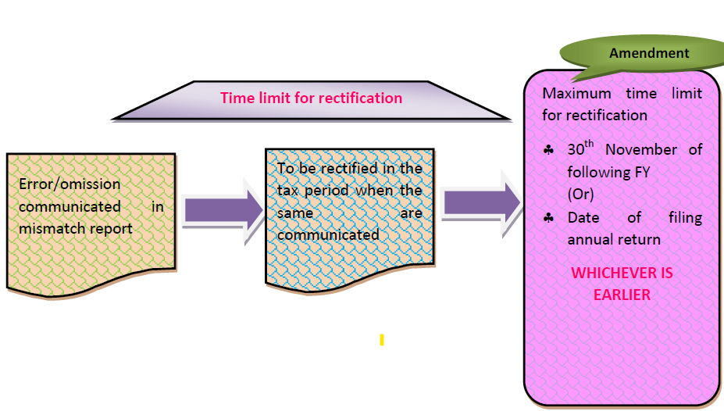
Amendments in GSTR-1 :

Slide 14
GSTR-1
Apart from Outward Supplies, the following data shall be furnished in GSTR-1, if applicable
Credit Notes
Debit Notes
EXWP: Exports with payment of Tax
EXWOP: Exports without payment of Tax
SEZWP / SEZWOP
Nil-rated, Exempted and Non-GST Supplies
Advances received
Advances Adjusted
Amendments related to B2B or B2C, SEZ Invoices & Export Invoices
Amendments related to CN & DN and Advances received & Advances Adjusted

Slide 15
GSTR-1
Apart from Outward Supplies, the following data shall be furnished in GSTR-1, if applicable
Documents Issued
Documents Issued
Cancelled
Net issued
HSN & SAC
HSN : Harmonized System of Nomenclature - For Goods
SAC : Service Accounting Code : For Services – Chapter No. 99

Slide 16
GSTR-1: HSN & SAC
HSN : Used for Goods : Harmonized System of Nomenclature
SAC: Used for Services : Service Accounting Code >>> Chapter “99”

Slide 17
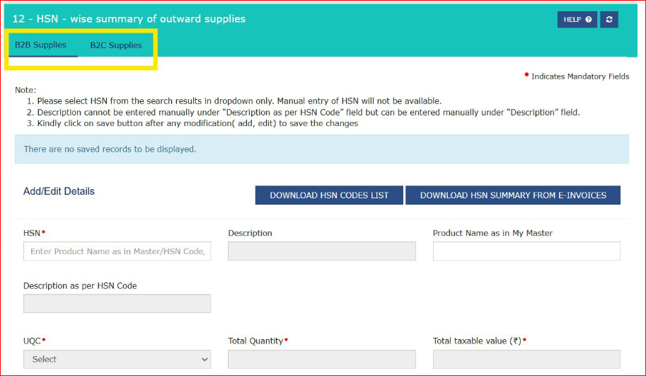
GSTR-1: HSN & SAC
HSN Summary for B2B Supplies
HSN Summary for B2C Supplies

Slide 18
GSTR-3B Summary Return (Section 39):
Due date for payment of tax [Section 39(7)]
Due dates for payment of tax in respect of the persons required to file GSTR- 3B, GSTR CMP-08, GSTR-5 and GSTR-7,8 are linked with the due dates for filing of such returns i.e., the last dates (due dates) of filing such returns are also the due dates for payment of tax in respect of persons required to file such returns.
A taxpayer needs to electronically sign the submitted returns otherwise it will be considered not-filed.
Taxpayers can electronically sign their returns using a DSC (earlier mandatory for all types of companies and LLPs), or EVC (Electronic Verification Code sent to the registered mobile number of the authorized signatory).

Slide 19
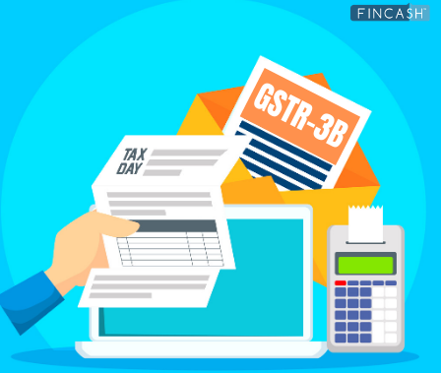
GSTR-3B

Slide 20
GSTR-3B Return:

Slide 22
Due date for filing GSTR-3B return in case of tax payers opting for QRMP Scheme

Slide 23
Due date for filing GSTR-3B return in case of tax payers Not opting for QRMP

Slide 24
Rule 86B w.r.t GSTR-3B
Rule 86B talks about the payment of 1% of Output Tax Liability in Cash
This rule is applicable on the registered person whose value of taxable supply other than exempted supply and zero-rated supply, in a month exceeds Rs 50 Lakh
It means the registered person can’t use ITC in excess of 99% of output tax liability in a month
Rule 86B starts with non-obstante clause and has override impact on any other provision of the rules
This rule is effective from 1st Jan 2021
Notification No. 94/2020-CT Dated 22.12.2020

Slide 25
Rule 88B w.r.t GSTR-3B
Rule 88B: Manner of calculating interest on delayed payment of tax
Net of ITC / Interest on Cash Deposited in ECL / ITC Wrongly utilized
Cash Deposited in the Electronic Cash Ledger on or before the Due Date : No Interest is applicable even set off not done, till the date of payment
Interest will be applicable on the Net of ITC: It means interest needs to be payable on the Cash component
Interest on ITC: If wrongly ITC availed and "utilized" : Interest will be applicable

Slide 26
ITC Wrongly Reversed in T-4B(2), But actual reversal is T-4B(1)
Correct Treatment is
In the Forthcoming GSTR-3B Return
Add the wrong ITC in the Table - 4A(5) "All Other ITC“
Report the wrong ITC in the Table - 4B(1) "As per rules 38,42 & 43 of CGST Rules and section 17(5)" i.e., ITC Permanent Reversal
Report wrong ITC again in Table - 4D(1) " ITC reclaimed which was reversed under Table 4(B)(2) in earlier tax period"

Slide 27
QRMP Scheme

Slide 28
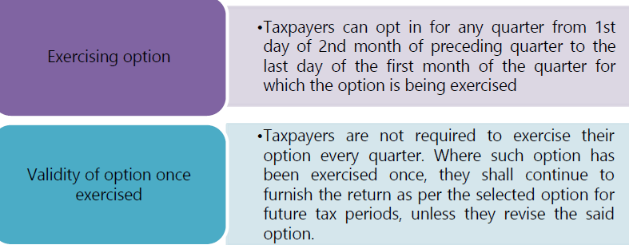
QRMP Scheme

Slide 29
Benefits of QRMP Scheme

Slide 30
Concept of IFF: Invoice Furnishing Facility
Invoice Furnishing Facility (IFF) is a facility provided to quarterly taxpayers who are in QRMP scheme, to file their details of outward supplies in first two months of the quarter (M1 and M2), to pass on the credit to their recipients. IFF consists of the following Tables of FORM GSTR-1:
4A, 4B, 6B, 6C – B2B Invoices, SEZ, Deemed Export Invoices
9B – Credit/ Debit Notes (Registered)
9A – Amended B2B Invoices
9C – Amended Credit/ Debit Notes (Registered)
Note: IFF can be furnished on or before 13th of subsequent Month, later the option expires
FAQ’s can be viewed:
https://tutorial.gst.gov.in/userguide/returns/FAQs_IFF.htm#:~:text=IFF%20is%20an%20optional%20facility,GSTR%2D1%20for%20the%20quarter.

Slide 31
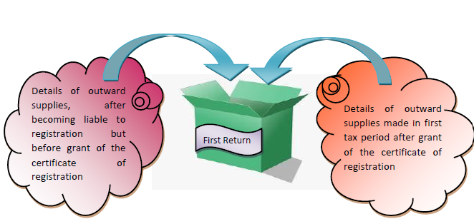
GST FIRST RETURN (Section 40)
Every registered person who has made outward supplies in the period between the date on which he became liable to registration till the date on which registration has been granted shall declare the same in the first return furnished by him after grant of registration.

Slide 32
Section 61 - Scrutiny of Returns
The proper officer can scrutinize the GST return and related particulars furnished by the registered person to verify the correctness of the return to verify its correctness. This is called a scrutiny assessment.
It is a non-compulsory pre-adjudication process
The officer will ask for explanations on discrepancies noticed.
GSTR-1 Vs GSTR-3B
GSTR-3B Vs GSTR-2B
RCM not paid compared with Auto Populated in GSTR-2B
Relevant Forms:
FORM GST ASMT – 10: Notice for intimating discrepancies in the return after scrutiny
FORM GST ASMT – 11: Reply to the notice issued u/s 61 (Reply shall be given with in the period say 30 days)
FORM GST ASMT – 12: Order of acceptance of reply against the notice issued under section 61

Slide 33
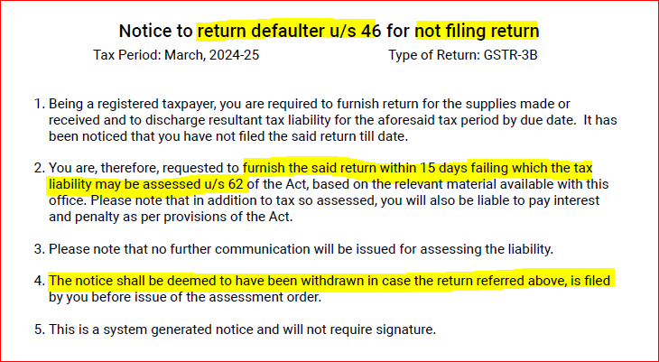
GSTR-3A: Failure to file the Return
S.62 - Assessment of registered person who have failed to file the tax returns

Slide 34
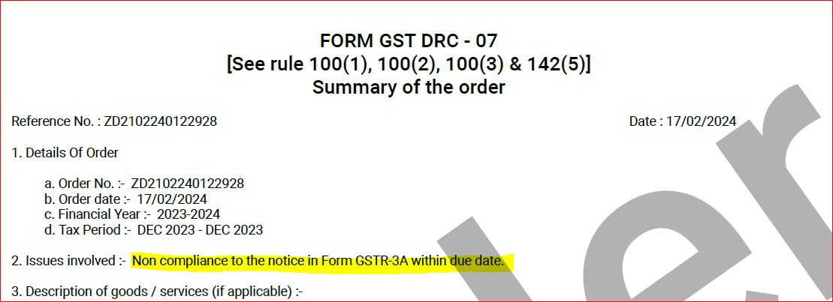
GSTR-3A: Failure to file the Return
S.62 - Assessment of registered person who have failed to file the tax returns

Slide 35
Form GSTR-2A

Slide 36
Form GSTR-2B

Slide 37
GSTR-2A Vs GSTR-2B

Slide 38
New Updates in the GST Portal:
Services >>> Returns
Return Compliances:
Liability Mismatch (DRC-01B) : GSTR-1 vs 3B
ITC Mismatch (DRC-01C) : GSTR-3B vs 2B
System driven notice will be served online >>> Part-A
Reply shall be given >>> if agree Pay Tax, else reply shall be furnished in Part-B

Slide 39
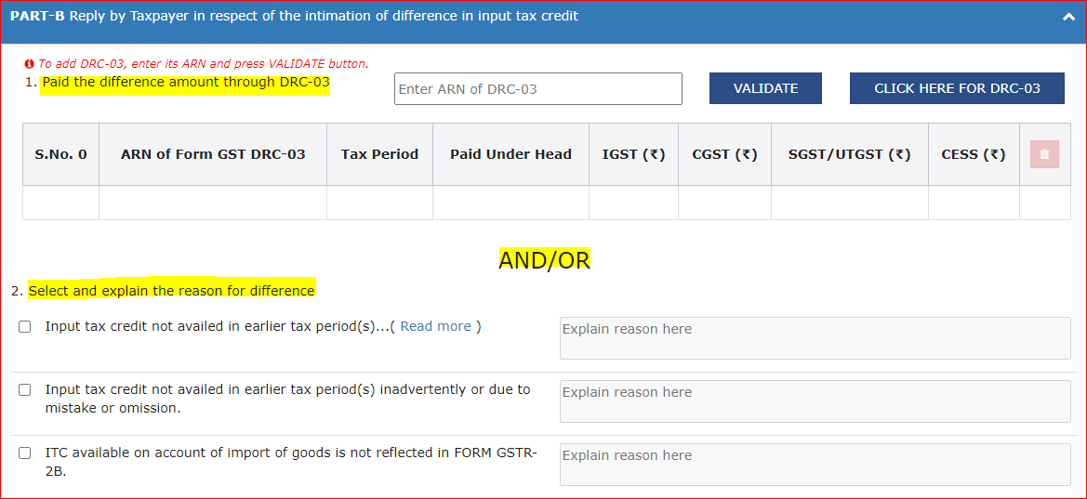
New Updates in the GST Portal:
Part- A of DRC-01C
Part- B of DRC-01C

Slide 40
New Updates in the GST Portal:
Part- A of DRC-01C : System Generated Notice

Slide 41
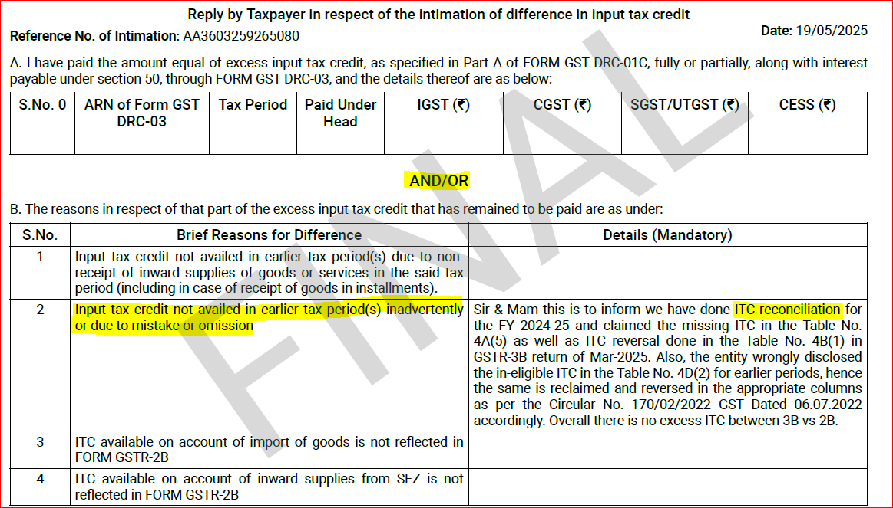
New Updates in the GST Portal:
Part- B of DRC-01C : Reply by Taxpayer in respect of the intimation of difference in input tax credit

Slide 42
New Updates in the GST Portal:
Services >>> Ledger >>> Electronic Cash Ledger
File PMT-09 for Transfer of amount in Cash Ledger (with in the same GSTIN)
File PMT-09 for Transfer of amount in Cash Ledger (to different GSTIN on the same PAN)
Part- B of DRC-01C
Question: Can we transfer the balance Electronic Credit Ledger for
Same GSTIN
Same Pan with Different GSTIN

Slide 43
New Updates in the GST Portal:
HSN & SAC codes on e-invoice : 6 digits need to mention
Time Limit for generating E-Invoice: W.e.f 01st Nov 2023
30 Days from the date of Invoice Date
Applicable to All Tax Payers whose AATO > = Rs 100 Cr
Payment of GST through Credit and Debit Cards & UPI:
Generate the Challan with option E-Payment
Then select “Mode of E-payment” >>> Debit / Credit Card >>> It will show “ Select Bank >>> Kotak Mahindra Bank >>> Proceed >>> Make payment with Any Indian Banks CC / DC / UPI >>> Payment Done.

Slide 44
S.16(4): Extended Time Limit till 30th Nov of NFY >>>>>> LA
S.N | Particulars | Section | Old Time Limit | New Time Limit
1 | ITC availment | Section 16(4) | Due date of furnishing GSTR-3B of September month of next financial year | 30 November of next financial year
2 | Reporting of credit notes | Section 34(2) | Due date of furnishing GSTR-3B of September month of next financial year | 30 November of next financial year
3 | Amendment in GSTR 1 | First proviso of Section 37(3) | Due date of furnishing GSTR-3B of September month of next financial year | 30 November of next financial year
4 | Amendment in GSTR 3B | Proviso of Section 39(9) | Due date of furnishing GSTR-3B of September month of next financial year | 30 November of next financial year

Slide 45
Sequential Filing of GSTR-1 and GSTR-3B :
This restriction is already in place on GST portal, now legalized under the GST Act
GSTR 1 cannot be furnished if GSTR 1 for earlier period is not furnished {Section 37(4)}
GSTR 1 cannot be furnished if GSTR – 3B for earlier period is not furnished
GSTR-1 mandatory before filing of return in Form GSTR-3B. {Section 39(10)}.

Slide 47
{Arise, awake and stop not until the goal is reached} - Swami Vivekananda
By
CA Kedarnath
Mobile No: 9985162155
Feedback / Queries: pkedarnathassociates@gmail.com

