Slide 1
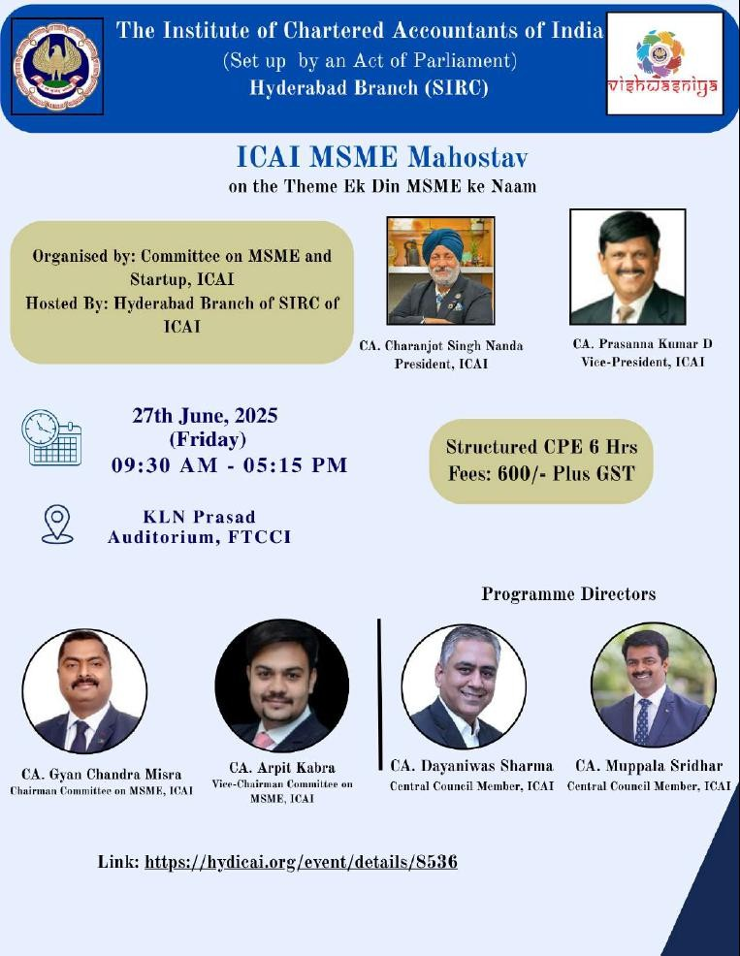
MSME INCENTIVES & COMPLIANCES
27 June 2025, Friday @ 2:00 PM –
3:30 PM
By
Vineet Suman Darda
Co-Founder & Managing Partner, Darda Advisors LLP
https://www.icai.org/
1
www.dardaadvisors.com

Slide 2
Introduction to MSME & Incentives
Snapshot of Central Government Schemes for MSMEs
List of Central Government Schemes (CGS) for MSMEs
List of State Government Schemes (SGS) for MSMEs
List of Compliances for MSMEs
Contents
https://www.icai.org/
1
www.dardaadvisors.com

Slide 3
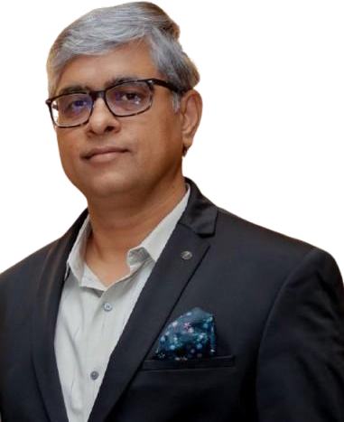
Speaker’s Profile
Vineet has over 20+ years of consulting experience in leadership role in Indirect tax including GST (around 13 years in Big 4)
He has assisted various Organizations including Start-ups and MSMEs in obtaining Central and State investment incentives, transaction incentives and providing advice, compliance assistance and litigation support on Central & State indirect tax laws including GST, Customs, FTA, SEZ, EOU and DGFT.
He is assisting clients in managing GST (including VAT and CST)
compliances, assessments and litigations in multiple States including
Vineet Suman Darda
VAT/GST Audits and also in in litigation management, involving preventive,
diagnostic and rectification studies on areas where disputes with Authorities either occurred or are likely to occur
B.Com | FCA, ACS, CMA(I)
He has conducted sessions on various indirect tax topics (including GST) at
Client’s place, Business Parks, and other forums (CII, FICCI, ASCI, FTCCI,
Strategic Management and Tax Advisor JICA, KOTRA, EPC, ICAI, ICFAI, ICWAI, JITO, RGA, ICSI and others)
91- 99529 26239
He has worked with leading players in diverse industry sectors such as Logistic, Auto Component, Financial Services, Technology, infrastructure and hospitality, Mining, PSU, Government, Pharma, Manufacturing, Trading and other sectors for addressing their concerns under indirect taxes
vineetdarda@dardaadvisors.com
https://www.icai.org/
1
www.dardaadvisors.com

Slide 4
Introduction to MSME & Incentives
https://www.icai.org/ www.dardaadvisors.com

Slide 5
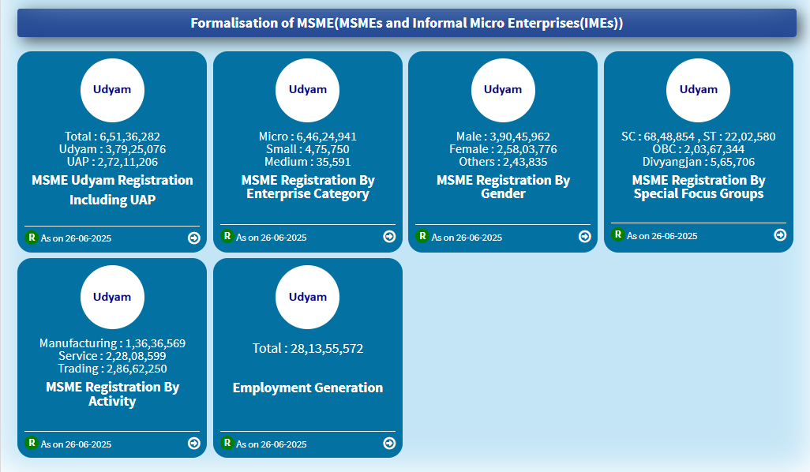
Ministry of Micro Small and Medium Enterprises
The Ministry of Micro, Small and Medium Enterprises, established on May 9, 2007 under the MSMED Act, 2006, is the nodal body for the development and promotion of MSMEs, including khadi, village, and coir industries.
The Ministry discharges its functions through statutory and autonomous bodies, including the Development Commissioner (MSME), Khadi and Village Industries Commission (KVIC), Coir Board, and National Small Industries Corporation (NSIC).
https://www.icai.org/
www.dardaadvisors.com

Slide 6
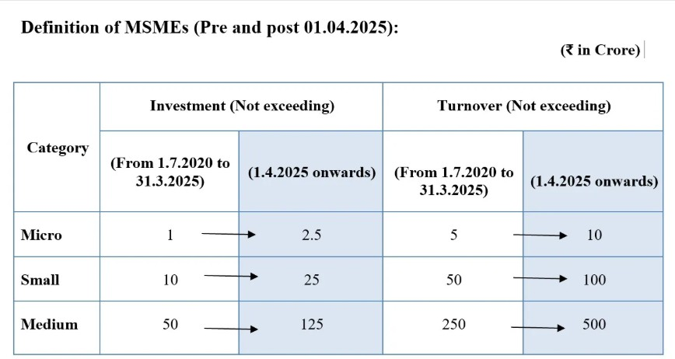
Definition of MSME
Note:
Investment: The expression “plant and machinery or equipment” of the enterprise, shall have the same meaning as assigned to the plant and machinery in the Income Tax Rules, 1962 framed under the Income Tax Act, 1961 and shall include all tangible assets (other than land and building, furniture and fittings).
Turnover: Exports of goods or services or both, shall be excluded while calculating the turnover of any enterprise whether micro, small or medium, for the purposes of classification
https://www.icai.org/
www.dardaadvisors.com

Slide 7
Zero Defect Zero Effect (ZED) certification
ZED (Zero Defect Zero Effect) Certification Scheme is a strategic initiative of the Government of India to enhance
MSME competitiveness and sustainability.
It promotes adoption of zero-defect manufacturing and zero-effect environmental practices.
The Scheme incentivizes quality, standardization, and resource efficiency across the MSME sector.
Aims to transform MSMEs into national and international champions through structured assessment, handholding,
and certification.
https://www.icai.org/
7
www.dardaadvisors.com

Slide 8
Zero Defect Zero Effect (ZED) certification
Aspect | Description
Objective | To ensure zero defects in products and zero effect on the environment, thereby promoting quality and sustainable practices among MSMEs.
Issued By | Quality Council of India (QCI) in association with Ministry of Micro, Small, and Medium Enterprises (MSME), Government of India.
Eligibility | Manufacturers under MSME.
Core Concept | Zero Defects: Ensuring product quality with no defects or rework. Zero Effect: Ensuring that production processes do not harm the environment (environmentally sustainable).
Assessment Criteria | Quality Management: Standards for quality control and quality management systems. Environmental Impact: Implementation of green and sustainable practices. Process Efficiency: Minimizing wastage and maximizing resource utilization.
Certifying Body | National Board for Quality Promotion (NBQP) under the Quality Council of India (QCI).
Validity | Typically valid for 3 years, after which re-assessment is required.
Focus Areas | Product Quality Process Efficiency Environmental Sustainability Human Resource Development Customer Satisfaction
LEVELS | Level 1 (Bronze) Level 2 (Silver) Level 3 (Gold)
https://www.icai.org/
7
www.dardaadvisors.com

Slide 9
Zero Defect Zero Effect (ZED) certification
h | Category | Details
 | 1. Benefits of ZED Certification | Enhanced Product Quality: Reduction in defects and waste, leading to higher product quality. Cost Savings: Reduction in rework, waste, and operational inefficiencies. Operational Efficiency: Streamlined processes, better resource utilization, and improved productivity. Improved Market Access: Increased competitiveness in both domestic and international markets. Brand Recognition: Certification enhances trust and credibility among customers. Environmental Sustainability: Adoption of eco-friendly and energy-efficient practices. Customer Satisfaction: Improved customer loyalty due to consistent product quality and compliance with environmental standards.
 | 2. Incentives for ZED-Certified MSMEs | Subsidy on Certification Fee: MSMEs can avail of a subsidy on the ZED certification fees: Micro Enterprises: 80% subsidy on certification costs. Small Enterprises: 60% subsidy on certification costs. Medium Enterprises: 50% subsidy on certification costs. Free (100% subsidy) ZED Certification for Women Owned MSMEs Government Recognition: ZED-certified MSMEs are recognized for their commitment to quality and environmental sustainability. Market Advantage: ZED certification helps enterprises differentiate their products in the market, providing a competitive edge.
 | 3. Financial Assistance | Access to Government Schemes: ZED-certified MSMEs are eligible for financial support under various schemes, including: PMEGP (Prime Minister’s Employment Generation Programme) MSME Development Fund Credit Linked Capital Subsidy Scheme (CLCSS) Reimbursement for Technology Upgradation: MSMEs may receive financial assistance for acquiring new technologies or improving manufacturing processes under the Technology Upgradation Fund Scheme (TUFS).
 | 4. Subsidies for MSMEs ttps://www.icai.org/ | Subsidy on Certification Process: MSMEs can receive up to 80% subsidy on certification fees depending on the enterprise category (Micro, Small, Medium). Reimbursement of Consultancy Fees: MSMEs can claim reimbursement for consultancy fees related to quality improvement or adopting environmental management systems. Subsidy for Energy Efficiency: MSMEs adopting energy-efficient technologies or making improvements to reduce environmental impact may be eligible ₉for subsidies for energy audits and resource conservationwwacwti.vdiatriedsa.advisors.com

Slide 10
Zero Defect Zero Effect (ZED) certification
Category | Details
5. Loans & Financial Support | Subsidized Loans: Concession of 50% on Processing Fee of 1.5% i.e. Effective PF of 0.75% and Applicable ROI of (Repo + 5.35%) on card rate of (Repo +7.6%) i.e. 2.25% p.a. concession [AU Bank]. Similar schemes with other Banks Credit Linked Capital Subsidy Scheme (CLCSS): Technology Upgradation Fund Scheme (TUFS): Access to Financial Institutions:
6. Preferential Treatment in Public Procurement | ZED-certified MSMEs enjoy preferential treatment in government procurement and tendering processes, which increases the chances of winning government contracts.
7. Support for Market Development | Marketing Assistance: Government-Backed Recognition:
8. Reimbursement for Training and Skills Development | Reimbursement for Training Costs: Skill Development Support:
9. Railway Transport Benefit | Discount on Railway Freight Charges: Powers to Zonal Railways to grant up-to 45% discount in freight rates on indented parcel trains and indented Parcel Vans in empty direction (vide FM Circular-26/2021 dated 22.11.2021)
Other Benefits | Financial Assistance In Testing/System/Product Certification For availing Testing OR Management Systems OR Product Certification, of upto 75% of the total cost of Certification, with the maximum ceiling of subsidy being Rs. 50,000/-. International Cooperation (IC) Scheme Stall Charges subject to a maximum of Rs. 4.00 lakh or actual rent paid, whichever is lower
https://www.icai.org/
www.dardaadvisors.com

Slide 11
Zero Defect Zero Effect (ZED) certification
Category | Details
Other Benefits | International Cooperation (IC) Scheme Economy class airfare subject to a maximum of Rs. 2.25 lakh or actual fare paid, whichever is lower Freight charges under International Cooperation (IC) Scheme Actuals subject to maximum of Rs. 50,000/- + Rs. 25,000/- per MSME unit and Rs. 75,000/- + Rs. 25,000/- per MSME for Latin American Countries. Joining Reward of Rs. 10,000/- Joining reward of Rs. 10,000/- will be offered to each MSME once they take the ZED Pledge which needs to be utilized within a defined time period. This joining reward may be used by an applicant MSME only once while applying for a ZED Certification (Bronze, Silver, Gold). This joining reward will be valid only for 1 year after taking the ZED Pledge. Credit Guarantee Scheme Increased Guarantee Coverage of 85% for ZED Certified MSEs Credit Guarantee Scheme 10% additional concession/relaxation in guarantee fee for ZED Certified MSEs
https://www.icai.org/
www.dardaadvisors.com

Slide 12
Government-e-Marketplace
The Government e-Marketplace (GeM), established and operated by the Directorate General of Supplies and Disposals (DGS&D), is a centralized online platform for procurement of commonly used goods and services by Government departments, public sector undertakings, and autonomous bodies under the Central Government. It is a dynamic, self- sustaining, and user-friendly digital interface intended to ensure transparency, efficiency, and ease of procurement.
https://www.icai.org/
12
www.dardaadvisors.com

Slide 13
Government-e-Marketplace
GEM ADVANTAGES
For Buyers
For Sellers
Rich listing of products for individual categories of Goods/Services
Search, Compare, Select and Buy facility
Buying Goods and Services online, as and when required.
Transparent and ease of buying
Continuous vendor rating system
User-friendly dash board for Buying and monitoring supplies and payments
Easy Return policy.
Direct access to all Government departments.
One stop shop for marketing with minimal efforts.
One stop shop for bids / reverse auction on products / services
New Product Suggestion facility available to Sellers
Dynamic pricing: Price can be changed based on market conditions
Seller friendly dashboard for selling and monitoring of supplies and payments
Consistent and uniform purchase procedures.
https://www.icai.org/
12
www.dardaadvisors.com

Slide 14
Government-e-Marketplace Compliance
Sr. No. | Compliance Area | Key Requirements
1 | Seller Registration | Valid PAN, GSTIN, Bank Details, Udyam/MSME Certificate- Aadhaar-authenticated signatory Timely updates to profile for any business changes
2 | Product/Service Listing | Accurate specifications and clear images- Datasheets, warranty info, correct category selection Inclusive pricing (taxes, shipping, installation) No duplicate or copied listings
3 | GFR & Procurement Policy Compliance | Follow GFR 144(xi) if foreign ownership/investment exists- Submit DPIIT registration if required Adhere to Make in India, MSME reservation, and PDS norms
4 | Order Fulfilment | Dispatch goods on time- Use GeM logistics or self-arranged shipping- Share tracking details Maintain quality packaging/labelling- Meet SLAs for services
5 | Invoice Compliance | Upload GST-compliant invoice within 10–15 days Mention GeM Contract ID & item-wise breakup
6 | Communication & Disputes | Respond to buyers within 24–48 hours- Attend bid clarification meetings Use Incident Reporting Address feedback with professional replies
7 | Blacklisting & Suspension Triggers | Avoid false documents, duplicate listings, SLA breaches Consequences: Temporary bans, catalog deactivation, permanent debarment, or legal action
https://www.icai.org/
12
www.dardaadvisors.com

Slide 15
Snapshot of Central Government MSME Incentives
Financial Schemes | Non - Financial Schemes | Funding Schemes
Prime Minister’s Employment Generation Programme (PMEGP) | Technology Centres / Extension Centres (TCEC) Scheme | Promoting Innovations in Individuals, Startups, and MSME (PRISM)
Procurement and Marketing Support (PMS) Scheme | Digital Communication Innovation Square | Innovations For Defence Excellence (Idex)
Second Loan for Up-gradation of Existing PMEGP/REGP/MUDRA Units | Niryat Bandhu Scheme | Raw Material Assistance Scheme
Cent Kalyani Scheme, Cent Stand Up India | Women Entrepreneur Cell | Aspire - A Scheme For Promotion of Innovation, Rural Industries And Entrepreneurship
SIDBI Make In India Soft Loan Fund For Micro Small And Medium Enterprises (SMILE) | Digital Services Facilitation through Aggregation Services | Technology Development Fund
Venture Capital By SIDBI Venture Capital Ltd. (SVLC) | Entrepreneurship Skill Development Programme (ESDP) scheme | Innovations For Defence Excellence (Idex)
Trade Related Entrepreneurship Assistance And Development (TREAD) Scheme For Women | Promotion of MSMEs in North Eastern Region (NER) and Sikkim
PM FME Scheme | Single Point Registration Scheme (SPRS)
Swarojgar Credit Card
Pradhan Mantri Mudra Yojana
Credit Guarantee Scheme for Micro & Small Enterprises (CGTMSE)
Uttar Poorva Transformative Industrialization Scheme (UNNATI)
Designing a Policy for Medium Enterprises
Raising and Accelerating MSME Performance (RAMP)
PM Vishwakarma – Enabling Artisans & Craftspeople to Scale-up their Enterprises
https://www.icai.org/
15
www.dardaadvisors.com

Slide 16
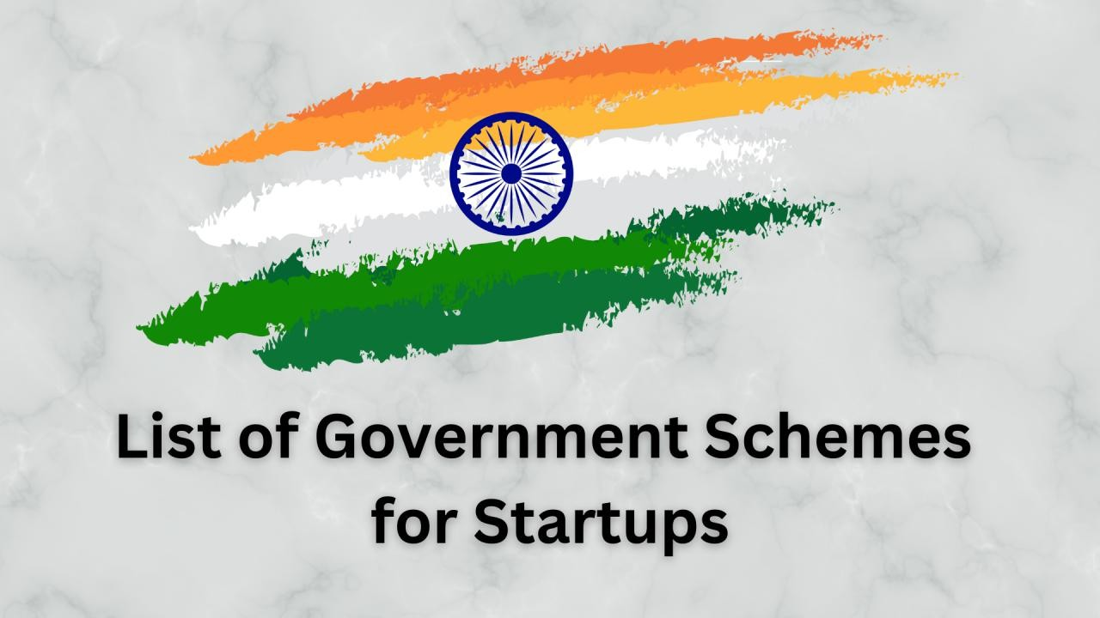
List of Central Government Schemes (CGS) for MSMEs
https://www.icai.org/ www.dardaadvisors.com

Slide 17
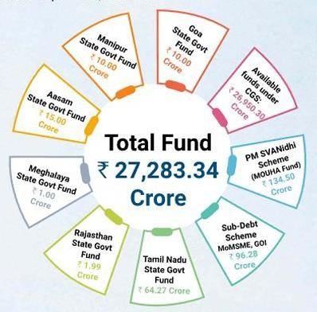
CGS - CREDIT GUARANTEE SCHEME FOR MICRO & SMALL ENTERPRISES (CGTMSE)
Ministry: Ministry of Micro, Small and Medium Enterprises
Key Sectors Covered: All sectors falling under Micro and Small Enterprises (MSEs) including manufacturing, services, trading (retail/wholesale), educational, and training institutions — essentially, all activities eligible under the MSMED Act.
Brief: The CGTMSE scheme aims to promote self-employment and entrepreneurship by providing collateral-free and third-party guarantee-free credit to MSEs. It facilitates loans up to ₹5 crore with credit guarantees ranging from 75% to 90%, depending on the borrower category. This allows new and existing MSEs to access finance without the typical security hurdles.
Benefit Tag: Collateral-free credit guarantee up to ₹5 crore
Tenure: Ongoing scheme
Benefits:
No need for collateral or third-party guarantee
Credit guarantee up to ₹5 crore per unit
Guarantee coverage:
Up to ₹5 lakh: 85% for all MSEs
₹5 lakh–₹50 lakh: 75% for general, 80–90% for special categories (SC/ST/Women/NER/ZED-certified/PwD/Aspirational Districts)
₹50 lakh–₹5 crore: 75% for general, 85% for NER/J&K/Ladakh
Identified Credit Deficient Districts get an additional 5% coverage
Hybrid security model permitted (partial collateral-based loans)
Available through banks, NBFCs, and other MLIs
Link to Apply: https://www.cgtmse.in
https://www.icai.org/
17
www.dardaadvisors.com

Slide 18
CGS - CENT KALYANI SCHEME
Ministry: Central Bank of India
Key Sector Covered: Women Entrepreneurship in Manufacturing & Services
Brief: A credit scheme aimed at empowering women entrepreneurs to start, expand, or modernize Micro and Small Enterprises under the MSMED Act, 2006. It provides concessional loans and working capital facilities to eligible women-led enterprises and professionals.
Eligibility Criteria: New and existing women entrepreneurs engaged in Micro/Small Enterprises in sectors like handloom, handicrafts, garment making, food processing, tailoring, beauty Parlors, mobile restaurants, transport services (3/4 wheelers), and professional services (doctors, CAs, engineers, artists, etc.).Retail trade, educational/training institutes, and SHGs are not eligible.
Quantum/ size of overall fund (only for funding):
Quantum of Finance: Maximum Rs. 100 Lacs.
Margin: 20%
Rate of Interest: Concession in Rate of interest - Loan up to Rs. 10 Lacs - MCLR + 0.25% Loan above Rs. 10 Lacs and up to Rs.100 Lacs - MCLR + 0.50% Additional Interest concession of 0.25% if an account is rated by an external agency.
Benefit Tags: Credit Benefit
Benefits:
Term Loan Fund Based Working capital Facility - Overdraft/Cash/Credit Non-Fund Based Working Capital - Letter of Credit/ Letter Of Guarantee etc.
For specific details about the initiative and its benefits, please visit the official website.
Notes:
The scheme aims to encourage Women Entrepreneurs to start new projects or expand/modernize the existing unit. New as well as Existing Women entrepreneurs for their Micro / Small enterprises i.e. engaged in manufacturing and service activity e.g. Handloom weaving Handicraft, Professionals & Self-employed women - Doctors, Chartered Accountants, and Engineers or trained in Art or Craft, etc. Target Group-New, as well as Existing Women entrepreneurs for her Micro / Small enterprise ( as defined under MSME Act- 2006), i.e. engaged in manufacturing and service activity for e.g. Handloom weaving Handicraft, Food-Processing, Garment making, etc., etc. Professionals & Self-employed women - Doctors, Chartered Accountants, and Engineers or trained in Art or Craft, etc. Health /Beauty clinics/Dieticians/Fashion Designing Beauty Parlors. Small Business-Small lunch/canteen, mobile restaurant, circulating library/ tailoring /Day Reaches for children, Tailoring, Typing / STD/Xerox booth etc. Transport Operators- Three wheeler /Four wheeler. (Retail Trade/ Education and training Institute/ Self Help Group not eligible)
Link to Application: https://www.centralbankofindia.co.in/en/Cent_Kalyani
https://www.icai.org/
17
www.dardaadvisors.com

Slide 19
CGS - PRADHAN MANTRI MUDRA YOJANA
Ministry: Ministry of Finance
Department: Department of Financial Services
Key Sector Covered: Manufacturing, processing, trading or service sector
Brief: The scheme was launched on 8th April 2015. Under the scheme a loan of up to Rs. 50,000 is given under sub-scheme ‘Shishu’; between Rs. 50,000 to 5.0 Lakhs under sub-scheme ‘Kishore’; and between 5.0 Lakhs to 10.0 Lakhs under sub-scheme ‘Tarun’. Loans taken do not require collaterals. These measures are aimed at increasing the confidence of young, educated or skilled workers who would now be able to aspire to become first-generation entrepreneurs; existing small businesses, too, will be able to expand their activities.
Eligibility Criteria:
Eligible borrowers : Individuals & Proprietary concern, Partnership Firm, Private Ltd, Company, Public Company, Any other legal forms.
The applicant should not be defaulter to any bank or financial institution and should have a satisfactory credit track record. The individual borrowers may be required to possess the necessary skills experience knowledge to undertake the proposed activity. The need for educational qualification, if any, needs to be assessed based on the nature of the proposed activity, and its requirement
Quantum/ size of overall fund (only for funding): Sanctioned Amount in 2023: 311811.38 Cr
Benefit Tags: Cash Benefit Schemes
Tenure: Active
Benefits:
The benefits under the scheme have been classified under three categories as 'SHISHU','KISHOR’ and 'TARUN 'to signify the stage of growth/development and funding needs of the beneficiary micro unit/entrepreneur.
Shishu: Covering loans up to Rs. 50,000/- & Kishor: Covering loans from Rs. 50,001 to Rs. 5,00,000/- & Tarun: Covering loans from Rs. 5,00,001 to Rs. 10,00,000/-
Notes: The scheme was launched on 8th April 2015. Under the scheme a loan of up to Rs. 50,000 is given under sub-scheme ‘Shishu’; between Rs. 50,000 to 5.0 Lakhs under sub-scheme ‘Kishore’; and between 5.0 Lakhs to 10.0 Lakhs under sub-scheme ‘Tarun’. Loans taken do not require collaterals. These measures are aimed at increasing the confidence of young, educated, or skilled workers who would now be able to aspire to become first-generation entrepreneurs; existing small businesses, too, will be able to expand their activities. As of 20.08.2021, Rs. 16,22,203 crores sanctioned in 30.7 crores accounts.
Link to Application: https://www.mudra.org.in/
https://www.icai.org/
17
www.dardaadvisors.com

Slide 20
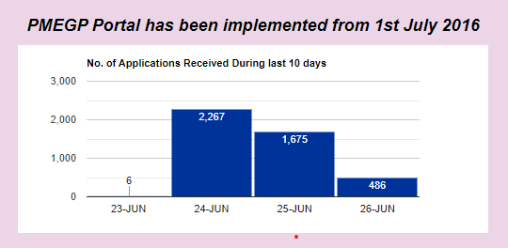
CGS - Prime Minister’s Employment Generation Programme
(PMEGP)
Ministry: Ministry of Micro, Small and Medium Enterprises
Key Sectors Covered: The scheme supports non-farm sectors, mainly focusing on manufacturing and service enterprises.
Brief: PMEGP is a credit-linked subsidy scheme aimed at promoting self-employment by helping individuals set up micro-enterprises in both urban and rural areas. It seeks to generate sustainable employment opportunities and reduce occupational migration, especially among unemployed youth and traditional artisans.
Benefit Tag: Self-employment support through margin money subsidy.
Tenure: It’s an ongoing scheme, launched in 2008, with regular annual budgetary support.
Benefits:
Margin money subsidy ranges from 15% to 35% of the project cost.
For manufacturing sector, financial support is available up to ₹50 lakh and for the service sector up to ₹20 lakh.
Special category applicants (SC/ST/OBC/PH/Women/NER/Aspirational districts) receive higher subsidies and need to contribute only 5% of the project cost.
General category applicants contribute 10%.
Link to Apply: https://www.kviconline.gov.in/pmegpeportal/pmegphome
https://www.icai.org/
20
www.dardaadvisors.com

Slide 21
CGS - SWAROJGAR CREDIT CARD
Ministry: Ministry of Finance
Key Sector Covered: Micro-entrepreneurs
Brief: The Swarojgar Credit Card scheme is an initiative by the Ministry of Finance aimed at providing easy access to credit for small entrepreneurs and self-employed individuals in India. SCC Scheme aims at providing adequate and timely credit i.e.. working/capital or blocks capital or both to small artisans, handloom weavers, service sector, fishermen, self-employed persons, rickshaw owners, other micro-entrepreneurs, etc. from the banking system in flexible, hassle-free and cost-effective manner. The facility may also include a reasonable component for consumption needs.
Eligibility Criteria:
The Swarojgar Credit Card scheme is open to small entrepreneurs, self-employed individuals, and small businesses in India.
Specific eligibility requirements may vary based on the lending institutions and financial regulations.
Quantum/ size of overall fund (only for funding): Rs. 25,000 per borrower as composite loan.
Benefit Tags: Credit Benefit
Tenure: Active
Benefits:
The scheme provides access to credit facilities, allowing eligible individuals and businesses to secure funds for their entrepreneurial and self-employment ventures.
Providing Access to Credit for Small Entrepreneurs and Self-Employed Individuals.
Participants gain access to credit on favorable terms, simplified documentation, and flexibility in repaying loans.
For specific details about the scheme and its benefits, please refer to the official notification.
Notes:
SCC Scheme aims at providing adequate and timely credit i.e.. working capital or block capital or both to small artisans, handloom weavers, service sector, fishermen, self-employed persons, rickshaw owners, other micro-entrepreneurs, etc. from the banking system in a flexible, hassle-free and cost-effective manner. The facility may also include a reasonable component for consumption needs.
Link to Application: https://www.rbi.org.in/Scripts/NotificationUser.aspx?Id=1373
https://www.icai.org/
21
www.dardaadvisors.com

Slide 22
CGS - SIDBI Make in India Soft Loan Fund for Micro Small and Medium Enterprises (SMILE)
Ministry: Ministry of Finance
Department: SIDBI
Key Sector Covered: MSME
Brief: SIDBI Make in India Soft Loan Fund for Micro Small and Medium Enterprises (SMILE) was initiated by the Government of India to make MSMEs take an active part in the ‘Make in India’ campaign. The primary focus is to provide financing to small enterprises within the MSME sector. The term Soft Loan was introduced to offer loans with Soft terms to meet the debt-equity ratio for the establishment of an MSME.
Eligibility Criteria: Eligibility Criteria for SMILE :
The majority emphasis will be on covering newly emerged enterprises in the manufacturing and service sector
The primary emphasis will be on financing smaller famous enterprises within the MSME sector
All the existing enterprises are undertaking expansion to take advantage of newly emerged opportunities along with modernization of technology up gradation techniques
Regarding the SMILE Equipment Finance (SEF), the MSME entities should be in existence for at least 3 years having a satisfactory financial position.
Quantum/ size of overall fund (only for funding):
Min. Loan Amount - Rs.10 lakh for equipment finance & Max. Loan Amount - Rs. 25 lakh
Benefit Tags: Loan
Tenure: Active
Benefits: Key Features & Benefits :
Attractive interest rates
Comparatively more extended periods of loan repayment
Speedy dispensation of financial assistance
Efficient funding of partial promoter contribution by methods of soft loans
Speedy dispensation of machinery loan through the contactless platform
In the case of SMILE equipment finance, there exists a lower amount of promoter contribution
Link to Application: https://www.paisabazaar.com/business-loan/sidbi-smile-scheme/
https://www.icai.org/
22
www.dardaadvisors.com

Slide 23
CGS - Venture Capital by SIDBI Venture Capital Ltd.
(SVLC)
Ministry: Public Sector Enterprise
Department: SIDBI
Key Sector Covered: Finance
Brief:
They aim to work for best returns by investing in deserving entrepreneurial teams using a combination of capital, strategic mentoring, skills and our vast network of relationships.
Eligibility Criteria:
A strong committed management team, established performance record and a high degree of integrity, Sustainable competitive advantage, Scalability of operations, Potential for above average profitability, leading to attractive returns on investment, Subscription to equity/ equity-type instruments, Unlisted companies preferably MSME and Availability of exit route for Venture Capital investment.
Benefits:
SVCL provides 'smart money' to entrepreneurs. Apart from finance, SVCL provides networking and management support as well with the objective to make the company grow rapidly. SVCL also assists investee companies to attract investment from other venture capitalists in subsequent rounds of financing
Link to Application: https://sidbiventure.co.in/
https://www.icai.org/
23
www.dardaadvisors.com

Slide 24
CGS - Promoting Innovations in Individuals, Startups and MSMEs (PRISM)
Ministry: Ministry of Science & Technology
Department: Department of Scientific and Industrial Research
Key Sector Covered: Science and Technology
Brief:
The scheme provides grants, technical guidance, and mentoring to individual innovators by incubating their ideas towards the creation of new enterprises in phases. It also provides grant-in-aid support to technology solution providers developing technology solutions aimed at helping MSME clusters. The scheme runs in two phases.
Eligibility Criteria:
The scheme runs in two phases.
For PRISM I, any Indian citizen including student innovators can apply.
For PRISM II, PRISM innovators or innovators who have successfully demonstrated proof of concept with the support of government institution/agency, PRISM- R&D proposals and public-funded – R&D institutes/autonomous institutions/laboratories/academic institutes, etc. are eligible.
Benefits:
PRISM Phase-I Category-I: For proof of concept/prototype/models, with a project cost up to INR 5 Lakhs, a maximum of INR 2 Lakhs or 90% of the total project cost (whichever is less) is provided.
PRISM Phase-I, Category-II: For fabrication of a working model/process know-how/testing & trial/patenting/technology transfer, etc. with a project costing
between INR 5 Lakhs to INR 35 Lakhs, a maximum of INR 20 Lakhs or 90% of the total project cost (whichever is less) is given.
Prism-Phase-II: Enterprise incubation, with a project costing between INR 35 Lakhs and INR 100 Lakhs, up to INR 50 Lakh limited to 50% of the total project cost is provided. For PRISM-R&D Proposals, up to INR 50 Lakhs limited to 50% of the total project cost is given.
Link to Application: https://www.indiascienceandtechnology.gov.in/funding-opportunities/startups/promoting-innovations-individuals-startups-and- msmes-prism
https://www.icai.org/
24
www.dardaadvisors.com

Slide 25
CGS - Women Entrepreneur Cell
Ministry: Central Bank of India
Key Sector Covered: Agriculture, Retail
Brief:
The Women Entrepreneur Cell is an initiative by the Central Bank of India dedicated to supporting and promoting women entrepreneurs. The aim is to emerge as a key player for Women Empowerment by enhancing their capabilities in Entrepreneurship, Responsive to their special credit needs, and offering them the best financial services and best Banking practices.
Eligibility Criteria: Women Entrepreneurs are eligible for this scheme.
Benefit Tags: Funding
Tenure: Active
Benefits:
Cater to women entrepreneurs across all levels of economic activity, with a focus on MSMEs, agriculture, and retail sectors in alignment with government priorities.
Participants gain access to funding, expert guidance, and a supportive community of women entrepreneurs.
To support new and existing Women Entrepreneurs in the expansion and modernization of their unit.
Notes:
To cater to Women Entrepreneurs at all levels of Economic activity with emphasis on MSME, Agriculture, and Retail in sinc with Govt. priorities.
To identify, encourage, and assist aspiring Women Entrepreneurs to start an Enterprise professionally.
To guide and support existing Women Entrepreneurs in the expansion and modernization of their unit.
To coordinate with Government Non-Government Organizations Association to bring more and more Women Entrepreneurs into Bank’s fold.
Link to Application: https://www.centralbankofindia.co.in/en/Women_Entrepreneur_Cell
https://www.icai.org/
25
www.dardaadvisors.com

Slide 26
CGS - Cent Stand Up India
Ministry:
Central Bank of India
Key Sector Covered:
Manufacturing
Brief:
CENT STAND UP INDIA is an initiative by the Central Bank of India aimed at supporting entrepreneurship and business initiatives for individuals and communities belonging to Scheduled Castes (SC) and Scheduled Tribes (ST). The purpose is to set up a new Green Field New Enterprise in the manufacturing, trading, or services sector by SC/ST/ Women entrepreneurs. Please note that the scheme is not applicable for existing units or expansion purposes.
Eligibility Criteria:
SC/ST and /or Woman Entrepreneurs, above 18 years of age. In case of non-individual enterprises, 51% of the shareholding and controlling stake should be held by either SC/ST and/or Women Entrepreneur.
Quantum/ size of overall fund (only for funding):
Max Finance 10 lakh to 1 CRORE
Margin 25%
Interest Rate Floating 7.80% to 12.40%
Loan Term 84 months
Benefit Tags :
CC cum TL – composite loan
Tenure:
Active
Benefits:
The initiative offers financial support and guidance to eligible SC and ST individuals and businesses for starting or expanding their ventures.
Participants gain access to funding, mentorship, and resources to help them succeed in entrepreneurship.
For specific details about the initiative and its benefits, please visit the official website.
Notes:
For setting up a new Green Field New Enterprise in manufacturing, trading or services sector by SC ST Women entrepreneur.
Link to Application: https://www.centralbankofindia.co.in/en/cent-stand-up-india
https://www.icai.org/
26
www.dardaadvisors.com

Slide 27
CGS - Digital Communication Innovation Square
Ministry: Ministry of Communications
Department: Department of Telecommunications
Key Sector Covered: Communication
Brief:
The Digital Communication Innovation Square (DCIS) is an initiative that is intended to catalyze startup culture and build a strong and inclusive ecosystem for innovation and entrepreneurship in India. TCOE India is implementing the Scheme on behalf of the Department of Telecom. The Implementing Agency (IA) is working under the overall supervision of the Apex Committee and guidelines issued by the DoT.
Eligibility Criteria:
The Digital Communication Innovation Square (DCIS) is open to startups defined by DPIIT and are working towards development or improvement of products and processes with scalable business models.
Specific eligibility requirements can be viewed in the official document of the policy.
Quantum/ size of overall fund (only for funding): 124 Crs of Budget Outlay
Benefit Tags: Regulatory
Tenure: Active
Benefits:
DCIS offers a platform for innovators to showcase their digital communication solutions and ideas.
Benefits include assistance in research, design, development, proof of concept testing, IPR creation, pilot project, and manufacturing i.e. complete value chain to make India a global hub for the production of telecommunication equipment and a center for digital communication services.
For specific details about DCIS and its offerings, please visit the official website.
Notes:
To promote the ecosystem for research, design, development, proof of concept testing, Minimum Viable Product (MVP), Intellectual Property Rights (IPR) creation, pilot project, and manufacturing i.e. complete value chain to make India a global hub for the production of telecommunication equipment and a center for digital communication services.
Link to Application: https://dcis.dot.gov.in/assets/document/DCIS_Guidelines-2023.pdf
https://www.icai.org/
27
www.dardaadvisors.com

Slide 28
CGS - Raising and Accelerating MSME Performance (RAMP)
Ministry: Ministry of Micro, Small and Medium Enterprises
Key Sectors Covered: All MSMEs across sectors – manufacturing, services, green enterprises, and women-led MSEs
Brief: RAMP is a World Bank-supported central sector scheme that aims to boost MSME competitiveness by enhancing the outreach and effectiveness of existing MSME schemes in areas like market access, technology, credit, digitization, and sustainability. It also strengthens Centre-State collaboration in MSME development.
Benefit Tag: MSME growth via state-level support & tech/credit access
Tenure: 2022–23 to 2026–27
Benefits:
Strengthens MSME access to markets, finance, and tech upgradation
Enhances CGTMSE & receivable financing
Promotes digitization, innovation, green initiatives, and reduced payment delays
Targets over 5.5 lakh MSMEs through State agency interventions
Link to Apply: https://ramp.msme.gov.in/ramp/
https://www.icai.org/
27
www.dardaadvisors.com

Slide 29
CGS - Trade Related Entrepreneurship Assistance and
Development (TREAD) Scheme for Women
Ministry: Ministry of Micro, Small and Medium Enterprises
Key Sector Covered: Trade
Benefit Tags: Credit Benefit
Notes:
This scheme envisages economic empowerment of women by providing credit (through NGOs), training, development and counseling extension activities related to
trades, products, services, etc.
Link to Application: https://www.msmediagra.gov.in/womentread.htm
https://www.icai.org/
29
www.dardaadvisors.com

Slide 30
CGS - Innovations for Defense Excellence (IDEX)
Ministry: Ministry of Defence
Department: Department of Defence Production
Key Sector Covered: Defence
Brief:
The IDEX initiative was launched by the Hon’ble PM in April 2018. IDEX aims to achieve self-reliance and foster innovation and technology development in Defence and Aerospace by engaging Industries including MSMEs, start-ups, individual innovators, R&D institutes and academia.
Eligibility Criteria:
Start-ups, as defined and recognized by Department of Industrial Policy and Promotion (DIPP), Ministry of Commerce and Industry, Government of India
Any Indian company incorporated under the Companies Act 1956/2013, primarily a Micro, Small and Medium Enterprises (MSME) as defined in the MSME Act, 2006.
Individual innovators are also encouraged to apply (research & academic institutions can use this category to apply).
Quantum/ size of overall fund (only for funding): Rs 498 crore for 5 years
Benefit Tags: Cash Benefit Schemes
Tenure: 2021-22 to 2025-26
Benefits: The objective of the scheme is to provide financial support to nearly 300 Startups MSMEs individual innovators and about 20 Partner incubators through Defence Innovation Organization (DIO).
Notes:
The Department of Defence Production, Ministry of Defence has approved a central sector scheme viz. Innovations for Defence Excellence (IDEX)with budgetary support of Rs. 498.78 crore for the next 5 years from 2021-22 to 2025-26. The objective of the scheme is to provide financial support to nearly 300 Startups MSMEs individual innovators and about 20 Partner incubators through the Defence Innovation Organization (DIO). Innovations for Defence Excellence (IDEX) framework aims to achieve
self-reliance and foster innovation and technology development in the Defence and Aerospace Sector by engaging Industries including MSMEs, startups, individual
innovators, R&D institutes, and academia.
Link to Application: https://pib.gov.in/PressReleasePage.aspx?PRID=1782604
https://www.icai.org/
30
www.dardaadvisors.com

Slide 31
CGS - Designing a Policy for Medium Enterprises
Ministry: Niti Ayog
Key Sector Covered: Medium Enterprises / MSME Policy
Brief: Strategic roadmap to scale medium enterprises as future drivers of growth under Viksit Bharat @2047
Eligibility Criteria: MSME
Benefit Tags: MSME Tag
Tenure: Active
Benefits:
Working capital financing scheme linked to enterprise turnover
₹5 crore MSME credit card at market interest rates
Fast-tracked fund disbursal through retail banks under MSME Ministry oversight
Sector-specific SME 4.0 Competence Centres for technology adoption
Dedicated R&D cell for cluster-based innovation under Self-Reliant India Fund
Sector-focused cluster-based testing and certification infrastructure
Customized skilling programmes integrated with ESDPs
Udyam sub-portal for scheme discovery, compliance, and AI-based assistance
Link to Application: https://www.niti.gov.in/sites/default/files/2025-05/Designing-a-Policy-for-Medium-Enterprises.pdf
https://www.icai.org/
31
www.dardaadvisors.com

Slide 32
CGS - Technology Development Fund
Ministry: Ministry of Defence
Department: DRDO
Key Sector Covered: Defence
Brief:
The TDF Scheme extends financial support and expertise to upgrade existing products/systems, processes, and applications by reducing production costs, improving functionality and quality by promoting Make in India, and the development of futuristic technologies with defense applications. The Scheme enlists requirements of Service Headquarters of upgrading products/systems and futuristic defense technologies as Projects for which eligible stakeholders can apply through this platform.
Eligibility Criteria:
Eligibility for Industry Private industry registered in India especially MSMEs and Startups The industry must be a public limited company, a private limited company, a partnership firm, a limited liability partnership, one-person company, sole proprietorship registered as per applicable Indian laws Industry to be owned and controlled by a Resident Indian Citizen with a shareholding of at least 51%
Benefits: Financial Support and expertise to upgrade existing products/systems
Link to Application: https://tdf.drdo.gov.in/
https://www.icai.org/
32
www.dardaadvisors.com

Slide 33
CGS - Raw Material Assistance Scheme
Ministry: Ministry of Micro, Small and Medium Enterprises
Department: NSIC
Key Sector Covered: Raw Material
Brief:
Raw Material Assistance Scheme aims at helping MSMEs by way of financing the purchase of Raw Materials (Both indigenous & imported). This gives an opportunity to MSMEs to focus better on manufacturing quality products.
Eligibility Criteria:
The Entrepreneurs are required to apply for Raw Material Assistance only on the prescribed application forms. The application forms downloaded from the link given below may be filled and can be submitted to the nearest Branch Office. The blank forms are also available free of charge from the Branch offices.
Benefits:
Facilitating procurement of Raw Material with credit support up to 180 days.
SMEs helped to avail Economics of Purchases like bulk purchase, cash discount etc.
Link to Application: https://www.nsic.co.in/Home/Index
https://www.icai.org/
32
www.dardaadvisors.com

Slide 34
CGS - PM FME Scheme
Ministry: Ministry of Food Processing Industries
Key Sector Covered: Food Processing Sector
Brief:
PM FME Scheme (PM Formalization of Micro Food Processing Enterprises Scheme) is a government initiative aimed at supporting and formalizing micro food processing enterprises. This scheme provides various benefits and resources to promote entrepreneurship and growth in the food processing sector.
Eligibility Criteria:
The company should be an existing Micro Food Processing Unit.
The company should not be corporate and would be having less than 10 workers.
The company should follow the policy of One District One Product (ODOP) then they will be given preference but other companies would also be considered.
The applicant should have the ownership right of the company.
The company or enterprise could be a Proprietary or Partner Firm.
The maximum age of the applicant to apply for the scheme should be 18 years old.
The applicant applying should be at least class 8th passed.
This scheme has been eligible for only one person from a single family.
The applicant should be willing to pay at least 10 percent of the amount and the rest of the amount will be given as a bank loan.
The cost of the land on which the enterprise has been set would not be considered in the total cost of the project.
The rent of the building cost, lease cost, or the rental cost could be included in the total cost of the project.
The lease cost that would included in the project cost would not be more than 3 years of lease.
Quantum/ size of overall fund (only for funding): Rs. 10,000 crore over a period of five years from 2020-21 to 2024-25.
Benefit Tags: Cash Benefit Schemes
Tenure: 2020-21 to 2024-25.
https://www.icai.org/
32
www.dardaadvisors.com

Slide 35
CGS - PM FME Scheme
Benefits:
Food processing entrepreneurs through credit-linked capital subsidy @35% of the eligible project cost with a maximum ceiling of Rs.10 lakh per unit.
Seed capital @ Rs. 40,000 - per SHG member for working capital and purchase of small tools.
Credit linked grant of 35% for capital investment to FPOs SHGs producer cooperatives.
Support for marketing & branding to micro-units.
Support for common infrastructure and handholding support to SHGs, FPOs and Producer Cooperatives.
Providing Capacity building and training support to increase the capabilities of the enterprises and upgradation of skills of workers.
Notes:
Ministry of Food Processing Industries (MoFPI), in partnership with the State UT Governments, has launched an all India Centrally Sponsored PM Formalisation of Micro food processing Enterprises Scheme (PM FME Scheme) for providing financial, technical and business support for upgradation of existing micro food processing enterprises.
Link to Application: https://pmfme.mofpi.gov.in/pmfme/newsletters/
https://www.icai.org/
35
www.dardaadvisors.com

Slide 36
CGS - SECOND LOAN FOR UP-GRADATION OF EXISTING PMEGP/REGP/MUDRA UNITS
Ministry: Ministry of Micro, Small and Medium Enterprises
Key Sectors Covered: Existing manufacturing, service, and trading units
Brief: This scheme supports successful and profit-making PMEGP/REGP/MUDRA units in expanding and upgrading their operations. It helps them adopt modern technology and improve productivity. The scheme provides a second round of financial assistance to eligible units.
Benefit Tag: Business expansion support for existing units
Tenure: Launched in FY 2018–19 and is ongoing.
Benefits:
15% subsidy on project cost (20% in North Eastern Region and Hill States)
Maximum project cost: ₹1 crore for manufacturing, ₹25 lakh for services/trading
Max subsidy: ₹15 lakh (non-NER) and ₹20 lakh (NER/Hill States)
Balance amount provided by banks as term loan
Must be a profit-making unit for the last 3 years
First loan must be repaid in time and margin money adjusted
Mandatory Udyam/UAM registration
Additional employment generation is a must
Can apply through same or different bank/implementing agency
Link to Apply: https://www.kviconline.gov.in/pmegpeportal/pmegphome
https://www.icai.org/
36
www.dardaadvisors.com

Slide 37
CGS - MICRO & SMALL ENTERPRISES CLUSTER DEVELOPMENT PROGRAMME (MSE-CDP)
Ministry: Ministry of Micro, Small and Medium Enterprises
Key Sectors Covered: Mainly Micro and Small Enterprises (MSEs) in manufacturing and related sectors, especially in clusters, requiring infrastructure, common facilities, and green technologies.
Brief: The MSE-CDP aims to boost the sustainability, competitiveness, and growth of MSEs through cluster-based development. It provides financial assistance to create or upgrade Common Facility Centres (CFCs) and industrial infrastructure, including plug & play units and green technologies. The scheme supports existing entrepreneurs operating via Special Purpose Vehicles (SPVs).
Benefit Tag: Cluster development + common infrastructure & green tech support
Tenure: Ongoing scheme
Benefits:
Common Facility Centres (CFCs):
Government of India assistance up to 80% of the project cost
Maximum project cost eligible: ₹30 crore
Facilities can include testing labs, raw material depots, training centres, etc.
Infrastructure Development Projects:
Government assistance up to 70% of the project cost
Maximum project cost eligible: ₹15 crore
Includes land development, roads, drainage, power, flatted factory complexes, etc.
Link to Apply: https://cluster.dcmsme.gov.in
https://www.icai.org/
36
www.dardaadvisors.com

Slide 38
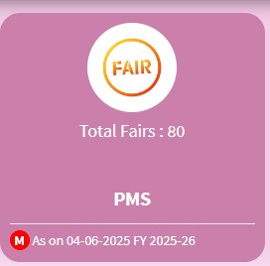
CGS - Procurement and Marketing Support (PMS) Scheme
Ministry: Ministry of Micro, Small and Medium Enterprises
Key Sectors Covered: MSEs in manufacturing and services
Brief: Aims to help MSEs enhance market presence through participation in trade fairs, vendor development, packaging upgrades, e-commerce, and promotion of GI products.
Benefit Tag: Market access & visibility support
Tenure: Ongoing scheme
Benefits:
Reimbursement for domestic/international trade fairs
Vendor Development Programs (VDPs)
Support for barcoding, packaging, e-commerce adoption
Funding for national workshops and GI retail outlets
Link to Apply: https://my.msme.gov.in/MyMsme/Reg/COM_Matu.aspx
https://www.icai.org/
36
www.dardaadvisors.com

Slide 39
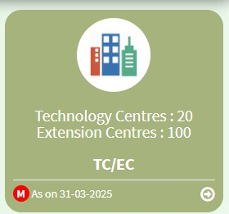
CGS - Technology Centres / Extension Centres (TCEC) Scheme
Ministry: Ministry of Micro, Small and Medium Enterprises (MoMSME)
Key Sectors Covered: MSMEs across manufacturing, tech-based industries, and skilling sectors
Brief: The scheme aims to set up 20 new Technology Centres and 100 Extension Centres across India to provide MSMEs with localized access to advanced technology, skilled manpower, and advisory support. It follows a Hub & Spoke model, where TCs are hubs and ECs extend their services in unserved areas.
Benefit Tag: Tech + skill + advisory boost for MSMEs
Tenure: Ongoing
Benefits:
Access to state-of-the-art technologies (AI, AR/VR, IoT, Robotics, etc.)
Hands-on skill development and training
Business and technical advisory services
₹125 Cr allocated per Technology Centre and ₹10 Cr per Extension Centre
Link to Apply: https://msme.gov.in/establishment-new-technology-centres-extension-centres-under-hub-spoke-model
https://www.icai.org/
36
www.dardaadvisors.com

Slide 40
CGS - DIGITAL SERVICES FACILITATION THROUGH AGGREGATION SERVICES
Ministry: Ministry of MSME (implemented by NSIC – National Small Industries Corporation)
Key Sectors Covered: All MSMEs seeking digital transformation across sectors
Brief: This scheme enables MSMEs to adopt digital solutions like ERP, cloud services, AI, IoT, e-commerce, and compliance tools at affordable rates. NSIC acts as an aggregator, connecting MSMEs with empanelled tech service providers offering plug-and-play digital services.
Benefit Tag: Easy & affordable digital tech access for MSMEs
Tenure: Ongoing
Benefits:
Access to ERP, accounting, compliance tools, cloud platforms, AI, IoT, and e-commerce services
Affordable pricing through bulk aggregation
Eliminates middlemen; NSIC ensures quality service delivery
Transparent empanelment of reputed service providers
6% NSIC aggregator fee ensures service facilitation and fulfilment support
Link to Apply: https://msmemart.com/DigitalServices
https://www.icai.org/
36
www.dardaadvisors.com

Slide 41
CGS - Uttar Poorva Transformative Industrialization Scheme (UNNATI), 2024
The Government of India has announced the Uttar Poorva Transformative Industrialization Scheme (UNNATI), 2024, for the North-Eastern Region. This scheme will cover all 8 northeastern states: Arunachal Pradesh, Assam, Manipur, Meghalaya, Mizoram, Nagaland, Sikkim, and Tripura.
COMMENCEMENT AND DURATION OF THE SCHEME: It will be effective on 09.03.2024 and will remain in force up to and inclusive of 08.03.2034 and 8 more years for meeting committed liabilities.
ABOUT THE SCHEME:
UNNATI, 2024 is designed to strengthen the Industrial Eco-System in the North East and attract New Investment. The Scheme is divided into two parts i.e. Part A and Part B.
Part A: Part A incentivizes eligible new industrial units and those undergoing substantial expansion. Part A will have three components namely Capital Investment Incentive (CII), Central Interest Subvention (CIS), and Manufacturing & Services Linked Incentive (MSLI).
Part B: Part B is for developing an industrial eco-system through activities such as (i) Project Monitoring Unit (PMU) and Project Implementation Unit (PIU); (ii) Third Party Evaluation and Impact Assessment; and (iii) Portal Development (aligned with National Single Window System, NSWS), Capacity Building workshops, IEC and others as
decided by the Steering Committee.
APPLICATION PERIOD FOR REGISTRATION: Registration shall commence from 09.03.2024 and will continue till 31.03.2026 subject to the guidelines issued in this regard.
ELIGIBILITY FOR AVAILING INCENTIVES:
All units eligible under the Manufacturing and Service sector will be granted incentive(s) under this scheme as defined under respective incentives.
Manufacturing sector units with a minimum investment of Rs. 1.0 crore in plant & machinery will be eligible for incentives under this scheme. For the calculation of any incentive under the scheme, the eligible value shall be determined based on the investment made in Plant & Machinery in the manufacturing sector. The scheme shall not apply to the units that manufacture the products listed in the Negative list in Annexure I.
Service sector units with a minimum investment of Rs. 50 Lakh in building and other durable physical assets will be eligible for incentives under this scheme. For the calculation of any incentive under the scheme, the eligible value shall be determined based on the investment made in building and other durable physical assets. The scheme shall be applicable only for services listed in the Positive list in Annexure II.
For Micro Industries the minimum investment limit shall be ₹50 lakhs for both the manufacturing and service sector.
For Micro industries (defined as per MSME industry norms), the Plant & Machinery calculation will include the cost of building construction as well.
All eligible units have to commence commercial production/operation within 4 years from the date of grant of registration. The unit shall be allowed to sell or supply* the finished goods produced/manufactured in the intermediate phases. It is envisaged that certain units may install plant & machinery in phases. Thus, there will be a provision for phased commencement of production (maximum 3 phases), but the incentives will only flow after the final commencement of production. The date of commencement of commercial production after the completion of all phases shall not be later than 4 years from the date of registration under the scheme.
Incentives for Investors:
Capital Investment Incentive
Central Capital Interest Subvention
Manufacturing & Services linked incentive (MSLI) for new units linked to Net Payment of GST, with upper limits based on zones.
https://www.icai.org/
41
www.dardaadvisors.com

Slide 42
CGS - Aspire - A Scheme for Promotion of Innovation, Rural Industries and Entrepreneurship
Ministry: Ministry of Micro, Small and Medium Enterprises
Key Sector Covered: Innovation, Rural Industries & Entrepreneurship
Brief:
ASPIRE- was launched to set up a network of technology centers and to set up incubation centers to accelerate entrepreneurship and to promote start-ups for innovation in the agriculture industry with the following objectives:
To generate employment opportunities by facilitating formal, scalable micro- enterprise creation.
To skill, up-skill, re-skill unemployed, existing self-employed/ wage earners in new technologies.
To provide skilled human capital to nearby industrial clusters and promote innovations for strengthening the competitiveness in the MSME sector
Eligibility Criteria:
Any agency/institution of Government of India, State government or existing training centers under Ministries/Departments of Government of India/State Government, Industry Associations, Academic Institutions.
Any not-for-profit private institutions with experience in successfully executing incubation and/or skill development programs may be eligible to set up an LBI.
Link to Application: https://aspire.msme.gov.in/ASPIRE/AFHome.aspx
https://www.icai.org/
42
www.dardaadvisors.com

Slide 43
CGS - Entrepreneurship Skill Development Programme (ESDP)
Scheme
Ministry: Ministry of Micro, Small and Medium Enterprises
Brief:
The objective of the program is to motivate youth representing different sections of the society including SC ST Women, differently abled, Ex-servicemen and BPL persons to consider self-employment or entrepreneurship as one of the career options. The ultimate objective is to promote new enterprises, capacity building of existing MSMEs and inculcating entrepreneurial culture in the country.
Eligibility Criteria: The scheme is applicable for all aspiring and existing entrepreneurs.
Benefit Tags: Skill Development
Tenure: Active
Benefits:
The scheme aims to expand the base of entrepreneurship to different sections of the society through skill development, achievement, and providing motivation for self-employment and entrepreneurial skill.
Notes: To promote new enterprises, capacity building of existing MSMEs and inculcating entrepreneurial culture in the country.
Link to Application: https://msmedi.dcmsme.gov.in/
https://www.icai.org/
42
www.dardaadvisors.com

Slide 44
CGS - Single Point Registration Scheme (SPRS)
Ministry: Ministry of MSME (Implemented by NSIC)
Key Sectors Covered: All MSMEs (manufacturing & services)
Brief: This SPRS enables MSEs to participate in government procurement with benefits like EMD exemption, free tender access, and price preference under the Public Procurement Policy. It facilitates easier access to tenders from Central Ministries, Departments, and PSUs.
Benefit Tag: Public procurement access for registered MSEs
Tenure: Ongoing
Benefits:
EMD exemption
Free tender document access
Price preference (L1+15%) up to 25% of order
25% mandatory government procurement from MSEs (including 4% for SC/ST, 3% for women-owned units)
Fee concession for SC/ST & North East MSEs
Link to Apply: https://www.nsicspronline.com/
https://www.icai.org/
42
www.dardaadvisors.com

Slide 45
CGS - PROMOTION OF MSMES IN NORTH EASTERN REGION
(NER) AND SIKKIM
Ministry: Ministry of MSME
Key Sectors Covered: All MSMEs in manufacturing, processing, tourism, and natural resources (fruits, spices, bamboo, etc.) in NER & Sikkim
Brief: A Central Sector Scheme to boost infrastructure and capacity of MSMEs in the North East and Sikkim through support for technology centres, industrial estates, and tourism-linked enterprises. Focus is on productivity, innovation, and leveraging regional strengths.
Benefit Tag: Regional MSME infrastructure & tourism cluster support
Tenure: Ongoing
Benefits:
Mini Tech Centres: Up to ₹13.5 crore (90% of cost) for new/modernized tool rooms
Industrial Estates: Up to ₹13.5 crore (new) or ₹9 crore (existing)
Tourism Cluster Projects: Up to ₹4.5 crore (90%) for common services supporting tourism-linked MSEs
All projects must be geo-tagged; DPR validation required for tourism
Link to Apply: https://www.nsicspronline.com/
https://www.icai.org/
42
www.dardaadvisors.com

Slide 46
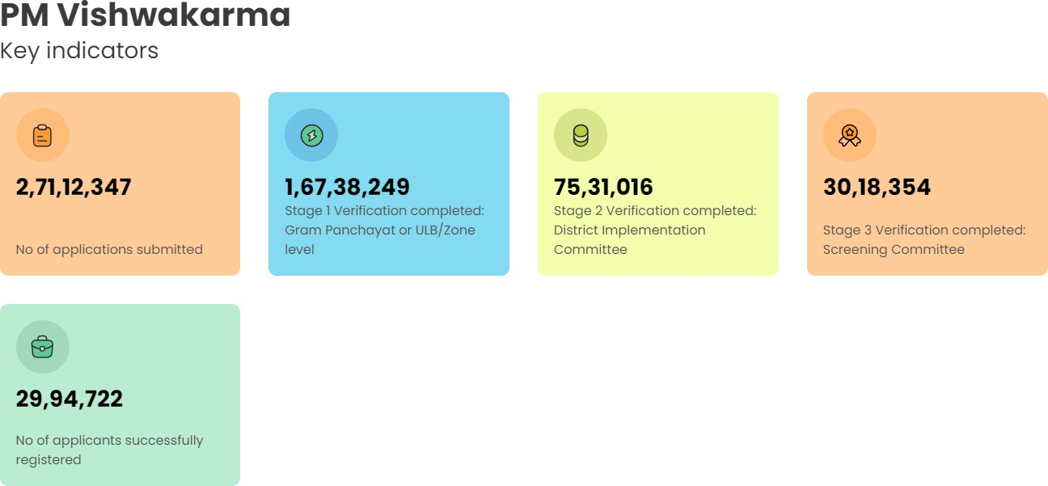
CGS - PM Vishwakarma – Enabling Artisans & Craftspeople to Scale-up their Enterprises
Ministry: Ministry of Micro, Small and Medium Enterprises
Key Sectors Covered: Traditional trades and crafts – 18 trades including carpenters, goldsmiths, tailors, potters, barbers, masons, cobblers, etc.
Brief: This scheme aims to empower traditional artisans and craftspeople by providing recognition, skill training, modern tools, credit support, digital incentives,
and marketing assistance to scale their enterprises.
Benefit Tag: Skill + credit + market boost for traditional artisans
Tenure: Ongoing scheme
Benefits:
Vishwakarma Certificate & ID Card
Basic & advanced training with ₹500/day stipend + ₹1,000 transport support
Toolkit incentive up to ₹15,000 via e-vouchers
Collateral-free loans up to ₹3 lakh in 2 tranches at 5% interest (Govt. subvention of 8%)
₹1 incentive per digital transaction (max 100/month)
Marketing & branding support including GeM onboarding, publicity, certification
Link to Apply: https://pmvishwakarma.gov.in/
https://www.icai.org/
42
www.dardaadvisors.com

Slide 47
List of State Government Schemes (SGS) for MSMEs
https://www.icai.org/ www.dardaadvisors.com

Slide 48
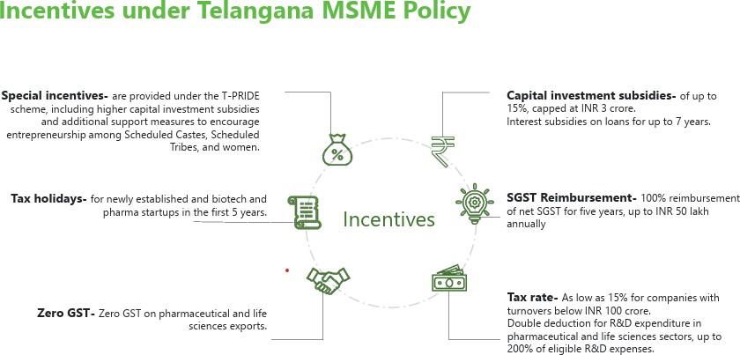
SGS - TELANGANA MSME POLICY 2024
https://www.icai.org/
www.dardaadvisors.com

Slide 49
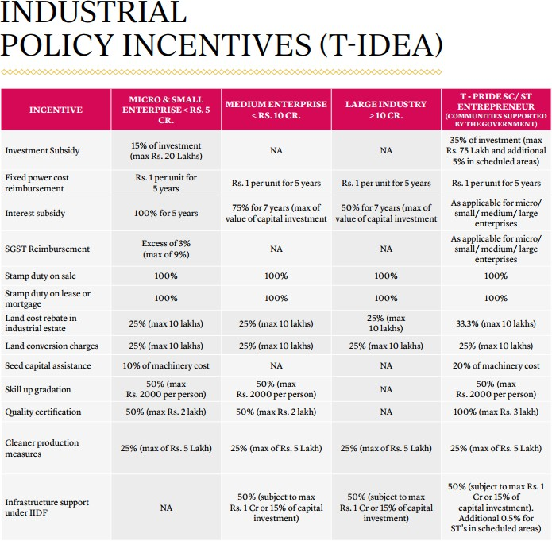
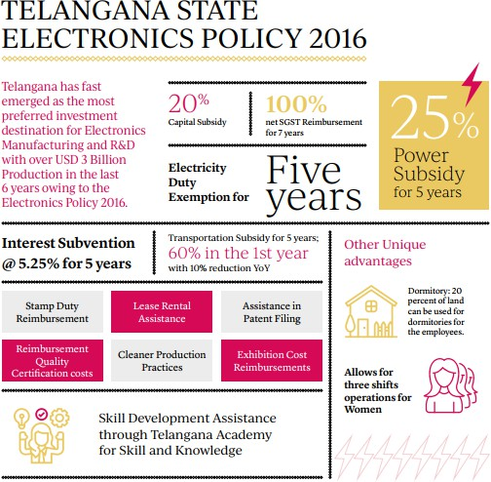
SGS - TELANGANA STATE POLICIES
https://www.icai.org/
www.dardaadvisors.com

Slide 50
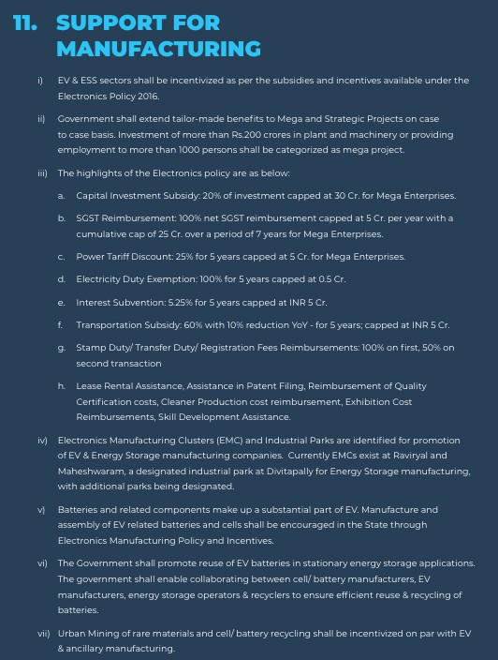
SGS - TELANGANA STATE POLICIES
https://www.icai.org/
www.dardaadvisors.com

Slide 51
SGS - T-PRIDE – Telangana State Program for Rapid Incubation of Dalit Entrepreneurs
Ministry:Department of Industries & Commerce, Government of Telangana
Key Sector Covered: SC/ST Entrepreneurship, Women & SAP-led Enterprises, MSME
Brief: Scheme to promote equity in industrial development by incentivizing SC/ST, women & specially-abled entrepreneurs through capital, land, and utility subsidies.
Benefit Tags: Capital Subsidy, Land Rebate, Stamp Duty Refund, Power Tariff Subsidy, Seed Capital
Benefits:
35% capital subsidy (up to ₹75L), 33.3% land cost rebate (up to ₹10L)
100% stamp duty reimbursement,
power @ ₹1.50/unit for 5 yrs
20% seed capital for 1st-gen entrepreneurs
Link to Application: https://invest.telangana.gov.in
https://www.icai.org/
52
www.dardaadvisors.com

Slide 52
SGS - Telangana state–Food processing and Preservation policy (T-FAPP) 2021
Ministry: Department of Industries & Commerce, Government of Telangana
Key Sector Covered: Food Processing, Agriculture, Rural Enterprises
Brief: Policy to develop food processing infrastructure, boost rural industry, and create employment by leveraging increased irrigation coverage
Benefit Tags: MSME Tag
Tenure: Active (2021 ONWARDS0
Benefits:
35% capital subsidy (up to ₹5 Cr under MoFPI) for units in SFPZs
Extra 15% capital grant (up to ₹20L) for SC/STs, SHGs, FPOs
₹2/unit power rebate for 5 years
Up to 75% interest subvention on term loan (max ₹2 Cr)
100% APMC fee reimbursement for 7 years
Land cost rebate: 25% (general), 33% (SC/ST/SHG/FPO)
Link to Application: https://industries.telangana.gov.in
https://www.icai.org/
52
www.dardaadvisors.com

Slide 53
SGS - Telangana State Industrial Project Approval and Self- Certification System (TS-IPASS)
Ministry: Department of Industries & Commerce, Government of Telangana
Key Sector Covered: Manufacturing, MSMEs, SC/ST & Women Entrepreneurs
Brief: Telangana’s industrial policy ensures fast-track approvals and financial incentives to boost investments across Micro, Small, Medium, and Large enterprises.
Benefit Tags: Investment Promotion, Infrastructure Support, SC/ST & Women Empowerment
Benefits:
Investment subsidy up to 35% (max ₹75 lakh for SC/ST)
Power cost reimbursement @ ₹1/unit for 5 years
Interest subsidy up to 100% for 5 years
SGST reimbursement up to 9% (Micro units)
100% stamp duty reimbursement on sale/lease/mortgage
25% land cost and conversion rebate (max ₹10 lakh)
Seed capital support up to 20% (for 1st-gen entrepreneurs)
Skill upgradation subsidy (₹2000/person)
Quality certification subsidy up to ₹3 lakh
25% support for cleaner production (max ₹5 lakh)
Infrastructure support up to ₹1 crore under IIDF
Link to Application: https://ipass.telangana.gov.in
https://www.icai.org/
52
www.dardaadvisors.com

Slide 54
Challenges faced by MSME and Government step taken
# | Challenge Area | Detailed Challenges Faced by MSMEs | Government Steps
1 | Access to Finance | MSMEs struggle to secure timely and affordable credit due to high-risk perception, lack of collateral, and cumbersome loan procedures. A large credit gap persists, with over 70% of MSME demand met via informal channels. | CGTMSE offers collateral-free credit guarantees, with recent efforts to increase coverage for women-led MSMEs. ECLGS supported MSMEs during COVID-19 with emergency liquidity. SIDBI directed to expand wholesale funding to NBFCs for onward lending. Push for credit flow through NBFCs, fintech, and revised Priority Sector Lending norms.
2 | Delayed Payments & Recovery | MSMEs face chronic delays in receiving payments from large corporate’s and government buyers. Weak enforcement of the MSMED Act (45-day payment rule) hampers liquidity and disrupts operations. | Samadhaan Portal enables MSMEs to report delayed payments to buyers and trigger legal follow-up. TReDS (Trade Receivables Discounting System) provides a digital platform for invoice financing. Budget 2023 introduced a tax disincentive for buyers delaying MSME payments beyond 45 days.
3 | Skill Gaps | A significant proportion of MSME workers fall into low-skill categories, limiting productivity and innovation. Lack of industry-specific training, especially in rural/semi-urban clusters. | Skill India aligned with MSME needs through cluster-based skilling. Development of dynamic, modular training programs in partnership with private sector and academia. Proposals for cost-sharing and grant-based skilling subsidies for micro-enterprises.
4 | Technology Obsolescence & Low Innovation | MSMEs are slow to adopt digital tools, automation, and AI due to cost, awareness, and lack of in-house capacity. Low participation in R&D or quality certification processes. | Cluster Development Programme (MSE-CDP) promotes shared technology centers. Subsidies and support for AI adoption, digital onboarding, and access to cloud platforms. Creation of Institutions for Collaboration (IFCs) to drive innovation via academia-industry linkages.
https://www.icai.org/
www.dardaadvisors.com

Slide 55
Challenges faced by MSME and Government step taken
# | Challenge Area | Detailed Challenges Faced by MSMEs | Government Steps
5 | Limited Product Diversification & Weak Branding | MSMEs focus on low-margin, undifferentiated goods. Lack of design thinking, market trend analysis, and global marketing expertise. | Government support for trade fairs, buyer-seller meets, and digital commerce platforms. Collaboration with design institutes and tech incubators for product innovation. Export incentives tailored for small businesses to expand global reach.
6 | Poor Infrastructure & Logistics | Many MSMEs operate in areas lacking reliable power, transport, storage, and digital connectivity. High logistics costs reduce competitiveness. | Expansion of MSE-CDP to build cluster-based industrial infrastructure. Promotion of co-working spaces, shared machinery, and logistics parks. Digitization of supply chains in key sectors like food processing and textiles.
7 | Missing Middle Phenomenon | MSME ecosystem is skewed: 97% are micro, with very few small or medium-sized firms due to scalability barriers. Labor regulations, compliance thresholds discourage size expansion. | 2025 MSME Definition Reform introduced uniform turnover + investment thresholds. Push for a scalable policy framework that doesn’t penalize growth. Need for supportive taxation, financing, and skill ecosystem to enable transition from micro to small and medium enterprises.
https://www.icai.org/
www.dardaadvisors.com

Slide 56
List of Compliances for MSMEs
https://www.icai.org/ www.dardaadvisors.com

Slide 57
AUDIT COMPLIANCE
Audit plays a critical role in enhancing the financial transparency, statutory compliance, and operational efficiency of MSMEs. It serves as a tool for validating financial records, internal controls, tax compliance, and inventory accuracy. Certain audits are mandatory based on legal thresholds, while others may be required for funding, credit, or internal governance.
Audit Type | Key Applicability / Description | Primary Law / Requirement | Due Date / Timeline
Financial Audit | Mandatory annually for all companies registered under the Companies Act. | Companies Act, 2013 | Within 6 months from the end of financial year (i.e., 30th Sept)
Tax Audit | Mandatory if turnover exceeds thresholds under Section 44AB of Income Tax Act. | Income Tax Act, 1961 (Section 44AB) | 30th Sept of the assessment year (if not extended)
Internal Audit | Required half-yearly or annually for specified companies (e.g., large, listed, etc.). | Companies Act, 2013 (Rule 13 of Companies Rules) | As per company’s internal policy (generally bi- annually or annually)
Stock Audit | Conducted as required, especially when mandated by banks/lenders for working capital loans. | Internal best practices / Bank requirements | As per loan agreement or bank request; usually annually
https://www.icai.org/
www.dardaadvisors.com

Slide 58
COMPANY LAW COMPLIANCE
Applicable Entity | Compliance Area | Key Description / Form / Due Date
Common | Maintain Statutory Records | Ongoing: Registers, Books of Accounts.
 | Director/Partner KYC (DIR-3 KYC) | Annually (by 30th Sept): For all Directors/Designated Partners with DIN.
 | Income Tax Return Filing | Annually (31st July / 30th Sept for Audit cases): Mandatory for all entities.
Company Specific | Board Meetings | Quarterly: Minimum 4 meetings/year (max 120 days gap).
 | Annual Return (MGT-7) | Annually (within 60 days of AGM): Summary of company, shareholding, etc.
 | Financial Statements (AOC-4) | Annually (within 30 days of AGM): Audited Balance Sheet, P&L, etc.
 | Auditor Appointment (ADT-1) | Annually (within 15 days of AGM for initial appointment): For 5-year term.
LLP Specific | Annual Return (LLP Form 11) | Annually (by 30th May): Summary of partners, capital contribution.
 | Statement of Accounts & Solvency (LLP Form 8) | Annually (by 30th Oct): Financial position and solvency status.
 | Tax Audit (Form 3CD) | Annually (by 30th Sept): If turnover > ₹40L or contribution > ₹25L.
https://www.icai.org/
www.dardaadvisors.com

Slide 59
INCOME TAX COMPLIANCE
Frequency | Compliance | Form / Description | Due Date / Timeline
Monthly | Deposit of TDS deducted | Payment of TDS deducted under various sections | 7th of the following month
Quarterly | Advance Tax payments | Payment in four instalments: 15%, 45%, 75%, and 100% | 15th June, 15th Sept, 15th Dec, 15th Mar
Quarterly | Filing of TDS return | Filing TDS statements in Form 24Q/26Q | 31st July, 31st Oct, 31st Jan, 31st May
Annual | Corporate ITR filing | Income Tax Return in Form ITR-6 (for companies) | 31st Oct (if audit is applicable) or 31st July (if not)
https://www.icai.org/
www.dardaadvisors.com

Slide 60
GST COMPLIANCE
COMPLIANCE UNDER GST LAW
Monthly | GSTR-1 (Details of Outward Supplies) GSTR-1: QRMP | GSTR-1 | 11th of following month 13th of the following month
Monthly | GSTR-3B (Summary Return & Tax Payment) GSTR-3B: QRMP | GSTR-3B | 20th of following month 22nd of following month
Quarterly | ITC-04 (Details of goods sent/received for job work) | — | 25th of month following quarter
Annual | GSTR-9 & 9C (Annual Return and Reconciliation) | GSTR-9 / 9C | 31st December (next FY)
E-Waybill Compliance:
E-Way Bill is an electronic document mandated under GST for tracking the movement of goods valued above ₹50,000, ensuring transparency and
compliance during transit. It must be generated before the commencement of transportation and includes key consignment and vehicle details.
Generate E-Way Bill (Part-A) before movement: Mandatory for goods valued above ₹50,000, including product information.
Update Part B (vehicle number) prior to transit: Essential for all movements and whenever the vehicle changes.
Recipient must accept/reject the E-Way Bill within 72 hours: Crucial for validating the transaction.
Report detentions (Form EWB-04) if over 30 minutes: Transporters must upload this to avoid issues.
Reconcile E-Way Bills with GSTR-1 regularly: Ensure consistency between generated E-Way Bills and outward supply returns.
Conduct internal review of generated E-Way Bills: Verify completeness and correctness of all data.
Preserve E-Way Bill records for audit trail: Essential for compliance checks and future reference.
https://www.icai.org/
www.dardaadvisors.com

Slide 61
GST COMPLIANCE
E-Invoicing is a digital system under GST where B2B invoices are authenticated through the Invoice Registration Portal (IRP) and assigned a unique Invoice Reference Number (IRN), enabling real-time reporting to the GST and e-way bill portals for enhanced accuracy and tax compliance.
Periodicity | Compliance Area | Details | Applicable Entity | Due Date / Threshold
Daily | E-invoice Generation | Generate IRN via IRP for B2B invoices, credit/debit notes | Registered persons with AATO > ₹5 Cr | At time of invoice issuance
 | Invoice Upload to IRP | Upload invoice JSON to IRP via ERP, ASP, GSP, or API integration | Registered persons with AATO > ₹5 Cr | Same day
 | Cancellation of e-invoice | Full cancellation only; partial not allowed | Registered persons with AATO > ₹5 Cr | Within 24 hours of IRN generation
Monthly | Reconciliation with GSTR-1 | Auto-populated from IRP; verify for mismatches | Registered persons with AATO > ₹5 Cr | Before GSTR-1 due date
Annual | Annual turnover assessment | Recalculate PAN-based AATO to check e-invoicing applicability for next FY | All registered taxpayers | March-end annually
https://www.icai.org/
www.dardaadvisors.com

Slide 62
GST COMPLIANCE
Invoice Management System: The Invoice Management System (IMS) under GST is a compliance tool introduced on the GST portal to help recipients accept, reject, or keep supplier invoices pending. It aims to streamline the Input Tax Credit (ITC) process by offering better visibility and control over inward invoices.
Action Required | Due Date / Frequency | Impact
Review Supplier Invoices | Monthly (By 14th) | View invoices uploaded by suppliers.
Accept/Reject/P end Invoices | Monthly (On or before GSTR-3B filing - 20th) | Crucial for ITC eligibility; defaults to accepted.
File GSTR-3B | Monthly (20th) | Accepted invoices flow to Table 4 for final ITC claim.
Monitor & Resolve Pending Invoices | Ongoing (Before Section 16(4) CGST Act expiry) | Avoid loss of ITC for carried-forward invoices.
Reconcile ITC Annually | Before Annual Return (GSTR-9) filing | Ensure all claimed ITC is matched and accurate.
https://www.icai.org/
www.dardaadvisors.com

Slide 63
GST COMPLIANCE
GST Reconciliation Compliance
Frequency | Compliance Area | Details
Monthly | GSTR-1 vs Sales Register | Reconcile outward supply as per books with GSTR-1 filed.
Monthly | GSTR-3B vs GSTR-1 | Ensure tax liability declared matches and no short reporting.
Monthly | GSTR-3B vs GSTR-2B (ITC Claim) | Verify that ITC claimed in GSTR-3B matches eligible ITC in GSTR-2B.
Monthly | GSTR-2B vs Purchase Register | Reconcile vendor-wise invoices and ITC eligibility; follow-up with vendors for mismatches.
Quarterly | Credit/Debit Notes Review | Ensure all notes are matched with correct invoices and reflected in returns.
Annual | GSTR-9 Reconciliation | Match GSTR-9 with books of accounts, GSTR-1, and GSTR-3B.
Annual | GSTR-9C | Reconciliation with financial statements (for businesses above threshold).
Annual | Unclaimed/Missed ITC Review | Identify missed invoices or ITC from previous months (claim before September of next FY).
Annual | Final Vendor Reconciliation | Confirm data and compliance with all major vendors to ensure proper ITC reflection.
https://www.icai.org/
www.dardaadvisors.com

Slide 64
CUSTOMS COMPLIANCE
Applicable Area | Compliance Area | Key Description
Common | Obtain IEC | Mandatory 10-digit Import Export Code (IEC) from DGFT, based on PAN, for all import/export activities. Renew every year on or before 30 June
 | Legal Compliance with Trade Laws | Ensure products are not prohibited/restricted and comply with foreign trade policy and product- specific rules for both import and export.
 | HSN Classification | Determine the correct HSN/CTH code for accurate duty rates, exemptions, and regulatory control (primarily for imports, but also relevant for exports).
 | SPEICAL VALUATION BRANCH | Special Valuation Branch is a special unit of the Customs department which is specializing in investigating the transactions which are entered into by importer based out in India and a supplier based in foreign country who have relationship like joint ventures, partnerships, holding- subsidiary etc.
Import Specific | Import Licenses | Obtain specific import licenses from relevant authorities for certain goods (e.g., electronics, chemicals).
 | File Bill of Entry | Submit Bill of Entry electronically to Customs (via ICEGATE) for clearance of imported goods.
 | Determine Applicable Duties | Calculate and pay duties (BCD, IGST, SWS, Anti-dumping, Safeguard duty) based on product and country of origin.
 | CAROTAR Compliance | Ensure origin criteria are fulfilled and documents maintained when claiming preferential duty under Free Trade Agreements (FTAs).
Export Specific | Export Licenses | Obtain licenses from DGFT or other regulators for specific categories (e.g., defence goods, strategic materials).
 | RCMC (Registration-cum-Membership Certificate) | Mandatory from Export Promotion Councils for restricted products or to avail Foreign Trade Policy (FTP) benefits.
 | Cover Export Risks through ECGC | Obtain credit limits from Export Credit Guarantee Corporation (ECGC) to protect against buyer payment defaults.
https://www.icai.org/
www.dardaadvisors.com

Slide 65
SEZ COMPLIANCE
Monthly | Monthly Performance Report (MPR) | — | 1st–5th of next month
Monthly | Service Export Reporting Form (SERF) | — | 1st–5th of next month
Quarterly | Quarterly Progress Report | Form-E | Within 30 days of quarter end
Half-Yearly | Half-Yearly Performance Report | Form-E | Within 30 days of half-year end
Half-Yearly | Utilization Certificate (Independent CA/CE/CMA) | — | 30 April (for Mar); 30 Oct (for Sep)
Annual | Annual Performance Report (APR) | Form-I | Within 90 days of FY-end
Annual | Renew / Revalidate LOP | — | Before 5-year block expiry.
https://www.icai.org/
www.dardaadvisors.com

Slide 66
EOU COMPLIANCE
Frequency | Compliance | Key Action / Due Date
Ongoing | Maintain Duty Foregone & B-17 Bond Registers | Essential for tracking duty obligations.
Quarterly | Submit Quarterly Performance Report | Report to Development Commissioner (DC).
Annual | Submit Annual Performance Report (APR) | To DC, usually within 90 days of FY end.
Annual | Renew / Revalidate LOP | Before 5-year block expiry.
Event-Based | Execute / Renew B-17 Bond | Before operations / on demand.
Event-Based | Obtain Permission for DTA Sale / Job Work | Prior to transaction.
Event-Based | Manage EOU Scheme Exit / De-bonding | At the time of opting out.
https://www.icai.org/
www.dardaadvisors.com

Slide 67
LABOUR COMPLIANCE
Applicable Law | Frequency | Key Description
EPF Act, 1952 | One-time | EPF Registration: Mandatory for establishments with ≥20 employees; voluntary for others u/s 1(4).
 | Monthly | EPF & EDLI Contribution Payment: Deposit both employer (12%) and employee (12%) shares by 15th of the next month.
 | Annual | EPF Statement & Record Maintenance: Distribute PF statement and maintain relevant registers.
 | As Needed | EPF On boarding & UAN Linking: Collect UAN, activate it, and link Aadhaar, PAN, and bank account.
 | As Needed | Nomination & PF Transfer: Use Form 2 (Nomination) & Form 13 (Transfer) as needed.
ESI Act, 1948 | One-time | ESI Registration: Required under Section 2A for covered factories/establishments.
 | Monthly | ESI Contribution Payment: Employer (4.75%) + employee (1.75%) by 15th of the following month.
 | Annual | ESI Return Filing (Form 1A): File annual return of employees and their dependents.
 | As Needed | Maternity/Accident/Disablement Claims Support: Provide documentation and submit accident reports (Form 12) as applicable.
Bonus Act, 1965 | Annual | Applicability Review & Bonus Calculation: Minimum 8.33% and maximum 20% of salary; review eligibility based on ₹21,000 salary.
 | Annual | Bonus Return Filing: Submit return to Inspector with bonus details.
 | Annual | Timely Disbursement of Bonus: Must be paid within 8 months from close of the financial year.
Factories Act, 1948 | One-time | Factory License & Notice of Occupation: Submit layout, appoint manager, and obtain license before starting factory.
 | Half-Yearly | Safety & Working Conditions Audit: Review of working hours, women/young persons, welfare and safety records.
 | Annual | Factory License Renewal: Renew license; update any changes to layout/process/occupier.
https://www.icai.org/
www.dardaadvisors.com

Slide 68
ENVIROMENT COMPLIANCE
Law | Frequency | Compliance Area | Description
Air Act, 1981 | One-time | Consent to Establish | Obtain prior approval from SPCB before setting up any industrial unit.
 | Annual | Consent to Operate Renewal | Renew before expiry; deemed granted if no response in 4 months.
 | Ongoing | Emission Control Compliance | Maintain emission levels within SPCB- prescribed norms.
Water Act, 1974 | One-time | Consent to Establish | Required before starting any unit discharging sewage or effluents.
 | Annual | Consent to Operate Renewal | Apply on time; deemed approved after 4 months if no reply.
 | Monthly | Water Cess Payment | Pay as assessed; late payments attract interest.
Environment Protection Act, 1986 | Annual | Environmental Statement (Form V) | File with SPCB by 30th September each year.
 | One-time | Environmental Clearance | Mandatory for new/expansion projects under scheduled category.
 | Ongoing | Emission/Discharge Standards | Ensure pollutant levels remain within limits; install control systems.
Noise Rules, 2000 | Ongoing | Loudspeaker Use & Noise Limits | Use only with permission; follow time and zone- specific limits.
https://www.icai.org/
www.dardaadvisors.com

Slide 69
EXTENDED PRODUCER RESPONSIBILITY (EPR) COMPLIANCE
Extended Producer Responsibility (EPR) is a statutory obligation under the Plastic Waste Management Rules, 2016 (as amended), requiring Producers, Importers, and Brand Owners (PIBOs) to manage post-consumer plastic waste through collection, recycling, or co-processing in an environmentally sound manner.
Action | Who (Entity) | Deadline / Frequency | Details
EPR Registration on Portal | Producer / Importer / Brand Owner (PIBO) | Before start of business using plastic packaging | Must register on CPCB EPR Portal. Required: GST, PAN, CIN, product details, packaging categories, plastic consumption history.
EPR Target Declaration (Action Plan) | PIBO | At time of application (auto-generated) | Upload action plan and sign-off documents (cover letter, DMP, signature scan).
Annual Returns Filing (Plastic Use & Waste Generated) | PIBO | By 30th June every year for preceding FY | Must include procurement & sales data, plastic category-wise EPR fulfilment.
Monthly Data Entry | PIBO | Monthly | Procurement & sales data to be entered on a monthly basis. Last date: end of each month.
Upload GST e-Invoice | PIBO | With every procurement/sale transaction | GST invoice must include EPR invoice number, plastic category, and recycled content.
Certificate Purchase (to meet targets) | PIBO | Ongoing till 30th June of the following FY | Purchase EPR certificates from registered PWPs (Recyclers/Co- processors).
Certificate Transfer & Credit Exchange | PIBO PWP | Till 30th June of next FY | Certificates to be transferred to PIBO wallet from PWP; viewable in dashboard.
PIBO Certificate Generation (Self-declared) | PIBO (using plastic in road making or recycled/reused plastic) | Post FY end (after 31st March) | Generate Reuse, Recycled Plastic, and Road Making certificates with supporting evidence.
Physical Verification (for PWPs) | SPCB (for PWP applicants) | Before certificate generation | Mandatory for PWP registration approval.
Third-Party Audit Appointment | PIBO | Annual (Before Annual Report Filing) | Auditor to verify data accuracy. Audit to be uploaded to portal.
https://www.icai.org/
www.dardaadvisors.com

Slide 70
BUREAU OF INDIAN STANDARDS (BIS) COMPLIANCE
BIS is the national standardization body under the BIS Act, 2016, responsible for ensuring product quality, safety, and compliance through certification schemes such as ISI Mark and CRS. BIS certification is mandatory for various goods notified under Quality Control Orders (QCOs) issued by concerned ministries.
Compliance Area | Requirement | Frequency / Timeline | Remarks / Dates
Product Certification (ISI Mark Scheme) | Apply for BIS certification for products under mandatory certification list (Schedule-II of BIS Act, 2016). | One-time (before manufacturing/sale) | Refer latest Quality Control Orders (QCOs) for implementation dates.
Online Application on Manakonline | Register and apply on www.manakonline.in with required documents. | One-time | Apply at least 60–90 days before commercial production.
Testing of Product Sample | Send product sample to BIS-recognized lab for testing as per Indian Standards (IS code). | During initial certification | MSMEs can avail testing fee rebate under government schemes.
Factory Inspection | BIS officials will inspect manufacturing process, quality control, test equipment. | Before grant of license | Schedule coordinated post-lab test clearance, usually within 15–30 days.
Grant of BIS License | License issued with license number and IS standard reference. | Valid for 2 years (renewable) | BIS generally issues license within 30 days after successful inspection.
Marking & Labeling Compliance | Affix ISI Mark with license number on certified products. | Continuous | Begin only after license is granted; ISI mark use without license is illegal.
Surveillance / Market Inspection | BIS may conduct periodic inspections or market surveillance. | Annual / As needed | Inspections may happen once every license year or randomly.
Renewal of License | Apply for renewal before expiry. | Every 2 years | Apply at least 60 days before expiry to avoid penalty.
Compulsory Registration Scheme (CRS) | For electronic & IT goods: Registration with BIS under CRS is mandatory. | One-time + Ongoing | Refer CRS Orders; latest implementation dates range up to March 2025.
https://www.icai.org/
www.dardaadvisors.com

Slide 71
Challenges faced by MSME during compliance and
Government step taken
S.No | Challenge Area | Detailed Challenges Faced by MSMEs | Government Steps
1 | High Informality | Over 90% of MSMEs operate in the informal sector, limiting their access to credit, formal markets, and government benefits. Compliance burden deters formal registration. | Udyam Registration Portal simplified online MSME registration. Udyam Assist Certificate empowers informal enterprises to access formal finance. Integration with e-Shram, ASEEM, and NCS for data convergence and inclusion.
2 | Tax Compliance Burden | MSMEs view tax systems as complex and unfair, especially under GST. Compliance costs and lack of digital literacy deter formalization. | Calls to revamp GST filing thresholds and simplify returns for small firms. Proposal for tax-to-turnover ratio-based tax policy. GSTN-linked data used to streamline compliance and detect risk-based evasion.
3 | Tax Compliance: GST, Income Tax & Customs | A. GST: Complex filing processes and high compliance cost. Low IT capabilities among micro enterprises. Ineligible for Input Tax Credit due to buyer defaults. B. Income Tax: Perceived unfairness in scrutiny and audits. High penalty risk due to non-digital bookkeeping. C. Customs: Long delays in import/export clearances. Burdensome paperwork and lack of digital literacy. Low awareness of preferential duty schemes. | GST: e-Invoicing, GSTN simplification efforts, proposals to raise turnover threshold for compliance. Income Tax: Presumptive taxation schemes (44AD), but no MSME-specific tax incentives. Customs: ICEGATE portal for digital clearances, but delays persist; need for MSME desks at customs. General: Budget 2023 proposal to penalize buyers who delay payments beyond 45 days (sec 43B(h)).
https://www.icai.org/
www.dardaadvisors.com

Slide 72
KEY TAKE AWAY
Law | Critical Compliance Requirements
Income Tax Act | Timely filing of ITR, Tax Audit (u/s 44AB), and TDS returns is mandatory Accurate TDS deduction, deposit & reporting is essential - Maintain records for 80JJAA, 35D, depreciation, etc.
GST | File GSTR-1, GSTR-3B monthly/quarterly and GSTR-9 annually Reconcile GSTR-2B with books to claim valid ITC E-invoicing & E-way bill as per turnover-based mandate
SEZ / EOU Units | Fulfil NFE obligations, submit APRs/SoFTEX timely Maintain valid LUT, bond and export-import documentation Adhere to DTA sales limits and conditions under LOP
EPR (Extended Producer Responsibility) | Mandatory CPCB registration for PIBOs Timely filing of EPR returns and maintaining traceability Meet annual plastic recycling targets to avoid penalties
BIS (Bureau of Indian Standards) | ISI-mark mandatory for notified products Obtain BIS/CRS registration, conduct periodic audits Avoid sale of non-certified/substandard products
Customs | Ensure correct HSN/CTH classification and licensing compliance File Bill of Entry promptly; maintain e-Cash Ledger For exports, claim DBK/RoDTEP with proper docs
Environment Laws | Hold valid Consent to Establish/Operate from SPCB Comply with Air, Water, Noise, and E-Waste Rules Submit Form V (Environmental Audit), monitor emissions/discharges
https://www.icai.org/
www.dardaadvisors.com

Slide 73
Darda Advisors LLP have made every attempt to ensure that the information presented in this report is accurate and free from any discrepancies. Darda Advisors LLP are not responsible for any inaccuracy in the information presented or for any damages caused by the use of information provided in this report. This report has been prepared in good faith on the basis of information available at the date of publication without any independent verification. Darda Advisors LLP does not guarantee the accuracy, reliability or completeness of the information in this report. Readers are responsible for assessing the relevance and accuracy of the content of this report. While this report talks about various individuals and institutions, Darda Advisors LLP will not be liable for any loss, damage, cost or expense incurred or arising by reason of any person using or relying on any information in this report. Information regarding third-party products, services and organizations was obtained from publicly available sources, and Darda Advisors LLP cannot confirm the accuracy or reliability of such sources or information. Its inclusion does not imply an endorsement by or of any third party. The views and opinions in this report should not be viewed as professional advice with respect to your business.
https://www.icai.org/
73
www.dardaadvisors.com

Slide 74
For any assistance or queries:
Vineet Suman Darda
(Co-Founder, Managing Partner, Darda Advisors LLP)
+91 99529 26239
da@dardaadvisors.com
https://www.linkedin.com/in/vineet-
suman-dardaa5a28729
www.dardaadvisors.com
For any assistance or queries:
Vineet Suman Darda
(Co-Founder, Managing Partner, Darda Advisors LLP)
+91 99529 26239
da@dardaadvisors.com
https://www.linkedin.com/in/vineet- suman-dardaa5a28729
www.dardaadvisors.com
For any assistance or queries:
Vineet Suman Darda
(Co-Founder, Managing Partner, Darda Advisors LLP)
For any assistance or queries:
Vineet Suman Darda
(Co-Founder, Managing Partner, Darda Advisors LLP)
+91 99529 26239
da@dardaadvisors.com
https://www.linkedin.com/in/vineet- suman-dardaa5a28729
www.dardaadvisors.com
+91 99529 26239
da@dardaadvisors.com
https://www.linkedin.com/in/vineet-
suman-dardaa5a28729
www.dardaadvisors.com
https://www.icai.org/ www.dardaadvisors.com

Slide 75
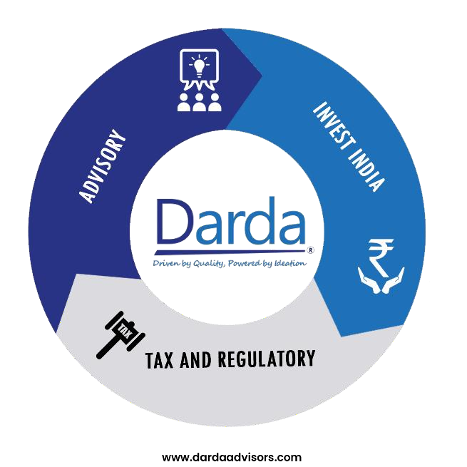
www.dardaadvisors.com da@dardaadvisors.com
+91 99529 26239
Hyderabad:, Jyoti Enclave Flat no. 502, Renuka Enclave, Raj Bhawan Road,
Somajiguda, Hyderabad -500082
Bangalore: 250, First Floor, Narasipura Layout, Vidyaranyapura Main Road, Bangalore – 560097, Karnataka
Chennai: 13, T.K. Mudali Street, Choolai, Chennai - 600112, Tamil Nadu
NCR: N93, Ground floor, Mayfield garden, Sector 51, Gurugram -
122018, Haryana
Bhilwara: Moti Chambers, 62&63, Sancheti Colony, Lane besides KK Tower, Pur Road. Bhilwara - 311001, Rajasthan
Darda Advisors (DA) refers to one or more of Darda Advisors LLP, a registered Limited Liability Partnership in India and its associate of firms, each of which is a legally separate and independent entity. Information in this publication is intended to provide only a general outline of the subjects covered.
https://www.icai.org/
www.dardaadvisors.com

