Slide 1
Compliance with Audit Documentation
Presentation at the Training Programme organised by the
Peer Review Board of ICAI and hosted by the
Hyderabad Branch of SIRC of ICAI
on 21 April 2025
CA. Dr. Chinnsamy Ganesan
FCA DISA (ICA)

Slide 2
Peer Review Major Observations
Non compliance with Accounting and Standards on Auditing
Improper/ inadequate disclosures/ Reporting
Adequacy of documentation of the work done
Audit conclusions not properly supported where judgemental issues involved

Slide 3
FRRB Major Observations
Non-Compliance with accounting and auditing standards
Non-compliance with reporting obligations under the Companies Act
Non-Compliance with disclosure requirements prescribed by regulatory bodies, statutes and rules and regulations
Inadequate/ improper audit opinions

Slide 4
The Common Thread
Non-Compliance with accounting standards
Non-Compliance with auditing standards
Inadequate/ improper audit opinions
The root cause is inadequate documentation to demonstrate the work done

Slide 5
Framework
Nature of Service
Audit
Review
Agreed Upon Procedures
Compilation
Level of assurance provided by auditor
High but not absolute assurance
Moderate assurance
No assurance
No assurance
Report provided by auditor
Positive assurance on assertions and other specific reporting requirement
Negative assurance on assertions and other specific reporting requirement
Factual findings of procedures performed as agreed
Identification of information compiled
Documentation is mandatory in all cases

Slide 6
Documentation why crucial?
Absolute assurance cannot be given
Use of auditor’s judgement
The use of test checks
Inherent limitations of any accounting and internal control systems
Most of the evidence available to the auditor is persuasive, rather than conclusive, in nature

Slide 7
Use of Audit Documentation
Primary
Evidence of the auditor’s basis for a conclusion about the achievement of the overall objectives of the auditor; and
Evidence that the audit was planned and performed in accordance with SAs and applicable legal and regulatory requirements

Slide 8
Use of Audit Documentation
Additional
Assisting the engagement team to plan and perform the audit
Assisting members of the engagement team responsible for supervision
Enabling the engagement team to be accountable for its work
Retaining a record of matters of continuing significance to future audits
Enabling the conduct of quality control reviews and inspections in accordance with SQC 1
Enabling the conduct of external inspections in accordance with applicable legal, regulatory or other requirements

Slide 9
Expectation Vs reality
Expectation
Reality
Characteristics of a good audit documentation is that a reviewer without previous knowledge of the client should reach the same conclusion, by reviewing the documentation, without any verbal communication with the auditor
A detailed and complete work done by every professional while performing even the tax audit assignments, but no proper documentation retained
If there is no documentation, it will be presumed that no work was done

Slide 10
Audit Phases and Audit Documentation
Audit
Planning
Understanding
the law
Accounting
Standards
NTE of
Audit
Procedures
Fraud Risk
Significant
Estimates
Relying on the work of others
Audit Opinion & communication

Slide 11
Planning and audit documentation
Agreeing the terms of audit engagements (SA 210)
Consideration of laws and regulations (SA 250)
Planning an audit (SA 300)
Materiality in planning and performing an audit (SA 320)
Preliminary analytics (SA 520)

Slide 12
Execution of an audit and audit documentation
Audit evidence (SA 500)
External confirmations (SA 505)
Analytical procedures (SA 520)
Audit Sampling (SA 530)

Slide 13
Execution of an audit and audit documentation
Auditing accounting estimates (SA 540)
Related Party Transactions (SA 550)
Subsequent events (SA 560)
Using the work of experts (SA 620)

Slide 14
NTE of audit procedures and audit documentation
Characteristics of the specific items or matters tested
Who performed the audit work?
The date such work was completed
Who reviewed the audit work performed?
The date and extent of such review

Slide 15
Completion of an audit and audit documentation
Letter of representation (SA 580)
Communication to those charged with governance (SA 260)
Final analytics (SA 520)
Forming an opinion and reporting (SA 700, 705 and 706)
Key Audit Matters (SA 701)

Slide 16
Communication with TCWG and related documentation
Discussions of significant
matters
Nature of the significant matters discussed
When and with whom the discussions took place?

Slide 17
Timely documentation
Preparing sufficient and appropriate audit documentation on a timely basis helps to enhance the quality of the audit and facilitates the effective review and evaluation of the audit evidence obtained and conclusions reached before the auditor’s report is finalised
Contemporaneous documentation is important

Slide 18
Check Point
Documentation of audit procedures performed on 12 April 2023 were completed on 15 April 2023
The audit report was issued on 9 May 2023. Is this an example of timely documentation?
TRUE – documentation must be contemporaneous not just by the audit report date.

Slide 19
Form and Content of Audit Documentation
The auditor shall prepare audit documentation that is sufficient to enable an experienced auditor, having no previous connection with the audit, to understand
The nature, timing, and extent of the audit procedures performed to comply with the SAs and applicable legal and regulatory requirements
The results of the audit procedures performed, and the audit evidence obtained
Significant matters arising during the audit, the conclusions reached thereon, and significant professional judgments made in reaching those conclusions

Slide 20
Form and Content of Audit Documentation
Depends on
The size and complexity of the entity
The nature of the audit procedures to be performed
The identified risks of material misstatement
The significance of the audit evidence obtained
The nature and extent of exceptions identified
The need to document a conclusion or the basis for a conclusion for judgemental areas
The audit methodology and tools used

Slide 21
Matters arising after the date of the Auditor’s Report
If in exceptional circumstances auditor performs new or additional audit procedures or draws new conclusions after the date of the auditor’s report,
the auditor shall document
The
circumstances encountered
New/ additional audit procedures performed
Audit evidence obtained, and conclusions reached
Their effect
on the auditor’s report
When and by whom audit documentation were made

Slide 22
Assembly of final audit file
SQC 1 requires firms to establish policies and procedures for the timely completion of the assembly of audit files
Ordinarily not more than 60 days after the date of the auditor’s report
After the assembly of the final audit file has been completed, the auditor shall not delete or discard audit documentation of any nature before the end of its retention period
Ordinarily is no shorter than seven years from the date of the auditor’s report

Slide 23
Check Point
Is it true that all audit evidence required to support our audit opinion be documented prior to issuance of the audit opinion?
FALSE – but it is a best practice. Documentation should be on a timely basis, so audit evidence received during the year should be documented at the time it is received.
Documentation is not required to be fully completed prior to issuance of the opinion, however, all audit evidence relevant to the opinion must be obtained by this date.

Slide 24
Best practices
Permanent and temporary files
Use of checklists
Training the audit team
Consult, consult, consult
Work paper review by senior auditor

Slide 25
Use of Check lists
Accounting Standards Checklist
Companies Act, 2013 Checklist
Schedule III Checklist

Slide 26
Key Takeaway
If there is no documentation, it will be presumed that no work was done

Slide 27
Questions?
?

Slide 28
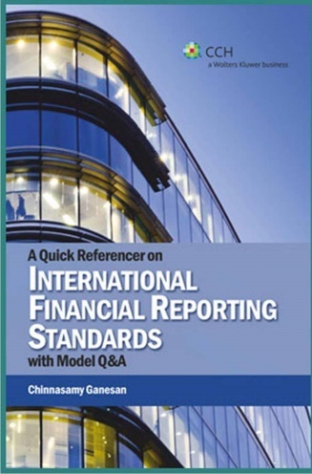
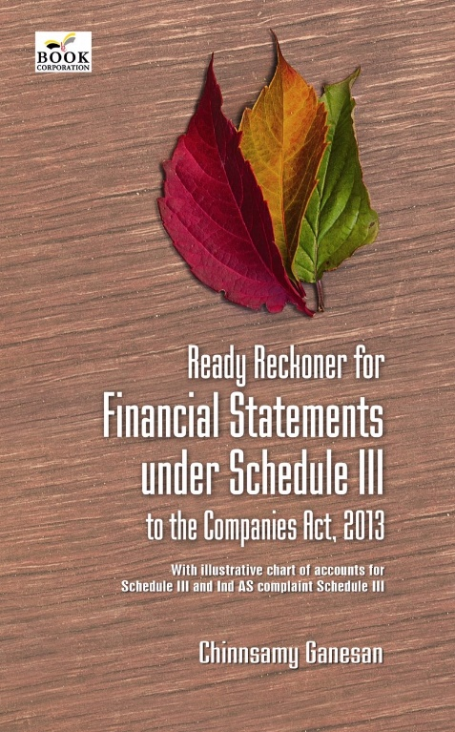
Thank you
ganesanca@yahoo.com/ 0 99401 30403

