Slide 1

CA Real Estate Practice Excellence
Values, Attitudes, and Habits for Success
Guiding First - Generation Wealth Creators Through Integrity and Excellence

Slide 2

What This Training Covers
5 Core Values for ethical real estate practice
3 Essential Attitudes that build client trust
5 Professional Habits that transform delivery
Networking Framework for one-stop shop services
Daily Reflection Ritual for continuous growth

Slide 3

Five Core Values
The Foundation of Ethical Real Estate Practice

Slide 4
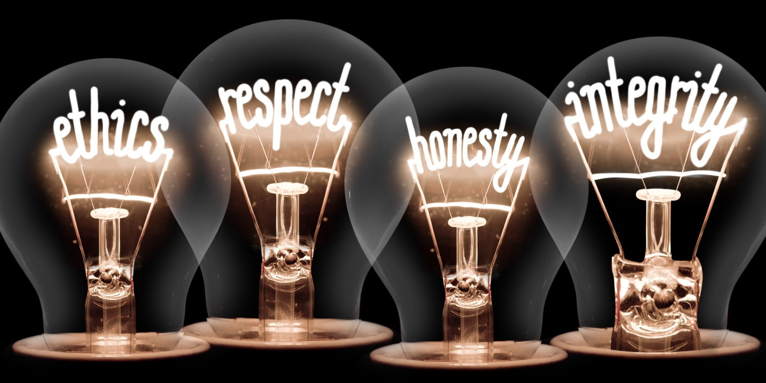
1. Integrity and Transparency
Why It Matters: Verifying title deeds protects clients from future disputes and hidden claims on their property.
In Practice: Explain in simple terms: "This check ensures no one else has a claim on your property—it protects your dream."
✓ Transparency is not abstract—it's the difference between safeguarding success and risking ruin.

Slide 5
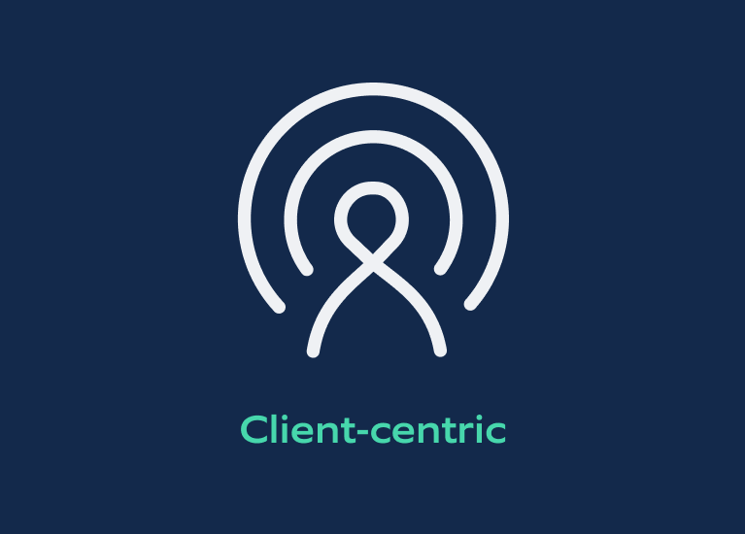
2. Client-Centric Service
The Challenge: Clients dazzled by quick profits may want to skip documentation or ignore compliance.
Your Response: "Your success is remarkable. Let's ensure it lasts by keeping records clean—so tomorrow you can borrow, expand, or sell without hurdles."
✓ Listen, acknowledge aspirations, then guide toward structured growth.

Slide 6

3. Ethical Responsibility
The Pressure: Developers suggest under-reporting transaction values to save tax.
Your Response: Hold the Line: "This shortcut may look profitable today, but it blocks loans, attracts penalties, and damages reputation."
✓ Teaching clients long-term discipline protects compliance AND the relationship.

Slide 7
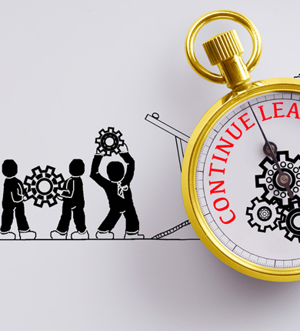
4. Continuous Learning
Learn On Two Fronts:
1. Technical: New regulations like GST rule shifts
2.Communicative: How to explain them clearly
✓ Example: Create "before and after" charts to show GST impact—this makes you indispensable.

Slide 8

5. Social Responsibility
Broader Perspective: Clients may not consider zoning or environmental impact.
Your Stewardship Role:
"If this land is reserved for agriculture, building here could harm the community and invite penalties."
✓ Become a steward of both financial and social good.
.

Slide 9

Building Trust Through Empathy, Education, and
Vision
Three
Essential Attitudes

Slide 10

1. Empathy and Patience
The Scenario: Client arrives with crumpled receipts and no balance sheet.
Your Attitude: "You've worked hard to earn this. Let's organize it together."
Patience Builds Trust
Over time, clients learn to value structure

Slide 11
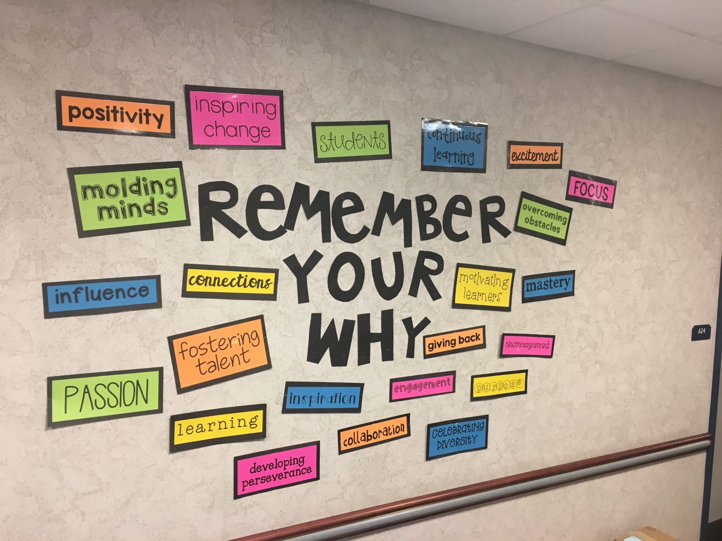
2. Educator's Mindset
Transform Confusion into Clarity
Example—Why Stamp Duty Varies:
"Just like bus fares differ from city to city, stamp duty changes depending on where you buy property."
✓ Use relatable analogies to make technical concepts accessible.

Slide 12

3. Resilience & Strategic Vision
Resilience: Clients change plans mid-deal. Adapt without losing professionalism.
Example: "If you reinvest part of this gain into structured assets, you'll secure your children's future."
Strategic Vision: Help clients see beyond immediate profits.

Slide 13
Five Professional Habits
Daily Practices That Transform Client Relationships

Slide 14

1. Simplified Communication
Not This: "Capital gains tax implications..."
Say This: "Out of your profit, here's how much you'll keep after government rules."
Clients understand and act confidently
Clarity eliminates decision paralysis

Slide 15
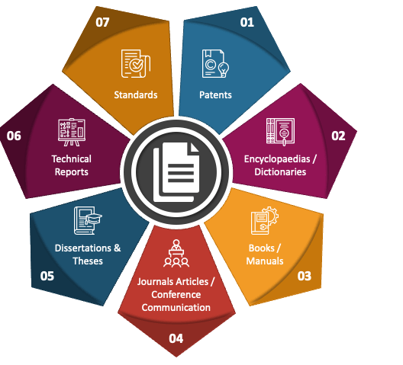
2. Hand-Holding in Documentation
When clients hesitate to sign: Walk them through each clause patiently.
Highlight risks and protections
Provide simple templates for record-keeping
Build client discipline over time

Slide 16
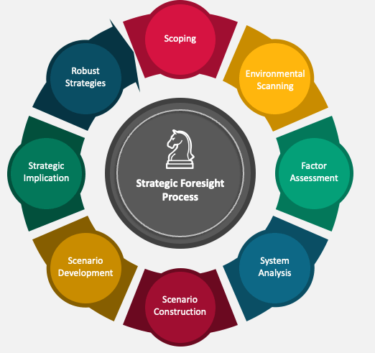
3. Scenario-Based Guidance
Common Question: "What happens if property prices fall?"
Your Practice: Run regular "what-if" scenarios.
Helps visualize risks and opportunities
Builds foresight in present-focused clients

Slide 17
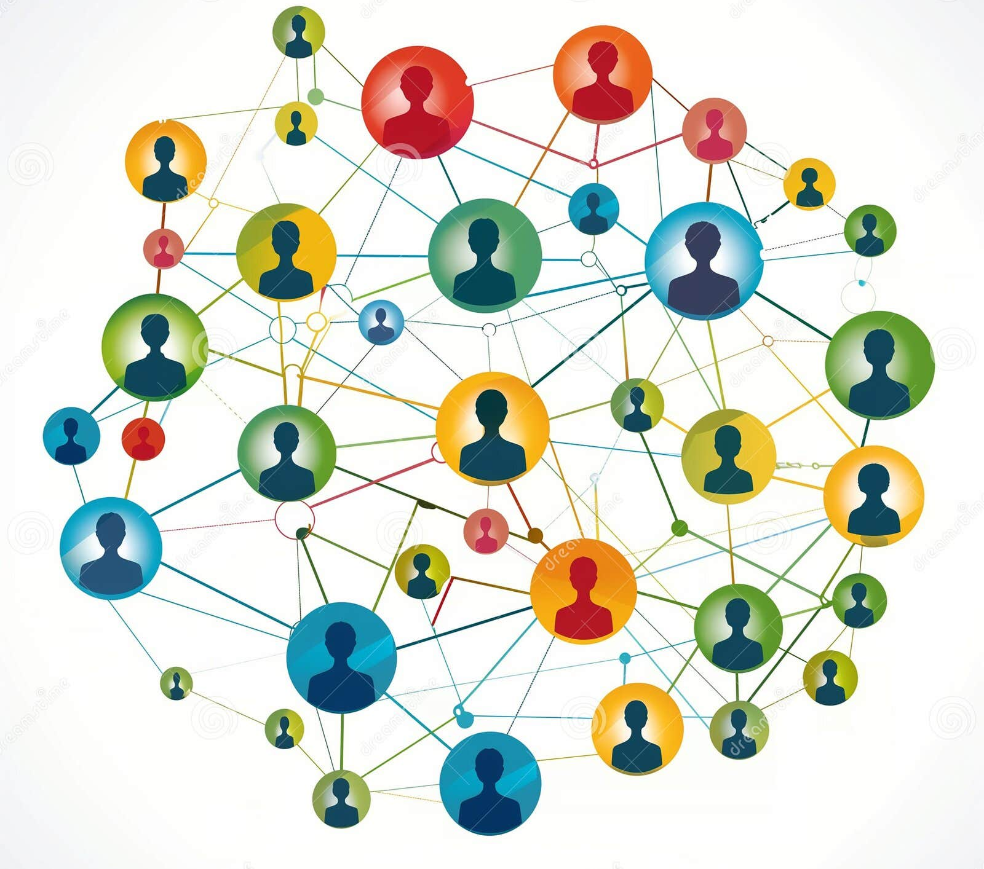
4. Regular Check-Ins &
5. Sensitive Networking
Regular Check-Ins: Quarterly reviews help unorganized clients stay aligned and build financial discipline.
Sensitive Networking: Preparing clients before introductions builds confidence.
Example: "The banker may ask for documents—don't worry, I'll help you organize them."

Slide 18

Networking for One-Stop Shop Services
Building Your Professional Ecosystem

Slide 19
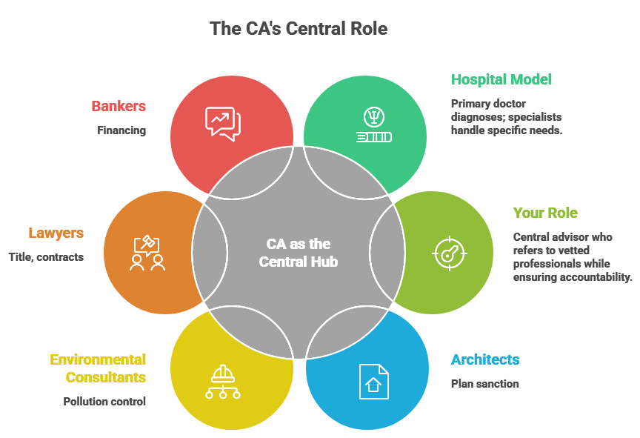

The CA as the Central Hub

Slide 20
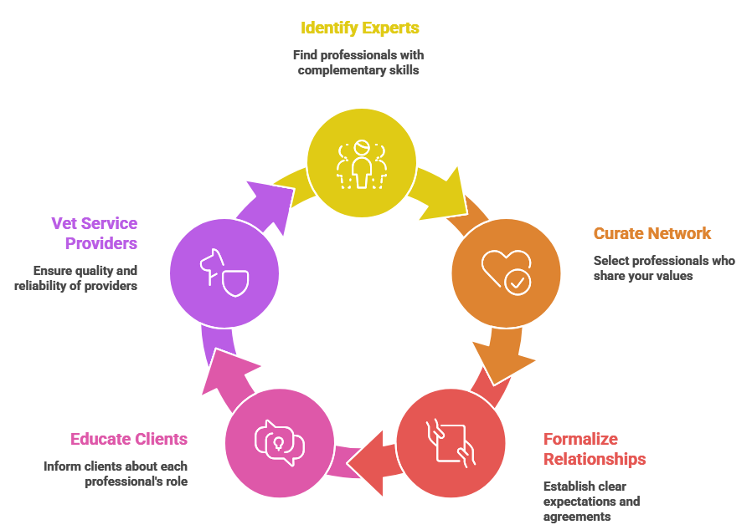

Building Your Network: Key Steps

Slide 21
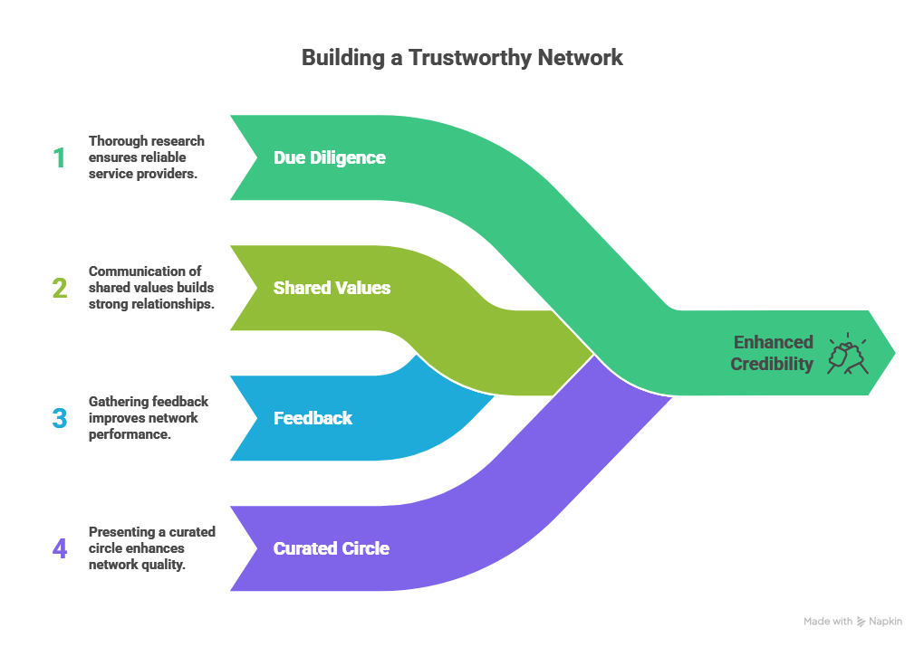
Ensuring Honest Services
Client fear: "Will I be cheated by unknown professionals?"

Slide 22
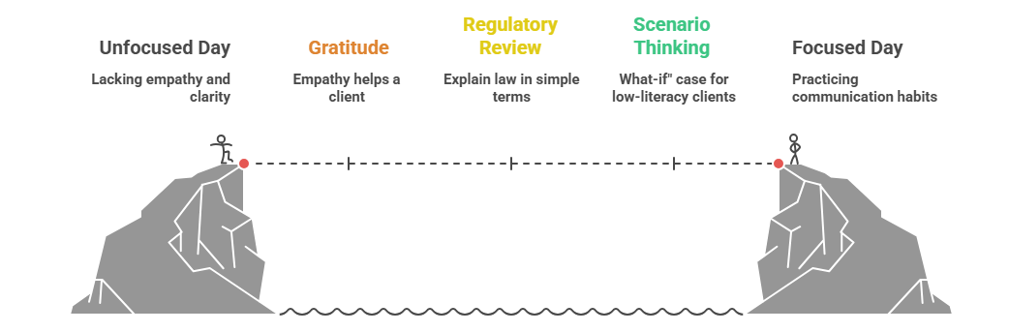
Daily Reflection Ritual
(10 minutes)

Slide 23
Thank You!
Your role in guiding first-generation wealth creators is transformational.
Material prepared using AI · Vetted by faculty CCM Madhukar N Hiregange

