Slide 1

Decoding Faceless Appeals & Practical Challenges and Remedies
By
Adv. Srinarayan Toshniwal, CA, CS
Jnr. Standing Counsel for Income Tax
(Telangana High Court)

Slide 2





Evolution and Initiatives
2020
CBDT launches Faceless Appeals Scheme for comprehensive reform
2021
Faceless Scheme officially notified to formalize implementation framework
2023
E-Appeals Scheme introduced for Joint CIT(A) proceedings
Ongoing
Continuous upgrades as part of India's tax administration overhaul

Slide 3




What is Faceless CIT (Appeals)?
Digital Process
No Physical Meetings
Complete online system for Income tax appeals before CIT(A)
Eliminates need for face-to-face interactions with tax officials
Virtual Communications
All hearings and correspondence conducted through digital platforms
Adv. Srinarayan Toshniwal, CA, CS

Slide 4




Structure of Faceless Appeals
NFAC - National Faceless Appeal Centre
National Faceless Appeal Centre as central hub to conduct e-appeal proceedings in centralized manner
Interface between Assessee, Assessing Officer, NFAC and AU's
Appeal Units
Facilitate the conduct of e-appeal proceedings by CIT(A) [Issuing Notices, disposing off appeals]
Adv. Srinarayan Toshniwal, CA, CS

Slide 5


Slide 6
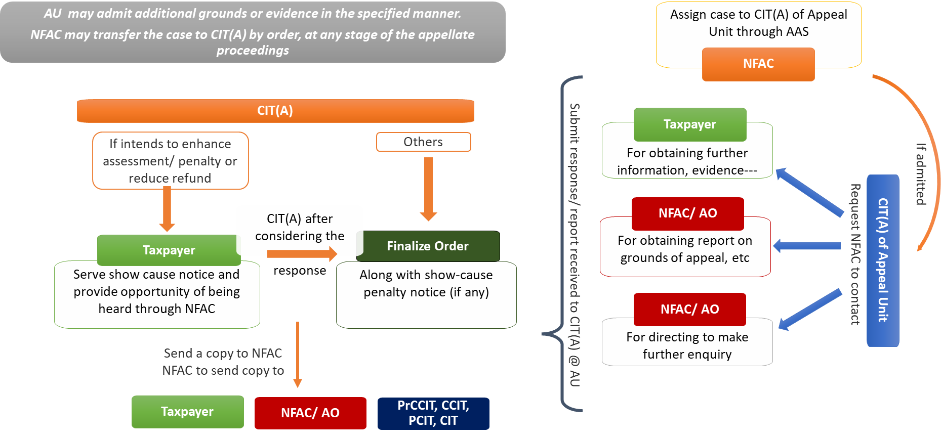
Faceless Appeal Scheme, 2021: Procedural flow

Slide 7





What is a Registered Email Address?
Email address as per e-filing portal
Email address as per last filed return
Email address as per PAN database
Email address as per Aadhar database
Email Address as per MCA database
Email made available by other person
Adv. Srinarayan Toshniwal, CA, CS

Slide 8


Slide 9

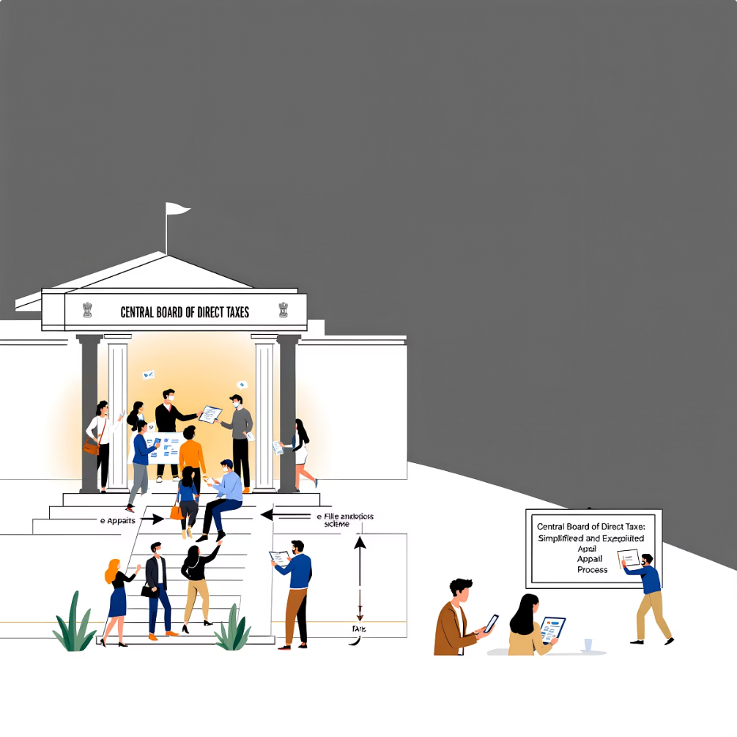
e-Appeals Scheme
The CBDT launched the e-Appeals Scheme 2023 via Notification 33/2023 to address pending income tax appeals, particularly for TDS/TCS defaults. This initiative streamlines appeal processes, enhancing efficiency and transparency in the tax system.
Introduction to e-Appeals Scheme 2023
The Finance Act 2023 established the Joint Commissioner (Appeals) through a section 246 amendment to handle small appeal disputes. Implemented May 29, 2023, the scheme defines application scope, procedures, penalties, and rectification processes, creating a structured framework for expedited resolution of minor tax disputes.

Slide 10
E-Appeals Scheme, 2023: Procedural flow
Additional grounds and Additional evidences are to be mandatorily admitted in cases of orders passed by CPC
  Assign case to JCIT(A) of Appeal Unit through Pr. DGIT(Systems) or the DGIT(Systems)
JCIT(A) of Appeal Unit
JCIT(A)
Shall / may issue notices to
If intends to enhance assessment/ penalty or reduce refund
Others
Taxpayer
AO
  JCIT(A) after considering the
  response
  For obtaining further information, evidence---
  For obtaining report on grounds of appeal other than in cases relating to sec 143(1), etc
Taxpayer
Finalize Order
Submit response/ report received to JCIT(A) @ AU
  Serve show cause notice and provide opportunity of being heard
  Along with show-cause penalty notice (if any)
Send a copy to
AO
  For directing to make further enquiry
Taxpayer
AO
PrCCIT, CCIT, PCIT, CIT

Slide 11
CIT(A) vs JCIT(A)
Particulars | JCIT (Appeals) | CIT (Appeals)
Legal Section | Section 246 | Section 246A
Scheme | e-Appeals Scheme, 2023 | Faceless Appeal Scheme, 2020
Effective Date | 12-May-23 | 25-Sep-20
Governing Notification | CBDT Notification No. 33/2023 | CBDT Notification No. 76/2020
Authority Rank | Joint Commissioner or Additional JC | Commissioner or Principal Commissioner
Appealable Orders | Basic/automated orders (143(1), 200A, TDS default, 143(3), 147, 144)* | All substantive orders incl. 153A, Transfer Pricing, 163
Additional evidence for orders passed by CPC | Shall accept additional evidence in case of orders passed by CPC | to get reports from the Assessing Officer before accepting additional evidence
Additional grounds for orders passed by CPC | Shall accept additional grounds in case of orders passed by CPC | to get reports from the Assessing Officer before accepting additional ground
Remand Power (Set Aside) | Not allowed | Allowed from 01.10.2024 for 144 orders
Appeal Against | Orders passed by officers below JC | Orders passed by JC or below/ complex issues
Final Order Issued By | JCIT(A) | NFAC on behalf of CIT(A)
Adv. Srinarayan Toshniwal, CA, CS

Slide 12
Matters not under purview of JCIT(A)
Appeals against assessment orders passed before 13.08.2020 u/s 143(3) or 144, where the disputed demand exceeds Rs. 10
lakh
Appeals against penalty orders passed on or before 12.01.2021, where demand exceeds Rs. 10 lakhs
Search and Survey Cases: Assessments pursuant to a search u/s 132 or requisition u/s 132A, or actions u/s 133A (survey), including assessment made on basis of seized material, and consequential penalty orders
Appeals against orders passed on or after 12.09.2019 under the e-Assessment Scheme, 2019, or the Faceless Assessment Scheme, 2019, or under section 144B, are not covered under the e-appeal scheme.
Appeals against penalty orders passed on or after 12.01.2021, under the Faceless Penalty Scheme, 2021
International Taxation Matters: Appeals pertaining to the jurisdiction of the Commissioner of Income-tax (International Taxation) are outside the scope of the faceless appeal scheme.
Adv. Srinarayan Toshniwal, CA, CS

Slide 13






Guidelines for Priority Disposal of Appeals
To be considered by Pr. CCIT, CCIT or DGIT on recommendation by Pr. CIT/ Pr. CIT(CC)/ Pr. CIT(IT), at request of Assessee/ AO/ Range head
Cases having demand above 1 Crore
Cases where request made by senior or super senior citizens
Directions of any Court
VIP or PMO reference
Other genuine reasons

Slide 14
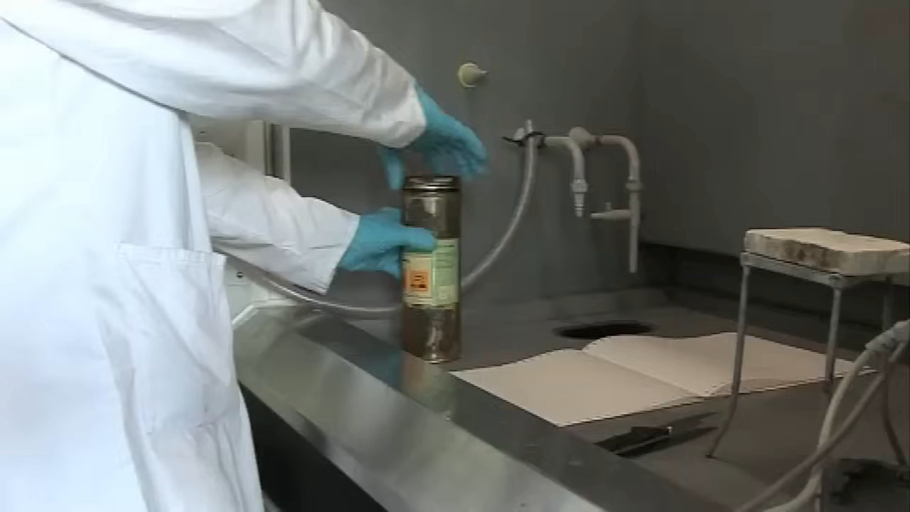

Slide 15


Slide 16
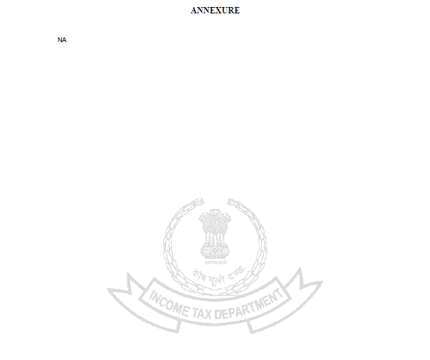
NA
- Not Applicable
- Not Available
- Not Assessed
- No Answer
- Non – Agricultural Land
- Na – Sodium

Slide 17


Slide 18
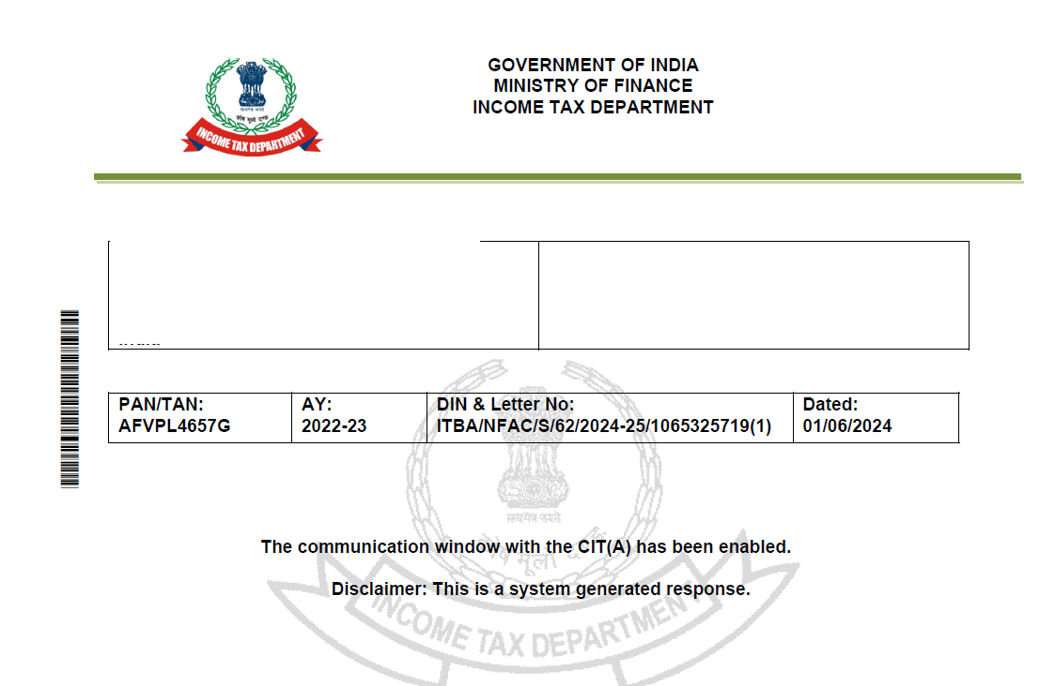

Slide 19
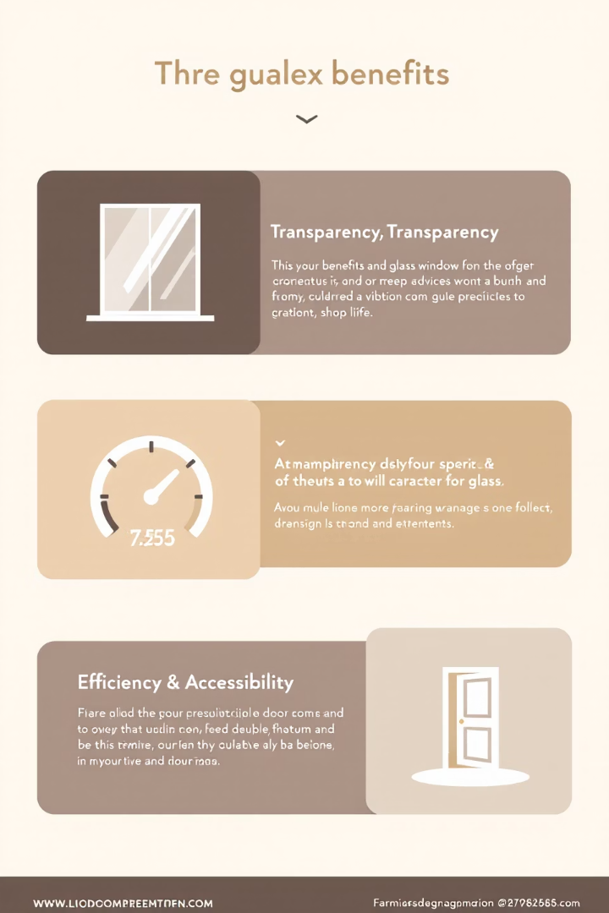




Key Features and Benefits
Transparency
Speed
Promotes independence and objectivity in decisions
Faster processing with reduced bureaucratic delays
Integrity
Accessibility
Reduced scope for corruption and bias
Available from anywhere, enhancing compliance ease

Slide 20

Judgements

Slide 21

144 vs 143(3)
G-Trans Logistics (India) Pvt Ltd vs Income Tax Officer Ward-1(2), Ghaziabad – (I.T.A 398/Del/2020)
Assessing Officer passed an order under Sec. 143(3) of the Income Tax Act, 1961, making certain additions.
Assessee filed an appeal before the Commissioner of Income Tax (Appeals). However, in the Form No. 35, the Assessee selected the order u/s 144 as against 143(3) of the Act.
The Commissioner of Income Tax (Appeals) dismissed the appeal of the Assessee, on the ground that wrong selection of order is a non-curable defect and hence appeal is not maintainable.
Interest of substantial prevails over technicalities.
Adv. Srinarayan Toshniwal, CA, CS

Slide 22
Revision Not Allowed During Pending Appeal
Yogendra Prasad Santosh Kumar v. CIT, [2014] 44 taxmann.com 299 (Allahabad)
The assessee filed an appeal under Section 246 and later applied to withdraw it, intending to opt for revision under Section 264. However, since no formal withdrawal order was passed by CIT(A), the appeal remained legally pending. The Commissioner initially allowed the revision but later withdrew it, declaring it void for lack of jurisdiction.
The High Court upheld this, holding that a withdrawal application doesn’t end the appeal unless formally accepted. Under Section 264(4), revision is barred if an appeal is pending. So, the revision petition was not maintainable while the appeal was still on record.
The ruling reinforced that procedural compliance is essential, and one cannot switch to revision unless the appeal is formally disposed of.
Adv. Srinarayan Toshniwal, CA, CS

Slide 23
Dismissal for Non-Payment of Advance Tax Set Aside
Priyanka Mandadi v. ITO [ITAT Hyderabad, ITA No. 1184/Hyd/2024]
The assessee, a non-filer, was reassessed under Section 147 after cash deposits of Rs. 1.07 crore were found. She claimed the funds were used for car purchases and sales, yielding no income. CIT(A) dismissed the appeal citing non-payment of advance tax under Section 249(4)(b).
ITAT held the dismissal invalid since no tax was due if there was no income. CIT(A) also failed to consider her reply or evidence. Mere cash deposits don’t trigger advance tax liability by default.
The matter was remanded to the AO for fresh adjudication after granting fair opportunity.
Adv. Srinarayan Toshniwal, CA, CS

Slide 24
Failure to Serve Physical Notice Despite Opt-Out
Srinivas Reddy Kothagadi & Raghuram Reddy vs. ITO, Ward-15(1), Hyderabad (ITAT Hyderabad Bench ‘B’, ITA Nos. 142 & 146/Hyd/2025)
The assessees challenged additions under Section 50C relating to land sale, arguing that the DVO report was pending and Section 54 exemption was ignored. The AO proceeded based on stamp duty value.
CIT(A) passed an ex-parte order via NFAC, despite the assessees opting out of email communication in Form 35. Since no physical notice was served, ITAT held this violated principles of natural justice.
Adv. Srinarayan Toshniwal, CA, CS

Slide 25
CIT(A) Cannot Dismiss Appeal for Non-Prosecution
Vahan Motors Pvt. Ltd. v. DCIT, Circle–8(1), Hyderabad (ITAT Hyderabad, ITA No. 160/Hyd/2025)
In this case, CIT(A) dismissed appeal for non-prosecution without addressing the merits or the specific grounds raised against the addition of Rs. 39.73 lakhs under Section 68. The dismissal followed reassessment under Section 263.
The ITAT held that under Sections 250(6) and 251, CIT(A) is legally bound to adjudicate appeals on merits and pass a speaking order, even if the assessee is absent. Dismissal without examining the grounds filed is procedurally invalid.
Accordingly, the appeal was restored to CIT(A) for fresh adjudication after granting a fair hearing.
Adv. Srinarayan Toshniwal, CA, CS

Slide 26
Implied Delay Condonation
Nafees Sultana v. ITO, Ward 14(1), Hyderabad [ITAT Hyderabad, ITA No. 642/Hyd/2025
The assessee contested a Rs. 1.10 crore rent addition under Section 147, claiming it was arrears from a court settlement, eligible for deduction. Since the appeal was delayed, CIT(A) denied condonation and dismissed, however, the CIT(A) also adjudicated the matter on merits.
ITAT held that once CIT(A) decides on merits and quantum, the delay stands impliedly condoned. As the rent was taxed, the AO was required to consider the standard 30% deduction. Since factual clarity on the nature of receipt was missing, the matter was remanded to the AO for fresh decision after hearing.
Adv. Srinarayan Toshniwal, CA, CS

Slide 27
Notice served on other email id
Dhanya TMT (P.) Ltd vs Deputy Commissioner of Income Tax – (2024) 159 taxmann.com 1563 (Bangalore – Trib)
Assessing Officer passed an order under Sec. 144 of the Income Tax Act, 1961, making certain additions. The Assessee was facing SARFAESI proceedings and hence could not respond to the assessment proceedings.
Assessee filed an appeal before the Commissioner of Income Tax (Appeals). Before the Commissioner of Income Tax (Appeals) it did not response since it was unaware of the proceedings as the notices were served on other email id.
The Hon’ble Tribunal held that notices were not served on the email id designated on the portal and hence the notices were not validly served.
Adv. Srinarayan Toshniwal, CA, CS

Slide 28
Notice served on Accountant’s email id
Chowgule Industries (P.) Ltd vs ACIT (2022) 142 taxmann.com 472 (Bombay)
Assessing Officer passed an re-assessment order under Sec. 147 of the Income Tax Act, 1961, making certain additions. The Assessee filed a Writ Petition before the Bombay HC stating that the PAN was duly surrendered and hence the order was passed against an non-existing entity. In addition to the above, the email-id on which it was served is also incorrect.
The Hon’ble Court observed that though the Assessee claims to have surrendered the PAN, transactions were carried out under the said PAN after due surrender. Also the notices and order was served on the Chartered Accountant’s email id, which was registered with the department.
The Hon’ble Court dismissed the Writ Petition
Adv. Srinarayan Toshniwal, CA, CS

Slide 29

Who’s first
Suparshva Swabs vs National Faceless Appeal Centre & Ors (Delhi High Court – W.P. (c) 356/2025)
The Assessee filed Writ Petition seeking early disposal of his appeal which was pending before the NFAC for more than 2 years.
The Hon’ble Court took cognizance of the pending matters and the road map laid down by the NFAC to ensure early disposal.
Considering the above, the Hon’ble Court directed to dispose the appeal within 8 weeks therefrom.
Adv. Srinarayan Toshniwal, CA, CS

Slide 30
CIT(A) lacks Remand Power in 143(3) Cases
Deenababu Kondubhatla v. ITO, (Intl. Tax)-1, Hyderabad (ITAT Hyderabad, ITA No. 347/Hyd/2025)
The assessee, a non-resident, declared LTCG of Rs. 13.18 lakhs, but the AO treated the sale as STCG of Rs. 2.15 crores due to missing cost details. The order was passed under Section 143(3). CIT(A), citing ex-parte nature, set aside the order and remanded it to the AO using powers under amended Section 251(1)(a).
ITAT ruled that such remand is only permitted if the order is passed under Section 144. Since this was a regular assessment under Section 143(3), CIT(A) exceeded his authority.
The Tribunal restored the matter back to CIT(A) for decision on merits, directing a fair hearing for the assessee.
Adv. Srinarayan Toshniwal, CA, CS

Slide 31

Adv. Srinarayan Toshniwal, CA, CS, LLB
Standing Counsel for Income Tax, Telangana High Court.
srinarayantoshinwal204@gmail.com
+91-8801701539

