Slide 1


Darak & Associates
Company Secretaries

Slide 2

ROC ANNUAL FILINGS

Slide 3


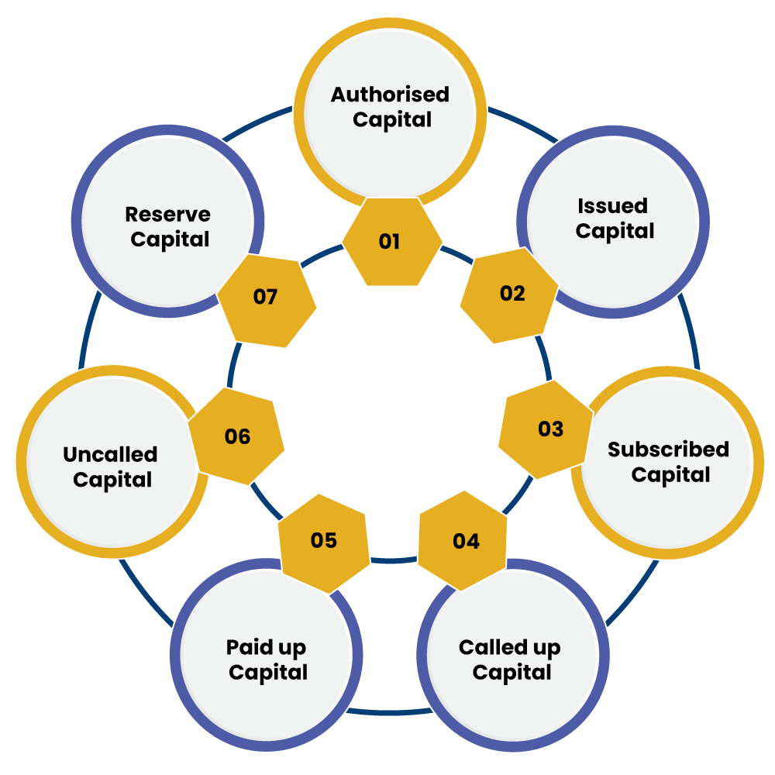
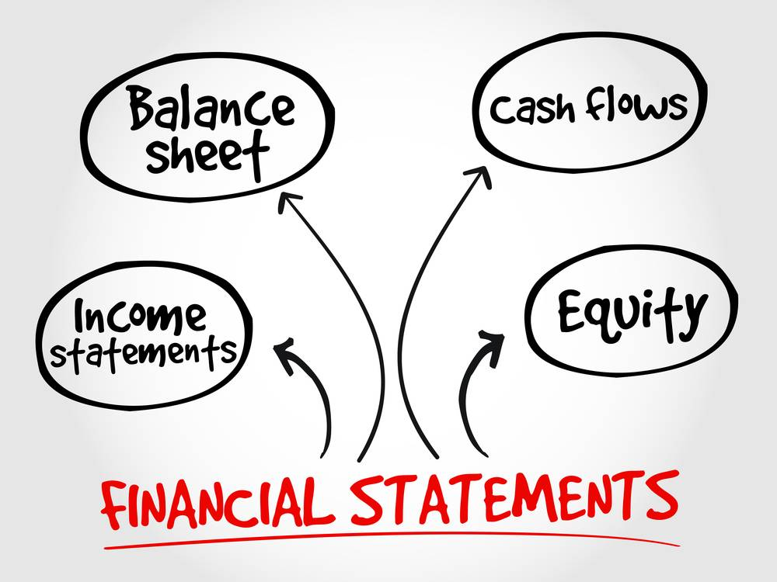
FORMS TO BE FILED

Slide 4
FORMS TO BE FILED
INC-20A
ADT-1
MGT-7
AOC-4

Slide 5

PRE REQUISITES

Slide 6
PRE REQUISITES
1) Digital Signature Certificate at your place
2) All DINs in active status
3) Last year’s filed Form
4) Form ADT-1 and its Challan
5) Form DIR-12 for Director regularization cases (if applicable)
6) Consolidated Financials (if applicable)
7) Financials figures in actuals and rounded off
8) Mandatory Attachments

Slide 7

MANDATORY ATTACHMENTS TO AOC-4
MANDATORY ATTACHMENTS TO MGT-7

Slide 8
MANDATORY ATTACHMENTS TO AOC-4
1) Signed Audit Report
2) Signed Financials
3) Signed Board Report and its annexures
4) CSR Report
5) Shorter Consent
MANDATORY ATTACHMENTS TO MGT-7
1) List of Shareholders, List of Transfer
2) MGT-8
3) UDIN Letter
4) List of Directors (only for MGT-7A)
5) Shorter Consent and Photos
Clarification Letter for peculiar cases

Slide 9

AOC-4 XBRL APPLICABILITY

Slide 10
AOC-4 XBRL APPLICABILITY
1) Company listed in India and their Indian subsidiaries
2) Paid up capital of Rs. 5 crore or above
3) Turnover of Rs. 100 cr or above
4) Companies to whom Companies (Indian Accounting Standards) Rules, 2015 are applicable
once XBRL is filed it becomes applicable for all subsequent years

Slide 11

AOC-4 CFS APPLICABILITY

Slide 12
AOC-4 CFS APPLICABILITY
Holding Company which has one or more subsidiary and/or associate companies

Slide 13

MGT-7A APPLICABILITY

Slide 14
MGT-7A APPLICABILITY
Small Company and 2) One Person Company
No requirement of obtaining PCS Certification
MGT-8 APPLICABILITY
Paid Up Capital: 10 cr or Turnover: 50 cr

Slide 15

SMALL COMPANY (WITH EFFECT FROM 15-9-2022)

Slide 16
SMALL COMPANY (WITH EFFECT FROM 15-9-2022)
Other than Public Company:
a) paid-up share capital of which does not exceed 10 cr
b) turnover of which does not exceed 100 cr
Holding Company, subsidiary Company, charitable Company and Company governed by any Special Act cannot be classified as a small company

Slide 17


GENERAL QUESTIONS
1) Due date of filing Form AOC-4 and MGT-7/7A
For AOC-4, AOC-4 CFS, AOC-4 XBRL –
For MGT-7, MGT-7A –
2) Due date of filing Form AOC-4 and MGT-7A for OPC
For AOC-4 –
For MGT-7A –
3) Is it ok to take print on regular papers

Slide 18
GENERAL QUESTIONS
1) Due date of filing Form AOC-4 and MGT-7/7A
For AOC-4, AOC-4 CFS, AOC-4 XBRL – 30 days from AGM Date
For MGT-7, MGT-7A – 60 days from AGM Date
2) Due date of filing Form AOC-4 and MGT-7A for OPC
For AOC-4 – 27 Sep (within 180 days from completion of the FY)
For MGT-7A – 28 Nov (60 days from AGM Date)
3) Is it ok to take print on regular papers
No. The documents need to be on letterhead

Slide 19


GENERAL QUESTIONS
4) Content in letterhead
5) Unsigned or SD mentioned on documents is ok
6) What need to be mentioned at the place of signing

Slide 20
GENERAL QUESTIONS
4) Content in letterhead
Name, Registered Office Address, CIN, Telephone Number, Fax Number, E-Mail and Website
5) Unsigned or SD mentioned on documents is ok
No
6) What need to be mentioned at the place of signing
Name, Designation and DIN/PAN (Refer section 158)

Slide 21

AGM NOTICE
1) Number
2) Meeting Particulars
3) Signing Details
4) Quorum
For Private Company –
For Public Company –

Slide 22
AGM NOTICE
1) Number
Mandatorily Serial number to be mentioned
2) Meeting Particulars
Incorrect Day, Date, Year etc
3) Signing Details
Place shall be of registered office and date shall be of Directors Report
4) Quorum
For Private Company – 2
For Public Company – 5 (members upto 1000)
15 (members from 1000-5000)
30 (members from 5001)

Slide 23

AGM NOTICE

Slide 24
AGM NOTICE
5) Items
a) Adoption of Audit Report, Financials, Directors Report (A)
b) Dividend Declaration (D)
c) Director rotation (D)
d) Auditor (Re) Appointment (A)
e) Director Regularization
f) Managing Director Reappointment
g) Section 180/185/186 approvals
h) MOA/AOA amendments
i) Remuneration of statutory auditors

Slide 25

AGM NOTICE
6) Type of Business
7) Type of Resolution
8) Signing of Notice
9) Invitees for AGM
10) AGM on holiday

Slide 26
AGM NOTICE
6) Type of Business
Ordinary Business – ADDA
Special Business – Other than ADDA
7) Type of Resolution
Ordinary – more than 50%
Special - 75% and above
8) Signing of Notice
One or more Directors or Company Secretary
9) Invitees for AGM
Members, Directors, Statutory Auditor, Secretarial Auditor, Cost Auditor, Debenture Trustees
10) AGM on holiday
Yes! Not on National Holiday

Slide 27



AGM NOTICE
11) Venue for AGM
12) Notice Period
13) Shorter Notice Period
14) Other Business items allowed
15) Annexures to AGM Notice
16) When AGM to be held

Slide 28
AGM NOTICE
11) Venue for AGM
Registered Office or other place within the town or city or village of RO
12) Notice Period
21 clear days
13) Shorter Notice Period
Prior Consent of atleast 95% is required
14) Other Business items allowed
No. AGM notice must contain the item of discussion from before
15) Annexures to AGM Notice
Explanatory Statement, Attendance Slip, Proxy Form, Venue map
16) When AGM to be held
6 months from FY Closure and for first year additional 3 months allowed

Slide 29

BOARD REPORT
1) Signing of BR
2) Year
3) Mandatory items in BR
4) Data to be considered
5) Annexures to BR
6) Extract of Annual Return (MGT-9)

Slide 30
BOARD REPORT
1) Signing of BR
a) Chairperson of Company if authorized otherwise
b) Minimum Two Directors (MD mandatory to sign if appointed)
c) One Director in case of OPC
2) Year
2023 from 2022
3) Mandatory items in BR
Section 134(3), 134(5), Rule 8 of Companies (Accounts) Rules, 2014. Close to 35 points
4) Data to be considered
Standalone data
5) Annexures to BR
AOC-1, AOC-2, CSR Report, Secretarial Audit Report, MDAR, CG Report, Employee Report etc
6) Extract of Annual Return (MGT-9)
Not required

Slide 31
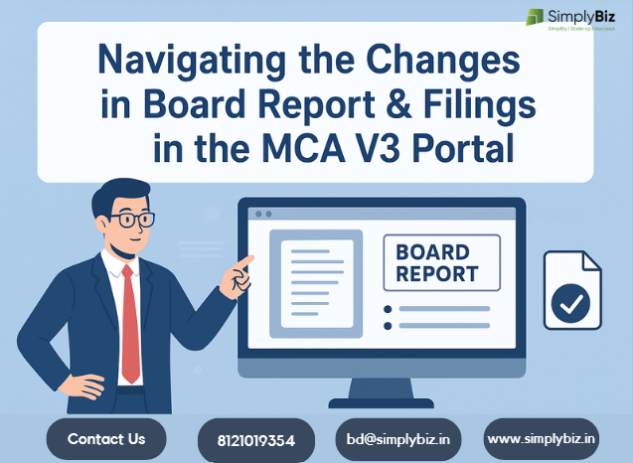
BOARD REPORT
7) Duplicity of data
8) Designation
9) Date in BR
10) Place in BR
11) CSR Report
12) Industry specific Disclosures

Slide 32
BOARD REPORT
7) Duplicity of data
Refer to other place where data is already available
8) Designation
Mention the correct designation of Board person signing the report
9) Date in BR
Date of signing financials or later date
10) Place in BR
Preferably Company’s RO
11) CSR Report
Use the latest updated report
12) Industry specific Disclosures
Mandatory

Slide 33

PRECAUTIONS
13) Written Confirmation
14) DSC instead of physical signature
15) Provisions Applicability

Slide 34
PRECAUTIONS
13) Written Confirmation
Obtain through electronic or offline mode on filled report and form
14) DSC instead of physical signature
Valid but avoid
15) Provisions Applicability
Enter the required financials data and automatically applicable cells pop up

Slide 35





SERVICES

Slide 36
SERVICES
DEMATERIALIZATION
NAME APPROVALS
REGISTERED VALUER
RBI FILINGS

Slide 37

Q&A

Slide 38






8977011791
www.darakandassociates.com
csdarakandassociates@gmail.com
Hyderabad, Vijayawada, Mumbai, Pune, Bengaluru, Delhi

