Slide 1
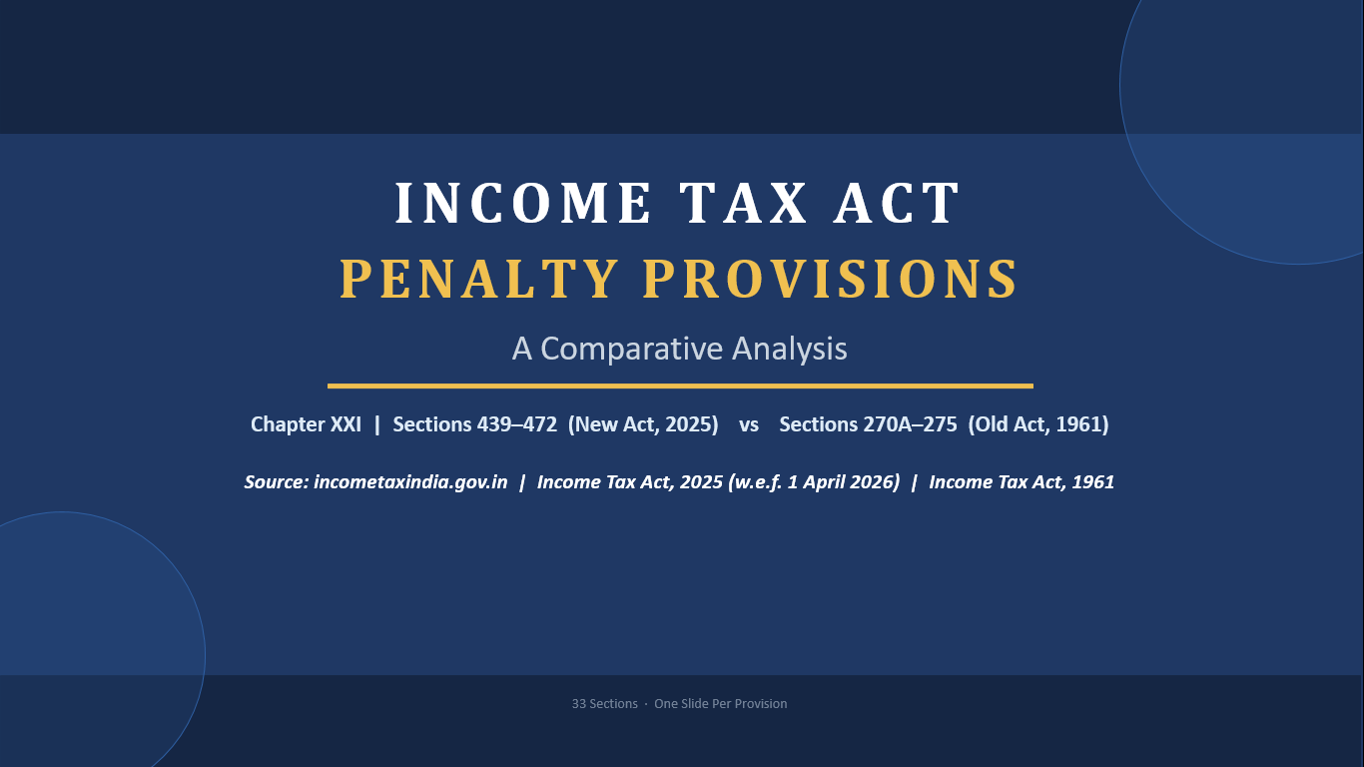
INCOME TAX ACT
PENALTY PROVISIONS
Comparative Analysis
INCOME TAX ACT
PENALTY PROVISIONS
1961
⇄
2025
A Comparative Analysis
Chapter XXI • Sections 439-472 (ITA 2025) vs Sections 270A-275 (ITA 1961)
Effective from 1 April 2026
Chapter XXI | Sections 439–472 (New Act, 2025) vs Sections 270A–275 (Old Act, 1961)
Source: incometaxindia.gov.in | Income Tax Act, 2025 (w.e.f. 1 April 2026) | Income Tax Act, 1961

Slide 2
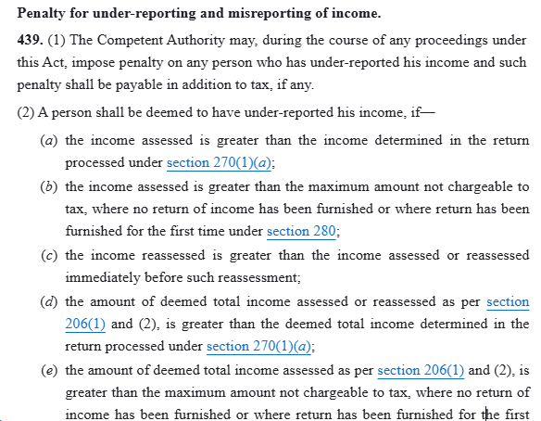
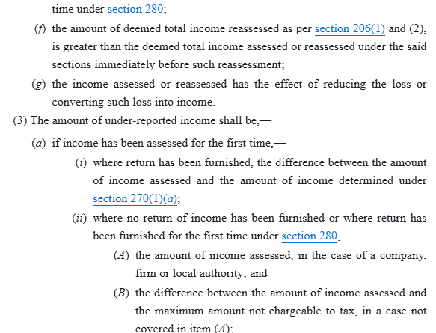
1
Penalty for Under-reporting and Misreporting of Income.
WHAS THE PENALTY FOR?
Section 270A of ITA, 1961
Section 439 of ITA, 2025
KEY CHANGES
Click to add content
New category of misreporting introduced, income referred to in Section 195(1)(b) added as a seventh category attracting 200% penalty.
Exclusion for undisclosed income covered under the search penalty provision omitted (old Section 270A(6)(e)).
“Competent Authority” defined, replacing repeated references to individual authorities.
Penalty rates remain unchanged, i.e., 50% for under-reporting and 200% for misreporting.
Section 270A – Penalty for Under-Reporting and Misreporting of Income
Section 270A was introduced by the Finance Act, 2016 and is applicable from AY 2017-18 onwards. It replaced the erstwhile penalty provisions under section 271(1)(c).
Applicability
The Assessing Officer, Commissioner (Appeals), Joint Commissioner (Appeals), Principal Commissioner or Commissioner may direct levy of penalty where a person has under-reported his income.
Cases of Under-Reporting of Income [Section 270A(2)]
A person is considered to have under-reported income where:
Income assessed is greater than income processed under section 143(1)(a);
No return is filed and assessed income exceeds the maximum amount not chargeable to tax;
Reassessed income exceeds previously assessed income;
Deemed income under sections 115JB/115JC assessed exceeds the amount processed under section 143(1)(a);
Assessment reduces loss or converts loss into income.
No order imposing a penalty under this Chapter shall be made unless the assessee has been heard, or has been given a reasonable opportunity of being heard [by way of a show-cause notice to that effect].
No order imposing a penalty under this Chapter shall be made without the prior approval of the Joint Commissioner—
where the penalty exceeds Rs. 10000, by the Income-tax Officer;
where the penalty exceeds Rs. 20000, by the Assistant Commissioner or Deputy Commissioner.
An income-tax authority on making an order under this Chapter imposing a penalty, unless he himself is the Assessing Officer, shall send a copy of the order to the Assessing Officer.
33 / 33

Slide 3
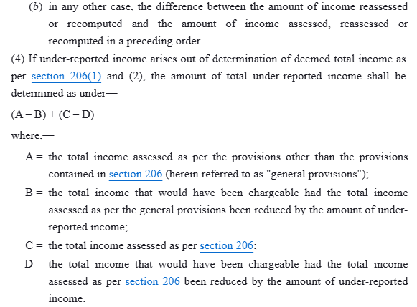
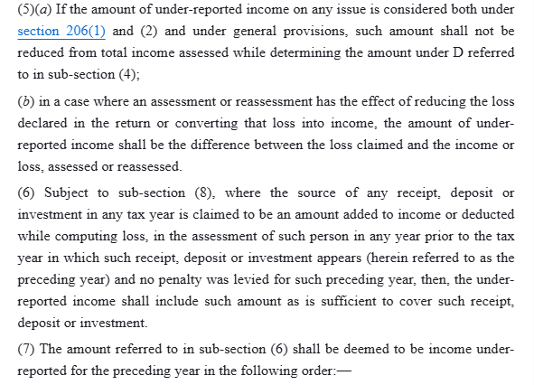
Cases Not Amounting to Under-Reporting [Section 270A(6)]
No penalty shall be levied where:
Explanation offered is bona fide and all material facts have been disclosed;
Estimate of income or expenditure is based on a bona fide estimate;
Addition is based on transfer pricing provisions and prescribed documentation is maintained;
Undisclosed income is already covered by penalty under section 271AAB.
Misreporting of Income [Section 270A(9)]
Under-reporting shall be treated as misreporting in cases involving:
Misrepresentation or suppression of facts;
Failure to record investments in books;
Claim of expenditure unsupported by evidence;
Recording false entries in books;
Failure to record receipts having a bearing on total income;
Failure to report international transactions or specified domestic transactions.
Rate of penalty
(2) The prescribed income-tax authority referred to in section 171(4) may impose a penalty of Rs. 5,00,000 on a person, if he fails to furnish the information and document required under the said section.
WHAT IS THE PENALTY FOR?
Nature of Default | Penalty
Under-reporting of income | 50% of tax payable on under-reported income
Under-reporting in consequence of misreporting | 200% of tax payable on under-reported income
IT Act 2025 vs IT Act 1961 | Penalty Provisions | Failure to Keep, Maintain or Retain Books, Documents, etc.
3 / 33

Slide 4
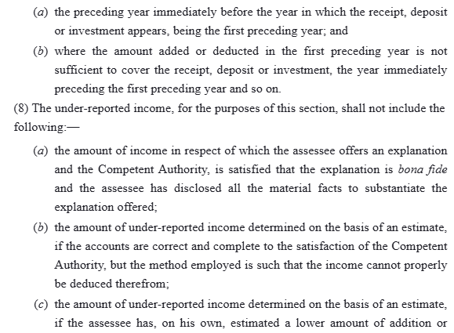
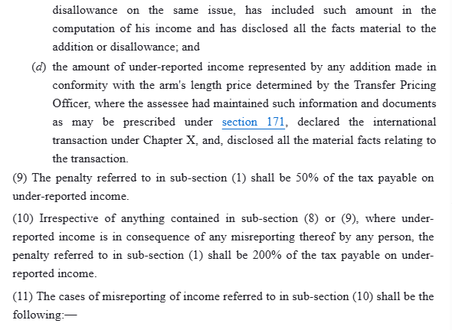
(2) The prescribed income-tax authority referred to in section 171(4) may impose a penalty of Rs. 5,00,000 on a person, if he fails to furnish the information and document required under the said section.
WHAT IS THE PENALTY FOR?
IT Act 2025 vs IT Act 1961 | Penalty Provisions | Failure to Keep, Maintain or Retain Books, Documents, etc.
3 / 33

Slide 5
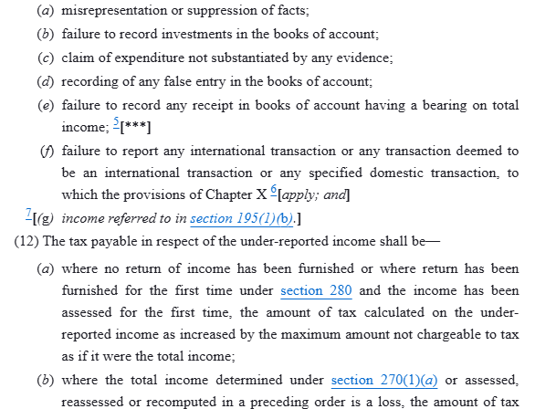
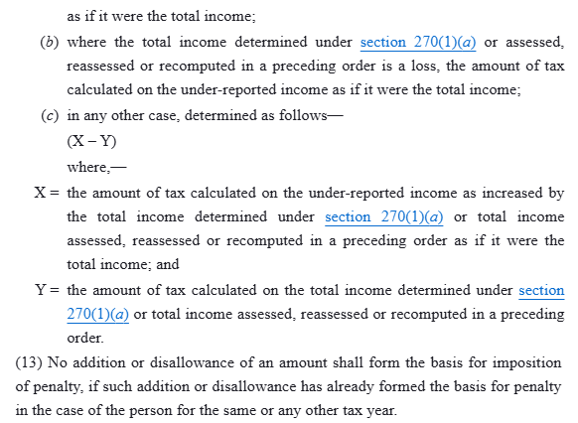
(2) The prescribed income-tax authority referred to in section 171(4) may impose a penalty of Rs. 5,00,000 on a person, if he fails to furnish the information and document required under the said section.
WHAT IS THE PENALTY FOR?
IT Act 2025 vs IT Act 1961 | Penalty Provisions | Failure to Keep, Maintain or Retain Books, Documents, etc.
3 / 33

Slide 6
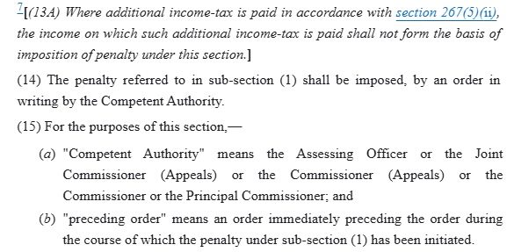
(2) The prescribed income-tax authority referred to in section 171(4) may impose a penalty of Rs. 5,00,000 on a person, if he fails to furnish the information and document required under the said section.
WHAT IS THE PENALTY FOR?
IT Act 2025 vs IT Act 1961 | Penalty Provisions | Failure to Keep, Maintain or Retain Books, Documents, etc.
3 / 33

Slide 7
2
Immunity from Penalty under section 270A.
WHAT IS THE PENALTY FOR?
Section 440 of ITA, 2025.
KEY CHANGES
Section 270AA of ITA, 1961.
An assessee may make an application to the Assessing Officer to grant immunity from imposition or, as the case may be, waiver of penalty under section 270A and immunity from initiation of proceedings under section 276C or section 276CC, if he fulfils the following conditions, namely: —
the tax and interest payable as per the order of assessment under sub-section (3) of section 143 or reassessment under section 147 has been paid within the period specified in the notice of demand;
where penalty has been levied or, as the case may be, leviable under the circumstances referred to in sub-section (9) of section 270A, additional income-tax amounting to one hundred per cent of the amount of tax payable on under-reported income has been paid within the period specified in the notice of demand, in lieu of such penalty; and ( WEF 01.03.2026)
no appeal has been filed against the order referred to in clauses (a) and (b).
An application referred to in sub-section (1) shall be made
An assessee may make an application to the AO to grant waiver of penalty levied under section 439 and immunity from initiation of proceedings under section 478 or 479 on fulfilment of the following conditions: ––
the tax and interest payable as per the order of assessment under section 270(10) or reassessment under section 279, has been paid within the period specified in the notice of demand;
where penalty has been levied under the circumstances referred to in section 439(11)(a) to (f), additional income-tax amounting to 100% of the amount of tax payable on under-reported income has been paid within the period specified in the notice of demand, in lieu of such penalty;
where penalty has been levied under the circumstances referred to in section 439(11)(g), additional income-tax amounting to 120% of the amount of tax payable on under-reported income has been paid within the period specified in the notice of demand, in lieu of such penalty; and
no appeal been filed against the order of re or assessment and levy of penalty referred to in clauses (a), (b) and (c).
Section reference updated from Section 270AA to Section 440.
Additional income-tax for waiver increased to 120% (from 100%) for cases covered under Section 439(11)(g) (new category of misreporting)
100% additional income-tax continues for other misreporting cases under Section 439(11)(a) to (f).
3 / 33

Slide 8
within one month from the end of the month in which the order referred to in clause (a) and clause (b) of the said sub-section has been received by the assessee, in such form and verified in such manner, as may be prescribed.
The AO shall, on fulfilment of the conditions specified in sub-section (1) and after the expiry of the period of filing the appeal as specified in clause (b) of sub-section (2) of section 249, grant immunity from imposition or, as the case may be, waiver of penalty under section 270A and initiation of proceedings under sec 276C or section 276CC.
(3A) No immunity or, as the case may be, waiver under sub-section (3) shall be granted where any proceedings has been initiated under Chapter XXII.]
The AO shall, within a period of 3 months from the end of the month in which the application under sub-section (1) is received, pass an order accepting or rejecting such application:
the assessee shall be been given an opportunity of being heard before accepting or rejecting such application.`
The order made under sub-section (4) shall be final.
No appeal under sec 246 or sec 246A or an application for revision under sec 264 shall be admissible against the order of assessment or reassessment, referred to in clause (a) of sub-section (1), in a case where an order under sub-section (4) has been made accepting the application.
An application referred in sub-section (1) shall be made within one month from the end of the month in which the order referred to in the said sub-section is received by the assessee, in such form and verified in such manner, as may be prescribed.
The Assessing Officer shall, on fulfilment of the conditions as specified in sub-section (1), and after the expiry of the period of filing appeal as specified in section 358(3)(a), grant waiver of penalty under section 439 and immunity from initiation of proceedings under section 478 or 479.
No waiver or immunity under sub-section (3) shall be granted if any proceeding has been initiated under Chapter XXII.]
The Assessing Officer, shall pass an order accepting or rejecting the application as referred to in sub-section (1) within three months from the end of the month of its receipt.
No order of rejection under sub-section (5) shall be made without giving the assessee an opportunity of being heard.
The order made under sub-section (5) shall be final.
No appeal under section 356 or 357 or an application for revision under section 378 shall be admissible against the order referred to in sub-section (1)(a), if an order under sub-section (5) has been made accepting the application.
WHAT IS THE PENALTY FOR?
3 / 33

Slide 9
3
Failure to Keep, Maintain or Retain Books, Documents, etc.
WHAT IS THE PENALTY FOR?
Section 441 of ITA, 2025.
KEY CHANGES
Section 271A of ITA, 1961.
Without prejudice to the provisions of section 270A or section 271, if any person fails to keep and maintain any such books of account and other documents as required by section 44AA or the rules made thereunder, in respect of any previous year or to retain such books of account and other documents for the period specified in the said rules, the Assessing Officer or the Joint Commissioner (Appeals) or the Commissioner (Appeals) may direct that such person shall pay, by way of penalty, a sum of twenty-five thousand rupees.
A penalty of Rs. 25,000 may be imposed on a person by the Assessing Officer or the Joint Commissioner (Appeals) or the Commissioner (Appeals), if he fails to—
keep and maintain the books of account and other documents as per section 62 or the rules made thereunder, in respect of any tax year; or
retain such books of account and other documents for the period specified in the said rules.
No substantive change.
Section reference updated from Section 271A to Section 441.
Penalty of Rs. 25,000 remains unchanged.
IT Act 2025 vs IT Act 1961 | Penalty Provisions | Failure to Keep, Maintain or Retain Books, Documents, etc.
3 / 33

Slide 10
4
Failure to Maintain Information & Documents for Specified Transactions (TP).
WHAT IS THE PENALTY FOR?
Section 442 of ITA, 2025.
KEY CHANGES
Section 271AA of ITA, 1961.
Without prejudice to the provisions of section 270A or section 271 or section 271BA, if any person in respect of an international transaction or specified domestic transaction,—
fails to keep and maintain any such information and document as required by sub-section (1) or sub-section (2) of section 92D;
fails to report such transaction which he is required to do so; or
maintains or furnishes an incorrect information or document,
the Assessing Officer or Commissioner (Appeals) may direct that such person shall pay, by way of penalty, a sum equal to two per cent of the value of each international transaction or specified domestic transaction entered into by such person.
(2) If any person fails to furnish the information and the document as required under sub-section (4) of section 92D, the prescribed income-tax authority referred to in the said sub-section may direct that such person shall pay, by way of penalty, a sum of five hundred thousand rupees.
The Assessing Officer or Commissioner (Appeals) may impose a penalty of 2% of the value of each international transaction or specified domestic transaction entered into by a person, if in respect of such transaction he—
fails to keep and maintain any such information and document as required by section 171(1);
fails to report such transaction which he is required to do so; or
maintains or furnishes an incorrect information or document.
The prescribed income-tax authority referred to in section 171(4) may impose a penalty of Rs. 5,00,000 on a person, if he fails to furnish the information and document required under the said section.
No substantive change.
Section reference updated from Section 271AA to Section 442.
Penalty rate of 2% and Rs. 5,00,000/- remains unchanged.
IT Act 2025 vs IT Act 1961 | Penalty Provisions | Failure to Keep, Maintain or Retain Books, Documents, etc.
3 / 33

Slide 11
Meaning of "Undisclosed Income" and "Specified Previous Year" – Section 271AAB
1. Undisclosed Income [Section 271AAB Explanation (c)]
"Undisclosed Income" means:
(A) Income represented by:
Money , Bullion ,Jewellery, Valuable article or thing, Entries in books of account or documents
Found during the course of search, which:
Had not been recorded before the date of search in the books of account or other documents maintained in the normal course; or
Had not been disclosed to the Principal Chief Commissioner / Chief Commissioner / Principal Commissioner / Commissioner before the date of search.
(B) Income represented by an expense entry
Where an expense recorded in the books is found to be false, and such falsity would not have been discovered but for the search.
2. Specified Previous Year [Section 271AAB Explanation (b)]
"Specified Previous Year" means:
(i) Previous year which has ended before the date of search, but:
The due date for filing return under section 139(1) has not expired, and
The return has not been filed before the date of search.
(ii) Previous year in which the search was conducted.

Slide 12
Section 271AAB - Penalty Where Search Has Been Initiated
Applicability
✔ Search under Section 132 has been initiated.
✔ Income qualifies as "undisclosed income".
✔ Such income relates to a specified previous year.
Penalty Rates
i. Search initiated on or after 15.12.2016 [Section 271AAB(1A)]
Circumstances | Penalty
Assessee, in the statement under section 132(4), admits the undisclosed income, specifies and substantiates the manner in which such income was derived, pays tax and interest thereon and furnishes the return declaring such income | 30% of undisclosed income
In any other case | 60% of undisclosed income
ii. Search initiated from 01.07.2012 to 14.12.2016 [Section 271AAB(1)]
Circumstances | Penalty
Conditions prescribed in clause (a) satisfied | 10%
Conditions prescribed in clause (b) satisfied | 20%
In any other case | 60%

Slide 13
Date of Search | Previous Year | Whether Specified Previous Year?
10.09.2023 | FY 2022-23 (AY 2023-24) – Return not filed and due date not expired | Yes
10.09.2023 | FY 23-24 (year of search) | Yes
10.09.2023 | FY 2021-22 (return already filed) | No

Slide 14
5
Penalty in respect of Certain Income (Unexplained Credits etc).
WHAT IS THE PENALTY FOR?
Section 443 of ITA, 2025.
Section 271AAC of ITA, 1961.
The Assessing Officer or the Joint Commissioner (Appeals) or the Commissioner (Appeals) may, notwithstanding anything contained in this Act other than the provisions of section 271AAB, direct that, in a case where the income determined includes any income referred to in section 68, section 69, section 69A, section 69B, section 69C or section 69D for any previous year, the assessee shall pay by way of penalty, in addition to tax payable under section 115BBE, a sum computed at the rate of ten per cent of the tax payable under clause (i) of sub-section (1) of section 115BBE:
Provided that no penalty shall be levied in respect of income referred to in section 68, section 69, section 69A, section 69B, section 69C or section 69D to the extent such income has been included by the assessee in the return of income furnished under section 139 and the tax in accordance with the provisions of clause (i) of sub-section (1) of section 115BBE has been paid on or before the end of the relevant previous year.
No penalty under the provisions of section 270A shall be imposed upon the assessee in respect of the income referred to in sub-section (1).
The provisions of sections 274 and 275 shall, as far as may be, apply in relation to the penalty referred to in this section.
Omitted (with effect from 01.04.2026.)
IT Act 2025 vs IT Act 1961 | Penalty Provisions | Failure to Keep, Maintain or Retain Books, Documents, etc.
3 / 33

Slide 15
Section 271AAB vs Section 271AAC
Particulars | Section 271AAB (up to 01.09.2024) | Section 271AAC (retro from 01.04.2017)
Nature of Penalty | Penalty on undisclosed income found during search | Penalty on unexplained income assessed under sections 68 to 69D
Trigger Event | Search initiated u/s 132 | Assessment resulting in additions u/s 68, 69, 69A, 69B, 69C or 69D
Applicability | Search and seizure cases | Normal assessment / reassessment cases
Income Covered | "Undisclosed income" of specified previous year | Deemed income taxable u/s 115BBE
Penalty Base | Amount of undisclosed income | Tax payable u/s 115BBE
Rate of Penalty | 30% or 60% of undisclosed income (for searches after 15.12.2016) | 10% of tax payable u/s 115BBE
Lower Penalty Available | Yes, if income is admitted during search and taxes are paid | Not applicable
Requirement of Search | Mandatory | No search required
Overriding Effect | Overrides other penalty provisions | Applies except where Section 271AAB is applicable
Immunity from Section 270A | No penalty u/s 270A on such income | No penalty u/s 270A on such income
Relevant Assessment Proceedings | Search assessments u/s 153A/153C | Regular assessment u/s 143(3), 147, etc.
Purpose | To penalize undisclosed income detected in search operations | To penalize unexplained income taxed under section 115BBE

Slide 16
Illustration
Search Case
Search u/s 132 conducted.
Undisclosed income found: ₹1 crore.
Penalty u/s 271AAB:
  30% (if conditions satisfied) = ₹30 lakh.
  Otherwise 60% = ₹60 lakh.
Normal Assessment
Addition u/s 69A: ₹1 crore.
Tax u/s 115BBE @ 60% = ₹60 lakh.
Penalty u/s 271AAC = 10% of tax payable = ₹6 lakh.

Slide 17
6
Penalty for false entry, etc, in the books of account.
WHAT IS THE PENALTY FOR?
Section 444 of ITA, 2025.
KEY CHANGES
Section 271AAD of ITA, 1961.
Without prejudice to any other provisions of this Act, if during any proceeding under this Act, it is found that in the books of account maintained by any person there is—
A false entry; or
An omission of any entry which is relevant for computation of total income of such person, to evade tax liability,
the Assessing Officer or the Joint Commissioner (Appeals) or the Commissioner (Appeals), may direct that such person shall pay by way of penalty a sum equal to the aggregate amount of such false or omitted entry.
The Assessing Officer or the Joint Commissioner (Appeals) or the Commissioner (Appeals), may impose a penalty equal to the aggregate amount of false or omitted entry, where during any proceeding under this Act, it is found that in the books of account maintained by any person there is—
A false entry; or
An omission of any entry which is relevant for computation of total income of such person, to evade tax liability.
No substantive change.
Section reference updated from Section 271AAD to Section 444.
Penalty quantum unchanged (i.e., penalty continues to be equal to aggregate amount of false or omitted entry.)
Explanation defining “False entry” shifted to a separate sub-section 3.
IT Act 2025 vs IT Act 1961 | Penalty Provisions | Failure to Keep, Maintain or Retain Books, Documents, etc.
3 / 33

Slide 18
(2) Without prejudice to the provisions of sub-section (1), the AO or the Joint Commissioner (Appeals) or the Commissioner (Appeals) may direct that any other person, who causes the person referred to in sub-section (1) in any manner to make a false entry or omits or causes to omit any entry referred to in that sub-section, shall pay by way of penalty a sum equal to the aggregate amount of such false or omitted entry.
Explanation.—For the purposes of this section, “false entry” includes use or intention to use—
forged or falsified documents such as a false invoice or, in general, a false piece of documentary evidence; or
invoice in respect of supply or receipt of goods or services or both issued by the person or any other person without actual supply or receipt of such goods or services or both; or
invoice in respect of supply or receipt of goods or services or both to or from a person who does not exist.
(2) Without prejudice to sub-section (1), the Assessing Officer or the Joint Commissioner (Appeals) or the Commissioner (Appeals) may impose a penalty equal to the aggregated amount of false or omitted entry, on any other person, who causes the person referred to in the said sub-section in any manner to make a false entry or omits or causes to omit any entry referred to in that sub-section.
(3) For the purposes of this section, the expression “false entry” includes use or intention to use—
forged or falsified documents such as a false invoice or, in general, a false piece of documentary evidence; or
invoice in respect of supply or receipt of goods or services or both issued by the person or any other person without actual supply or receipt of such goods or services or both; or
invoice in respect of supply or receipt of goods or services or both to or from a person who does not exist.
WHAT IS THE PENALTY FOR?
IT Act 2025 vs IT Act 1961 | Penalty Provisions | Failure to Keep, Maintain or Retain Books, Documents, etc.
3 / 33

Slide 19
7
Penalty for failure to get accounts audited.
WHAT IS THE PENALTY FOR?
Section 446 of ITA, 2025.
KEY CHANGES
Section 271B of ITA, 1961.
If any person fails to get his accounts audited in respect of any previous year or years relevant to an assessment year or furnish a report of such audit as required under section 44AB, the Assessing Officer may direct that such person shall pay, by way of penalty, a sum equal to one-half per cent of the total sales, turnover or gross receipts, as the case may be, in business, or of the gross receipts in profession, in such previous year or years or a sum of one hundred fifty thousand rupees, whichever is less.
If any person who is required to furnish a statement in respect of a transaction of a crypto-asset under section 509(1), fails to furnish such statement within the time prescribed under the said section, the prescribed income-tax authority under that section may impose on him, a penalty of Rs. 200 for every day for which such failure continues.
The prescribed income-tax authority may impose a penalty of Rs. 50,000 on a person referred in sub-section (1), if such person—
provides inaccurate information in the statement and fails to remove such inaccuracy as per section 509(4); or
fails to comply with due diligence the requirement under section 509(5).
Section completely substituted by the Finance Act, 2026 (w.e.f 01.04.2026).
Audit penalty provision replaced with crypto-asset reporting penalty.
Introduces Rs. 200 per day penalty for failure to furnish crypto-asset transaction statement, and Rs. 50,000 for inaccurate reporting.
Penalty for failure to get accounts audited is no longer contained in Section 446.
Penalty for not conducting audit is now contained in section 428 of new act.
IT Act 2025 vs IT Act 1961 | Penalty Provisions | Failure to Keep, Maintain or Retain Books, Documents, etc.
3 / 33

Slide 20
9
Penalty for failure to Deduct/Pay Tax at source.
WHAT IS THE PENALTY FOR?
Section 448 of ITA, 2025.
KEY CHANGES
Section 271C of ITA, 1961.
If any person fails to—
deduct the whole or any part of the tax as required by or under the provisions of Chapter XVII-B; or
pay or ensure payment of, the whole or any part of the tax as required by or under—
sub-section (2) of section 115-O;
the proviso to section 194B;
the first proviso to sub-section (1) of section 194R; or
the proviso to sub-section (1) of section 194S; or
sub-section (2) of section 194BA,
then, such person shall be liable to pay, by way of penalty, a sum equal to the amount of tax which such person failed to deduct or pay or ensure payment of, as aforesaid.
Any penalty imposable under sub-section (1) shall be imposed by the Joint Commissioner:
[Provided that any penalty under sub-section (1) on or after the 1st day of April, 2025, shall be imposed by the Assessing Officer.]
If any person fails to—
deduct the whole or any part of the tax as required under Chapter XIX-B; or
pay or ensure the payment of, the whole or any part of the tax as required by or under—
Note 2 below the Table in section 393(3); or
Note 6 to section 393(1) (Table: Sl. No. 8),
then, the Assessing Officer may impose on him, a penalty equal to the tax which such person failed to deduct or pay or ensure payment of, as aforesaid.
Penalty authority changed to the Assessing Officer (earlier imposed by the Joint Commissioner, this change was already introduced in the 1961 Act w.e.f. 01.04.2025 and is now incorporated in the 2025 Act).
References to sections 115-O, 194B, 194R, 194S and 194BA replaced with corresponding Notes under Section 393.
Penalty quantum remains unchanged (i.e., equal to the amount of tax not deducted or not paid/ensured to be paid).
3 / 33

Slide 21
10
Penalty for failure to Collect Tax at source [TCS].
WHAT IS THE PENALTY FOR?
Section 449 of ITA, 2025.
KEY CHANGES
Section 271CA of ITA, 1961.
(1) If any person fails to collect the whole or any part of the tax as required by or under the provisions of Chapter XVII-BB, then, such person shall be liable to pay, by way of penalty, a sum equal to the amount of tax which such person failed to collect as aforesaid.
(2) Any penalty imposable under sub-section (1) shall be imposed by the Joint Commissioner:
¹¹[Provided that any penalty under sub-section (1), on or after the 1st day of April, 2025, shall be imposed by the Assessing Officer.]
If any person fails to collect the whole or any part of the tax as required under Chapter XIX-B, the Assessing Officer may impose on him, a penalty equal to the tax which such person failed to collect.
Section reference updated from Section 271CA to Section 449.
Penalty authority changed to the Assessing Officer (replacing the Joint Commissioner; already effective in the 1961 Act from 1.4.2025).
Penalty quantum remains unchanged (i.e., equal to the amount of tax not collected).
IT Act 2025 vs IT Act 1961 | Penalty Provisions | Failure to Keep, Maintain or Retain Books, Documents, etc.
3 / 33

Slide 22
11
Penalty for failure to Comply with cash Loan/deposit restrictions.
WHAT IS THE PENALTY FOR?
Section 450 of ITA, 2025.
KEY CHANGES
Section 271D of ITA, 1961.
If a person takes or accepts any loan or deposit or specified sum in contravention of the provisions of section 269SS, he shall be liable to pay, by way of penalty, a sum equal to the amount of the loan or deposit or specified sum so taken or accepted.
Any penalty imposable under sub-section (1) shall be imposed by the Joint Commissioner:
¹²[Provided that any penalty under sub-section (1), on or after the 1st day of April, 2025, shall be imposed by the Assessing Officer.]
If a person takes or accepts any loan or deposit or specified sum in contravention of the provisions of section 185, the Assessing Officer may impose on him, a penalty equal to the amount of the loan or deposit or specified sum so taken or accepted.
No Substantive change.
Section reference updated from Section 271D to Section 450.
Penalty authority changed to the Assessing Officer (replacing the Joint Commissioner; already effective in the 1961 Act from 1.4.2025).
Penalty quantum remains unchanged (i.e., equal to the amount of the loan, deposit or specified sum).
IT Act 2025 vs IT Act 1961 | Penalty Provisions | Failure to Keep, Maintain or Retain Books, Documents, etc.
3 / 33

Slide 23
12
Penalty for failure to Comply with cash receipt restrictions.
WHAT IS THE PENALTY FOR?
Section 451 of ITA, 2025.
KEY CHANGES
Section 271DA of ITA, 1961.
If a person receives any sum in contravention of the provisions of section 269ST, he shall be liable to pay, by way of penalty, a sum equal to the amount of such receipt:
Provided that no penalty shall be imposable if such person proves that there were good and sufficient reasons for the contravention.
Any penalty imposable under sub-section (1) shall be imposed by the Joint Commissioner:
¹³[Provided that any penalty under sub-section (1), on or after the 1st day of April, 2025, shall be imposed by the Assessing Officer.]
The Assessing Officer may impose on a person, a penalty equal to the sum received by him in contravention of the provisions of section 186.
No Substantive change.
Section reference updated from Section 271DA to Section 451.
Penalty authority changed to the Assessing Officer (replacing the Joint Commissioner; already effective in the 1961 Act from 1.4.2025).
Proviso granting relief on showing “good and sufficient reasons” has been omitted.
Penalty quantum remains unchanged (i.e., equal to the amount of the received).
IT Act 2025 vs IT Act 1961 | Penalty Provisions | Failure to Keep, Maintain or Retain Books, Documents, etc.
3 / 33

Slide 24
13
Penalty for failure to provide prescribed Payment Facility.
WHAT IS THE PENALTY FOR?
Section 452 of ITA, 2025.
KEY CHANGES
Section 271DB of ITA, 1961.
If a person who is required to provide facility for accepting payment through the prescribed electronic modes of payment referred to in section 269SU, fails to provide such facility, he shall be liable to pay, by way of penalty, a sum of five thousand rupees, for every day during which such failure continues:
Provided that no such penalty shall be imposable if such person proves that there were good and sufficient reasons for such failure.
Any penalty imposable under sub-section (1) shall be imposed by the Joint Commissioner of Income-tax:
¹³[Provided that any penalty under sub-section (1), on or after the 1st day of April, 2025, shall be imposed by the Assessing Officer.]
The Assessing Officer may impose on a person, a penalty of Rs. 5,000 for every day of the duration of failure where he fails to provide a facility for accepting payments through the prescribed electronic modes of payment, as referred to in section 187.
No Substantive change.
Section reference updated from Section 271DB to Section 452.
Penalty authority changed to the Assessing Officer (replacing the Joint Commissioner; already effective in the 1961 Act from 1.4.2025).
Proviso granting relief on showing “good and sufficient reasons” has been omitted.
Penalty quantum remains unchanged (i.e., Rs. 5,000 per day for the period of default).
IT Act 2025 vs IT Act 1961 | Penalty Provisions | Failure to Keep, Maintain or Retain Books, Documents, etc.
3 / 33

Slide 25
14
Penalty for failure to comply with Cash Repayment Restrictions.
WHAT IS THE PENALTY FOR?
Section 453 of ITA, 2025.
KEY CHANGES
Section 271E of ITA, 1961.
If a person repays any loan or deposit or specified advance referred to in section 269T otherwise than in accordance with the provisions of that section, he shall be liable to pay, by way of penalty, a sum equal to the amount of the loan or deposit or specified advance so repaid.
Any penalty imposable under sub-section (1) shall be imposed by the Joint Commissioner:
¹⁴[Provided that any penalty under sub-section (1), on or after the 1st day of April, 2025, shall be imposed by the Assessing Officer.]
If a person repays any loan or deposit or specified advance referred to in section 188 otherwise than in accordance with the provisions of that section, the Assessing Officer may impose on him, a penalty equal to the loan or deposit or specified advance so repaid.
No Substantive change.
Section reference updated from Section 271E to Section 453.
Penalty authority changed to the Assessing Officer (replacing the Joint Commissioner; already effective in the 1961 Act from 1.4.2025).
Penalty quantum remains unchanged (i.e., equal to the amount of loan, deposit or specified advance repaid).
IT Act 2025 vs IT Act 1961 | Penalty Provisions | Failure to Keep, Maintain or Retain Books, Documents, etc.
3 / 33

Slide 26
15
Failure to Furnish Statement of Financial Transaction (SFT).
WHAT IS THE PENALTY FOR?
Section 454 of ITA, 2025.
KEY CHANGES
Section 271FA of ITA, 1961.
If a person who is required to furnish a statement of financial transaction or reportable account under sub-section (1) of section 285BA, fails to furnish such statement within the time prescribed under sub-section (2) thereof, the income-tax authority prescribed under said sub-section (1) may direct that such person shall pay, by way of penalty, a sum of five hundred rupees for every day during which such failure continues:
Provided that where such person fails to furnish the statement within the period specified in the notice issued under sub-section (5) of section 285BA, he shall pay, by way of penalty, a sum of one thousand rupees for every day during which the failure continues, beginning from the day immediately following the day on which the time specified in such notice for furnishing the statement expires.
Where any person, who is required to furnish a statement of financial transaction or reportable account under section 508(1), fails to furnish such statement or reportable account within the period specified in the notice issued under section 508(7), the income-tax authority prescribed under section 508(1) may impose on him, a penalty of Rs. 1000 for every day for which such failure continues, beginning from the day immediately after the period specified in such notice for furnishing such statement or reportable account expires and such penalty shall not exceed Rs. 1,00,000.]
Section reference updated from Section 271FA to Section 454.
Initial penalty of Rs. 500 per day omitted.
Penalty of Rs. 1,000 per day after notice continues.
Maximum penalty capped at Rs. 1,00,000.
Penalty linked to non-compliance with notice under Section 508(7).
IT Act 2025 vs IT Act 1961 | Penalty Provisions | Failure to Keep, Maintain or Retain Books, Documents, etc.
3 / 33

Slide 27
16
Furnishing Inaccurate Statement of Financial Transaction (SFT).
WHAT IS THE PENALTY FOR?
Section 455 of ITA, 2025.
KEY CHANGES
Section 271FAA of ITA, 1961.
If a person referred to in sub-section (1) of section 285BA, who is required to furnish a statement under that section,—
provides inaccurate information in the statement or fails to furnish correct information within the period specified under sub-section (6) of the said section; or
fails to comply with the due diligence requirement prescribed under sub-section (7) of the said section,
then, the prescribed income-tax authority referred to in sub-section (1) thereof may direct that such person shall pay, by way of penalty, a sum of fifty thousand rupees.]:
The prescribed income-tax authority referred to in section 508 may direct that a person required to furnish a statement under sub-section (1) of the said section shall pay penalty of Rs. 50,000, if such person—
provides inaccurate information in the statement or fails to furnish correct information within the period specified under section 508(8); or
fails to comply with the due diligence requirement under section 508(9).
The prescribed income-tax authority referred to in section 508, shall direct that reporting financial institution referred to in section 508(1)(k) shall, in addition to the penalty under sub-section (1) of this section, if any, pay a sum of Rs. 5,000 for every inaccurate reportable account, if—
No substantive change.
Section reference updated from Section 271FAA to Section 455.
Penalty of Rs. 50,000/- remains unchanged.
Additional penalty of Rs. 5,000/- per inaccurate reportable account remains unchanged.
IT Act 2025 vs IT Act 1961 | Penalty Provisions | Failure to Keep, Maintain or Retain Books, Documents, etc.
3 / 33

Slide 28
(2)Where in the case of a person, referred to in clause (k) of sub-section (1) of section 285BA, who is required to furnish a statement under that section (herein referred to as the reporting financial institution) provides inaccurate information in the statement and the inaccuracy in such statement is due to false or inaccurate information furnished by the holder or holders of the relevant reportable account or accounts, the prescribed income-tax authority under sub-section (1) of section 285BA, shall direct that the reporting financial institution shall, in addition to the penalty under sub-section (1), if any, pay a sum of five thousand rupees for every inaccurate reportable account and the reporting financial institution shall be entitled to recover the sum so paid on behalf of such reportable account holder, or to retain out of any moneys that may be in its possession, or may come to it from every such reportable account holder, an amount equal to the sum so paid.].
the said institution provides inaccurate information in the statement required to be furnished under section 508(1); and
the inaccuracy in the said statement is due to false or inaccurate information furnished by the holder or holders of the relevant reportable account or accounts.
(3) The reporting financial institution as referred to in sub-section (2) shall be entitled to—
recover the amount paid under sub-section (2) on behalf of the reportable account holder; or
retain an amount equal to the sum so paid out of any moneys that may be in its possession, or may come to it from every such account holder.
WHAT IS THE PENALTY FOR?
IT Act 2025 vs IT Act 1961 | Penalty Provisions | Failure to Keep, Maintain or Retain Books, Documents, etc.
3 / 33

Slide 29
21
Failure to Furnish Information or Documents (Offshore / Foreign Assets).
WHAT IS THE PENALTY FOR?
Section 460 of ITA, 2025.
KEY CHANGES
Section 271GC of ITA, 1961.
If any person who is required to furnish statement under section 285, fails to do so within the period prescribed under that section, the Assessing Officer may direct that such person shall pay, by way of penalty, a sum of—
one thousand rupees for every day for which the failure continues, if the period of failure does not exceed three months; or
one lakh rupees in any other case.
If any person required to furnish statement under section 505, fails to do so within the period prescribed under that section, the Assessing Officer may impose on him, a penalty of—
Rs. 1,000 for every day for which the failure continues, if the period of failure does not exceed three months; or
Rs. 1,00,000 in any other case.
No substantive change.
Section reference updated from Section 271GC to Section 460.
Penalty of Rs. 1,000/- per day for delay up to 3 months remains unchanged.
Penalty of Rs. 1,00,000/- in other cases remains unchanged.
IT Act 2025 vs IT Act 1961 | Penalty Provisions | Failure to Keep, Maintain or Retain Books, Documents, etc.
3 / 33

Slide 30
24
Penalty for furnishing incorrect information in reports or certificates by professionals.
WHAS THE PENALTY FOR?
Section 271J of ITA, 1961
Section 463 of ITA, 2025
KEY CHANGES
Click to add content
Without prejudice to the provisions of this Act, where the Assessing Officer or the Joint Commissioner (Appeals) or the Commissioner (Appeals), in the course of any proceedings under this Act, finds that an accountant or a merchant banker or a registered valuer has furnished incorrect information in any report or certificate furnished under any provision of this Act or the rules made thereunder, the Assessing Officer or the Joint Commissioner (Appeals) or the Commissioner (Appeals) may direct that such accountant or merchant banker or registered valuer, as the case may be, shall pay, by way of penalty, a sum of ten thousand rupees for each such report or certificate.
Explanation.—For the purposes of this section,—
"accountant" means an accountant referred to in the Explanation below sub-section (2) of section 288;
"merchant banker" means Category I merchant banker registered with the Securities and Exchange Board of India established under section 3 of the Securities and Exchange Board of India Act, 1992 (15 of 1992);
"registered valuer" means a person defined in clause (oaa) of section 2 of the Wealth-tax Act, 1957 (27 of 1957).
Any accountant or merchant banker or registered valuer, shall be liable to pay a penalty of Rs. 10000 for any incorrect information in any report or certificate furnished under any provision of this Act or the rules made thereunder.
The penalty under sub-section (1) shall be payable for each such report or certificate.
The penalty under sub-section (1) shall be payable on directions of the Assessing Officer or the Joint Commissioner (Appeals) or the Commissioner (Appeals) where the incorrect information mentioned in sub-section (1) is found by such authority in the course of any proceedings under this Act.
In this section,—
"merchant banker" means Category I merchant banker registered with the Securities and Exchange Board of India established under section 3 of the Securities and
Exchange Board of India Act, 1992 (15 of 1992); and
"registered valuer" means a person registered as a valuer under section 514.
No Substantive changes.
Section reference updated from Section 271J to Section 463.
Penalty amount of Rs. 10000 for each default remains unchanged.
33 / 33

Slide 31
26
Penalty for failure to answer questions, sign statements, furnish information, returns or statements, allow inspections, etc.
WHAS THE PENALTY FOR?
Section 272A of ITA, 1961
Section 465 of ITA, 2025
KEY CHANGES
Click to add content
A person shall be liable to pay a penalty of Rs. 10000 for each default or failure as mentioned below, if that person,—
being legally bound to state the truth of any matter touching the subject of his assessment, refuses to answer any question put to him by an income-tax authority in the exercise of its powers under this Act; or
refuses to sign any statement made by him in the course of any proceedings under this Act, which an income-tax authority may legally require him to sign; or
to whom a summons is issued under section 246(1), either to attend to give evidence or to produce books of account or other documents at a certain place and time omits to attend or produce books of account or documents at the place or time; or
fails to comply with a notice under section 268(1) or 270(8) or fails to comply with a direction issued under section 268(5).
A person shall be liable to pay a penalty of Rs. 500 for every day during which the following failures continue, if that person fails to—
comply with a notice under section 175(7); or
If any person,—
being legally bound to state the truth of any matter touching the subject of his assessment, refuses to answer any question put to him by an income-tax authority in the exercise of its powers under this Act; or
refuses to sign any statement made by him in the course of any proceedings under this Act, which an income-tax authority may legally require him to sign; or
to whom a summons is issued under sub-section (1) of section 131 either to attend to give evidence or produce books of account or other documents at a certain place and time omits to attend or produce books of account or documents at the place or time; or
fails to comply with a notice under sub-section (1) of section 142 or sub-section (2) of section 143 or fails to comply with a direction issued under sub-section (2A) of section 142,
he shall pay, by way of penalty, a sum of ten thousand rupees for each such default or failure.
If any person fails—
to comply with a notice issued under sub-section (6)
No Substantive changes
Section reference updated from Section 272A to Section 465.
Penalty amount of Rs. 10000/- per default remains unchanged and same is retained in new provisions.
33 / 33

Slide 32
31
Penalty not to be imposed in certain cases
WHAS THE PENALTY FOR?
Section 273B of ITA, 1961
Section 470 of ITA, 2025
KEY CHANGES
Click to add content
Irrespective of anything contained in the provisions of section_441 or 442 or 446 ¹⁵[***] or 448 or 449 or 450 or 451 or 452 or 453 or 454 or 455 or 456 or 457 or 458 or 459 or 460 or 461 or 462 or 463 or 465(1)(c) or 465(1)(d) or 465(2) or 466 or 467 or 468, no penalty shall be imposed on a person or assessee for any failure referred to in the said provisions, if he proves that there was reasonable cause for the said failure.
Notwithstanding anything contained in the provisions of section 271(1)(b), section 271A, section 271AA, section 271B, section 271BA, section 271BB, section 271C, section 271CA, section 271D, section 271E, section 271F, section 271FA, ¹⁸[section 271FAA,] section 271FAB, section 271FB, section 271G, section 271GA, section 271GB, ¹⁹[section 271GC,] section 271H, section 271-I, section 271J, clause (c) or clause (d) of sub-section (1) or sub-section (2) of section 272A, sub-section (1) of section 272AA or section 272B or sub-section (1) or sub-section (1A) of section 272BB or sub-section (1) of section 272BBB or clause (b) of sub-section (1) or clause (b) or clause (c) of sub-section (2) of section 273, no penalty shall be imposable on the person or the assessee, as the case may be, for any failure referred to in the said provisions if he proves that there was reasonable cause for the said failure.
No substantive changes.
Some sections were newly added whereas some section were not carry forwarded for relief of reasonable cause.
33 / 33

Slide 33
32
Procedure for Imposition of Penalty
WHAS THE PENALTY FOR?
Section 274 of ITA, 1961
Section 471 of ITA, 2025
KEY CHANGES
Click to add content
No order imposing a penalty under this Chapter shall be made unless the assessee has been heard, or has been given a reasonable opportunity of being heard [by way of a show-cause notice to that effect].
No order imposing a penalty under this Chapter shall be made without the prior approval of the Joint Commissioner—
where the penalty exceeds Rs. 10000, by the Income-tax Officer;
where the penalty exceeds Rs. 20000, by the Assistant Commissioner or Deputy Commissioner.
An income-tax authority on making an order under this Chapter imposing a penalty, unless he himself is the Assessing Officer, shall send a copy of the order to the Assessing Officer.
Irrespective of anything contained in any other provision of this Act, where any draft of the proposed
No order imposing a penalty under this Chapter shall be made unless the assessee has been heard, or has been given a reasonable opportunity of being heard [by way of a show-cause notice to that effect].
No order imposing a penalty under this Chapter shall be made—
by the Income-tax Officer, where the penalty exceeds ten thousand rupees;
by the Assistant Commissioner or Deputy Commissioner, where the penalty exceeds twenty thousand rupees, except with the prior approval of the Joint Commissioner.
An income-tax authority on making an order under this Chapter imposing a penalty, unless he is himself the Assessing Officer, shall forthwith send a copy of such order to the Assessing Officer.
No Substantive changes
Section reference updated from Section 274 to Section 471.
Penalty Order u/s 270A need not be passed separately, it shall form part of assessment or re-assessment order from 01.04.2027.
Sub-section (2A), (2B), (2C) of section 274 has been omitted and not retained in section 471 of new act. (Faceless Scheme provisions).
33 / 33

Slide 34
33
Bar of Limitation for Imposing Penalties
WHAS THE PENALTY FOR?
Section 275 of ITA, 1961
Section 472 of ITA, 2025
KEY CHANGES
Click to add content
No order imposing a penalty under this Chapter shall be passed after the expiry of six months from the end of the quarter in which—
the proceedings, in the course of which action for the imposition of penalty has been initiated, are completed, if the relevant assessment or other order is not the subject-matter of an appeal under section 356 or 357 or 362;
the order of revision is passed, if the relevant assessment or other order is the subject-matter of revision under section 377 or 378;
the order of appeal is received by the jurisdictional Principal Commissioner or Commissioner, if the relevant assessment or other order is the subject-matter of an appeal under section 356 or 357 or 362;
notice for imposition of penalty is issued, in any other case.
The order imposing or enhancing or reducing or cancelling penalty or dropping the proceedings for the imposition of penalty may be revised on the basis of assessment as revised by giving effect to the order under section 356 or 357 or 362 or 365 or 367 or revision under section
No order imposing a penalty under this Chapter shall be passed after the expiry of six months from the end of the quarter in which,—
the proceedings, in the course of which action for the imposition of penalty has been initiated, are completed, if the relevant assessment or other order is not the subject matter of an appeal under section 246 or section 246A or section 253;
the order of revision under section 263 or section 264 is passed, if the relevant assessment or other order is the subject matter of revision under the said sections;
the order of appeal under section 246 or section 246A is received by the jurisdictional Principal Commissioner or Commissioner, if the relevant assessment or other order is the subject matter of an appeal under the said sections and no further appeal has been filed under section 253;
the order of appeal under section 253 is received by the jurisdictional Principal Commissioner or Commissioner, if the relevant assessment or other order is the subject matter of an appeal under the said section;
No substantive change.
Section reference updated from Section 275 to Section 472.
Time Limits and Authority to pass the penalty order remain unchanged and retained the same.
33 / 33

Slide 35
B
notice for imposition of penalty is issued, in any other case.
The order imposing or enhancing or reducing or cancelling penalty or dropping the proceedings for the imposition of penalty may be revised on the basis of assessment as revised by giving effect to the order passed under section 246 or section 246A or section 253 or section 260A or section 261 or revision under section 263 or section 264, where the relevant assessment or other order is the subject matter of an appeal or a revision under the said sections.
No order imposing or enhancing or reducing or cancelling penalty or dropping the proceedings for the imposition of penalty under sub-section (2) shall be passed—
unless the assessee has been heard, or has been given a reasonable opportunity of being heard;
after the expiry of six months from the end of the quarter in which the order passed under section 246 or section 246A or section 253 or section 260A or section 261 is received by the jurisdictional Principal Commissioner or Commissioner, or the order of revision under section 263 or section 264 is passed.
The provisions of sub-section (2) of section 274 shall apply to the order imposing or enhancing or reducing penalty under sub-section (2).
377 or 378, where the relevant assessment or other order is the subject-matter of an appeal or revision under the said sections.
No order imposing or enhancing or reducing or cancelling penalty or dropping the proceedings for the imposition of penalty under sub-section (2) shall be passed—
unless the assessee has been heard, or has been given a reasonable opportunity of being heard;
after the expiry of six months from the end of the quarter in which the order under section 356 or 357 or 362 or 365 or 367 is received by the jurisdictional Principal Commissioner or Commissioner or the order of revision under section 377 or 378 is passed.
The provisions of section 471(2) shall apply to the order imposing or enhancing or reducing penalty under this section.
In computing the period of limitation for the purposes of this section, following period shall be excluded—
the time taken in giving an opportunity to the assessee to be reheard under section 244(2);
the period commencing on the date on which stay on proceeding for levy of penalty was granted by an order or injunction of any court and ending on the date on which certified copy of the order vacating the stay was received by jurisdictional Principal Commissioner or Commissioner.
WHAS THE PENALTY FOR?
Click to add content
IT Act 2025 vs IT Act 1961 | Penalty Provisions | Bar of Limitation for Imposing Penalties
33 / 33

Slide 36
B
In computing the period of limitation for the purposes of this section, the following period shall be excluded:—
the time taken in giving an opportunity to the assessee to be reheard under the proviso to section 129;
the period commencing on the date on which stay on proceeding for levy of penalty was granted by an order or injunction of any court and ending on the date on which certified copy of the order vacating the stay was received by the jurisdictional Principal Commissioner or Commissioner.]
WHAS THE PENALTY FOR?
Click to add content
IT Act 2025 vs IT Act 1961 | Penalty Provisions | Bar of Limitation for Imposing Penalties
33 / 33

Slide 37
Bar of Limitations for imposing penalty
1 | CIT VS Hissaria Brothers | Supreme Court of India | 74 taxmann.com 22 (SC) | Headnote | 28 | 28
2 | Salora Intl Ltd. Vs. CIT | High Court of Delhi | 91 taxmann.com 287 | 11 & 12 | 34 | 29-34
3 | PCIT Vs Mahesh Wood Products (P.) Ltd | High Court of Delhi | 82 taxmann.com 39 | 9 | 36 | 35-37
4 | PCIT Vs Thapar Homes Ltd. | High Court of Delhi | 159 taxmann.com 450 | 15 & 16 | 41 | 38-42
5 | PCIT Vs Rishikesh Buildcon (P) Ltd. | High Court of Delhi | 147 taxmann.com 220 | 12 | 48 | 43-48
6 | Jagdish Chandra Suwalka Vs JCIT | ITAT Jaipur | 154 taxmann.com 504 | 7.1 | 59 | 49-61
7 | ITO Vs. Prashant Sharma | ITAT Jaipur | ITA No. 960/JP/2016 | 5 | 66 | 62-69
8 | DCIT Vs Kiran Fine Jewellers (P.) Ltd. | ITAT Jaipur | 176 taxmann.com 360 | 8 & 9 | 79 | 70-84
9 | Karia Builders Vs ITO | ITAT, Pune | 176 taxmann.com 872 | 20 & 29 | 91 & 94 | 85-95
Sale of Agricultural Land was not covered under section 269SS of the Act so as to violate provisions of 271D of the Act
10 | Rakesh Ganapathy Vs JCIT | ITAT, Bangalore | 170 taxmann.com 239 | Headnote | 96 | 96-105

Slide 38
Invalid recording of satisfaction u/s 271D of the Act
11 | CIT Vs. Jai Laxmi Rice Mills | Supreme Court of India | 64 taxmann.com 75 | Headnote | 106 | 106-108
12 | Srinivasa Reddeppagari Vs. JCIT | High Court of Telangana | WP No. 44285 of 2022 | 24 to 28 | 124 | 109-128
13 | Grandhi Sri Venkata Amarendra Vs. JCIT | High Court of Andhra Pradesh | 167 taxmann.com 352 | 8 & 9 | 132 | 129-132
14 | Bhowmick Singh Vs. JCIT | ITAT Raipur | 171 taxmann.com 575 | 15 | 141 | 133-142
15 | Raja Reddy Nalla Vs. ACIT | ITAT Hyderabad | ITA No. 520/Hyd/2022 | 14 | 165 | 143-167
Once the amount is recorded in Books of Accounts- No penalty u/s 271D of the Act
16 | Diwan Enterprises vs CIT | High Court of Delhi | [2000] 246 ITR 571 (Delhi) | Headnote | 168 | 168-174
17 | PCIT vs Aman Sharma | High Court of Punjab and Haryana | 149 taxmann.com 377 | 10 | 177 | 175-177
18 | CIT Vs Bhagwati Prasad Bajoria (HUF) | High Court of Gauhati | [2003] 133 Taxman 426 | Headnote | 178 | 178-182
19 | DCIT vs Deepak Kumar | ITAT Delhi | ITA No.1306/Del/2020 | 5 & 6 | 185 | 183-192
20 | DCIT vs M/s H.S Raghav Constructions | ITAT Amritsar | ITA No. 5/(Asr/2011 | 8 | 196 | 193-196
21 | DCIT vs G.S. Entertainment | ITAT Mumbai | 28 SOT 39 | Headnote | 197 | 197-198

Slide 39

Thank You
THANKIYOU
Income-tax Act, 1961 ⇄ Income-tax Act, 2025
Penalty Provisions
CA LAXMIKANTH RATHI
Contact: 8121060396

