Slide 1
efiling of tds returns
HYDERABAD BRANCH of SIRC
CA. Ritesh Mittal Sanjay Kumar Kothari and Co., Chartered Accountants,
MOBILE: 09885377421
mrriteshmittal@gmail.com

Slide 2
defining terms
What is TDS?
In case of TDS, the payer of certain specified incomes has to deduct the tax on such incomes at specified rates. The tax so deducted by him is to be paid to the Government.

Slide 3
Objectives of TDS
Objectives of TDS
Regular inflow of revenue for the Government
Checking of tax evasion
Widening of tax base

Slide 4
defining terms DEDUCTOR AND DEDUCTEE
Employer
Salary
Employee
Tenant
Rent
Owner
Contractee
Contract Charges
Contrator

Slide 5
defining terms DEDUCTOR AND DEDUCTEE
Deductor/ payer
Nature of Payment
Deductee/ payee
Employer
Salary
Employee
Tenant
Rent
Owner
Contractee
Contract Charges
Contractor

Slide 6
defining terms DEDUCTOR AND DEDUCTEE
Who is a deductor or payer?
The person liable to deduct TDS is called deductor. A deductor is also termed an employer in cases where the payments are under Salaries.
Who is a deductee or payee?
The person to whom payment is made after deduction of tax is called deductee or payee.

Slide 7
Pan
Permanent Account Number (PAN) is a ten-digit alphanumeric number, issued in the form of a laminated card, by the Income Tax Department.
PAN enables the department to link all transactions of the “person” with the department. These transactions include tax payments, TDS/TCS credits, returns of income specified transactions, correspondence, and so on.
Thus, PAN acts as an identifier for the “person” with the tax department

Slide 8
Tax Deduction and Collection Account Number (tan)
TAN, or Tax Deduction and Collection Account Number, is a 10-digit alphanumeric number required to be obtained by all persons who are responsible for deducting or collecting tax.
TAN can be obtained by the person concerned by submitting an application in Form No. 49B
TAN must be quoted on all challans, certificates, statements/returns and other correspondences related to TDS.

Slide 9
Challans
For depositing - Advance tax, - Self Assessment tax, - Tax on Regular Assessment | Pan Linked | 280
For depositing TDS/TCS by company or non company deductee | Tan Linked | 281
For TDS Remitances Challan only 281 has to be used

Slide 10
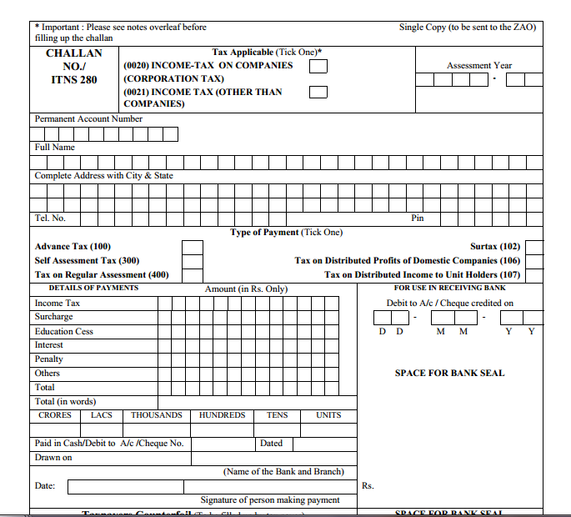
CHALLAN-280

Slide 11
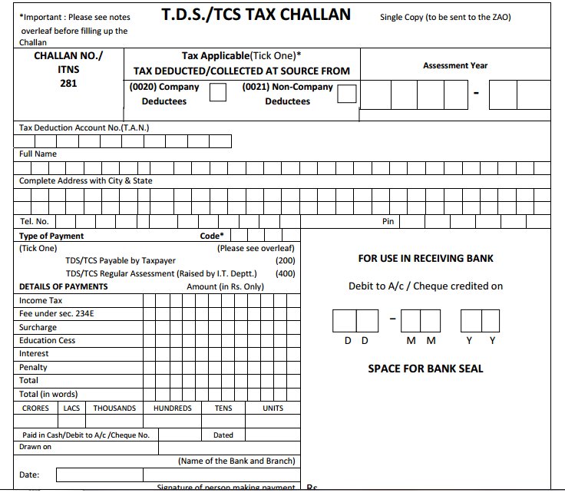
CHALLAN-281- TDS

Slide 12
CASES WHERE TDS RETURN IS FILED WITHOUT TAN NUMBER
Section | Form No | TDS Certificate No | Particulars
194IA | 26QB | Form No.16B | TDS on Sale of Property Transfer of immovable Property other than Agricultural Land consideration of which is equal to or in excess of Rs. 50,00,000/-
194IB | 26QC | Form No.16C | Rent paid under lease, sub-lease, tenancy or any other agreement for use of a land or building or both. Deduct if amount exceeds ₹ 50,000/- per month or part of month.
194M | 26QD | Form 16A | Payment made for carrying out any work in pursuance of contract or commission or brokerage or fees for professional services in excess of Rs. 50 lakhs p.a
194S | 26QE |  | Form FY 2022- TDS on Transfer of Virtual Digital Asset (Crypto Currency)

Slide 13
Tds On Purchase of property PAN LOGIN https://eportal.incometax.gov.in

Slide 14
Tds On Purchase of property PAN LOGIN https://eportal.incometax.gov.in

Slide 15
Tds On Purchase of property PAN LOGIN https://eportal.incometax.gov.in

Slide 16
Tds On Purchase of property PAN LOGIN https://eportal.incometax.gov.in

Slide 17
Tds On Purchase of property PAN LOGIN https://eportal.incometax.gov.in

Slide 18
Tds On Purchase of property PAN LOGIN https://eportal.incometax.gov.in

Slide 19
Tds On Purchase of property PAN LOGIN https://eportal.incometax.gov.in

Slide 20
Tds On Purchase of property PAN LOGIN https://eportal.incometax.gov.in

Slide 21
Tds On Purchase of property PAN LOGIN https://eportal.incometax.gov.in

Slide 22
Download tds certificate Register in TRACES

Slide 23
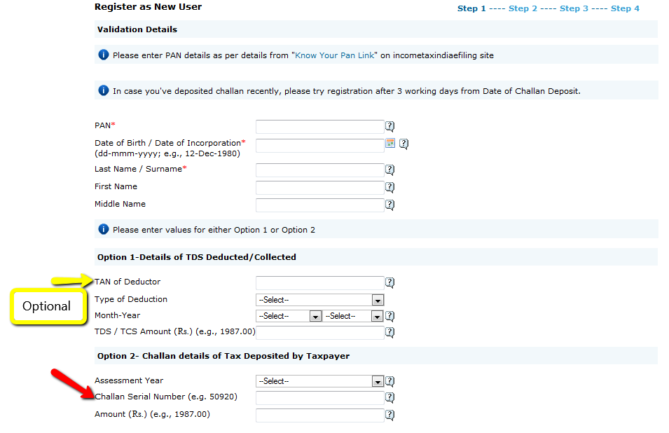
Download tds certificate Register in TRACES

Slide 24
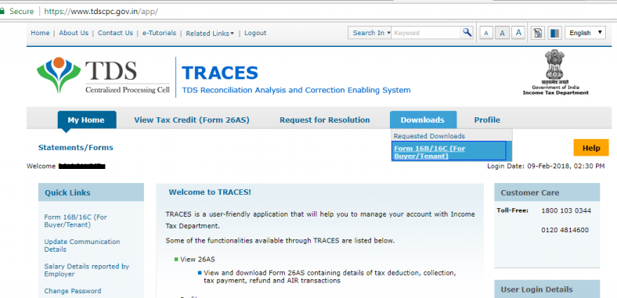
Download tds certficates

Slide 25
Income Tax E Portal
eportal.incometax.gov.in
TAN Login
PAN Login

Slide 26
In traces login Register for E-Filing site

Slide 27
In traces login Register for E-Filing site

Slide 28
eportal.incometax.gov.in through tan login

Slide 29
eportal.incometax.gov.in through tan login

Slide 30
eportal.incometax.gov.in through tan login

Slide 31
eportal.incometax.gov.in through tan login

Slide 32
eportal.incometax.gov.in through tan login

Slide 33
eportal.incometax.gov.in through tan login

Slide 34
eportal.incometax.gov.in through tan login

Slide 35
Single challan for all sections
Section Code quoted in the challan for payment of Tax deducted is no more relevant.
Deductor can quote any Section Code on the challan for payment of TDS under other codes also.
There will be no challan mismatch and no consequent tds demands in this case.
Since, the section code is no more relevant therefore CPC (TDS) has introduced a system where a single challan can be used for payment of TDS under different section codes.

Slide 36
Payment of Tax Deducted for different Assessment Years
In case tax has been deposited more than the required tax deducted at source for a particular Assessment Year, the excess amount of tax can be claimed in the following quarters of the relevant year. The balance amount if any, can be carried forward to the next year for claim in the TDS statement.
Example: If excess payment of Tax has been made in Quarter 1 of financial year 2024-25, the same can be used for Quarter 2, 3 &4 of F.Y. 2024-25 as well as for Q1 to Q4 of F.Y.2025-26. The excess amount of tax paid in Q1 of F.Y.2024-25 can also be used for payment of tax default of Q1 to Q4 of F.Y.2023-24
Refunds Can also be applied for Excess Amount paid

Slide 37
Inoperative PAN
If the collectee’s/deductee’s PAN is inoperative, then a higher rate of TCS/TDS will be collectible/deductible in accordance with section 206CC/206AA of the Income-tax Act.

Slide 38
sumup
Deductor
Deductee Tax Payer
TAN No
Should have
PAN No
Form 49B
Application TIN - FC
Form 49A
Tan Ledger with CPC
Ledger Accounts
PAN Ledger 26AS

Slide 39
Section | Tds Rates at a Glance Nature of Payment | Threshold | Indv / HUF | Others
192 | Salaries | – | Avg | –

Slide 40
Income TAX Slab rates
Income Tax Slab under New Tax Regime for FY 2025-26 | Tax Slab (FY 2024-25) in Rs. | Tax Rate
Rs.0 to Rs. 4,00,000 | Up to 3,00,000 | NIL
Rs. 4,00,001 to Rs. 8,00,000 | 3,00,001 - 7,00,000 | 5%
Rs. 8,00,001 to Rs. 12,00,000 | 7,00,001 - 10,00,000 | 10%
Rs. 12,00,001 to Rs. 16,00,000 | 10,00,001 - 12,00,000 | 15%
Rs. 16,00,001 to Rs. 20,00,000 | 12,00,001 - 15,00,000 | 20%
Rs. 20,00,001 to Rs. 24,00,000 |  | 25%
Above Rs. 24,00,000 | Above 15,00,000 | 30%

Slide 41
Sec 192
After the introduction of the new tax regime under section 115BAC, employees will be provided with an option to choose the tax regime, old or new tax regime, at the beginning of the financial year accordingly, the income tax shall be calculated on the total income after consideration of applicable exemptions, deductions etc.,
If the employee fails to choose the tax regime, the default tax regime shall be applied, and taxes shall be calculated.
For FY 2023-24 and onwards, the new tax regime is the default tax regime.

Slide 42
Annexure II of 24Q
Annexure II consists of a total breakup of the salary, any deductions to be claimed by the employee, his income from other sources, and house property and overall tax liability as calculated.
Annexure III of 24Q
Annexure III consists of a total breakup of pension and interest income paid or credited during the financial year, his income from other sources, and house property and overall tax liability as calculated.

Slide 43
Section | Nature of Payment | Threshold Limit of Payment For F.Y.2024-25 | Change in Threshold for F.Y.2025-26 if any | Rates
193 | Interest on Securities (including Listed Debentures) | Rs. 5,000 | Rs. 10,000 | 10%
 |  | (Rs. 10,000 on 8% Savings (Taxable) Bonds, 2003)
194 | Dividend | Rs. 5,000 | Rs. 10,000 | 10%
194A | Interest (Other than on Securities) by a Banking Company/ Post Office | Senior citizen : Rs. 50,000 p.a. Others : Rs. 40,000 p.a. | Senior citizen : Rs. 1,00,000 p.a. Others : Rs. 50,000 p.a. | 10%
194A | Interest (Other than on Securities) by others | Rs. 5,000 p.a. | Rs. 10,000 p.a. | 10%

Slide 44
Section | Nature of Payment | Threshold Limit of Payment For F.Y.2024-25 | Change in Threshold F.Y.2025-26 if any | Rates
194B | Winning from Lotteries & Cross Word Puzzles, Card games and other games on any sort (Other than winning from online Games) | Rs. 10,000 p.a. |  | 30%
194BA | Winning From Online Games | No Limit |  | 30%
194BB | Winnings from horse races | Rs. 10,000 p.a. |  | 30%

Slide 45
Section | Nature of Payment | Threshold Limit of Payment For F.Y.2024-25 | Change in Threshold F.Y.2025-26 if any | Rates
194C | Payment to contractor/sub-contractor | Rs.30,000 Single Transaction (or) | Same | Individual/HUF : 1%
 |  | Rs. 1,00,000 Aggregate of transactions |  | Others : 2%
194D | Insurance Commision | Rs. 15,000 | Rs. 20,000 | Other than Company : 5%
 |  |  |  | (Reduced rate of 2% shall be wef 1.4.25 onwards)
 |  |  |  | Domestic Company:10%

Slide 46
Section | Nature of Payment | Threshold Limit of Payment For F.Y.2024-25 | Change in Threshold F.Y.2025-26 if any | Rates
194DA | Payment under life insurance policy (The tax shall be deducted on the amount of income comprised in insurance pay-out) | Rs.1,00,000 p.a. |  | Upto 30.9.24 : 5%
 |  |  |  | Wef 1.10.24 : 2%
194EE | Payment under National Savings Scheme | Rs.2,500 |  | 10%
194F | Payment on account of repurchase of units by Mutual Fund or Unit Trust of India | No Limit |  | Upto 30.9.24 : 20%
 |  |  |  | Wef 1.10.24 : NA

Slide 47
Section | Nature of Payment | Threshold Limit of Payment For F.Y.2024-25 | Change in Threshold F.Y.2025-26 if any | Rates
194-I(a) | Rent of Plant / Machinery | Rs. 2,40,000 p.a. | Rs. 50,000 pm | 2%
194-I(b) | Rent of Land or building or furniture or fitting | Rs. 2,40,000 p.a. | Rs. 50,000 pm | 10%

Slide 48
Section | Nature of Payment | Threshold Limit of Payment For F.Y.2024-25 | Change in Threshold F.Y.2025-26 if any | Rates
194-IA | Payment or transfer of immovable property (other than rural agriculture land) | Rs. 50,00,000 & above |  | 1%
 |  |  |  | (on the higher of amount of consideration or the stamp duty value)
194-IB | Rent payable by an individual or HUF not liable to tax audit | Rs.50,000 per month |  | Upto 30.9.24 : 5%
 |  |  |  | Wef 1.10.24 : 2%

Slide 49
Section | Nature of Payment | Threshold Limit of Payment For F.Y.2024-25 | Change in Threshold F.Y.2025-26 if any | Rates
194-IC | Payment of monetary consideration under Joint Development Agreements to Resident individual/HUF | No Limit |  | 10%

Slide 50
Section | Nature of Payment | Threshold Limit of Payment For F.Y.2024-25 | Change in Threshold F.Y.2025-26 if any | Rates
194J | Fees for Professional / Technical Services / Royalty / Remuneration to director | Rs. 30,000 p.a. (Rs. 0 in case of Directors) | Rs. 50,000 p.a. (Rs. 0 in case of Directors) | 10% (For Professional Services, Director remuneration and other Royelty)
 |  |  |  | 2% (For Call Centre, Fees for Technical Services & Royalty in case of cinematograh films)

Slide 51
Section | Nature of Payment | Threshold Limit of Payment For F.Y.2024-25 | Change in Threshold F.Y.2025-26 if any | Rates
194K | Income in respect of units of Mutual funds or specified company | Rs. 5,000 | Rs.10,000 | 10%
194LA | Compensation on acquisition of immovable Property | Rs. 2,50,000 | Rs. 5,00,000 | 10%

Slide 52
Section | Nature of Payment | Threshold Limit of Payment For F.Y.2024-25 | Change in Threshold F.Y.2025-26 if any | Rates
194M | Payment to resident contractors and professionals or by way of commission / brokerage (other than those who covered u/s 194C or 194J) by individual/HUF not liable for tax audit. | Rs. 50 lacs |  | Upto 30.9.24 : 5%
 |  |  |  | Wef 1.10.24 : 2%

Slide 53
Section | Nature of Payment | Threshold Limit of Payment For F.Y.2024-25 | Change in Threshold F.Y.2025-26 if any | Rates
194N | Aggregate Cash withdrawal from Bank / Co-operative bank / Post office etc. (by persons who have not filed ITR for 3 previous years immediately preceding the previous year and the due date for filing ITR under section 139(1) has expired) | Rs. 20 lakhs |  | Cash withdrawal between Rs. 20 lakhs to Rs. 1 crore : 2%
 |  |  |  | Cash withdrawal above Rs. 1 crore : 5%
194N | Aggregate Cash withdrawal from Bank, Post office etc. in case of others. | Rs. 1 crore |  | 2%

Slide 54
Section | Nature of Payment | Threshold Limit of Payment For F.Y.2024-25 | Change in Threshold F.Y.2025-26 if any | Rates
194Q | Payment for purchase of goods | 50 Lakhs |  | 0.1% (on the value above Rs. 50 lakhs)
194R | Benefits or perquisites arising from business or profession | Rs. 20, 000 |  | 10%

Slide 55
Section | Nature of Payment | Threshold Limit of Payment For F.Y.2024-25 | Change in Threshold F.Y.2025-26 if any | Rates
194T | TDS on payment of salary, remuneration, interest, bonus or commission by partnership firm to partners for aggregate amounts more than Rs. 20,000 in the financial year | NA | Rs. 20,000 | FY 24-25 : Nil
 |  |  |  | FY 25-26 onwards : 10%

Slide 56
Section | Nature of Payment | Threshold Limit of Payment For F.Y.2024-25 | Change in Threshold F.Y.2025-26 if any | Rates
206AA | TDS rate in case of Non availability of PAN (Including inoperative PAN ) |  |  | Higher of-
 |  |  |  | Rates in force
 |  |  |  | 20%
206AB | TDS on non-filers of ITR at higher rates |  | Not Applicable/omited effective from 1st April 2025. | Higher of – – 5% or – Twice the rate or rates in force

Slide 57
Tax Collection at source (tcs)
sec 206c

Slide 58
Tax Collection at source (tcs) sec 206c
Section | Goods/Services | Rates
206C (1) | Alcoholic Liquor for Human Consumption | 1.00%
206C (1) | Indian made for foreign liquor | 1.00%
206C (1) | Minerals,coal lignite, Iron ore by a trader | 1.00%
206C (1F) | Purchase of Motor vehicle exceeding Rs.10 lakh | 1%
206C (1C) | Parking lot, toll plaza, mining & quarrying (Lease or license) | 2.00%
206C (1) | Scrap | 1.00%
206C (1) | Tendu Leaves | 5.00%
206C (1) | Timber or any other forest produce (not being tendu leaves) obtained under a forest lease | 2.00%
206C (1) | Timber obtained by any mode other than under a forest lease | 2.00%

Slide 59
Sec | Goods/Services | Nature | Threshold Limit of Payment | Rates
206 (1G) | Overseas Tour Package | Sale | No Limit | Upto 10 Lacs : 5% Above 10 Lacs: 20%
206 (1G) | Remittance under LRS of RBI is a loan for education obtained from any financial institution defined in section 80E | Foreign Remittance | Rs. 10 lacs | 0.00%
206 (1G) | Remittance under LRS of RBI for education in other cases or for medical treatment | Foreign Remittance | Rs. 10 lacs | 5%
 | Any other Remittance | Foreign Remittance | Rs. 10 lacs | 20%
206CC | TCS rate in case of Non availability of PAN | - |  | Higher of- Twice the rate or 5%

Slide 60
Tax Collection at source (tcs) sec 206c
Where total turnover is more than Rs.10 crore in the previous financial year and receives sale consideration of any products of more than Rs.50 lakh, such seller must collect TCS upon receiving consideration from the buyer on such amount over and above Rs.50 lakh, as per Section 206C(IH). (Without PAN, then 1% is TCS) | 0.1%

Slide 61
S. No. | Perspective | Section 194Q TDS | Section 206C(1H) TCS
1 | Applicability | Buyer's Turnover exceeds Rs. 10 Crores in the preceding financial year. | Seller's Turnover exceeds Rs. 10 Crores in the preceding financial year.
2 | Liability | Buyer shall be liable for Tax Deduction. | Seller shall be liable for Tax Collection.
3 | Time of Deduction/ Collection | At the time of credit or payment, whichever is earlier (Accrual Basis) | At the time of Receipt (Cash Basis)
4 | Amount on which tax to be deducted/collected | On the amount of purchase in excess of Rs. 50 lakhs. | On the amount of sale consideration in excess of Rs. 50 lakhs.
5 | Rate | 0.1% | 0.1%
6 | Penal Rate if PAN is not available | 5%. | 1%.
7 | Preference to be given | Purchaser is first liable to deduct the tax if the transaction could be subject to both provision | Seller shall be liable to collect the tax only if purchaser is not liable to deduct the tax or purchaser failed to deduct tax

Slide 62
194Q and 206C applicable?
If any transaction on purchase of goods attracts TDS under Section 194Q as well as tax collected at source under Section 206C(1H), then only Section 194Q shall apply in such a case.
As per Circular No. 13/2021, if, for any reason, TCS has been collected by the seller u/s 206C(1H) of the Act, before the buyer could deduct TDS u/s 194Q of the Act on the same transaction, such transaction would not be subjected to TDS again by the buyer. This concession is provided to remove difficulty, since rate of tax deduction and collection are same in both these sections.

Slide 63
Latest Update
The Union Budget 2025 removed the Tax Collected at Source (TCS) on the Sale of Goods u/s 206C(1H), effective from April 1, 2025.
Previously, TCS was applicable when the aggregate value of goods sold to a single buyer exceeded Rs 50 lakh

Slide 64
TAX DEDUCTED AND TAX REMITANCE
Has to make a Payment/Credit Rs 1,00,000 to
Deductee
Deductor
Tax Deduction Pays/Credits 90,000
& Deducts 10,000
Tax Payment He Pays 10,000 in the TDSAccount Challan 281 with TAN No
He pays 10,000 in TAN Account

Slide 65
When tax has to be deducted date of deduction
In the case of salaries
In the case of other payments
At the time of payment
At the time of payment or credit, whichever is earlier

Slide 66
TAX PAYMENT or TAX REMITTANCE for government deductors
When the tax is paid without producing an income tax challan
When the tax paid is accompanied by an income tax challan
On the same day
On or before 7 days from the end of the month in which the deduction is made
March Month – 30th April

Slide 67
Interest
Delay in deduction of tax
Delay in payment of tax
@ 1% per month or part of the month
@ 1.5% per month or part of the month

Slide 68
Tds return fORMS
24Q – For salaries.
26Q – All Other Cases
27Q – For Non Resident Deductee
27EQ – Tax Collected at Source

Slide 69
DUE DATE FOR FILING TDS & TCs RETURNS
Quarter ending | TDS Return Due Date | TCS Return Due Date
30th Jun | 31st Jul | 15th Jul
30th Sep | 31st Oct | 15th Oct
31st Dec | 31st Jan | 15th Jan
31st Mar | 31th May | 15th May

Slide 70
Tds rpu ttps://www.protean-tinpan.com/services/etds-etcs/etds-rpu.html

Slide 71
Java platform (JRE RUNTIME) IS REQUIRED IN BACKEND
https://www.java.com/en/download/manual.jsp

Slide 72
Java platform (JRE RUNTIME) IS REQUIRED IN BACKEND

Slide 73
EXTRACT TDS RPU FOLDER

Slide 74
CLICK ON TDS_RPU WINDOWS BATCH FILE

Slide 75
ABOUT ETDS

Slide 76
precautions to be taken before efiling
Match Challans with TAN Login.
Interest Amount paid should be shown in the right column
PAN Nos are correct.
Section is Correct
Tax Percentage is correct
Company/Individual Code is Correct
Date of Payment/Credit, Date of Deduction and Date of Challan Payment
Lower Deduction and Non Deduction Tag are proper
197 Certificate Verifications
Amount of Deduction and Amount of Payment
For 24Q - Q4, Annexure 2, Tax Calculations are correct

Slide 77
Lower deduction tab

Slide 78
Lower deduction tab sec 194C is selected

Slide 79
Lower deduction tab
A - lower deduction or No deduction Certificate U/s 197 B - Form 15G /15H - No deduction on account of declaration under sec 197A. Allowed only for section 194, 194A, 194EE and 193
C - Deduction of tax at higher rate due to non-availability of PAN
T - In case of Transporter transaction and valid PAN is provided
Y - Transactions were Tax is Not Deductions as amount has not crossed the Threshold Limit
Applicable for sections 193,194, 194A, 194B, 194BB, 194C, 194D, 194EE, 194G, 194H, 194I, 194J, 194LA.
S - Software acquired under section 194J (Notification 21/2012).
Applicable from FY 2012-13 onwards.
Z - No deduction on account of payment under section 197A (1F).
Applicable from FY 2013-14 onwards

Slide 80
Creation of FVU

Slide 81
Creation of FVU

Slide 82
FVU File created

Slide 83
Form 27A

Slide 84
uploading Of TDS Return – tan login https://eportal.incometax.gov.in

Slide 85
uploading Of TDS Return – tan login https://eportal.incometax.gov.in

Slide 87
uploading Of TDS Return – tan login https://eportal.incometax.gov.in

Slide 88
uploading Of TDS Return – tan login https://eportal.incometax.gov.in

Slide 89
uploading Of TDS Return – tan login https://eportal.incometax.gov.in

Slide 90
uploading Of TDS Return – tan login https://eportal.incometax.gov.in

Slide 91
uploading Of TDS Return – tan login https://eportal.incometax.gov.in
The FVU File should be in zip format

Slide 92
uploading Of TDS Return – tan login https://eportal.incometax.gov.in

Slide 93
uploading Of TDS Return – tan login https://eportal.incometax.gov.in

Slide 94
uploading Of TDS Return – tan login https://eportal.incometax.gov.in

Slide 95
uploading Of TDS Return – tan login https://eportal.incometax.gov.in
A 15 digit TDS Filing ACK will be generated

Slide 96
WHEN UPLOADED WITH NSDL TINFC
A 15 digit TDS Filing ACK will be generated

Slide 97
DUE DATE FOR ISSUE OF tds/TCS CERTIFICATE
In the case of salaries Form 16
In other cases TDS in Form16A
TCS in Form 27D
Within 15 days of Duedate of filing of Quarterly TDS Return
Yearly once before 15th of June

Slide 98
Download TDS Certificates tdscpc.gov.in

Slide 99
Deductor
Deductor can download
Form 16 and 16A
Default Reports
Consolidated File for Revising TDS Return

Slide 100
Register as a new user if login is not created

Slide 101
Downloading of Form 16 & 16A tan login

Slide 102
Downloading of Form 16 & 16A Single PAN Download

Slide 103
Downloading of Form 16 & 16A Bulk PAN Download

Slide 104
Downloading of Form 16 & 16A GENERATE AUTHENTICATION CODE

Slide 105
AFTER IS REQUEST FOR FORM 16/16a IS MADE GO TO REQUESTED DOWNLOADS

Slide 106
AFTER IS REQUEST FOR FORM 16/16a IS MADE GO TO REQUESTED DOWNLOADS

Slide 107
AFTER IS REQUEST FOR FORM 16/16a IS MADE GO TO REQUESTED DOWNLOADS

Slide 108
AFTER IS REQUEST FOR FORM 16/16a IS MADE GO TO REQUESTED DOWNLOADS

Slide 109
AFTER IS REQUEST FOR FORM 16/16a IS MADE GO TO REQUESTED DOWNLOADS

Slide 110
AFTER IS REQUEST FOR FORM 16/16a IS MADE GO TO REQUESTED DOWNLOADS

Slide 111
AFTER IS REQUEST FOR FORM 16/16a IS MADE GO TO REQUESTED DOWNLOADS

Slide 112
TDS CERTIFICATES UTILITY PASSWORD FOR INPUT FILE IS TAN NUMBER

Slide 113
Income Tax E Portal | Traces Portal
eportal.incometax.gov.in | tdscpc.gov.in
TAN Login | TAN Login
PAN Login | PAN Login

Slide 114
Revision of TDS Return

Slide 116
tdscpc.gov.in DASHBOARD

Slide 117
tdscpc.gov.in DASHBOARD

Slide 118
tdscpc.gov.in - STATEMENT/PAYMENTS

Slide 119
tdscpc.gov.in DEFAULTS

Slide 121
tdscpc.gov.in FORMS

Slide 122
tdscpc.gov.in DOWNLOADS

Slide 123
tdscpc.gov.in PROFILE

Slide 124
ONLINE CORRECTIONS

Slide 125
DEFAULT SUMMARY

Slide 126
DEFAULT SUMMARY

Slide 127
REQUEST FOR CORRECTIONS

Slide 128
REQUEST FOR CORRECTIONS

Slide 129
REQUEST FOR CORRECTIONS

Slide 130
TRACK CORRECTION REQUEST

Slide 131
TRACK CORRECTION REQUEST WITH/WITHOUT DSC

Slide 132
TRACK CORRECTION REQUEST

Slide 133
ONE CHALLAN DETAILS AND THREE DEDUCTEE DETAILS

Slide 134
TRACK CORRECTION REQUEST

Slide 135
TRACK CORRECTION REQUEST WITH DSC

Slide 136
TRACK CORRECTION REQUEST WITHOUT DSC

Slide 137
CORRECTION REQUEST

Slide 138
CORRECTION REQUEST

Slide 139
CORRECTIONS READY FOR SUBMISSION

Slide 140
CORRECTIONS READY FOR SUBMISSION

Slide 141
Submit for processing

Slide 142
Submit for processing

Slide 143
Submit for processing

Slide 144
SUBMIT FOR PROCESSING e-mudra signing utility

Slide 145
CORRECTIONS SUBMITTED SUCCESSFULLY

Slide 146
TRACK CORRECTION REQUEST

Slide 147
FILE CORRECTIONS PERSONNEL INFORMATION

Slide 148
FILE CORRECTIONS CHALLAN CORRECTIONS

Slide 149
FILE CORRECTIONS CHALLAN CORRECTIONS

Slide 150
FILE CORRECTIONS CHALLAN CORRECTIONS

Slide 151
TAG CHALLANS

Slide 152
PAY LATE FEES INTEREST AND PENALTY

Slide 153
PAY LATE FEES INTEREST AND PENALTY

Slide 154
PAY LATE FEES INTEREST AND PENALTY

Slide 155
PAY LATE FEES INTEREST AND PENALTY

Slide 156
PAN CORRECTIONS

Slide 157
PAN CORRECTIONS

Slide 158
ADD CHALLANS TO STATEMENTS

Slide 159
ADD CHALLANS TO STATEMENTS

Slide 160
WHEN ONLINE RECTIFICATIONS ARE NOT ENABLED?
THEN WE HAVE TO PROCEED BY C1 OFFLINE CORRECTION FOR ENABLING ONLINE CORRECTION

Slide 161
REQUEST FOR CONSO FILE

Slide 162
REQUESTED DOWNLOADS

Slide 163
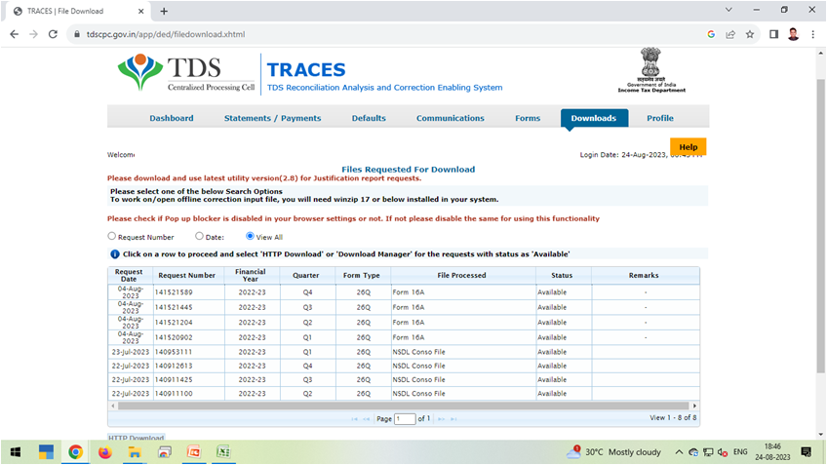
REQUESTED DOWNLOADS

Slide 164
REQUESTED DOWNLOADS CONSO FILES

Slide 165
IMPORT THE CONSO FILE IN RPU SELECT CORRECTION RETURN

Slide 166
SELECT THE CONSO FILE DOWNLOADED FROM TRACES PORTAL

Slide 167
SELECT THE CONSO FILE DOWNLOADED FROM TRACES PORTAL

Slide 168
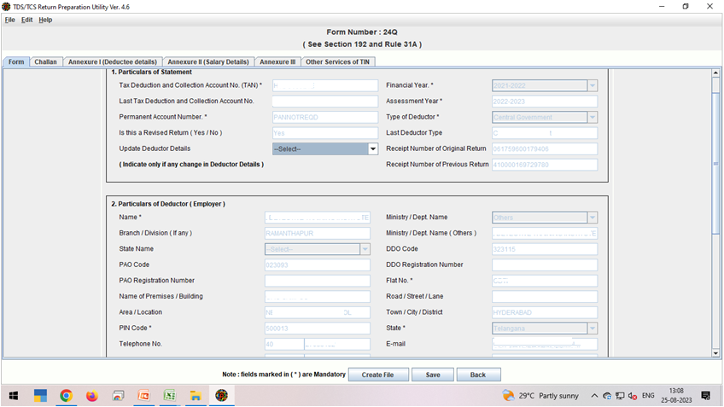
SELECT THE CONSO FILE DOWNLOADED FROM TRACES PORTAL

Slide 169
SELECT THE CONSO FILE DOWNLOADED FROM TRACES PORTAL

Slide 171
uploading Of REVISED TDS Return – FVU FILE - tan login
https://eportal.incometax.gov.in

Slide 172
uploading Of REVISED TDS Return – FVU FILE - tan login

Slide 173
uploading Of REVISED TDS Return – FVU FILE - tan login

Slide 174
uploading Of REVISED TDS Return – FVU FILE - tan login

Slide 175
uploading Of REVISED TDS Return – FVU FILE - tan login

Slide 176
uploading Of REVISED TDS Return – FVU FILE - tan login

Slide 177
SELECT CORRECTION RETURN

Slide 178
SELECT CORRECTION RETURN
The FVU File should be in zip format

Slide 179
SELECT CORRECTION RETURN

Slide 180
SELECT CORRECTION RETURN

Slide 181
SELECT CORRECTION RETURN

Slide 183
QUESTIONS

Slide 184
THANK YOU
CA. Ritesh Mittal Sanjay Kumar Kothari and Co., Chartered Accountants,
MOBILE: 09885377421
mrriteshmittal@gmail.com

