Slide 1
Invoice Management System & GSTR-2B
CA VAMSHI KRISHNA II PARTNER II J V N & ASSOCIATES
Ph: 8951012020 Em: vamshi@cajvn.in

Slide 2
Agenda
Need for IMS / GSTR-2B
Legal Provisions
Practical solutions
Notes:
Ensure correctness Clarity & Confidence
Department
Cross-checks from data
Avod re-working

Slide 3
Why should I pay attention to this?
Notes:
Ensure correctness Clarity & Confidence
Department
Cross-checks from data
Avod re-working

Slide 4
Flow of returns - Planned
GSTR-1
(1st to 10th)
GSTR-1
Monthly / Quarterly
X
Y
Z
GSTR-2A
GSTR-1A
(16th to 17th)
GSTR-3B
Monthly
GSTR-2A
Auto
GSTR-1A
(After 1 & before 3B)
GSTR-3
(By 20th)
Accept
Reject
Modify
Pending
Add missing
GSTR-2B
Auto generated
GSTR-2
(11th to 15th)
P
Q
R

Slide 5
Flow of returns – With IMS
GSTR-1
X
Y
Z
GSTR-1A
GSTR-3B
Invoice Management System (IMS)
A
Accept
CNs rejected in prev. month’s IMS
GSTR-2B
R
Reject
P
Pending

Slide 6
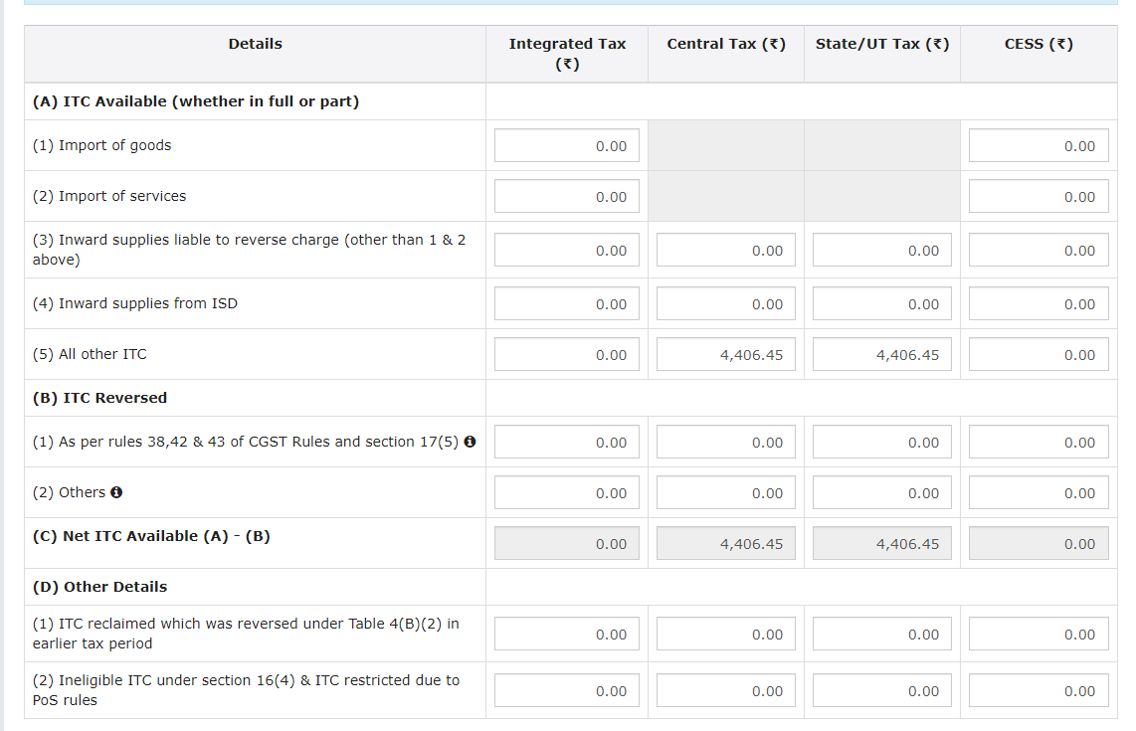
Table 4 of GSTR-3B

Slide 7
ITC : Conditions
Business purpose & Taxable supplies
Should have invoice and Should have receive Goods / Service
Supplier should have paid tax to govt
Should have filed the GST return
Supplier should be paid in 180 days
Time limit – 30th Nov of Next FY
Should reflect in GSTR-2B
Should not be part of ITC marked as Ineligible by the govt. / GSTIN

Slide 8
Extract of provisions relevant for IMS & 2B
16(2)(aa) the details of the invoice or debit note referred to in clause (a) has been furnished by the supplier in the statement of outward supplies and such details have been communicated to the recipient of such invoice or debit note in the manner specified under section 37; (w.e.f. 01.01.2022)
16(2)(ba) the details of input tax credit in respect of the said supply communicated to such registered person under section 38 has not been restricted (w.e.f. 01-10-2022)
Rule 36(4) : (w.e.f. 01.01.2022)
No ITC shall be availed by a registered person in respect of invoices or debit notes the details of which are required to be furnished under sub- section (1) of section 37 unless,-
(a) the details of such invoices or debit notes have been furnished by the supplier in the statement of outward supplies in FORM GSTR-1 as amended in FORM GSTR-1A if any, or using the invoice furnishing facility; and
(b) the details of input tax credit in respect of such invoices or debit notes have been communicated to the registered person in FORM GSTR-2B under sub-rule (7) of rule 60.

Slide 9
Recommendations of 55th Council meeting
The GST Council recommended inter-alia-
To amend section 38 and rule 60 to provide a legal framework in respect of generation of FORM GSTR-2B based on the action taken by the taxpayers on the IMS.
To amend section 34(2), to specifically provide for requirement of reversal of input tax credit as is attributable to a credit note, by the recipient, to enable the reduction of output tax liability of the supplier.
To insert a new rule 67B, to prescribe the manner in which the output tax liability of the supplier shall be adjusted against the credit note issued by him.
To amend section 39 (1) and rule 61 to provide that FORM GSTR-3B of a tax period shall be allowed to be filed only after FORM GSTR-2B of the said tax period is made available on the portal.

Slide 10
Invoice Management System

Slide 11
Source:
Advisory of GSTN, consolidating all the advisories till date:
https://services.gst.gov.in/services/advisoryandreleases/read/549

Slide 12
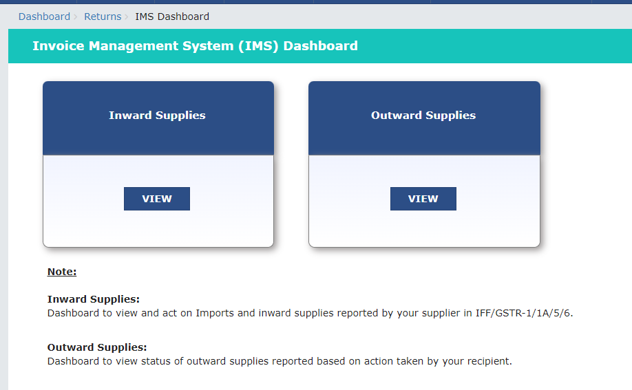
IMS dashboard

Slide 13
IMS : Key Features - Recipient
Revised version of GSTR-2A
Shall have all the invoices saved by supplier
Past & Present (Future)
Filed & Just added
Updates on Real time basis
Action: Accept, Reject & Pending _ No action ~ Deemed acceptance
These actions can be taken from the time of saving the records in GSTR 1 / IFF / 1A by the supplier till the recipient files corresponding GSTR-3B.
GSTR-2B shall be generated based on actions
All the accepted/ deemed accepted/ rejected records will move out of IMS dashboard after filing of respective GSTR 3B.
Pending records will remain on IMS dashboard and these records can be accepted or rejected in future months.

Slide 14
IMS : Key Features - Recipient
Below invoices will not go to IMS and will be directly populated in the GSTR – 2B & 3B
1. Document flowing from the following forms: • GSTR 5 • GSTR 6
2. ICEGATE documents
3. RCM records
4. Document where ITC is ineligible due to: • POS rules • Section 16(4) of CGST Act
5. Documents where ITC to be reversed on account of Rule 37A
What if the supplier updated invoice after acceptance/rejection:
Any change made in a record/invoice before filing GSTR-1/1A/IFF by the supplier will reset the record’s status on recipient’s IMS dashboard.
Amendment in diff return period: Mandatory to act on original invoice before acting on amendment
Amendment in Same return period: Act only on amended invoice

Slide 15
IMS : Key Features - Recipient
‘Pending’ action shall not be allowed in following scenarios:
Original Credit note
Upward amendment of the credit note – Irrespective of action on original
Downward amendment of the credit-note - if original credit note was rejected by
Downward amendment of Invoice/ Debit note - If original Inv/ DN was accepted and filed 3B Click in ‘Save” Button after acting
RESET option is provided to restore the original position of No-Action
Bulk action - Multiple invoices can be selected, and common action can be applied
Filtering option is also available
Can be downloaded in excel

Slide 16
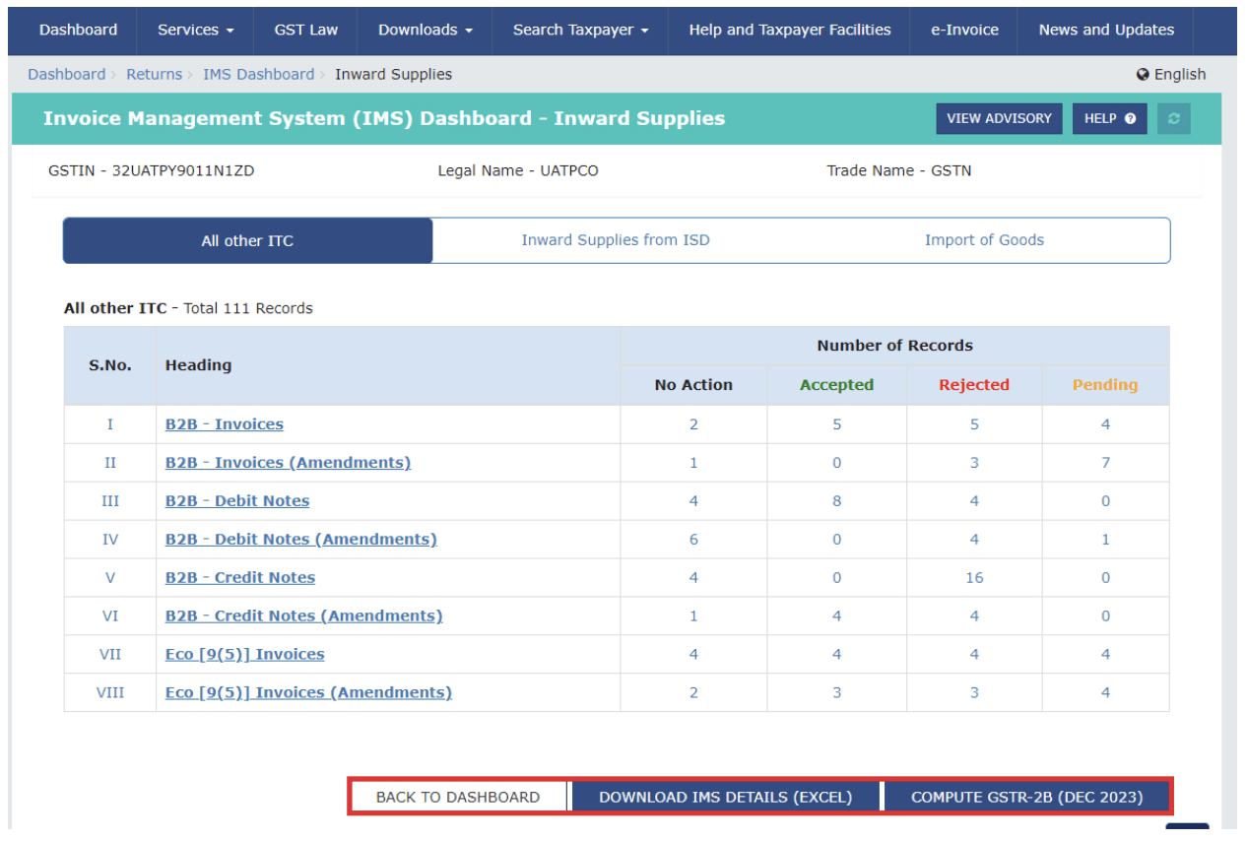
IMS dashboard

Slide 17
IMS – Issues / Queries
Contains invoices of future months as well
Contains invoices added in GSTR-1 but not filed, supplier may delete afterwards
What if the RCM invoice is incorrect or not related to the recipient? –
Not part of IMS, check with supplier to rectify
What if there is a credit note for ineligible ITC invoice? (Q.no. 7 of Additional FAQs dated 17.10.2027)
In such cases recipient can accept the said credit note in IMS. As recipient had already reversed the ITC, there is no need for reversal of ITC again in case of such credit note.
What to do in case wrong invoice is corrected by issuance of Credit Note by the supplier instead of amending the same and such Credit note has been rejected by the recipient?
if the invoice is not correct, then it is advisable to rectify the mistake through amendment of invoices in the GSTR 1 instead of issuance of a Credit Note

Slide 18
IMS – Issues / Queries
What if there was a mistake in IMS and couldn’t be corrected before 3B?
Correct the corresponding number in GSTR-3B directly
Source: https://services.gst.gov.in/services/advisoryandreleases/read/547

Slide 19
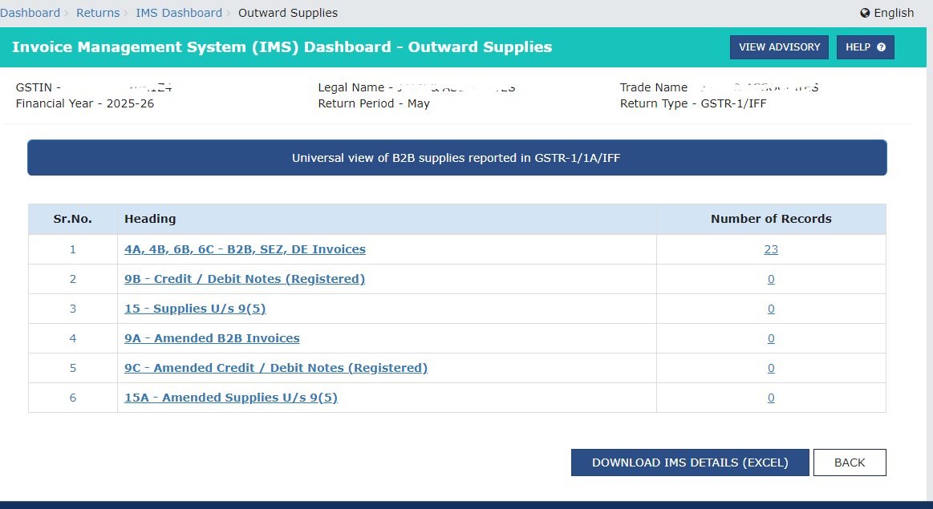
IMS – Key Features - Supplier
Supplier can view the details in his dashboard and take necessary action in GSTR-1A or GSTR-1

Slide 20
IMS – Impact on Supplier
The liability of supplier will be increased in GSTR 3B for the subsequent tax period, for the invoices/records which have been rejected by the recipient in the IMS for the following transactions
Original Credit note
Upward amendment of the credit note - irrespective of the action on the original credit note
Downward amendment of the credit note - if original credit note was rejected by him
Downward amendment of Invoice/ Debit note- if original Inv/DN was accepted and filed GSTR 3B

Slide 21
GSTR-2B
Shall be generated on 14th of the following month
Shall be updated as per the actions in IMS
From 14th, Shall update only if we click on “Compute-2B” option in IMS
If an invoice has been accepted by recipient but supplier is yet to file GSTR-1, then invoice shall not come into GSTR-2B
Shall be static after filing GSTR-3B
QRMP – 2B Shall bot be generated in 1st & 2nd months
Sequential: Shall not be generated if previous month’s GSTR-3B has not been filed
Any amendments through GSTR-1A shall impact the GTSR-2B of subsequent period

Slide 22
IMS-Changes to Table 4 of GSTR-3B
The concept of Temporary reversal and reclaim shall have limited application

Slide 23
Best Practices for GSTR-2B/IMS Reconciliation
Books are the primary source:
Cleaner the books, easier for reconciliations
Tools shall help for the volume, but if the source data is incorrect, then nothing helps
Regular Vendor Follow-up:
Ensure suppliers file GSTR-1 on time to avoid ITC mismatches.
Invoice-wise Tracking:
Maintain a sheet to monitor invoice status, ITC eligibility, and reflection in 2B.
Block Non-compliant Vendors:
Stop dealing with vendors who repeatedly delay GSTR-1 filing.
Set Reconciliation Frequency:
Reconcile monthly for large businesses and at least quarterly for smaller ones.

Slide 24
GSTR-2B Reconciliation & IMS Tools
Tally Prime
Mid size Businesses- MSMEs, traders, CAs
Zoho Books
Mid size Businesses- Service firms, SMEs
Suvit
CA Firms managing multiple clients, MSMEs and Enterprises with large invoice volumes
ClearTax GST
Large Enterprises and Corporates.
Master GST, GST Zen

Slide 25
Invoice wise tracking
It is suggested to maintain the following information for each of the invoices
Doc.type, Doc.no & Date as per source doc.
Dt. Of accounting
GSTIN of supplier
TV, HSN, Description & I/C/SGST
Categorization as Inputs/Services/Capital goods
Eligibility and remark (Reason for ineligibility)
Month of 2B and Month of 3B
GSTIN & Inv no. as per 2B
TV & Tax as per 2B and value considered for 3B
Dt. Of payment and name of bank
Remarks column for any notes of adjustments

Slide 26
Any Doubts????

Slide 27
Thank you for the Opportunity & Support
CA VAMSHI KRISHNA JAVVAJI
IDT Partner,
J V N & Associates
8951012020 II vamshi@cajvn.in

