Slide 1




Beyond Borders: How Indian Startups are building Global legacies
Presented by -
CA Lalit Valecha

Slide 2
1
COVERAGE
5
01
05
UPCOMING SECTORS
An Overview of topics to be covered
2
STARTUP TREND
6
GLOBAL SHIFT IN ACCOUNTING PROFESSION
02
06
What are recent trends in Startup
3
UNICORN BOOM
7
03
07
GEOPOLITCAL LANDSCAPE
India’s Rise on the Global Startup Map
4
8
OTHER
04
FLIP AND REVERSE FLIPS
08

Slide 3
STARTUP AND UNCIRORNS

Slide 4












Startup trends
Global startups with entities in US, Singapore, UK and UAE
Fund Raise
2024
$12 Bn+ across 1,000 deals
Post – Transformer (AI-Native)
Emergence of VC ecosystem in India
India 3rd largest startup ecosystem
Startup India and MSME
benefits
IPO
Sectors: D2C, Qcomm, Fintech SaaS and AI
India has 123 unicorns
Ghar
Wapsi

Slide 5
Startup India and MSME
benefits
Emergence of VC ecosystem in India
India 3rd largest startup ecosystem
Ghar
Wapsi
Fund Raise
2024
$12 Bn+ across 1,000 deals
Startup trends
IPO
Sectors: D2C, Qcomm, Fintech SaaS and AI
Global startups with entities in US, Singapore, UK and UAE
Post – Transformer (AI-Native)
India has 123 unicorns

Slide 6
Unicorn Boom
Global startups with entities in US, Singapore, UK and UAE
Fund Raise
2024
$12 Bn+ across 1,000 deals
Post – Transformer (AI-Native)
Emergence of VC ecosystem in India
India 3rd largest startup ecosystem
Startup India and MSME
benefits
IPO
Sectors: D2C, Qcomm, Fintech SaaS and AI
India has 123 unicorns
Ghar
Wapsi

Slide 7
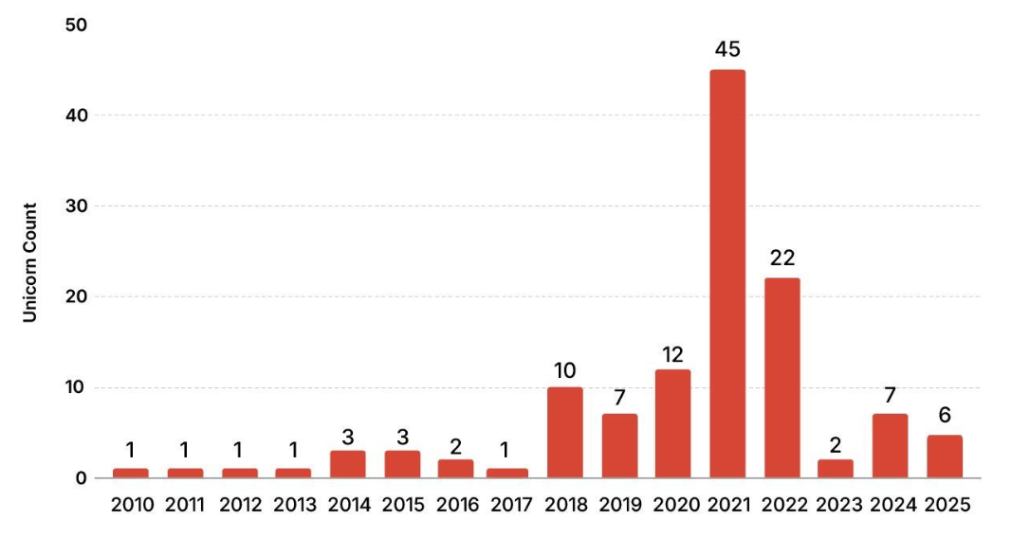
Unicorn Boom: India’s Rise on the Global Startup Map
Country wise Unicorn count
New Indian Unicorns Y-o-Y
India Has the Third Highest Number of Unicorns Globally
Indian Startup Ecosystem Added Six New Unicorns In 2024
Source: Inc42

Slide 8
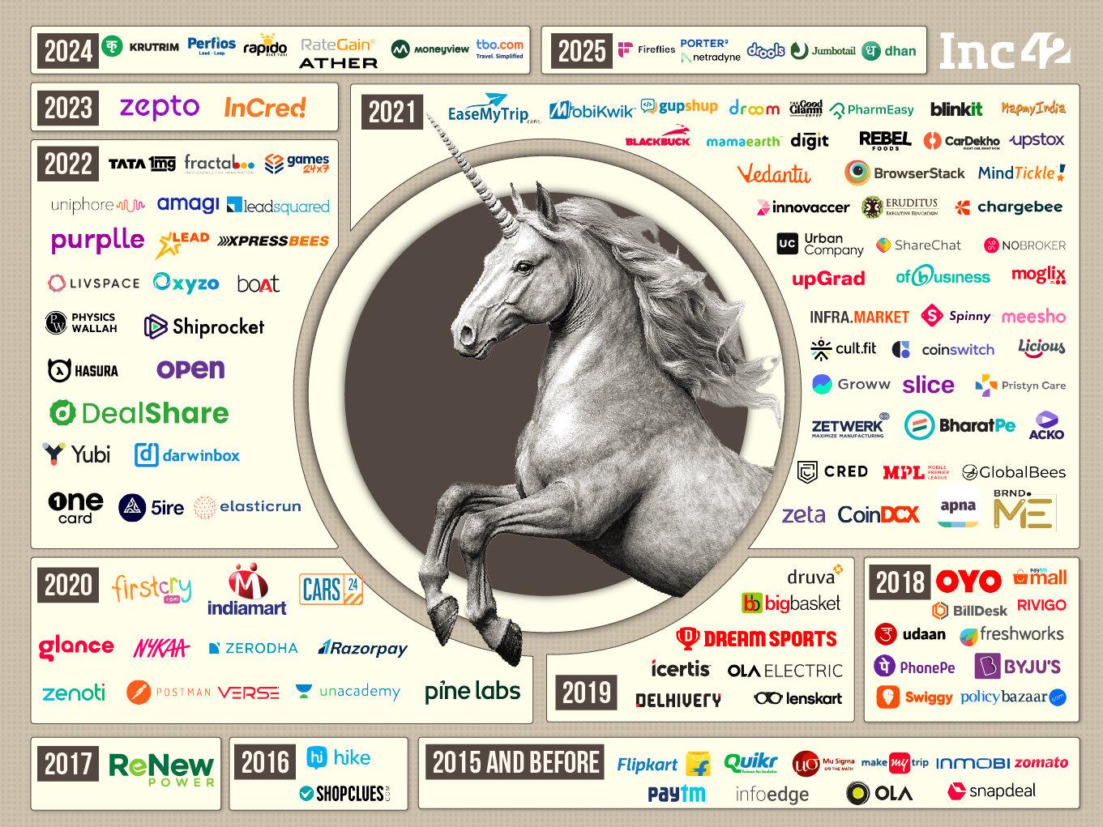
Indian Startup Landscape
A privately held startup company with a valuation of $1 billion or more, typically before going public.
Unicorn
Source: Inc42

Slide 9
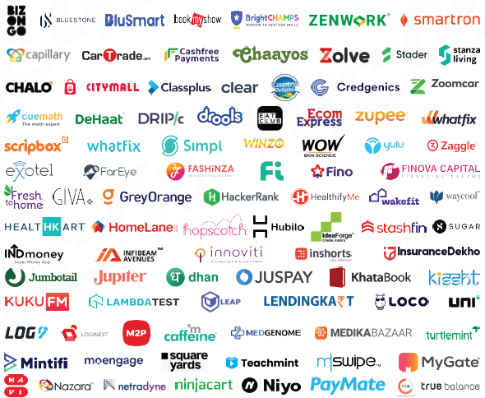
Indian Startup Landscape
A startup that hasn't yet reached a $1 billion valuation but is on track to become a unicorn soon based on its growth, funding, and market potential
Soonicorn
Source: Inc42

Slide 10























Indian Startup Landscape
An Indicorn is a profitable Indian startup with ₹100+ crore revenue, founded within the last 15 years. Titan Capital has curated a list of 200+ such startups.
Indicorn

Slide 11
Opportunity in Startups going global
Financing round both deal sourcing and transaction/ deal support
(Investment banking or Transaction advisory)
India Compliance under Income tax and FEMA for setting up
Global support for outside India ongoing compliances and Accounting
Global and local Incorporation support
Support in availing incentives and government support
Structure advisory
Corporate transactional support for M&A

Slide 12
FLIP AND REVERSE FLIPS
AIFs & Family Office
Artificial Intelligence
Tourism & Hospitality
Life Science
Space
GCC
Defense

Slide 13
US VCs Vs Indian VCs
Particulars | US VC | Indian VC
Risk | High Risk Takers | Moderate Risk Takers
Trust | Higher of Trust | Lower on Trust
Guidance in growth and network benefits | High including assisting in hiring senior positions, mentorship, industry insights, perks like AWS / Google Credits, peer support, global expansion support | Non-Convertible
Cheque size and Valuation | Higher in both cheque size & Valuation | Slightly lower valuation but this is slowly changing
Exit Terms | More flexible | Few have strong exit terms but all have best effort basis exit clause due to AIF structures in India which is a closed ended scheme

Slide 14



Flip Structure
Alternative 1
Alternative 2
Indian Resident Individual
Indian Resident Individual
Indian Resident Individual
Invests in Foreign Entity with control*
Foreign Entity (Hold Co.)
Founder’s LLP
Overseas account having foreign sourced income
Indian Entity (Subsidiary Co.)
Foreign Entity (Hold Co.)
Foreign Entity (Hold Co.)
Issues
Round Tripping
POEM
Indian Entity (Subsidiary Co.)
Indian Entity (Subsidiary Co.)
Transfer Pricing

Slide 15



Comparison between Countries
Parameter | Singapore | USA | UAE
Tax Rate | 17% with various exemption | >21% (Federal plus state taxes) | 9% & 0% if Free zone
Capital Gains | Exempt, except for as provided under 10L | Taxable | Any gains on disposal of capital assets would form part of taxable income subject to participation exemption
Dividend | Exempt | Taxable | Exempt subject to participation exemption
Local Director | 1 Local Director required | Not Required | Mainland entity may require local partner upto 51% as per business requirement
Audit | Required if threshold met | Not Applicable for unlisted entity | Required in Freezone
Incorporation Time | 2-3 Days | 1 Day | 2-3 weeks
Incorporation Cost | Moderate | Low | High
Time Required to open bank account | Upto 15 Days | 3-4 Days | Upto 2 Months
Requires travel for bank account | No | No | Yes

Slide 16
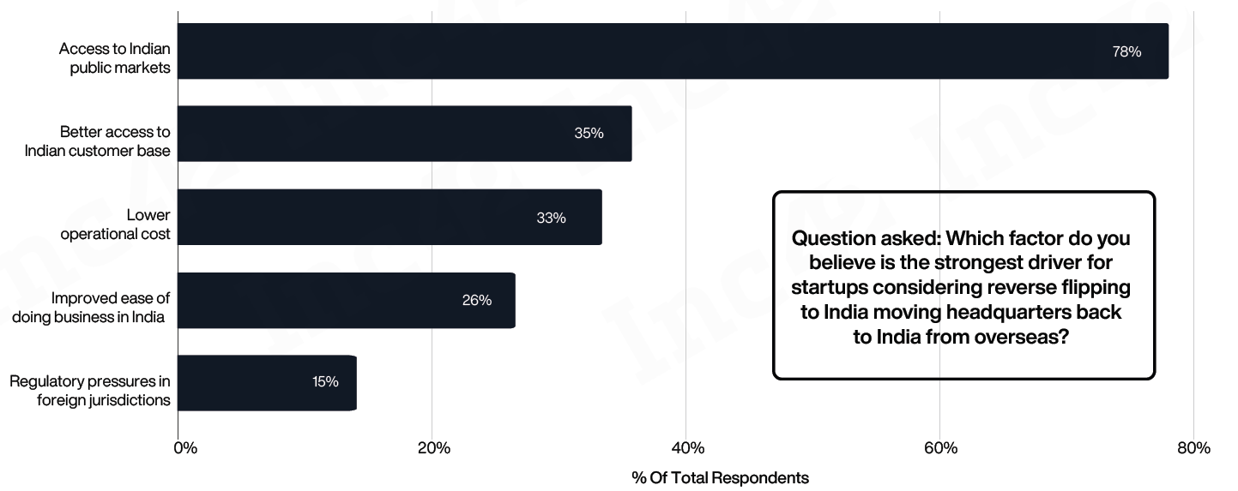
Founder’s LLP
Foreign Entity (Hold Co.)
Merged Indian Entity
Indian Entity (Subsidiary Co.)
Issues
Exit Tax in US
Indirect Transfer tax on NR
Reverse Flipping: Why Indian Startups Are Moving Back Home
Source: Inc42

Slide 17
Reverse Flip Structure – Inbound Merger
Founder’s and Investors
Foreign Entity (Hold Co.)
Merged Indian Entity
Indian Entity (Subsidiary Co.)
Issues
Exit Tax in US
Indirect Transfer tax on NR

Slide 18
Exit Tax in US
Company | Original Domicile | Tax Paid for the Flip (approx.)
Meesho | US (Delaware) | $288–$300 million
Razorpay | US | $150 million
Groww | US | $160 million

Slide 19
SECTORS
AIFs & Family Office
Artificial Intelligence
Tourism & Hospitality
Life Science
Space
GCC
Defense

Slide 20







Upcoming Sectors
Artificial Intelligence
Life Science
Defense
AIFs & Family Office
Tourism & Hospitality
Space
Fintech

Slide 21
~ 74,165 candidates sat for CPA Exam in 2024
National Association of State Boards of Accountancy (NASBA)
~ 6,53,408 active licensed CPAs (USA)*
Institute of Chartered Accountants of India (ICAI)
~ 4,07,000+ members * (1,60,000 in practice)
~ 10,00,000 students
Global Shift in ACCOUNTING
Chinese Institute of Certified Public Accountants (CICPA)
~ 3,60,000 members **
Not reliably published
~ 5,30,100 future members/students
Association of Chartered Certified Accountants (ACCA)
~ 2,57,900 members **
> 24,000 students (enrolled in CPA PEP 2024)
Chartered Professional Accountants of Canada (CPA Canada)
~ 2,17,000+ members **
Institute of Chartered Accountants in England and Wales (ICAEW)
~ 2,10,000 members **
~ 5,85,000 students

Slide 22
Global Shift in Accounting Profession
National Association of State Boards of Accountancy (NASBA)
~ 6,53,408 active licensed CPAs (USA)*
~ 74,165 candidates sat for CPA Exam in 2024
Institute of Chartered Accountants of India (ICAI)
~ 4,07,000+ members * (1,60,000 in practice)
~ 10,00,000 students
Chinese Institute of Certified Public Accountants (CICPA)
~ 3,60,000 members **
Not reliably published
Association of Chartered Certified Accountants (ACCA)
~ 5,30,100 future members/students
~ 2,57,900 members **
Chartered Professional Accountants of Canada (CPA Canada)
> 24,000 students (enrolled in CPA PEP 2024)
~ 2,17,000+ members **
Institute of Chartered Accountants in England and Wales (ICAEW)
~ 2,10,000 members **
~ 5,85,000 students
*Data as at 31st March 2025
** Data as at 31st December 2024

Slide 23

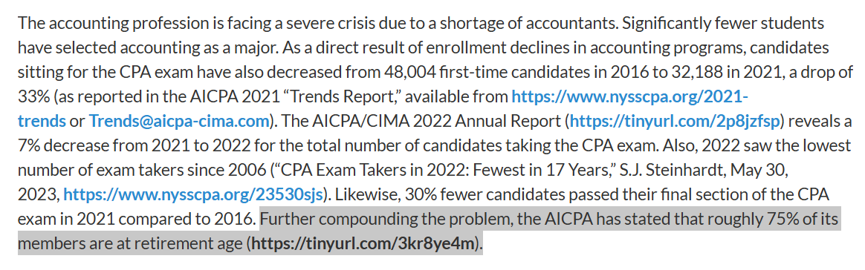
ICYMI | The Accounting Profession Is in Crisis - The CPA Journal August 2025

Slide 24
Tariff wars & supply-chain realignment
Russia–Ukraine conflict
Sanctions checks, FX/commodity sensitivity, deal DD add-ons
Trade-impact modelling, TP redesign, landed-cost analytics, customs advisory
GEOPOLICTCAL AND ECONOMIC LANDSCAPE
GCC e-invoicing rollouts
UAE corporate tax (9%)
“E-invoicing readiness”: GAP → vendor → UAT → go-live → controls
CT registration, group relief, TP documentation, CbCR
India–GCC corridor surge
Digital tax & OECD Pillar Two
Cross-border structuring, payroll/VAT, Virtual CFO for GCC
Pillar-Two modelling, entity rationalisation, disclosure packs

Slide 25

Geopolitical
Tariff wars & supply-chain realignment
SEBI BRSR for top-1000
Russia–Ukraine conflict
AI in finance & audit
BRSR readiness, data pipes, limited assurance
Trade-impact modelling, TP redesign, landed-cost analytics, customs advisory
Sanctions checks, FX/commodity sensitivity, deal DD add-ons
AI-enabled close, anomaly detection, dashboarding
Clean/Green steel transition and EU CBAM (steel, cement, etc.)
India Carbon-Credit Trading (CCTS)
UAE corporate tax (9%)
GIFT City
Project origination, MRV, registry onboarding, accounting & audit
CT registration, group relief, TP documentation, CbCR
“Fund/FO structures, FEMA/IFSC compliance, audit
Product-level emissions accounting, capex/ROI decarb models. CBAM readiness: data, verifier liaison, pricing strategy
E-governance & real-time compliance
Digital tax & OECD Pillar Two
Cross Border taxation
GIFT City & “mirror firms”
Reg-tech process design, Cyber Security, SOC-style controls
Pillar-Two modelling, entity rationalisation, disclosure packs
Cross-border structuring, payroll/VAT, Virtual CFO
Fund/FO structures, FEMA/IFSC compliance, audit

Slide 26
OTHERS

Slide 27
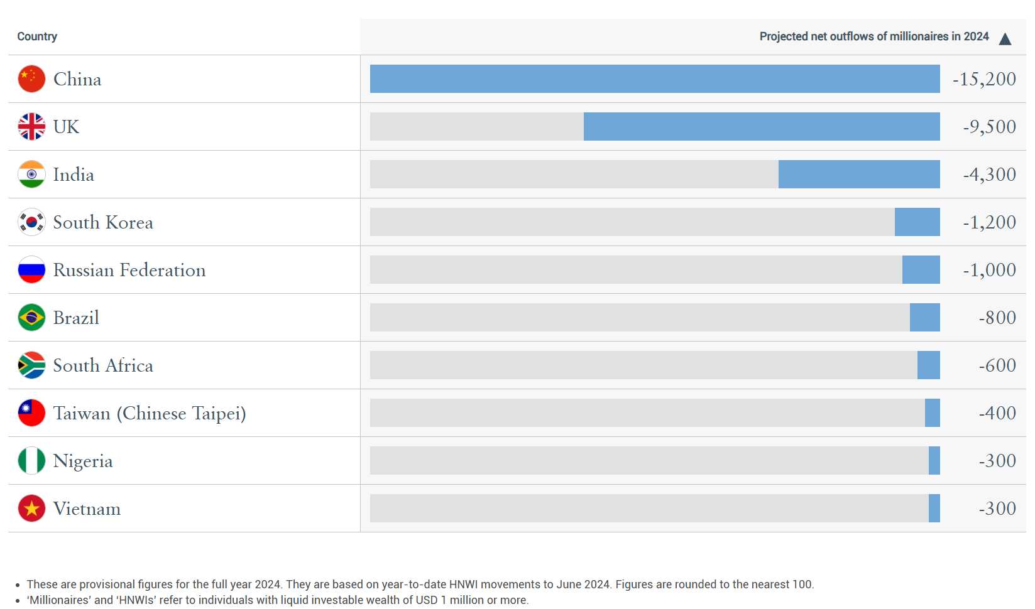
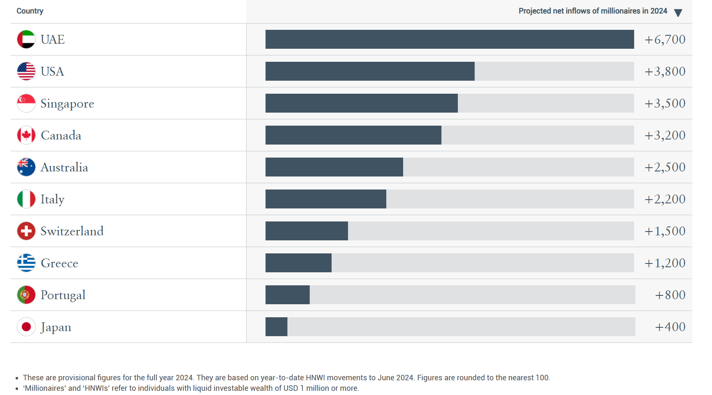
Migration of the World’s Millionaires
This dataset represents the Top 10 countries or territories globally in terms of projected net outflows of millionaires for 2024.
This dataset represents the Top 10 countries globally in terms of projected net inflows of millionaires for 2024.
Source: New World Wealth and Henley Private Wealth Migration Report 2024

Slide 28
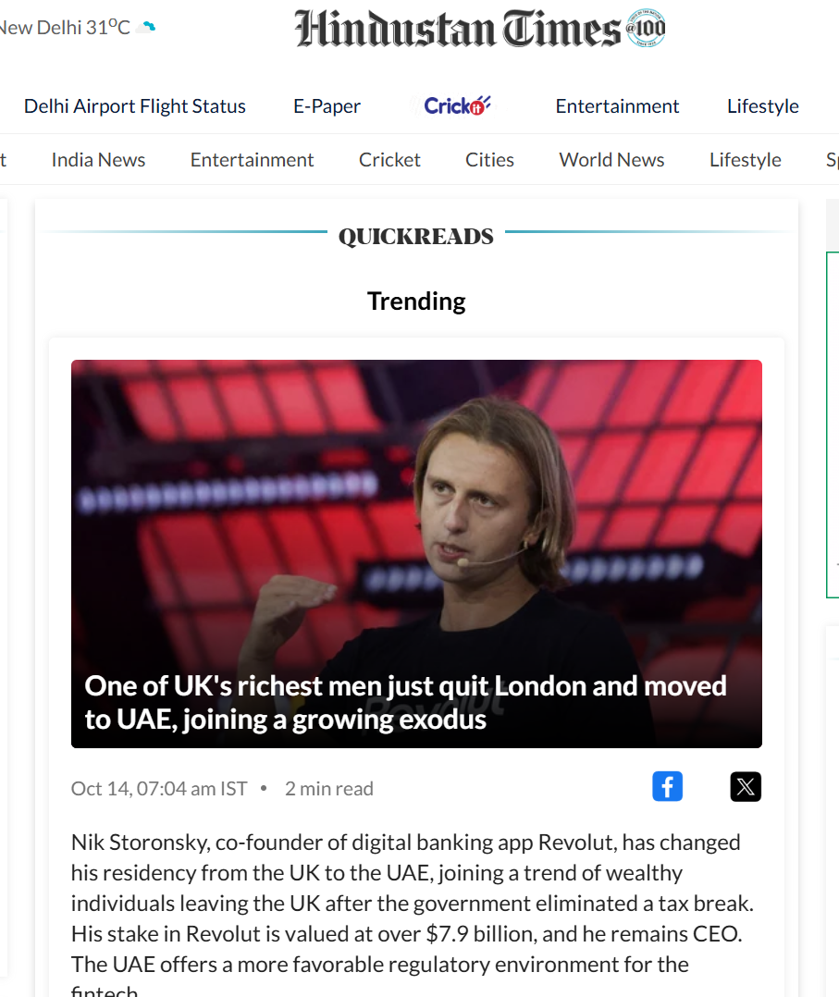

Slide 29
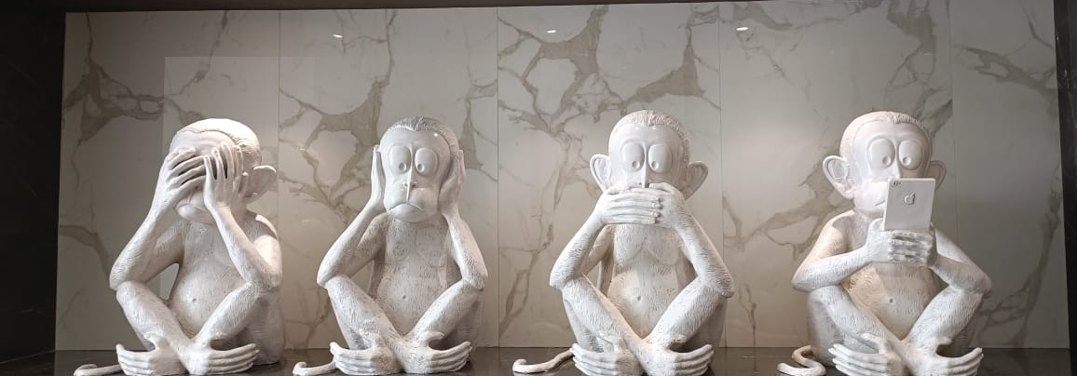

Slide 30

Any Questions?

Slide 31

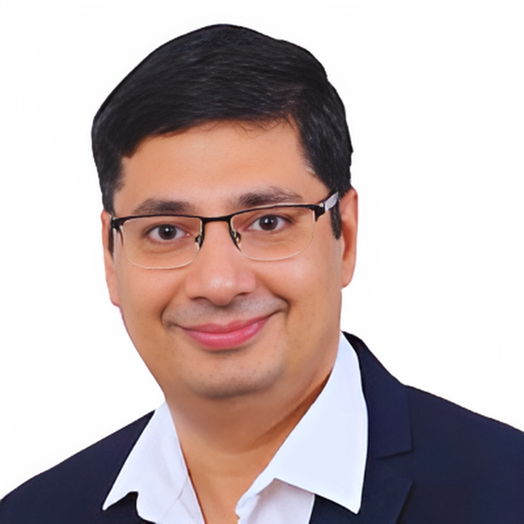

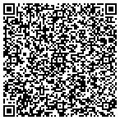




Thank You
CA LALIT VALECHA
Let’s Connect on LinkedIn
Founder Partner
Ahuja Valecha and Associates LLP
+91- 9422024019
lalit.valecha@avallp.in
Meera Madhav, 38, Sainik Vihar , Cloud 9Estate, Off NIBM Road Pune 411060, India
www.avallp.in
Pune | Bengaluru | Hyderabad | Delhi | Belagavi | Ahmedabad | Surat | Kolkata | Jaipur

