Slide 1


GST Tribunal Procedures & Practice
- CA. Sudhir V. S
June 16, 2025

Slide 2
1
Legal Provisions relating to GST Tribunal
Session
Coverage
2
GST Tribunal Procedures
3
Code of Conduct at Tribunal - Practical Experience
4
Q&A
5

Slide 3

Origin of Tribunal System in India
HNA & CO LLP

Slide 4
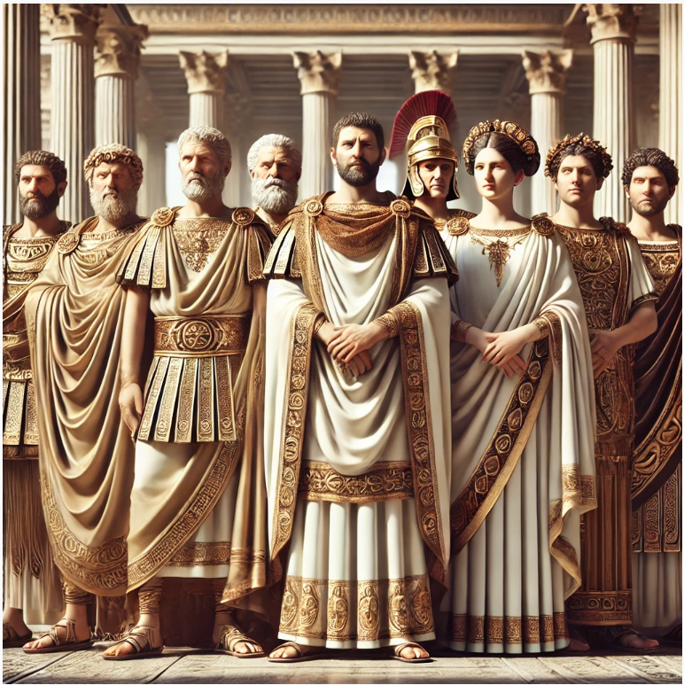
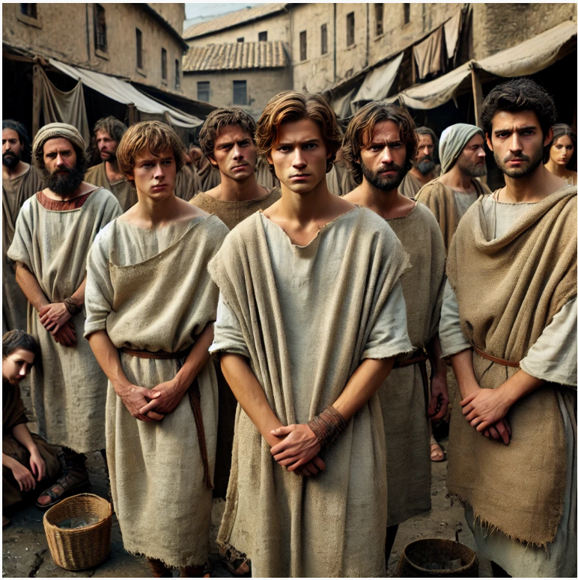
Origin & Evolution of Tribunal
Plebeians, long marginalized and ignored by the government, grew increasingly dissatisfied.
Realizing Rome's vulnerability without them, the patricians reluctantly negotiated.
This led to the creation of the Office of the Tribunus Plebis, established to safeguard plebeian interests from patrician dominance.
CITY OF ROME
Patricians
Plebeians
Wealthy – Ruling Class
Common People

Slide 5
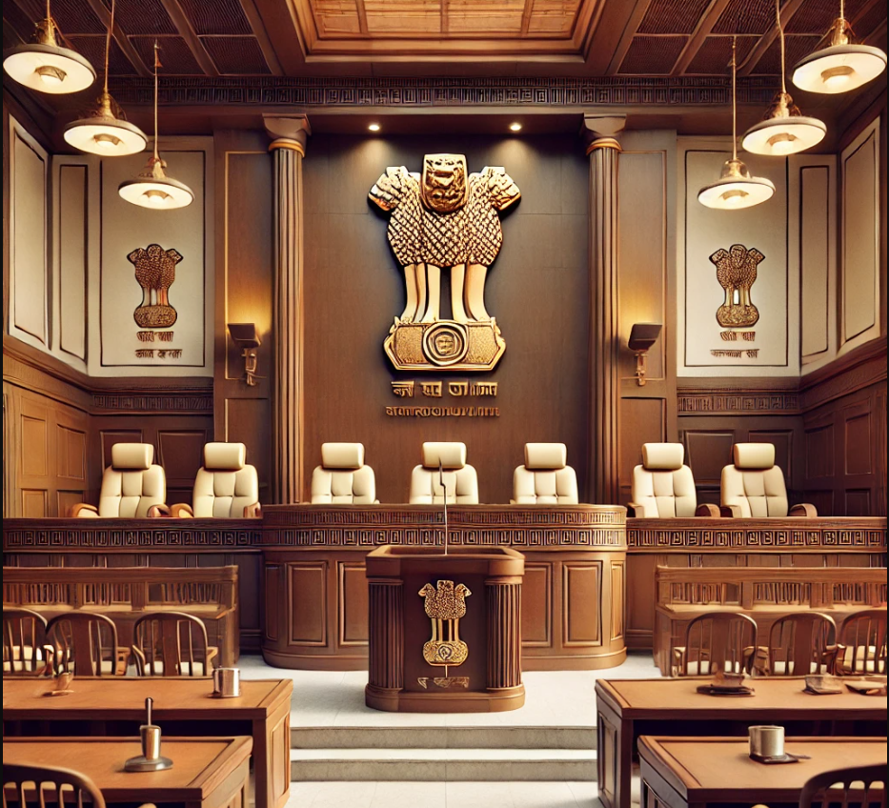
HENCE
THE ELEVATED PLATFORM
&
THE ORIGIN
OF WORD
“ TRIBUNAL ”

Slide 6

Key developments in Indian Tribunal System
Start of dispute
In the Year 1941 - The Income Tax Appellate Tribunal was established as the first Tribunal in India.
Referred to as 'Mother Tribunal' being the oldest Tribunal in the country.
BUT
India got Independence on 15th August 1947
&
The Constitution of India was adopted by the Constituent Assembly on November 26, 1949, and came into effect on January 26, 1950.

Slide 7
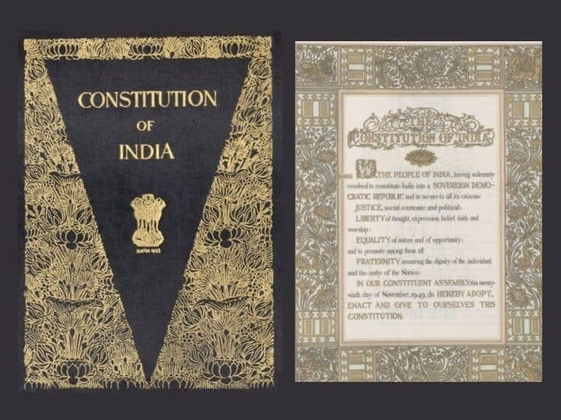
Original Framework of the Constitution
Start of dispute
The original text of the Indian Constitution (1950) did not contain any specific provisions that allowed for
or discussed
the creation of tribunals.

Slide 8
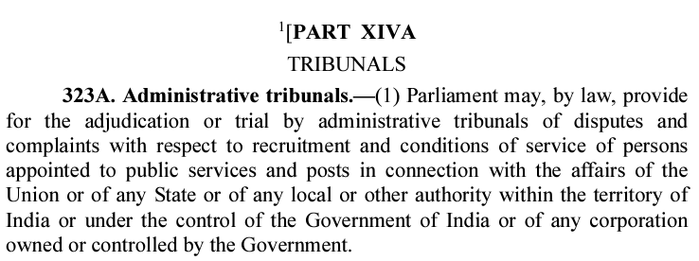

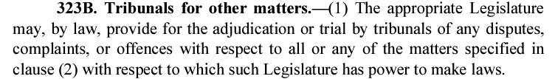
42nd Constitutional Amendment (1976)
Start of dispute
The concept of Tribunals formally entered the constitutional framework with the 42nd Amendment Act, 1976
This amendment introduced Articles 323A and 323B, which authorized the creation of tribunals.

Slide 9
Decision of Apex Court - L. Chandra Kumar
Start of dispute
JUDICIAL REVIEW IS A BASIC FEATURE:
The Court ruled that the power of Judicial Review vested in the High Courts under Article 226 and Article 227, and the Supreme Court under Article 32, is a basic feature of the Constitution that cannot be taken away by any law or amendment.
The Court held that tribunals may function as specialized bodies, but they cannot replace the High Courts or the Supreme Court in exercising judicial review. The decisions of tribunals would be subject to scrutiny by the High Courts, and Tribunals could not oust the jurisdiction of constitutional courts.

Slide 10
Flow of Litigation Proceedings in GST
Start of dispute
1
Show Cause Notice with Summary in DRC-01
Reply in Form GST DRC-06
2
Order (DRC-07) : Order-in-Original
Appeal in Form GST APL-01
3
Order (APL-04) : Order-in-Appeal
Appeal to Tribunal in Form GST APL-05
4
Order of GST Tribunal
Appeal to High Court or Supreme Court
5
High Court
Appeal to Supreme Court
6
Supreme Court
(Law of the Land)
Notes:
Inquiry – more in the nature of formal proceedings.
Q.1) Can Authorised person attend Summon ?
-- Yes, as per CBIC issued FAQ. No. 32, However Sec 70 exhibits presence of “concerned person”
Authorised Representative can also attend when only documents asked for (FSM Education)
Case Laws Ratio of Judgement say to attend in person, however assistance can be taken.

Slide 11

Circular No. 224/18/2024
Stay of Recovery in absence of GSTAT
ROI
Cases Pending before GSTAT – CBIC Clarification
Stay on Recovery in Absence of Tribunal - Taxpayer pays the required pre-deposit amount,
Taxpayers must pay via: Dashboard > Services > Ledgers > Payment towards demand to correctly credit the payment against the demand in the Electronic Liability Register (ELL) Part-II,
Taxpayer must submit a declaration to the jurisdictional officer committing to file an appeal before the Tribunal within the prescribed timeline,
11

Slide 12
Circular No. 224/18/2024
Stay of Recovery in absence of GSTAT
ROI
If pre-deposit not done/ undertaking not given, Recovery proceedings may begin.
Once the functionality is made available on the common portal, Adjustment of Payments made via DRC-03, if they file an application via new FORM GST DRC-03A (inserted via Notification No. 12/2024),
DRC-03A cannot be used if proceedings were already concluded via FORM DRC-05.
12

Slide 13
Section 112
Appeals to the Appellate Tribunal
ROI
Any person aggrieved by an order passed against him under section 107 or section 108 of this Act or the State Goods and Services Tax Act or the Union Territory Goods and Services Tax Act may appeal to the Appellate Tribunal against such order within three months from the date on which the order sought to be appealed against is communicated to the person preferring the appeal or the date, as may be notified by the Government, on the recommendations of the Council, for filing appeal before the Appellate Tribunal under this Act, whichever is later.
[Guidelines for recovery of outstanding dues, in cases wherein first appeal has been disposed of, till Appellate Tribunal comes into operation. - Circular No. 224/18/2024 GST 11th July, 2024]
13

Slide 14
Section 112
Appeals to the Appellate Tribunal
ROI
(2) The Appellate Tribunal may, in its discretion, refuse to admit any such appeal where the tax or input tax credit involved or the difference in tax or input tax credit involved or the amount of fine, fee or penalty determined by such order, does not exceed fifty thousand rupees.
14

Slide 15
Section 112
Appeals to the Appellate Tribunal
(3) The Commissioner may, on his own motion, or upon request from the Commissioner of State tax or Commissioner of Union territory tax, call for and examine the record of any order passed by the Appellate Authority or the Revisional Authority under this Act or the State Goods and Services Tax Act or the Union Territory Goods and Services Tax Act for the purpose of satisfying himself as to the legality or propriety of the said order and may, by order, direct any officer subordinate to him to apply to the Appellate Tribunal within six months from the date on which the said order has been passed or the date, as may be notified by the Government, on the recommendations of the Council, for the purpose of filing application before the Appellate Tribunal under this Act, whichever is later, for determination of such points arising out of the said order as may be specified by the Commissioner in his order.
ROI
15

Slide 16
Section 112
Appeals to the Appellate Tribunal
Filing of Appeal
(5) On receipt of notice that an appeal has been preferred under this section, the party against whom the appeal has been preferred may, notwithstanding that he may not have appealed against such order or any part thereof, file, within forty-five days of the receipt of notice, a memorandum of cross-objections, verified in the prescribed manner, against any part of the order appealed against and such memorandum shall be disposed of by the Appellate Tribunal, as if it were an appeal presented within the time specified in sub-section (1).
16

Slide 17
Section 112
Appeals to the Appellate Tribunal
Filing Memorandum of Cross Objections:
(6) The Appellate Tribunal may admit an appeal within three months after the expiry of the period referred to in sub-section (1) or permit the filing of an application within three months after the expiry of the period referred to in sub-section (3), or permit the filing of a memorandum of cross-objections within forty-five days after the expiry of the period referred to in sub-section (5) if it is satisfied that there was sufficient cause for not presenting it within that period.
17

Slide 18

Section 112
Appeals to the Appellate Tribunal
Payment of Pre-Deposit:
(8) No appeal shall be filed under sub-section (1), unless the appellant has paid––
(a) in full, such part of the amount of tax, interest, fine, fee and penalty arising from the impugned order, as is admitted by him, and
(b) a sum equal to ten per cent. of the remaining amount of tax in dispute, in addition to the amount paid under sub-section (6) of section 107, arising from the said order subject to a maximum of twenty crore rupees, in relation to which the appeal has been filed.
*Reduction from 20% to 10% and Reduction in maximum amount of pre-deposit from Rs. 50 crore to Rs. 40 crore.
18

Slide 19
Section 112
Appeals to the Appellate Tribunal
Pre-Deposit in case of only Penalty:
Provided that in case of any order demanding penalty without involving demand of any tax, no appeal shall be filed against such order unless a sum equal to ten per cent. of the said penalty, in addition to the amount payable under the proviso to sub-section (6) of section 107 has been paid by the appellant.
Stay of Recovery:
(9) Where the appellant has paid the amount as per sub-section (8), the recovery proceedings for the balance amount shall be deemed to be stayed till the disposal of the appeal.
19

Slide 20
Rule 110
Appeal to the Appellate Tribunal
ROI
Form and Manner of Appeal:
The Appeal to the Appellate Tribunal under sub-section (1) of Section 112 shall be filed in Form GST APL-05 electronically.
Manual filing allowed only on a special or general order to that effect is issued by the Registrar.
The appeal shall be treated as filed only when the final acknowledgement indicating the appeal number is issued.
Filing Fees:
Rs. 2,000/- for every Rs. 1,00,000/- of Tax or ITC involved or difference in Tax or ITC involved or the amount of fine, fee or penalty, subject to a max of Rs. 50,000/- and a min of Rs. 5,000/-.
In case no tax, interest, penalty, fine - Fee shall be Rs. 5,000/-.
20

Slide 21
Appeal to the Appellate Tribunal
Start of dispute
Section 112 (1)
3 Months
Section 112(6)
+ 3 Months
20 Sep
Pre-Deposit
Filing Fees
19 Dec
20 March
Unfavourable Order (APL-04)
passed
against Appeal
filed to
DRC-07 Order
Due date file Appeal
[APL-05]
Last Date with COD
Order of GSTAT
Additional 10% of the disputed tax amount
100% of the admitted amount (tax, interest, penalty)
Can be deposited
via Cash Ledger or Credit Ledger or
a mix of both
Max of ₹40 Cr
₹2,000
per
₹1 lakh
of tax/ITC involved,
with a minimum of ₹10,000 and a maximum of ₹50,000.
Normal time limit to file an Appeal
Appeal to be filed with Condonation of Delay (COD)
Passed by Appellate Authority
May or may not be accepted

Slide 22
Section 113
Orders of the Appellate Tribunal
ROI
Powers of the Tribunal:
The Appellate Tribunal can take any of the following actions after considering an appeal:
  Confirm: If the Tribunal finds the order passed by the Appellate Authority to be just and proper, it can confirm the decision.
  Modify: The Tribunal may modify the order of the Appellate Authority if it finds that adjustments or corrections are necessary.
  Annul: If the Tribunal determines that the order was wrong, it can annul or cancel the order in full.
  Refer back the case: In some cases, the Tribunal may decide to refer the case back to the Appellate Authority or the original adjudicating authority with such directions as it may think fit, for a fresh adjudication or decision after taking additional evidence, if necessary.
22

Slide 23
Section 113
Orders of the Appellate Tribunal
Adjournment of Hearings:
The Appellate Tribunal may, grant time to the parties and adjourn the hearing of the appeals, if sufficient cause is shown.
No adjournment to be granted more than 3 times to a party during hearing of the appeal.
Rectification of Errors:
If the Tribunal finds any mistake apparent on the face of the record, it can rectify such errors on its own or upon application by either party within three months from the date of the order.
Timeline for Orders:
The tribunal shall as far as possible, hear and decide every appeal within a period of one year from the date on which it is filed.
ROI
23

Slide 24
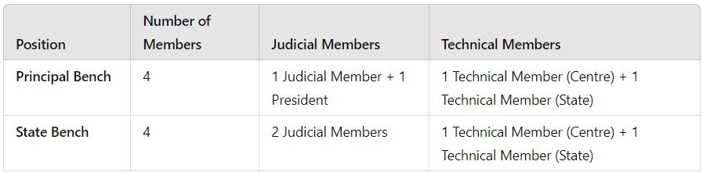
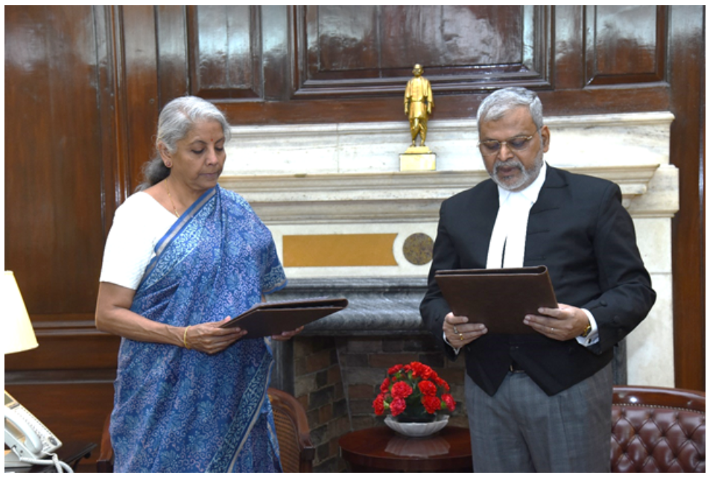
Composition of the Tribunal Benches
Start of dispute
Section 109(3)
Section 109(4)
Union Finance Minister Nirmala Sitharaman administers oath of integrity and sincerity to the GST Tribunal President - Justice (Retd) Sanjaya Kumar Mishra.
06 May 2024

Slide 25

Scope of Tribunal Benches
Start of dispute
GSTAT
Principal Bench
[New Delhi]
State Benches
Dispute : Place of Supply/ Anti-Profiteering & Any other aspect
Dispute : Any other aspect
Supreme Court
High Court
Substantial
question
of law

Slide 26
Section 109
Constitution of the Appellate Tribunal
ROI
Distribution of work:
The President shall distribute the business of the Appellate Tribunal among the Benches and may transfer cases from one Bench to another, by a general or special order.
Vice-President:
The senior-most Judicial Member within the State Benches, shall act as the Vice-President for State Bench and shall exercise the powers of the President as may be prescribed.

Slide 27
Section 109
Constitution of the Appellate Tribunal
ROI
Decision-making process:
Appeals, where the tax or input tax credit involved or the amount of fine, fee or penalty determined in any order appealed against does not exceed Rs. 50 lakh, and where no question of law is involved, the appeal may be heard by a Single Member, with the approval of the President.
In all other cases, the appeals shall be heard together by a Judicial Member and a Technical Member.
Note: The limit of Rs. 50 lakhs, when read together for both CGST Act and SGST Act, is to be read as Rs. 1 Crore.

Slide 28
Section 109
Constitution of the Appellate Tribunal
ROI
Decision-making process:
In case there is any difference of opinion among the members, the President shall refer the case to-
State Bench matter: Another member of a State Bench, or where no other State Bench is available, to a Member of a State Bench in another State,
Principal Bench matter: Another member of the Principal Bench, or where no such Member is available, a Member of any State Bench.
Validity of Proceedings notwithstanding defect:
No act or proceedings of the Tribunal shall be questioned or shall be invalid merely on the ground of existence of any vacancy or defect in the Constitution of the Appellate Tribunal.

Slide 29
Appointment of the Members (Section 110)
Start of dispute
President
Judicial Member
Technical Member (Central)
Technical Member (State)
Judge of the Supreme Court
Chief Justice of a High Court.
Judge of a High Court
10 years of combined experience as a District/Additional District Judge
An Advocate with substantial experience in indirect tax litigation for 10 years.
Member of Indian Revenue Service (Customs & Indirect Taxes)
All India Service, with 25 years of service in Group A, and 3 years of experience in existing law or GST administration.
Must be or have been an Officer of State Government or All India Service, with 25 years of service in Group A, and 3 years of experience in existing law or GST administration or finance/taxation in State Department.
Term: 4 + 2 Yrs
Age: Min 50 Yrs
Max 70 Yrs
Term: 4 + 2 Yrs
Age: Min 50 Yrs
Max 67 Yrs
Term: 4 + 2 Yrs
Age: Max 67 Yrs
Term: 4 + 2 Yrs
Age: Max 67 Yrs

Slide 30
Section 111
Procedure before Appellate Tribunal
ROI
Power to regulate procedure:
The Appellate Tribunal is not bound by the procedure laid down in the Code of Civil Procedures, 1908. It shall be guided by the Principles of Natural Justice.
The Appellate Tribunal shall have the power to regulate its own procedure, subject to other provisions and rules.
Powers of a Civil Court:
The Appellate Tribunal shall have the same powers as are vested in a civil court under the Code of Civil Procedure, 1908, while trying a suit, in respect of the following matters-
  (a) summoning and enforcing the attendance of any person and examining him on oath;
  (b) requiring the discovery and production of documents;

Slide 31
Section 111
Procedure before Appellate Tribunal
ROI
(c) receiving evidence on affidavits;
(d) requisitioning any public record or document or a copy of such record or document from any office;
(e) issuing commissions for the examination of witnesses or documents;
(f) dismissing a representation for default or deciding it ex parte;
(g) setting aside any order of dismissal of any representation for default or any order passed by it ex parte; and
(h) any other matter which may be prescribed.

Slide 32
Section 111
Procedure before Appellate Tribunal
Enforcement of the Orders:
The order passed by an Appellate Tribunal may be enforced by it as if it were a decree made by a court in a suit proceeding.
It shall be lawful for the Appellate Tribunal to send for execution of its orders to the court within the local limits having jurisdiction.
  In case of a company – the registered office of the company,
  In case of any other person – the place where the person voluntarily resides or carries on business or personally works for gain.
ROI

Slide 33
Section 111
Procedure before Appellate Tribunal
Deemed Judicial Proceedings:
The proceedings before the Appellate Tribunal shall be deemed to be judicial proceedings within the meaning of sections 193 and 228, and for the purposes of section 196 of the Indian Penal Code.
The Tribunal shall be deemed to be a Civil Court for the purpose of Section 195 of the Code of Criminal Procedure, 1973.
ROI

Slide 34
GST Appellate Tribunal (Procedure) Rules, 2025
Procedure before Appellate Tribunal
ROI
Computation of Time Period (Rule 3) | The day from which the said period is to be reckoned shall be excluded, If the last day expires on a day when the office of the Appellate Tribunal is closed, that day and any succeeding day or days on which the Appellate Tribunal remains closed shall also be excluded
Sitting/ Working hours (Rule 8 & 9) | Sitting hours: 10.30 a.m. to 01.30 p.m. & 2.30 p.m. to 4.30 p.m. Working hours: 9.30 am to 6.00 pm
Inherent Powers (Rule 10) | Appellate Tribunal has inherent powers to make such orders or give such directions as may be necessary for meeting the ends of justice or to prevent abuse of the process of the Appellate Tribunal.

Slide 35
GST Appellate Tribunal (Procedure) Rules, 2025
Procedure before Appellate Tribunal
ROI
Listing of Cases (Rule 12) | Any urgent matter filed before 12:00 noon shall be listed before the Appellate Tribunal on the following working day. It may be received after 12:00 noon but before 3:00 p.m. for listing on the following day, with the specific permission of the Appellate Tribunal or President.
Power to Exempt (Rule 13) | Power to exempt parties from compliance with any requirement of these rules and may give such directions in matters of practice and procedure, as it may consider just and expedient to render substantial justice.
Power to extend time (Rule 14) | Extend the time appointed by these rules or fixed by any order, for doing any act or taking any proceeding, upon such terms, if any, as the justice of the case may require, and any extension may be ordered, although the application for the same is not made until the expiration of the time appointed or allowed.

Slide 36
GST Appellate Tribunal (Procedure) Rules, 2025
Procedure before Appellate Tribunal
Power of Adjournment (Rule 16) | All adjournments shall normally be sought before the concerned Bench In extraordinary circumstances, the Registrar may, if so directed by the Appellate Tribunal in chambers, at any time adjourn any matter.
Filing of Appeals (Rule 18) | An appeal to the Appellate Tribunal shall be filed online on GSTAT Portal in Form prescribed under the Rules. Single Appeal for each OIA even if there were multiple show cause notices, refund claims or demands, letters or declarations etc. Single Appeal for each OIO, if multiple OIO culminates in a single OIA. – DGGI, EWB, Multiple POB, URD Person Multiple OIA issued to multiple persons, each person aggrieved to file separate Appeal - Single/ Multiple OIO’s.
ROI

Slide 37
GST Appellate Tribunal (Procedure) Rules, 2025
Procedure before Appellate Tribunal
Date of Presentation of Appeals (Rule 19) | If the Appeal is filed manually, then the date on which the appeal is presented or deemed to have been presented as endorsed by the registrar.
Contents of Appeal Form (Rule 20) | Grounds of Appeal shall be set-forth concisely under distinct heads, Typed neatly in double spacing A4 size paper duly paged, indexed and tagged firmly, Form of appeal shall be signed and verified by the appellant or respondent or Authorised representative, Documents produced before the GSTAT to be certified as True Copy
ROI

Slide 38
GST Appellate Tribunal (Procedure) Rules, 2025
Procedure before Appellate Tribunal
ROI
Documents along with the Appeal (Rule 21) | A certified copy of the order appealed against, All the relevant documents including relied upon documents. Challan of Fees as specified under rule 110 (5)
Endorsement and verification (Rule 22) | Every appeal or pleadings shall be signed and verified by the party concerned. At the foot of every appeal or pleading along with all the relevant documents including relied upon documents, there shall appear the name and signature of the authorised representative.
Translation of Documents (Rule 23) | A document other than English language intended to be used shall be accompanied by a translated copy in English, which is agreed to by both the parties or certified to be a true translated copy by the authorised representative engaged on behalf of parties in the case.

Slide 39
GST Appellate Tribunal (Procedure) Rules, 2025
Procedure before Appellate Tribunal
ROI
Scrutiny of the Appeal/ Documents (Rule 24) | If appeal, application of document is found to be defective upon scrutiny, then such document be returned for compliance within 7 days extendable to 30 days. If not satisfied, the matters be listed with defects for hearing before the bench and the bench may accept or reject the same.
Interlocutory Applications (Rule 29) | It is an application in any appeal or proceeding already instituted in such Appellate Tribunal, other than a proceeding for execution of an order. It can be filed for matters such as stay, direction, rectification in order, condonation of delay, early hearing, extension of time prayed for or exemption from production of copy of order appealed against. It is over and above any affidavit filed, supporting the application.

Slide 40
GST Appellate Tribunal (Procedure) Rules, 2025
Procedure before Appellate Tribunal
ROI
Procedure on production of defaced, torn documents (Rule 30) | A mention regarding the condition and appearance shall be made by the party producing the same in the Index of such pleading and same shall be verified and initialed by the officer authorized to receive the same.
Additional Grounds in Appeal (Rule 31) | Grounds not set forth in the form of Appeal can be heard upon grant of leave by the bench, Bench need not restrict its decision on only the grounds taken.
Who may Joined as Respondents (Rule 33) | Appeal by Other Party – Commissioner to be the respondent Appeal by Commissioner – Other Party
Filing of Rejoinder (Rule 37) | Bench can allow filing of rejoinder with an advance copy to be served upon the respondent within one month or such time as may be specified or extended by Bench.

Slide 41
GST Appellate Tribunal (Procedure) Rules, 2025
Procedure before Appellate Tribunal
ROI
Service of Notice and Communications (Rule 40) | Any notice or communication to be issued by the Appellate Tribunal may be served by any of the method specified in section 169 of the Act. For the purpose of this rule, the common Portal referred in the said section shall mean the GSTAT Portal.
Default in hearing of Appeal (Rule 42) | If appellant does not appear, the Appellate Tribunal may, in its discretion, either dismiss the appeal for default or hear and decide it on merits. Appellate Tribunal may set aside the dismissal order and restore the appeal, if later the appellant appears and satisfies the appellate tribunal with sufficient cause. What if appeal is decided on merits??

Slide 42
GST Appellate Tribunal (Procedure) Rules, 2025
Procedure before Appellate Tribunal
ROI
Hearing of Appeals Ex-parte (Rule 43) | On the day fixed for the hearing, the appellant appears and the respondent does not appear, the Appellate Tribunal may hear and decide the appeal ex parte.
Continuance of proceedings after death/ Insolvency (Rule 44) | In the case of death, insolvency etc., the appeal or application shall abate, unless an application is made for continuance of such proceedings by or against the successor-in-interest, the executor, receiver, liquidator etc.

Slide 43
GST Appellate Tribunal (Procedure) Rules, 2025
Procedure before Appellate Tribunal
ROI
Appeal referred to larger bench (Rule 50) | In case of different opinion of Members of Bench while hearing an appeal, the appeal shall be referred to larger Bench by the President, as it deems fit, for disposal of the appeal.
Production of Additional Evidence before Tribunal (Rule 45) | The parties to the appeal shall not be entitled to produce any additional evidence, either oral or documentary, before the Appellate Tribunal. If the Appellate Tribunal is of opinion that any documents shall be produced or any witness shall be examined or any affidavit shall be filed to enable it to pass orders or for any sufficient cause, or if case is decided without giving sufficient opportunity to any party to adduce evidence on the points specified by them or not specified by them, the Appellate Tribunal may, for reasons to be recorded, allow such documents to be produced or witnesses to be examined or affidavits to be filed or such evidence to be adduced.

Slide 44
Production of Additional Evidence
ROI
No additional evidence can be produced before the GSTAT, which hitherto were not produced in the course of proceedings before the adjudicating authority.
Additional evidences are permissible in following cases:
  Earlier authority refused to admit any evidence,
  Appellant was prevented by sufficient cause,
  Order passed without giving sufficient opportunity to adduce evidence relevant to any ground of appeal.
Adjudicating authority or any officer shall be allowed to examine or cross-examine any evidence or document or to produce any evidence or a witness to rebuttal the evidence produced.
GSTAT has powers to direct the production of any evidence to enable it to dispose of the appeal.
44

Slide 45
GST Appellate Tribunal (Procedure) Rules, 2025
Procedure before Appellate Tribunal
ROI
Authorised Representative (Rule 72) | Authorised representative shall be entitled to appear only if he files a vakalatnama or Memorandum of Appearance or letter of authorisation It shall include all the information as specified in GSTAT FORM-04.
To appear personally for examination on oath or affirmation,
Authorized representative shall be a person authorized to appear on his behalf, being:
  His relative or regular employee,
  An advocate entitled to practice in India in any court,
  CA/ CMA/ CS holding a certificate of practice,
  Retired officer of Commercial Tax Department,
  Authorized GST Tax Practitioner.

Slide 46
GST Appellate Tribunal (Procedure) Rules, 2025
Procedure before Appellate Tribunal
ROI
Consent for change of Authorised Representative (Rule 73) | With the written consent of the legal practitioner or the authorised representative on record or when such consent is refused, with the permission of the Appellate Tribunal.
Disposal of cases (Rule 99) | Appellate tribunal can pass such orders as it deems fit. Provided that the Appellate Tribunal, after considering an appeal, may summarily dismiss the same, for reasons to be recorded, if the Appellate Tribunal is of opinion that there are no sufficient grounds for proceedings therewith.

Slide 47
GST Appellate Tribunal (Procedure) Rules, 2025
Procedure before Appellate Tribunal
ROI
Operative Portion of the Order (Rule 100) | All orders or directions of the Bench shall be stated in clear and precise terms in the last paragraph of the order.
Pronouncement of Order (Rule 103) | The Appellate Tribunal, shall pronounce an order not later than thirty days from the final hearing excluding vacations or holidays.
Enlargement of Time (Rule 107) | Where any period is fixed by or under these rules, or granted by Appellate Tribunal for the doing of any act, or filing of any document or representation, the Appellate Tribunal may, in its discretion from time to time in the interest of justice and for reasons to be recorded, enlarge such period, even though the period fixed by or under these rules or granted by the Appellate Tribunal may have expired.

Slide 48
GST Appellate Tribunal (Procedure) Rules, 2025
Procedure before Appellate Tribunal
ROI
Electronic filing of Appeals/ Applications (Rule 115) | Every appeal or application to be filed before the Appellate Tribunal shall be uploaded electronically on the GSTAT portal. All replies filed and documents shall be signed, verified and uploaded electronically on the GSTAT portal. All proceedings before the Appellate Tribunal shall be conducted through the GSTAT portal and all such proceedings shall be recorded on the said portal. A summary of the final order passed by the Appellate Tribunal, shall be uploaded. All hearings before the Appellate Tribunal may be conducted, either in the physical mode or upon the permission of the President, in the electronic mode.

Slide 49
GST Appellate Tribunal (Procedure) Rules, 2025
Procedure before Appellate Tribunal
ROI
Award of costs in the proceedings (Rule 120) | Whenever the Appellate Tribunal deems fit, it may award cost for meeting the legal expenses of the respondent of defaulting party. The Appellate Tribunal may in suitable cases direct appellant or respondent to bear the cost of litigation of the other side, and in case of abuse of process of court, impose exemplary costs on defaulting party.
Dress for the parties (Rule 122) | Authorised representative shall appear in his professional dress, if any, and, if there is no such dress — (a) Male: In a close-collared black coat, or in an open-collared black coat, with white shirt and black tie; or (b) Female: In a black coat over a white sari or any other white dress: Summer season: From 15th April to 31st August, the authorised representatives may, when appearing before a Bench of the Appellate Tribunal, dispense with the wearing of a black coat.

Slide 50
Rule 113A
Withdrawal of Appeal/ Application filed
ROI
Withdrawal of Appeal/ Application filed:
This Rule deals with the withdrawal of appeal or application filed before the GST Appellate Tribunal.
The Appellant may withdraw the Appeal or Application, at any time before the issuance of the order by the GST Appellate Tribunal.
In case where the final acknowledgement has been issued for the appeal, the withdrawal of the Appeal is required to be approved by the GST Appellate Tribunal.
50

Slide 51
Code of Conduct before the bench
Start of dispute
One Pager Synopsis followed with detailed synopsis
Synopsis must be crisp – Para no. referencing
Case laws – relevant to the issue in hand
Prepare 5 set of synopsis and separate case law compilation
File must be on the finger tips
Proper Page numbering and indexing
Mark the relevant portion of the case law/ agreements
Anticipate the case laws dept could rely upon and be prepared for the same.
Always think from the dept officers perspective while preparing for the case
Carry file/ Digital File - IPAD
Should be present in the tribunal before the commencement
Carry the cause list
You are an officer of the court to assist the court
Take your first best point first – Structure your arguments
Face value matters
Answer the Questions neutrally and to the point

Slide 52
Code of Conduct before the bench
Start of dispute
Don’t harp on technical issues in the first instance
Limitation can be pressed for provided supported with merits
Keep your ears open and mouth shut
Be humble and respectful yet firm
Respect the DR while arguing the case – Refer as a friend
In case the DR disrespect you – raise the issue before the bench
Don’t interrupt the judge while he speaking
Make note to rebut each of DR’s points in note pad
If needed, seek adjournments with valid reasons
Never Lie nor breach the judges trust
Know your judges
Know the departmental AR
Dress Code – Black Coat with Bow/ Tie
Use simple persuasive language
Rebut opposing counsels arguments without being defensive
Know when to stop

Slide 53
Practice for Hearing
Start of dispute
Study the entire file
See the hearing intimation
Confirm the correct file
Check the authorization letter
Check one day before the availability officer for a hearing
Study the file
Prepare synopsis – Don’t print what is there in the file.
Understand the grounds taken
See the documentary evidence available in file
If you come across an alternative point which is missing in the file - can be added
Ensure the synopsis is prepared and finalized by your partner
Ensure 2 set of print out for of case laws and synopsis is taken

Slide 54
Start of dispute
“A good case can be lost by
bad preparation and
a bad case be won by
good preparation."
- Lord Denning

Slide 55


For any queries, contact us at:
sudhir@hnaindia.com
THANK YOU
(for your valuable time and kind attention)

