Slide 1

Balance Sheets to Board Rooms- CA's in M & A
Presentation By-
CA Mithanshu Sarda

Slide 2




INTRODUCTION-FINANCE
(MONEY MANAGEMENT)
PERSONAL FINANCE
CORPORATE FINANCE
PUBLIC FINANCE
Individual/household
Subjective Financial Strategy
Long/Short Term Focused
Financial activities of Businesses
Stability, profitability & Sustainability
Investment, Financing & WCM
Government Finance
Resource allocation & Economic Stability
Financial Strategy focused-Public at large

Slide 3
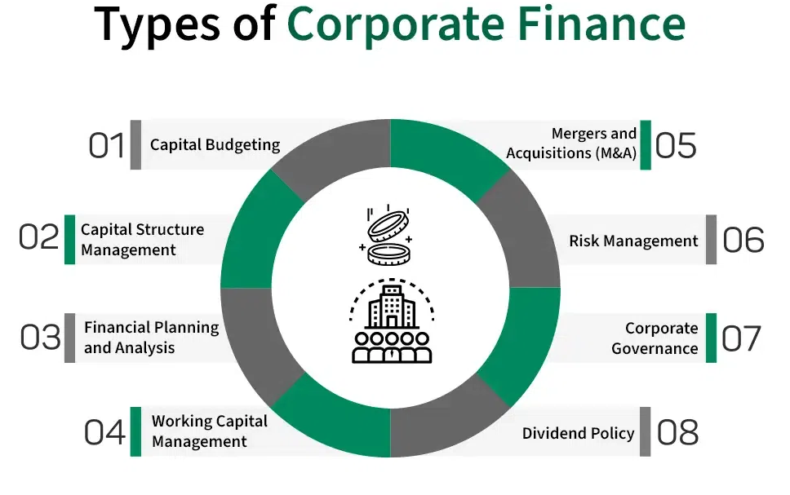
CORPORATE FINANCE

Slide 4



FINANCE & SOURCES
Growth
Expansion
Business
Expanded Business
Financial Resources

Slide 5






























FINANCE & SOURCES
DEBT/ LOANs
EQUITY
Short Term- Working Capital or Bridge Finance
Initial- Angel, Seed, Incubation funding
Long Term- Term Loans (Business, Machinery)
Medium/Long Term- Series A, B, C*
Ultra Long Term- Project Finance
Ultra Long Term- Series D/E, IPO, M & A
Leveraged Finance- Acquisitions
Investors- HNIs, VCs, PE, Family Office, etc.
*Series A, B, C- $1Mn to $100Mn

Slide 6
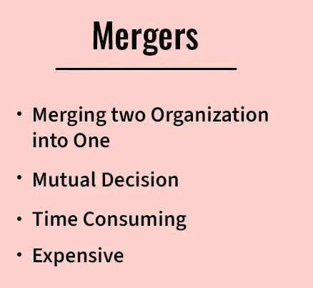
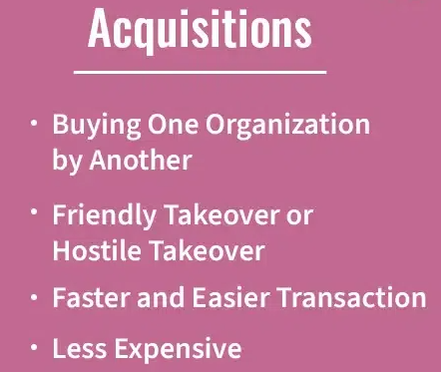


DEEP DIVE-M & A
Notes:
Merger/De-merger- Amalgamation (Consolidation through court scheme) & DeMerger (Business Acquisition by court scheme).
Acquisition- Business Transfer (Slump Sale/Itemized Sale) & Share transfer (Primary/Secondary)

Slide 7



















DEEP DIVE-M & A
USD 8.5 Bn-INR 72K Cr
USD 8.0 Mn-INR 62 Cr
USD 26.2 Bn-INR 2.3L Cr
USD 142 Mn-INR 870 Cr
USD 0.6 Bn-INR 4.4K Cr
USD 34 Mn-INR 280 Cr
EUR 68 Mn-INR 620 Cr
USD 4.2 Bn-INR 32K Cr
USD 1.0 Bn-INR 8.7K Cr

Slide 8
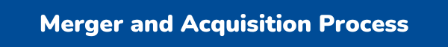
DEEP DIVE-M & A-STEPS
Pre M & A-
PLANNING & STRATEGY
VALUATION & NEGOTIATION
DUE DILIGENCE
STRUCTURING
REGULATORY COMPLIANCE
POST M&A INTEGRATION

Slide 9



DEEP DIVE-M & A- STEPS
Role of Chartered Accountants in Mergers & Acquisitions (M&A) - SELL SIDE
Explaining the client about available opportunities
Sharing Pros & Cons of M&A Transactions
Giving them perspective of value creations
Preparing Client
Understanding the Client Business
Collecting Information from the Client
Preparing the Information Memorandum
Information Memorandum
Valuation exercise for the Client to give indicative valuation
Setting the right expectation
Valuation

Slide 10
DEEP DIVE-M & A- STEPS
Role of Chartered Accountants in Mergers & Acquisitions (M&A) - SELL SIDE
Review of corporate records
Determining the suitable adjustments to Financial Statements
Conducting legal and commercial due diligence
Vendor Due Diligence
Preparation of documents for potential buyer due diligence
Guiding the Client to ensure proper compliance to minimize issues during the transaction
Data Room
Potential buyers/ Investor Search
Using network to locate potential buyers
Reaching out through multiple channels of communication
Using Social Networks

Slide 11
DEEP DIVE-M & A- STEPS
Role of Chartered Accountants in Mergers & Acquisitions (M&A) - SELL SIDE
Initial discussion with potential buyers/investors/their advisors
Setting valuation expectation
Assisting on various negotiations
Negotiation
Documents (Term Sheet/SPA/SHA) Discussion
Communicating the implications of each clause in the agreement
Documentation
Areas of legal compliance which needs to be professionally managed
Restrictions on merger control in any applicable law
Regulatory Compliance

Slide 12
DEEP DIVE-M & A- STEPS
Role of Chartered Accountants in Mergers & Acquisitions (M&A) - BUY SIDE
Explaining the client about available opportunities
Identification of Strategy for growth
Preparing Client
Using network to locate potential buyers
Reaching out through multiple channels of communication
Using Social Networks
Potential target search
Initial discussion with potential target/their advisors
Client buy-in to evaluate the opportunity
Valuation expectation
Evaluation

Slide 13
DEEP DIVE-M & A- STEPS
Role of Chartered Accountants in Mergers & Acquisitions (M&A) - BUY SIDE
Assisting on key terms of transaction
Arriving at consensus valuation
Issuing term sheet/LOI
Negotiations
Financial Due Diligence
Tax & Legal Due Diligence
ESG Due Diligence (if applicable)
Due Diligence
Documents (Term Sheet/SPA/SHA) Discussion
Communicating the implications of each clause in the agreement
Negotiation with seller & finalization of documentation
Documentation

Slide 14
DEEP DIVE-M & A- STEPS
Role of Chartered Accountants in Mergers & Acquisitions (M&A) - BUY SIDE
Areas of legal compliance which needs to be professionally managed
Restrictions on merger control in any applicable law
Regulatory Compliance
Financial statements preparation & audit support
Risk Advisory Services
Business transformation services (Automation)
Post Merger Integration

Slide 15
DEEP DIVE-M & A- STEPS
Other Roles of Chartered Accountants in Mergers & Acquisitions (M&A)
Financial Advisory- Assess the capital structure & funding sources (Debt/Equity)
Transaction Structuring- Financial, legal & operational framework, ensures compliances
Cross Border Advisory- RBI & FEMA Compliance
Drafting – Document drafting SPA, SHA, Mergers Scheme, etc.
Financial Reporting Services– Accounting integration post merger, audit support, IND-AS
Risk Advisory Services– Process Mapping & Implementation

Slide 16


Slide 17






CASE STUDIES-M & A
~USD 350 Mn-INR 3.0K Cr
R Multiple- 8.45x v/s 7x
~USD 280 Mn-INR 2520 Cr (90%) Revenue Multiple 4.5x
~USD 4 Bn-INR 35K Cr
EV/EBITDA Multiple- 1.6x v/s 8x
~USD 2.1 Bn-INR 18K Cr
EV/Revenue Multiple- 0.9x

Slide 18


















CASE STUDIES-M & A
~USD 240 Mn-INR 1.8K Cr , R Multiple- 1.2x v/s 2x
~USD 3.5 Bn-INR 315k Cr, R Multiple- 1.5x
USD 8.5 Bn-INR 72K Cr R Multiple- 11.3x v/s 10x
USD 8 Bn-INR 70K Cr Global Acquisition
~USD 5.5 Mn-INR 48 Cr, R Multiple- 1.4x v/s 2x
~USD 1 Mn-INR 9-10 Cr, R Multiple- 1.5-2x
Deal Value- Undisclosed , Market Multiple-1x-3x of revenue
USD 70.7 Mn-INR 1272 Cr E Multiple- 1 – 1.5x
~INR 820 Cr for 53% stake R Multiple- 0.85x (!NR 1547Cr)
USD 51 Mn-INR 450 Cr R Multiple – 4 - 6x

Slide 19





CASE STUDIES-M & A
~USD 476 Mn-INR 3.9K Cr
~INR 602 Cr
~USD 43 Bn, INR 3.27L Cr

Slide 20



LEARNINGS-SUMMARY

Slide 21

Q-A

Slide 22





Thank You
+91 9595985944
mithanshu.sarda@avallp.in
Pune | Bengaluru | Hyderabad | Delhi | Belagavi | Ahmedabad | Surat | Kolkata | Jaipur | Navi Mumbai

