Slide 1
Transforming MSMEs into Startup Growth Engines

Slide 2
Objectives
▶ India’s $5T ambition and MSME Contribution
▶ MSME Landscape in India and Startup Experience
▶ Professionals as catalysts for change

Slide 3
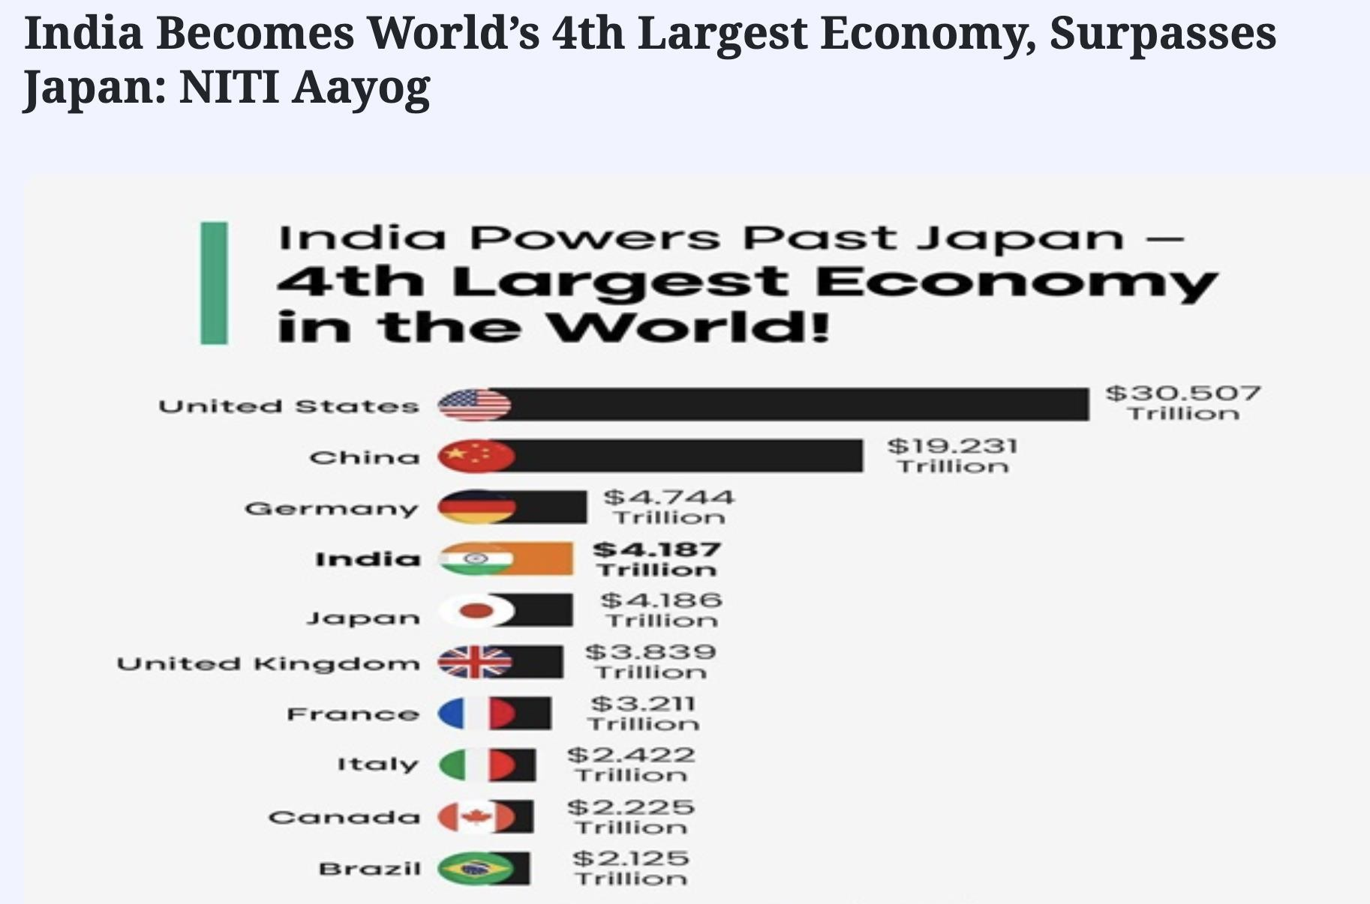

Slide 4
MSMEs: India’s Backbone
▶ 30% of GDP, 45% of exports, 6+ Cr MSMEs,11 Cr jobs
▶ Decentralised, community-rooted enterprises
▶ 30+ core sectors, covering both manufacturing and services
▶ 6,000+ products and service lines across urban and rural India
▶ Urban MSMEs (Tier I metros): ~40–45%
▶ Tier II & III cities, semi-urban, and rural areas: ~55–60%

Slide 5
MSMEs: India’s Backbone
City | Known For
Ludhiana | Hosiery, Bicycles, Auto parts
Tiruppur | Knitwear and Textiles
Moradabad | Brassware and Handicrafts
Surat | Diamond cutting, Textiles
Rajkot | Engineering goods
Kanpur | Leather products
Coimbatore | Pumps, Motors, Textiles
Hubli-Dharwad | Agri tools, Precision parts
Varanasi | Silk Sarees, Handlooms
Jaipur | Jewelry, Stone Crafts

Slide 6
What Holds MSMEs Back?
▶ Informality: Operate without formal registration or documentation.
▶ Limited Access to Credit: Depend on informal finance; underutilise government schemes.
▶ Digital Divide: Manual processes, low adoption of digital tools.
▶ Restricted Market Reach: Local sales only; limited branding or e-commerce exposure.
▶ Talent Challenges: Can’t attract skilled professionals; high attrition and mismatch.
▶ Resistance to Change: Legacy thinking; fear of formalization and external advice.
▶ Compliance Burden: Struggle with GST, labor, and legal filings without support.
▶ Low Innovation and IP Awareness: Minimal investment in R&D; unaware of IP protections.
▶ Poor Financial Literacy: Weak financial records, poor pricing and cash flow management.

Slide 7
Startups: India’s Growth Frontier
▶ India: 3rd largest startup ecosystem globally (after US & China)
▶ 100+ unicorns; 1.5+ lakh registered startups (DPIIT-recognised)
▶ Sectors: fintech, edtech, agritech, healthtech, spacetech, deeptech
▶ Fueling innovation, digital transformation, and job creation
▶ Focused on scalable, tech-driven, and investor-backed models
▶ Startups created over 12 lakh direct jobs (and many more indirectly)
▶ Supported by 500+ incubators/accelerators across India
▶ Tier II & III cities emerging as new startup hubs – Indore, Jaipur, Vizag, Warangal

Slide 8
 | MSMEs | vs Startups – Deta | iled
 | Compa | rison
 | Dimension | MSMEs | Startups
 | Core Objective | Income generation, livelihood, stability | Innovation, rapid growth, market disruption
 | Market Focus | Local or regional | National or global
 | Growth Pattern | Linear, steady | Exponential, aggressive
 | Risk Appetite | Low to moderate | High risk, high reward
 | Capital Source | Bank loans, government schemes (CGTMSE, Mudra) | Angel investors, VCs, convertible instruments
 | Innovation Level | Low to moderate | Core differentiator (product, tech, model, or IP)
 | Digital Maturity | Often manual, basic tech | Tech-enabled, digital-first
 | Scalability | Limited by physical, geographic constraints | Designed to scale rapidly with tech or network effects
 | Legal Structure | Often informal or partnerships | Registered Pvt Ltd or LLP with DPIIT recognition
 | Talent Capability | Limited managerial/professional skills | Attracts cross-functional skilled teams

Slide 9
 | MSMEs vs Startups – Detailed Comparison
 | Dimension | MSMEs | Startups
 | Financial Focus | Profitability, cost control | Growth, customer acquisition, market share
 | Exit Strategy | Generally none – generational/family-run | IPO, acquisition, or secondary sale
 | Metrics of Success | Revenue, profits, sustainability | CAC, LTV, Burn rate, TAM, Valuation, Traction
 | Time Horizon | Long-term, stable income | Short to medium term for growth and exit
 | Government Schemes | Udyam, PMEGP, CGTMSE, MSE-CDP | Startup India, Seed Fund, Fund of Funds, incubator grants
 | Regulatory Focus | Labor law, GST, pollution boards | DPIIT, MCA, SEBI, IP filings

Slide 10
Professional's Role
▶ From compliance to strategy
▶ Six Pillars of Transformation roadmap
▶ Collaborating with ecosystem partners

Slide 11
compliance to strategy
Expanded Role Includes:
Business model analysis and reinvention
Risk management and internal controls
Financial forecasting and fundraising strategy
Advisory on corporate governance and board practices
Pricing, costing, and working capital optimisation
Creating KPIs, dashboards, and investor reports
Coaching founders on scalability, IP protection, and valuation building

Slide 12
The Six Pillars of Transformation Roadmap
Mindset Shift
Formalisation
Model Reinvention
Go Digital
Funding Preparation
Ecosystem Connect

Slide 13
i. Mindset Shift
▶ Encourage innovation, risk-taking, and long-term thinking
▶ Help founders move from “manager” to “visionary”

Slide 14
i. Mindset Shift- CHUK – From MSME Manufacturing to Scalable Sustainable Brand
Phase | MSME (Before) | Start-up (After Reinvention)
Business Model | Low-margin B2B bulk supply | High-margin B2C brand (CHUK)
Product | Generic moulded trays | Patented, microwave-safe tableware
Channel | Local catering vendors | Swiggy, Zomato, IRCTC, Airports
Innovation | Minimal R&D | Design-led, IP-backed products
Mindset | "We manufacture trays" | "We lead India’s sustainable packaging future"

Slide 15
i. Mindset Shift- CHUK – From MSME Manufacturing to Scalable Sustainable Brand
Impact & Scale:
Export-ready, high-growth product line
Featured in UNEP, supported by Government of India’s Swachh
Bharat mission
Serves food giants like Haldiram’s, IRCTC, Swiggy kitchens
Reinvested profits into R&D, automation, and branding
Became a national benchmark for circular economy in MSME
“CHUK shows how a manufacturing MSME can move from bulk utility
to brand-driven innovation with scale, storytelling, and sustainability.”

Slide 16
ii. Formalization
▶ Move to Pvt Ltd or LLP
▶ Register on Startup India portal
▶ Adopt SOPs and transparent governance

Slide 17
iii. Model Reinvention
▶ Subscription, SaaS, platform models
▶ White labeling and channel innovation
▶ Use BMC and Value Proposition Canvas

Slide 18
EduBridge – From Classroom Training to Digital Skilling Platform
▶ EduBridge – From Classroom Training to Digital Skilling Platform
▶ Background:
EduBridge started in 2009 as a traditional classroom-based training institute in rural Maharashtra,
offering employability skills to youth under government schemes.
▶ Model Reinvention Journey:
Pain Point: Limited reach, physical infrastructure dependency, high dropout due to travel/logistics.
Solution: Pivoted to a tech-enabled skilling platform, especially during and post-COVID.
▶ Key Transformations:
Launched online training programs with a mobile-first approach.
Developed an in-house LMS (Learning Management System) to manage content, attendance, and progress tracking.
Introduced employer-funded models (pay after placement) and outcome-linked pricing.
Created sector-specific micro-courses with tiered subscription pricing.
Partnered with corporates (e.g., Tata STRIVE, Accenture) for bulk training programs.
•
•

Slide 19
EduBridge – From Classroom Training to Digital Skilling Platform
▶ Impact:
Trained over 1,50,000 youth across 20+ states.
Expanded reach to Tier II & III cities using blended models.
Attracted funding from Acumen, IIM-A's CIIE, and the Michael & Susan Dell Foundation.
▶ "EduBridge showed that even a rural training institute can scale nationally by rethinking its delivery,
pricing, and technology model."

Slide 20
iv. Go Digital
▶ Tools: CRM, UPI, Shopify, ZohoBooks
▶ Digitize ops: billing, inventory, marketing
▶ Cloud collaboration and storefront setup

Slide 21
iv. Go Digital - Khadi Essentials – Traditional
Wellness Brand Embraces Digital
▶ Digital Transformation Steps:
Online Storefront Setup:
Launched their own website using Shopify, offering direct-to-consumer (D2C) sales
Listed products on Amazon, Nykaa, Flipkart, and other major e-commerce platforms
Digital Payments:
Integrated UPI, Razorpay, and Paytm for seamless customer payments
Enabled auto-invoicing and recurring billing for bulk B2B buyers
Inventory & CRM Digitisation:
Adopted ZohoBooks and Zoho Inventory to track raw materials, production batches, and fulfillment
Used HubSpot CRM for managing customer relationships and retargeting
Cloud Collaboration:
Shifted marketing and design teams to Google Workspace and Trello, allowing remote and agile work
Coordinated with manufacturing partners across India through shared digital dashboards
Digital Marketing & Customer Acquisition:
Invested in Instagram, Facebook, and YouTube campaigns with influencer tie-ups
Collected data on customer preferences using feedback forms and analytics tools

Slide 22
iv. Go Digital - Khadi Essentials – Traditional
Wellness Brand Embraces Digital
▶ Impact:
Scaled from a regional MSME to a PAN-India D2C brand
Revenue grew 5x within 2 years
Achieved top rankings on Nykaa & Amazon in the natural products category
Attracted angel investment and became part of Startup India ecosystem
Khadi Essentials showed how even traditional MSMEs can use digital tools not just for survival, but for brand-building, visibility, and high- scale growth.

Slide 23
v. Funding Preparation
▶ Pitch deck, projections, term sheets
▶ Understand angel, seed, and venture rounds
▶ Know equity vs debt instruments

Slide 24
vi. Ecosystem Connect
▶ Link to incubators, accelerators, missions
▶ Apply to SISFS, SIDBI, DST schemes
▶ Attend startup expos and challenges

Slide 25
13. Key Takeaways
▶ Not every MSME = unicorn, but many can scale
▶ Professionals as change enablers
▶ India needs MSMEs to become startups
▶ MSMEs need to evolve to be relavent

Slide 26
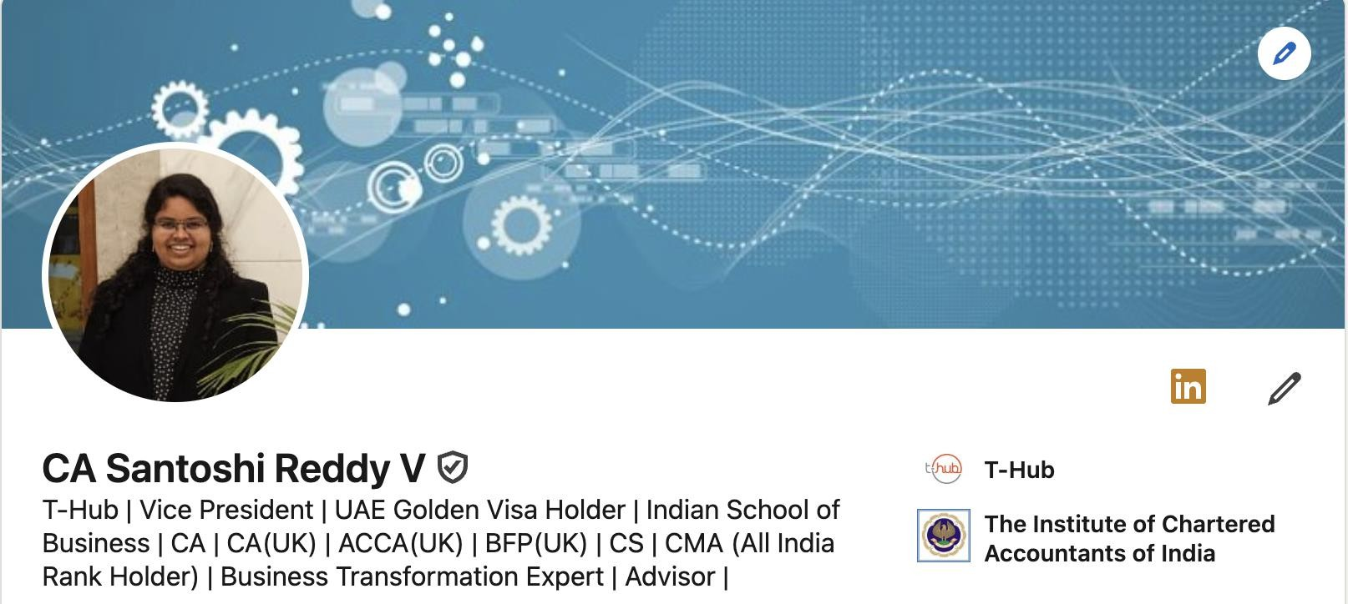
Connect :

