Slide 1
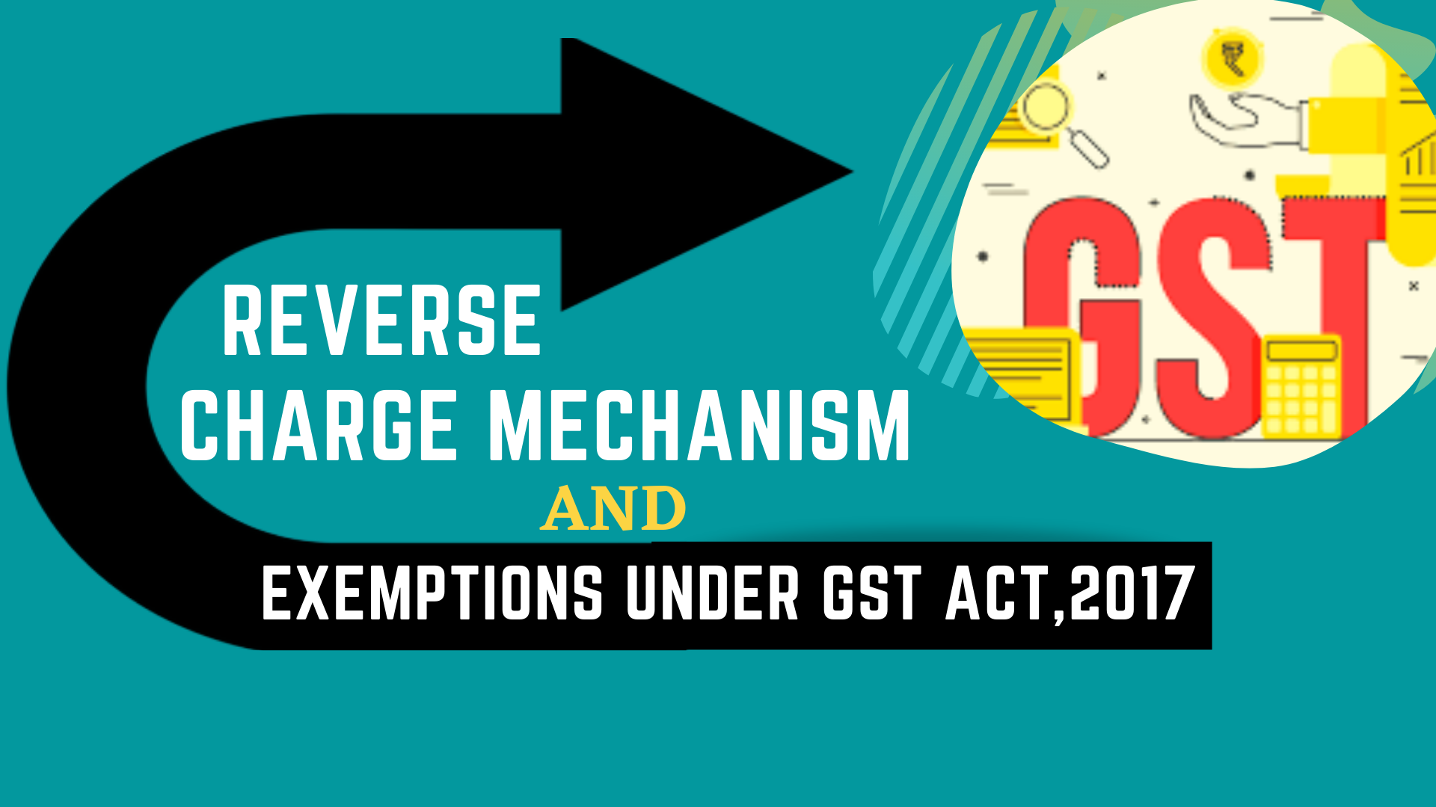
- By CA Arpan Bohra - Hyderabad Branch of ICAI

Slide 2

In a nutshell, under RCM, the RESPONSIBILITY to pay tax is on the RECEIVER of the goods/ services or both rather than the Supplier.

Slide 3
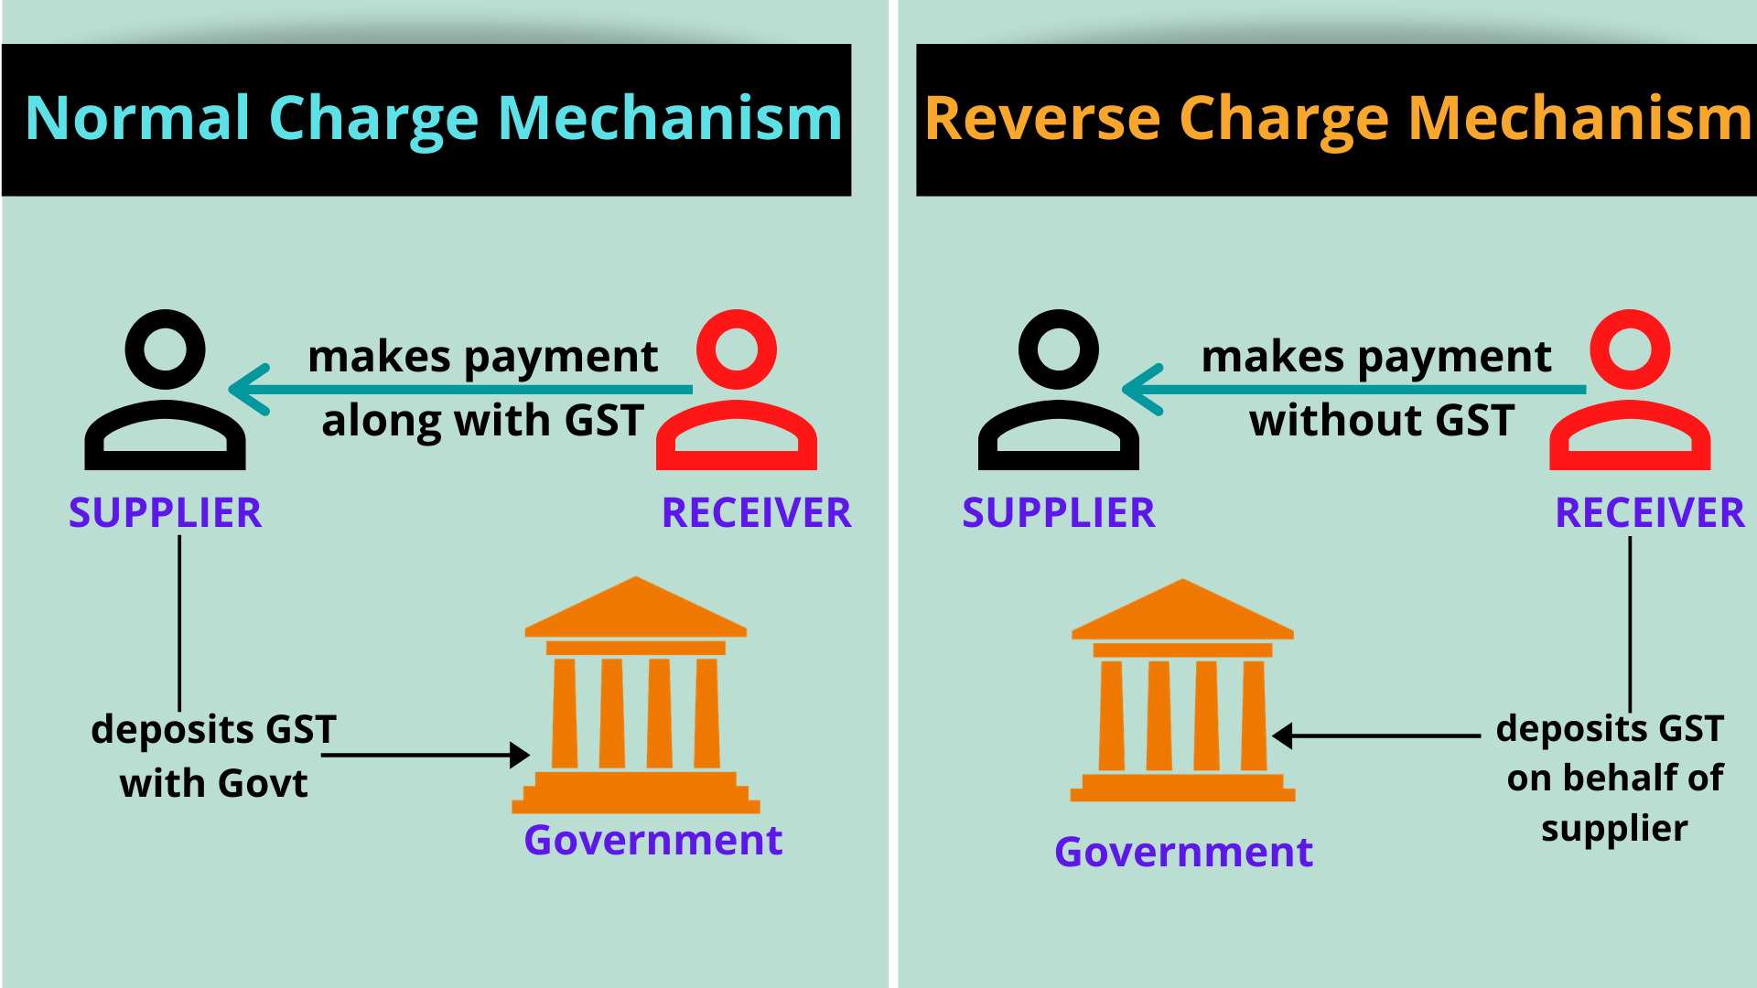

Slide 4

Rs.118
Rs.100
INVOICE
Rs.18
Rs.18
Value = Rs. 100
(+)GST = Rs. 18
Total = Rs. 118
EXAMPLE

Slide 5

01
TAX EVASION
Acts as a measure to curb Tax Evasion
02
Ensures that the small firms don’t hide their original benefits and turnover of the business
The Rationale
Behind RCM
TRANSPARENCY
03
To encourage the small businesses in unorganized sector and increasing tax base
EXPANDING TAX BASE
04
ITC will be made available on purchases made from unregistered dealers
AVAILABILITY OF ITC

Slide 6

Section 9(3)
Section 9(4)
Import of Goods/
Services or both
Section 9(5)
Transactions for SPECIFIED Goods and Services
Transactions with Unregistered Dealers
Transactions involving imports (which are treated as Inter state Supply)
Transactions
with
E Commerce operators

Slide 7




Section 9(4) of Central Goods and Services Act, 2017
Supplied Goods/services or both
Makes payment without GST
Unregistered Supplier
Registered Receiver
“The central tax in respect of the supply of taxable goods or services or both by a supplier, who is not registered, to a registered person shall be paid by such person on reverse charge basis as the recipient and all the provisions of this Act shall apply to such recipient as if he is the person liable for paying the tax in relation to the supply of such goods or services or both.”
Responsibility to deposit tax
with Govt
Government

Slide 8

EVOLUTION of SECTION 9(4)
28/06/2017
13/10/2017
23/03/2018
Notification no. 8/2017 – Central Tax (Rate)
Notification no. 38/2017 – Central Tax (Rate)
Notification no. 10/2018 – Central Tax (Rate)
Tax payable on RCM was Exempted;
1st PROVISIO
Exemption was constricted to Rs. 5000/- of aggregate value of supplies from any or all the
suppliers within a day
The Exemption was extended up to 30/06/2018
The first Proviso was Omitted;
The Exemption was made applicable to all Registered persons up to 31/03/2018

Slide 9
EVOLUTION of SECTION 9(4)
29/06/2018
06/08/2018
29/08/2018
Notification no. 12/2018 – Central Tax (Rate)
Notification no. 12/2018 – Central Tax (Rate)
The Central Goods and services Tax (Amendment) Act, 2018
The Exemption was further extended up to 30/09/2018
The Exemption was further extended up to 30/09/2019
Substituted Section 9(4)

Slide 10
Section 9(4) of Central Goods and Services Act, 2017
As substituted by The Central goods and Services (Amendment) Act, 2018
“The Government may, on the recommendations of the Council, by notification, specify a class of registered persons who shall, in respect of supply of specified categories of goods or services or both received from an unregistered supplier, pay the tax on reverse charge basis as the recipient of such supply of goods or services or both, and all the provisions of this Act shall apply to such recipient as if he is the person liable for paying the tax in relation to such supply of goods or services or both.”.

Slide 11
EVOLUTION of SECTION 9(4)
29/01/2019
29/01/2019
01/02/2019
Notification no. 8/2017 – Central Tax (Rate) was Rescinded
Notification no. 02/2019 – Central Tax (Rate)
The Central Goods and services Tax (Amendment) Act, 2018
and
Notification no. 8/2017 – Central Tax (Rate) was Rescinded
Issued to notify that The Central Goods and services Tax (Amendment) Act, 2018 would come into force from 01/02/2019
But the things done or omitted to be done before rescission was kept unaltered

Slide 12
Section 9(4) of Central Goods and Services Act, 2017
Notification No. 07/2019 Central Tax (Rate) – 29/03/2019
The Government notified that Section 9(4) will be applicable for “Promoters” only for the supplies namely
1
Supply of such goods and services or both [other than services by way of grant of development rights, long term lease of land (against upfront payment in the form of premium, salami, development charges etc.) or FSI (including additional FSI)] which constitute the shortfall from the minimum value of goods or services or both required to be purchased by a promoter for construction of project, in a financial year (or part of the financial year till the date of issuance of completion certificate or first occupation, whichever is earlier) as prescribed in notification No. 11/ 2017- Central Tax (Rate), dated 28th June, 2017, at items (i), (ia), (ib), (ic) and (id) against serial number 3 in the Table, published in Gazette of India vide G.S.R. No. 690, dated 28th June, 2017, as amended.

Slide 13
Section 9(4) of Central Goods and Services Act, 2017
Notification No. 07/2019 Central Tax (Rate) – 29/03/2019
The Government notified that Section 9(4) will be applicable for “Promoters” only for the supplies namely
2
Cement falling in chapter heading 2523 in the first schedule to the Customs Tariff Act, 1975 (51 of 1975) which constitute the shortfall from the minimum value of goods or services or both required to be purchased by a promoter for construction of project, in a financial year (or part of the financial year till the date of issuance of completion certificate or first occupation, whichever is earlier) as prescribed in notification No. 11/ 2017- Central Tax (Rate), dated 28th June, 2017, at items (i), (ia), (ib), (ic) and (id) against serial number 3 in the Table, published in Gazette of India vide G.S.R. No. 690, dated 28th June, 2017, as amended.

Slide 14
Section 9(4) of Central Goods and Services Act, 2017
Notification No. 07/2019 Central Tax (Rate) – 29/03/2019
The Government notified that Section 9(4) will be applicable for “Promoters” only for the supplies namely
3
Capital goods falling under any chapter in the first schedule to the Customs Tariff Act, 1975 (51 of 1975) supplied to a promoter for construction of a project on which tax is payable or paid at the rate prescribed for items (i), (ia), (ib), (ic) and (id) against serial number 3 in the Table, in notification No. 11/ 2017- Central Tax (Rate), dated 28th June, 2017, published in Gazette of India vide G.S.R. No. 690, dated 28th June, 2017, as amended.
Thus in the present scenario Section 9(4) is only applicable for the “Promoters” who are engaged in Supply of the above mentioned services, without any exemption limit.

Slide 15

Reverse Charge Mechanism in Real Estate Sector
As per Decision taken in 34th GST council Meeting
In case of a project developer or construction of apartment by the developer, 80% of inputs and input services [other than capital goods, TDR/JDA, FSI, long-term lease (premium) shall be purchased from registered persons.
On shortfall of purchases from 80% tax shall be paid by the builder @18% on RCM basis. However, Tax on cement purchased from unregistered person shall be paid @28%/18% under RCM, and on capital goods under RCM at applicable rates in terms of Section 9(4) the CGST Act, 2017, in terms of C.B.I & C., Notification No. 7/2019-C.T. (Rate), dated 29th March, 2019.

Slide 16
RCM on Renting of Immovable Property
Change made wef 13/07/2022 by:
Notification 04/2022 CT(R) – Exemption Notification
Notification 05/2022 CT(R) – RCM Notification
Vide Notification 04/2022 CT(R), the exemption provided by Notification 12/2017 was amended and read as under:
“Services by way of renting of residential dwelling for use as residence, except where the residential dwelling is rented to a registered person”.
Vide Notification 05/2022 CT(R), a new RCM entry 5AA was inserted in original Notification 13/2017 CT(R), which read as under:
“Service by way of renting of residential dwelling by any person to any registered person”.

Slide 17
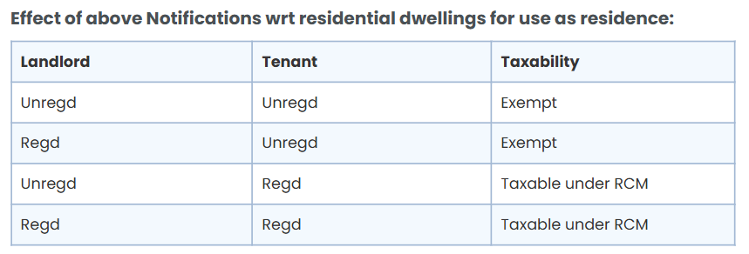
RCM on Renting of Immovable Property

Slide 18
RCM on Renting of Immovable Property
RCM on Renting of Immovable Property – Important GST Amendment
Changes made wef 10/10/2024 vide Notification 09/2024:
[RCM Notification] Vide Notification 09/2024, a new RCM entry 5AB was inserted, which read as under:
“Service by way of renting any property other than residential dwelling by any unregistered person to a registerd person” shall be taxable on RCM basis.

Slide 19
RCM on Renting of Immovable Property
Change made wef 01/01/2023 vide Notification 15/2022: [Exemption Notification]
Vide Notification 15/2022, amendment was made to Notification 04/2022. After amendment, the clause reads as under:
“Services by way of renting of residential dwelling for use as residence, except where the residential dwelling is rented to a registered person”
Explanation: For the purpose of exemption under this entry, this entry shall cover services by way of renting of residential dwelling to a registered person where, –
the registered person is proprietor of a proprietorship concern and rents the residential dwelling in his personal capacity for use as his own residence; and
such renting is on his own account and not that of the proprietorship concern.”

Slide 20
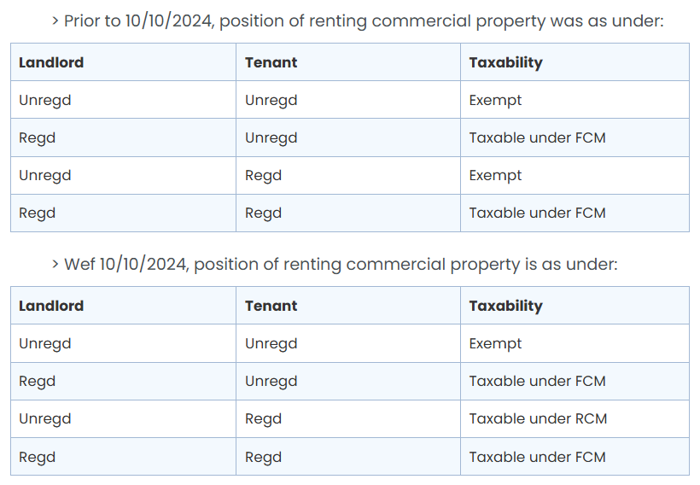
RCM on Renting of Immovable Property

Slide 21
Liability of Registration under Reverse Charge Mechanism
Change made wef 16/01/2025 vide Notification 07/2025 CT(R): [RCM Notification] Vide Notification 07/2025 CT(R), RCM Entry 5AB was amended to read as under:
“Service by way of renting any property other than residential dwelling by any unregisterd person to a registerd person, other than a person who has opted to pay tax under composition levy” shall be taxable on RCM basis.

Slide 22
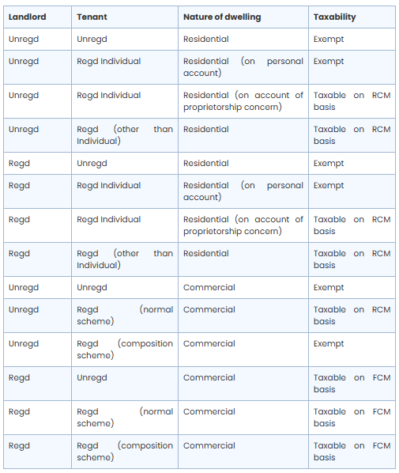
RCM on Renting of Immovable Property

Slide 23

Section 9(3) of Central Goods and Services Act, 2017
Section 9(3) of CGST Act and section 5(3) of GST Act state that Government can specify categories of supply of goods or services or both, the tax on which is payable on reverse charge basis.
GOVERNMENT
Notify Specific Category of
Goods
Services
AND

Slide 24


RCM incase of Goods Transport Agency(GTA) – w.e.f. 01/07/17
12% with ITC
FCM
##The recipient of GTA service is entitled to take ITC irrespective of the GST being discharged through RCM or FCM, provided it is used in the course or furtherance of business at his end.
7 specified recipients*
OR
5% without ITC##
RCM
TO
GTA
(service Provider)
12% with ITC
FCM
Individual/URD
OR
5% without ITC
*7 Specified Recipients:
any factory
any society
any co-operative society
any person registered under CGST/SGST/UGST Act
any body corporate
any partnership firm
Casual taxable person
The service includes not only the actual transportation of goods, but other intermediate/ancillary services provided such as-
Loading/unloading
Packing/ unpacking
Trans-shipment
Temporary warehousing etc.

Slide 25
GTA(service Provider)
Transporting Goods
Exempt
Taxable
agricultural produce
milk, salt and food grain including flour, pulses and rice
organic manure
newspaper or magazines registered with the Registrar of Newspapers
relief materials meant for victims of natural or man-made disasters
defense or military equipment
Where consideration
Any other goods
On a consignment transported in a single carriage is doesn’t exceed
Rs. 1,500
On all such goods for a single consignee doesn’t exceed
Rs. 750
5% No ITC
OR
12% with ITC
notification no.12/2017-Central Tax (Rate) dated 28.06.2017 (sr.no.21)

Slide 26



RCM on Legal Services, w.e.f.,01/07/17. {Notification no. 13/2017-Central tax(Rate)}
Legal services
Shall deposit GST with Govt.
Payment without GST
Service Provider
An individual advocate (incl. senior advocate)/ firm of advocates.
Recipient
(Business Entity Located in Taxable territory)
Requirement to obtain registration:
A person engaged in supply of legal services having turnover exceeding Rs.20 lacs shall mandatorily be required to take registration- Section 22
A person engaged in supplying intra-state services is exempted from obtaining registration where entire tax is payable under RCM- Notification No. 05-Central Tax dated 19.06.2017.
Government

Slide 27


RCM on Director Services, w.e.f.,01/07/17. {Notification no. 13/2017-Central tax(Rate)}
Shall deposit GST with Govt.
Services
Payment without GST
Government
Service Provider
(Director of a Company/Body Corporate)
Recipient
(Company/Business Corporate in Taxable territory)
The term DIRECTOR refers to:
Independent Director
Whole –time-Director services not in the capacity of Employment. ( Eg. On which TDS(194J) is applicable.)
Services covered:
Sitting fees
Director’s Remuneration
Any other services

Slide 28


RCM on Security Services, w.e.f., 01/01/2019. {Notification no. 29/2018- Central Tax(Rate)}
Shall deposit GST with Govt.
Security Services
Payment without GST
Government
Service Provider
Recipient
(Registered Person in Taxable territory)
EXCEPTIONS:
(i) (a) a Department or Establishment of the CG/SG/UT; or
(b) local authority; or
(c) Govt. agencies;
which has taken registration under CGST Act, 2017 only for the purpose of deducting tax u/s 51 & not for making a taxable supply; or
(ii) registered person paying tax u/s 10.
Other than
Services like Supply of Security Personnel.
BODY CORPORATE

Slide 29


RCM on Renting of Motor Vehicle, w.e.f., 01/10/2019. {Circular No. 130/49/2019}
Where,
GST is charged @5% with limited ITC (instead of @12%)
Renting
To
Service Provider
(Any Person)
Motor Vehicle
(Incl. Cost of Fuel)
Recipient
(Body Corporate)
RCM
Other than
BODY CORPORATE
What if the supplier is a body corporate?
They are outside RCM and they would continue to pay GST under forward charge. In all other cases, RCM would apply.

Slide 30
Section 9(3) of Central Goods and Services Act, 2017
Other Notified Services on which RCM is applicable as per Notification No. 04/2017 and as amended from time to time
S.No | Description of Goods | Recipient of Goods | Notification No. | With Effect from
3 | Services of Arbitral Tribunal | Business Entity | 13/2017-Central Tax(Rate) | 1/7/17
4 | Sponsorship | Body Corporate or Partnership Firm | 13/2017-Central Tax(Rate) | 1/7/17
5 | Services provided or to be provided by Central government or State government or Union territory | Business Entity NOTE RCM will not be applicable for following services: 1.Renting of Immovable property 2. Services by department of Post 3. Services in relation to aircraft or Vessel 4. Transport of goods or passengers | 04/2017-Central Tax(Rate) | 1/7/17

Slide 31
Section 9(3) of Central Goods and Services Act, 2017
Other Notified Services on which RCM is applicable as per Notification No. 04/2017 and as amended from time to time
S.No | Description of Goods | Recipient of Goods | Notification No. | With Effect from
5A | Services supplied by Central Government, State Government, Union Territory, or Local Territory by way of renting Immovable property to a person registered under the CGST Act,2017. | Any person Registered under CGST Act | 03/2018-Central Tax(Rate) | 25/1/18
5B | Services supplied by any person by way of transfer of development rights or Floor Space Index (FSI) (including additional FSI) for construction of a project by a promoter. | Promoter | 05/2019-Central Tax(Rate) | 1/4/19

Slide 32
Section 9(3) of Central Goods and Services Act, 2017
Other Notified Services on which RCM is applicable as per Notification No. 04/2017 and as amended from time to time
S.No | Description of Goods | Recipient of Goods | Notification No. | With Effect from
5C | Long term lease of land (30 years or more) by any person against consideration in the form of upfront amount (called as premium, salami, cost, price, development charges or by any other name) and/or periodic rent for construction of a project by a promoter. | Promoter | 05/2019-Central Tax(Rate) | 01/4/19
7 | Service by Insurance Agent | Insurance Companies | 13/2017-Central Tax(Rate) | 1/7/17

Slide 33
Section 9(3) of Central Goods and Services Act, 2017
Other Notified Services on which RCM is applicable as per Notification No. 04/2017 and as amended from time to time
S.No | Description of Goods | Recipient of Goods | Notification No. | With Effect from
8 | Service of Recovery Agent | Bank/ NBFC/any other financial institution | 13/2017-Central Tax(Rate) | 01/7/17
9 | Services of an author, music composer, photographer, artist or the like by way of transfer or permitting the use or enjoyment of a copyright covered under section | Publisher, music company, producer or the like, located in the taxable territory | 13/2017-Central Tax(Rate) | 1/7/17
9B | Author can exercises the option to pay GST on the service relating to original literary works under forward charge w.e.f 01.10.2019

Slide 34
Section 9(3) of Central Goods and Services Act, 2017
Other Notified Services on which RCM is applicable as per Notification No. 04/2017 and as amended from time to time
S.No | Description of Goods | Recipient of Goods | Notification No. | With Effect from
10 | Services of overseas Committee | Reserve Bank of India | 33/2017-Central Tax(Rate) | 13/10/17
11 | Services of an individual Direct Selling Agents (DSAs) | Banks/NBFc’s located in Taxable Terrritory | 15/2018-Central Tax(Rate) | 27/7/18
12 | Services of a business facilitator (BF) | A banking company, located in the taxable territory | 29/2018-Central Tax(Rate) | 01/1/19

Slide 35
Section 9(3) of Central Goods and Services Act, 2017
Other Notified Services on which RCM is applicable as per Notification No. 04/2017 and as amended from time to time
S.No | Description of Goods | Recipient of Goods | Notification No. | With Effect from
13 | Services of business correspondent (BC) | A business correspondent, located in the taxable territory | 29/2018-Central Tax(Rate) | 01/1/19
16 | Services of lending of securities under Securities Lending Scheme, 1997 (“Scheme”) of Securities and Exchange Board of India (“SEBI”), as amended. | Borrower i.e. a person who borrows the securities under the Scheme through an approved intermediary of SEBI. | 22/2019-Central Tax(Rate) | 01/10/19

Slide 36
Section 9(3) of Central Goods and Services Act, 2017
Notified Goods on which RCM is applicable as per Notification No. 04/2017 and as amended from time to time
S.No | Description of Goods | Recipient of Goods | Notification No. | With Effect from
1 | Cashew nuts, not shelled or peeled supplied by agriculturist | Any Registered Person | 04/2017-Central Tax(Rate) | 1/7/17
2 | Bidi wrapper leaves (tendu) supplied by agriculturist | Any registered person | 04/2017-Central Tax(Rate) | 1/7/17
3 | Tobacco leaves | Any registered person | 04/2017-Central Tax(Rate) | 1/7/17
4 | Silk Yarn supplied by any person who manufactures silk yarn from raw silk or silk worm cocoons for supply of silk yarn | Any registered person | 04/2017-Central Tax(Rate) | 1/7/17

Slide 37
Section 9(3) of Central Goods and Services Act, 2017
Notified Goods on which RCM is applicable as per Notification No. 04/2017 and as amended from time to time
S.No | Description of Goods | Recipient of Goods | Notification No. | With Effect from
4A | Raw Cotton supplied by Agriculturist | Any Registered Person | 43/2017-Central Tax(Rate) | 15/11/17
5 | Supply of lottery. | Lottery distributor or Selling agent | 04/2017-Central Tax(Rate) | 1/7/17
6 | Used vehicles, seized and confiscated goods, old and used goods, waste and scrap supplied by Central Government, state Government, union Territory, Or a local authority | Any registered person | 36/2017-Central Tax(Rate) | 13/10/17
7 | Priority Sector Lending Certificate | Any registered person | 11/2018-Central Tax(Rate) | 28/5/18

Slide 38



Reverse Charge on Import of Goods/Services or Both
For a consideration
&
Irrespective
of Business Purposes
Goods
Services
SUPPLIER
(outside India)
RECIPIENT (In India)
Recipient shall pay tax on RCM
IGST will be levied in addition to Basic Customs Duty(BCD) on import of Goods.
GST compensation cess, may also be leviable on certain luxury and demerit Goods.
IGST shall be computed on the Transaction value in case of goods (From customs law).
Duty free import of Goods(exemption from Custom duties, IGST & Compensation Cess) Exemption to 100% EOU’s & SEZ’s was only available till 31/03/2018
EXCEPTIONS:
In case of Imports made from a Related/Distinct parties located outside India, GST shall be charged on RCM even if such import is made without paying any consideration.(Wef 01/02/2019)
In case of OIDAR (Online Information Data Access and Retrieval) services, the supplier has to seek registration and pay taxes.
IGST(Goods)
=
%(Assessable value + BCD+ED u.cess)

Slide 39


Section 9(5) of Central Goods and Services Act, 2017
Supplier
E-Commerce Operator
Recipient
As per Sec 9(5) of CGST Act, 2017, in case of notified services, the tax shall be paid by E-commerce operator if such services are supplied through it and all the provisions of the Act shall apply to such electronic commerce operator as if he is the supplier liable to pay tax in relation to the supply of such services. A similar provision for inter-State supply is provided for in Sec. 5(5) of the IGST Act, 2017.
Government

Slide 40



Section 9(5) of Central Goods and Services Act, 2017
Notified Services under sec 9(5) of CGST ACT, 2017 and under sec 5(5) of IGST Act, 2017
1
Transportation of passengers by a radio-taxi, motor cab, maxi cab and motor cycle
Supplier
Recipient
Any Supplier whether or not liable to register under GST Act
Government

Slide 41


Section 9(5) of Central Goods and Services Act, 2017
2
Notified Services under sec 9(5) of CGST ACT, 2017 and under sec 5(5) of IGST Act, 2017
Providing accommodation in hotels, inns, guest houses, clubs, campsites or other commercial places meant for residential or lodging purposes.
Supplier
Recipient
Any Supplier Except who is liable to register under GST Act
Government

Slide 42


Section 9(5) of Central Goods and Services Act, 2017
3
Notified Services under sec 9(5) of CGST ACT, 2017 and under sec 5(5) of IGST Act, 2017
Services by way of house- keeping, such as plumbing, carpentering etc.
Supplier
Recipient
Any Supplier Except who is liable to register under GST Act
Government

Slide 43

Liability of Registration under Reverse Charge Mechanism
Liable to pay GST under Reverse Charge Mechanism;
BUT
His Turnover is below Annual Threshold Limit.
Is Mr. A Liable to Register under GST Act, 2017 ?
MR. A
Yes
A person who pays taxes under reverse charge is required to register under GST irrespective of the threshold and annual threshold Limit is 20 lakhs (10 lakhs in case of Hill states and North Eastern State)
Note: In the GST council meeting, states were given liberty to impose double threshold limit for registration i.e. 40 lakh up from the earlier INR 20 lakh.

Slide 44

TIME OF SUPPLY UNDER RCM
In case of Goods
1
2
3
Earliest of the following
The date of payment as entered in Books of Recipient, OR;
The Date of Actual Payment
Whichever is Earlier.
the date immediately following thirty days from the date of issue of invoice or any other document, by whatever name called, in lieu thereof by the supplier
The date of receipt of Goods

Slide 45
HOWEVER
if it is not possible to find out the time of supply in mentioned above cases,
TOS = Date of entry in the Books of Account of the Recipient of the Supply
EXAMPLE
Date of Payment – 18th June 2019
Date of Invoice – 1st July 2019
Date of Entry in books by the recipient – 19th June 2019
In this case, the time of supply will be 18th June 2019

Slide 46
What if Supplier is Located Outside India ?
In that Case, Time of Supply is
Date of Payment
Date of Record of Payment in Books
OR
Whichever is earlier

Slide 47

TIME OF SUPPLY UNDER RCM
In case of Services
1
2
Earliest of the following
the date immediately following after sixty days from the date of issue of the invoice by the supplier
The date of Payment

Slide 48
HOWEVER
if it is not possible to find out the time of supply in mentioned above cases,
TOS = Date of entry in the Books of Account of the Recipient of the Supply
EXAMPLE
Date of Payment – 18th August 2019
Date of Invoice – 1st September 2019
Date of Entry in books by the recipient – 19th August 2019
In this case, the time of supply will be 18th August 2019

Slide 49

Self Invoicing under Reverse Charge Mechanism
RECIPIENT
What is Self Invoice?
Self Invoice(Self Bill) Shall be raised by Recipient when he is liable to pay GST under RCM, since supplier cannot raise tax invoice
Why is Self Invoicing necessary?
In order to pay the tax and avail the benefit of ITC
Details to be included in Self Invoice:
All details of Recipient and the Supplier(excl. His GSTIN)
INVOICE

Slide 50
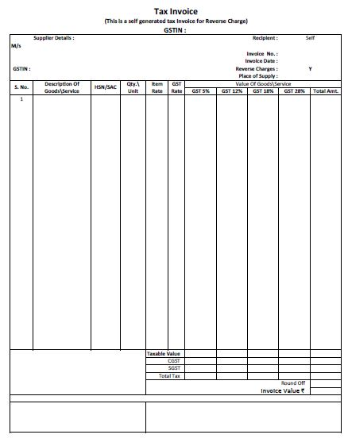

FORMAT OF SELF INVOICE UNDER RCM
Supplier & Recipient details
Other details with respect to Rate, Value ,Etc

Slide 51
Other Aspects of Reverse Charge Mechanism
The Manner of Payment of GST under Reverse Charge Mechanism
Tax under Reverse Charge can be paid only through “CASH”, Input Tax credit cannot be used for this purpose.
Input Tax Credit under Reverse Charge Mechanism
Service Recipient can claim ITC on tax amount paid under RCM
If the Goods/services are used for business or furtherance of Business.
NOTE
If the composite dealer falls under reverse charge mechanism then the dealer is ineligible to claim any credit of tax paid. The tax will be paid at the normal applicable rates and not at the composition rates.

Slide 52
Rule 47A
www.arpanbohra.co.in

Slide 53
Index
Rule 47A
Agenda
15[Rule 47A. Time limit for issuing tax invoice in cases where recipient is required to issue invoice. - Notwithstanding anything contained in rule 47, where an invoice referred to in rule 46 is required to be issued under clause (f) of sub-section (3) of section 31 by a registered person, who is liable to pay tax under sub-section (3) or sub-section (4) of section 9, he shall issue the said invoice within a period of thirty days from the date of receipt of the said supply of goods or services, or both, as the case may be.]
15 Inserted vide Notification No.20/2024 - CT dated 08.10.2024, w.e.f. 01.11.2024

Slide 54
RCM Liability & ITC Statement
www.arpanbohra.co.in

Slide 55

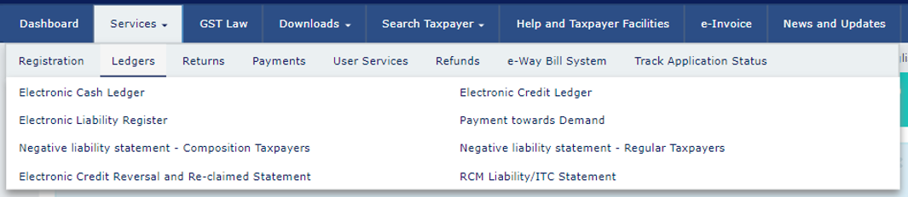
Index
Ledgers Dashboard
Agenda

Slide 56
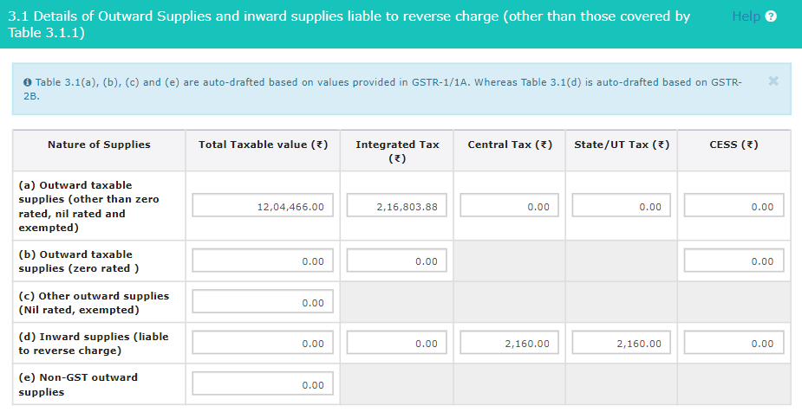
Index
RCM Liability & ITC Statement
Table 3.1 & Table 4 of GSTR-3B

Slide 57
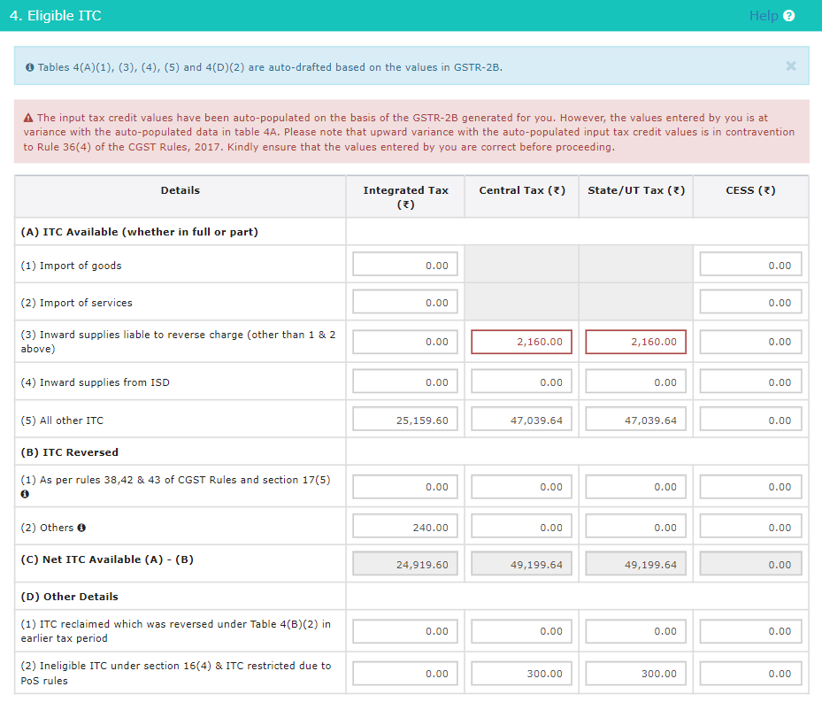
Index
RCM Liability & ITC Statement
Table 4 of GSTR-3B : Eligible ITC

Slide 58
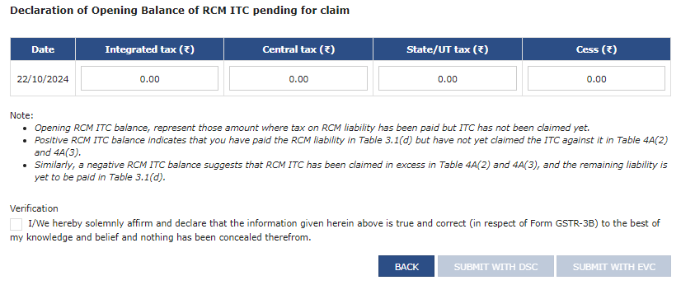
Index
RCM Liability & ITC Statement
Dashboard > Returns > RCM ITC Opening Balance Declaration
Reconcile up to July 2024 & Report
Deadline to report the values – 31st October 2024
Amendment – up to 30th November 2024 (3 Rectifications Allowed)

Slide 59

WHAT IS EXEMPT SUPPLY?
Exempt Supply refers to those supplies which do not attract Goods and Services Tax, i.e., No GST is applicable on such Supplies
Input tax credit attributable to exempt supplies will not be available for utilization/setoff.

Slide 60
Power to grant exemption
Government, based on the recommendation of the Council
S.11 (3)
Is satisfied that it is necessary, in the public interest
Exempt tax on taxable G/S of any specified description
Considers it necessary
to clarify the scope or applicability of A or B
S.11 (1)
S.11 (2)
By Notification
By Notification - A
By Special Order – B
Exempt Generally
Exempt
Insert an explanation in A or B, as the case may be, within 1 year (such clarification to have retrospective effect)
Absolutely (not optional); or
Subject to conditions
Under exceptional circumstances, explicitly specified in such Order
Whole Tax; or
Part tax
Whole Tax

Slide 61
Exempt supplies, non-taxable supplies and zero-rated supplies
Section 2(47) – “exempt supply” means supply of any goods and/ or services
which attract nil rate of tax; or
which may be exempt from tax under Section 11 or Section 6 of IGST Act
and includes non-taxable supply
Section 2(78) – “non-taxable supply” means a supply of goods and/or services which is not leviable to tax under this Act or IGST Act
Section 16(1) of IGST Act – “zero-rated supply” means any of the following supplies of goods and/or services, namely -
Export of goods and/or services
Supply of goods and/or services to a SEZ developer or an SEZ unit

Slide 62

Section 11 of Central Goods and Services Act, 2017
As per Section 11(1)
Where the Government is satisfied that it is necessary in the public interest so to do, it may, on the recommendations of the Council, by notification, exempt generally, either absolutely or subject to such conditions as may be specified therein, goods or services or both of any specified description from the whole or any part of the tax leviable thereon with effect from such date as may be specified in such notification.
GOVERNMENT
Exempt by Notification
Refer Notification No. 02/2017 Central Tax (Rate), as amended from time to time for list of Goods exempted
Refer Notification No. 12/2017 Central Tax (Rate), as amended from time to time for list of Services exempted
Goods
AND
Services

Slide 63

Supplies Taxable at ‘Nil’ Rate of Tax (0% Tax)
Supplies that are wholly or partially exempted from CGST or IGST, by way of a notification amending Section 11 of CGST Act or Section 6 of IGST Act;
Non-taxable supplies as defined under Section 2(78) – supplies that are not taxable under the Act (For Example Alcoholic liquor for human consumption.

Slide 64



Few Important Exempt Services
Services by way of Charitable Activities
Services by way of Educational Institutions
Services by way of Health Care and ambulance

Slide 65
Other Important Exempt Services
Service of transportation of passengers
Transmission or distribution of electricity by an electricity transmission or distribution utility
Services of religious ceremony
Services by a hotel, inn, guest house having declared tariff less than one thousand rupees per day
To view Complete List of Exempt Services, refer Notification No. 12/2017 central Tax (Rate) as amended from time to time.

Slide 66

Reasons for Exemptions of Goods
The exemption is allowed on specific goods through an official notification
The exemption is granted by the Government through a special order
As per GST Council’s recommendation
In the interest of the public
EXEMPTIONS OF GOODS

Slide 67




Few Important Exempt Goods.
Fresh fruits & Vegetables
(Other than frozen & processed)
Silk worm laying cocoon.
Betel Leaves
Firewood Or Fuel Wood

Slide 68
Other Important Exempt Goods.
Coffee beans not roasted
All types of Contraceptives
Organic manure other than those bearing a brand name
Wood Charcoal
Puja Samagri
Coconut Coir Fibre
To view Complete list of Exempt Goods, refer Notification No. 2/2017- central tax(rate) as amended from time to time.

Slide 69
Thank You
CA ARPAN BOHRA
+91-9030499151
ab@arpanbohra.co.in

