Slide 1

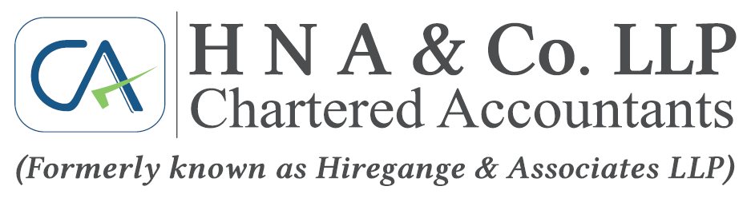

Recent Judicial Trends & Key Rulings under GST
CA Asha Latha T
28th November 2025

Slide 2
Introduction
Principle of ‘Judicial discipline’ – Orders of higher appellate authorities should be followed unreservedly by the subordinate authorities, unless its operation has been suspended by a competent Court - UOI v. Kamlakshi Finance Corporation Ltd [1991 (55) E.L.T 433 (S.C)].
Principle of ‘Stare decisis’ - Before reviewing or revising its earlier decision, the Court must satisfy itself whether it is necessary to do so in the interest of public good or for any other compelling reason. The Court must endeavor to maintain consistency, certainty and continuity in interpretation of law –Keshav Mills Co. Ltd. Vs. C.I.T. [AIR 1965 SC 1636].
Facts of decision relied upon have to be shown to fit factual situation of a given case. Without such discussion, reliance could not be placed on a decision. Circumstantial flexibility, one additional or different fact may make world of difference between conclusions in two cases. C.C.E., Calcutta vs. Alnoori Tobacco Products [2004 (170) ELT 135 (S.C.)].

Slide 3
Initial Caveats
Last 1 year cases were taken.
Omission of any case laws is purely unintentional and try to discuss if memory permits.
To give more content & time constrains - Coverage of facts, issues involved is limited. If any specific case to be elaborated, much privileged to do.
Application & adoption of case laws purely depends the text & context of facts, legal provisions. Hence, due care may be taken while relying on cited case law.
Future developments of the case laws (reversed or upheld or changes in legal provisions) is also to be considered.
AAR & AAAR’s are not considered.

Slide 4

Reasons for Disputes
Department Perspective
Aggressive tax collection behaviour.
Lack of Training and skills of tax officers
Lack of accountability and judicial indiscipline
Lack of supervision and guidance
Fear of Audit, Vigilance machinery and CBI
Taxpayers perspective
Complicated law
Cumbersome procedures
Compliance requirements
Ignorance
Deliberate evasion
Competition by tax evaders

Slide 5
Interest on refunds under GST

Slide 6
Interest on delayed refunds under GST
Sec 56(1) - Interest @6% is payable, if not refunded within 60 days from the date of receipt of Refund Application u/s 54(1) till refund sanction.
Interest @9% is payable from refund application filed (consequent to higher authority order - which has attained finality) till sanction, if not refunded within 60 days from consequential refund application.
The orders of 1st Appellate Authority or GSTAT or Court will be considered as orders passed by refund sanctioning authority.
Notification No. 13/2017 –CT dated 28-06-2017 notifies interest rate of 6% for Sec 56 and 9% for proviso to Sec 56.
ROI
6

Slide 7
Interest on delayed refunds under GST
Rule 94(2) - Non-inclusion of following for beyond 60 days delay-
Period beyond 15 days from date of notice (FORM GST RFD-08) for submitting reply (FORM GST RFD-09) or additional documents.
Period taken either for furnishing/validating bank account details.
Cir 125/44/2019 – GST dated 18-11-2019 @para-No. 34 clarifies that
Interest is payable from the date of filing of original RA.
Date when amount is credited to the bank account (as mentioned in registration particulars) of the Applicant, shall be considered to have been refunded.
ROI
7

Slide 8
Interest on delayed refunds under GST
6% Interest [61st day of org. refund application till sanction] and 9% interest [61st day of consequential refund application till sanction] payable, as held in
Lupin Limited v. UOI & Ors.[TS-701-HC(BOM)-2025-GST] [Para 14 & 15]
Bansal International v. Commissioner, DGST[(2023) 13 Centax 210 (Del.)]
SBI Cards & Payment Services Ltd. v. UOI [2023 (3) Centax 217 (P & H)].
Interest rate provided in a specific provision shall be considered - UOI v. Willo Wood Chemicals Pvt. Ltd. [2022 (60) G.S.T.L. 3 (S.C.)].
Interest is payable on unconstitutional levies [Article 265 of COI) – West India Continental Oils Fats (P.) Ltd. v. UOI [2025 (179) taxmann.com 603 (Bom.)].
ROI
8

Slide 9
Interest on delayed refunds under GST
6% interest is payable, even in cases of refund sanction within 60 days from consequential refund application - Altisource Business Solutions India Pvt. Ltd. v. UOI & Ors. [TS-848-HC(BOM)-2025-GST]
Interest is payable on amounts made under protest during investigation - Anand Engineering Ltd., Commissioner of Central Excise & CGST, Lucknow [Final order No. 70771-70772/2025 dated 03-11-2025] [Para 8 & 9].
Interest is payable, also in cases where refund is delayed beyond 60 days due to technical system glitches - Vineet Polyfab Pvt. Ltd. v UOI [(2025) 36 Centax 15 (Guj.)].
ROI
9

Slide 10
Interest on pre-deposits under GST
Section 107(6)/112(8) – compulsory pre-deposit
Section 115 → refund consequences.
Section 56 provides interest from the date of payment of pre-deposit (not from order) till date of refund
Issue is at what rate? Q. 33 of CBIC FAQs notified the rate of interest of 6% p.a.
Pre-deposit along with interest is to be paid in cash irrespective of pre-deposit paid in cash or credit - Flipkart India Private Limited v The Assistant Commissioner of Commercial Taxes [2025-TIOL-1489-HC-KAR-VAT] [para 31(ii) & (iii)]
ROI
10

Slide 11
Relevant date for fresh refund application

Slide 12
Relevant date for fresh refund application
Refund Application is to be filed within 2 years from the relevant date [Sec 54(1) r/w 2nd explanation to Sec 54 and Rule 89(1)].
In case of deficiencies noticed in application, Deficiency Memo shall be issued requiring Applicant to file a fresh RA after rectification of deficiencies [Rule 90(3)].
Time period b/w refund application and Deficiency Memo shall be excluded from 2 years period for filing fresh application [proviso to Rule 90(3)].
Circular No. 125/44/2019 - GST dated 18-11-2019 [para 11] - Another DM shall not be issued unless the deficiencies communicated through the previous DM were not rectified or any other substantive deficiency is noticed subsequently.
ROI
12

Slide 13
Relevant date for fresh refund application
Limitation u/s 54(1) is directory and not mandatory - BLA Infrastructure Pvt. Ltd. v. State of Jharkhand [2025 (27) Centax 81 (Jhar.)] and Lenovo (India) (P.) Ltd. v. Jt. Commissioner [2023 (79) G.S.T.L. 299 (Mad.)].
Date of original RA shall be considered for limitation & not fresh RA -
Varidhi Cotspin Pvt. Ltd. v UOI [(2025) 35 Centax 136 (Guj.)]
Lenovo (India) Pvt. Ltd., V. Joint Commissioner… [2023 (11) TMI 774 (Mad)]
La-Gajjar Machineries Pvt Ltd V UOI & Ors. [2023 (9) TMI 1518 (Guj.)]
National Internet Exchange of India v UOI & Ors. [2023 (8) TMI 1211 (Del.)].
When DM was issued without any reasons, original RA should be considered for calculating 2 years’ time limit - CCE v. Arya Exports [2005 (192) ELT 89 (Del)] and Banco Products India Ltd v CCE [2016 (42) STR 535 (Tri-Ahmd)].
ROI
13

Slide 14
Refund for taxes collected without authority of law

Slide 15
Refund for taxes collected without authority
Time limit in Sec 54 is not applicable to amounts paid under “Mistake of Law” -
Nspira Management Services Pvt. Ltd. v. Assistant/ Deputy Commissioner of Central Tax [(2025) 35 Centax 239 (A.P.)]
Louis Dreyfus Co. (P) Ltd. v. UOI [2025 SCC OnLine AP 3070] @Para 16
Varshan Enterprises v. Office of the GST Council [2023 (69) G.S.T.L. 133 (A.P.)]
Comsol Energy Pvt. Ltd. v. State of Gujarat [2021 (55) G.S.T.L. 390 (Guj.)].
Circular 188/20/2022-GST dated 27-12-2022 and Agenda Item 7(ii) of 48th GST Council Meeting - Recipients are eligible to claim refunds of wrongly paid tax when they have borne the tax burden.
ROI
15

Slide 16
Refund for taxes collected without authority
Defect Memo cannot replace adjudication
Rule 92(3) - if refund is inadmissible, SCN shall be issued and pass order providing Personal Hearing [Section 75(4)].
Issuing successive deficiency memos without fresh grounds is illegal - K.A. Wholesale Traders Pvt. Ltd. v. Assistant Commissioner (ST)[W.P. No. 23331 of 2024 - Telangana HC].
Deficiency memos cannot be used to reject refund claims on merits –
Nspira Management Services Pvt. Ltd. v. Assistant/ Deputy Commissioner of Central Tax [(2025) 35 Centax 239 (A.P.)]
BT (India) Pvt. Ltd. v. UOI [2023 (13) Centax 89 (Del.)]
Circular 125/44/2019-GST dated 18-11-2019.
ROI
16

Slide 17
Amendment in IDS formulae – Retrospective or Prospective?

Slide 18
Amendment in IDS formulae
ITC accumulated due to inputs rate > output rate.
N. N. 14/2022-CT dated 05-07-2022 amended the Rule 89(5).
Circular 181/13/2022-GST dated 10-11-2022 - Amendment in Rule 89(5) is not clarificatory in nature and is applicable prospectively from 05-07-2022.
There is no embargo on preferring 2nd refund application, if the petitioner is entitled to the same within the period of 2 years as held in –
ABN Industries v. UOI & Ors. [2025-TIOL-566-HC-AHM-GST]
Shree Renuka Sugars Ltd. v. State of Gujarat [2023 (8) Centax 235 (Guj.)]
Pee Gee Fabrics (P.) Ltd. v. UOI [2023 (11) Centax 330 (Guj.)].
ROI
18

Slide 19
Amendment in IDS formulae
Unamended Rule 89(5) prior to 05-07-2022 was as under:
In the case of refund on account of IDS, refund of ITC shall be granted as per the following formula:
Maximum Refund Amount = {(Turnover of inverted rated supply of goods and services) x Net ITC Adjusted Total Turnover} - tax payable on such inverted rated supply of goods and services.
Explanation.- For the purposes of this sub rule, the expressions "Net ITC" and "Adjusted Total turnover" shall have the same meanings as assigned to them in sub-rule (4).
ROI
19

Slide 20
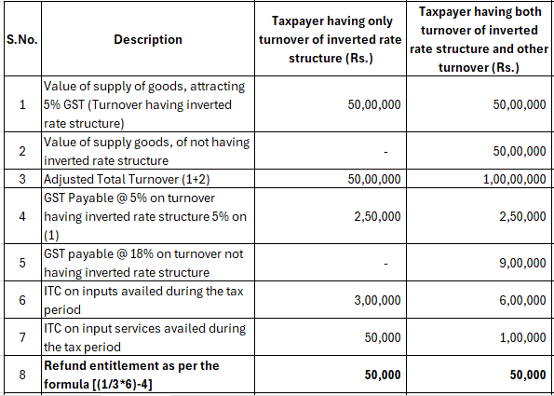
Amendment in IDS formulae
Unamended Rule 89(5) prior to 05-07-2022 [para-No.97 of UOI v. VKC Footsteps India Pvt. Ltd. [2021 (52) G.S.T.L. 513 (S.C.)]
ROI
20

Slide 21
Amendment in IDS formulae
Amended Rule 89(5) - is as under:
In the case of refund on account of IDS, refund of ITC shall be granted as per the following formula:
Maximum Refund Amount = {(Turnover of inverted rated supply of goods and services) x Net ITC Adjusted Total Turnover} - [{tax payable on such inverted rated supply of goods and services x (Net ITC ITC availed on inputs and input services)}]
Explanation:-For the purposes of this sub-rule, the expressions
(a) "Net ITC" shall mean ITC availed on inputs during the relevant period; and
(b) "Adjusted Total turnover" and "relevant period" shall have the same meaning as assigned to them in sub-rule (4)".
ROI
21

Slide 22
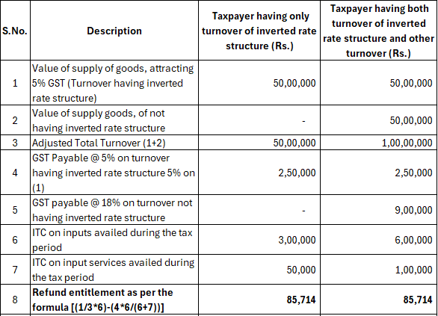
Amendment in IDS formulae
Amended Rule 89(5):
ROI
22

Slide 23
Amendment in IDS formulae
Ascent Meditech Ltd v UOI [(2024) 24 Centax 405 (Guj.)] affirmed by Apex Court in UOI v. Ascent Meditech Ltd. [(2025) 29 Centax 78 (S.C.)], has held that
Amended formulae is curative, aiming to rectify anomalies, and thus apply retrospectively.
Amended formulae is applicable for all applications filed within statutory period, regardless of filing date.
Relied on Shree Renuka Sugars (supra) and Pee Gee Fabrics (P.) Ltd. (supra).
Artificial class cannot be created based on date of filing refund application as it would be discriminatory and violate Section 54 as well as Article 14 of the Constitution.
ROI
23

Slide 24
Refund of unutilized ITC on business closure

Slide 25
Refund of unutilized ITC on business closure
Registered person upon cancellation of registration, shall pay an amount equivalent to higher of the following [Section 29(5)] -
In respect of inputs (stock/semi-finished) or stock of finished goods - ITC by way of debit in the E-credit or E-cash ledger, and in respect of capital goods/ Plant & Machinery - ITC reduced by percentage points as prescribed u/r 44(1) (OR)
Output tax payable on such goods/ capital goods or plant & machinery.
Balance in the E-cash or E-credit ledger after dues payable (tax, interest, penalty, fee or any other amount) may be refunded in accordance with Section 54 [Section 49(6)].
As per Sec 54(3), refund of unutilized ITC is allowed only in cases of -
Zero rated supplies made without payment of tax;
Inverted duty structure (other than nil rated or fully exempt supplies).
ROI
25

Slide 26
Refund of unutilized ITC on business closure
In UOI v. Slovak India Trading Co. Pvt. Ltd. [2008 (223) E.L.T. A170 (S.C.)], refund of unutilized CENVAT credit was allowed on closure of business stating
There is no express prohibition in terms of Rule 5 of CENVAT Credit Rules.
Rule 5 refers to a manufacture. In the light of closure of the company, there would be no manufacture, accordingly adjustment of CENVAT credit is not possible.
Subsequently the provisions of Rule 5 of CCR was amended overcoming the language of “where adjustment is not possible,… shall be allowed refund”.
Gauri Plasticulture P. Ltd. v. Commissioner of Central Excise [2018 (360) E.L.T. 967 (Bom.)] denied the refund stating that Apex Court has not delcared question of law in Slovak (supra) and revenue appeal was dismised on the ground of concession.
ROI
26

Slide 27
Refund of unutilized ITC on business closure
UOI v. VKC Footsteps India Pvt. Ltd. [2021 (52) G.S.T.L. 513 (S.C.)] – refund of unutilized ITC is allowed in 2 cases as specified in Section 54(3).
Mafatlal Industries Ltd. v UOI [1997 (89) E.L.T. 247 (S.C.)], it was held that refund is allowed only as per Statute.
Single Bench in case of SICPA India Pvt. Ltd. v. UOI [(2025) 31 Centax 268 (Sikkim)] has directed refund of unutilized ITC on business closure -
There is no express prohibition or restriction in Section 49(6) r/w Section 54 against refunds on closure of the business;
Article 265 of COI prohibits retention of taxes without legal sanction.
Denial of refund would amount to unauthorized expropriation.
Relied on pre-GST regime decision of Slovak (supra).
ROI
27

Slide 28
Refund of unutilized ITC on business closure
However, a Division Bench of the same court in UOI v. SICPA India Pvt. Ltd [(2025) 34 Centax 200 (Sikkim)] denied the refund stating that -
Section 49(6) allows refund only “in accordance with Section 54.” It cannot be read as a standalone source of refund entitlement.
Refund of unutilized credit u/s 54(3) is exhaustive and expressly confined only to 2 situations and closure of business is not covered.
Relied on VKC Footsteps (supra) decision.
Observed that SICPA had not shown proof of reversals made u/s 29(5) and stated that refund was sought under the vague “any other” category without statutory support.
ROI
28

Slide 29
Refund of unutilized ITC on business closure
Food for thought –
Balance credit lying after the reversal of credits – deemed lapse?
Section 54(3) is applicable to unregistered Persons?
Section 54 covers any person. ‘person’ covers the unregistered person.
Section 49(6) states “in accordance with provisions of section 54” but not Section 54(3), thereby, Section 49(6) is wide to cover entire Section 54 and not merely Section 54(3).
Unutilized credit on business closure represents tax already paid on inputs but not transferred down the supply chain - thereby incidence is not passed on.
Collector of Central Excise v. Dai Ichi Karkaria Ltd. [1999 (112) E.L.T. 353 (S.C.)] referring Eicher Motors Ltd. v. UOI [1999 (106) E.L.T. 3] has categorically held that “a credit under the MODVAT scheme was as good as tax paid.”
ROI
29

Slide 30
Long safari of ITC eligibility – Section 17(5)(d)

Slide 31
Long safari of ITC eligibility – Section 17(5)(d)
Section 17(5)(c) – ITC is restricted on works contract services used for construction of an immovable property (other than plant & machinery) except where it is used for further supply of works contract service.
Section 17(5)(d) – ITC is restricted on goods or services used for construction of an immovable property (other than plant OR machinery) on own account including used in the course or furtherance of business (old provision).
“Plant and machinery” – excludes
land, building or any civil structures
Telecommunication towers and
Pipeline laid outside the factory premises.
Apex court in Chief Commissioner of CGST v. Safari Retreats Pvt. Ltd. [2024 (23) Centax 62] – Commercial mall meant for lease is “plant” and ITC is eligible.
ROI
31

Slide 32
Long safari of ITC eligibility – Section 17(5)(d)
Section 17(5)(d) - amended with “plant and machinery” with w.e.f. 01-07-2017 [N. N. 16/2025-CT dated 17-09-2025]
Is Apex court decision in case of Safari Retreats (supra) nullified?
Fate of ITC claimed in past on individual components of “plant” or “machinery” based on judicial interpretations.
Eligible credit availed in past is vested right & indefeasible -
Dal Ichi Karkaria Ltd. [1999 112 ELT. 353 (SC)]
Jayam & Co [2018 (19) GSTL 3 (SC)].
Retrospective amendments cannot take away vested rights, and the amendments shall not be violative of Articles 14 and 16 of COI -
Eicher Motors Ltd. V. UOI [1999 (106) E.L.T 3],
P.D. Aggarwal & Ors v State of U.P. & Ors [1987 (3) SCC 622] and
Filco Trade Centre Pvt. Ltd. v UOI [2018 (17) G.S.T.L. 3 (Guj.)].
ROI
32

Slide 33
Long safari of ITC eligibility – Section 17(5)(d)
Apex Court in State of Punjab & Ors v. Trishala Alloys Pvt Ltd [(2025) 28 Centax 42 (S.C.)], in the context of CENVAT credit has held that
Credit validly earned is a vested right forming part of a taxpayer’s property.
It cannot be revoked by later rules or circulars unless the statute itself authorises such retrospective deprivation.
Once statutory conditions are met and credit is availed, it enters the taxpayer’s asset pool.
Any later administrative instruction or subordinate rule attempting to claw back that credit is ultra vires.
ROI
33

Slide 34
Intermediary services

Slide 35
Intermediary services
“Intermediary” = broker/agent who arranges/facilitates supply between parties (not supplying on own account). [IGST Act s.2(13)]
Circular No. 159/15/2021-GST dated 20-09-2021 – clarification on intermediary
Under s.13(8)(b) IGST Act, place of supply = location of supplier (India, if intermediary is in India).
Result → Supply fails export condition → Taxable @ 18% even when forex earned.
Outcome → Litigation over definition; Indian businesses relocating abroad; forex & business opportunities lost.
ROI
35

Slide 36
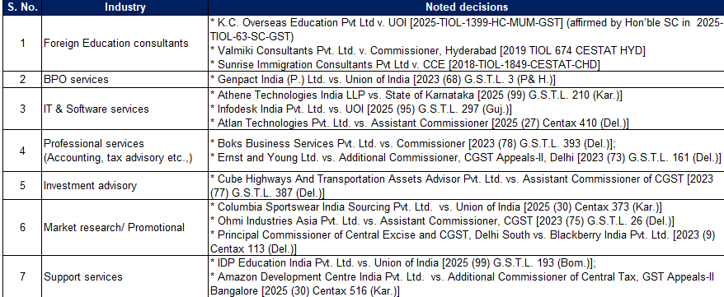
Intermediary services
Noted decisions in respect of intermediary services
ROI
36

Slide 37
Intermediary services
GST 2.0 change
Clause 13(8)(b) omitted.
Place of supply now = location of recipient (default s.13(2)).
Indian intermediaries → services to overseas clients qualify as exports (zero-rated).
Foreign intermediaries → services to Indian clients taxable @18% under reverse charge.
Analysis (Business Impact)
Major relief for Indian BPOs, consultants, brokers facilitating cross-border trade.
Encourages service exports & retention of forex inflows.
Reduces litigation on “intermediary” classification.
Aligns Indian GST regime with international trade practice.
ROI
37

Slide 38
Intermediary services
Prospective amendment - unless explicitly provided.
As amending the statute takes considerable amount of time - an exemption can be provided with the facility of ITC during the intervening period.
Action points for Industry
Revisit your cross border service procurement contracts - Import of service taxable, once amendment is effective
Industry could now consider realigning its charges for providing intermediary services, that could make them more competitive in the international market.
ROI
38

Slide 39
Concept of Mutuality

Slide 40
Concept of Mutuality
Section 7(1)(aa) – Supply includes the activities or transactions, by a person, other than an individual, to its members or constituents or vice-versa, for cash, deferred payment or other valuable consideration.
Apex Court has always held that supply of service as understood by COI requires existence of two persons -Ranchi Club v. CCE 2012, also quoted in Calcutta Club.
Self supply or self service is not envisioned in COI for the purpose of levy.
Article 246A empowers Union and States to levy tax on “supply” of goods and services. But does not empower to levy tax on “deemed supply” nor to enlarge the scope of the word “supply”
The above position is confirmed by the fact that sales tax on supply of goods by association to members was made leviable by inserting article 366 (29A). Thus, the power was given though Constitution amendment.
ROI
40

Slide 41
Concept of Mutuality
Sections 2(17)(e) and 7(1)(aa) and Explanation thereto as amended with retrospective effect from 01-07-2017 are unconstitutional and void being ultra vires provisions of Article 246A r/w Articles 366(12A) and 265 of COI - Indian Medical Association v. UOI – [2025 (29) Centax 232 (Ker.)].
Consequent amendments should be brought in CGST Act.
Supply between Distinct persons also under challenge.
Levy invalid – payments made shall be refunded without limitation subject to unjust enrichment.
ROI
41

Slide 42
GST implications of Affiliation fee

Slide 43
GST implications of Affiliation fee
The term “affiliation” typically refers to the formal recognition by a university, allowing a college to offer its courses.
University Grants Commission (UGC) regulates affiliation process.
Entry 66A of exemption N. No. 12/2017-CT (R) dated 28-06-2018 exempts affiliation services when provided by a Central or State Educational Board or similar body to a government school.
No such exemption to private schools, colleges, or deemed universities as clarified in Circular No. 234/28/2024-GST dated 11-10-2024.
Any classification which does not satisfy ‘Intelligible differentia’ and ‘Rational nexus to the objective’ could be struck down as violative of Article 14 of COI – Right to Equality.
Validity of entry 66A under GST is yet to be judicially tested in Courts.
ROI
43

Slide 44
GST implications of Affiliation fee
In Malappuram Distt. Parallel College Association v. UOI [2006 (2) S.T.R. 321 (Ker.)], it was held that
imposing tax on private (parallel) colleges while exempting regular government-affiliated ones was discriminatory, and violative of Article 14.
Equality must be assessed from the students’ perspective.
University also falls within the purview of ‘educational institution’ - Principal and Others v. Presiding Officer and Others [(1978) 1 S.C.C. 498] and Maharishi Markandeshwar Medical College and Hospital v. State of Himachal Pradesh [(2017) 6 S.C.C. 675].
No exemption provided for services exchanged b/s 2 educational institutions, except entry 66A ibid.
ROI
44

Slide 45
GST implications of Affiliation fee
Apex court in Mother Superior Adoration Convent [2021 (376) ELT 242 (SC)] has held that any ambiguity in exemptions should favor the taxpayer.
Is affiliation a sovereign, statutory or regulatory function?
UGC’s regulatory activities are not sovereign - P. Mahalingam v. University Grants Commission [W.P. No. 23672 of 2011 decided on 19-10-2012 [Madras HC]
Granting affiliation is a statutory/regulatory function - Rajiv Gandhi University of Health Sciences [2024 (8) TMI 209 - Karnataka HC] and Manonmaniam Sundaranar University [2021-TIOL-888-HC MAD-ST].
ROI
45

Slide 46
GST implications of Affiliation fee
Is education a business?
Providing education is not a business - T. M. A. Pai Foundation & Ors v State of Karnataka & Ors on 31-10-2002.
Service fees/charges collected by Corporations are obviously in the nature of compulsory levy and used for statutory obligations and hence cannot be subjected to service tax - In Commissioner of Central Excise, Nasik v Maharashtra Industrial Development Corporation [2018 (9) GSTL 372 (Bom)].
Where the main activity is not a business then any incidental or ancillary transaction would not get covered under business - Commissioner of Sales Tax v. Sai Publication Fund [(2002) 4 SCC 57].
ROI
46

Slide 47
GST implications of Affiliation fee
Nature of affiliation fee?
Payment made towards statutory functions is not consideration -
Bengaluru North University v. Joint Commissioner of Central Tax [TS-770-HC(KAR)-2025-GST]
Goa University v. Joint Commissioner of CGST & Central Excise [2025 (4) TMI 1056 - Bombay HC]
Principal Addl. Directorate General DGGSTI v. Rajiv Gandhi University of Health Sciences [2024 (8) TMI 209 - Karnataka HC].
Therefore, granting of affiliation could be fairly concluded as discharge of statutory or regulatory functions, thereby not leviable to GST, in the absence of contractual relationship.
Yet to be settled by Apex Court.
ROI
47

Slide 48
Limitation for filing appeal after rectification application

Slide 49
Limitation for filing appeal
Appeal is to be filed within 3 months from the date of communication of the decision or order. Further 1 month delay is condoned if Appellate Authority is satisfied that appeal was delayed due to sufficient cause.
Section 161 provides for rectification of any error apparent on the face of record of any decision or order or notice or certificate or any other document within a period of 3 months from the date of issue of such document sought for rectification.
No rectification after lapse of 6 months from date of issue.
Period of 6 months shall not apply for clerical or arithmetical error.
Personal hearing shall be given in case rectification adversely affects any person.
ROI
49

Slide 50
Limitation for filing appeal
Period spent in pursuing rectification application shall be excluded - Arvind Fashion Ltd. v. State of Haryana [2025 (36) Centax 7 (P&H.)].
Limitation shall begin from rectification order as original order merges into rectification order - Sri Ramajeyam Engineering Industries v. The Deputy Commissioner (ST) [2025 (1) TMI 886 - Madras HC] and SPK And Co. v. State Tax Officer, Ramanathapuram [(2024) 25 Centax 410 (Mad.)].
Appeals if filed immediately after rectification order, shall be heard on merits - TVL. SKL Exports v. Deputy Commissioner… [(2024) 19 Centax 278 (Mad.)].
ROI
50

Slide 51
Whether credit can be used for pre-deposit?

Slide 52
Whether credit can be used for pre-deposit?
Jyoti Construction v. Deputy Commissioner… [2021 (54) G.S.T.L. 279 (Ori.)], it was held that credit cannot be used for making pre-deposit.
Credit can be used for any payment towards output tax, whether assessed in the return or payable because of any proceeding instituted under GST –
Cir No. 172/04/2022-GST dated 06-07-2022
Oasis Realty v. UOI & Ors [2022 (10) TMI 42 - Bombay HC],
Tulsi Ram & Company v. Commissioner [2022 (9) TMI 1265 - Allahabad HC]
Yasho Industries Limited v. UOI (SCA NO. 10504 of 2023) (Guj) maintained by SC (SLP (CIVIL) Diary No(s). 17547/2025).
ROI
52

Slide 53
Provisional attachment of property

Slide 54
Provisional Attachment of property
Radha Krishan Industries v. State of Himachal Pradesh & Ors [2021 (48) G. S. T. L. 113 (SC)] & Valerius Industries v. UOI [2019 (30) G.S.T.L. 15 (Guj.)] -
It is very drastic and far reaching power, hence must be exercised with extreme care and caution.
Not to harass the tax payers or cause detrimental effect on business.
It shall be exercised as last resort/Measure and not as means of regular recovery.
It shall be done based on some credible materials & supervening factor and not casual evidence.
The Joint Commissioner while ordering a provisional attachment u/s 83 was acting as a delegate of the Commissioner in pursuance of the delegation effected u/s 5(3) and an appeal against the order of provisional attachment was not available u/s 107 (1);
The writ petition before the High Court under Article 226 of the Constitution challenging the order of provisional attachment was maintainable.

Slide 55
Provisional Attachment of property
The expression “necessary so to do for protecting the government revenue” implicates that the interests of the government revenue cannot be protected without ordering a provisional attachment;
The person whose property is attached is entitled to dual procedural safeguards:
An entitlement to submit objections on the ground that the property was or is not liable to attachment; and
An opportunity of being heard;
The Commissioner is duty bound to deal with the objections to the attachment by passing a reasoned order which must be communicated to the taxable person whose property is attached;
If appeal is filed against the order u/s. 73/74(9), the provisional attachment shall cease.
No second time attachment without change in facts & circumstances.

Slide 56
Blocking of E-credit ledger

Slide 57
Blocking of E-credit ledger
Blocking order of E-credit ledger without recording any reasons under Rule 86A and post-decisional hearing was set aside, subject to bank guarantee - Rithwik Projects Pvt. Ltd. v. UOI [(2025) 35 Centax 104 (Bom.)].
Parity Infotech Solutions (P.) Ltd. v. Government of National Capital Territory of Delhi [(2023) 7 Centax 169 (Del.)], it was held that
ITC blocking merely based on communication of another authority that same was availed on of fake invoices, was not sustainable.
Commissioner or an officer authorized by him not below rank of Assistant Commissioner is required to record reasons in writing upon specified conditions are fully satisfied for blocking of ITC.
Blocking would cease to have effect after 1 year from blocking date.
ROI
57

Slide 58
Parallel Proceedings

Slide 59
Parallel Proceedings
Section 6(2)(b) - Once a proceeding is started by Proper officer in either of the CGST/SGST acts, another proceeding for the same subject matter cannot be initiated by Proper officer of the other Act.
In Armour Security (India) Ltd. v. Commissioner… [(2025) 33 Centax 222 (S.C.)], it has held that -
“initiation of any proceedings” refers to the formal commencement of adjudicatory proceedings by way of issuance of a SCN, and does not encompass issuance of summons, or the conduct of any search/seizure etc.
“same subject matter" refers to any identical tax liability of tax or alleged offence on the same facts, and if the demand or relief sought is identical.
SCN issued for a liability already covered by an existing SCN shall be quashed.
Authorities shall decide inter-se whom to continue with the inquiry/ investigation and accordingly forward all material & information.
If not, the authority that first initiated the inquiry or investigation shall be empowered to carry it to its logical conclusion...”
ROI
59

Slide 60
Other Judicial Decisions

Slide 61
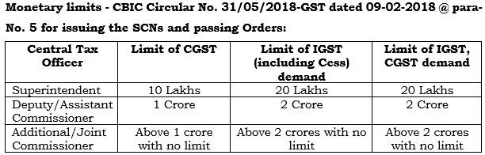
Other Judicial Decisions
Orders set-aside for lack of monetary jurisdcition -
Tata Steel Ltd. v. State of Jharkhand [2025 (4) TMI 427 - Jharkhand HC]
R.K. Ispat Ltd. & Ors. v. UOI & Ors. [TS-831-HC(J&K)-2025-GST]
Mansoori Enterprises v. U.O.I. [2024 (2) TMI 1183 - Allahabad HC].
ROI
61

Slide 62
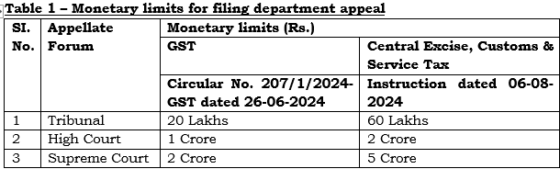
Other Judicial Decisions
Apex Court dismissed the department appeal on account of low tax effect (i.e., monetary threshold is not met) under GST and Customs in -
Assistant Commissioner v. Usha Gupta [Civil Appeal Nos.4533-4534/2023] (SC) (GST)
Commissioner of Customs and Central Excise, Hyderabad-II v. Crystal Dot Scan Pvt. Ltd. [(2025) 34 CENTAX 319 (S.C.)] (Customs).
ROI
62

Slide 63
Other Judicial Decisions
ITC could not be denied on account of seller’s registration cancellation after transaction date, since registration is valid on the date of transaction - Kesarwani Traders [(2025) 34 Centax 98 (All.)].
ITC cannot be denied on account of retrospective cancellation of seller’s registration without verifying the genuineness of transaction - Engineering Tools Corporation [2024 (15) Centax 388 (Mad.)].
In Bharat Aluminum Company Ltd. v. State of Chhattisgarh [(2025) 36 Centax 30 (Chhattisgarh)], it was held that -
ITC including Cess used for generating electricity for township consumption [non-business use] rather than for manufacturing or captive consumption, is ineligible.
ITC availed for effecting exempt supplies by sale of Duty Credit Scrips prior to 05-07-2022 is ineligible since amendment to Rule 43 excluding such sales from value of exempt supplies is prospective in nature.
ROI
63

Slide 64
Other Judicial Decisions
Composite SCN/order for multiple adjudications/periods is not permissible - Milroc Good Earth Developers v. UOI [(2025) 36 Centax 97 (Bom.)].
Issuance of multiple SCNs & orders for same period due to anomalies like orders on different entities, duplicated orders, or fresh orders – to be rectified as per Department SOP dated 14-10-2025 - Sri Venkateshwara Dairy Products v. Assistant Commissioner, [(2025) 36 Centax 12 (Telangana)].
SCN cannot fix the same date for reply and PH - Cosmopolitan Solar Energizer v. State of West Bengal & Ors. [2025 (11) TMI 188 – Calcutta HC].
PH cannot be fixed prior to date fixed for furnishing reply - GAC Shipping India Pvt. Ltd. v. Sales Tax Officer, Delhi [2024 (86) G.S.T.L. 340 (Del.)].
ROI
64

Slide 65
Other Judicial Decisions
Statutory requirement of proper officer’s signature cannot be dispensed with - Commissioner of CGST v. Water Techengineers [(2025) 36 Centax 58 (S.C.)].
Demands in order shall not be in excess that of SCN and no demand shall be confirmed on grounds other than grounds specified in notice - Prestige Nottinghill Investments v. UOI [(2025) 36 Centax 290 (Kar.)].
DRC-01 summary issued without authenticated attachments, any formal SCN and mentioning PH details is not valid - Diganta Kumar Deka v. State of Assam [(2025) 35 Centax 270 (Gau.)].
Order cannot be passed without issuing SCN - Baba Agriculture Export v. UOI [(2025) 35 Centax 232 (A.P.)].
Appeal filed within time limit cannot be rejected with hyper technical approach solely due to non-receipt of certified copies without hearing on merits - Sanjeet Kumar Bhagat v. Commissioner of State Tax [(2025) 35 Centax 105 (Jhar.)].
ROI
65

Slide 66
Other Judicial Decisions
Payments made during search & seizure before any SCN or quantification and without acknowledgment, was not voluntary u/s 74(5) or C.B.I. & C. Instruction No. 01/2022-23, rendering recovery illegal, thus requiring refund with interest as obtainment violated Articles 265 and 300-A - J. Ramesh Chand v. UOI [(2025) 35 Centax 272 (Kar.)].
Stock discrepancy cannot trigger confiscation u/s 130 rather assessment u/s 73 or 74 should be initiated - Santosh Pigment and Chemical Industries Pvt. Ltd. v. State of UP [(2025) 35 Centax 174 (All.)] and Additional Commissioner Grade-2 v. Dayal Product [(2025) 34 Centax 238 (S.C.)].
Where contract is quoted price exclusive of GST, department could not arbitrarily treat quoted price as GST-inclusive - SMS Ltd. v. Western Coalfields Ltd. [(2025) 35 Centax 219 (Bom.)].
ROI
66

Slide 67
Other Judicial Decisions
Section 74 cannot be invoked without allegations or establishing ingredients i.e., fraud or will-full misstatement or suppression of facts - Neeyamo Enterprise Solutions Pvt. Ltd. v. Commercial Tax Officer (State Tax) (Intelligence), Madurai [(2025) 36 Centax 341 (Mad.)].
Penalty u/s 129 cannot be imposed upon detention of goods in transit merely for non-filing of E-way bill due to technical glitch & no intent to evade tax -Archana Plasmould v. State of U.P. [(2025) 36 Centax 226 (All.)]
Information regarding GST returns cannot be provided under RTI Act as section 158 of GST Act specifically prohibits giving information of GST returns – Adarsh v. State of Maharashtra [(2025) 35 Centax 212 (Bom.)].
ROI
67

Slide 68

Thank You
Email queries/feedback -
ashalatha@hnaindia.com

