Slide 1
Income Tax Filing AY 2025-26
CA Mohit Bang |May 21, 2025
mohit.bang@trivbang.com | 91-7799 779957

Slide 2
ITR Forms and ITR Filing

Slide 3
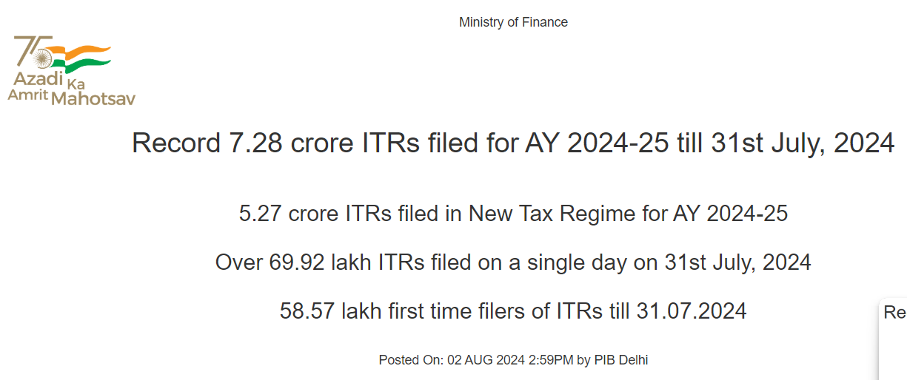
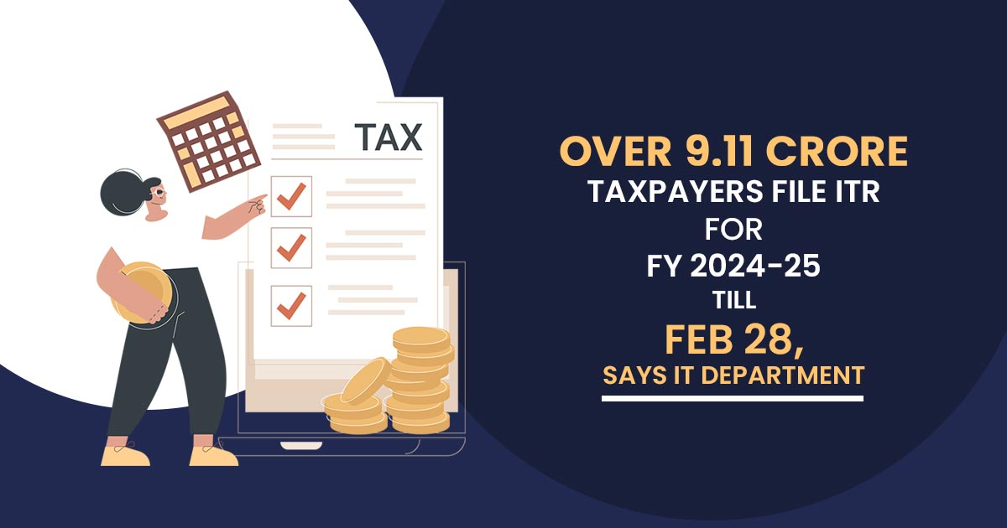

Slide 4
Sec 139 – Tax Filing
Total income in the FY > the exempted Income (Old Regime 2.5L & New Regime 3L)
Foreign Income or Holding assets outside India
Beneficiary of any foreign asset where details of such assets are NOT included by the Owner of such asset.
Deposited Rs. 1 crore or more in one or more current accounts with a bank.
Deposited more than Rs 50 lakh in your 'savings' bank accounts
Spent more than Rs 2 lakh on foreign travel whether for yourself or any other person
Electricity expenditure is more than Rs 1 lakh
TDS/TCS is more than Rs 25,000 (Rs 50,000 in case of Sr. Citizen)
Business turnover is more than Rs 60 lakh
Income from your profession is more than Rs 10 lakh
To carry forward your loss from business/profession or capital gains head.
For claiming income tax refund
For a visa or a loan
Filing within 139(1) Due date: 31st July 2025
Belated Filing Due Date 139(4): 31st December 2025
Revised Filing Due Date 139(5): 31st December 2025

Slide 5
ITR-1 (SAHAJ)
Applicable
Not Applicable
Individual (Ordinary Resident)
Losses to be B/f or C/f
Income / Loss under the head Capital Gains
Agricultural income in excess of Rs. 5,000;
Income from Business or Profession
Person claiming relief under section 90, 90A and/or 91
Holding Foreign Assets or having foreign sourced income
Is a director in any company
Has held any unlisted equity share at any time during the previous year.
Income to be Clubbed
Payment of tax has been deferred in respect of ESOPs allotted by an eligible startup
Income from Salary or Pension
Income from House Property or loss from One House Property
Long-term capital gains under section 112A up to Rs. 1.25 lakh and
Income from other sources
Income or loss from more than one house property.
Income from winnings from lottery or income from race horses
Sharing of Tax Credit
Total income must not exceed Rs. 50 Lakhs

Slide 6
ITR-4 (SUGAM)
Applicable
Not Applicable
Income from business and profession which is computed under sections 44AD, 44ADA or 44AE.
Losses to be B/f or C/f
Income / Loss under the head Capital Gains
Agricultural income in excess of Rs. 5,000;
Income from Speculative Business
Holding Foreign Assets or having foreign sourced income
Is a director in any company
Has held any unlisted equity share at any time during the previous year.
Income to be Clubbed
Payment of tax has been deferred in respect of ESOPs allotted by an eligible startup
Income or loss from more than one house property.
Income from winnings from lottery or income from race horses
Sharing of Tax Credit
Individuals, HUFs and Firms (other than LLP)
Income from Salary or Pension
Income from House Property or loss from One House Property
Long-term capital gains under section 112A up to Rs. 1.25 lakh and
Income from other sources
Total income must not exceed Rs. 50 Lakhs
Person claiming relief under section 90, 90A and/or 91

Slide 7
ITR-2 & ITR-3
ITR 2
ITR 3
It is applicable to an individual or an Hindu Undivided Family NOT having income chargeable to income-tax under the head “Profits or gains of business or profession”
It is applicable to an individual or a Hindu Undivided Family who has any income chargeable to tax under the head business or profession

Slide 8
Key changes in ITR Forms

Slide 9
11 Key Changes in ITR Forms
1/11
Expanded Eligibility for ITR-1 and ITR-4
Taxpayers with long-term capital gains (LTCG) up to ₹1.25 lakh from listed equity shares and mutual funds can now file using the simpler ITR-1 (Sahaj) and ITR-4 (Sugam) forms, provided there are no capital losses to carry forward or set off.
2/11
Mandatory Aadhaar Number
The option to use the Aadhaar Enrolment ID for PAN applications and ITR filings has been removed. Taxpayers must now provide their actual Aadhaar number when filing returns
3/11
Detailed Capital Gains Reporting
The updated ITR forms require more granular reporting of capital gains, including specifying the date of sale to determine if it occurred before or after July 23, 2024. This change aligns with the tax rule adjustments for LTCG introduced in the Union Budget 2024

Slide 10
Key Changes in ITR Forms
4/11
Clause-Level Deduction Reporting
Deductions under Sections 80C to 80U must now be selected from a detailed drop-down list in the ITR forms, improving transparency and precision in claims.
5/11
Increased Reporting Threshold for Assets and Liabilities
The threshold for mandatory reporting of assets and liabilities has been raised to ₹1 crore of Gross Income, enhancing compliance for higher-income taxpayers.
6/11
Changes in TDS Schedule of the ITR Forms
Additional column to mentioned the section under which the TDS was to be deducted instead of just amount and deductor.

Slide 11
Key Changes in ITR Forms
7/11
Providing disability certificates for deduction under Section 80DD and 80U
This year, a taxpayer claiming any of the deduction is required to provide acknowledgement number of the disability certificate in addition to the Ack no and date of Form 10-IA.
8/11
Reporting of buy-back proceeds as deemed dividends
From October 1, 2024, the amount received on the buy-back of shares by domestic listed companies will be considered as deemed dividends in the hands of shareholders and the Cost of Acquisition is to be claimed as Capital Loss. The new rule was announced in Budget 2024. The reporting requirements have been made in the ITR-2 and ITR-3 for this.
9/11
Detailed disclosure under Income from House Property
Detailed disclosure related to Interest on Borrowed Capital for House Property. Dropdown to be provided in the efiling utility.
This reporting requirement is applicable only if ITR-2 and ITR-3 is filed. There is no reporting requirement if the taxpayer files ITR-1

Slide 12
Key Changes in ITR Forms
10/11
Reporting for capital gains from Unlisted Bonds & Debentures
According to the new rules, if unlisted debentures or bonds redeemed, matured, or transferred on or after 23rd July 2024, the entire gain will be taxed as short-term capital gains, regardless of the holding period. As per the new rules, the gains will be taxed at the income tax slab rates applicable to your income. However, if the maturity, redemption or transfer occurs before July 23, 2024, the resulting gain will be classified as long-term and taxable according to the old provision. Under the old rules, the capital gains will be taxed at 20% with indexation benefit.
.
11/11
Enhanced Disclosure for Tax Regime Selection
Taxpayers must explicitly declare their choice between the old and new tax regimes within the ITR forms. For those with business income opting out of the new regime, submission of Form 10-IEA is mandatory, along with providing the acknowledgment number in the return.
Detailed questionnaire required to be filed now under ITR 3 & 4

Slide 13
Key Changes in ITR Forms

Slide 14
Precautions while Filing the Returns
Understanding the Requirements
Validate Pre Filled Data
Verify 26AS, AIS, TIS
Verify all Supporting Documents
Pre-validate on IT Portal
Other Forms
Identify the ITR Form based on the Income Sources
Ensure details like permanent address, contact details, bank account details, etc. are correct in the pre-filled data.
Carefully consider the Form 26AS, AIS/ TIS. Avoid duplicate information.
Gather all key documents including bank statements, interest certificates, receipts for deductions, Form 16, Form 26AS, investment proofs, etc. Reconcile information in AIS with other documents.
Carefully select the tax regime. The new tax regime applies by default.
Pre-validate the Bank account on Tax Portal to get refund.
Carefully file and quote The other Forms wherever necessary. Form 67, 10E, 10 IEA, 10IA
Ensure Aadhar – Pan linking
Provide feedback on Insight portal related to invalid entries in AIS/TIS
Check for any self assessment tax paid in the relevant AIS/ TIS forms
Specific Reporting
Carefully report the Specific reporting sections – Passthrough Income, Foreign Assets, Buyback of Shares, etc
Report income under the correct head
Report income under the correct head – Ex. Receipts under 194J should not be reported as Other Income
Timely E-verification
After filing, e-verify your return is a must. If not everified within 30 days of filing, the return is treated an invalid.

Slide 15
Consequences of Delayed Filing
Delayed Filing
No option to choose Tax Regime
Losses cannot be carried forward
Additional interest u/s 234A & 234C
Penalty u/s 234F of Rs. 5,000/1,000

Slide 16
Updated Returns – ITR U
What’s Changed?
Time limit to file ITR-U extended from 24 to 48 months from end of relevant assessment year
Who Can File ITR-U?
Taxpayers who: Missed filing ITR; Reported incorrect income; Used wrong income heads or tax rates
When Can It Be Filed?
Starts after the end of relevant assessment year
Penalty Structure Based on Delay
Filed within 12 months: 25% additional tax
Between 12–24 months: 50% additional tax
Between 24–36 months: 60% additional tax
Between 36–48 months: 70% additional tax
Both filers and non-filers of original ITR
Cannot be used to claim refunds or reduce tax liability
Example: FY 2024-25 → AY 2025-26
ITR-U filing: April 1, 2026 to March 31, 2030
This means you can now file updated ITRs for assessment years 2021-22, 2022-23, 2023-24, and 2024-25.

Slide 17
Disclosure of Foreign Assets in ITR

Slide 18
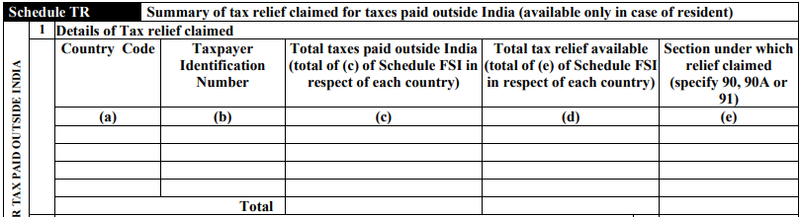
Schedule FSI & TR

Slide 19
Schedule FA Disclosure Requirement
As a part of the income tax filing, Schedule FA requires taxpayers to disclose details about their investments, including stocks, Stock Options and other assets.
Resident (Ordinary Resident) holding foreign assets are mandatorily required to file return and report assets under Schedule FA (Fourth proviso to Section 139(1))
Table No. | Particulars
A1 | Details of Foreign Depository Accounts held (including any beneficial interest) at any time during the calendar year ending as on 31st December 2024
A2 | Details of Foreign Custodial Accounts held (including any beneficial interest) at any time during the calendar year ending as on 31st December 2024
A3 | Details of Foreign Equity and Debt Interest held (including any beneficial interest) in any entity at any time during the calendar year ending as on 31st December 2024
A4 | Details of Foreign Cash Value Insurance Contract or Annuity Contract held (including any beneficial interest) at any time during the calendar year ending as on 31st December 2024
B | Details of Financial Interest In Any Entity held (including any beneficial interest) at any time during the calendar year ending as on 31st December 2024
C | Details of Immovable Property held (including any beneficial interest) at any time during the calendar year ending as on 31st December 2024
D | Details of Any Other Capital Asset held (including any beneficial interest) at any time during the calendar year ending as on 31st December 2024
E | Details of Account(s) in which you have signing authority held (including any beneficial interest) at any time during the calendar year ending as on 31st December 2024 and which has not been included in A to D above
F | Details of trusts, created under the laws of a country outside India, in which you are a trustee, beneficiary or settlor
G | Details of any other income derived from any source outside India Which is not included in,-(I)item A to F above and, (II)Income under the head business or profession

Slide 20
Schedule FA – Disclosure of Broker Account
Rule 114F
(a) "depository account" includes any commercial, checking, savings, time, or thrift account, or an account that is evidenced by a certificate of deposit, thrift certificate, investment certificate, certificate of indebtedness, or other similar instrument maintained by a financial institution in the ordinary course of a banking or similar business and also an amount held by an insurance company pursuant to a guaranteed investment contract or similar agreement to pay or credit interest thereon;
(b) "custodial account" means an account (other than an insurance contract or annuity contract) for the benefit of another person that holds one or more financial assets;

Slide 21
Schedule FA – Disclosure of Stocks
Any Asset held at anytime during the calendar year ending as on
31st December 2024
For the purpose of this Schedule, the rate of exchange for conversion of the peak balance or value of investment or the amount of foreign sourced income in Indian currency shall be the “telegraphic transfer buying rate” of the foreign currency as on the date of peak balance in the account or on the date of investment or the closing date of the accounting period.
Telegraphic transfer buying rate means the rate or rates of exchange adopted by SBI

Slide 23
Thank You!
mohit.bang@trivbang.com | 91-7799 7799 57

