Slide 1


THE FINANCE BILL, 2026
CA Rajendra Prasad Talluri
B.Com; CA; Grad CWA, DIIT (ICAI), LLB
Date: 2nd Feb 2026
CA RAJENDRA PRASAD TALLURI [RP]

Slide 2
Various Amendments proposed to the Income Tax Act, 1961
Sl No | Particulars
A | Rates of Income Tax
B | Ease of living
C | Rationalizing penalty and prosecution
D | Co-operatives
E | Supporting IT Sector as India’s growth Engine
F | Attracting global business and investment
G | Rationalization of corporate tax regime
H | Rationalization of other direct tax provisions
CA RAJENDRA PRASAD TALLURI [RP]
2

Slide 3
A: Rates of taxes
CA RAJENDRA PRASAD TALLURI [RP]
3

Slide 4
No Changes in Rates of Income Tax for the Tax Year 2026-27
There are no changes in the rates of taxes.
New Scheme of Taxation shall be the default scheme even under the New IT Act, 2025 for the Individuals, HUFs, AOPs (Other than Co-operative Societies), BOIs, AJPs. This is clear from the language employed in Sec 202(4). Where they wish to opt for old scheme, then the tax rates would be as specified in Part 1B of the First Schedule of the Fin Bill 2026.
Note : Sec 202 of ITA, 2025 corresponds to Sec 115BAC of IT Act, 1961.
CA RAJENDRA PRASAD TALLURI [RP]
4

Slide 5
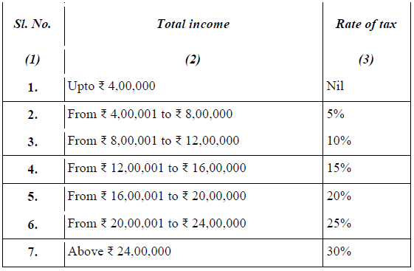
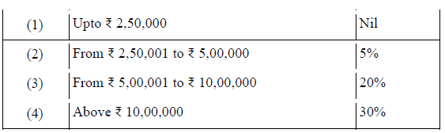
Tax rates applicable to Individuals, HUFs, AOPs (Other than Co-ope), BOIs, AJPs for TY2026-27
Sec 202(4) Rates
Rates as per Part 1B of the First schedule to the Fin Bill, 2026
CA RAJENDRA PRASAD TALLURI [RP]
5

Slide 6
B: Ease of living
CA RAJENDRA PRASAD TALLURI [RP]
6

Slide 7
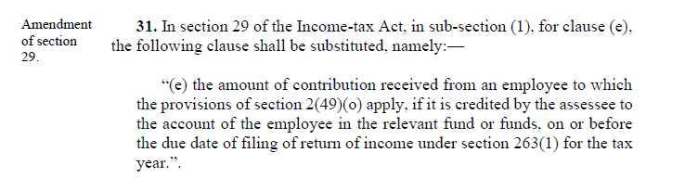
Employees’ contributions to welfare funds are allowed as deduction if deposited by the due date for filing the return of income U/s 263(1) [Sec 29(1)(e)] [WEF TY 2026-27]
Sec 29(1)(e) dealing with Employees’ contributions to welfare funds is substituted so that the same will be allowed as deduction while computing the PGBP U/s 26 if they were deposited on or before the due date for filing return of income U/s 263(1).
Note : Sec 29(1)(e) of ITA, 2025 corresponds to Sec 36(1)(va) of IT Act, 1961.
Note : Sec 263(1) of ITA, 2025 corresponds to Sec 139(1) of the IT Act, 1961.
CA RAJENDRA PRASAD TALLURI [RP]
7

Slide 8
Interest received under Motor Vehicles Act, 1988 is exempt for individuals and their legal heirs and Consequently no TDS is required on such interest {Sec 11 read with Schedule III} and {Sec 393(4) [Table Sl No 7, Column C (c)(iv)]} [W.E.F TY 2026-27]
Newly 3 entries (viz 38A, 38B and 38C) are added in Schedule III of which entry number 38B provides exemption to an individual or his legal heir on the interest received under the Motor Vehicles Act, 1988.
Thus, where an individual or his legal heir receives any interest on the compensation under the Motor Vehicles Act, 1988, then such interest is exempt from Income Tax.
The table in Sec 393(4) deals with the cases where No TDS is required on rent, commission, compensation, interest etc,. Sl No 7 of the said table provides the cases where TDS is not required w.r.t certain types of interests. Sl No 7(c)(iv) is so amended to provide that
TDS is not required on the interest on compensation amount awarded by a Motor Accidents Claims Tribunal to an individual;
TDS is not required on the interest on compensation amount awarded by a Motor Accidents Claims Tribunal to any person other than an individual where the aggregate interest on such compensation does not exceed RS 50,000/- during the tax year.
CA RAJENDRA PRASAD TALLURI [RP]
8

Slide 9
Application for Lower TDS / Nil TDS certificates can also be made to prescribed Income Tax Authority [Sec 395(6)] [W.E.F TY 2026-27]
Introduction of new subsection (6) in Sec 395 which enables the small tax payers to make application for lower TDS / Nil TDS with prescribed income tax authority: It is proposed to ease the compliance burden of small taxpayers by providing an option to the payee, to file the application for issuance of certificate for lower or nil deduction of income-tax electronically before the prescribed income-tax authority, which may issue the certificate subject to fulfilment of conditions as may be prescribed, or reject the application if prescribed conditions are not fulfilled or the application is incomplete.
CA RAJENDRA PRASAD TALLURI [RP]
9

Slide 10
TAN requirements are not applicable for Resident Individuals / HUFs when they are buying immovable property even from a non-resident [Sec 397(1)] [W.E.F 01.10.2026]
Substitution of Sec 397(1)(c) which provides that TAN requirements are not applicable for ‘Resident Individuals / HUF’ buyers w.r.t immovable property : Presently, if a person buys an immovable property from a resident seller, the person is not required to obtain (TAN) to deduct tax at source. However, where seller of the immovable property is a non-resident, the buyer is required to obtain TAN to deduct tax at source. This creates unnecessary compliance burden for the buyer, as he would need TAN for a single transaction. In order to reduce compliance burden for the resident individual and Hindu undivided family, it is proposed to amend section 397(1)(c) of the Act to provide that resident individual or Hindu undivided family, is not required to obtain TAN to deduct tax at source in respect of any consideration on transfer of any immovable property under section 393(2).
CA RAJENDRA PRASAD TALLURI [RP]
10

Slide 11
Enabling filing of declaration for no deduction to a depository in stead of filing to the companies / MFs [Sec 393(6)] [W.E.F 01.04.2027]
Amendment of Sec 393(6) which enables Small Resident individual investors to furnish declarations to the depositories for non deduction of TDS so that they can receive interest income / dividend income / income from units of mutual funds without TDS; The depositories in turn share the same to the companies / mutual funds who shall file the same to the prescribed authority on quarterly basis:
Investors earning income from multiple units and securities face a cumbersome process, needing to submit separate forms to all entities thus leading to enhanced compliance. In order to reduce compliance burden of such investors, it is proposed to allow filing of the declaration to the depository which in turn shall provide such declaration to the person responsible for paying such income.
Further, in order to ease the compliance for the person responsible for paying income or sum of the nature as specified in Column C of the Table in section 393(6), the time limit for furnishing the declaration received by them to the prescribed Income tax authority have been changed from monthly basis to quarterly basis.
However, only those investors who have held the securities or units in the depository and where the securities are listed in registered stock exchange in India are proposed to furnish the declaration to the depository.
CA RAJENDRA PRASAD TALLURI [RP]
11

Slide 12
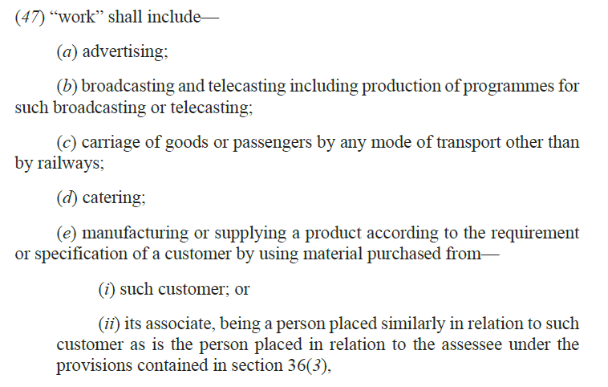

Supply of manpower is included in the scope of ‘WORK’ and attracts TDS at 1% or 2% [Sec 393(1) Table 6(i) / 6(ii)] read with Sec 402(47) [W.E.F 01.04.2026]
Sec 402(47) is so amended to include ‘Supply of manpower’ within the scope of ‘WORK’ for the purposes of TDS U/s 393(1) Table 6(i)/(ii) and hence TDS is attracted at 1% or 2% as the case may be:
There is ambiguity with regard to applicable rate of TDS for supply of manpower that whether provisions under section 393(1) [Table: Sl. No. 6(i)/(ii)] or [Table: Sl. No. 6(iii)] shall be applied.
In order to provide clarity with regard to the deduction of tax at source in case of supply of manpower, it is proposed to include it under the ambit of “work” in section 402(47) so that the provisions of Section 393(1)[Table: Sl. No. 6(i)] or 393(1)[Table: Sl. No. 6(ii)], as the case may be, applies.
Sec 393(1) Table 6(i) is parallel to Sec 194C;
Sec 393(1) Table 6(ii) is parallel to Sec 194M [Ind / HUF paying in excess of Rs 50 lakhs for works etc];
Sec 393(1) Table 6(iii) is parallel to Sec 194J
CA RAJENDRA PRASAD TALLURI [RP]
12

Slide 13
Amendment of Schedule XIV dealing with Non Life Insurance Business [W.E.F 01.04.2026]
Schedule XIV dealing with computation of Business income for Non Life Insurance Business is so amended to allow expenses as allowable deductions upon compliance to TDS provisions at a later point in time. [i.e Similar to Sec 40(a)(ia)/(i)]. Post amendment, not only the expenses disallowed due to Sec 37 [i.e Old Sec 43B] but also due to Sec 35(b)(i) and (ii) [i.e Old Sec 40(a)(ia)/(i)] are allowed after the same were paid / TDS provisions are complied with, as the case may be.
Note: Section 35(b)(i) and (ii) of the Act provides that any sum, interest, etc. payable on which tax is deductible at source but has not been deducted or deducted but not paid within the due date specified in section 263(1), then the amount as mentioned in the respective sections shall not be allowed as deduction. Further, section 35(b)(i) and (ii) also provide that the amount disallowed shall be allowed in a tax year when the due tax was deducted and paid as per the provisions of the section. [Sec 35(b)(i) covers the expenses paid / payable to residents while Sec 35(b)(ii) covers the expenses paid / payable to non-residents].
CA RAJENDRA PRASAD TALLURI [RP]
13

Slide 14
Income received on account of compulsory acquisition of land is exempt for individuals and HUFs where the award / agreement is made under the provisions of RFCTLARR, 2013 {Sec 11 read with Schedule III} [W.E.F 01.04.2026]
Newly 3 entries (viz 38A, 38B and 38C) are added in Schedule III of which entry number 38C provides exemption to an individual or HUF where they receive any income on account of compulsory acquisition of any land and where the award or agreement is made under the provisions of the Right to Fair Compensation and Transparency in Land Acquisition, Rehabilitation and Resettlement Act, 2013.
Please note that under the provisions of the IT Act, 1961, exemption is provided in the above cases through circular 36/2016 whereas the exemption is provided in the new ITA, 2025 through the Act itself. Please also note that Sec 96 of RFCTLARR provides exemption to the compensation awarded under that Act except in the cases covered under section 46 of the said Act. [Sec 46 deals with the cases of land acquisition by private parties exceeding the threshold limit which is not exempt.]
Entry Number 38A Schedule III : Disability pension received by armed personnel
Entry Number 38B Schedule III : Interest on motor accident claims
Entry Number 38C Schedule III : Compensation on compulsory acquisition of land
CA RAJENDRA PRASAD TALLURI [RP]
14

Slide 15
Disability pension received by an individual pursuant to invalidation out of ‘Armed Forces / Para military’ on account of bodily disability attributed to service is exempt {Sec 11 read with Schedule III} [W.E.F 01.04.2026]
Newly 3 entries (viz 38A, 38B and 38C) are added in Schedule III of which entry number 38A provides exemption to the disability pension received by an individual who has been a member of the armed forces (including paramilitary forces) of the Union.
Please note that exemption is available if the following 2 conditions are satisfied.
The individual has been invalided out of service in the armed forces on account of bodily disability attributable to, or aggravated by such service; and
The individual has not retired on superannuation or otherwise.
Entry Number 38A Schedule III : Disability pension received by armed personnel
Entry Number 38B Schedule III : Interest on motor accident claims
Entry Number 38C Schedule III : Compensation on compulsory acquisition of land
CA RAJENDRA PRASAD TALLURI [RP]
15

Slide 16
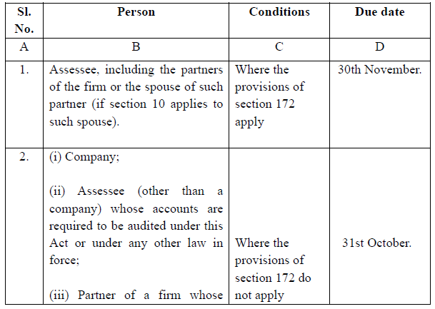
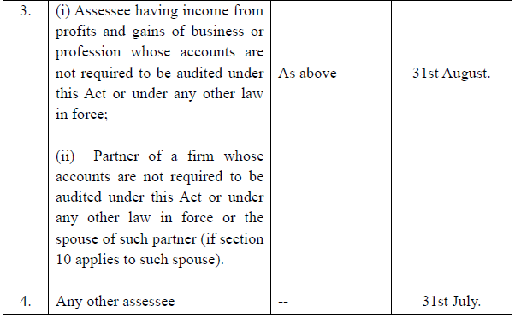
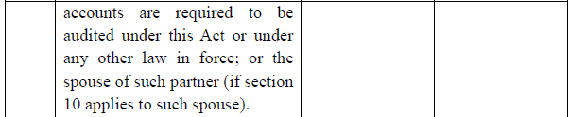
Due dates for filing the returns are amended [Sec 263 of the ITA 2025] [WEF TY 2026-27]
Due dates for filing the returns are amended [Sec 139(1) of the ITA 1961] [WEF AY 2026-27]
TP cases: 30th Nov; Companies, Audit cases = 31st Oct; Others having Business / Profession = 31st Aug; Others not having Business / Profession = 31st July
Sec 172 of ITA 2025 deals with TP Audit Report which is parallel to Sec 92E of ITA 1961.
CA RAJENDRA PRASAD TALLURI [RP]
16

Slide 17
Time limit for revised returns is extended till March but with a fees [Sec 263(5) of the ITA 2025] [WEF TY 2026-27]; [Sec 139(5) of the ITA 1961] [WEF AY 2026-27]
It is proposed to amend section 263(5) of the Act so as to increase the prescribed time limit for filing the revised return from its existing time limit of nine months to twelve months from the end of the relevant tax year. Further, a fee is also proposed under section 428(b), for revised returns which are filed beyond nine months from the end of relevant tax year. similar amendments are also proposed in section 139(5) of the Income-tax Act, 1961. Further, a fee is also proposed under section 234-I.
Both Original Return and Belated Return can be revised;
Belated return is to be filed within a period of 9 months from the Relevant Tax Year / Relevant Previous Year; [Note that belated return attracts fees of Rs 1000 where TI is up to Rs 5 Lakhs and attract a fees of Rs 5000 where the TI exceeds Rs 5 Lakhs]
Revised Return can be filed up to 12 months from RTY / RPY;
Fees U/s 428(b) or Sec 234-I are not attracted if the revised return is filed till 9 months; However, fees is attracted for beyond 9 months till 12 months. [Taxable income up to Rs 5 Lakhs = Rs 1,000 Fees; Taxable income exceeding Rs 5 Lakhs = Rs 5,000 Fees]
CA RAJENDRA PRASAD TALLURI [RP]
17

Slide 18
Updated return is possible in case of reduction of losses [Sec 263(6) of the ITA 2025]; [WEF TY 2026-27]; [Sec 139(8A) of the ITA, 1961] [WEF 1st March 2026]
Section 263(6)(b) provides that taxpayer may file the updated return in such cases where original return filed under section 263(1) of the Act is a return of loss and updated return being filed thereafter, is a return of income. However, section 263(6)(c)(i) of the Act had created a restriction that updated return cannot be furnished in such cases where updated return is a return of loss for the said tax year.
It is proposed to amend section 263(6) of the Act, so as to allow filing of updated return in such cases where taxpayer reduces the amount of loss in comparison to the amount of loss claimed in the return of loss furnished within the due date specified under sub-section (1).
Similar amendments are made in Sec 139(8A) of the ITA, 1961.
CA RAJENDRA PRASAD TALLURI [RP]
18

Slide 19
Updated return is possible after issuance of notice of re-assessment U/s 280 [WEF TY 2026-27]; To pay extra 10% over and above the existing amounts of 25% / 50% / 60% or 70% of ‘tax plus interest’ as per Sec 267; In such cases penalty U/s 439 is not attracted. [Sec 139(8A) rws Sec 148; Sec 270A of the ITA 1961] [WEF 1st March 2026]
It is proposed that updated return may also be allowed in such cases where proceedings of reassessment have been initiated and notice of reassessment has been issued under section 280 of the Act as the same would reduce litigation and in such a case assessee shall be precluded from filing return of income in pursuance of notice under section 280 in any other manner.
It is further proposed to amend the section 267 of the Act so as to prescribe that where an updated return is filed in pursuance of a notice issued under section 280 within the period specified in the said notice, the additional income-tax payable shall be increased by a further sum of 10 % of the aggregate of tax and interest payable on account of furnishing the updated return.
It is further proposed that where additional income-tax is paid as per proposed additional income-tax, the income on which such additional income-tax is paid shall not form the basis of imposition of penalty under section 439. [Similar amendments are made in Sec 139(8A); Sec 140B; 270A of the ITA, 1961.]
CA RAJENDRA PRASAD TALLURI [RP]
19

Slide 20
Introduction of FAST – DS 2026 [Foreign Assets of Small Tax Payers – Disclosure Scheme, 2026 [To be effective from the date to be notified by the CG]
The Black Money (Undisclosed Foreign Income and Assets) and Imposition of Tax Act, 2015 was enacted to address the issue of undisclosed foreign income and assets held by resident taxpayers.
It has been observed that non-compliance is particularly prevalent in cases involving legacy or inadvertent non-disclosures for small taxpayers, including holdings arising from foreign employment benefits such as ESOPs or RSUs, dormant or low-value foreign bank accounts of former students, savings or insurance policies of returning non-residents, and assets held by individuals on overseas deputation. Further, information received under the Automatic Exchange of Information framework indicates non-disclosure of foreign financial assets by a significant number of PAN holders.
In order to facilitate voluntary compliance and enable resolution of such legacy cases of small taxpayers, it is proposed to introduce a time-bound scheme for declaration of foreign assets and foreign-sourced income, with payment of tax or fee based on the nature and source of acquisition and grant of limited immunity from penalty and prosecution under the Black Money Act in respect of matters covered by the declaration.
Cases involving prosecution or proceeds of crime are proposed to be excluded from the scheme. [i.e They are not eligible for opting of the scheme.]
CA RAJENDRA PRASAD TALLURI [RP]
20

Slide 21
C: Rationalizing penalty and prosecution
CA RAJENDRA PRASAD TALLURI [RP]
21

Slide 22
Aligning Prosecution Provisions with Penalty Provisions under the Black Money Act, 2015 [WEF 01.10.2024]
Relaxation from the prosecution provisions in the case of Non Disclosure of Foreign Assets where the aggregate value of the Foreign Assets does not exceed Rs 20 Lakhs. However, there is no relaxation w.r.t immovable property. i.e Even minor amount of immovable property requires disclosure, else, prosecution provisions are applicable.
The Black Money (Undisclosed Foreign Income and Assets) and Imposition of Tax Act, 2015 was enacted to address the issue of undisclosed foreign income and assets held by resident taxpayers.
Sec 49 and 50 of the said Act deal with Prosecution provisions ranging from rigorous imprisonment for a minimum term of 6 months to maximum of term of 7 years plus fine.
Note: [Sec 49 covers the cases where the ROR wilfully fails to furnish Return before the end of the Relevant Assessment Year]; [Sec 50 covers the cases where the ROR filed the return but wilfully fails to disclose foreign assets / foreign sourced income].
In order to provide relief in cases of minor and inadvertent non-disclosures and to align the prosecution provisions with the penalty framework under the Black Money Act, it is proposed to amend sections 49 and 50 to provide that these provisions shall not apply in respect of foreign assets, other than immovable property, where the aggregate value does not exceed twenty lakh rupees.
CA RAJENDRA PRASAD TALLURI [RP]
22

Slide 23
Rationalization of prosecution proceedings [Sec 473 to 485 and 494 of ITA, 2025] [WEF 01.04.2026]
Rationalization of prosecution proceedings [Sec 275A to 278A and 280 of ITA, 1961] [WEF 01.03.2026]
General Principles followed in the proposed decriminalization exercise are as under:
The nature of punishment is changed from rigorous imprisonment to simple imprisonment wherever prescribed in the sections mentioned above. [Simple imprisonment = No hard labor]
Maximum punishment is proposed to be limited to 2 years from its current 7 year and for the subsequent offences, it is reduced to 3 years from its current 7 years.
Wherever punishment of offences is prescribed based on certain grading of amount of tax evaded, new grading of offences and its corresponding punishment is prescribed.
For amount of tax evaded does not exceeds ten lakh rupees, punishment of only fine is prescribed.
Imposition of fine is introduced in lieu of or in addition of imprisonment. Certain offences are fully decriminalized.
CA RAJENDRA PRASAD TALLURI [RP]
23

Slide 24
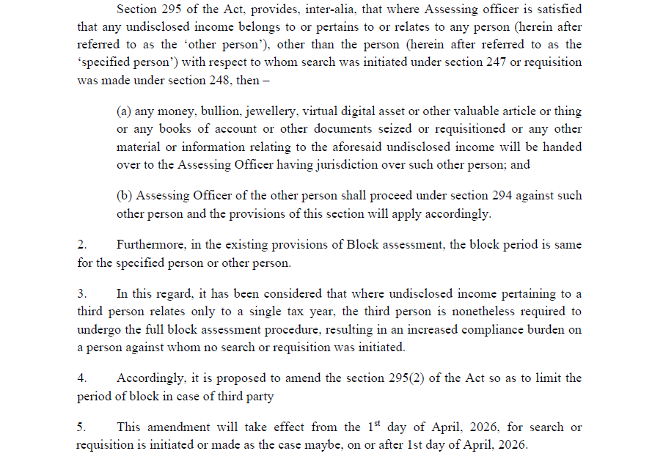
Rationalizing the period of block in case of other persons [Sec 295 of ITA, 2025] [WEF 01.04.2026]
Block Period is same for the searched party and other party in the ITA 2025. Sec 295 is further amended to restrict the search assessment to a single year in the case of other party where the undisclosed income relates to a single year.
CA RAJENDRA PRASAD TALLURI [RP]
24

Slide 25
Time Limit for completion of search assessment is to be reckoned from the date of initiation of search and it is extended to 18 months from the end of the quarter [Sec 296 of ITA, 2025] [WEF 01.04.2026]
As per the existing provisions of Sec 296 of ITA, 2025 the search assessment is to be completed within a period of 12 months from the end of the quarter in which the last search authorization was executed or requisition was made.
It is proposed to amend the provisions of Sec 296 of ITA, 2025 so as to take the date of initiation of search as the reference point to decide the date of limitation for block assessment and the existing period of 12 months is extended to 18 months.
Thus, post amendment, the search assessment order U/s 294 is to be passed within a period of 18 months from the end of the quarter in which the search was initiated. [Sec 296]
CA RAJENDRA PRASAD TALLURI [RP]
25

Slide 26
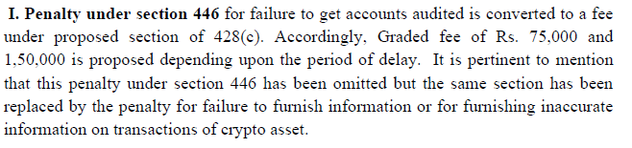

Rationalization of Penalties into Fee [Sec 446,447 and 454 of ITA, 2025] [WEF 01.04.2026]
Hence, delay in tax audit report attracts fees of Rs 75K where the delay is one month; Beyond that it attracts fees of Rs 1.50 Lakhs
Hence, delay in TP audit report attracts fees of Rs 50K where the delay is one month; Beyond that it attracts fees of Rs 1.00 Lakh
Hence, delay in filing SFT attracts per day fees of Rs 200 and the maximum amount is Rs 1 Lakh;
Further, there is a penalty in the cases covered in Sec 454. i.e It is for the delay beyond the period permitted by the AO for submission of SFT. In such cases, penalty of Rs 1000 per day subject to a maximum of Rs 1 Lakh.
CA RAJENDRA PRASAD TALLURI [RP]
26

Slide 27
Imposition of penalty for under-reporting or misreporting of income within Assessment Order: [Both the Acts]
Going forward, there will be a combined order (i.e Assessment and penalty order in the same order); Int U/s 220(2) is attracted from the date of the order of the CIT-A Or ITAT (for appeal against DRP Orders)
CA RAJENDRA PRASAD TALLURI [RP]
27

Slide 28
Rationalization of tax rate under section 195 and penalty under section 443 in respect of certain Income: [WEF 01.04.2026] [These correspond to Sec 115BBE and 271AAC]
It is proposed to amend section 195 to reduce the tax rate from 60% to 30%. Further, it is also proposed to omit penalty under section 443 and subsume this penalty under section 439(11) of the Act. [i.e The tax rate is reduced to 30% and the penalty of 10% contained in Sec 271AAC is moved to Sec 270A in the new Act.]
CA RAJENDRA PRASAD TALLURI [RP]
28

Slide 29
Expanding the scope of immunity from penalty or prosecution under section 440 of the Act [WEF 01.04.2026] [These correspond to Sec 270AA]
Proposals in the New Act, 2025: Waiver is possible for mis reporting cases also. In such cases, 100% of the taxes are to be paid extra for obtaining immunity. [i.e Tax + Int + 100% of tax extra]; Where waiver is sought w.r.t 195 cases (i.e parallel to 115BBE cases), then pay 120% of tax as extra. [i.e Tax + Int + 120% of tax extra]
Proposals in the ITA Act, 1961: Waiver is possible for mis reporting cases also. In such cases, 100% of the taxes are to be paid extra for obtaining immunity. [i.e Tax + Int + 100% of tax extra]; Here, 115BBE cases are not covered under the immunity scheme.
CA RAJENDRA PRASAD TALLURI [RP]
29

Slide 30
D: Co-operatives
CA RAJENDRA PRASAD TALLURI [RP]
30

Slide 31
E: Supporting IT Sector as India’s growth Engine
CA RAJENDRA PRASAD TALLURI [RP]
31

Slide 32
F: Attracting global business and investment
CA RAJENDRA PRASAD TALLURI [RP]
32

Slide 33
G: Rationalization of corporate tax regime
CA RAJENDRA PRASAD TALLURI [RP]
33

Slide 34
Rationalization of MAT provisions [Sec 206] [W.E.F 01.04.2026]
MAT rate reduced from 15% to 14% of book profit.
MAT is made as final tax in the old regime. Hence, no more fresh MAT credit.
What about the existing MAT Credit? The existing MAT credit is allowed to be set off only in the new regime. In the case of domestic companies, the set off is allowed to the extent of 25% of the tax liability. In the case of foreign companies, 25% restriction is not applicable.
MAT is not applicable to foreign companies paying taxes on all types of 6 presumptive schemes. Earlier only 4 schemes are excluded. Now through this budget 2026, the other 2 schemes are also excluded (Viz: business of operation of cruise ships and the business of providing services or technology for the setting up an electronics manufacturing facility in India to a resident company)
Pl note that MAT does not arise in the new tax regime.
CA RAJENDRA PRASAD TALLURI [RP]
34

Slide 35
H: Rationalization of other direct tax provisions
CA RAJENDRA PRASAD TALLURI [RP]
35

Slide 36
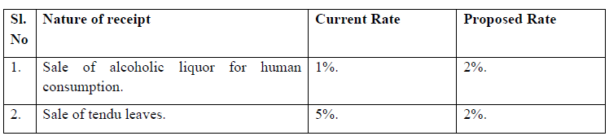
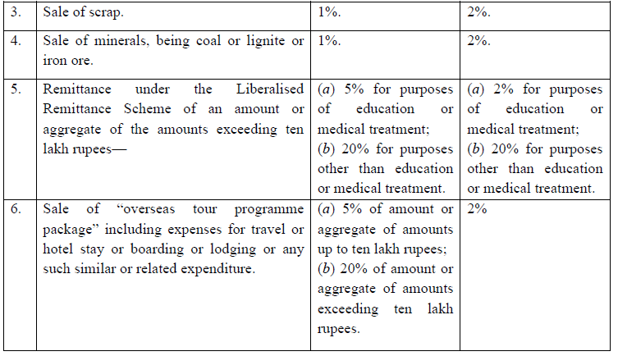
Rationalization of TCS rates [W.E.F 01.04.2026]
CA RAJENDRA PRASAD TALLURI [RP]
36

Slide 37
Judicial Rulings Overruled to bring certainty [W.R.T ITA 2025 WEF 01.04.2026] [Retrospective w.r.t ITA 1961]
JAO Vs FAO issue [Sec 148 and Sec 148A : Whether by JAO / FAO?]: It is proposed to clarify in the Income-tax Act, 1961 that notwithstanding anything contained in any judgment, order or decree of court, the Assessing Officer for the purposes of section 148 and section 148A shall mean and shall always be deemed to have meant Assessing Officer other than the National Faceless Assessment Centre or any of its assessment units. [New section Sec 147A is introduced in ITA,1961] [Sec 279 of ITA, 2025]
DIN issue: Assessments not to be invalid on ground of any mistake, defect or omission on account of computer-generated DIN, if such assessment is referenced by computer generated DIN in any manner. it is proposed to clarify in section 292B that notwithstanding anything contained in any judgment, order or decree of court, no assessment in pursuance of any of the provisions of Income-tax Act, 1961 shall be invalid or shall be deemed to have been invalid on the ground of any mistake, defect or omission in respect of quoting of a computer generated Document Identification Number, if such assessment order are referenced by such number in any manner. [Sec 292B of the ITA, 1961] [Sec 522 of ITA, 2025]
CA RAJENDRA PRASAD TALLURI [RP]
37

Slide 38
Judicial Rulings Overruled to bring certainty [W.R.T ITA 2025 WEF 01.04.2026] [Retrospective w.r.t ITA 1961]
Time Limit for Sec 144C [Divergent views of the SC in Shelf Drilling Ron case; Madras HC in ROCA case]: Notwithstanding anything contained in any judgment, order or decree of court, it is proposed to clarify in section 153 and section 153B that time lines in these sections govern the draft order stage and the timelines provided in section 144C operate for finalization of assessments, notwithstanding the time limit provided in section 153 and section 153B. [Sec 286 of the ITA, 2025]
CA RAJENDRA PRASAD TALLURI [RP]
38

Slide 39
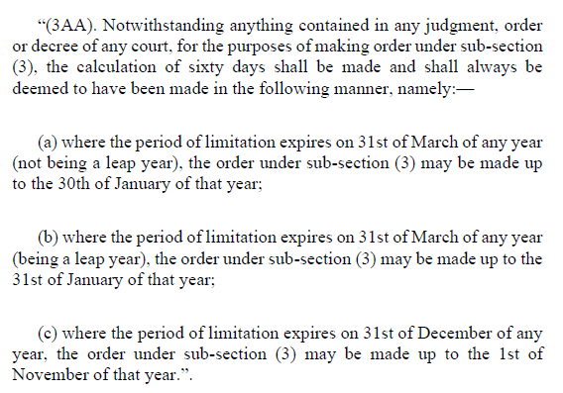
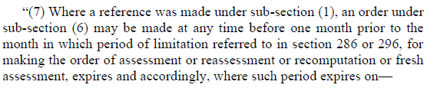
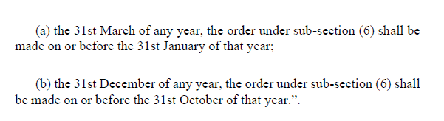
Judicial Rulings Overruled to bring certainty [W.R.T ITA 2025 WEF 01.04.2026] [Retrospective w.r.t ITA 1961]
Time limit for passing of the order by the TPO [How to count the period of 60 days?]: Jaguar Land Rover India Ltd case: Notwithstanding anything contained in any judgment, order or decree of court, it is proposed to be clarified in section 92CA(3A) as to how the period of sixty days is required to be computed. Parallel amendment is made in Sec 166 of the ITA 2025.
Amendment in ITA 1961 [Sec 92CA]
Amendment in ITA 2025 [Sec 166]
CA RAJENDRA PRASAD TALLURI [RP]
39

Slide 40
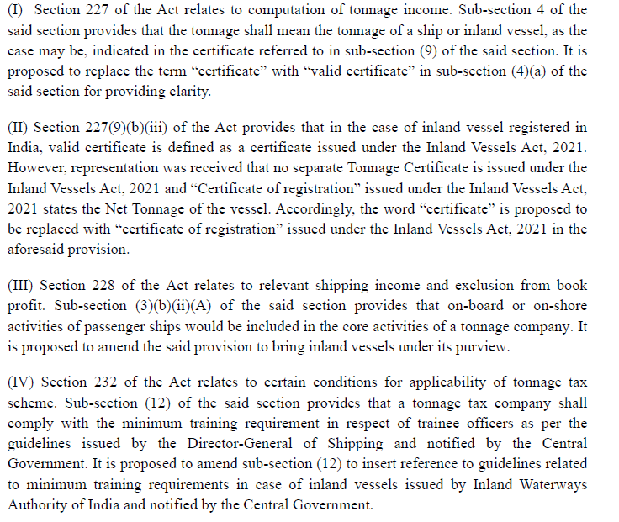
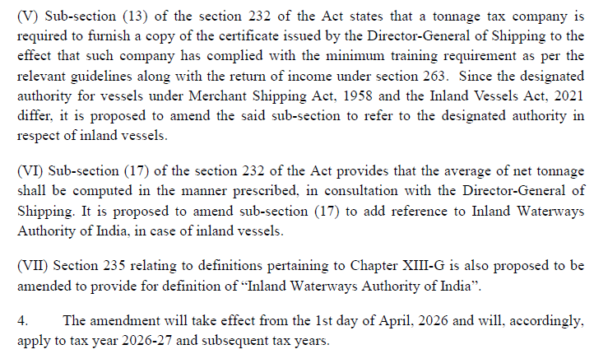
Chapter XIII-G dealing with Tonnage Tax Provisions are amended to extend the benefit to Inland Vessels [WEF 01.04.2026]
CA RAJENDRA PRASAD TALLURI [RP]
40

Slide 41
Penalty provision for non-furnishing of statement or furnishing inaccurate information in a statement on transaction of crypto-assets [WEF 01.04.2026]
As per Sec 509 prescribed reporting entity has the obligation to furnish information in respect of transactions in a crypto asset in a statement.
It is proposed to introduce penalty provision. Penalty of Rs. 200 per day for non furnishing of statement and Rs. 50,000 for furnishing inaccurate particulars and failure to correct such inaccuracy is proposed to be levied.
Accordingly, it is proposed to amend section 446 of the Act to provide penalty provisions for non-furnishing of statement and for furnishing inaccurate information in the statement.
CA RAJENDRA PRASAD TALLURI [RP]
41

Slide 42
Various Amendments in ITA, 2025 for aligning with IT Act, 1961 [WEF 01.04.2026]
Amendments are made mainly for aligning of the ITA, 2025 with the ITA, 1961:
Commodity Derivative is defined [Sec 66(33)];
Authorized person in the context of payments to non-residents is defined [Sec 402(27)]
Correction of 99(2) to give correct reference number in the context of Clubbing provisions in the case of individual. [Sec 99(2)]
Note 3 to Sec 393(1) is corrected to give a correct reference to Table Sl No 3(i) in stead of Sl No 3(iii). [This is in relation to TDS on sale of immovable property] [Note 3 to Sec 393(1)]
Sec 21(5) dealing with IHP provisions is so corrected that annual value of property held as stock in trade is to be taken as Nil up to 2 years from the end of the year in which OC is obtained from the competent authority. [Sec 21(5)]
Sec 22 dealing with aggregate deduction w.r.t interest in the case of self occupied property is so corrected that the limit of Rs 2 lakhs is applicable for the combined amount of ‘Interest and prior period interest’. [Sec 22]
CA RAJENDRA PRASAD TALLURI [RP]
42

Slide 43
Various Amendments in ITA, 2025 for aligning with IT Act, 1961 [WEF 01.04.2026]
Amendments are made mainly for aligning of the ITA, 2025 with the ITA, 1961:
Sec 262(10)(c) dealing with the powers of Board are so amended that Board can specify the transactions whether related to business or not on which PAN is to be quoted;
Sec 400(2) dealing with the powers of the Board are so amended that the guidelines ‘issued by the Board and laid before each house of the parliament w.r.t removing difficulties arising in giving effect to the TDS / TCS chapter’ shall be binding on the IT Authorities and on the person liable to deduct / collect tax.
Repeal provisions contained in Sec 536(2)(h) are amended such that where any sum has been allowed as deduction or has not been included in the total income under the repealed Income-tax Act, 1961, such sum will be deemed to be income under Income-tax Act, 2025, even without violations of any conditions, if it was to be included in the total income under the provisions of Income-tax Act, 1961 had it not been repealed.
Specified fund definition in Note 1(g) of Schedule VI is so amended to align with the definition provided in Sec 10(4D) of the IT Act, 1961. It refers to investment vehicles primarily located in the IFSC.
CA RAJENDRA PRASAD TALLURI [RP]
43

Slide 44
Amendments relating to NPOs [WEF 01.04.2026]
Amendments are made mainly for aligning of the ITA, 2025 with the ITA, 1961:
Tax on accreted income is payable in the case of merger of a registered NPO with another NPO which is not registered / registered but having different objectives / not satisfied the prescribed conditions. [Sec 354A and Sec 352(4)];
Specified violation definition is corrected to align with the provisions of the IT Act, 1961 [Sec 351]
Sec 332(1)(f) dealing with registrations of NPOs is so corrected that Schedule VII [Table 10 to 16] entities need not take registration under the IT Act to claim the income tax exemptions. [Thus, the income of PM National Relief Fund, PM Fund for promotion of folk arts, etc, is exempt directly even without registration under the IT Act.] [Sec 332]
Sec 349 dealing with filing of returns by NPOs is so amended to include reference to Sec 263(4) and hence NPOs can file belated returns also. [Sec 349]
CA RAJENDRA PRASAD TALLURI [RP]
44

Slide 45
Non-allowability of Interest as a deduction against Dividend Income [Sec 93] [WEF 01.04.2026]
Section 93 of the Act provides for allowing certain deductions against such income, i.e interest expenditure incurred for earning such income, subject to a ceiling of twenty per cent of the gross dividend or income from units of mutual funds.
It is proposed to amend section 93(2) to provide that no deduction shall be allowed in respect of any interest expenditure incurred for earning dividend income or income from units of mutual funds.
CA RAJENDRA PRASAD TALLURI [RP]
45

Slide 46
Rationalization of Schedule XI relating to Provident Funds [WEF 01.04.2026]
Sec 17(1)(h) of the ITA,2025 provided an overall cap of Rs 7.50 lakhs for the employer’s contribution to PF, Superannuation, NPS. i.e Any contribution by the employer to these funds in excess of the overall limit of Rs 7.50 lakhs is treated as ‘taxable perquisite’ in the hands of the employee.
As 17(1)(h) already contained restriction on an overall basis of Rs 7.50 Lakhs, other restrictions in Schedule XI are removed viz employer contribution in excess of 12% of salary; restriction of employer contribution on parity with employee contribution; differentiated limits for shareholder employees and others, etc,.
CA RAJENDRA PRASAD TALLURI [RP]
46

Slide 47
Exemption for Sovereign Gold Bond [Sec 70(1)(x)] [WEF 01.04.2026]
It is proposed to amend section 70(1)(x) to provide that the exemption shall be available only where the ‘Sovereign Gold Bond’ (SGB) is subscribed to by a subscriber at the time of original issue and is held continuously until redemption on maturity, for all Sovereign Gold Bonds issued by the Reserve Bank of India from time to time.
Thus, the exemption is extended to all series of SGBs not only limited to SGB, 2015;
Exemption is available to original subscriber only and the subscriber should hold the SGB till the maturity.
Note that interest on SGB is taxable.
CA RAJENDRA PRASAD TALLURI [RP]
47

Slide 48
Increase in tax rates of Securities Transaction Tax [WEF 01.04.2026]
It is proposed to increase the rate of STT as follows:
On sale of an option in securities from 0.1 % to 0.15 % of the option premium;
On sale of an option where the option is exercised from 0.125 % to 0.15 % of the intrinsic price; and
On sale of a future in securities from 0.02 % to 0.05 % of the traded price.
CA RAJENDRA PRASAD TALLURI [RP]
48

Slide 49
Taxation of buyback of shares [Sec 69 of ITA, 2025] [WEF 01.04.2026]
Buyback of shares will be taxed under ‘Capital Gains’ but not under ‘IOS’; Overall tax rate for promoter companies stands at 22%; for other promoters it stands at 30%; and for non-promoters the tax rate would be the relevant rates.
Under the existing provisions of the Income-tax Act, 2025, consideration received by a shareholder on buy-back of shares by a company is treated as dividend income under section 2(40)(f) of the Act and taxed accordingly, while the cost of acquisition of the shares extinguished on buy-back is recognized separately as a capital loss U/s 69.
It is proposed to rationalize the taxation of share buy-backs by providing that consideration received on buy-back shall be chargeable to tax under the head “Capital gains” instead of being treated as dividend income.
CA RAJENDRA PRASAD TALLURI [RP]
49

Slide 50
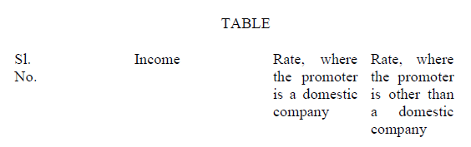
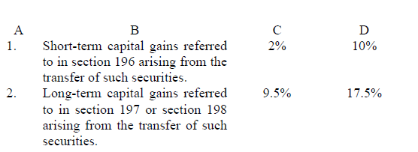
Taxation of buyback of shares [Sec 69 of ITA, 2025] [WEF 01.04.2026]
Buyback of shares will be taxed under ‘Capital Gains’ but not under ‘IOS’; Overall tax rate for promoter companies stands at 22%; for other promoters it stands at 30%; and for non-promoters the tax rate would be the relevant rates.
Analysis for additional tax rate:
For domestic companies, the general rate of tax is 22%.
The STCG is taxed at 20% and hence the additional tax is 2% [i.e 22% - 20%].
Likewise, the LTCG is taxed at 12.5% and hence the additional tax is 9.5% [i.e 22% - 12.5%].
For other than domestic companies, the general rate of tax is 30%.
The STCG is taxed at 20% and hence the additional tax is 10% [i.e 30% - 20%].
The LTCG is taxed at 12.5% and hence the additional tax is 17.5% [i.e 30% - 12.5%].
Table indicating Additional Taxes
CA RAJENDRA PRASAD TALLURI [RP]
50

Slide 51
No tax to de deducted at source in respect of interest income credited or paid to any co-operative society engaged in carrying on the business of banking (including a co-operative land mortgage bank) [Sec 393(4) of ITA, 2025] [WEF 01.04.2026]
Section 393(4) of the Act provides for the conditions where tax is not required to be deducted at source under corresponding provision of the Act.
In order to align the provisions of the Act with the Income-tax Act, 1961, section 393(4) [Table: Sl. No. 7, Column C (a)(i)] is proposed to be amended to provide that deduction of tax at source shall not be made on interest income (other than interest on securities) credited or paid to any co-operative society engaged in carrying on the business of banking (including a co-operative land mortgage bank).
CA RAJENDRA PRASAD TALLURI [RP]
51

Slide 52
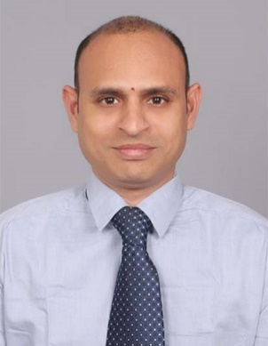
Talluri Rajendra Prasad, fondly known as RP in his professional & personal circles is a member of Institute of Chartered Accountants of India and Institute of Cost & Works Accountants of India. He has 21+ years of post-qualification experience in both direct and indirect tax laws.
He is one of the most distinguished faculties for Direct Tax Laws and Indirect Tax Laws. He contributed several articles on Taxation in leading journals which included magazines of ICAI, Taxmann publications, Student news letters, journals of IFA (International Fiscal Association). He is a visiting faculty at ICAI and ICWAI, Hyderabad, Vijayawada, Bangalore.
He has addressed several seminars at South India Forums on direct and indirect tax laws covering the aspects like GAAR, POEM, TP Provisions, PE, GST Audit, GST Annual Returns, GST impact on Health Care Industry, etc,.
He is a regular trainer for Income Tax officers, Assistant and Deputy Commissioners of IT Department, GST Department and C&AG Department, Practicing Chartered Accountants.
He can be reached at ‘rpdynamic@gmail.com’ or askrpsir@gmail.com and on +91-98495-79413 / 9963 250 500.
Rajendra Prasad Talluri (RP),
B.Com; CA; Grad CWA, DIIT (ICAI), LLB
rpdynamic@gmail.com, +91-98495-79413.

Slide 53

The Views / Comments in the above slides are purely the personal views of Mr Rajendra Prasad Talluri
Thank You
Rajendra Prasad Talluri (RP),
B.Com; CA; Grad CWA, DIIT (ICAI), LLB
rpdynamic@gmail.com, +91-98495-79413.

