Slide 1
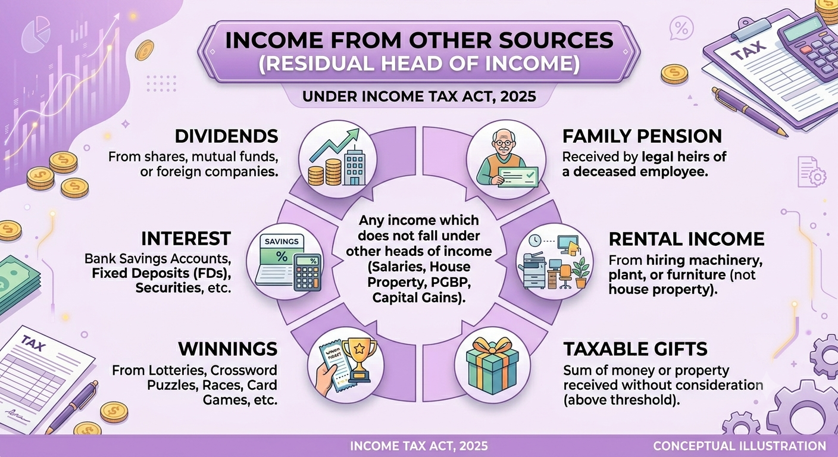
IFOS &
Deemed Income
Interplay - ITA 1961 vis-à-vis ITA, 2025
A to Z of INCOME TAX ACT SERIES

Slide 2
Session Road Map
IFOS | SEC 56-59(ITA 1961) >> SEC 92-95 (ITA 2025)
DEEMED DIVIDEND | Sec 2(22)/2(40) |
1
Charging Provision & Specific Incomes
1
Deemed Dividend Overview
2
Gift Taxation and Exceptions
2
Deemed Dividend Clause (e)
Shareholder Loan Trap
3
Interest, Winnings, Family Pension
4
3
Buyback Taxation w.e.f. 1-04-2026
Angel Tax: Lifecycle
5
Deductions & Non-Deductibles
6
Structural Mapping

Slide 3
1. Charging Provision & Specific Incomes
Section 56(1) & 56(2) [ITA 1961] | Section 92(1) & 92(2) [ITA 2025]
Residuary Head Principle [Sec 56(1)/92(1)]
All income not chargeable under Salaries, HP, PGBP or Capital Gains falls here.
Income Category
ITA 1961 Section
ITA 2025 Section
Status
Dividends
Sec 56(2)(i)
Sec 92(2)(a)
Retained
Lottery / Horse races / Gambling
Sec 56(2)(ib)
Sec 92(2)(b)
Retained
Employee PF contributions
Sec 56(2)(ic)
Sec 92(2)(c)
Retained
Keyman Insurance Policy
Sec 56(2)(iv)
Sec 92(2)(d)
Retained
Interest on Securities
Sec 56(2)(id)
Sec 92(2)(e)
Retained
Machinery / Plant / Furniture let on hire & building
Sec 56(2)(ii)/(iii)
Sec 92(2)(f)/(g)
Rationalized
Forfeited advance (capital asset negotiation)
Sec 56(2)(ix)
Sec 92(2)(h)
Retained
Compensation on termination
Sec 56(2)(xi)
Sec 92(2)(j)
Retained
Life Insurance maturity proceeds
Sec 56(2)(xiii)
Sec 92(2)(l)
Rationalized
Gift — Money / Immovable / Movable (incl. VDA)
Sec 56(2)(x)
Sec 92(2)(m)
VDA added expressly
Angel Tax [Share issue at premium > FMV]
Sec 56(2)(viib)
NOT REPRODUCED
ABOLISHED

Slide 4
2.1 Gift Taxation — Cash / Money Receipts
Section 56(2)(x)(a) [ITA 1961] | Section 92(2)(m)(i) [ITA 2025]
Aspect | ITA 1961 / ITA 2025
Trigger | Any sum of money received without consideration
Threshold | Aggregate exceeds ₹ 50,000 in a previous year
Taxability | ENTIRE sum taxable (not just excess over Rs. 50,000)
Year of Tax | Previous Year / Tax Year of receipt
Mode of receipt | Cash / Cheque / DD / NEFT/UPI etc. — all covered
Donor not a "person" | Recipient taxed irrespective of donor status
Valuation | Actual sum received
Section 93: Deductions Allowed

Slide 5
2.2 Gift Taxation — Immovable Property
Section 56(2)(x)(b) [ITA 1961] | Section 92(2)(m)(ii) [ITA 2025]
Scenario A: Gift — No Consideration
ITA 1961/ 2025
If SDV > ₹ 50,000: Entire SDV taxable in recipient's hands as IFOS
Scenario B: Inadequate Consideration (Underpayment)
ITA 1961/ ITA 2025
If SDV > Consideration AND Excess (SDV - consideration) HIGHER of Rs. 50,000 or 10% of consideration taxable.
AGREEMENT DATE PROVISO [Sec 92(4)(a) / Sec 56(2)(x) proviso]: Where the date of agreement differs from date of registration, SDV on the DATE OF AGREEMENT applies — PROVIDED the consideration (in whole or part) was paid via banking/online mode on or before the agreement date.

Slide 6
2.3 Gift Taxation — Movable Property & Virtual Digital Assets
Section 56(2)(x)(c) [ITA 1961] | Section 92(2)(m)(iii) [ITA 2025]
Scenario A: Gift — No Consideration
ITA 1961& 2025
If FMV > ₹ 50,000: Aggregate FMV taxable in recipient's hands as IFOS
Scenario B: Inadequate Consideration (Underpayment)
ITA 1961/ ITA 2025
If FMV > consideration, then Aggregate FMV exceeding the consideration is taxable when the difference is more than Rs. 50,000

Slide 7
2.3 Gift Taxation — Movable Property & Virtual Digital Assets
Section 56(2)(x)(c) [ITA 1961] | Section 92(2)(m)(iii) [ITA 2025]
“Property” means
(i) Shares & Securities
(vi) Sculptures
(ii) Jewellery
(vii) Any Work of Art
(iii) Archaeological Collections
(viii) Bullion
(iv) Drawings
(ix) Immovable property
(v) Paintings
(x) Virtual Digital Asset (VDA)
MAJOR CHANGE — VDA (Crypto/NFT) Expressly in "Property" [ITA 2025]
.Gift of VDA without adequate consideration > Rs. 50,000 = fully taxable as IFOS.

Slide 8
2.4. Gift Tax — Exceptions (Not Taxable)
Section 56(2)(x) Proviso [ITA 1961] | Section 92(3) [ITA 2025]
Relative
Gift from "relative" as defined: spouse, siblings, siblings of spouse/parents, lineal ascendants/descendants (maternal & paternal), spouses thereof. HUF: any member.
Marriage Occasion
Gifts received on occasion of marriage of the individual - unlimited amount. Only marriage; not engagement or reception.
Will / Inheritance
Property/money received under a will or by way of inheritance — fully exempt. Both testate and intestate succession covered.
Contemplation of Death
Gift by donor in contemplation of death (gift mortis causa) — exempt. Donor must be apprehensive of impending death
Local Authority
Gift received from any local authority as defined under Sec 10(20) of ITA 1961 / Schedule III Note 6 of ITA 2025.
Registered NPO / Trust
Gift from any registered non-profit organization [Sec 12AA/355(g) entity] — exempt except where recipient is covered u/s 13/355(h).
Not a Transfer (Sec 47)
Transactions not regarded as transfers [Sec 47 ITA 1961 / Sec 70(1) ITA 2025] — e.g., succession in amalgamation, demerger, HUF partition etc.
Trust for Relatives
Gift from an individual to a trust created solely for the benefit of relatives of the individual — exempt in the hands of the trust.
Prescribed Class
Any class of persons and subject to conditions as may be prescribed by CBDT [Sec 92(3)(i) ITA 2025] — empowers rule-making for new categories.

Slide 9
3. Interest, Winnings & Family Pension​
A. Interest on Securities [Sec 56(2)(id) / Sec 92(2)(e)]
Government Securities, Listed Debentures Interest, RBI Bonds / Savings Bonds
B. Lottery / Winnings / Online Games [Sec 56(2)(ib) / Sec 92(2)(b)]
Winnings from Lotteries, Board Games, Horse Races – Taxable at 30% on Gross winnings
In case of Winning from Online Games – the tax of 30% on net winnings.
C. Family Pension Deduction [Sec 57(Iia) / Sec 93(d)(i)] — KEY CHANGE
ITA 1961 [Sec 57(ii a)] Standard deduction
Lower of:
>> 1/3rd of pension received, OR
>> Rs. 15,000 (Provided that if an assessee opts for Sec 115 BAC, the limit is Rs. 25,000
ITA 2025 [Sec 93(d)(i)] Standard deduction
​
Lower of:​
>> 1/3rd of pension received, OR​
>> Rs. 25,000 (increased from Rs. 15,000)
when default regime 202(1) – new regime

Slide 10
4. Angel Tax — Lifecycle ​
Section 56(2)(viib) [ITA 1961] — Introduction 2012 to Abolition AY 2025-26
Sec 56(2)(viib): Company issuing shares to resident at a price > FMV excess treated as income of the company (IFOS). Popularly called "Angel Tax" as it hit start-up fundraising.
FA 2012 inserts​
Sec 56(2)(viib).​
Unlisted company​
issues shares at​
> FMV to resident.​
Excess = IFOS of​
the company.​
FA 2023: Extended
to non-residents.
FDI.
Significant industry
outcry.
FA 2024: Sec
56(2)(viib) deleted
w.e.f. 1-4-2025.
Not reproduced in
ITA 2025. Applies
to shares issued
on/after 1-4-2025.
2012
CBDT prescribes​
Rule 11UA for​
FMV computation.​
DCF Method for​
unlisted shares.​
Multiple litigations​
arise on valuation.​
Startups with DPIIT
recognition &
Govt./SEBI/AIF
investors exempted.
CBDT Notification
13/2019
Partial relief.
2025-26
2016
2019
2023
EXTENDED
BORN
RULE 11UA
DPIIT RELIEF
EXTENDED
ABOLISHED​
LEGACY ALERT :
Pending angel tax assessments of AY 2023-24 & AY 2024-25 still proceed. Abolition is prospective (AY 2025-26 onwards).
Notes:
Targeted Money Laundering: Aimed to stop unaccounted funds from entering the formal economy through artificially inflated share premiums in unlisted shell companies.
Established a Benchmark: Created a mechanism to scrutinize and tax unexplained cash credits by penalizing any share premium received above the government-prescribed Fair Market Value (FMV).
Reasons for Abolition:
The Valuation Clash: Tax authorities relied on historical metrics (like Net Asset Value), penalizing genuine startups that raised capital based on future growth potential.
Drained Working Capital: The heavy tax burden (up to ~31%) depleted the essential funds early-stage companies needed to scale.
FDI Bottleneck: The 2023 extension to foreign investors threatened to stifle global venture capital and private equity inflows.
Redundancy: Enhanced digital tracking, stricter KYC, and robust FEMA reporting made a blanket tax on share premiums unnecessary.

Slide 11
5.1 Deductions from IFOS
Section 57 [ITA 1961] | Section 93 [ITA 2025]
Deduction Type
ITA 1961 & 2025
Expenditure for earning income
Any exp. not being capital exp. laid out wholly & exclusively for earning such income
Repairs & Insurance (Machinery/Plant/Furniture)
Tenant repairs, insurance premium
Depreciation on asset let on hire
Depreciation allowable
Family Pension — Standard Deduction
Rs. 15,000 or 1/3rd of pension whichever is less
Interest on money borrowed for investment
Allowed — up to actual interest paid; 20% cap for earning dividends/ No deduction under 2025
Contributions to PF etc.(by assessee as employer)
Contribution if paid before due date
Interest on compensation/enhanced compensation
50% of the interest is allowed
No deduction for lottery/online gaming

Slide 12
5.2 Not Deductibles
Restriction
ITA 1961 — Sec 58
ITA 2025 — Sec 94
Restriction
A. Amounts NOT Deductible [Sec 58 / Sec 94]
Personal expenses
Sec 58(1)(a): Not deductible
Sec 94(1)(a): Retained
Interest paid outside India (TDS not deducted)
Sec 58(1)(b): Disallowed
Sec 94(1)(b): Retained
Salaries paid outside India (TDS not deducted)
Sec 58(1)(c): Disallowed
Sec 94(1)(c): Retained
Deduction against Lottery / Winnings
Sec 58(4): Absolute bar — no deduction or set-off
Sec 94(4): Same absolute restriction

Slide 13
6. Structural Mapping
ITA 1961 vs ITA 2025 | Both Acts place IFOS under Chapter IV
Structural Aspect | ITA 1961 | ITA 2025 | Remark
Act | Income-tax Act, 1961 [43 of 1961] | Income-tax Act, 2025 [Effective 1 April 2026] | 819 sections -> 536 sections
Chapter | Chapter IV Computation of Total Income | Chapter IV Computation of Total Income | Same chapter in both Acts
Sub-Part | F. — Income from other sources | F. — Income from other sources | Exact sub-part letter retained
Charging Section | Section 56 | Section 92 | Language simplified & rationalized
Deductions | Section 57 | Section 93 | Family pension deduction raised Rs.15,000 to Rs.25,000
Non-Deductibles | Section 58 | Section 94 | Retained with minor drafting changes
Profits Chargeable | Section 59 | Section 95 | Retention of recaptured deductions
Deemed Dividend | Section 2(22) Sub-clauses (a) to (e) | Section 2(40) Sub-clauses (a) to (f) | New clause (f): Buyback proceeds Abolished [w.e.f. 1-04-2026]
Angel Tax | Section 56(2)(viib) | Not reproduced | ABOLISHED w.e.f. AY 2025-26 [Finance Act 2024]
Rules Reference | Rules 11U, 11UA, 11UAA, 11UAB [FMV determination] | Rules 56, 57, 58, 59 [carried over under ITA 2025] | Valuation methodology unchanged
Sec 56(1) – Charging Provision: Scope & Conditions
Sec 56(1) – Charging Provision: Scope & Conditions

Slide 14
FAQ's
❓
An individual receives a cash distribution of ₹5,00,000 from a Hindu Undivided Family (HUF) in which he is a coparcener. While the statutory definition explicitly states that "in case of an HUF, any member thereof" is a relative(exempting member-to-HUF gifts), does the inverse hold true for an individual receiving a gift from the HUF?​​
No, The HUF is not a "relative," but the receipt is exempt under Section10(2).
❓
Has the deduction for expenditure incurred wholly and exclusively for earning Income been changed under the Finance Act, 2025?
​
No. The deduction continues to be available without any change.
❓
Can a taxpayer claim a deduction for interest on money borrowed for investments under the Finance Act, ​
2025?​​
No. Such deduction is no longer available under the 2025 provisions.​​
❓
Are employer contributions to provident fund deductible if paid before the due date?​
Yes. The deduction continues to be allowed if the contribution is paid before the prescribed due date.​
❓
Whether gift received during marriage engagement taxable?
Yes, technically only marriage function is covered as non taxable vent but to prove the transaction keep relevant transaction trail/proof

Slide 15
Deemed Dividend — Overview
Section 2(22) [ITA 1961] | Section 2(40) [ITA 2025] | Sub-clauses (a) to (f)
Clause
Description — Nature of Deemed Dividend
ITA 1961
Sec 2(22)
ITA 2025
Sec 2(40)
Status
(a)
Distribution of accumulated profits entailing release of company assets
Sec 2(22)(a)
Sec 2(40)(a)
Retained
(b)
Distribution of debentures / deposit certificates / bonus shares to preference shareholders
Sec 2(22)(b)
Sec 2(40)(b)
Retained
(c)
Distribution at liquidation to the extent of accumulated profits
Sec 2(22)(c)
Sec 2(40)(c)
Retained
(d)
Distribution on reduction of capital to the extent of accumulated profits
Sec 2(22)(d)
Sec 2(40)(d)
Retained
(e)
Loan or advance by closely-held company to:- Shareholder holding >= 10% voting power, OR - Concern in which such shareholder has substantial interest
Sec 2(22)(e)
Sec 2(40)(e)
Retained
Not present
Sec 2(40)(f)
[NEW]
MAJOR CHANGE
(f)
Buyback proceeds received by shareholder from company w.e.f. 1-04-2026

Slide 16
Deemed Dividend-Clause (e): Shareholder Loan Trap
Section 2(22)(e) [ITA 1961] | Section 2(40)(e) [ITA 2025] | Most Litigated Provision
CONDITIONS FOR TRIGGERING — ALL FOUR MUST BE MET:
1
Payer is a company in which the public are NOT substantially interested (closely-held company)
2
Payment is by way of loan or advance (not payment of normal business dues)
3
Recipient is: (i) shareholder holding >= 10% voting power, OR (ii) concern in which such shareholder has "substantial interest" (>= 20% beneficial ownership)
4
Company has accumulated profits (amount deemed as dividend limited to accumulated profits)
CBDT Circular 19/2017:
Loan/advance in ordinary course of business for trade purposes does NOT constitute deemed dividend u/s 2(22)(e). Purely commercial transactions excluded.

Slide 17
Buyback Tax Revolution — w.e.f. 01-04-2026
BACKGROUND — Why was Sec 115QA removed and not reproduced in ITA 2025?
PRE-FA 2024 REGIME (upto 30-09-2024)
NEW REGIME — FA 2024 (w.e.f. 1-10-2024)
NEW REGIME –FA 2026 (w.e.f. 1-4-2026)
Sec 115QA: Company pays Additional Income Tax @ 20% on buyback proceeds
Sec 115QA ABOLISHED. Not reproduced in ITA 2025 (already gone from 1-10-2024)
Sec 115QA remains ABOLISHED. Not reintroduced
Distributed income = Buyback consideration paid MINUS amount received by company on issue of shares
Buyback proceeds = "Deemed Dividend"
"Deemed Dividend" provision OMITTED [Clause removed from Sec 2(40) of ITA 2025]
Surcharge @ 12% applicable on 115QA tax
Taxable as IFOS in the hands of the Shareholder at applicable slab / special rates
Taxable strictly as Capital Gains in the hands of the SHAREHOLDER
Shareholder receives buyback proceeds as EXEMPT (not taxable)
TDS @ 10% u/s 194 of ITA 1961 (company to deduct at time of buyback payment)
Non-Promoter Shareholders: Taxable at standard concessional Capital Gains rates (STCG / LTCG).
Shareholder's capital loss (cost minus nil) was disputed/disallowed
Shareholder's original cost of acquisition: allowed as capital loss in the tax year
Shareholder's original cost of acquisition is directly allowed as a deduction to compute the actual gain
Company: No deduction of 115QA tax from total income
Company gets credit for TDS paid; no double taxation
Company continues to have no buyback tax liability

Slide 18
Buyback Tax Revolution — w.e.f. 01-04-2026
Budget 2026 Rate Summary (w.e.f. 1-Apr-2026)
Category
Short-Term CG Rate
Long-Term CG Rate
Remarks
Non-Promoter Shareholders
20%
12.5%
Normal CG rates. Full benefit of threshold.
Promoter — if Company
22%
(20%+2% surcharge)
22%
(12.5%+9.5% surcharge)
Anti-arbitrage surcharge ensures parity.
Promoter — Other than Company
30%
(20%+10% surcharge)
0%
(12.5%+17.5% surcharge)
Highest effective rate to curb promoter exit route.

Slide 19
FAQ's
❓
Has the provision treating the distribution of accumulated profits through the release of company
assets as deemed dividend been retained under the Income-tax Act, 2025?
Yes. The provision has been retained under Section 2(40)(a)​
❓
Does the Income-tax Act, 2025 introduce any change in the deemed dividend provisions relating to buybacks?
Yes. The buyback proceeds removed from deemed dividend and categorized as capital gain income effective from 1 April 2026.
❓
Does the definition of property include both financial assets and valuable collectibles?
Yes. It covers assets such as shares and securities as well as items like jewellery, artworks, and archaeological collections.
❓
If an individual wins ₹2,00,000 from a horse race lottery and spends ₹10,000 on buying tickets and entry fees, is the taxable income under IFOS ₹1,90,000?
No. winnings from lotteries, horse races, card games, or betting are always taxed on the gross winnings.

Slide 20
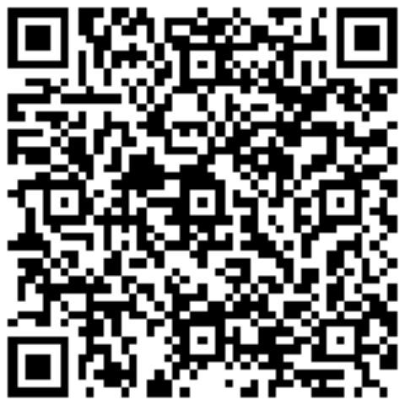

Thank You !!
CA P Yashodhan, DISA, DIIT
Let’s connect on LinkedIn:
CA Yashodhan Pogulakonda | LinkedIn
Our Offices
Bangalore | Chennai | Hyderabad | Mumbai | Vijayawada
www.rvks.in

