Slide 1

Arrest under GST
- CA Sudhir V S
16/07/20199

Slide 2
Coverage
Intro and GST provisions
Provisions of bail
Compounding provisions
Prosecution provisions

Slide 3
Introduction and GST provisions of Arrest

Slide 4
Introduction
    What is Arrest?
      The definition of arrest not defined under CGST ACT, 2017.
      It means taking into custody under some lawful authority.
      As per judicial interpretations the word Arrest means restraining liberty under lawful warrant.
    GST embarking through Article 246A of the COI, is a unique tax that has the power and field of legislation in a single article.
    The constitutionality of arrest under GST is challenged based on the contention that offences and Punishments are of Criminal nature that could not have been enacted under Article 246A.

Slide 5
GST provisions for Arrest
    Who can Arrest ?
    Any officer under the Act AND
    Authorized by Commissioner.
    When a person can be arrested ?
    Commissioner has reasons to believe that a person committed the following offences (Sec. 132) and amount involved is more than 2 crore
      Supply without invoices
      Issues invoices without supplies for fraudulent ITC or refund
      Availing ITC without receipt of goods/services
      Availing ITC without invoices
      Collecting tax but not paying within 3 months

Slide 6
When a person can be arrested?
Commissioner has reasons to believe that a person is a repeated offender of the following nature
      Supply without invoices
      Issues invoices without supply
      Availing ITC without receipt of goods/services
      Availing ITC without invoices
      Collecting tax but not paying within 3 months
      Evades tax (Not covered above)
      Fraudulently obtains a refund
      Falsifying records to evade payment of tax
      Dealing in goods known to be liable for confiscation
      Knowingly receives, engages in, or deals with any service supply made in violation of the Act
      Attempting/abetting such offences.

Slide 7
Cognizable and non-bailable offences
    Amount involved is more than 5 crore
      Supply without invoices
      Issues invoices without supplies for fraudulent ITC or refund
      Availing ITC without receipt of goods/services
      Availing ITC without invoices
      Collecting tax but not paying within 3 months
    Post arrest
      Inform such person of the grounds of arrest AND
      Produce him before a Magistrate within twenty-four hours
    Note: Any offences other than the above are non-cognizable and bailable

Slide 8
Section 132 CGST: Punishment for certain offences
Nature of offence | Amount involved | Period of maximum Imprisonment and Fine
Issues invoices without supply for fraudulent ITC or refund – where the tax evaded or ITC wrongly availed/utilized, or refund wrongly taken | Exceeds Rs 1 Cr but up to Rs 2 Cr | 1 year + fine
All offences including, Tax evaded or ITC wrongly availed/utilized, or refund wrongly taken | Exceeds Rs 2 Cr but up to Rs 5 Cr | 3 years + fine
 | Exceeds Rs 5 Cr | 5 years + fine
Commits or abets the commission of an offence involving falsifying records to evade payment of tax |  | 6 months or fine or with both
For second or every subsequent offences | No limit | 5 years + fine

Slide 9
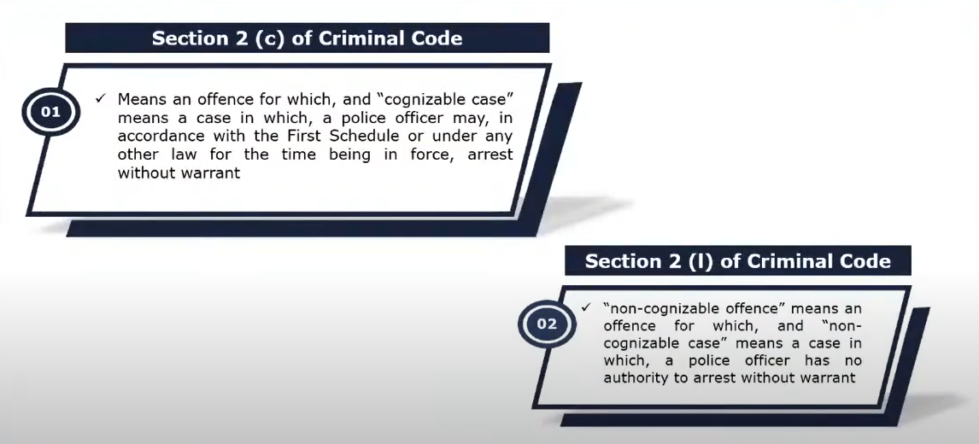
‘Cognizable and Non-cognizable Offence

Slide 10
Life and Personal liberty
As the procedure of Arrest is not mentioned in the law, there can a chance of arbitrary action by the officers which may violate the fundamental right granted under Art 21 of COI.
Article 21 of the COI says - No person shall be deprived of his life or personal liberty except according to procedure established by law.
Bail is rule and jail is an exception [Maneka Gandhi Vs UOI] – rigor of jail should be avoided & the procedure established by law should be fair and just, reasonable, and not arbitrary.

Slide 11
Radhika Agarwal Versus Union Of India And Others
2025 (2) TMI 1162 - SUPREME COURT (LB)
The amendments to the Customs Act and GST Act are valid.
The procedural safeguards under the CrPC apply to arrests under the Customs Act and GST Act, ensuring protection of individual rights.
Customs officers must exercise their arrest powers with caution, ensuring compliance with statutory and constitutional safeguards.
The power of arrest under these Acts is subject to judicial review to prevent arbitrary or unlawful arrests.
The constitutional validity of Sections 69 and 70 of the GST Acts is upheld, affirming the legislative competence to enact such provisions.

Slide 12
Serious offences lead to Arrest
    Whoever commits, or causes to commit and retain the benefits arising out of, any of the following offences, namely:-
      Supplies without invoice in contravention of Act/Rules, with the intention to evade tax;
      Invoice/bill without actual supply in contravention of Act/Rules, leading to wrongful availment/utilization of ITC or refund of tax;
      Availing ITC without supply of goods/ services
      Collected GST but not paid > 3 months

Slide 13
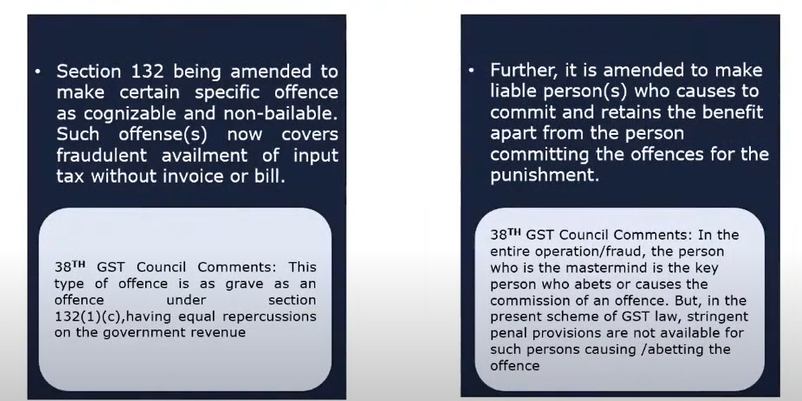
Who are covered u/s 132? – Amendment w.e.f. 01-01-2022

Slide 14
Scope of “Reason to Believe”

Slide 15
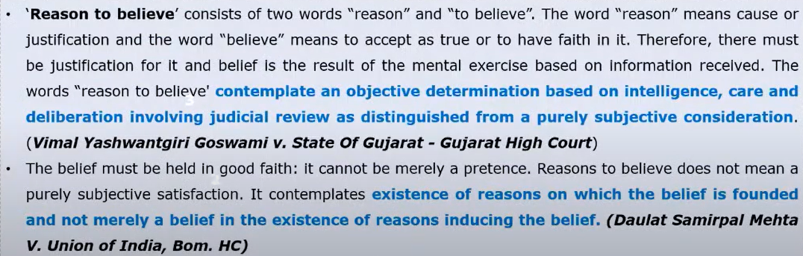
Reasons to believe – Judgements under GST regime

Slide 16
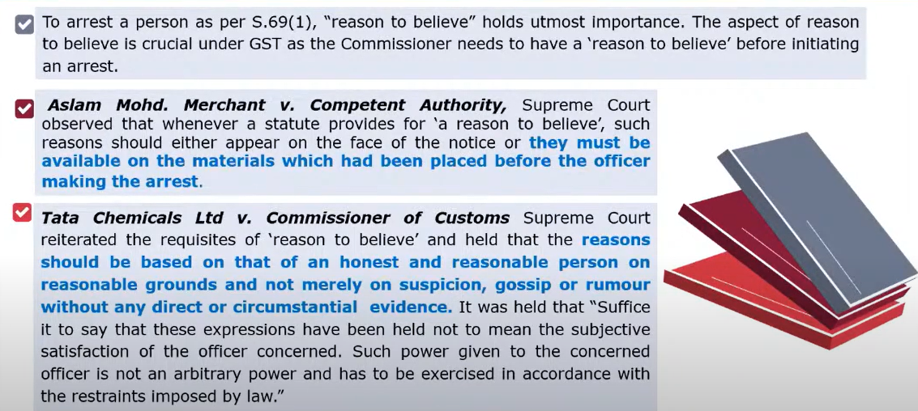
Reasons to believe – Judgements Pre-GST regime

Slide 17
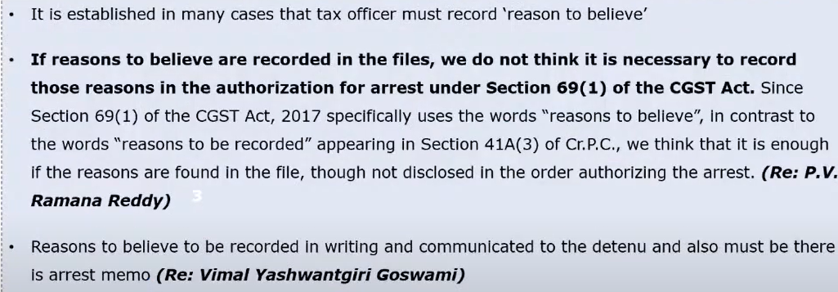
Whether “Reasons to believe” to be in writing?

Slide 18
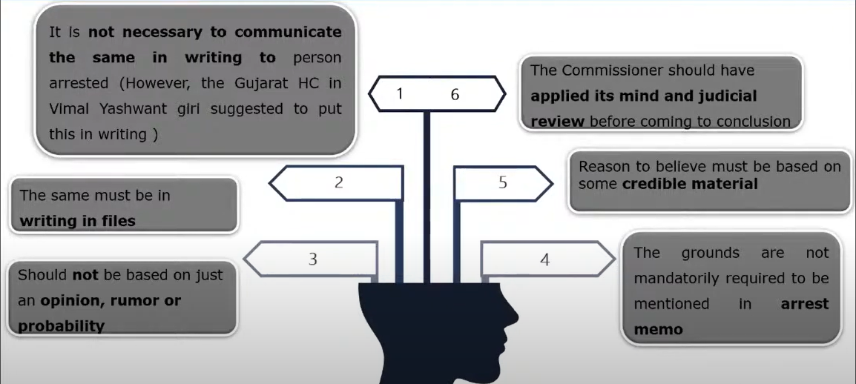
“Reason to believe” – Conclusion

Slide 19
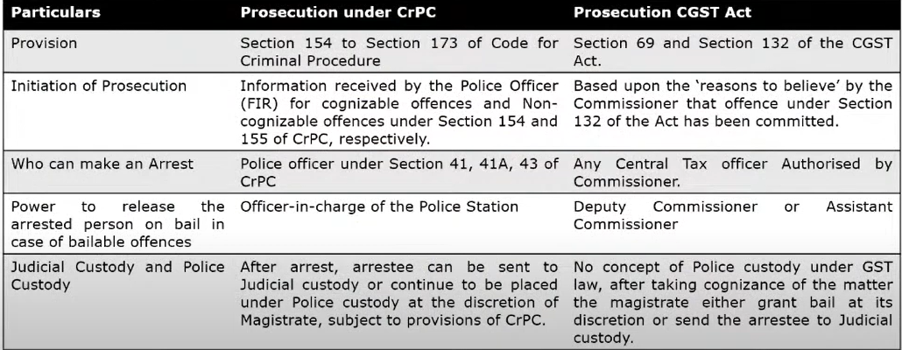
Procedure for Prosecution under GST Law v/s Criminal Procedure Code

Slide 20
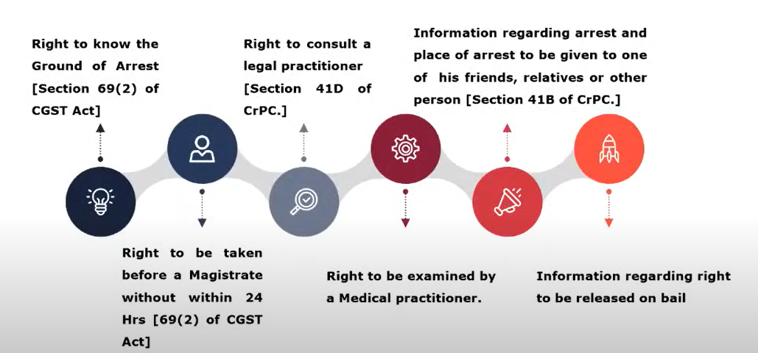
Rights of arrested person- ‘D.K. Basu v. State of Bengal’ - 1997 (1) SCC 416

Slide 21
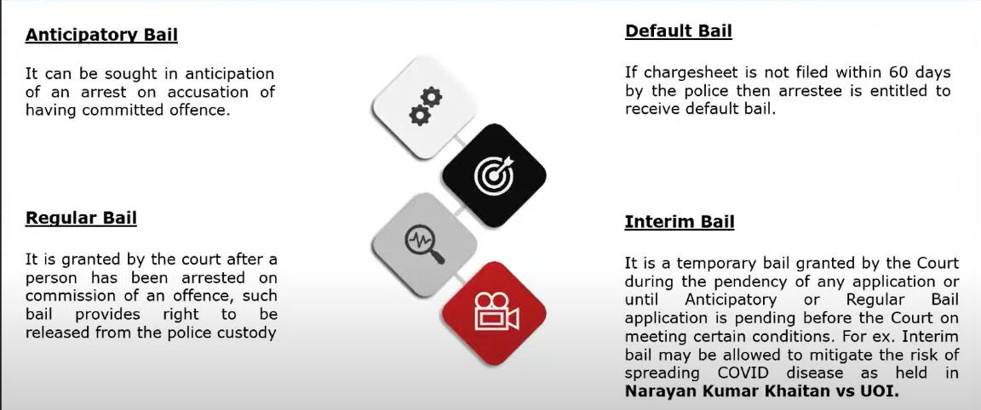
Types of Bails

Slide 22
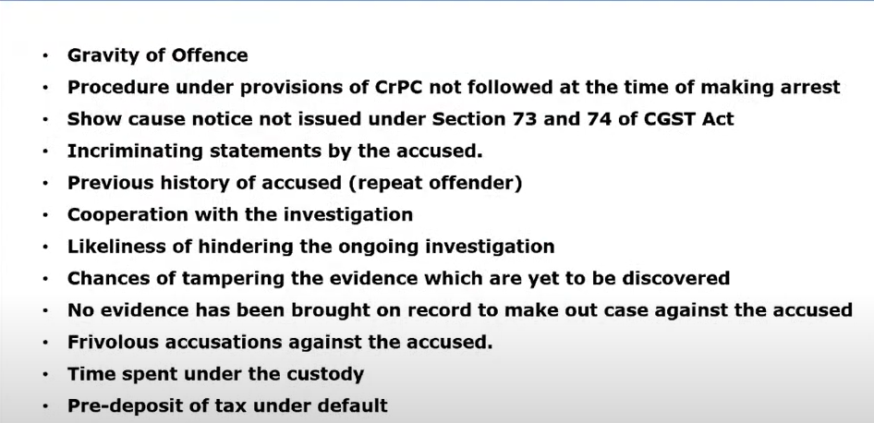
Factors Affecting grant of Bails under GST Law

Slide 23
Power to Arrest – Strict action by Judiciary
In ‘P.V. Ramana Reddy v. Union of India’ - 2019 (25) G.S.T.L. 185 (Telangana) Hon’ble Telangana HC held
  Arrest can be made before completion of the assessment
  Pre-trail arrest can be challenged before HC
  Compounding is not possible if not applied;
Further, the Supreme Court dismissing the plea, said that it is not inclined to interfere [2019 (26) G.S.T.L. J175 (S.C.)] against the Special Leave Petition filed against the above the judgment of Telangana High Court.
In Vimal Yashwantgiri Goswami v. State of Gujarat – Gujarat HC- If Commissioner has reason to believe that the person has committed specified offences, without there being any adjudication for the assessment. Similarly held by Rajasthan HC in case of Bharat Raj Punj, M/s. Leel Electricals Ltd vs Comm (CGST), Jaipur .
Favourable decision – Make My Trip (India) Pvt Ltd v. UOI (Supreme Court)

Slide 24
Issues & concerns
Threshold limit for arrest is specified, however, the law does not specify any time-period in respect of the same. So, if a person has failed to issue tax invoices in respect of supplies effected during a period of 3 years, wherein the tax evaded > Rs. 250 lakhs, even in such a case, it appears that the proper officer has the powers to arrest such person.
No indication as to whether the reference is made to a taxable person / registered person (GSTIN)

Slide 25
Compounding of Offences
Any offences under the CGST Act can be compounded
Offences which cannot be compounded
  Issues invoices without supplies for fraudulent ITC or refund
  A court-convicted offender under this Act
  Second-time offenders
Before compounding tax, interest and penalty has to be paid.

Slide 26
Compounding of Offences
An application has to be filed with the Commissioner.
Commissioner may accept the compounding application and determines the compounding amount payable and issue order.
The commissioner may also reject the compounding application.
Before making any decision, an opportunity of being heard to the applicant.
Compounding amount has to be paid within 30 days from date of order.
If compounding amount is not paid within 30days from the date of order, the order would be void.

Slide 27
Compounding Amount
Offences | Compounding Amount – When amount involved is more than Rs. 5 crore | Compounding Amount – When amount involved is more than Rs. 2 crore up to Rs. 5 crore
Supply without invoices Availing ITC without receipt of goods/services Availing ITC without invoices Collecting tax but not paying within 3 months | Maximum Amount – 75% of amount involved Minimum Amount – 50% of amount involved | Maximum Amount – 60% of amount involved Minimum Amount – 40% of amount involved

Slide 28
Compounding Amount
Offences | Compounding Amount
Falsifying records to evade payment of tax Dealing in goods known to be liable for confiscation Knowingly receives, engages in, or deals with any service supply made in violation of the Act Attempting/abetting all the above offences. | 25% of amount involved

Slide 29

Thank you
For any clarification
sudhir@hnaindia.com

