Slide 1
Evolving Insolvency Jurisprudence :
Inroads into Common Law
Presentation by:
Dr. SV Rama Krishna
M.Com., CAIIB, FCS, LL.M.
Ph.D. in Law (NALSAR)
Advocate & Corporate Legal Advisor
Ph: 98484 03691 svrklawassociates@gmail.com

Slide 2
Law in general
State exercise its sovereign power through legislations.
Law prescribes and regulates general conditions of human activity in the state
Holland- “A Law is a general rule of external behaviour enforced by a sovereign political authority.”
Austin “Law is the command of the sovereign.” “It is the command of the superior to an inferior and force is the sanction behind Law.”
According to Sir William John Salmond, Law is body of principles recognised and applied by State in the administration of Justice.

Slide 3
Emergence of formal Legislation
Custom, Religion and Morality are the earliest sources of law.
Formal Legislation emerged in 13th Century until then the King or Sovereign Authority used to pass decrees or royal charters
Later on, the legislature emerged as an organ of the government and chief source of law and Legislature got recognition as Law Making organ of State.
It began transforming the customary rules of behaviour into definite and enacted rules of behaviour of the people.

Slide 4
Civil Law & Common Law
The main difference is that civil law systems rely on comprehensive, written legal codes created by legislatures, while common law systems rely heavily on uncodified case law and binding judicial precedents set by courts.
Article 141 of Constitution of India provides that “ The law declared by the Supreme Court shall be binding on all courts within the territory of India”.

Slide 5
Article 13 (3) of Constitution of India – inclusive definition of “law”
Article 13 (3) In this article, unless the context otherwise requires,—
(a) “law” includes any Ordinance, order, bye-law, rule, regulation, notification, custom or usage having in the territory of India the force of law;
(b) “laws in force” includes laws passed or made by a Legislature or other competent authority in the territory of India before the commencement of this Constitution and not previously repealed, notwithstanding that any such law or any part thereof may not be then in operation either at all or in particular areas.

Slide 6
Delegated Legislation
Delegated Legislation is rule making power of executive given by legislature in the statute itself subject to its ratification.
It always works under the superior law or principal Act of Legislature.
It is because of several reasons:
- paucity of time
- lack of expertise
- to meet future evolving needs of society.
- to give more flexibility in implementing law

Slide 7
Judicial Decisions/ precedents/ratio decidendi
When Courts interpret and apply laws to specific cases in hand, the reasons or ratio given in interpreting the intention of law makers, becomes a precedent to later cases as far as the principle explained.
The judicial decisions, are binding on the parties to the case. These also get accepted as laws for future cases. But not all judicial decisions are laws.
Only the judicial decisions given by the apex court or the courts which stand recognized as the Courts of Record, (like the Supreme Court and High Courts of India) are recognized and used as laws proper. Lower Courts can settle their cases on the basis of such judicial decisions.

Slide 8
Principles of Equity
Actus curiae neminem gravabit means “an act of the court shall prejudice no one.” (impersonal, objective, rule based judgment)
Equity refers to fairness and sense of justice. While deciding cases, the judges interpret and apply laws to the specific cases. But laws cannot always fully fit in each case and these can be silent in some respects.
In all such cases, the judges depend on equity and act in accordance with their sense of fair play and justice.
Equity is used to provide relief to the aggrieved parties and such decisions perform the function of laying down rules for the future.
As such equity also acts as a source of law in administration of justice.

Slide 9
Civil Law & Common Law
Civil law is formed using codified legislation and legal rules i.e. Acts, Rules and Regulations in a specific Act enacted on a subject matter.
Common Law is developed adhering to precedents and court decisions on principles of equity and justice.

Slide 10
The Common Law
Oliver Wendell Holmes Jr. (March 8, 1841 – March 6, 1935) was an American jurist who served as an Associate Justice of the U.S. Supreme Court from 1902 to 1932.
Holmes is one of the most widely cited and influential Supreme Court justices in American history. In his famous book ‘The Common Law’ he observes:
The life of the law has not been logic: it has been experience. The felt necessities of the time, the prevalent moral and political theories, intuitions of public policy, avowed or unconscious, even the prejudices which judges share with their fellow-men, have had a good deal more to do than the syllogism in determining the rules by which men should be governed.

Slide 11
The law embodies the story of a nation's development through many centuries, and it cannot be dealt with as if it contained only the axioms and corollaries of a book of mathematics. In order to know what it is, we must know what it has been, and what it tends to become.
We must alternately consult history and existing theories of legislation. But the most difficult labor will be to understand the combination of the two into new products at every stage. The substance of the law at any given time pretty nearly [2] corresponds, so far as it goes, with what is then understood to be convenient; but its form and machinery, and the degree to which it is able to work out desired results, depend very much upon its past.

Slide 12
INSOLVENCY AND BANKRUPTCY CODE 2016
Some of special features
Definitions Sec. 3 and 5
Caution or mandate of law – Sec. 7,8 and 10 time is essence
Insolvency and Bankruptcy not defined – bankrupt defined
Earlier legislations – 2 Provincial Insolvency Act and another repealed
Large number of other Acts amended through Schedules

Slide 13
Preamble of IBC 2016
An Act
To consolidate and amend the laws relating to reorganisation and insolvency resolution of
corporate persons, partnership firms and individuals
in a time bound manner
for maximization of value of assets of such persons,
to promote entrepreneurship,
availability of credit and
balance the interests of all the stakeholders
including alteration in the order of priority of payment of Government dues and to establish an Insolvency and Bankruptcy Board of India, and for matters connected therewith or incidental thereto

Slide 14
Sec 3(6) “Claim”
Sec. 3 (6) “claim” means –
(a) a right to payment, whether or not such right is reduced to judgment, fixed, disputed, undisputed, legal, equitable, secured, or unsecured;
(b) right to remedy for breach of contract under any law for the time being in force, if such breach gives rise to a right to payment, whether or not such right is reduced to judgment, fixed, matured, unmatured, disputed, undisputed, secured or unsecured

Slide 15
“Debt” and “Default”
Sec. 3 (11) “debt” means a liability or obligation in respect of a claim which is due from any person and includes a financial debt and operational debt;
Sec. 3(12) “default” means non-payment of debt when whole or any part or instalment of the amount of debt has become due and payable and is not 1[paid] by the debtor or the corporate debtor, as the case may be

Slide 16
Sec. 5(6) “Dispute”
Sec. 5 (6) “dispute” includes a suit or arbitration proceedings relating to–
(a) the existence of the amount of debt;
(b) the quality of goods or service; or
(c) the breach of a representation or warranty (sale of goods)

Slide 17
Se. 238A : Limitation introduced/amended w.e.f. 6.6.2018
Sec. 238A. Limitation. –
The provisions of the Limitation Act, 1963 (36 of 1963) shall, as far as may be, apply to the proceedings or appeals before the Adjudicating Authority, the National Company Law Appellate Tribunal, the Debt Recovery Tribunal or the Debt Recovery Appellate Tribunal, as the case may be.

Slide 18
Entry 137 of Schedule to Limitation Act, 1963
Any other application for which no period of limitation is provided elsewhere in this Division - Three years - when right to apply accrues.

Slide 19
Innoventive Industries Ltd. vs. ICICI Bank and another (2018) 1 SCC 407 (31.07.2017)
Para 30 . On the other hand, as we have seen, in the case of a corporate debtor who commits a default of a financial debt, the adjudicating authority has merely to see the records of the information utility or other evidence produced by the financial creditor to satisfy itself that a default has occurred.
It is of no matter that the debt is disputed so long as the debt is "due" i.e. payable unless interdicted by some law or has not yet become due in the sense that it is payable at some future date.
It is only when this is proved to the satisfaction of the adjudicating authority that the adjudicating authority may reject an application and not otherwise.

Slide 20
Pre-existing Dispute
Mobilox Innovations Pvt. Ltd. vs. Kirusa Software Pvt. Ltd. (2018) 1 SCC 353
Para 51. It is clear, therefore, that once the operational creditor has filed an application, which is otherwise complete, the adjudicating authority must reject the application Under Section 9(5)(2)(d) if notice of dispute has been received by the operational creditor or there is a record of dispute in the information utility. It is clear that such notice must bring to the notice of the operational creditor the "existence" of a dispute or the fact that a suit or arbitration proceeding relating to a dispute is pending between the parties.

Slide 21
Therefore, all that the adjudicating authority is to see at this stage is whether there is a plausible contention which requires further investigation and that the "dispute" is not a patently feeble legal argument or an assertion of fact unsupported by evidence.
It is important to separate the grain from the chaff and to reject a spurious defence which is mere bluster. However, in doing so, the Court does not need to be satisfied that the defence is likely to succeed. The Court does not at this stage examine the merits of the dispute except to the extent indicated above.
So long as a dispute truly exists in fact and is not spurious, hypothetical or illusory, the adjudicating authority has to reject the application.

Slide 22
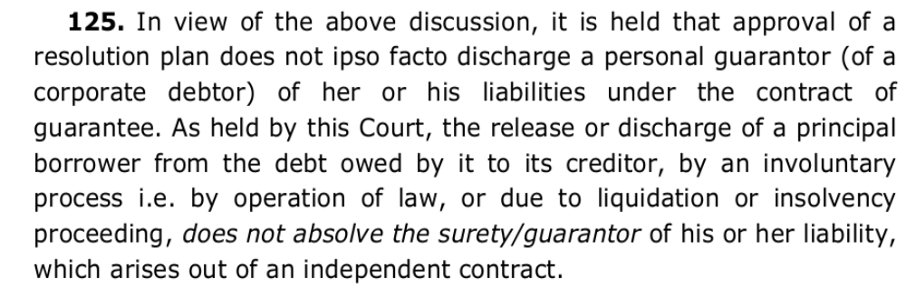
Sec. 95 of IBC, 2016 personal guarantors
Landmark judgment of Supreme Court of India
Lalit Kumar Jain vs. Union of India (2021) 9 SCC 321 – para 125

Slide 23
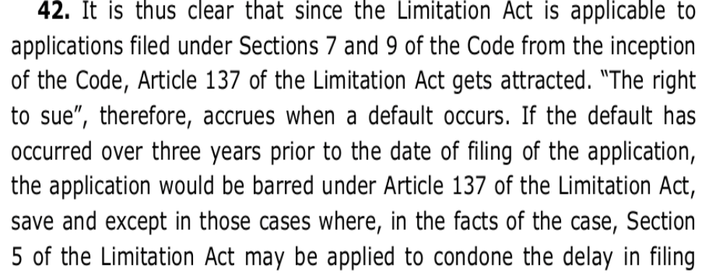
Limitation –
B.K. Educational Services Pvt. Ltd. vs. Parag Gupa and Associates – (2019) 11 SCC 633 – para 42

Slide 24
Some other common law principles in IBC
Doctrine of Commercial Wisdom of CoC
Doctrine Clean Slate – protection to auction purchaser
Constitutional provisions in Sec. 142 to do complete justice
Bhushan Power and Steel – failure to implement approved Scheme leading to winding up
SC reversed two judge judgement of SC – Bhushan Power

Slide 25
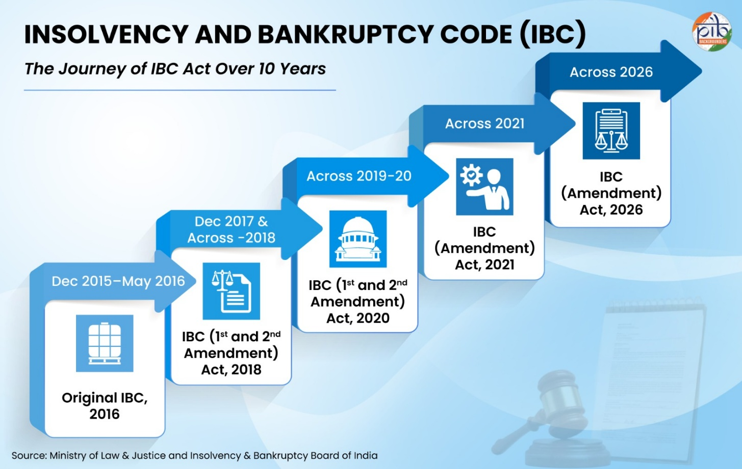

Slide 26
Press Information Bureau release – 28.05.2026
India’s insolvency framework has undergone a major transformation through the Insolvency and Bankruptcy Code, 2016 (IBC).
It introduced a unified, creditor-driven and time-bound mechanism for resolving financial distress.
Over the years, the Code has strengthened recovery mechanisms and improved resolution outcomes, with creditors realising nearly ₹4.32 lakh crore through approved resolution plans till March 2026.

Slide 27
Building on this experience, the Insolvency and Bankruptcy Code (Amendment) Act, 2026 introduces several reforms to reduce delays, strengthen creditor oversight and improve procedural clarity.
The amendment seeks to make the insolvency resolution and liquidation process more efficient, predictable and resolution-oriented.

Slide 28
Success story of IBC 2016
Since its enactment, the Insolvency and Bankruptcy Code, 2016 has significantly strengthened India’s insolvency and credit ecosystem. The framework improved recovery mechanisms, strengthened creditor discipline and created a more structured resolution process for distressed entities.
Till March 2026, 8,987 CIRPs have been admitted under the Code. 1,419 corporate debtors were resolved through approved resolution plans. While several other cases were closed through settlements, appeals, reviews and withdrawals under section 12A.

Slide 29
As of March 2026, creditors realised approximately ₹4.32 lakh crore through approved resolution plans under the IBC. Recoveries exceeded 116.85 of liquidation value and more than 94.56% of fair value.
The framework also improved recovery outcomes for the banking sector. The RBI’s Report on Trends and Progress of Banking in India for 2024-25 (released on December 29, 2025) highlights that out of a total of ₹1,04,099 crore recovered by SCBs through various channels, the IBC alone has contributed a significant ₹54,528 crore, accounting for 52.4% of the total recoveries.
This was higher than recoveries through SARFAESI, Debt Recovery Tribunals and Lok Adalats.

Slide 30
Thank you

